Slide 1
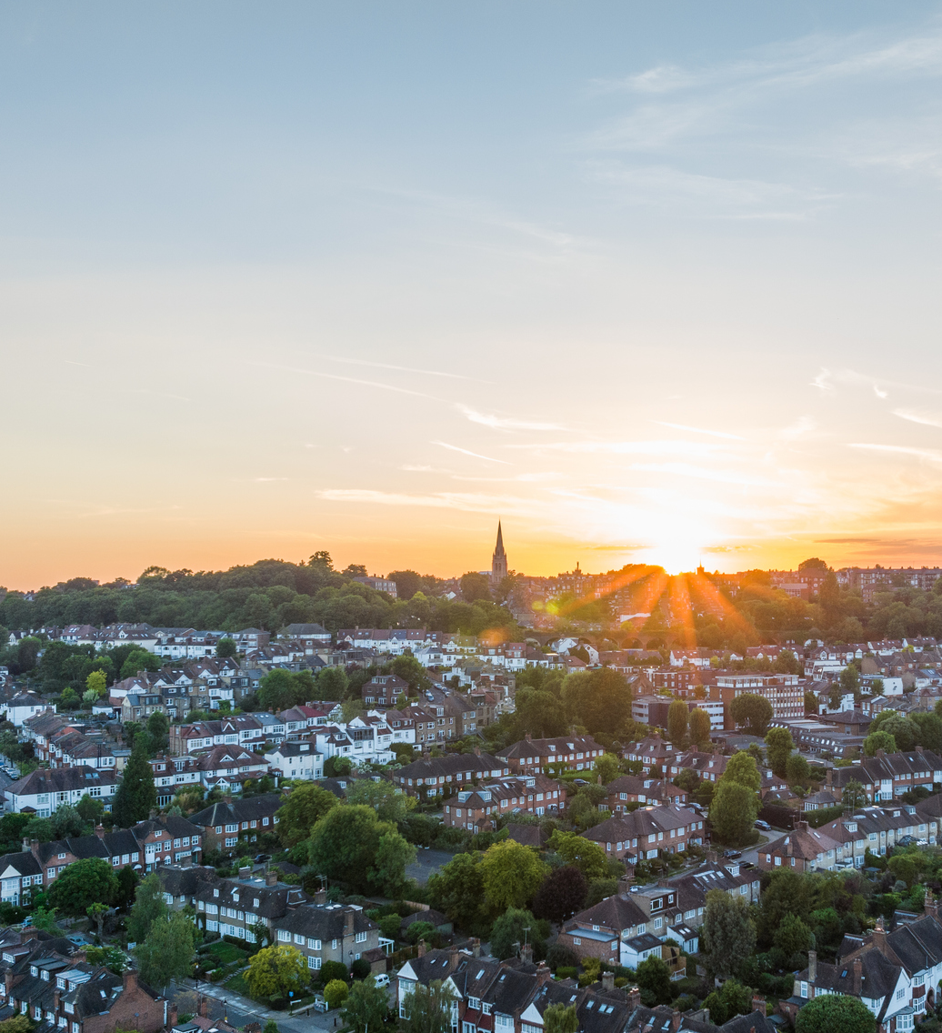
Supporting local government to build healthier places
Cooperative Councils Innovation Network
Sharlene McGee
Notes:
Slide 1
Thank you Michael, and good morning everyone.
It’s great to be here at the CCIN
My name is Sharlene McGee, and at the Health Foundation my role focuses on supporting local and regional government to improve health.
I’ll briefly highlight how our work supports councils — particularly around strengthening the building blocks of health through a HiAP approach — and I’ll share some key learning that I hope will be useful in your work, and connects these social assets with values central to the cooperative movement – coproduction, social partnership, and democratic engagement.

Slide 2
Notes:
If you don’t know us, the Health Foundation is an independent charity working to build a healthier UK.
Our focus is on understanding how we keep people healthy in the first place — through things like decent housing, good employment, high-quality skills, and connected communities.
Local government is of course at the forefront of shaping these conditions, and improving the lives of people experiencing both health and economic inequalities. Through their core activities but also how they act in partnership with Voluntary sector and community/ resident groups.

Slide 3
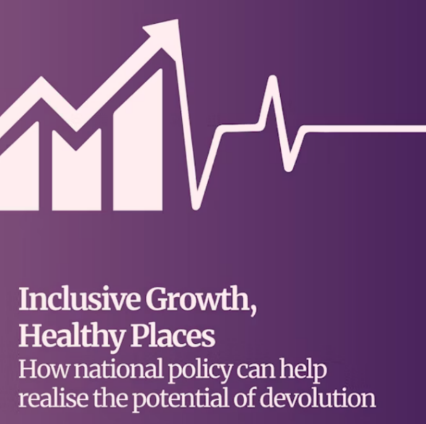
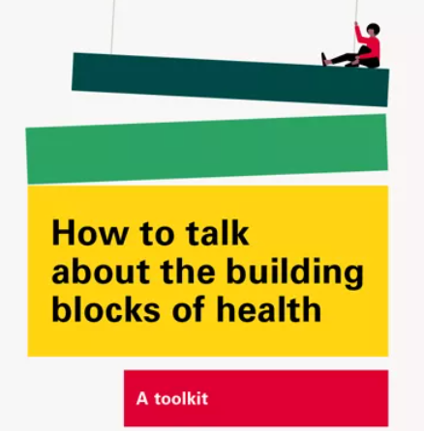
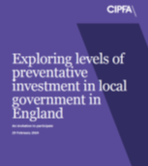
We commission work from others
Growth & Reform Network - International evidence review, policy report and toolkit
Frameworks toolkit - How to talk about the building blocks of health
CIPFA report - levels of preventative spend in local government and framework for measuring spend
Notes:
A key part of our work is strengthening the evidence base on what works to improve health and the local economy.
For example, we’ve been working with GRN to understand what approaches are effective, what policy change may be needed, and what practical actions local areas can take.
We’ve also developed tools to help communicate these ideas more clearly — including our frameworks toolkit, which helps reframe conversations around the building blocks of health.
We’re also working with CIPFA to better understand how preventative spending is being used in local government, and how it can be deployed more effectively.
This work has both an analytical and a practical focus — helping councils understand how preventative investment is being used locally and how it might be strengthened.

Slide 4
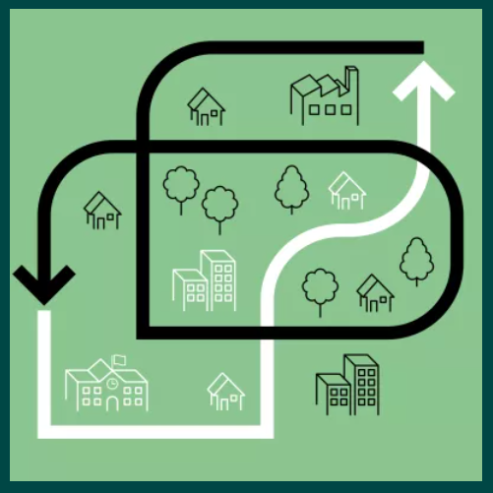
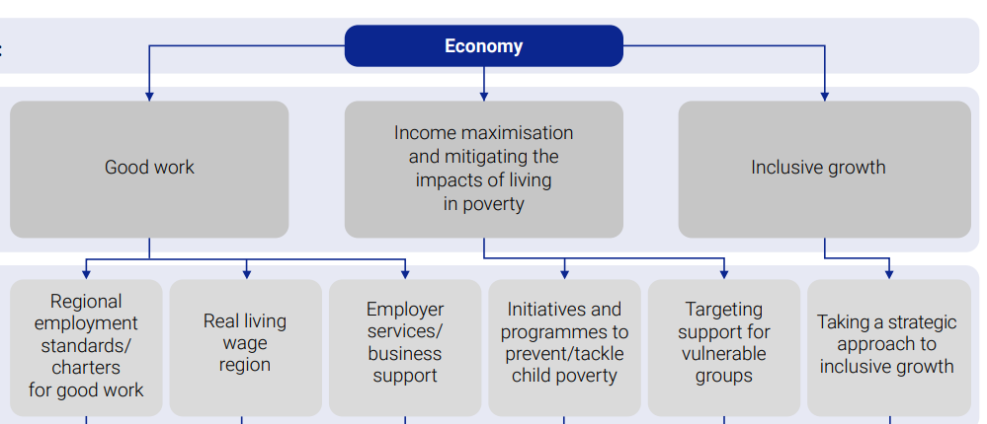


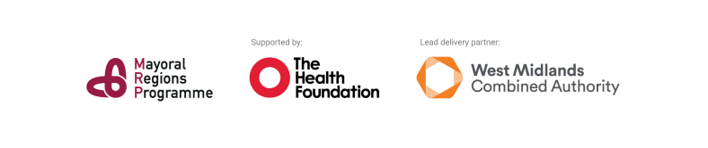



We fund local action
Economies for Healthier Lives
Mayoral Regions Programme & Health in All Policies toolkit
Notes:
Alongside research, we also fund and support local action directly.
One example is our Economies for Healthier Lives programme, which ran from 2021 until last year across five places.
Each council focused on a different priority — from assessing the health impact of major infrastructure projects, to strengthening data capacity around employment and skills support, and convening anchor networks to influence employment and procurement practices locally. I’m delighted that we’ll hear from our partners in Salford and Glasgow today.
We’re also working with metro mayors and Strategic authorities to explore the role they can play in improving health.
This funding includes dedicated posts within strategic authorities and a central team based in the West Midlands Combined Authority.
One output from this work is a Health in All Policies toolkit, which others can draw on to support similar approaches. Although focussed on SAs, we’ve found that its learning can also be applied across the local system.

Slide 5
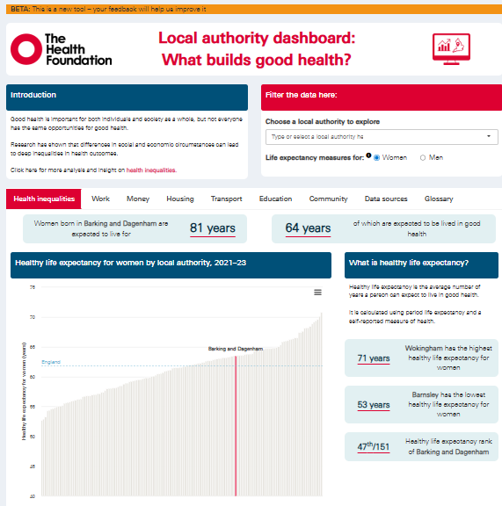
We provide tools to support place-based action
Notes:
LA dashboard – online data tool across LAs in England, across the social and economic factors that shape health locally.
Part of Evidence Hub – data and analysis that sets out the key drivers of our health

Slide 6
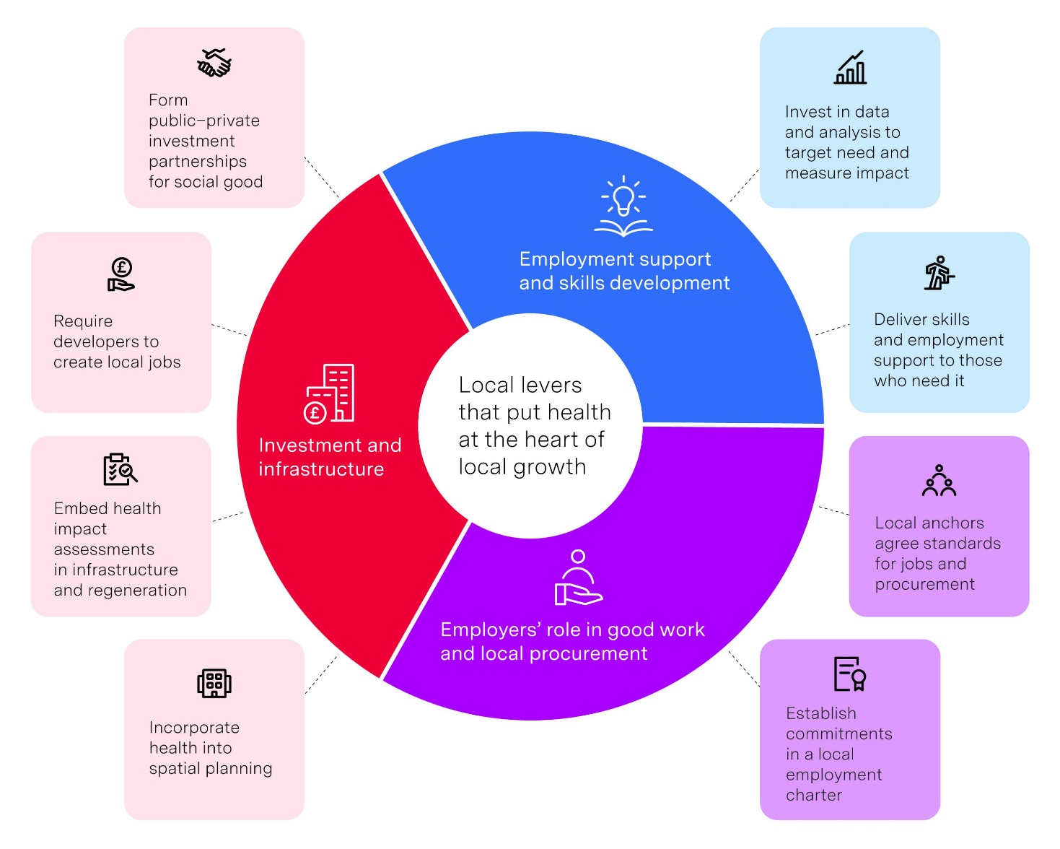
We provide tools to support place-based action
Liverpool City Region’s health and employment data integration toolkit
Westminster City Council’s Fairer Economy Plan
Ealing’s Our Seven Towns & 20 minute neighbourhoods
Greater Manchester’s Good Employment Charter
Health Foundation briefing: Health at the heart of local growth, 2026
Notes:
Recent briefing on economic development and health – showcasing evidence and existing good practice to take action across ED and health in a council
Employment support and skills development; engaging with employers; investment and infrastructure – and showcasing good practice

Slide 7
Poor health is holding us back
Notes:
Before talking about solutions, let me briefly highlight some data that illustrates the scale of the challenge.
Some charts – just quick overview, not to overload you with data on this sunny Thursday morning

Slide 8
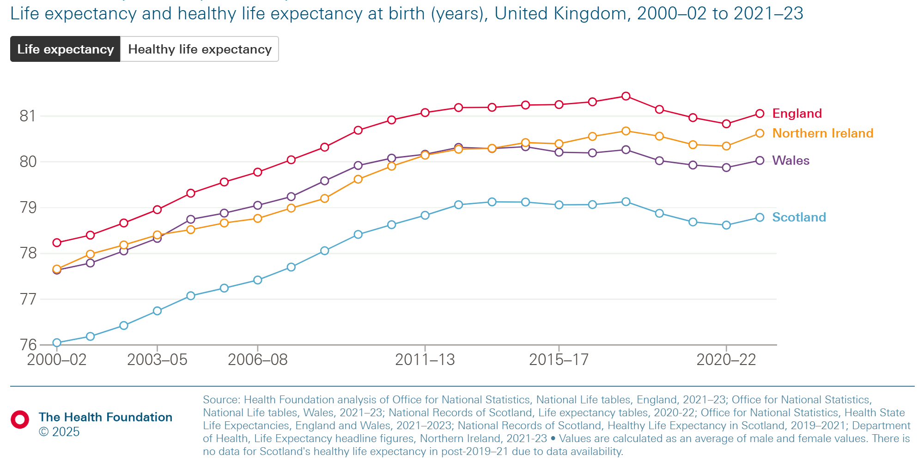
Improvements in life expectancy have stalled
Notes:
What the evidence shows is that improvements in life expectancy — which increased steadily from the early 2000s to around 2015 — have stalled in recent years.

Slide 9
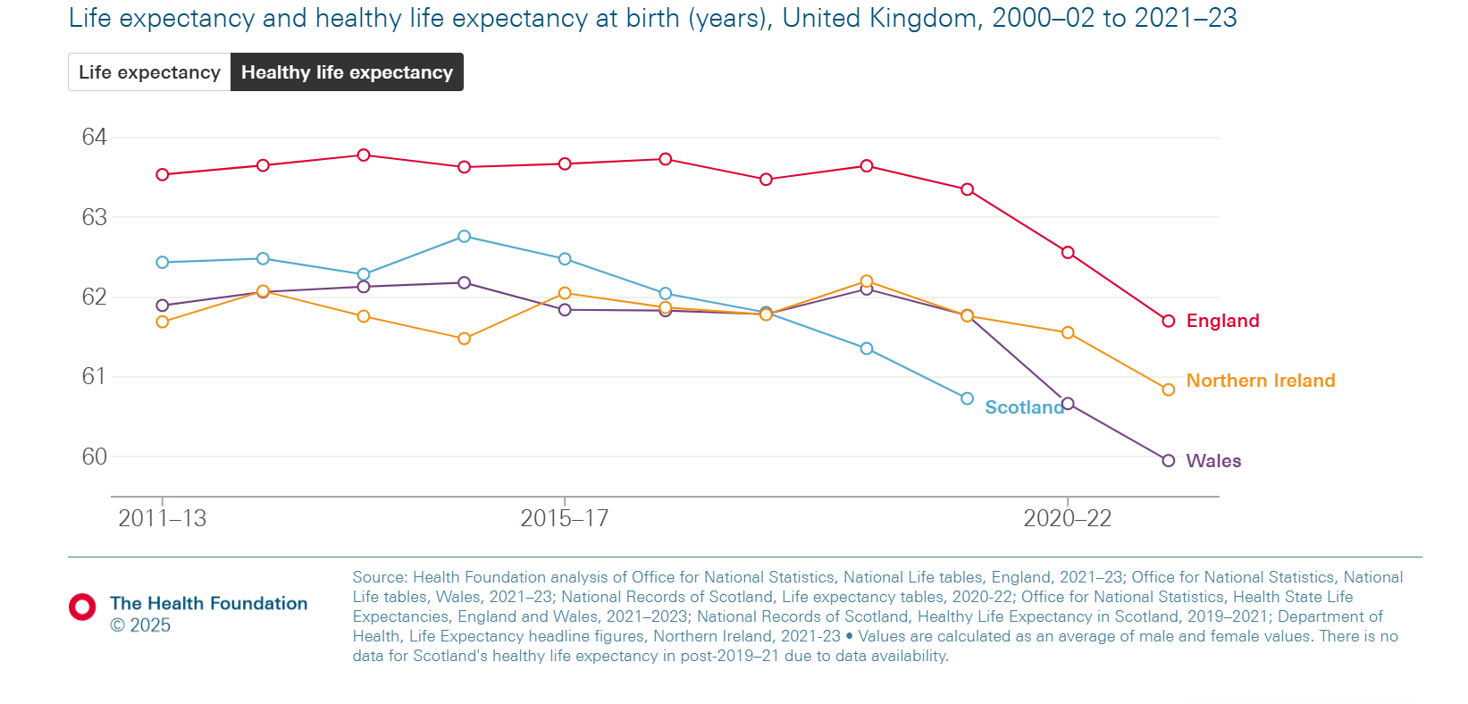
Improvements in healthy life expectancy have stalled or worsened
Notes:
And over the same period, healthy life expectancy has also stalled and in some cases worsened.

Slide 10


The working-age health challenge in numbers
8.2 million 16-64-year-olds with work-limiting health conditions
…….. of whom 3.9 million are in work
Each year, 300,000 fall out of the workforce and report such conditions
After a year out of work only 3% of people with work-limiting conditions return to employment
51% of businesses expect workforce health challenges to increase in the next 5 years
Source: Commission for Healthier Working Lives. Action for healthier working lives. The Health Foundation; 2024
Notes:
This matters not only for individuals and communities, but also for local economies — because poor health can significantly affect people’s ability to participate in work. Impact on employers – a really big concern – and how this poses serious risks to local growth efforts
This is from our Commission for HWL from last year and in a follow-on from this work is some new analysis just published recently about young people who aren’t earning or learning

Slide 11
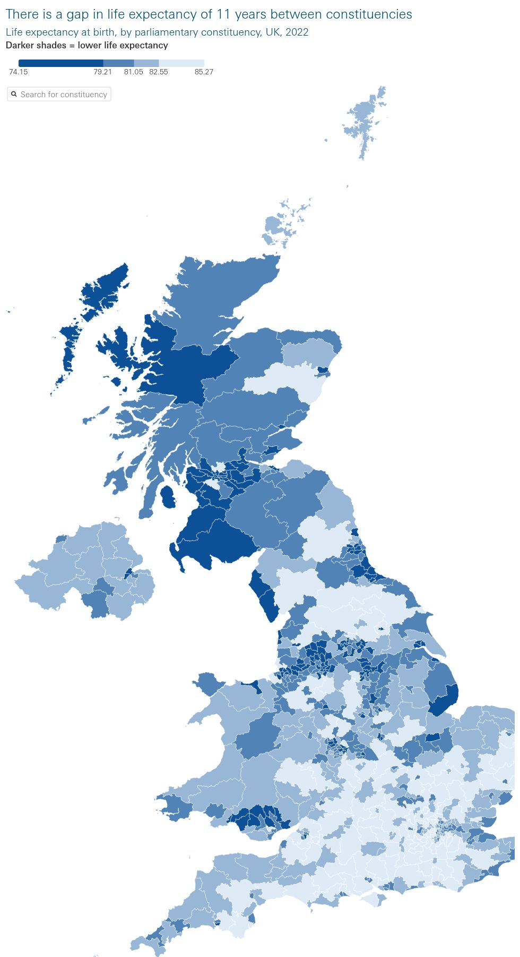
Lives cut short
National inequality
Life expectancy gap of 11 years between constituencies
E.g. Liverpool Riverside constituency has shortest Life Expectancy in England
Notes:
Place Matters
What this map highlights is the scale of geographical inequalities in life expectancy across the UK.
In some cases there is an 11-year difference in life expectancy between parliamentary constituencies.

Slide 12
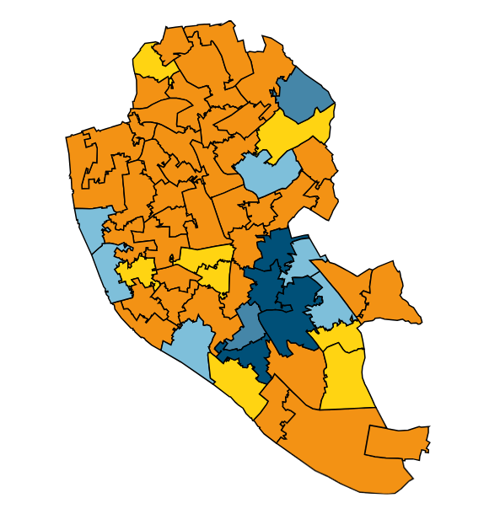
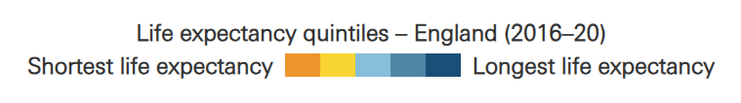
Lives cut short
Local inequality
Life expectancy gap of 16 years between MSOAs
E.g. 13 year gap between Edge Hill and Calderstones within Liverpool
Life expectancy by
Notes:
And even places cities the differences can be stark — for example, in Liverpool there is around a 13-year gap between neighbourhoods.

Slide 13
Building blocks of health
Notes:
Moving Toward Solutions
So what can help address these challenges?
In order to develop a Health in All policies approach, one approach we’ve found particularly effective is the Building Blocks of Health.
And I think there are some close bonds between the building blocks of health and core Cooperative values such as co‑production, social partnership, and democratic engagement – and could offer a platform to strengthen these assets.

Slide 14
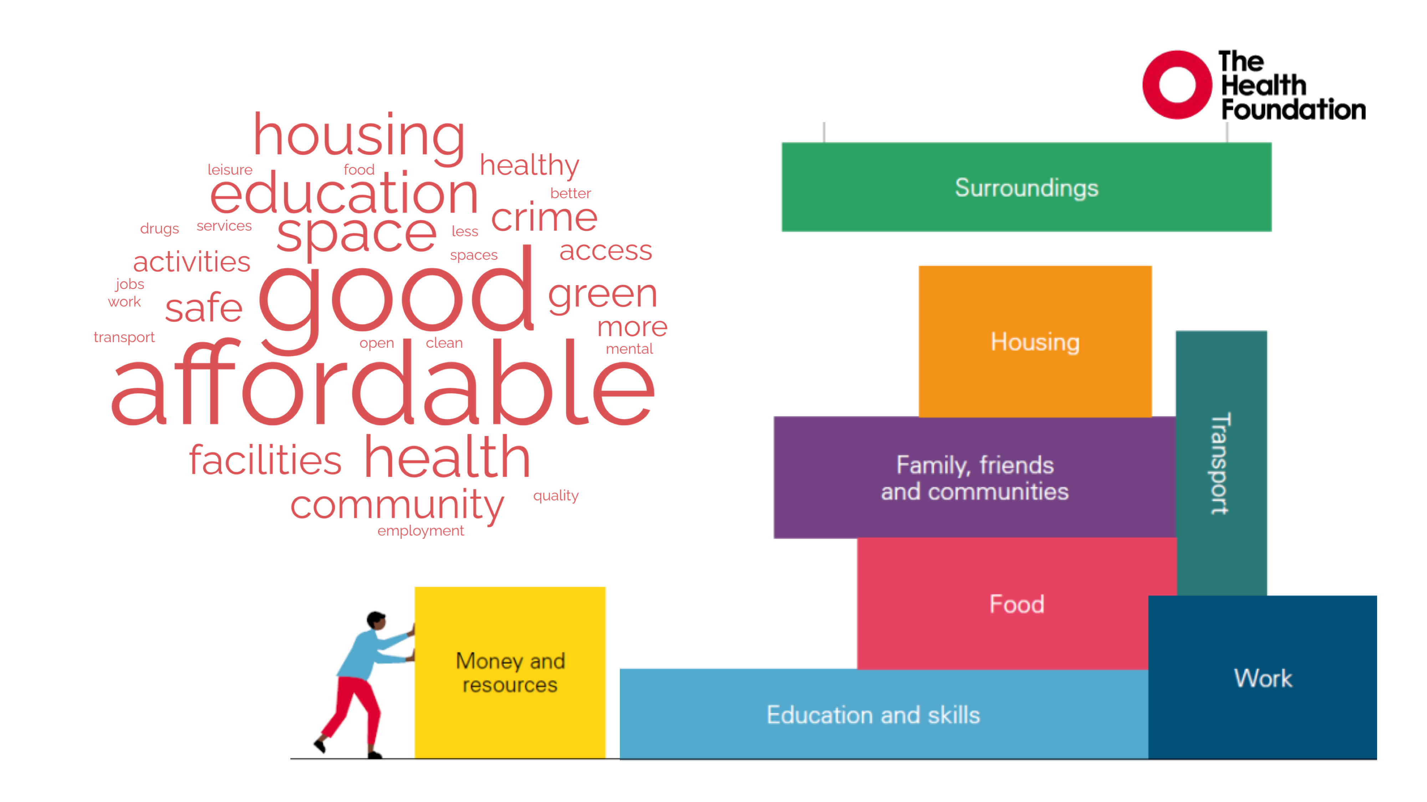
Notes:
Building Blocks of Health
The Building Blocks of Health is a tested metaphor that helps explain how the foundations of our lives — our jobs, our homes, and our neighbourhoods — shape our health.
It provides a simple and engaging way to talk about health inequalities while also pointing to practical solutions.
What we’ve found is that this approach helps make complex issues more understandable and memorable, while still reflecting the scale of the challenge.

Slide 15
Embedding the building blocks of health
Key conditions for success
A golden thread throughout all council activities
  What frameworks can help to formally badge a joined-up approach?
Winning hearts and minds/ securing senior buy-in and leadership
  What will make the case to decisionmakers?
3. Staying curious by evaluating what works
  How can impact and value secure support in tight funding environments?
4. Codesigning with communities to avoid widening inequalities
  How can communities be involved to strengthen success?
5. Building the right skills for healthy places
  What skills and capacity is needed to make the building blocks of health a reality across a council’s activities?
Notes:
Key Learning
Finally, I’d like to highlight some key learning from our work on embedding the Building Blocks of Health across council activities.
There are five conditions that appear particularly important: I’ve set these out alongside some questions that may be helpful to shape the discussions this afternoon.
First, ensuring the building blocks of health run as a golden thread across council activities.
Second, securing senior leadership and buy-in.
Third, staying curious and evaluating what works so that impact can be demonstrated.
Fourth, co-designing with communities to avoid widening inequalities.
And finally, building the skills and capacity needed to create healthier places.
Closing
So to conclude, improving health takes a whole society approach as it is so closely linked to the economic and social conditions that shape people’s lives —
local and regional government play a critical role in influencing these conditions. A congratulations to everyone involved in the HM action plan – I’m looking forward to hearing about progress in its delivery phase and what we can learn to spread the learning so other places can benefit.
Thank you for listening.
I’d be delighted to hear about the work happening in your council, particularly the challenges you’re facing in undertaking similar initiatives, and where additional support might be helpful. If you’re interested in discussing any of the work I’ve mentioned further please do get in touch.

