Slide 1
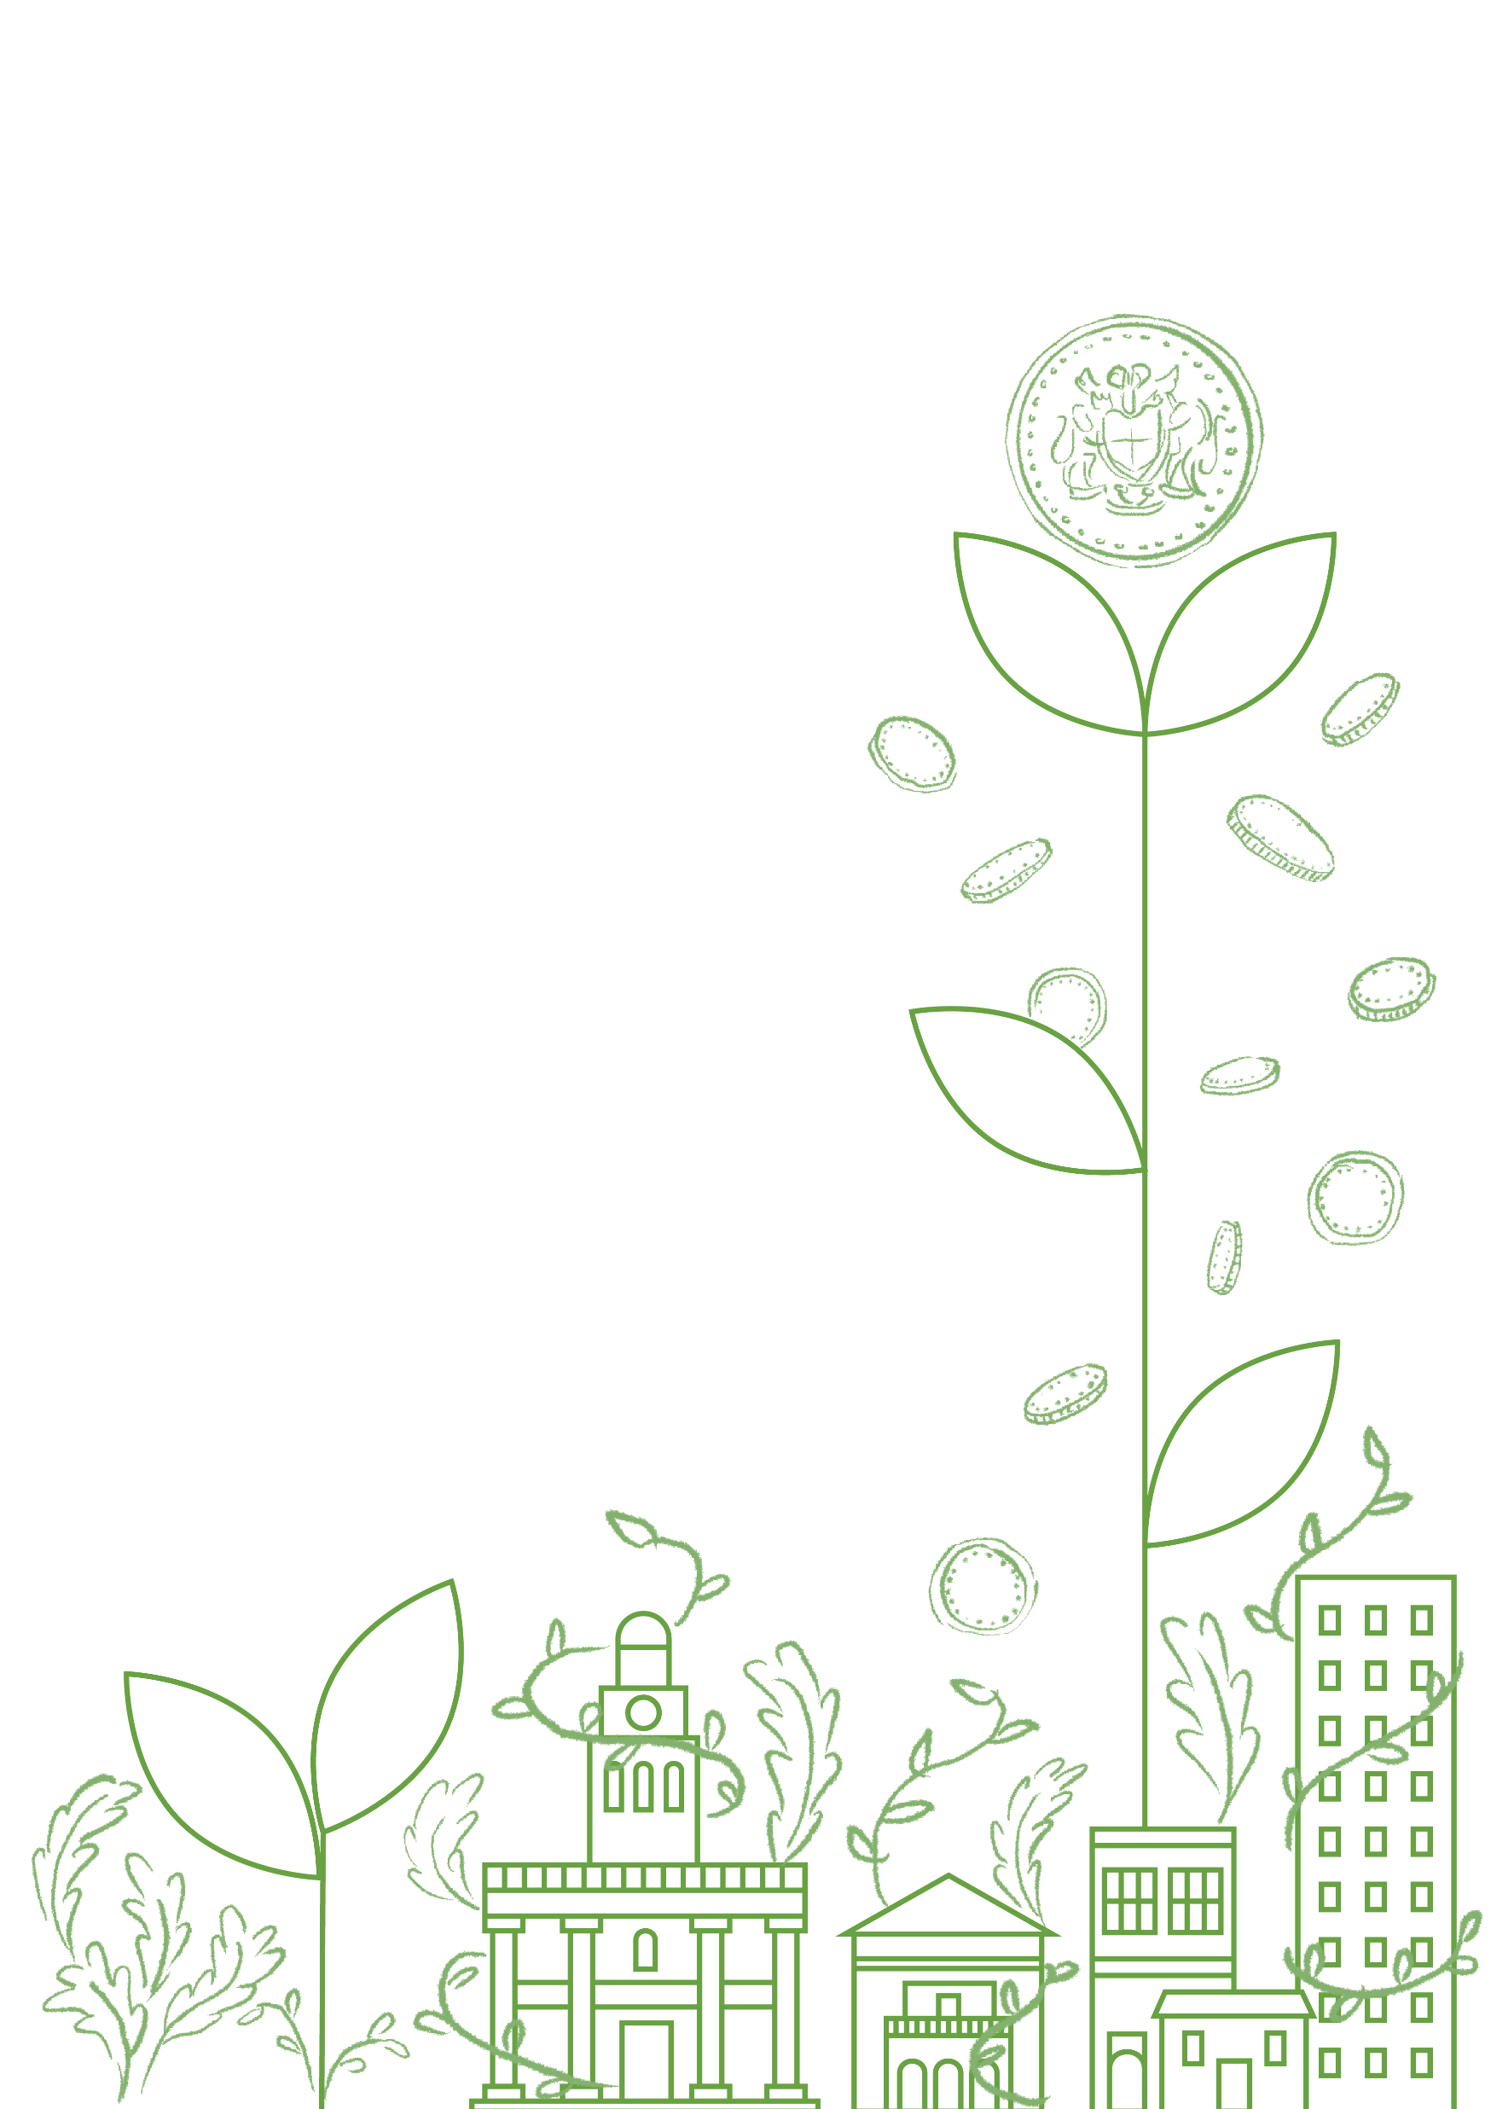


Fairer, Greener, Healthier
Growing community wealth

Slide 2
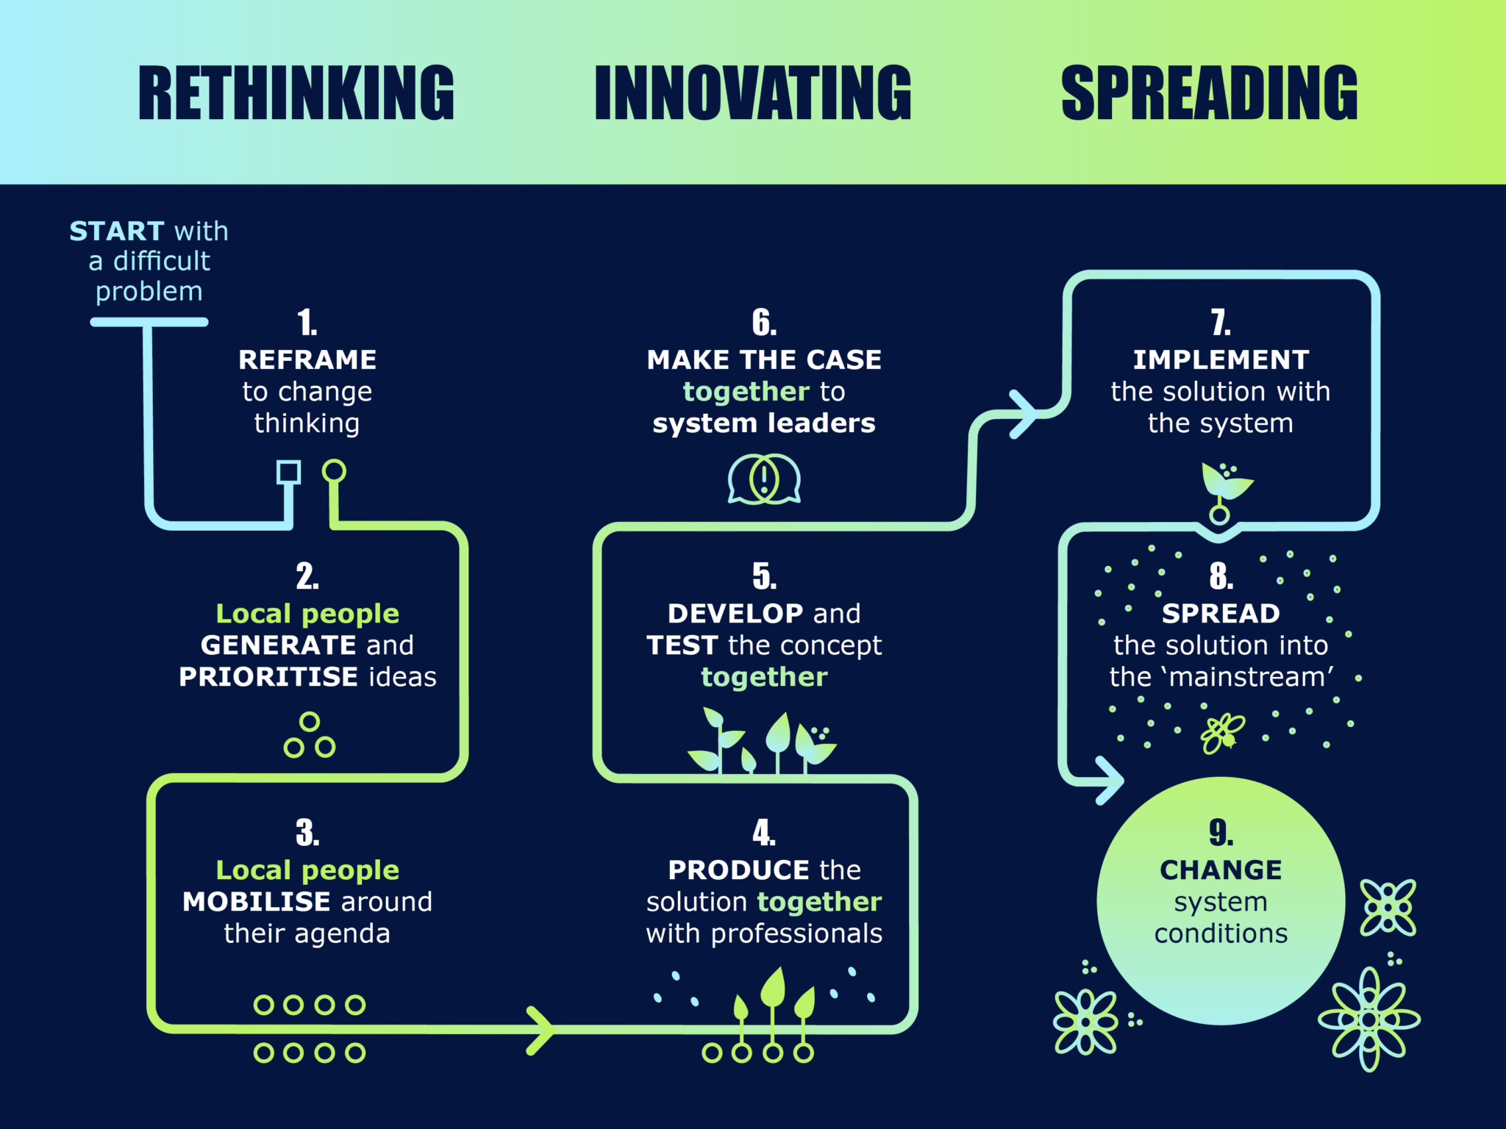
Social and Economic Innovation
Notes:
Unlimited Potential – a community benefit society that specialises in social and economic innovation, working towards system change.
Description of U.P innovation process.

Slide 3

Notes:
A child born in a low-wealth neighbourhood risks spending nearly 20 fewer years in good health than a child born in a prosperous one. They also risk dying ten years earlier.

Slide 4
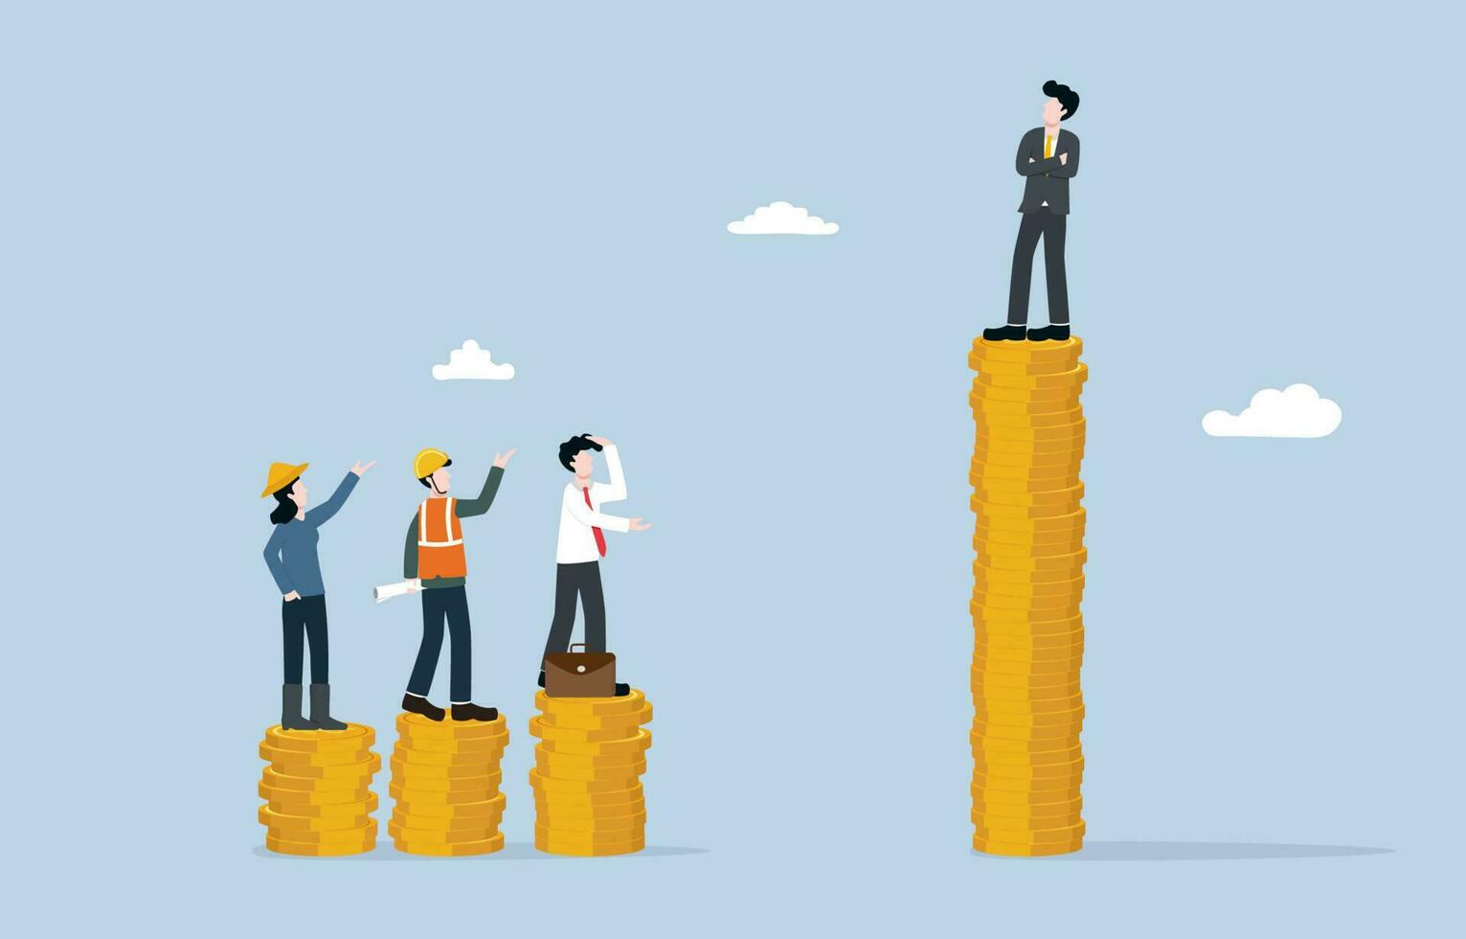
Economics as a determinant of health
Notes:
People with higher socio-economic position in society have a greater array of life chances and more opportunities to lead a flourishing life. Reducing economic inequality improves public health and well-being.
The Marmot Review (2010) found that “Economic growth is not the most important measure of our country’s success. The fair distribution of health, well-being and sustainability are important social goals. Tackling social inequalities in health and tackling climate change must go together.”
It also found that “Action taken to reduce health inequalities will benefit society in many ways. It will have economic benefits in reducing losses from illness associated with health inequalities. These currently account for productivity losses, reduced tax revenue, higher welfare payments and increased
treatment costs.”

Slide 5
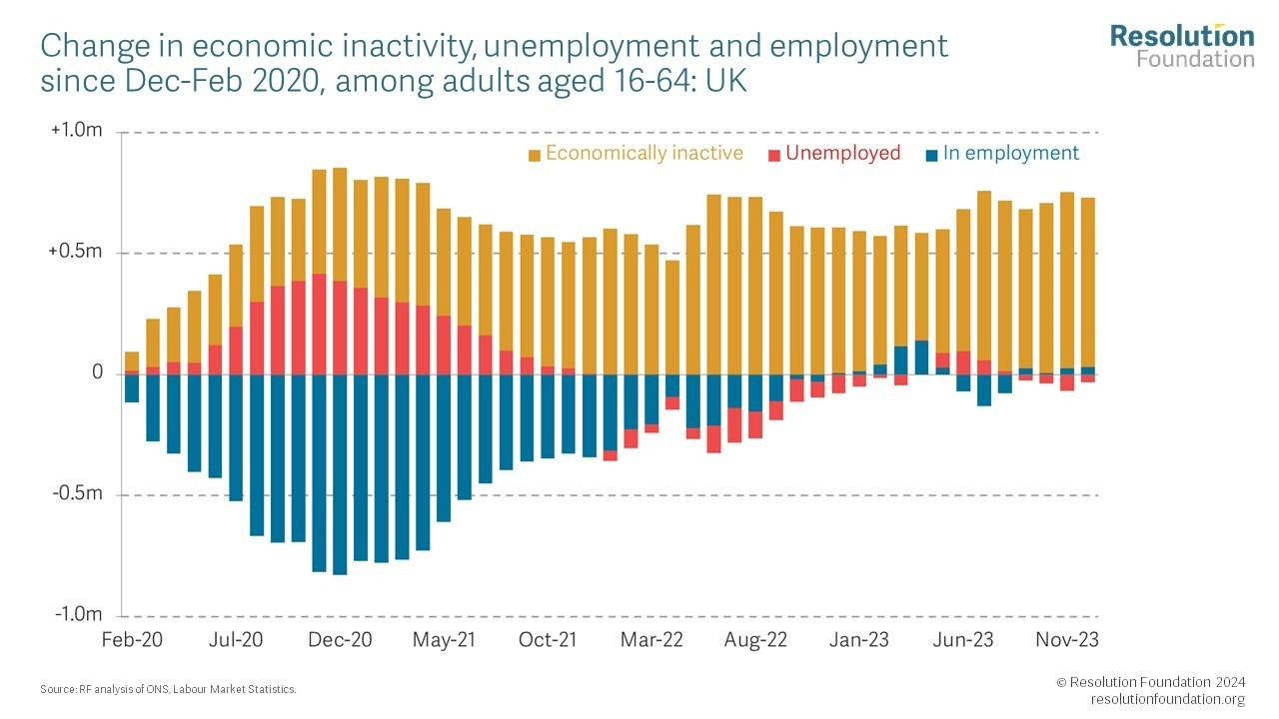
Ill-health and economic inequality drive each other
Notes:
Economic inactivity has increased since 2020. It is an undeniable determinant of health and well-being.
On current trends reported by the Health Foundation in its Health Inequalities in 2040 report, inequalities in health will persist over the next two decades: people in the 10% most deprived areas can expect to be diagnosed with major illness a decade earlier than people in the 10% least deprived areas. In many parts of the country where inequality is only growing, this will be the result that we see.
It is important to shift the focus from only jobs and income to ownership and control of wealth. The Marmot Review - 10 Years On states: “Wealth is associated with good health directly and indirectly – it provides a buffer from economic shocks and insecure work and it gives a sense of security, which is hugely beneficial to mental and physical health.” It continues: “wealth inequality increased faster in the U.K. than in any other country” according to the Organisation for Economic Co-operation and Development (OECD).
We are working to reshape the narrative on the economic system – our current economy was designed which means it can be re-designed. We do not have to be stuck with the economy that we have now.
If we want better health and well-being, we need economic change.

Slide 6

Ownership and control as a determinant of health
Notes:
Many of the people we work with are from communities with low or no wealth and power, which contribute to overall ill-health. They often have little individual or collective control economically and own less or nothing, such as homes, land, businesses and data.
Giving a sense of control and growing local power can be a determinant of health and well-being. For example, if we focus on collective action around economics, such as co-operative models of business, there can be very feasible ways of people from lower-wealth communities to gain control over local economies with less risk or personal investment involved to which they might not have access individually.
Spreading this approach would enable communities to create local supply chains and ecosystems of businesses that are much more likely to recirculate wealth locally. Such collective actions could eventually infuse this money into the local economy. More collective ownership of businesses by local people can retain the wealth locally. This can enable local people to develop collective wealth, increase resilience and improve health and well-being.

Slide 7
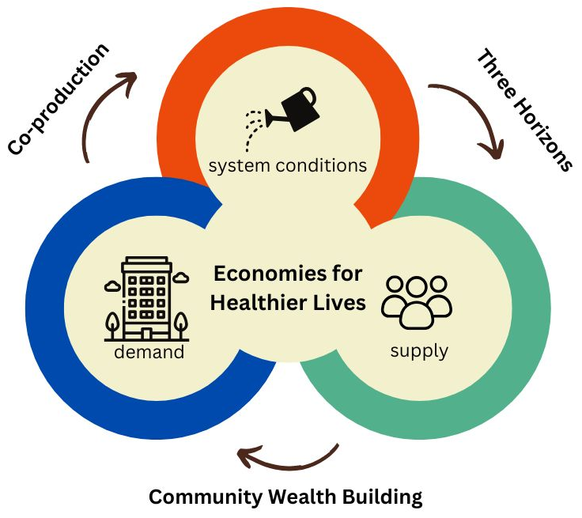
Economies for Healthier Lives
Notes:
Salford’s approach
For 3 years, with support from the Health Foundation, we tested a people-centred approach to growing community wealth as a co-produced a solution to health inequalities in Salford. This approach redirects wealth back into the local economy and places control and benefits into the hands of local people which will improve health and reduce health inequalities by providing agency and a hopeful future.
There are 3 main elements of this approach: system conditions; local people; and local anchor institutions.
The right system conditions are important so that an environment is created that is both receptive to change and willing to make the changes to the economy to allow everyone a chance to participate and create a healthy life for themselves. These lie partly in local strategies and policies.
Embedding approaches to growing and sharing power in policy and strategy is key to effecting system change.
Some examples of how system conditions have changed in in Salford include that there is now greater collaboration between economic development and public health. Economic development are now thinking about public health in regeneration plans.

Slide 8
Local Anchor Institutions
Notes:
The local agencies who are rooted in a place and hold power in regards to their size, spend and who they employ can have a significant impact on their local area when recognised at economic entities and interact with local people in new ways.
With a focus on the progressive procurement element of growing community wealth, we analysed the supply chains of 6 local anchor institutions and were able to identify at least £10 million of spend that was deemed transferable. This is money that is spent every year, regardless of budgets for these anchor institutions to run, but if spent differently (such as with local or socially driven enterprises) could have a significant positive impact on the local area.
With this work in procurement, it is important to highlight that the impact is not overnight. A lot of the work requires a shift in mindsets especially around ‘value for money’ and long-term changes to health inequalities, and where teams like procurement can have an impact on this. The time it takes will depend on contract length, existing relationships and organisational buy-in. From connecting with other anchor networks across the U.K. such as Birmingham and Leeds, we know that to change one contract can take a number of years. It is not a quick fix, but an effective change with eventual lasting impact.
This is just one way that local anchor organisations could use their impact in a better way to help grow community wealth.

Slide 9
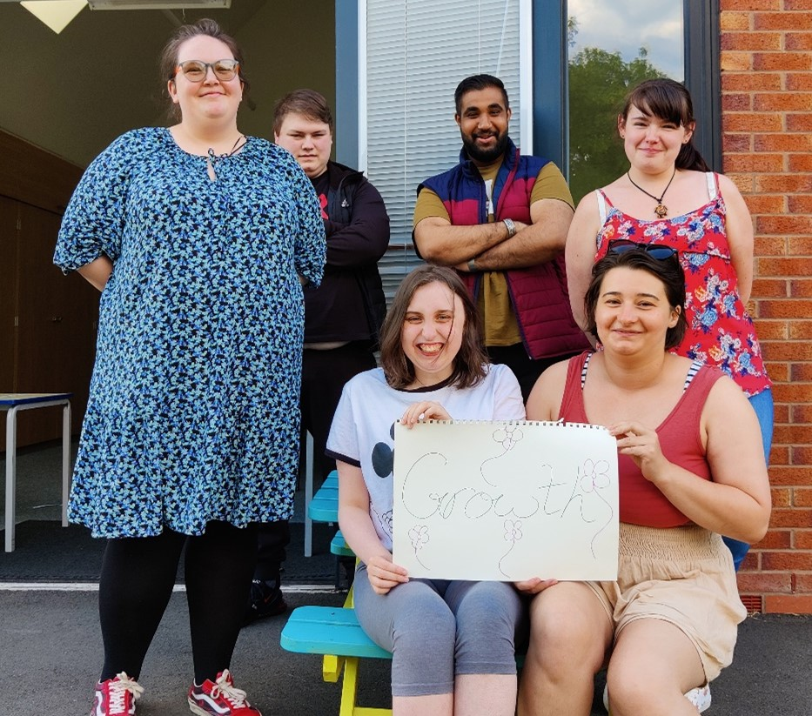
Local People
Notes:
Traditionally, economic development excludes local people and the resources that exist in the communities around us, especially where attitudes to growth and wealth are concerned. Connecting local people and anchor institutions in new ways helps to create a fairer economy that serves everyone and utilises everything we already have at our disposal.
There are always strengths and assets existing in communities. When it comes to Economic Development (ED), these are largely untapped. Local people tell us that they are very infrequently involved in anything to do with ED, feel they can’t be involved or do not have the knowledge or expertise to get involved. This even came down to language used in or traditionally associated with ED. We created our Grower’s Guide as a way to share our approach, but also test a language shift to more organic, softer language, rather than the more traditional industrial framing.
Spreading this approach would enable communities to create local supply chains and ecosystems of businesses that are much more likely to recirculate wealth locally. Such actions could eventually infuse this money into the local economy. More collective ownership of businesses by local people can retain the wealth locally. This can enable local people to develop collective wealth, increase resilience and improve health and well-being.
We are continually learning about this process with what does and does not work. It was really important that we ensured opportunities for collective businesses were focused in a low-wealth area, giving local people there the opportunity to own and control a social business.
The biggest challenge facing people from lower-wealth backgrounds to creating and owning their own enterprises is the lack of access to resources especially capital and set up funds. They are relying on piecing together small grants or neighbourhood funds and often cannot find the full funds required. Many do not have the financial history needed to access traditional bank loans or affordable lending.
It is worth mapping out what is available in your area and potentially creating pots for this specific purpose to address this barrier fully.

Slide 10
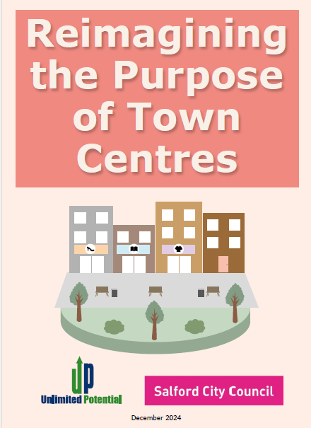


What has this led to?
Notes:
Local policy and strategy in Salford are being refreshed this year, so we have a great opportunity to have this work reflected in these strategies and for Salford to commit to shifting the economy and addressing economic determinants of health. The City Mayor of Salford has said that “This work … will inform important forthcoming work as we refresh the Salford Way and our Locality Plan, all with the aim of delivering a Fairer, Greener and Healthier Salford.” This is already reflected in Salford City Council’s Corporate Plan.
In the meantime, the work through Economies for Healthier Lives has resulted in spin-off projects, such as:
Reimagining the Purpose of Town Centres in Salford
growing community wealth in Rochdale Borough
influencing Live Well across Greater Manchester, in relation to its approach to community wealth
As Andy Burnham, Mayor of Greater Manchester, has said: "For too long, others have extracted out of our communities, and people have lived their lives not having control of the basics … Live Well is about putting communities back in control so that they can create and keep wealth and recirculate it in communities. It’s about switching investment towards our own communities and away from organisations that are not always serving them.“

Slide 11
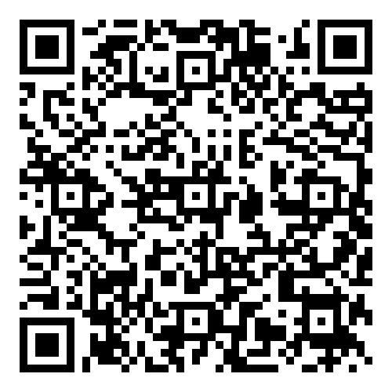
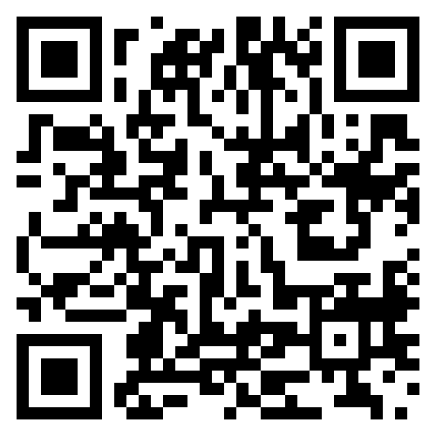
Find out more…
Economies for
Healthier Lives web page
‘Rooting for a Healthy Economy’ animation
Notes:
You can find out more on the Economies for Healthier Lives web page, and by watching our Rooting for a Healthy Economy animation.

