Slide 1
Capital Investment Health Impact Assessment (CHIA)
Economies for Healthier Lives:
A Health in all Policies approach
in
Glasgow City Region
April 2026
Notes:
Good afternoon, all, I am going to share GCR approach to HIAP in regional/ LA decision making, particularly Capital infrastructure.

Slide 2

Outline
Glasgow City Region
Developing CHIA
Early Impact of CHIA
Enablers & Barriers
What next?

Slide 3
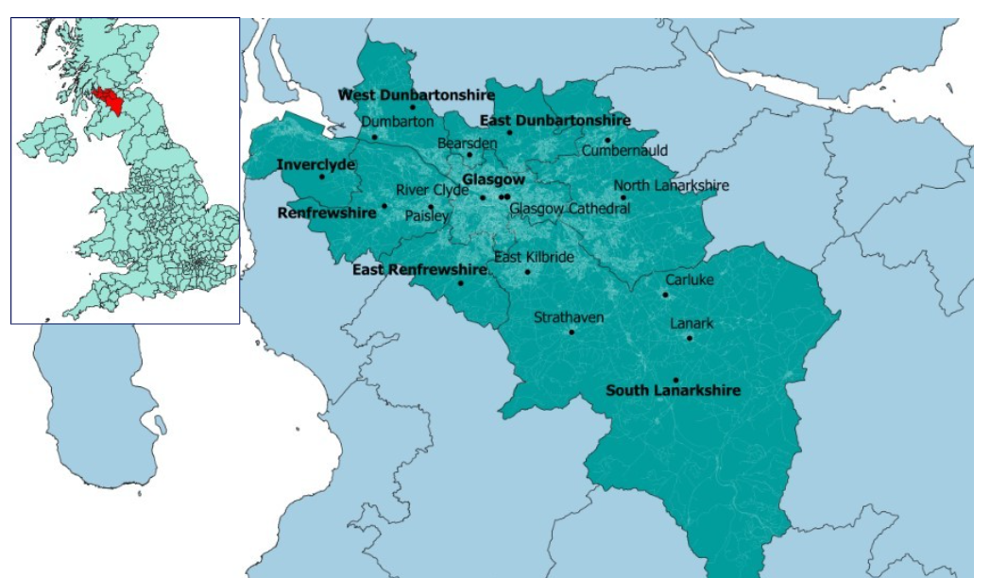
Glasgow City Region
Partnership of 8 Local Authorities ( 1st City Deal in Scotland)
Fourth largest city region in the UK
One third of the Scottish Population and Economy
Regional Economic Strategy and Action Plan

Slide 4






Regional Economic Strategy
What
RES Vision:
By 2030, Glasgow City Region will have the most innovative, inclusive and resilient economy in the UK.
Mission 1: Productive and Prosperous Economy
Mission 2: Inclusive Economy
Mission 3: Net Zero and Climate Resilient Economy
Why
Enhance productivity
Promote inclusive growth
Address the climate emergency
How
City Deal
Investment
Innovation
Inverclyde
Clyde Mission
Commercial Land & Property
Inverclyde
Economy & Health
Inclusive Economy
Sustainable City Region
Housing Retrofit
Electric Vehicle Charging Infrastructure
Clyde Metro
Clyde Mission
State of Play and Measuring Impact Target indicators
GVA per hour worked
Worklessness
GHG Emissions per capita

Slide 5
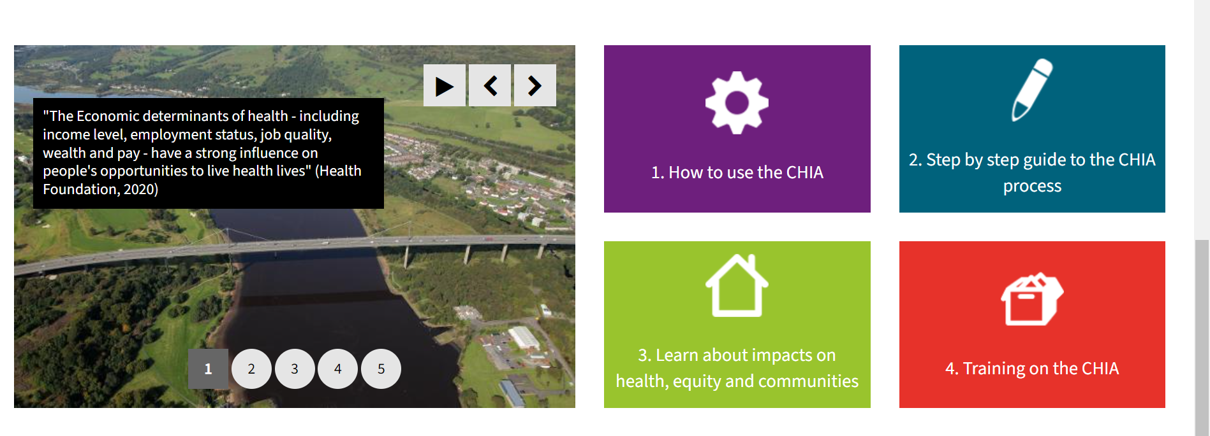
Developing CHIA resources
Appreciative Inquiry
Shared understanding
Shared vision
Shared ownership
Co-production
Development Cohorts
Community Panel
Systems and processes map
User testing
Training materials
Formative Evaluation
Academic partner
Reflexive learning
Meaningful engagement

Slide 6

Early Impact of CHIA
Mutually beneficial partnerships - wider Regional Local Authority, PHS and NHS boards regional collaboration
Increased capacity building on Health Determinants and Health Inequalities
Health workstream and full HIA as part of Clyde Metro programme
Local Authority commitment to screening for health impacts of capital investment projects
Private sector engagement

Slide 7

Enablers & Barriers
Enablers
Capital investment and public health - relationships and ongoing collaboration
GCR PMO role in managing City Deal funding
Scottish Government Public Health Framework
Barriers
Resourcing public health input for capital investment
Decision making pace and process in capital investment [health evidence]
Competing demand for limited time and resources
( ED &PH)

Slide 8
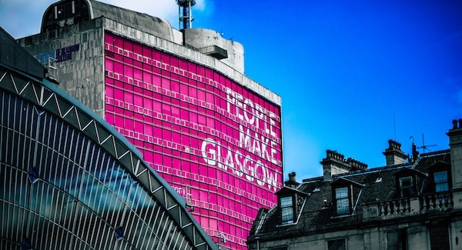
Planned Next Steps
CHIA Champions Network
Continued engagement and collaboration with member authorities, third sector and academic partners
Training and Governance
Exploring role of CHIA in Glasgow City’s Local Development Plan
Notes:
This Photo by Unknown Author is licensed under CC BY-NC-ND

Slide 9
Thank you! Sonia.Milne@glasgow.gov.uk

