Slide 1
CCIN Meeting
Supporting Residents from crisis to resilience
2026-2029
March 2026

Slide 2


Slide 3












Who we are…
The UK’s leading provider of free, independent debt advice
Over 30 years’ experience
Flexible debt advice online or by phone to suit customers’ needs
Working in partnership with over 1,700 organisations
A broad range of debt solutions

Slide 4





The StepChange client journey
We assess the client’s situation which includes identifying vulnerabilities and other areas of crisis
We work with clients to create an income and expenditure statement, to identify the most appropriate solution for them
They receive a personalised action plan, detailing their recommended solution and next steps
We set up their managed solution or advise them on how to proceed with their selected solution
We provide advice and aftercare until they’ve financially recovered or are debt free

Slide 5

Top 5 causes of financial difficulty reported by our clients
1
1. Lack of control over finances (18%)
2
2. Cost of Living Increase (16%)
3
3. Unemployment or redundancy (15%)
4
4. Injury or Health Issue (10%)
5
5. Reduced Income or Benefits (9%)

Slide 6




Stats Yearbook – 2025 key takeaways
60%
StepChange clients in some type of employment
54%
StepChange clients who accessed our services recorded having a vulnerability
28%
StepChange clients we work with have a negative budget
33%
StepChange clients in council tax arrears

Slide 7
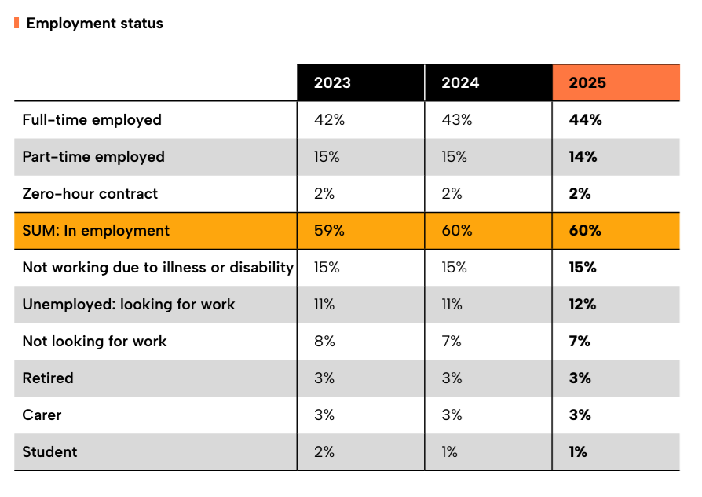
60% StepChange clients in employment

Slide 8
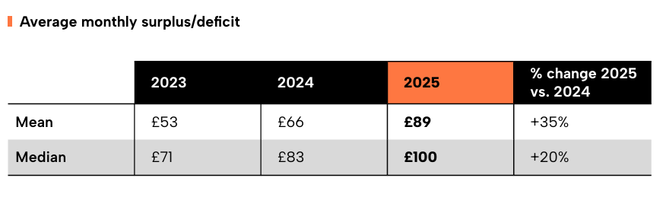
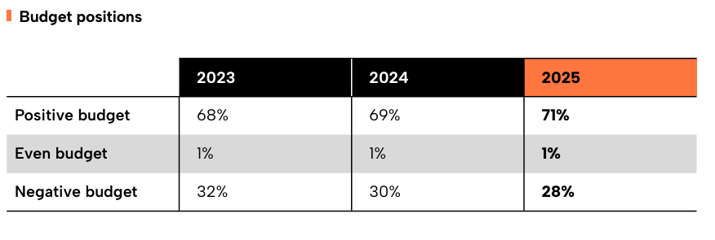
28% clients with a negative budget (-2% since 2024)

Slide 9
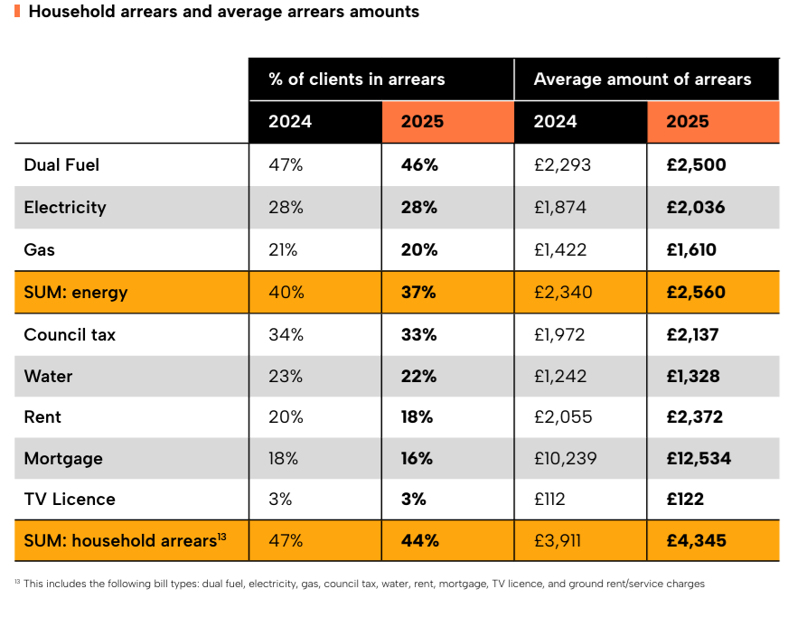
33% clients in council tax arrears (-1% since 2024)

Slide 10

77% of our clients complete their advice session online…
Benefits of our online debt advice tool:
Available 24/7
Receive advice without having to speak to anybody
Able to recommend all suitable solutions
Ability to setup repayment solutions through the service
Support available via chat and over the phone
Ability to signpost vulnerable customers to relevant partners for additional support
Increases phone capacity for the most vulnerable or digitally excluded

Slide 11

The StepChange referral journey
We assess their full financial situation, and allocate debts – prioritising housing and council debts
Client is presented with a recommended solution and any others they meet the criteria for
Council makes ERR referral to StepChange
Resident becomes StepChange client
Resident does not engage
StepChange reach out to client up to 3 times
We issue a Personal Action Plan with our recommendations and their next steps.
We inform the client how we provide advice
We provide monthly referral MI data back to council

Slide 12
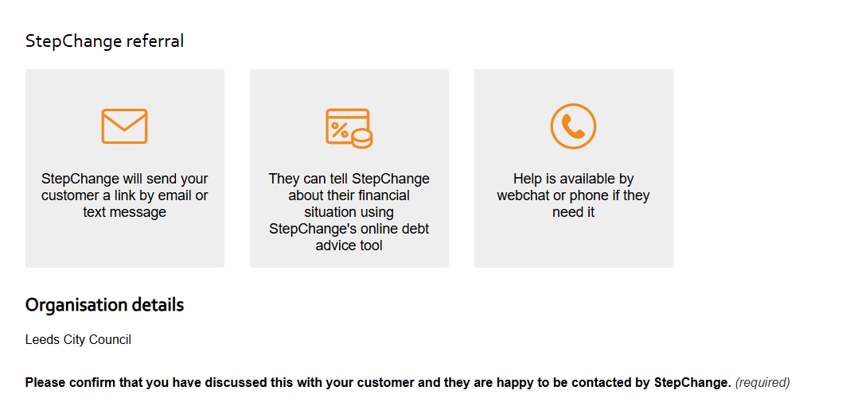
Easy Referral Route

Slide 13
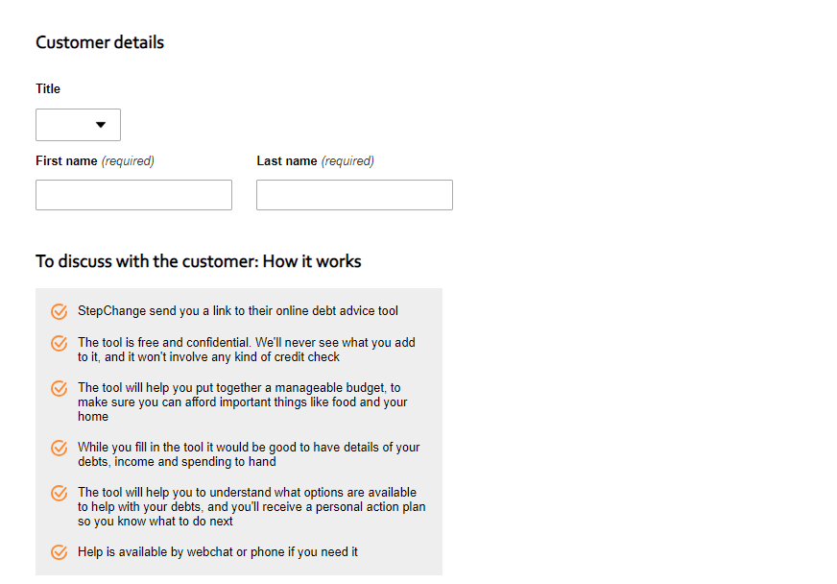
Easy Referral Route

Slide 14


Hi there, Oldham Council has referred you to us for free, confidential advice. We’ve helped over a million people with free debt advice, and we can help you too.
Start your journey now:
https://tx.vc/u/4P5BV/

Slide 15
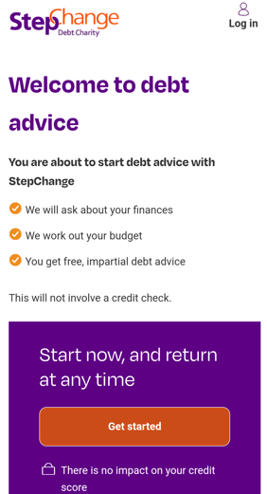
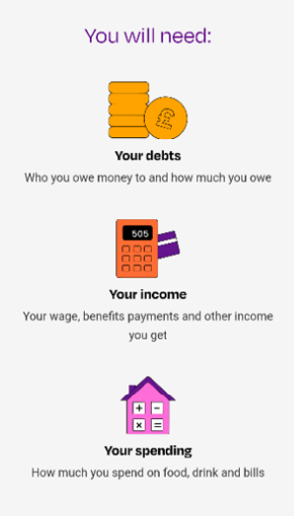
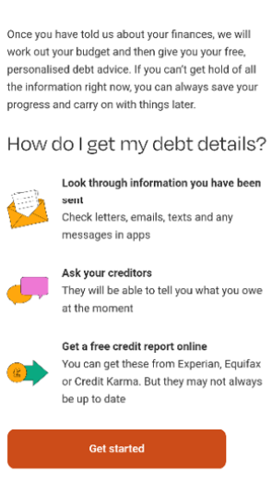
The client journey

Slide 16
Partnership Model
2026 – 2027
Bespoke referral tools for your council
Monthly MI reporting
Joint campaigning and engagement work including multi-platform comms support
Employee awareness sessions as well as StepChange referral training sessions for teams
Protected council payments and prioritised council debts repayments, as evidenced in MI reporting
2027-2029
All aspects of Phase 1 continue for duration of fund

Slide 17
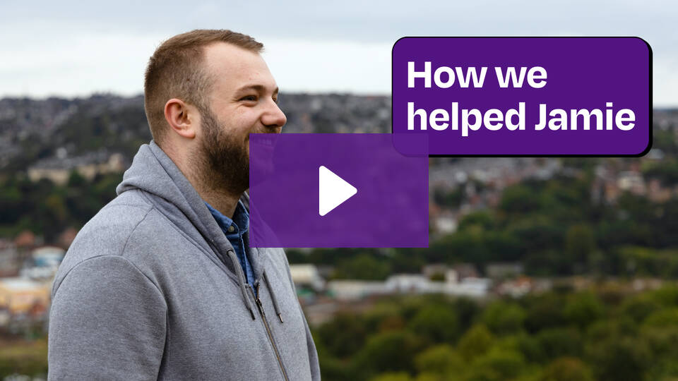
Jamie’s Story - How talking about debt helped Jamie find a way out
Our clients share – in their own words – the impact debt has had on them and their journey out: https://www.stepchange.org/about-us/our-clients-stories.aspx

Slide 18
Thank you

