Slide 1
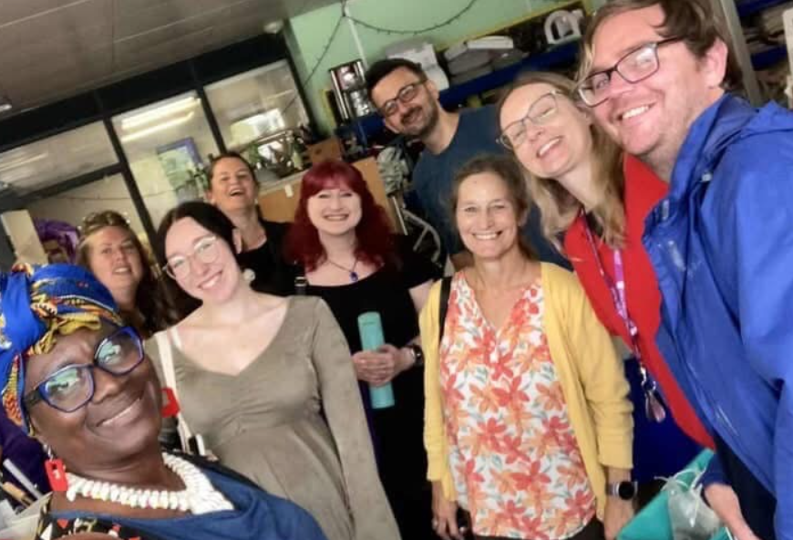


Plymouth’s Community Builder Programme Making the invisible visible
Mobilizing community assets to address the social determinants of health and shape the city we want together
Debbie Burton and Zoe Sydenham - Plymouth City Council

Slide 2
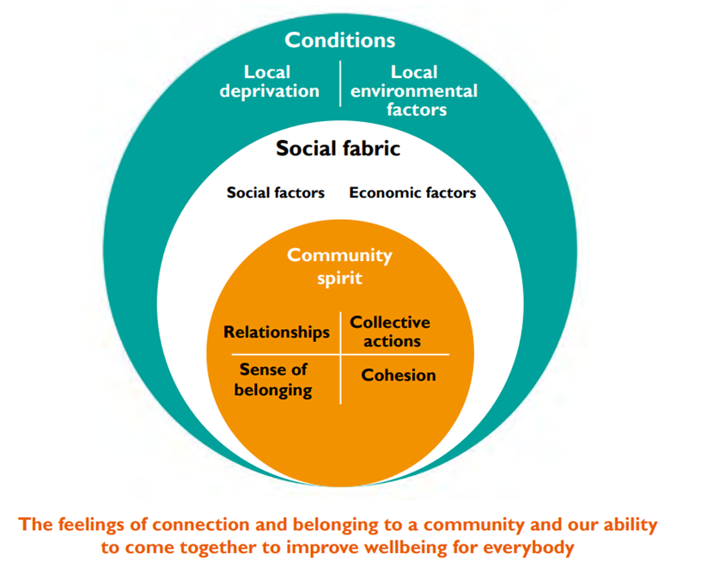
Based on theory
Strategic partnership with Council and NHS
A team of 13 Community Builders of Geography and Identity, embedded in the VCSE
Connecting, Listening, Mobilising,
Shaping
with communities
Royal Society for Public Health, Community Spirit Level
“A strong sense of belonging, encompassing community, social, and cultural connectedness…acts as a buffer against stress, reduces social isolation, and is associated with better self-rated health, lower risk of chronic diseases, and improved mental health”.
Haim-Litevsky, D., Komemi, R., & Lipskaya-Velikovsky, L. (2023).

Slide 3
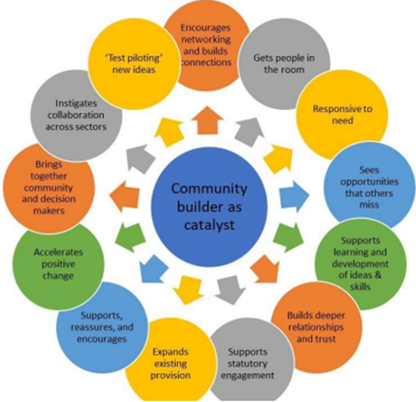
Evaluated in practice
They act as the ‘bridge’
They are catalysts
They help to ‘change lives’
They can give ‘warm handovers’
“I'm keen to give back and help others in the same situation” Dave
“It has strengthened my connection to my local community support networks” Sarah
“Getting involved has changed my life and I look forward to coming weekly” Chrissy
University of Plymouth evaluation 2024

Slide 4
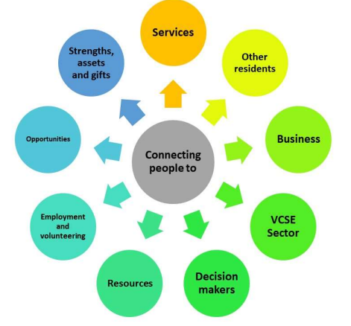
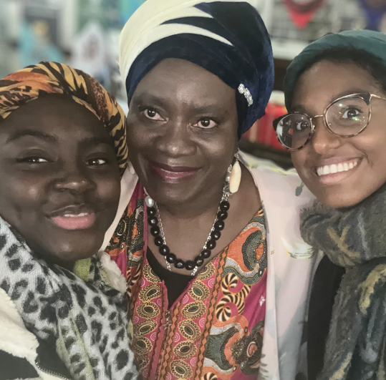
In 2025 we:
Supported 833 volunteers (connectors) to develop NEW community led activity
Connected 498 people into existing services
Helped create 252 new community led activities
Held 1,394 listening conversations
Had over 27,000 views on our community asset maps
Lead and participed in over 20 citywide networks, collectives and partnerships

Slide 5
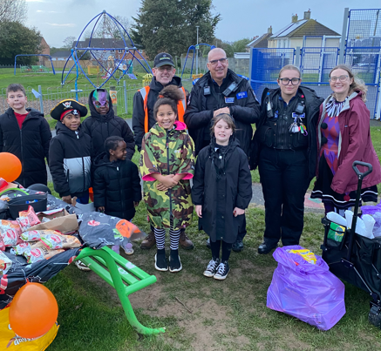
Mobilising Community Assets
Enabling people to follow their passions and bring joy
Examples of new community led activities in Q3:
Journey Together - peer bereavement support group for 'younger-older' people.
Plant & Pick working with home educators and family hubs in Stonehouse
Craft afternoons in Devonport
Jam music sessions and tech café in Southway
Adult SEND support group
Men’s meet up in Honicknowle
New compassionate cafés, gardening groups, food co-ops
Police collaboration at a skate park in East End
“Thank you for believing in me”
“Sharing my experiences to help others helps me”
Facilitating ‘Connectors Circles’ and
‘Connecting Gifts to Create Associations’

Slide 6
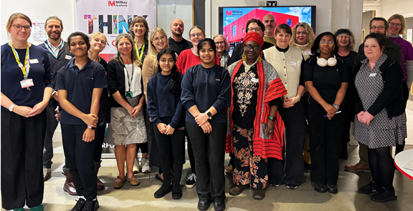
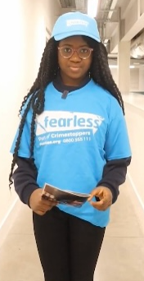
Example: Collective Action in a place-based community
Identifying Stonehouse assets
Connecting associations and institutions
Listening through over 100 appreciative enquiries
Themes – connection, feeling safe, resilience
Mobilising action – asset mapping, fearless.org, money clubs, knife angel, young people, new community spaces
Glory says: “Being involved in projects like this has made me aware that carrying a knife puts you in more danger rather than keeping you safe and I can share this with others”.

Slide 7
Contribution to Council’s Wider objectives: Listening, influencing and shaping
Equalities framework – listening campaigns focusing on hate and community cohesion
Armed Forces Covenant – support for veteran communities and female veterans
Safer Plymouth Safer Communities – listening campaigns focused on community safety and knife crime
Ageing Well Plan – listening campaign focusing on what ageing well means
Inclusive Growth – providing insight into the barriers faced by women furthest from the labour market
Net Zero plan – listening to and mobilising communities to focus on climate initiatives incl. new food waste programme.
Thriving Communities Framework 2026-2030 – informing the values and approach to community engagement
Plymouth Pride in Place– listening week and ‘Love your Community’ film production
Adult Safeguarding Partnership – support for engagement to reach out, understand barriers and promote awareness

Slide 8



Main drivers of success
Long term investment and embedded in Public Health’s Thriving Communities Framework = Consistent not episodic engagement
Relationships are seen as essential infrastructure
Enabling ‘doing with and doing by’
Independency and autonomy of Community Builders and direct link into the Council strategy and delivery
Partnership between NHS, VCFSE, local businesses, Council and Councillors
Creative use of existing spaces
Using the learning/evidence to drive a Council wide culture shift to community engagement – commitment by political leadership and CMT
Embedded within Public Health and Human Learning Systems approach to prevention, reporting to the HWB Board
Stewarding a healthier system through collective action

Slide 9
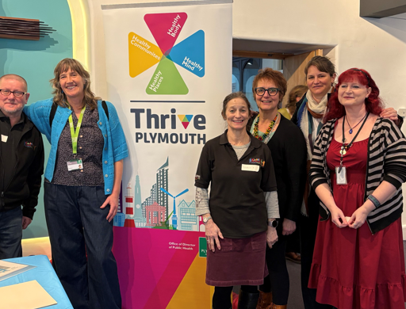
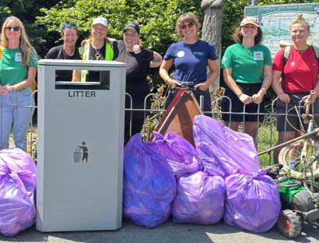
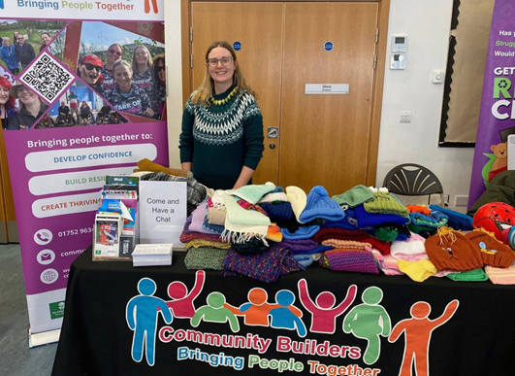
Plymouth’s community builder programme
Is recognised as a critical element of the Council’s community engagement infrastructure
Enables more effective co-design of our strategic plans and informs the way we work
Is informing our local approach to ‘care in the community’ helping to design our Neighbourhood Health model
Building social fabric by catalysing engagement and citizen action with people who would not otherwise have got involved
Shines a light on everyone’s gifts, having a positive impact on people’s lives - increasing communities’ sense of belonging, connection and cohesion
Is spreading ABCD work across the city and being seen as a model which can be replicated and adapted for other local areas

