Slide 1
Liverpool Community Champions
26th February
Kate Steen Senior Public Health Practitioner, LCC
Rebecca Ross-Williams – Community Champion, Creative Director Liverpool Lighthouse

Slide 2
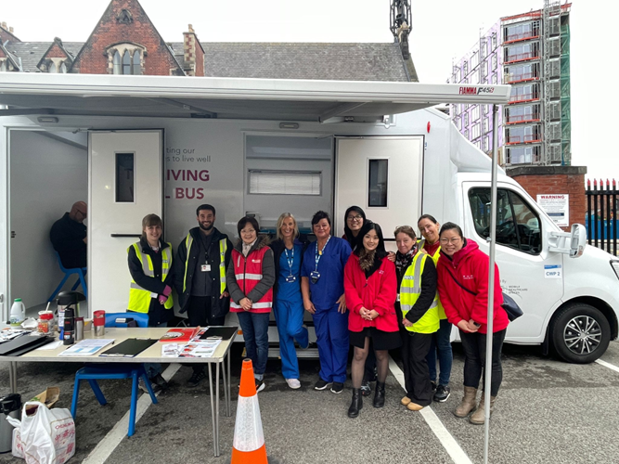





Community Champions
Developed in 2021 as a result of the Covid Pandemic:
Provide engagement vehicles Liverpool City Council could use to help engage audiences.
Increase compliance with Covid-19 guidelines and vaccine take up.
Increase the take up of mental health support and healthier lifestyle behaviours
Gain insights into barriers which were stopping or delaying people to access services.
Dispel Covid-19 myths
Notes:
Community Organisations: Chinese Wellbeing, Refugee Women Connect, Merseyside Polonia, Merseyside Refugee Support Network, Moulana, Pagoda Arts, Torus Housing/Fire Fit Hub, Merseyside Somali Community Organisation, Liverpool Arabic Centre, Granby Toxteth Development Trust, Irish Community Care
The aim of Liverpool's Community Champions is to communicate key messages within their communities in the way they know works the best, link communities to services and support communities to navigate systems to enable them to access the right support in a timely manner.

Slide 3




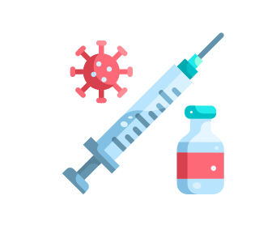
Liverpool Community Champions
The primary goal is to empower communities by amplifying their voices and addressing specific health target areas, including:
Aim:
To offer community leadership and influence to increase engagement and uptake in health and wellbeing services and activities.
Increasing uptake of cancer screenings
improving mental health
improving cardiovascular health
increasing uptake of routine vaccinations
Notes:
Goals: The primary goal is to empower communities by amplifying their voices and addressing specific health target areas, including increasing uptake of cancer screenings, improving cardiovascular health, increasing uptake of routine vaccinations, and improving mental health.
Structure: LCC funds a network of ten community organisations, which in turn use their local knowledge and trusted networks to share accessible and culturally relevant health messages.
Role of Champions: Community Champions are trusted members of their communities who act as a bridge between citizens and government/health services. They provide on-the-ground insight, tackle misinformation, and encourage engagement with health services, especially among underserved groups where trust in formal services might be low.
Funding: The programme launched with significant funding from both the Ministry of Housing, Communities and Local Government (initially for COVID-19 response) and LCC, which committed a further £900,000 to the three-year public health program running from late 2024 to August 2027.

Slide 4
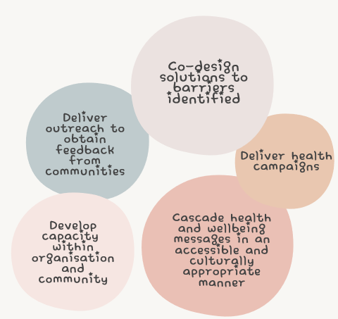
Liverpool Community Champions
Working with Public Health, Community Champions will:
Notes:
Goals: The primary goal is to empower communities by amplifying their voices and addressing specific health target areas, including increasing uptake of cancer screenings, improving cardiovascular health, increasing uptake of routine vaccinations, and improving mental health.
Structure: LCC funds a network of ten community organisations, which in turn use their local knowledge and trusted networks to share accessible and culturally relevant health messages.
Role of Champions: Community Champions are trusted members of their communities who act as a bridge between citizens and government/health services. They provide on-the-ground insight, tackle misinformation, and encourage engagement with health services, especially among underserved groups where trust in formal services might be low.
Funding: The programme launched with significant funding from both the Ministry of Housing, Communities and Local Government (initially for COVID-19 response) and LCC, which committed a further £900,000 to the three-year public health program running from late 2024 to August 2027.

Slide 5
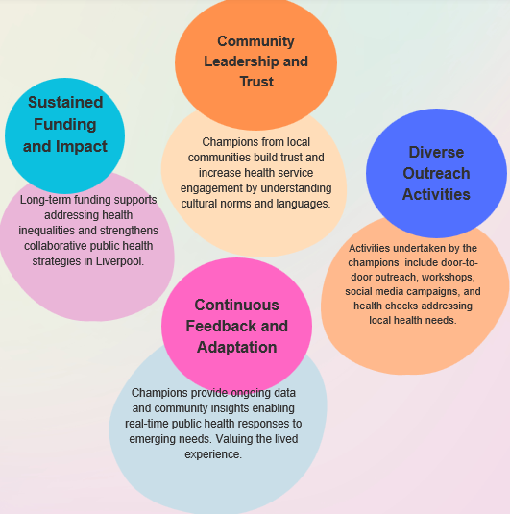
Delivered through…

Slide 6

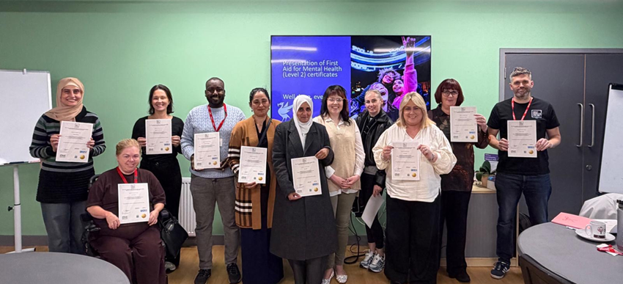









Community Champion Organisations 2024/27
Chinese Wellbeing
Daisy Inclusive
First Person Project
Granby Toxteth Development Trust
Irish Community Care
Liverpool Arabic Centre
Liverpool Lighthouse
Merseyside Polonia
Merseyside Refugee Support Network
Refugee Women Connect
Notes:
The aim of Liverpool's Community Champions is to communicate key messages within their communities in the way they know works the best, link communities to services and support communities to navigate systems to enable them to access the right support in a timely manner.
Community Champions deliver outreach to obtain feedback from communities, co-design solutions to barriers identified and deliver health campaigns, develop capacity, and cascade health and wellbeing messages in an accessible culturally appropriate manner. Each community organisation submits a quarterly monitoring form which include quantitative and qualitative data to demonstrate the outcomes being achieved.

Slide 7
Community Champion 2024/25 Priorities (year 1 )
Vaccination uptake, including Covid-19, Flu and childhood immunisations
Mental health and wellbeing
Cancer awareness and screening
Cardiovascular disease

Slide 8
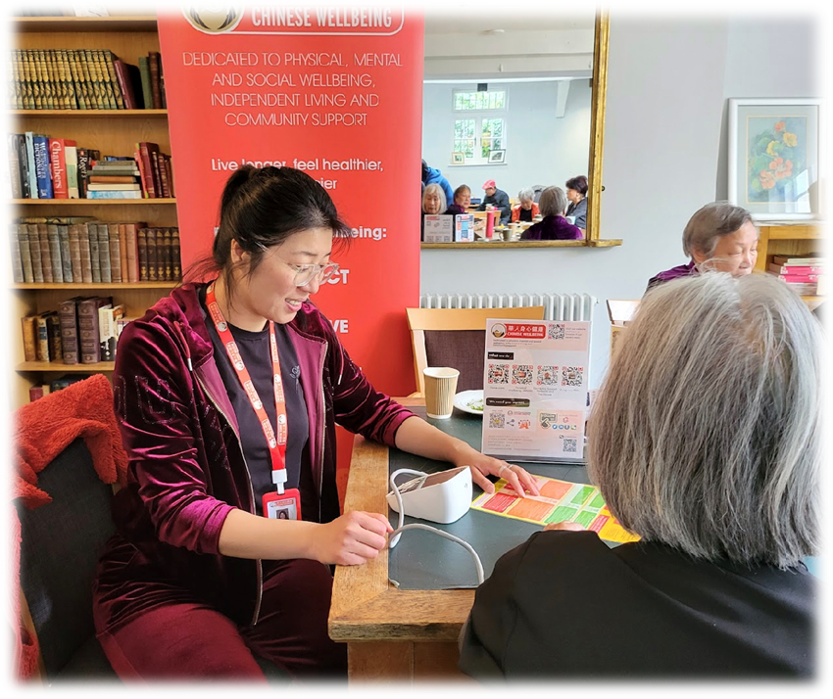
Community Champion Examples
In 2024/25, the Community Champions delivered in excess of 3,000 community-based events and activities, engagements were recorded, alongside the development and dissemination of multilingual social media content.
Vaccine pop ups delivering over 270 Covid vaccinations and boosters
280 Health Checks which resulted in a number of GP referrals for:
cholesterol (31%)
blood pressure (22%)
glucose checks (22%)
Cancer awareness sessions
Mental health coffee mornings
Notes:
In 2024/25, the Community Champions delivered in excess of 3,000 community-based events and activities, such as one‑to‑one support, online sessions, workshops, webinars, Live Well Bus activity, health promotion events, learning sessions, blood pressure checks, cancer awareness activities, and mental health coffee mornings. Over 11,000 community engagements were recorded, alongside the development and dissemination of multilingual social media content.

Slide 9
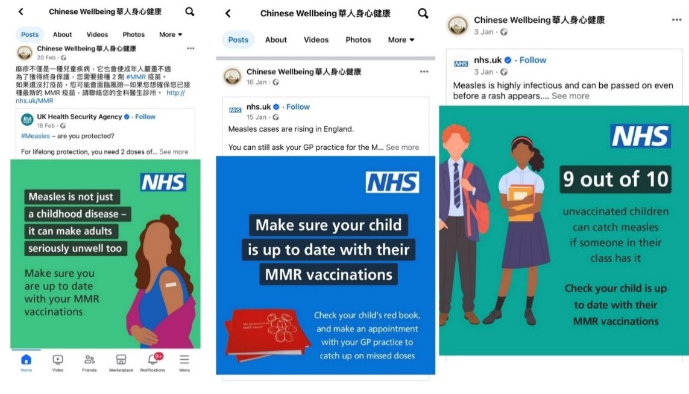
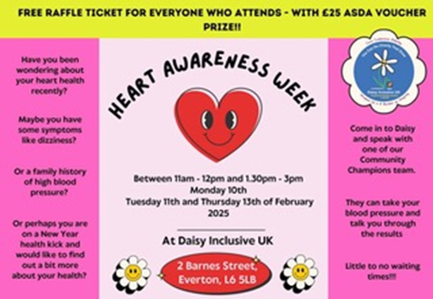
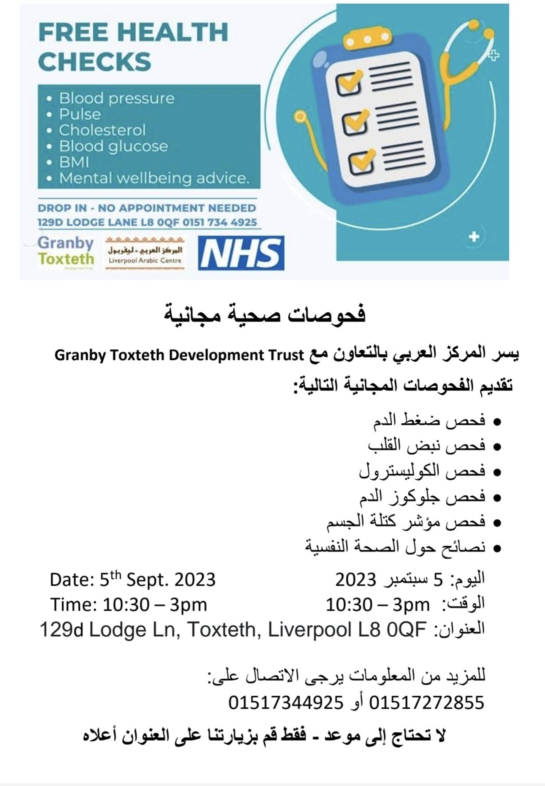
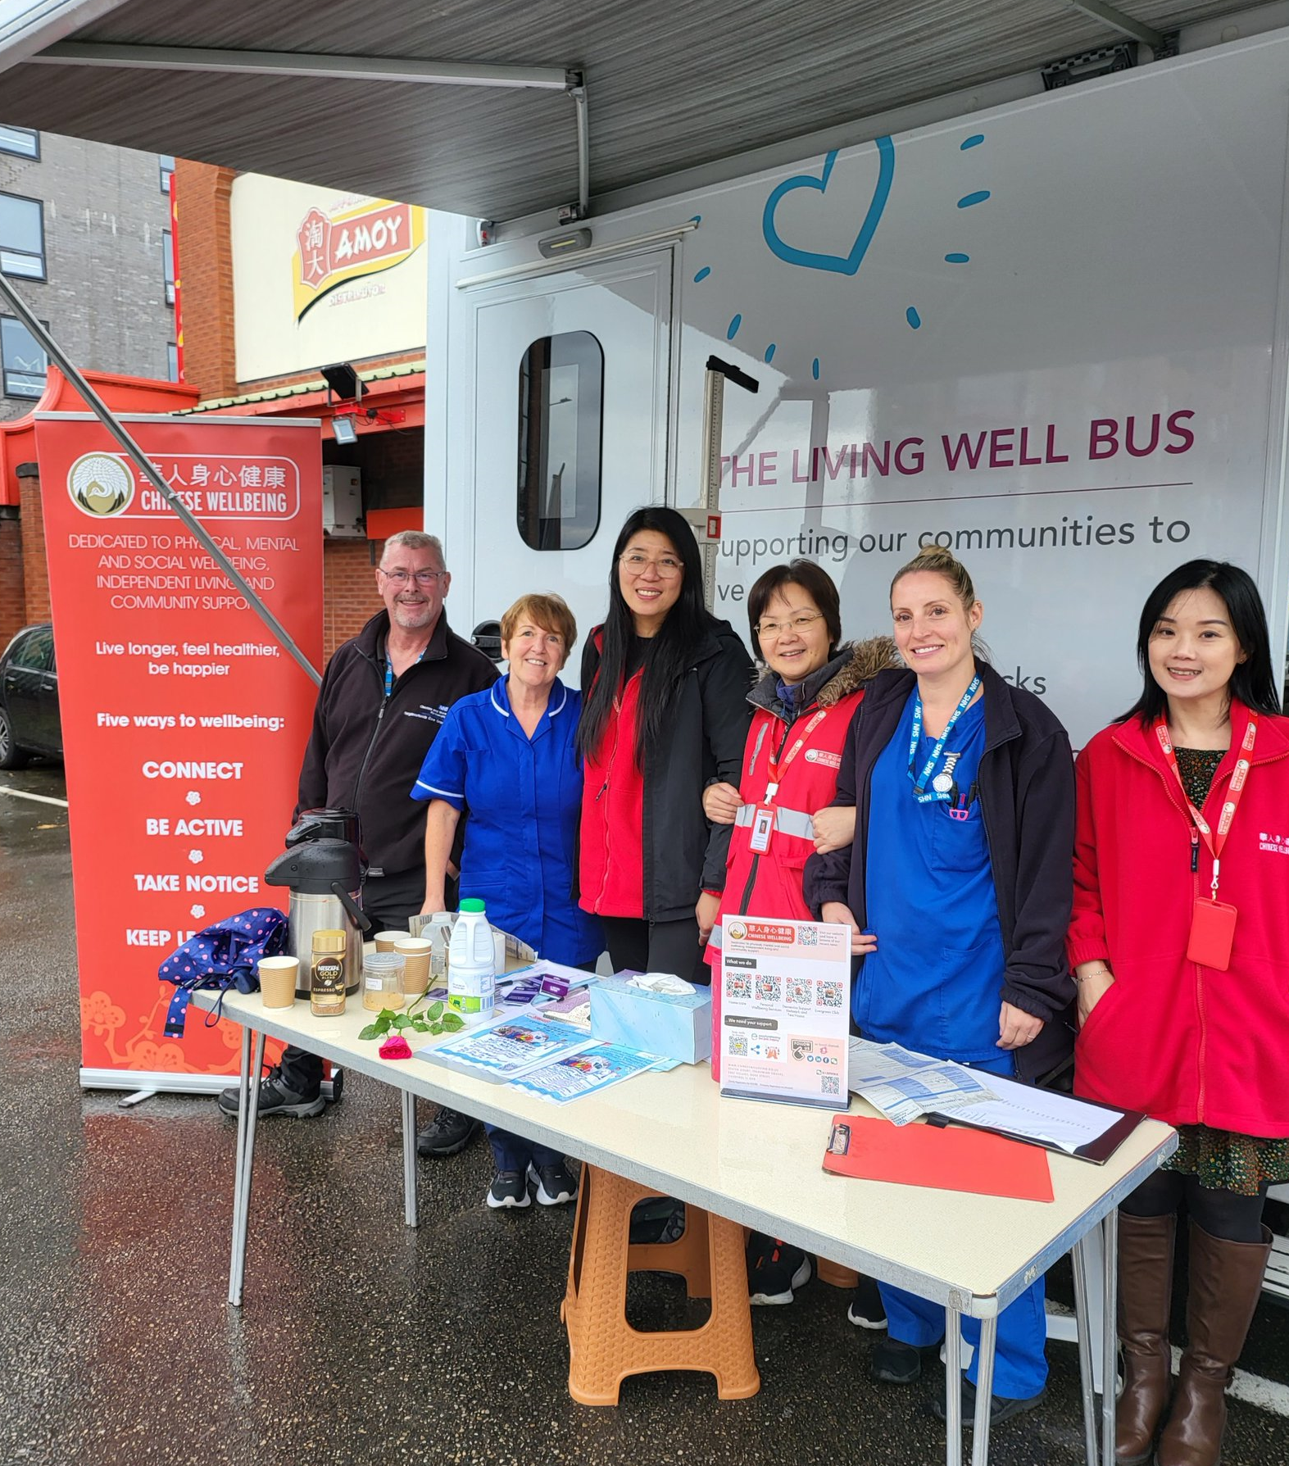
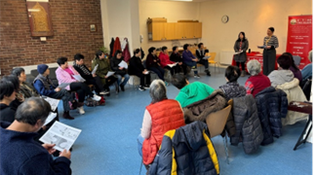
Examples
Notes:
What can you do now as a Community Champion? – how will this model work in your community?
How can you involve your community? – engagement – what work best, focus groups, questionnaires, surveys, coffee mornings, newsletters, flyers, social media
What ideas would you like to try? – think creatively,
What support is required? – training, volunteers, equipment, venues, knowledge, links with other services etc

Slide 10


Example: Mental Health
Challenges around mental health:
Stigma that holds many people back from discussing mental health
Lack of awareness regarding their own mental health
Feeling uncomfortable when mental health is being discussed
Overcoming the challenges:
Building trust, we are recognised faces and through this people are becoming comfortable and opening up.
Raising mental health and access to services in a relaxed and informal way.

Slide 11

Example: Mental Health
Community Member Christmas Event:
Through a growing and trusted relationship, we were able to present to the entire group about all aspects of mental health including:
There are many different strands of mental health and all feelings are valid
Wintertime can be difficult for many
Providing information and signposted services that were always available.
Culturally specific examples
Outcome…
The information was welcomed, the group were thankful, and some members openly expressed that they could relate to what we had presented. It opened a conversation amongst the group!

Slide 12

Example: Breast Cancer Screening
Challenges around Cancer:
It isn’t spoken about in the community
If you talk about it, you will get it
Perceived as 'bad luck' or 'contagious' leading to fear and reluctance to seek a diagnosis
Overcoming the challenges:
Held an event to raise awareness of breast screening and the importance of the screening process.
The talk by was very informative and attendees learned about the signs, symptoms and also how to prevent and catch the disease early.
Shared relevant translated NHS information including instructions on ‘you know your body better than anyone’,
Information was also shared on our social media platforms therefore reaching more people in the community.

Slide 13

Example: Breast Cancer Screening
Opportunity:
To explain about the cancer screening bus due to be situated at the Women’s Hospital from May for 8 weeks and information about the breast screening unit was shared.
Outcome:
11 attendees indicated that they would support in making an appointment having not previously taken up their offer of a mammogram.
Subsequently, discussed with the Breast Screening Coordinator, and they were offered a longer breast screening appointment at the Breast Screening Mobile Clinic.
Community champion offered to accompany members on the day or alternatively, they may bring a friend or family member
Ensured they have access to a translation service.

Slide 14
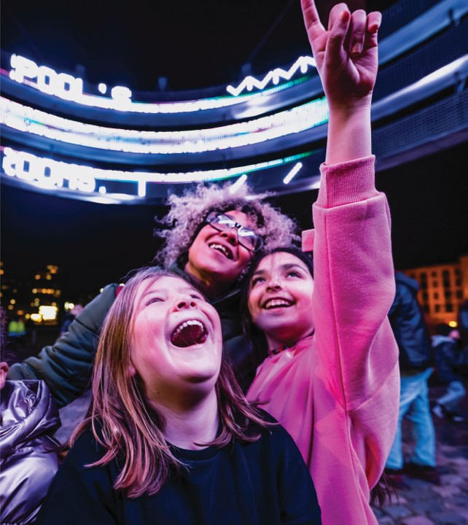
Liverpool Lighthouse
Rebecca Ross-Williams –
Community Champion, Creative Director Liverpool Lighthouse

Slide 15
Every Photo Tells a Story

Slide 16
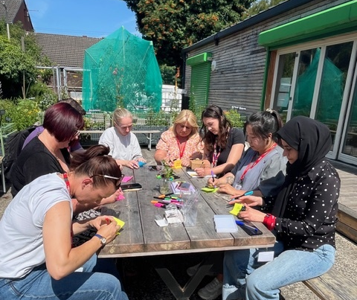



Co-production
What does health mean to you?
Think about…
What makes you feel good mentally, physically, socially, spiritually
Who are what supports you to be health - Community, social networks, places and spaces
Changes that could improve health

Slide 17
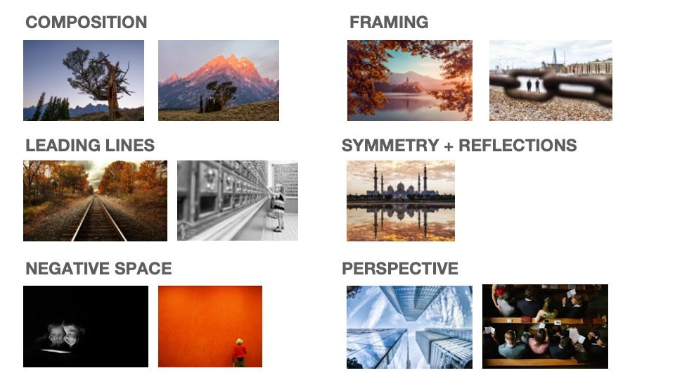
Photography Workshops
Notes:
Emma Case local photographer to support this process.
Training and up skilling – each organization provided with 5 disposal cameras and a timeframe to complete the task.

Slide 18



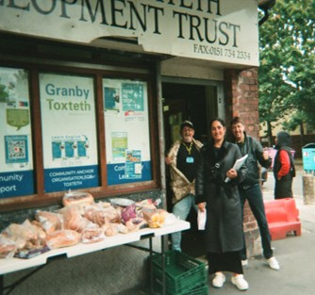

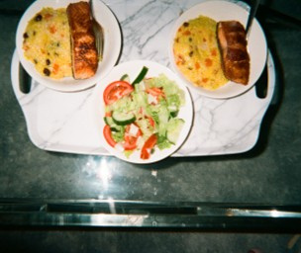


Notes:
Don’t generalise the photos / put your own meaning on it ​
Didn’t feel the photo was the best it could be due to the camera – especially when to be used in an exhibition – people’s perception of the word ‘perception’​
Every creative session someone says they’re rubbish and will do everything to avoid doing it, unlike children, at some point in lives we lose the ability to do this freely ​
Original / organic photos – can’t see it once taken and no filter, makes it real. You have a perception on your mind when you are taking the photo – you are describing it in your head when taking it ​
It can be used in so many different circumstances and offers a different insight to traditional focus groups / workshops ​
Strengthened relationship between the champions

Slide 19

Community Involvement Is Invaluable
Emphasise the depth not just the presence of community participation
Community knowledge:
Local lived experience
Existing social networks
Cultural fluency
How these create more
effective and sustainable
interventions.
Notes:
Here are some additional strong, clear bullet points you can add under **“Meaningful co‑production – looks like”** to expand the slide:
* shared decision‑making
* community‑led solutions
* valuing lived experience as equal to professional expertise
* working *with* communities from the start, not consulting at the end
* transparent communication and open sharing of information
* building trust through consistent, respectful relationships
* recognising strengths and assets within the community
* co‑designing actions, not just identifying problems
* shared ownership of outcomes and accountability
* flexibility to adapt based on community feedback

Slide 20
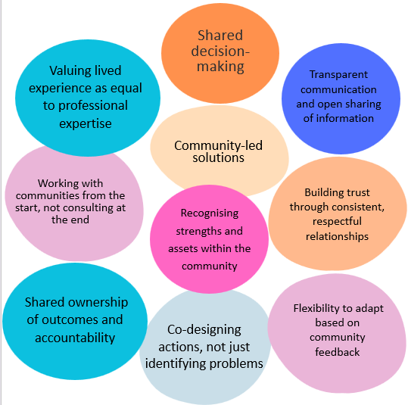
Meaningful co-production

Slide 21
Insight
Recruitment & training of community champions
Working with local networks (faith groups, neighbourhood groups, schools) - cultural relevance of interventions
Embedding lived experience in programme design and delivery
How to measure change in a way that feels meaningful to communities
Investment within the programme i.e. current 3 years
Provide practical learning that officers can apply

Slide 22
Why this way?
Establishing trusting relationships between Liverpool City Council and the community champions / volunteers
Sharing best practice
Providing advice and support for communities
Support to each other and sharing resources

Slide 23

Summary
A collaborative community approach enables long‑term, relationship‑driven solutions instead of purely transactional services
Reassurance: co-production is possible even with limited budgets.
Innovation
Partnership
Creativity

