Slide 1
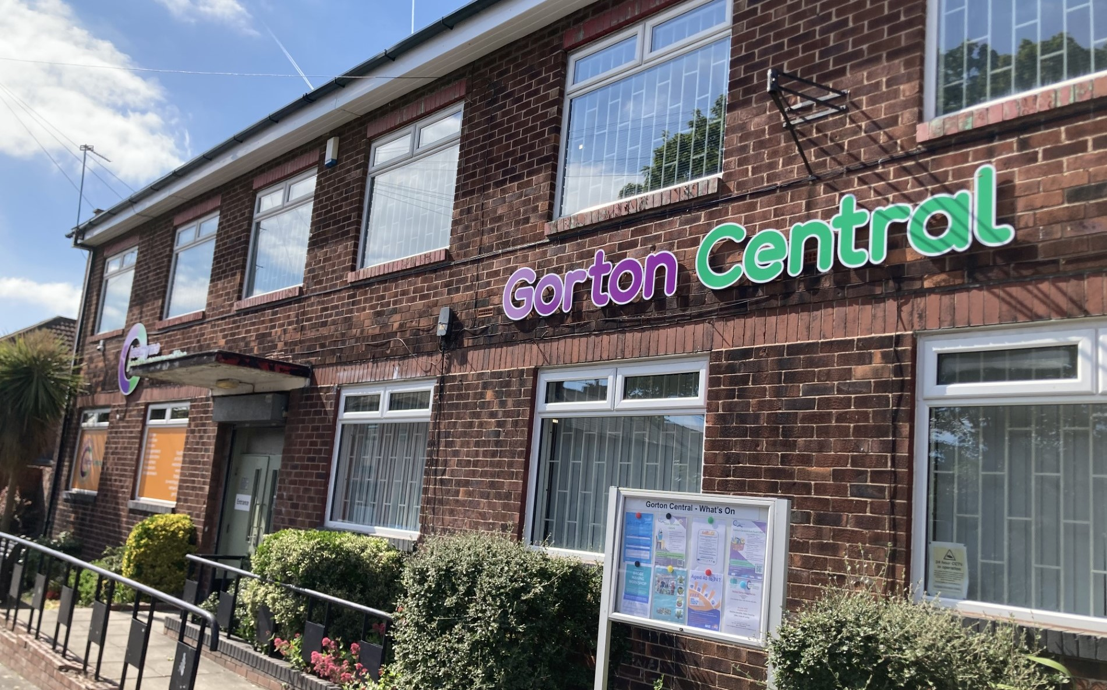

Healthy Me Healthy Communities CIC

Slide 2

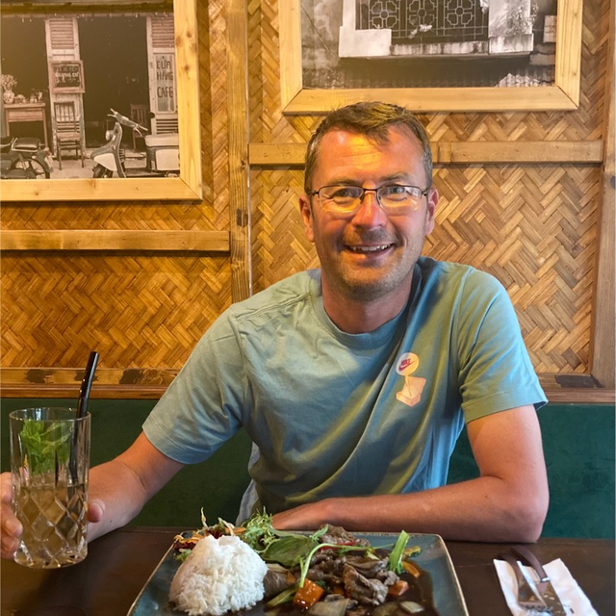
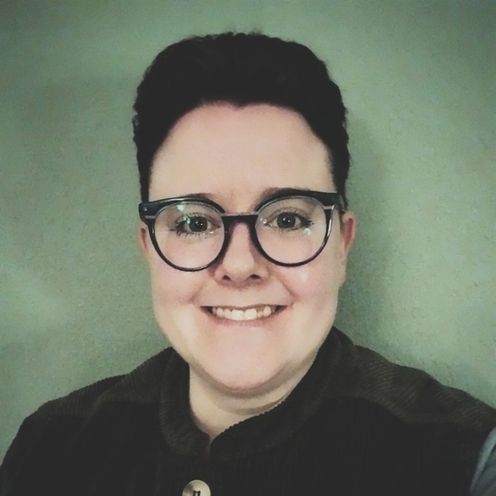
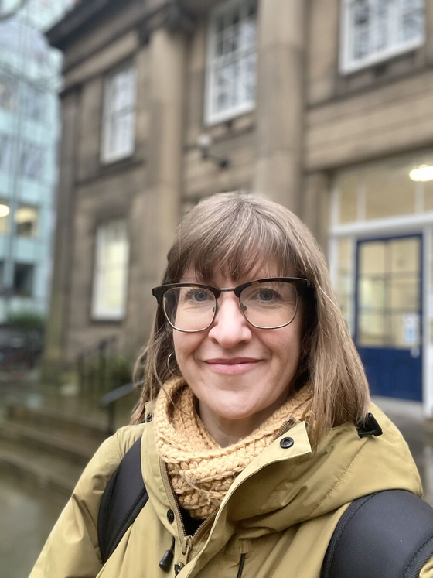
Rich Browning, CEO
Hollie Walsh, COO
Kate Harrison,
Service & Business Manager
Vice-chair of Manchester Food Board, and member of Manchester BRC Governance Board. MA in Community Practice.
PhD Researcher at University of Lincoln​ conducting trauma-informed qualitative longitudinal research into accessing welfare services. Leads the Making Manchester Fairer Community Forum.
Experienced adult educator in ESOL and digital inclusion.
Member of the GM Research Engagement Network Learning for Change programme.

Slide 3
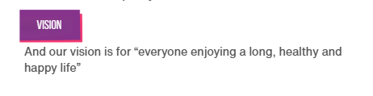
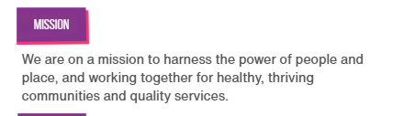
Vision & Mission

Slide 4

Our Purpose

Slide 5
Our Golden Thread
Connect & Collaborate
Skills & Wealth Building
Power in Practice

Slide 6
Connect & Collaborate
Lifestyle Activities
01
Gorton Together Heritage Project
03
Growing Garden
04
Partner Activities
05
Ageing Well
02

Slide 7
Skills & Wealth Building
Community Grocer & Good Food Gorton
01
Volunteering
04
Adult & Community Learning
03
Jobs
05
Signposting & Advice Services
02

Slide 8
Power in Practice
Making Manchester Fairer Community Forum
01
Leaving Care Collaborative
02
Community Power Forum
03
Health Research
04
Board roles: Manchester Food Board, Manchester BRC, HDRC, Public Sector Reform Group
05

Slide 9
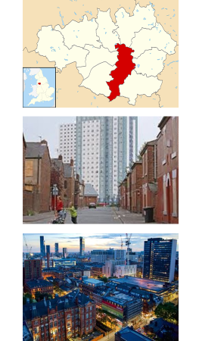


Slide 10

Systems Approach
Local knowledge & Insights
Expert by experience
Policy
Strategy
Practice
Health & Humanities Research Findings
Data

Slide 11


















Governance &
Programme Management
Children & Young People
Poverty & Debt
Monitoring
Eight themes we need to take action on to tackle health inequalities
Kickstarters – funded projects that exemplify the principles of Making Manchester Fairer
Seven workstreams – the ‘building blocks’ of the Action Plan
Employment & Jobs
Evaluation
Preventing Illness &
Early Death
W
T
Engagement
Homes & Housing
Communication
Places, Transport &
Climate Change
Resident & Community Engagement &
Involvement
MAKING
MANCHESTER
FAIRER
Tackling Racism &
Discrimination
Workforce Engagement
& Development
Communities & Power
Making Manchester Fairer
Programme Scope
K
Phase 1 (implementation/delivery)
Children & Young People;
Early Help for Adults
Phase 2 (in development)
Work & Health;
Physical Activity
Making Manchester Fairer Investment Fund

Slide 12
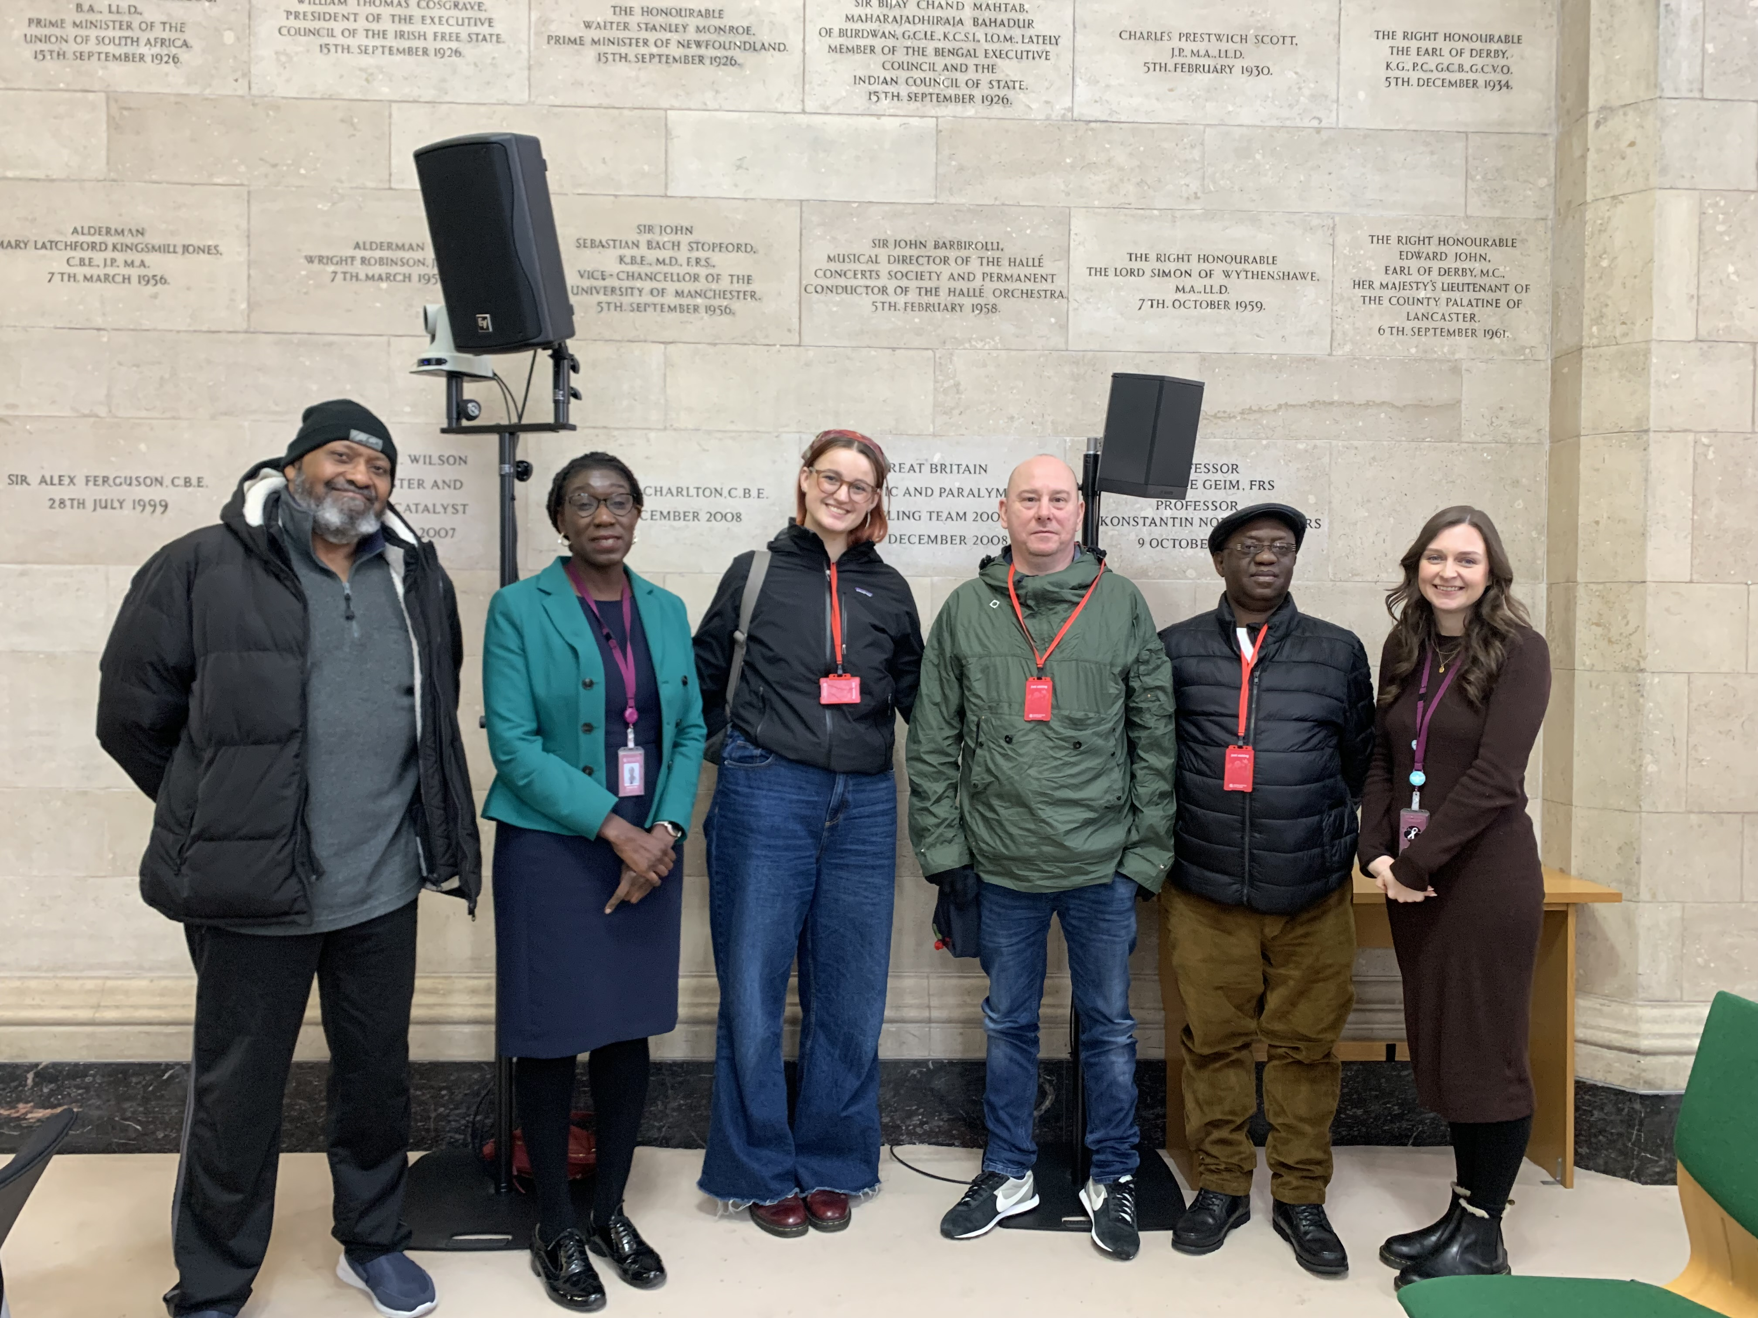
Making Manchester Fairer Community Forum Co-producing democratic involvement Forum members attending health scrutiny with Cordelle Ofori, Director of Public Health, MCC

Slide 13
Making Manchester Fairer Community Forum Innovative social partnership
Partnership between residents, officers and elected members.
Commission from Manchester City Council Department of Public Health
16 Manchester residents from underserved communities, those most affected by inequalities and least likely to usually take part.
Far reaching recruitment campaign; materials in easy read, BSL, 8 community languages and through specific publications such as the Jewish Telegraph and Asian Leader.
Generated 191 high quality applications which were whittled down to the final 16 by giving priority to residents from minority backgrounds, lived experience of homelessness, ex-military, being in LA care and those living in 'cost of living' priority wards. Applications were reviewed by HMHC staff and non-executive members from the MMF Programme Board (governance)

Slide 14
Sustainability / funding Different to tokenistic forms of engagement
Clear commission for Manchester City Council – commission amount and budget for member expenses was set out clearly upfront.
Budget set by MCC included provision for expenses for all members and flexibility as to how distributed for HMHC. Members are renumeratED at real living wage for the following: time spent at monthly forum meetings, travel time to and from, travel costs to and from, a meal allowance where meetings go over meal times and time for reading papers/materials in advance of meeting
At the beginning we signposted to information regarding renumeration and benefits and provided letters members could give to the DWP explaining participation to avoid this interfering with benefits.
Flexibility of payments – cash or BACS

Slide 15
Making Manchester Fairer Community Forum Co-producing democratic involvement
Community Forum embedded into MMF governance structures at start of programme.
Right to request established coming from the executive members chairing the Programme Board – city council officers asked to attend CF meetings are required to attend.
Amendment to Programme Board Terms of Reference – no item can be signed off by PB without consideration by Community Forum first.
Members invited to (and renumerated for) attendance at Health Scrutiny meetings and Programme Board.
In addition to reviewing objectives, members lived experience insights are being accounted for in high level policy objectives. Such as the importance of turning disused properties into affordable homes and the impact of mental health conditions on being able to access cancer screening.

Slide 16
Governance Structure
Manchester Health & Wellbeing Board
Manchester Partnership Board
Making Manchester Fairer Community Forum
Making Manchester Fairer Programme Board
Making Manchester Fairer Task Force
Making Manchester Fairer Programme Management Team

Slide 17
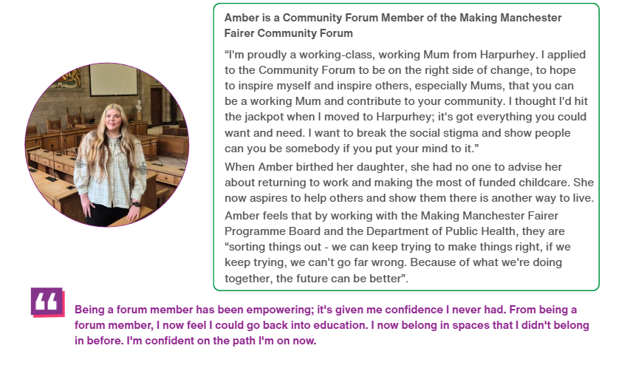

Slide 18
Q&A

