Slide 1

Barton and Barton Park Healthy New Town
Leanne Cooper
Locality Manager
Gertrud Pakot
Community Health Development Officer

Slide 2

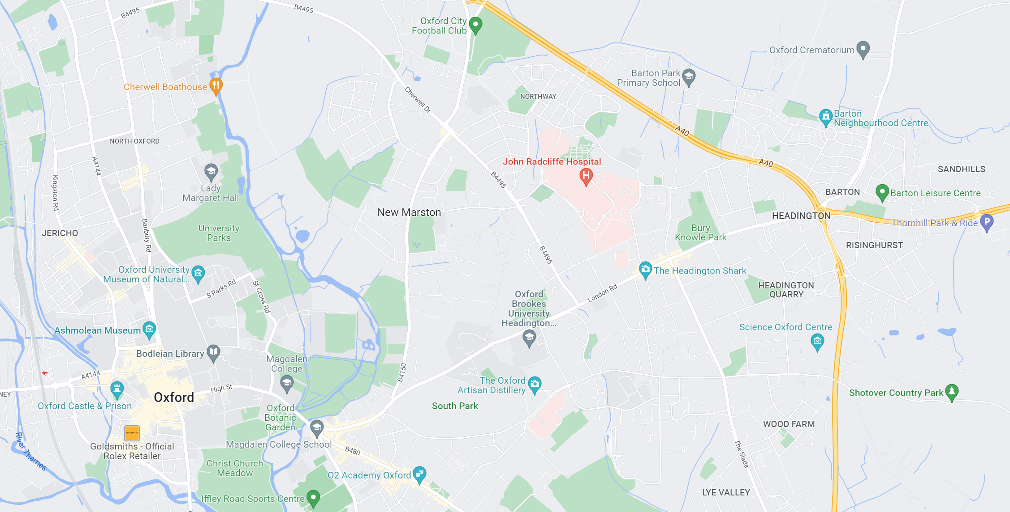







BARTON
3.4 miles
Female Life expectancy in Barton is 82.3 years. 4.9 years less than N. Oxford
Male life expectancy in Barton is 76.7 years. 9.6 years less than N. Oxford
36% of children in Barton are carrying excess weight or obese
CITY CENTRE
Hospital stays for Self-harm and all other causes are dramatically higher than local and UK average.
30.4% of children in Barton are living in poverty compared with 4.6% in Headington Ward
35.2% of older people living in Barton are living alone. 21% of older people in Barton are living in deprivation

Slide 3






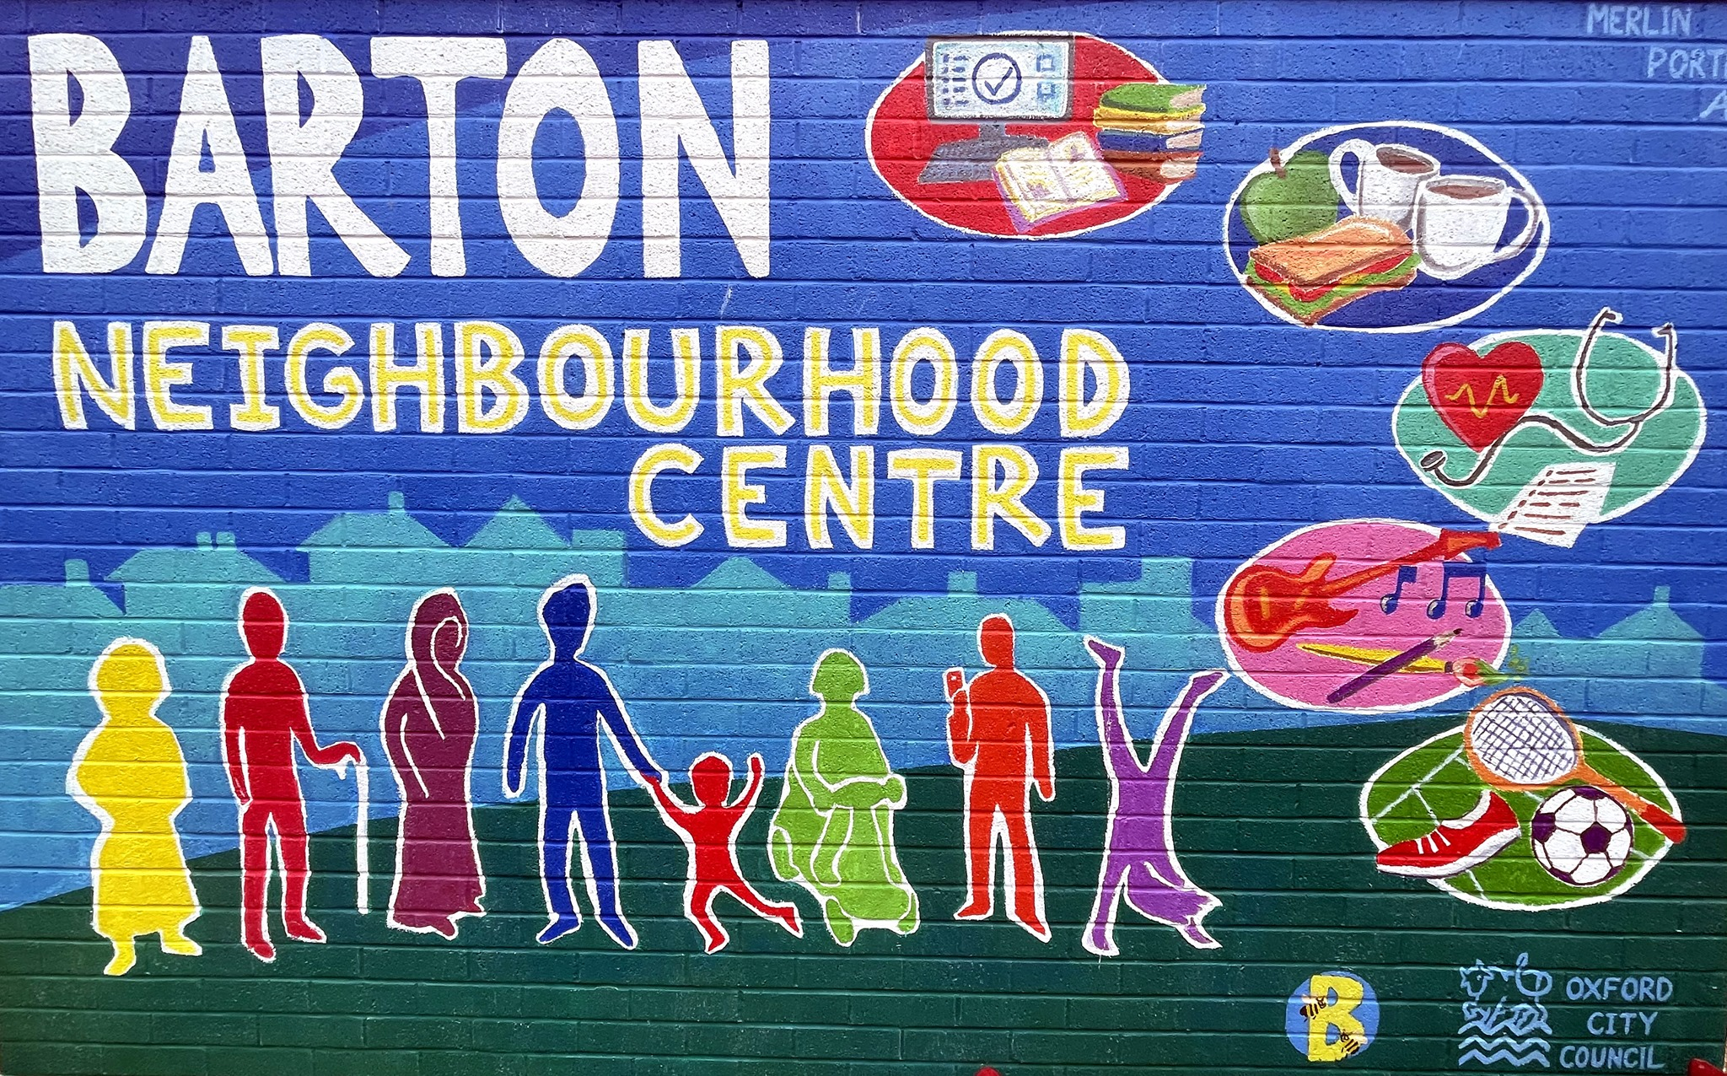




NEIGHBOURHOOD CENTRE
NHS HEALTHY TOWNS
ALLOTMENTS
SPORTS FACILITIES
LEISURE CENTRE
SCHOOLS
GP SURGERIES
PUBLIC ART
CENTRE FOR MUSIC
ENGAGED COMMUNITY

Slide 4
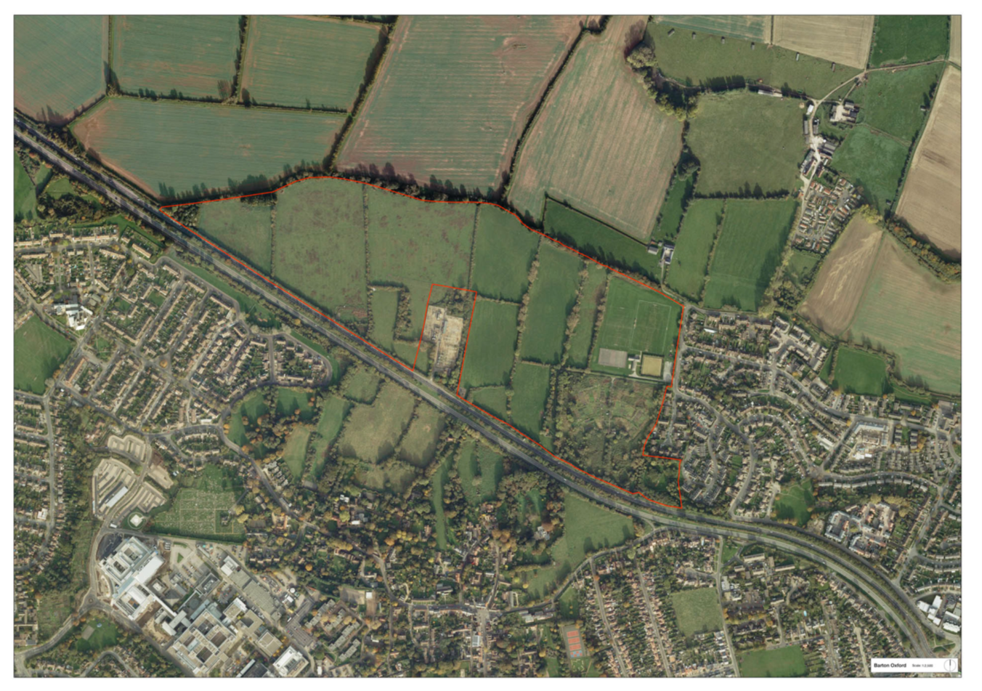
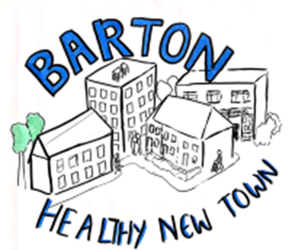


94-acre allocated site located on the North-East of the City of Oxford.
Convenient road and railway network connection.
Adjacent to Barton, one of the most deprived communities in Oxford.
Key constraints to the site included electric substation, overhead powerlines which needs to be rerouted, A40 landscape buffer and flood plain of Bayswater Brook.
Barton Park

Slide 5
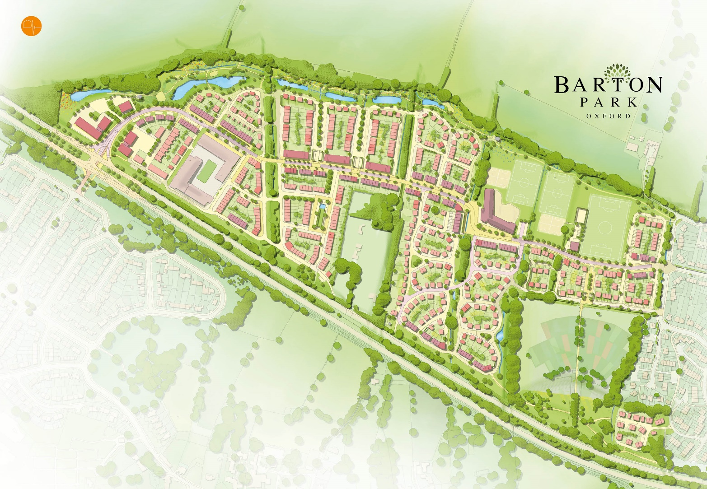
885 new homes, 354 ( 40%) of which are social rented, we are now onto the final phase of delivery
Master plan was selected winner of the ‘Planning for Housing Growth’ Awards, 2014
High quality architecture and public realm assured by the Design Code and enforced through land sale contracts.
A new 10-acre linear park with suds, play areas and new sports facilities.
A new primary school and integrated Community Hub
A new Junction on A40, Two civic squares to encourage residents' interaction.
Complementary retail provisions
Improved allotments
As it developed

Slide 6


Objectives:
Housing supply (affordable)
Design quality
Integration of adjacent communities
Sustainable transport
Exemplar development
Active investment plan
Landowner
Brings local knowledge and provides guidance from City’s perspective
50% decision making
Funder of planning costs and infrastructure delivery
Provides development expertise
Run the project day to day
50% decision making
Mutual Values:
Act to deliver a positive impact on the communities we serve
Long term vision for successful placemaking
Building straight forward relationships
Governed by the Member’s Agreement signed 30th October 2011.

Slide 7
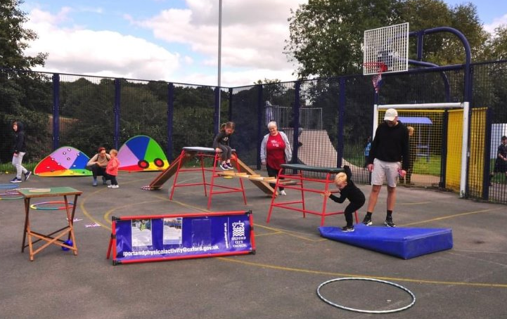
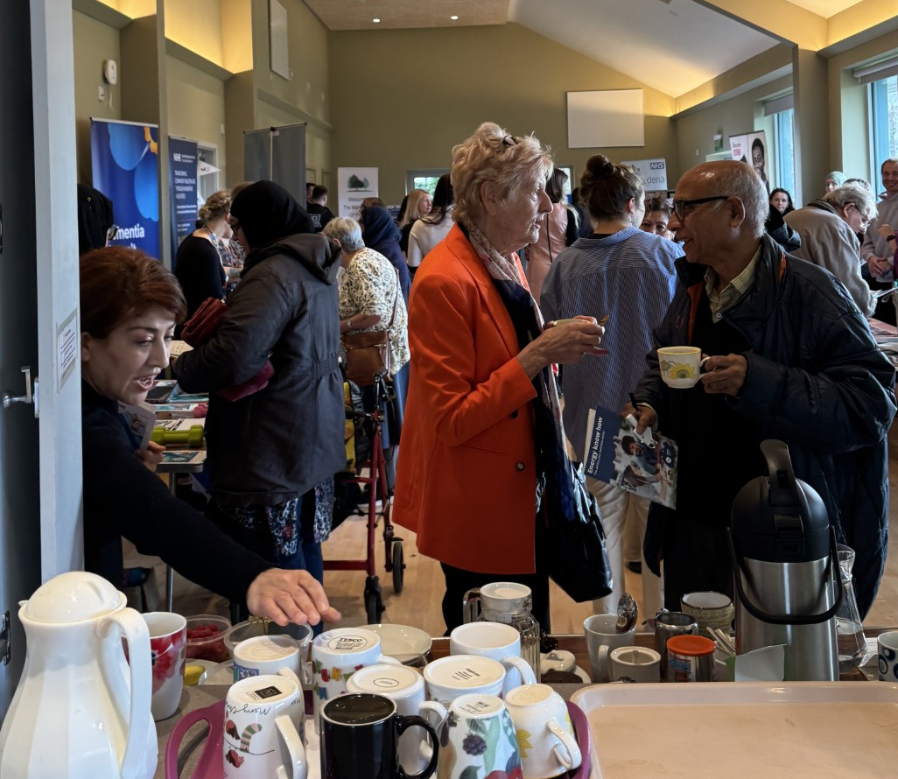

Role of the Community Health Development Officer
Builds trust with communities through outreach and relationship‑building
Identifies local health needs and barriers to wellbeing
Connects partners to supports in the design of new projects, activities and interventions
Bridges the Council to its localities and residents by strengthening partnership working
Promotes equity, ensuring that everyone in the locality is heard and supported
Supports long‑term community resilience by empowering residents to take control of their health

Slide 8

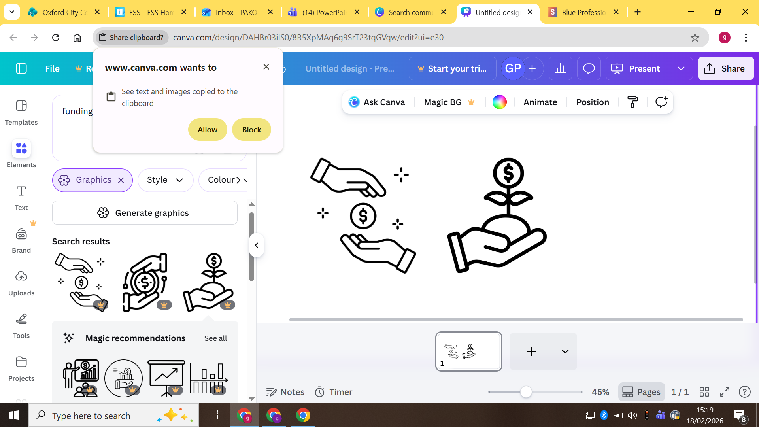




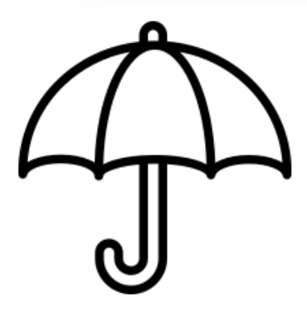
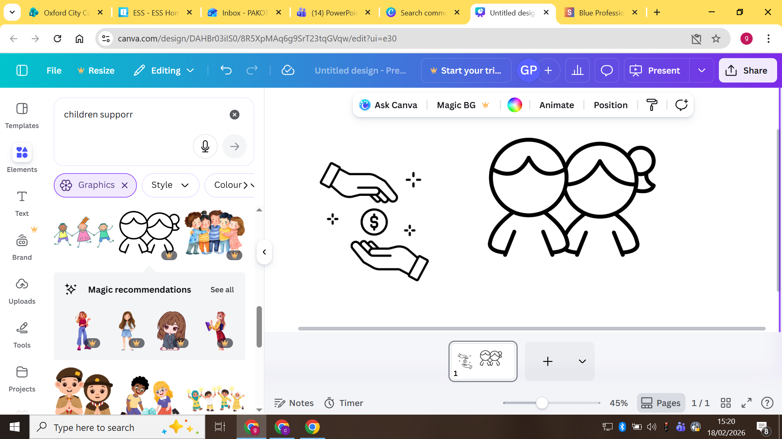
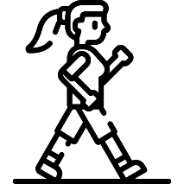
Larder Café and Breakfast Club
The Barton Community Partnership between Barton and Barton Park
Funding
Community Health Development Officer
Barton and Barton healthy place shaping work
Street Art Free Wall
Men’s Mental Health Football
Wellbeing Garden Digs
Umbrella Club
Listening Service for Children
Health Walks
Notes:
So far I have supported local groups and residents to develop a series of projects and initiatives that focus on encouraging Active Travel and providing spaces for people to come together and make new connections. Some of these include; Health Walks with local residents being trained as health walk leaders and get people active, the Barton Park school Walking Bus which is an initiative to support families to safely walk to school and reduce car emissions, Joyriders female led bike rides for beginners to develop the confidence to get on a bike, the Men’s Mental Health Football group provides a place for local men to get active and talk about their wellbeing, the Barton Community Partnership is a group of local residents who put on events & workshops to bring people together to reduce isolation and loneliness, the Community Larder Café provides a place for larder members to meet and make new friends, the Barton Youth Partnership which brings together a range of local stakeholders to consider ways to tackle anti-social behaviour and reengage vulnerable young people at risk, the Street Art Free Wall to aid young people’s creativity and expression, and the Wellbeing Garden Digs to provide people with the skills to grow their own food.
I have chosen to focus today on the built environment surrounding the Linear path along Bayswater Brook that begins in Barton and ends in Barton Park. The new path in Barton Park represents a small intervention with a big impact and encourages integration with the two areas, cohesion, continuity and convenience with existing Barton.
Residents have commented that since the new development of Barton Park the linear path feels safer, looks nicer, and is less muddy and more wheelchair and pushchair friendly, and more practical. New gym equipment was installed to encourage longer fitness trails with the same outdoor gym equipment used in Barton to ensure everyone had access to the same facilities.
A health walk led by two local residents has encouraged people from Barton who have previously had no reason to visit Barton Park to traverse the route weekly. The linear path has additionally provided a new exit on the Barton Park side which has increased use of Active Travel on foot and bikes as there is now a route out of Barton that avoids the steep and difficult hills infamous to those who live here.

Slide 9

Community Insight Profile and Grant Funding
To understand local need The profiles bring together key data and community perspectives to help us understand the unique strengths, challenges, and priorities within each neighbourhood.
To inform decision‑making They support evidence‑based planning, helping us target resources, funding, and services where they will have the greatest impact.
To improve partnership working The profiles create a shared understanding across partners, enabling more coordinated and joined‑up approaches to community development.
To monitor progress over time By establishing a clear baseline, the profiles allow us to track changes, measure outcomes, and evaluate the effectiveness of local initiatives.
To amplify community voices They ensure that residents lived experience is captured alongside data, shaping decisions that reflect what matters most to local people.
Grant Funding
Phase 1- £25, 000
Phase 2- £29,100
Phase 3- £15,000

Slide 10
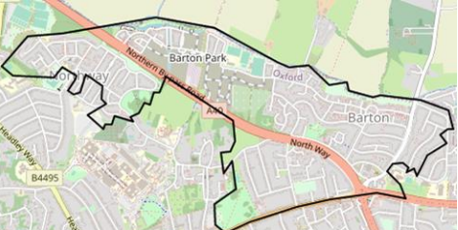
Key Recommendations
New Models of Care
Collaboration and Co-Production
Built and Physical Environment
Targeted work with young people
Active Travel

Slide 11
Reflecting on the Community Insight profile
Sustainability & Continuity
Outdoor and “soft” community spaces (gardening clubs, larders, churches)
Joint funding bids and shared delivery between groups.
Supporting project with longer term funding to continue projects.

Slide 12
24
Insight Profile Grant Funding Applications
New Models of Care
9 applications
Collaboration and Co-production
4 application
Built and Physical Environments
2 applications
Grant Funding Available:
£29,100
Youth Work
7 applications
Active Travel
2 application

Slide 13
Community Health Partnership
Builds Trust and Relationships
Fosters stronger working relationships that improve long‑term collaboration.
Networking after the meeting creates a culture of openness, accountability, and mutual support.
Health Promotion
Keeps relevant health-related events visible to all partners, increasing opportunities to connect with residents.
Supports wider engagement by linking services with existing community networks.
Brings Partners Together
Creates a shared space for NHS, council teams, community organisations, and residents to collaborate.
Ensures everyone is aligned around local health priorities.
Improves Service Delivery
Helps partners share resources and reduce duplication.
Leads to more accessible, joined‑up support for residents.
Keeps a focus on the progress in delivering the recommendations.
Addressing Arising Priorities
Allows a space for partners to raise new priorities that may change or arise.
Helps ensure services reflect what communities need.

Slide 14
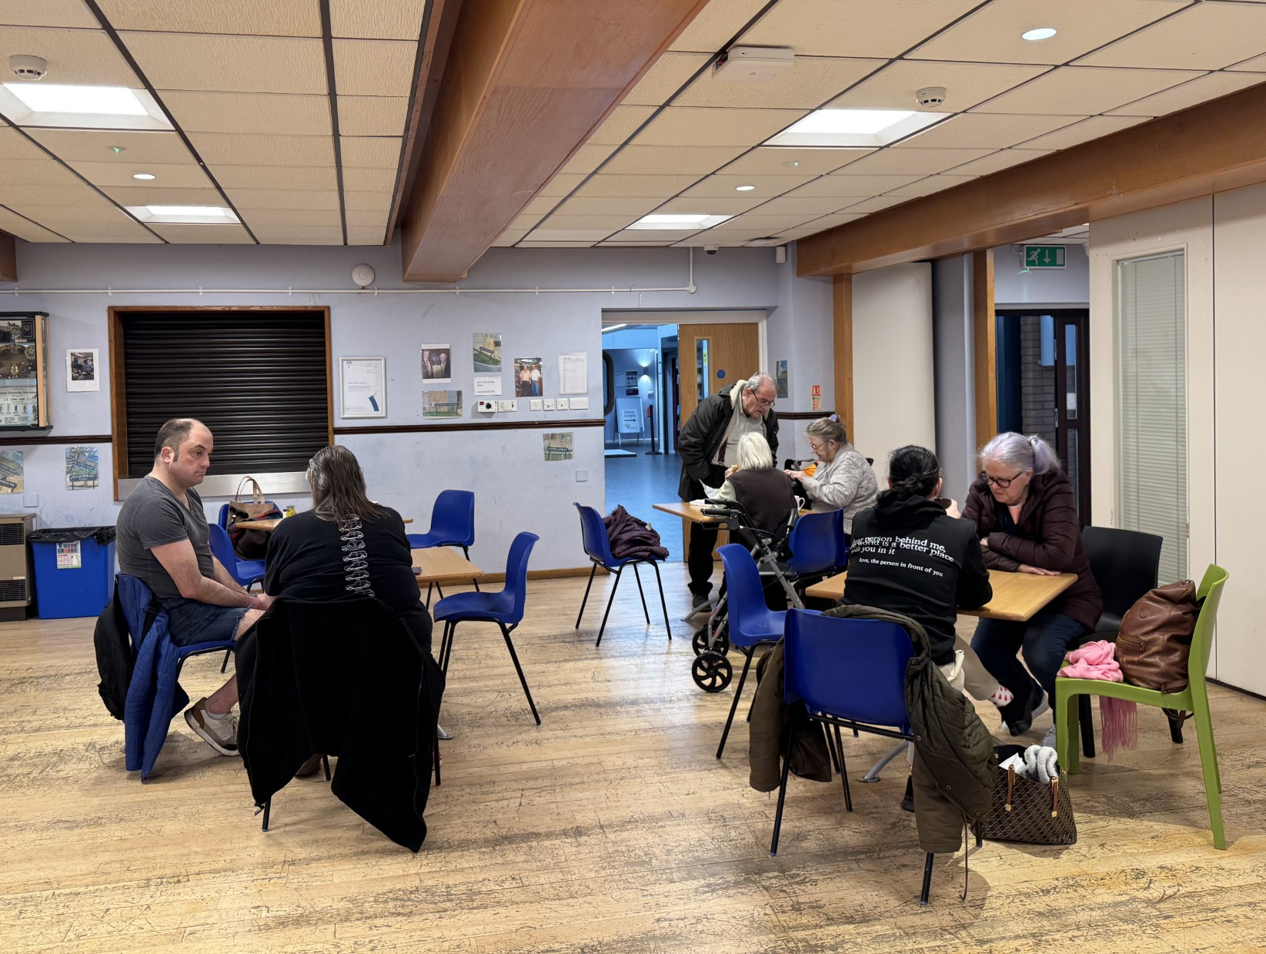
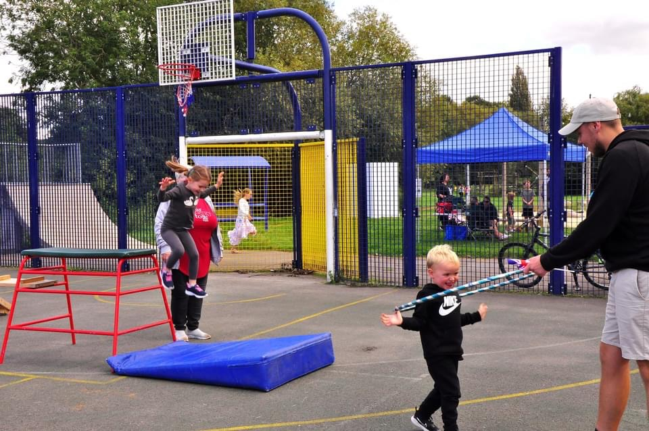
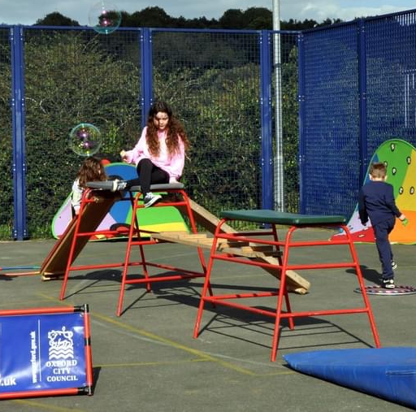
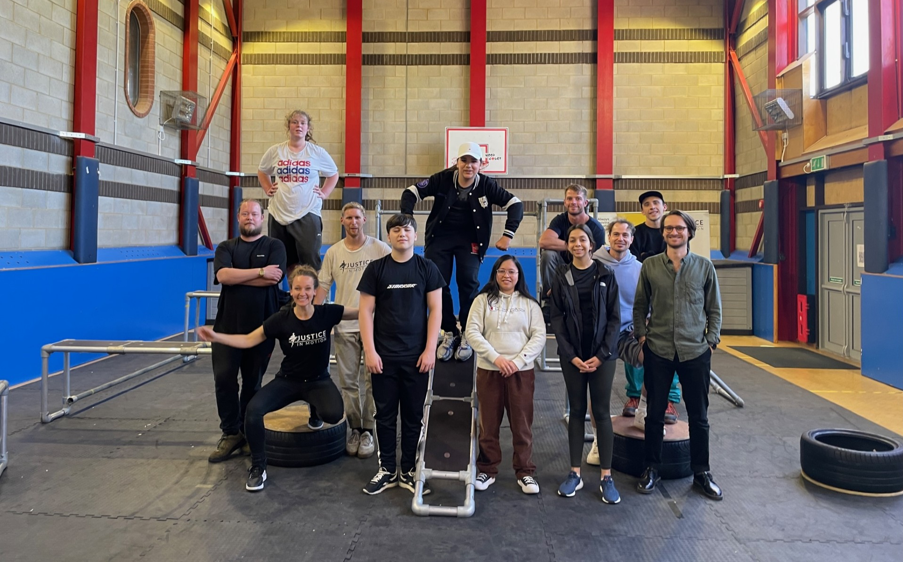
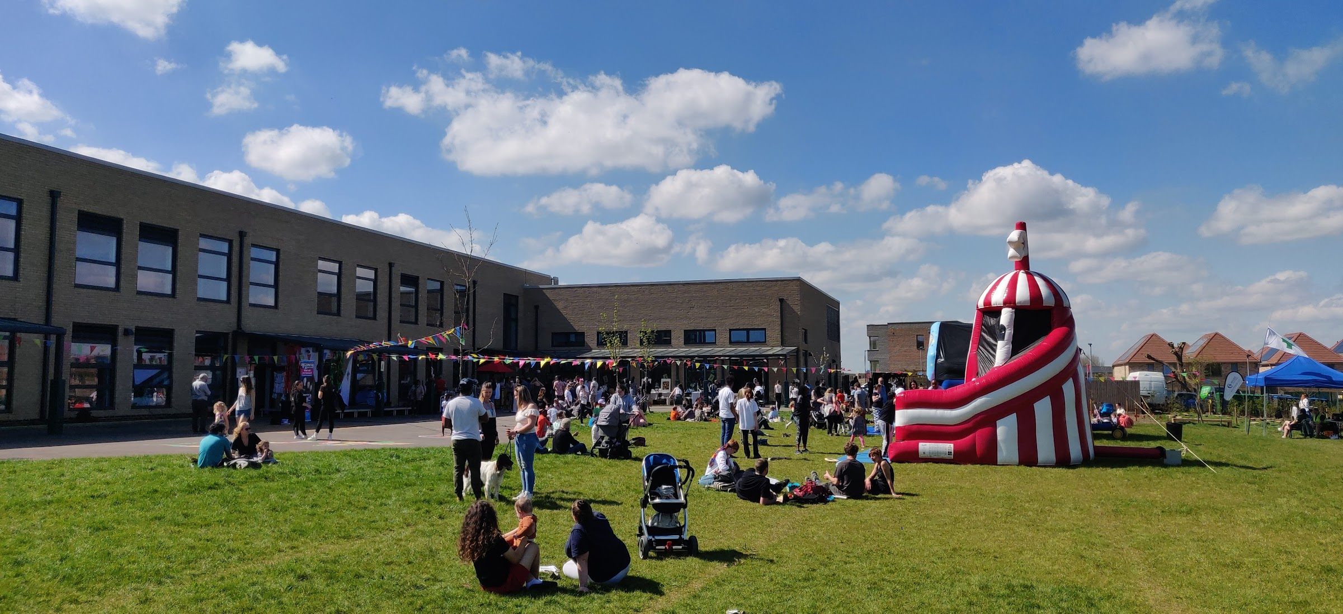
Notes:
Grosvenor funded a Public Art project that has seen a series of installations along the path that helps to bring the area to life. The outdoor living statues installed in Barton Park were a perfect opportunity to reflect what people are proud of in Barton, the beautiful fields surrounding the area and natural wildlife habitats for animals. The Wellbeing Garden installed took the form of tiered allotments for communal growing of vegetables and wildflowers with a weekly social prescribing course designed specifically for people with mental health issues to connect with nature and each other. A rockery in both Barton and Barton Park allowed for workshops to be delivered with local children from both sides to create colourful rocks that show what Barton means to them, telling a story and leaving a piece of history through Art. New seating through the form of parklets have provided spaces for residents to picnic and rest while soaking in the natural environment. Considering how the linear path is now used, it is a great example of how small steps to the built environment can have a huge impact on the physical and mental wellbeing of those who live there.

Slide 15
Questions?
Notes:
And in my last few moments with you I just want to tell you a story about my grandma who recently returned to Barton after many years since moving away to attend a community event with me. She immediately commented on the Linear path and reminisced about how historically getting out of Barton has always been an issue and a barrier for most people who live here. How difficult it was to get up the hill, how psychologically and physically challenging it is to traverse the roundabout where the Barton exit is the only one without a traffic light, and how the underpasses never felt safe to use alone, and now there is a safe and accessible new route out of Barton for everyone to use and enjoy.

