Slide 1

Tackling Health Inequalities through an income lens

Slide 2
Context: Poverty Review & Anti Poverty Action Plan
Why?
CoL pressures & rising inequality
How?
Poverty Review - asks 2 questions:
Who?
Residents experiencing or at risk of poverty and other poor outcomes
What?
38 Actions to enhance and improve our current offer & prevent poor future outcomes
High-cost pressures in the public sector (Fair Funding Review)
Changing Welfare Policy
What are we doing to support residents experiencing poverty?
Members want Anti Poverty Strategy
Is our response optimal?
5 deep dives
VCSO partners
Council officers
Anti Poverty Action Plan

Slide 3
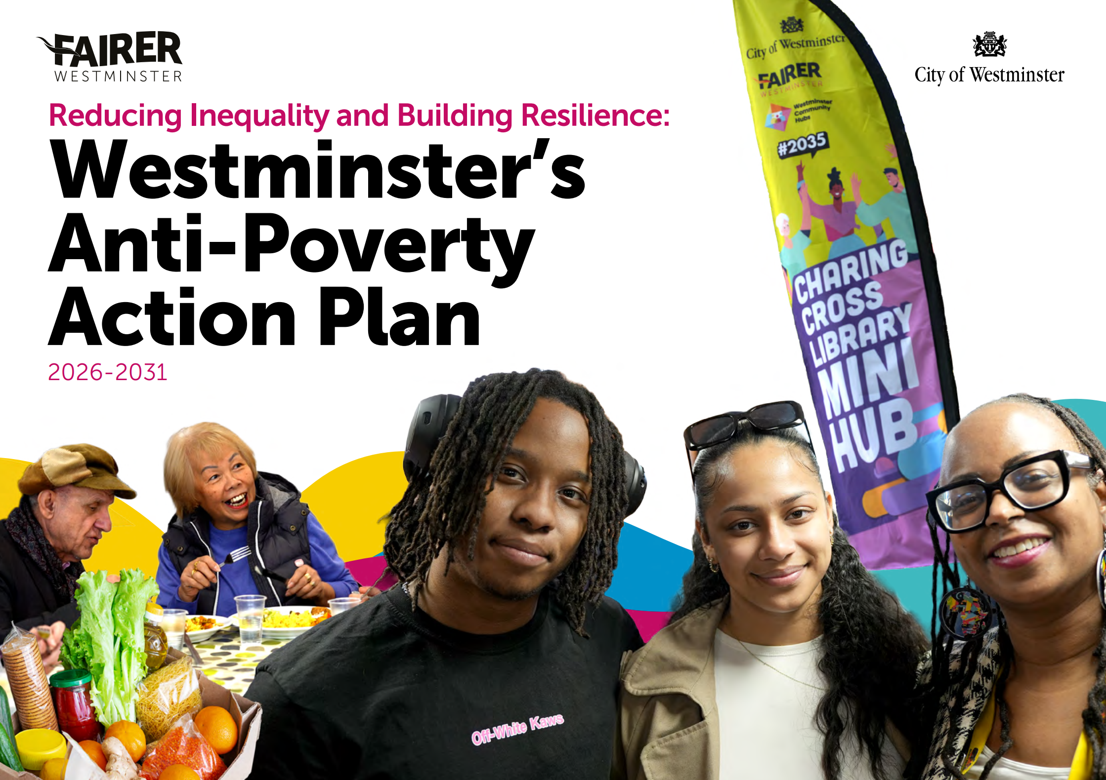
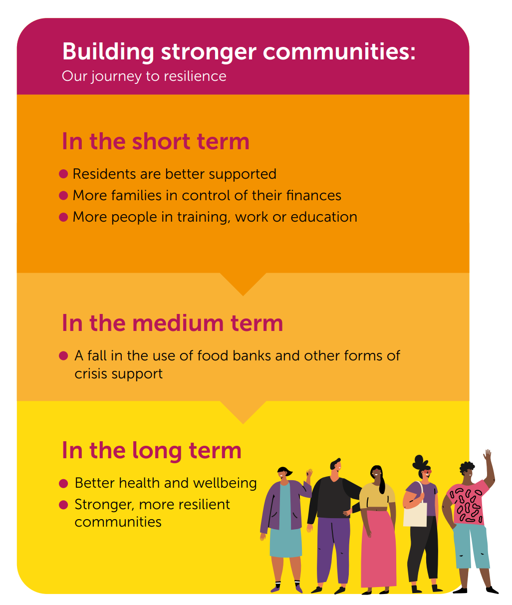
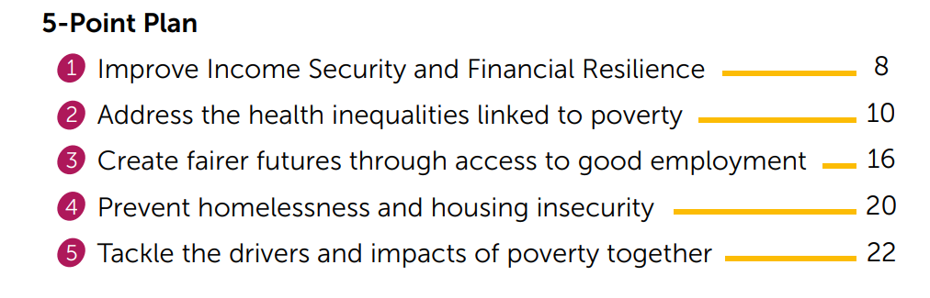
5 Priorities
39 Actions
6 Outcomes
Westminster’s Anti–Poverty Action plan | Westminster City Council

Slide 4
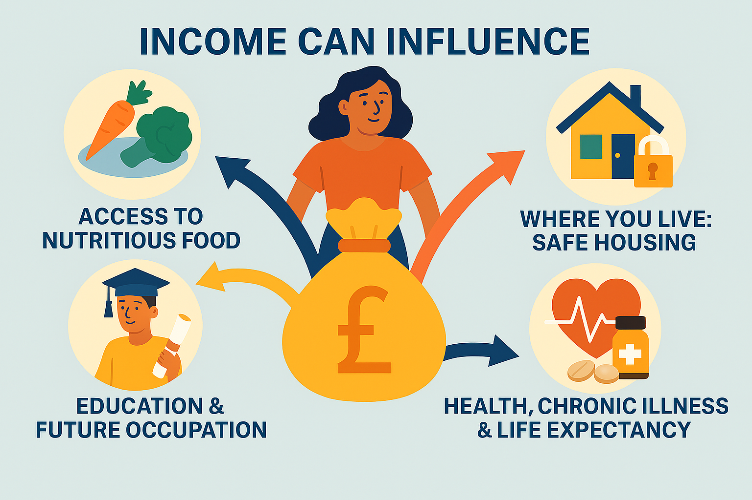
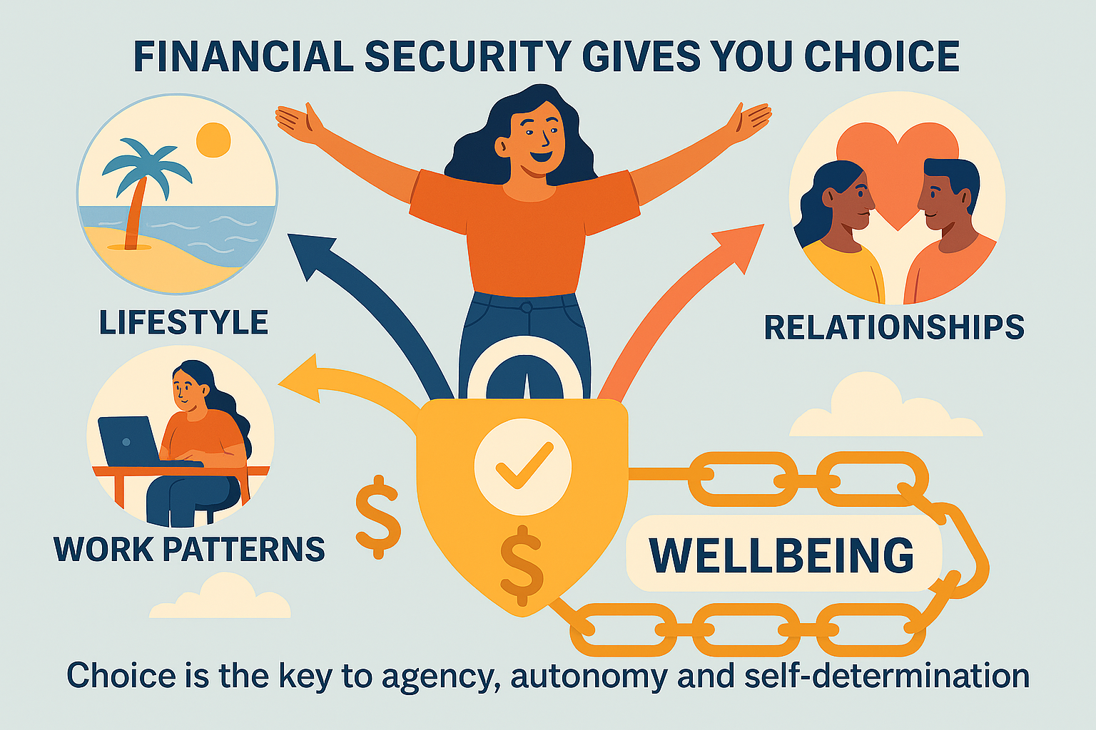
Income as a wider determinant of health
Having enough money is really crucial to wellbeing but focusing solely on income oversimplifies health inequalities. Even individuals with high incomes can experience stress and poor health if they feel financially insecure or burdened by debt.

Slide 5
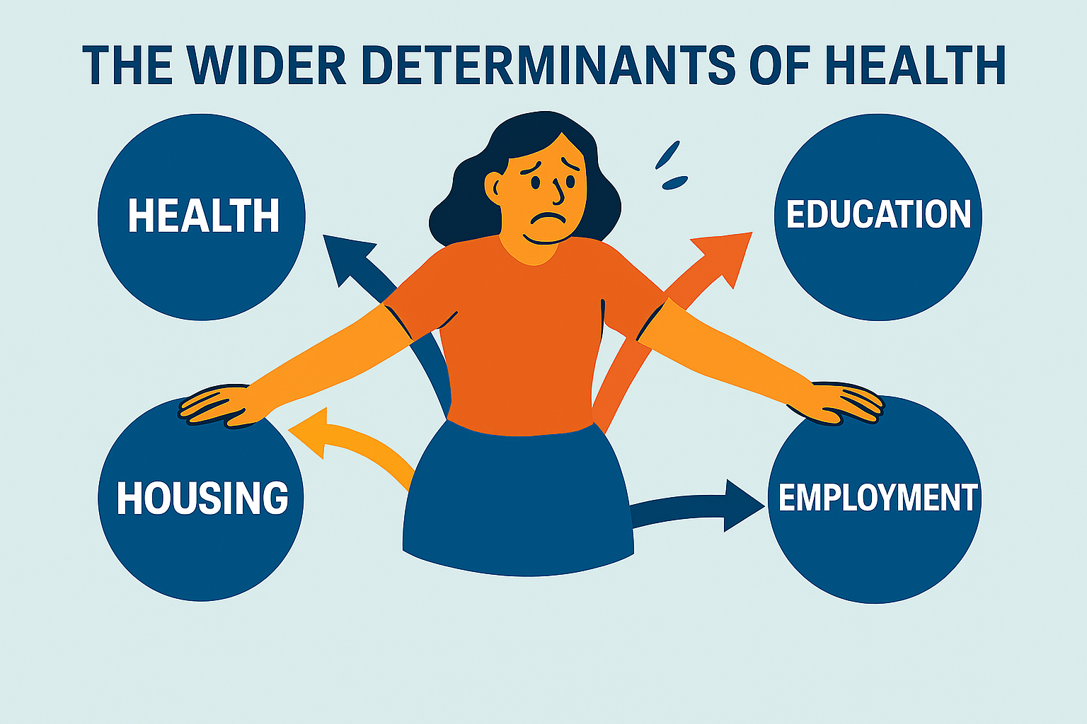
Income cuts across all the other determinants
The wider determinants of health are all connected and solving one doesn’t always fix the rest but having enough income can help to address the negative impact some of the other social determinants.
Poverty Review deep dives looked at wider determinants:
Income: Income Maximisation & debt
Health: Food & Fuel insecurity & mental health & wellbeing
Employment & Education: youth opportunity
Solving one doesn’t always fix the rest

Slide 6
Not just about making residents better off financially : agency, autonomy and resilience at the heart of our approach to poverty prevention
Systemic working
Community led approaches
Agency, Autonomy & Resilience
Transitioning Food Aid to more sustainable initiatives e.g. Community Kitchens (North Paddington Food Bank)
shared decision making and pooled funding - Anti Poverty alliance
Community led approaches to income maximisation
Data / systems integration
Fuel poverty Action Plan
Community based financial resilience
Community led comms approach
Addressing Stigma
Addressing structural barriers to access
Better quality digital information for young people post 16
Addressing shortage of discount supermarkets in Westminster
Improved Health and Wellbeing

Slide 7
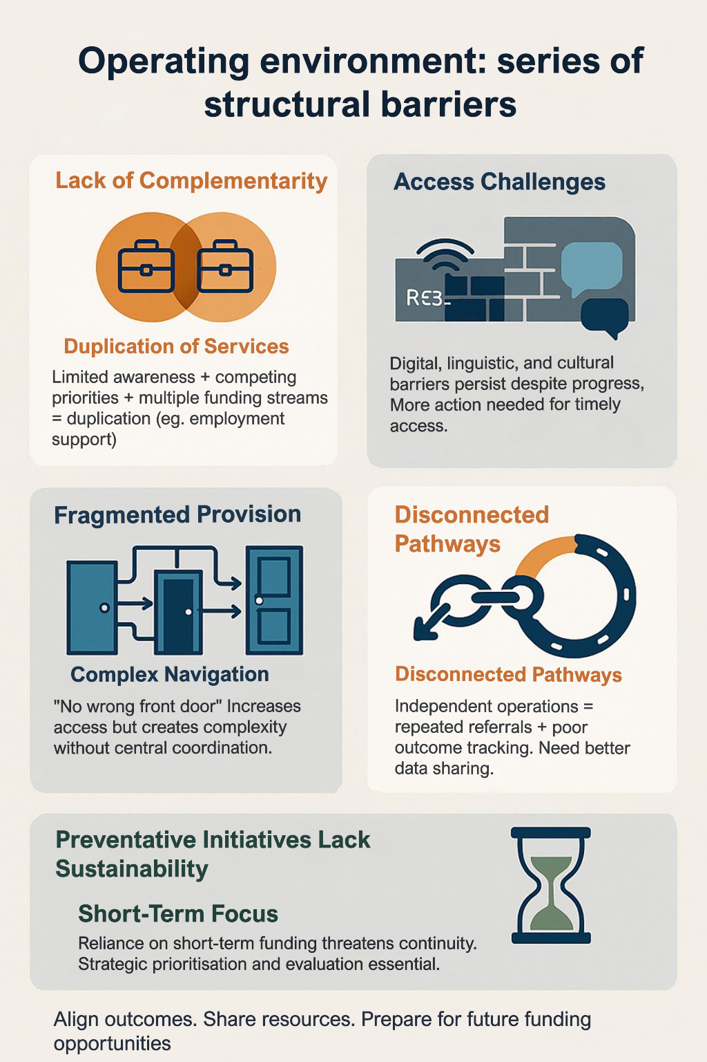
Addressing structural barriers to access
Comprehensive Support provided – not many service gaps
Complex ecosystem, featuring a series of structural barriers that hinder easy access and timely support

Slide 8
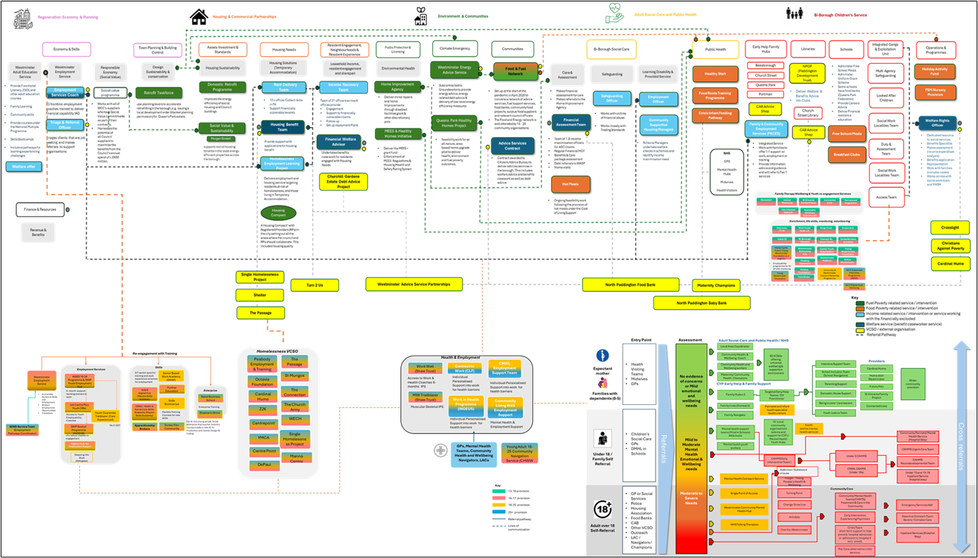
Poverty Ecosystem is complex

Slide 9
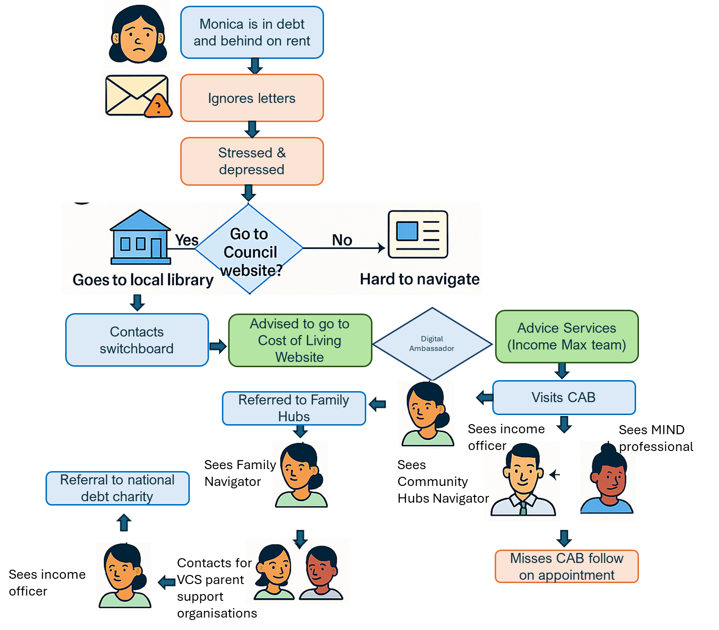
Addressing structural barriers
Focus of the APAP is about enabling autonomy & agency by making it easier to access services and get help
Aim is to reduce the volume of secondary contacts
To do so will require a systemic approach to individual problem resolution
Co-location of services through hubs improves geographical access but CRM systems need automation and data integration that enable services to work together seamlessly and spot problems before they occur
There is a space for AI to make those connections
Universal Navigators / access workers are a short-term solution. Need to tackle the root of the problem through integrated provision and complementary navigator services for communities experiencing specific barriers (language etc).
Lack of awareness of what is available in a confusing landscape – lack of tailored& segmented comms
Access challenges: Monica is not digitally excluded - website is not user friendly
When asked if residents were aware of a particular service, they almost always said ‘no’
“I started looking on our website but had to give up”
Comprehensive Support is available at each step of Monica’s journey but one service cannot deal with all of Monica’s challenges at once.
“I want someone to deal with my problem in one go – I don’t want to keep having to come back”
Fragmented provision: No wrong front door means Monica ultimately gets help but in an inefficient way
Disconnected Pathways / Multiple triage: Siloed provision means Monica has to explain her problem multiple times to multiple professionals
“I keep having to repeat myself over and over again”

Slide 10
Pragmatic approach to engagement adopted
The Action Plan itself is not exclusively co-produced but Council facilitated:
Extensive engagement & consultation (SWOT, Gap Analysis)
Joint problem solving, ideation & short-listing ideas
  13 local voluntary partners
  8 national charities
  Local residents via:
  Change Makers Workshop on Food Poverty
  Consultation and engagement sessions on Equality of Access underpinning the Community Equalities Strategy
  82 WCC Officers
  20 benchmark London local authorities, including 4 outside London
  2 Higher Education Institutions
Opportunity for residents and communities to take the lead in shaping / implementing individual actions

Slide 11

The Governance quandary
Cross Cutting - Everyone’s business but no one’s responsibility
So where does it sit?
…..3 options considered
Anti Poverty Alliance

Slide 12
Questions

