Slide 1


Community Health and Wellbeing Workers in Battersea
Dr Jenni Ellingham | Chassidy Robertson CHWW | Mathy Kimvuidi CHWW
Battersea PCN

Slide 2


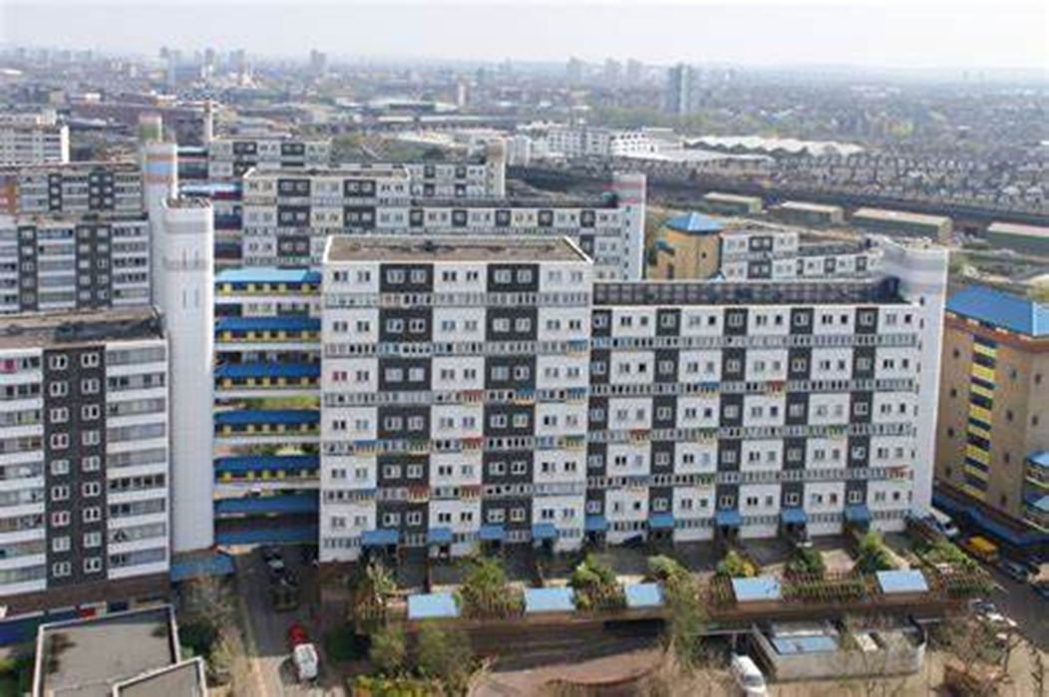
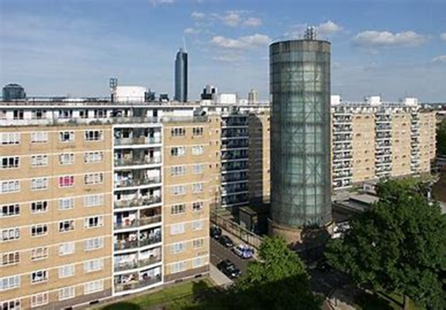
Community Health Worker Model
Comprehensive
Hyperlocal
3. Universal
4. Integrated
Notes:
This model started in Brazil over 30 years ago where it is now the delivery model for primary care with over 70% of the population now having a CHWW. Since the 1990s the results in population health improvement that Brazil has seen have been remarkable;
hence why it was bought over here to the UK.
CHWWs are recruited on character and there is no particular requirement for particular skills; CHWWs are natural problem solvers; empathic, culturally competent, emotionally intelligent, honest and integral, team players, have the right attitude; and recognise the need to be persistent, respectful and maintain confidentiality. The specially recruited teams get to know families and assess their health, social and wellbeing needs, promote healthy living, signpost to appropriate services and help residents navigate the health and care system. They become allies and advocates for their residents.
In Westminster where the model was first implemented it has shown:
The households were 47% more likely to have immunisations that they were eligible for and 82% more likely to have cancer screenings and NHS health checks.
These households saw a 7.3% drop in unscheduled GP consultations.
Residents were appreciative of the ease of access, support and comprehensive approach provided
Engagement had been maintained with 60% of residents and increasing. Residents who engaged with CHWWs did not disengage.
Multiple instances of issues being unearthed around suicidal ideation, child carers, domestic violence and intractable housing.

Slide 3

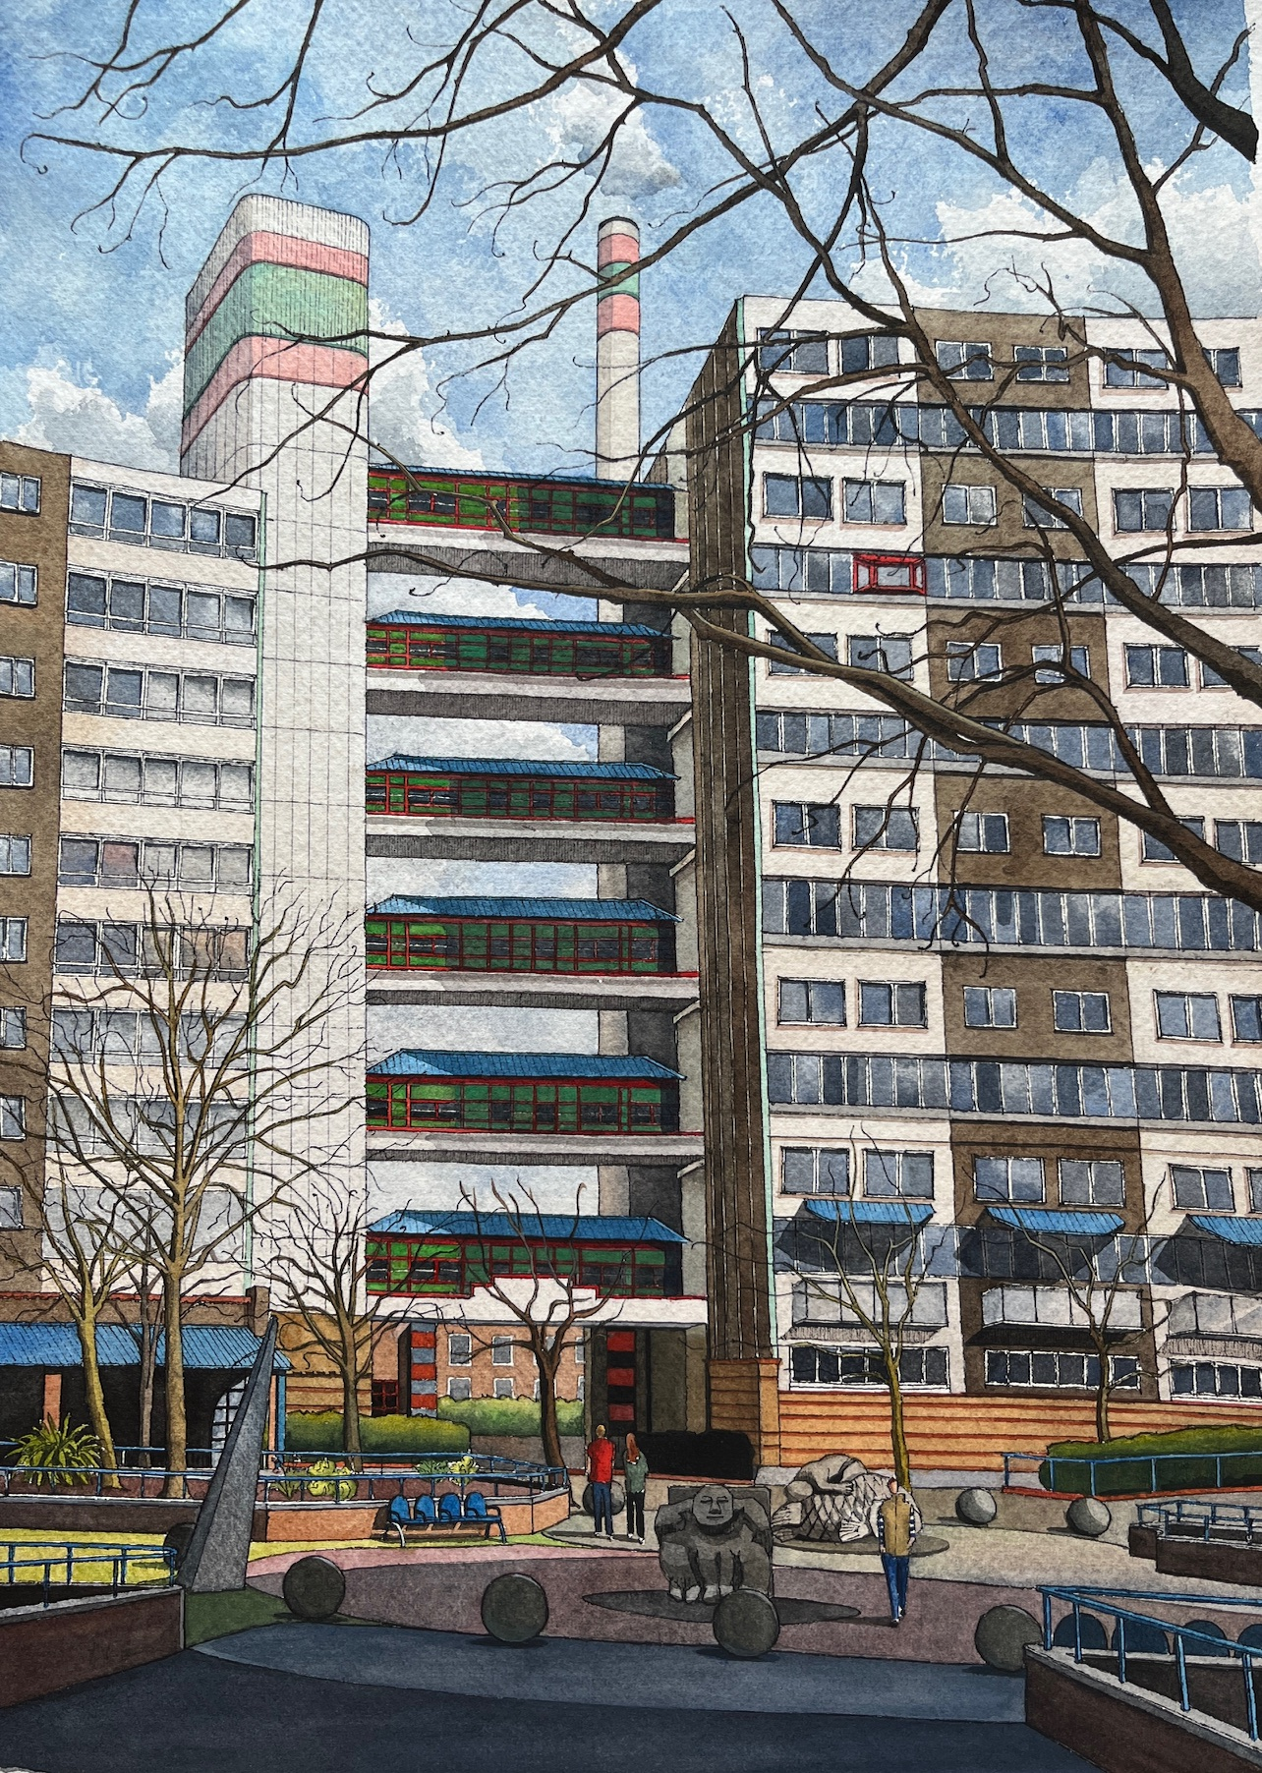
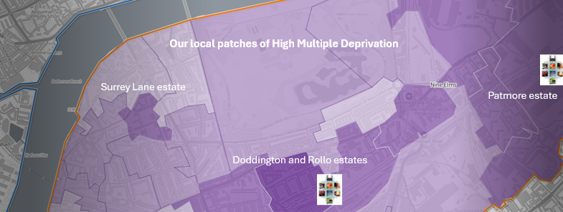

Slide 4
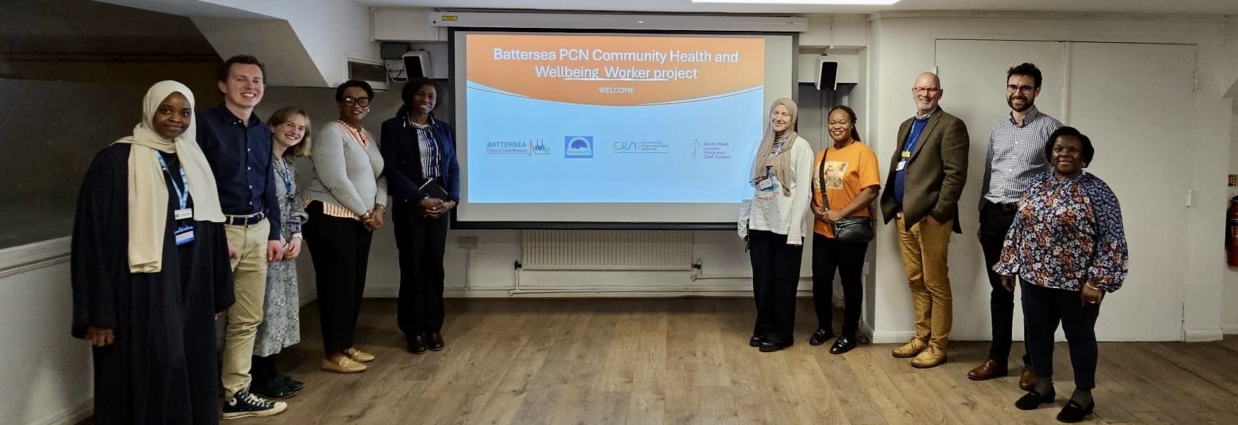
The Stakeholder Team Spring 2024

Slide 5
What are our CHWWs doing day-to-day?
Monthly door knock
Monthly community breakfast event
Supporting engaging residents further
Building trust and getting to know the whole household
Offering referrals/signposting to the GP/local professional and community services/knowledge building
Weekly supervision with GP
Visiting speakers/hosts share on health and wellbeing topics over food and conversation
Another point of contact for the community
Weekly drop in sessions at local community hub
This takes many forms but our CHWWs have the flexibility to support residents in lots of ways
Notes:
Monthly Breakfast - Our monthly breakfast consist of a healthy and delicious breakfast and a topic every month, regarding something our residence have stated they would like to now about or something we noticed is lacking in the community.
Such as Vaccine drop in sessions, Bowel cancer discussion, health eating, getting back into work, housing and citizens advice, financial advice sessions and many more.
Drop in sessions every Thursday - we have a drop in session every Thursday where all members of the community can come down to the hub and have coffee, tea. etc with us and have general catch- up sessions. some of the older generation use this time to ask us to help them with their healthcare apps, or filling or triage forms, less formal and more intimate.
Service Fair - We recently put on a service fair in October and hoping to do this more often, a lot of our residence we see have more than just medical related issues, therefore we got all the service providers in one place (Battersea square) this is surrounding the blocks we visit, the community hub and storm center, which is a center founded by a lady that experienced domestic abuse, people can go there, and garden, get free food, get free advice and many more.
For this fair we had, Wandsworth housing, Citizens advice, MacMillian, Womens aid, the local food bank, parental mental health, social services, Neighborhood safety team, Royal Trinity Hospice, The youth bus, so many different services and people got to speak to these service providers face to face.

Slide 6
What we’ve achieved so far
>700 eligible residents across ~200 households
1220 door-knocks and 1,046 meaningful contacts in between Sept 23 and March 25
> 40% engagement and increasing continuous engagement as trust builds
Improved Screening and > 65 Flu uptake in residents engaging with CHWW
270 referrals in the first 18 months

Slide 7
Onward referrals
Addressing clinical and non-clinical barriers to health

Slide 8
| What our residents say

Slide 9
What else we’ve achieved
18 Breakfast events
Established an ever-growing network of community partners
Year 1 Evaluation in partnership with Roehampton University – included stakeholder, team and resident focus groups
Advocated for the model alongside other groups across England, securing funding to continue through to 2026

Slide 10
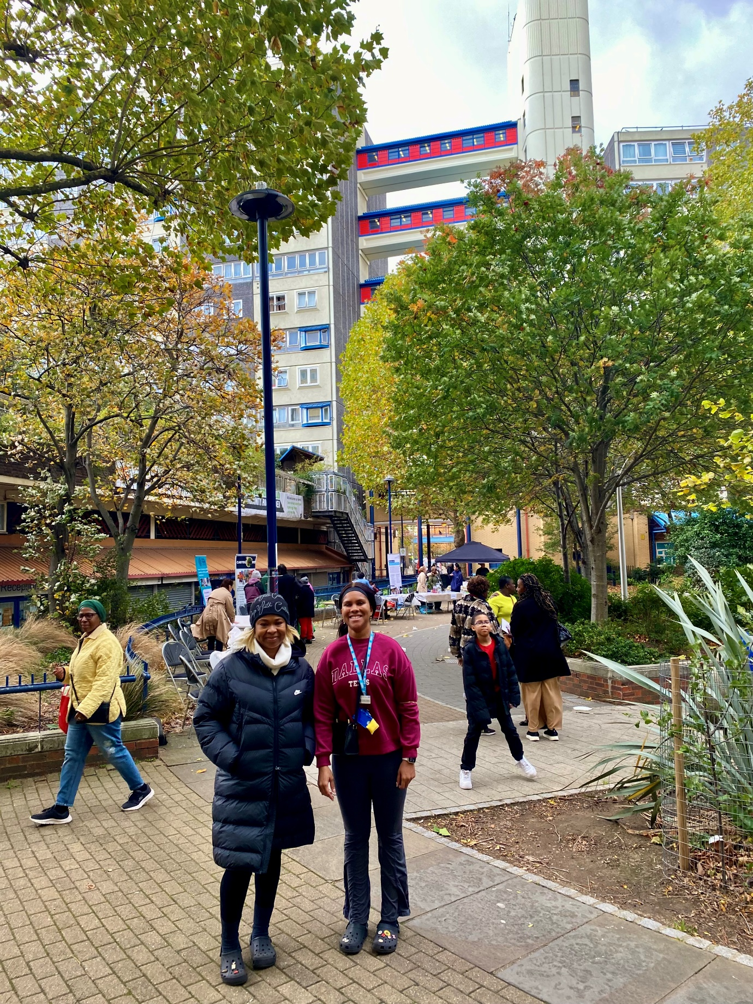
Doddington Community Resource Fair October 2025
18 local partners
200 interactions with residents

Slide 11
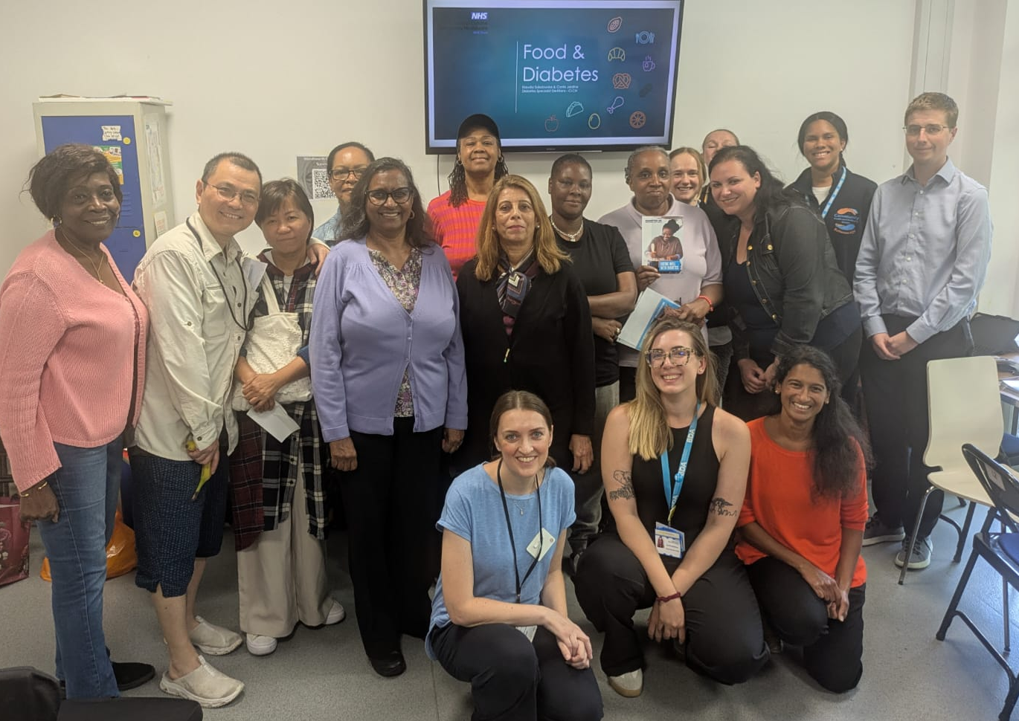
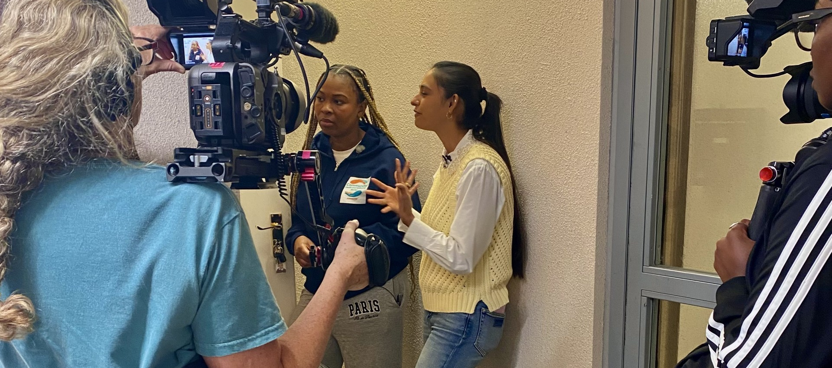
Food & Diabetes Event focussing on the Caribbean diet with CLCH September 2025
BBC one show feature August 2025

Slide 12
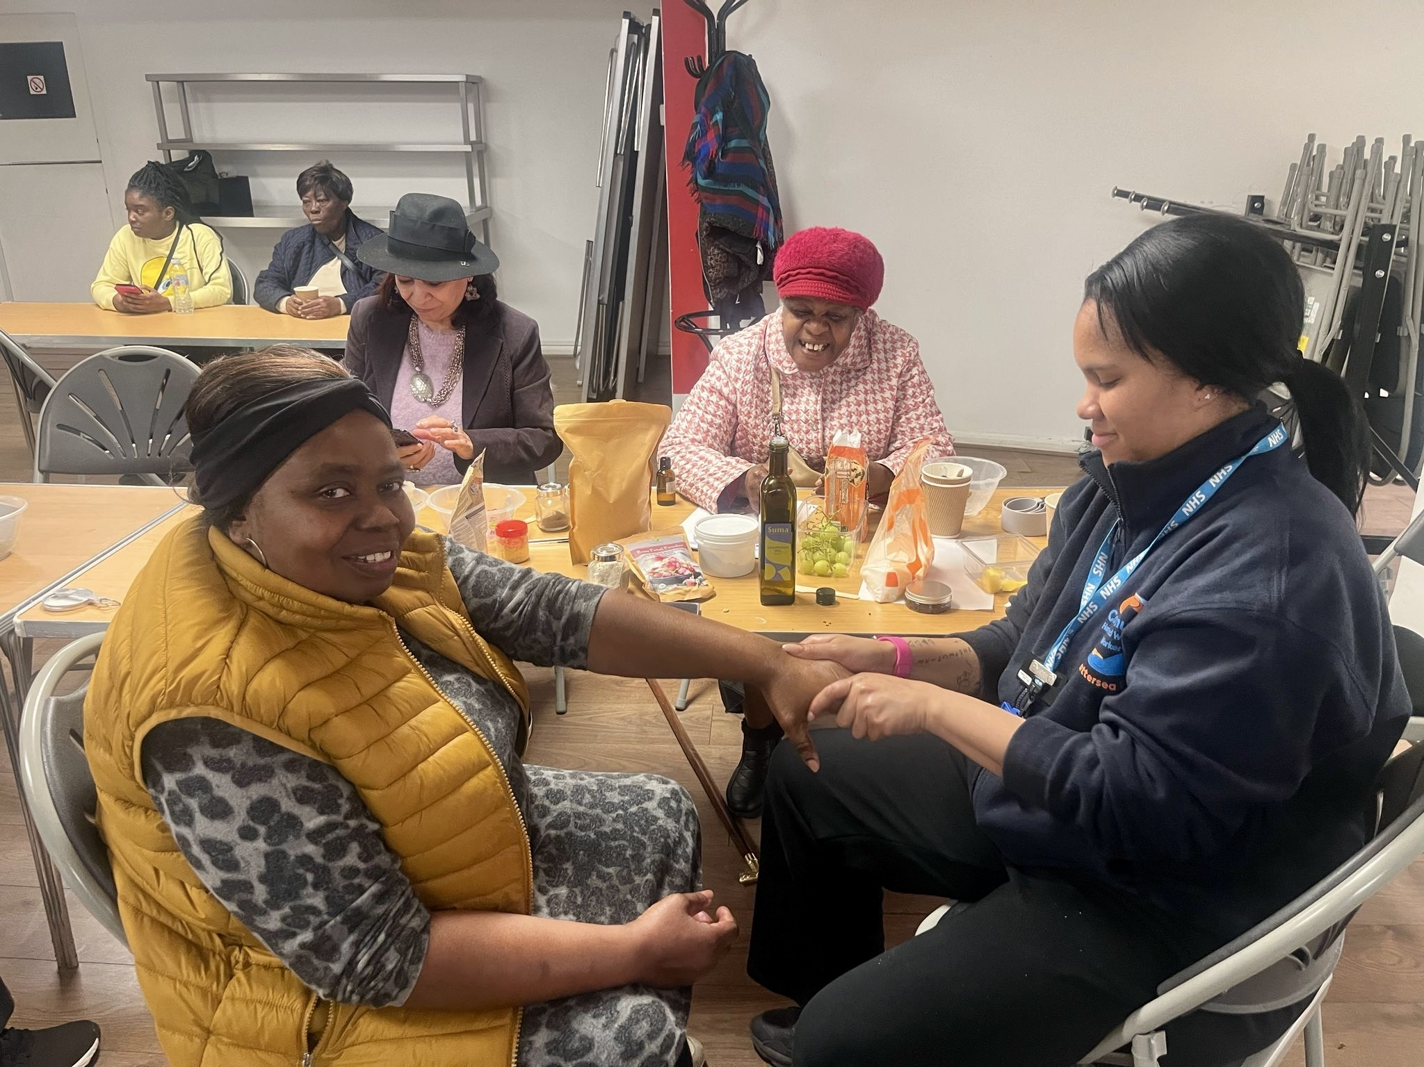
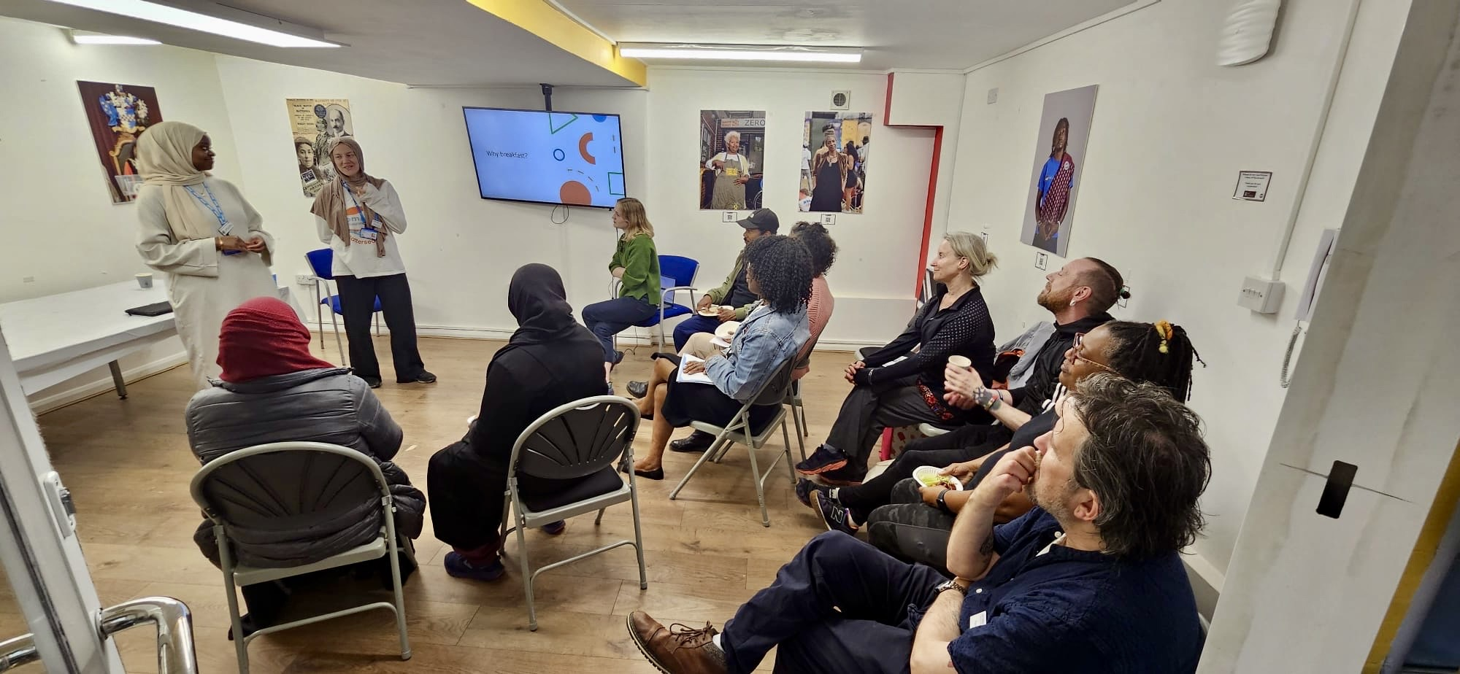
Resident’s feedback
Survey data points to ‘connecting with local activities’ being valued highly and residents most valuing ‘being listened to’

Slide 13
Summary
Community Based and addressing local needs
Addressing Core 20 “on Steroids”
Data and Evaluation- impact from other projects
Funding

Slide 14
Any Questions?

