Slide 1



Brent Health Matters
Addressing the Social Determinants of Health and Poverty Webinar
14th January 2026

Slide 2




Brent Health Matters Model
STAFF
BHM FUNCTIONS
Brent Health Matters is both a model to tackle inequalities and a team supporting that model.
The model recognises that very often the way in which we provide health and care services and engage with our residents, does not make it easy for people to access the care they need, or encourage the behaviours that would support healthier happier lives.
Brent Health Matters is a partnership across all stakeholders in Brent setup in 2020 to understand the barriers faced by some communities and people who are seldom heard from and support them to improve the management of long-term conditions and quality of life.
Active community partners: community capacity building (including VCS grants)
Inform and support residents: range of, support, education, & advice offers
HEALTH & CARE ECONOMY
COMMUNITIES
Brent Health Matters creates a better connection between all communities in Brent and the health and care system
Community lead
Communications & Engagement
Community coordinators
Community champions
Clinical team
Mental Health team
Health Educators
GPs
Community engagement/ involvement: building trust & listening
Improving access to the range of services available in the borough
SERVICES
Perform, monitor & learn: active performance management
Flexible & Iterative model

Slide 3
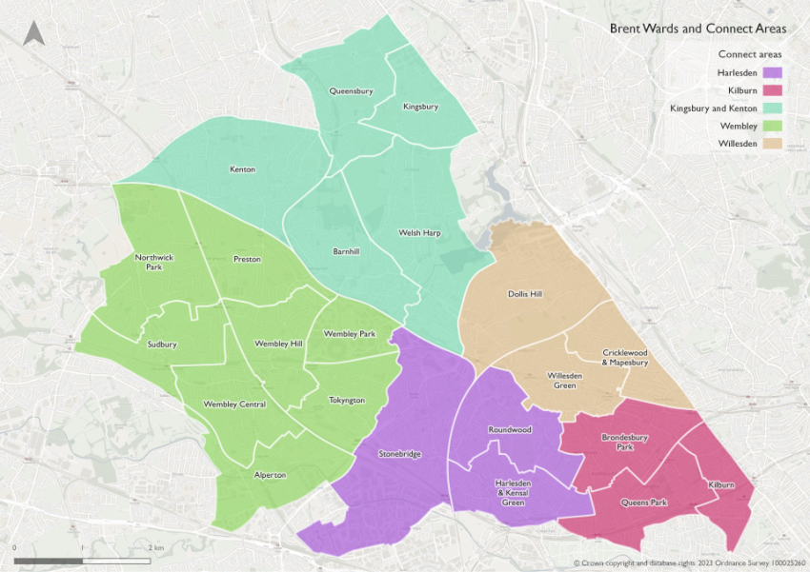
Locality teams
The programme covers the whole of Brent. The borough is split into five local ‘Brent Connect’ areas.
Each area has volunteer Community Champions and a locality team made up of:
1 Community Coordinator
1 Community Connector
Clinical team (Nurse/Senior Nurse/Healthcare Coordinator)
Health Educators
Public Health Officers
Locality team meet at least once a month.

Slide 4
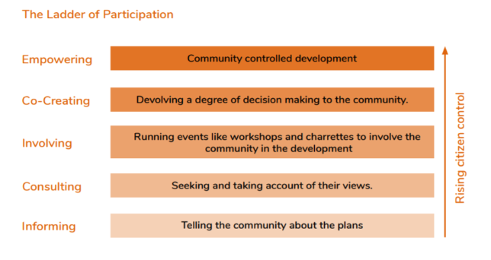
Community approach
We work with residents and local organisations from diverse communities who don’t normally access health and care services e.g. specific BAME communities, homeless people, emerging communities, people with disabilities, people with mental health issues, deprived areas, and night shift workers.
Our approach seeks to understand residents’ needs and challenges around health and care, and to work with them to improve their health and wellbeing.
We learn as we deliver and adapt our approach based on resident’s feedback.
We use the ladder of participation to monitor our progress.

Slide 5
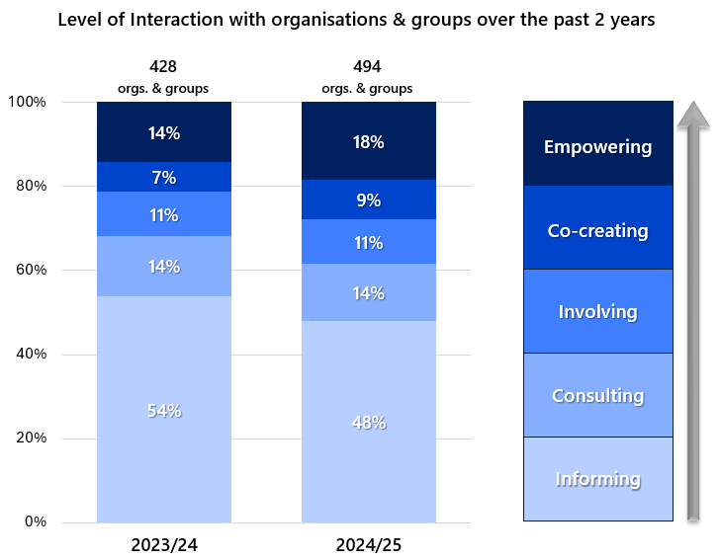
Community connections
We build and maintain networks of community contacts focussing on communities we haven’t engaged with as much.
Our community engagement staff have built connections with 494 organisations to co-produce action plans and events.
We gradually build relationships with residents and communities, often progressing from informing to consulting, involving, co-creating and empowering levels of interaction. The graph below highlights the levels of participation we achieved in 2024/25 in comparison to 2023/24.
Level of Interaction with organisations & groups over the past 2 years

Slide 6
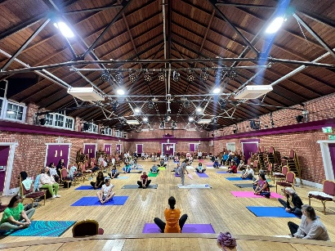
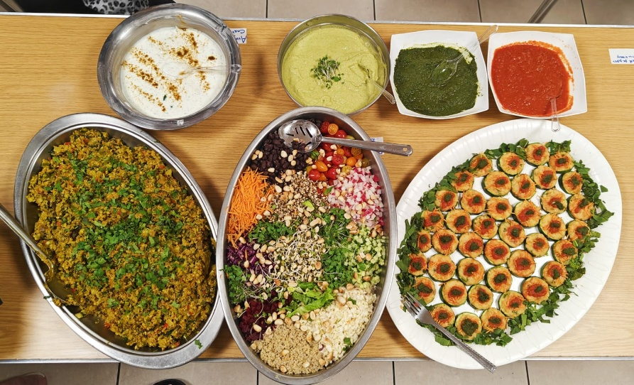
Local action plans
The locality team co-produce and deliver action plans based on the community’s need and ideas.
Examples of actions delivered:
Set up an advice line for residents
6-week cookery programme for people with special needs at Brent Mencap
The formation of a Somali forum made up of 9 Somali community organisations.
8-week diabetes community programme in partnership with Gujarati Arya Association, to deliver a joint healthy cooking demonstration, diabetes talk in Gujarati, and exercise session.
Mental health workshops.
NHS App training for staff, and awareness sessions for residents.

Slide 7
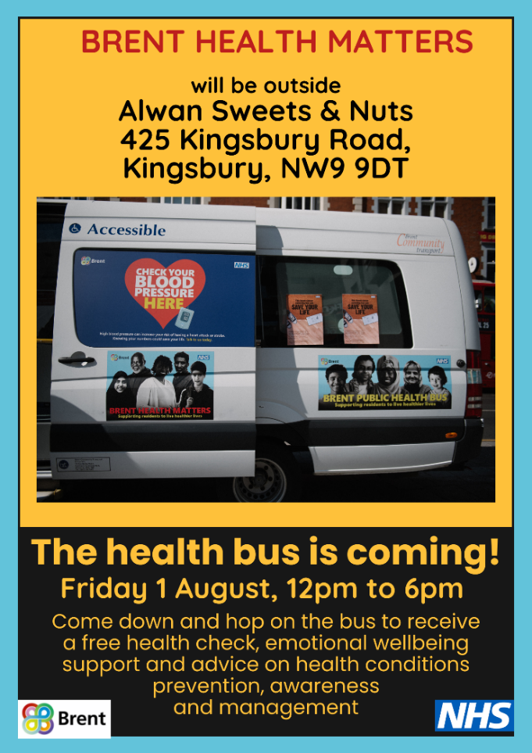
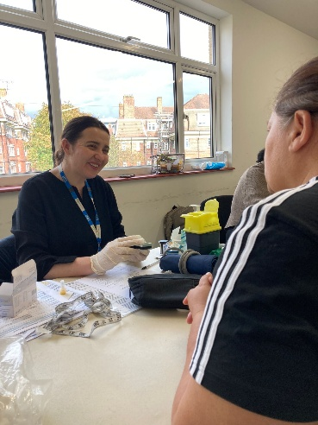
Health and wellbeing events
We co-create health and wellbeing events with organisations and groups across various venues in the community – from foodbanks and factories to libraries and community hubs.
Our events consists of:
Health checks;
Height, Weight and Body Mass Index (BMI)
Blood Pressure
Heart Rate
Blood Sugar level
Diabetes risk assessment
Consultation with nurse or GP
1:1 mental health consultations
Healthy eating and nutrition advice
Information and signposting to other support
Link Worker for Housing, Adult Social Care and Employment
Brent patients’ abnormal blood sugar or blood pressure readings are escalated to their GPs. GPs follow-up with these patients, which may lead to a diagnosis for diabetes or hypertension.

Slide 8

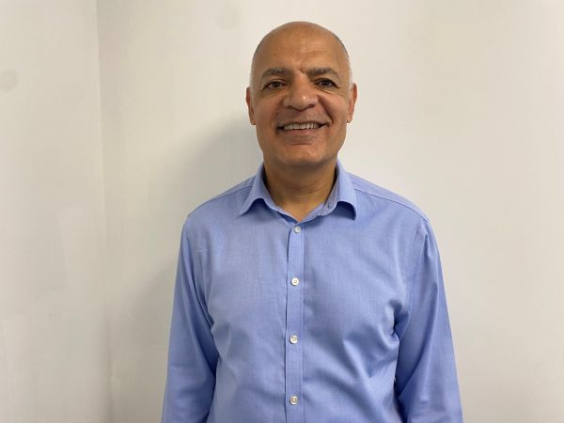
Community grants scheme
Following COVID, the community voiced their need for more resources to tackle health inequalities themselves. We launched the community grants scheme because of this.
We have given out £900k to community organisations through 3 rounds of community grant.
Community organisations have delivered a range of initiatives targeting different community groups e.g. physical activity, mental health support, digital upskilling, and raise awareness about health conditions.
For the 2024/25 grants round, 50% of the attendees experienced a lot of improvement due to the service, and 36% experienced a fair amount of improvement due to the service.
“
In 2023/24 Citizens Advice Brent was awarded £10,000 to support residents in Brent to access free, confidential and impartial information and advice.
“The grant has made a significant and tangible difference to our service and the community we support,” said Chief Executive Officer, Raj Kapoor. “It allowed us to recruit and train seven full-time volunteers who provide triage support and information on various issues, which has greatly increased our capacity to respond to growing demand.”
Grant round | Number of organisations funded
2020/21 | 19
2022/23 | 30
2023/24 | 43
“Thanks to this additional resource, we’ve been able to assist many more residents in accessing vital support — from energy grants and warm home discounts to discretionary local authority funds, cost-of-living payments, and charitable applications for essential household items and school clothing. This has had a real, immediate impact on the lives of local people facing financial hardship.”
“We’re extremely grateful for this opportunity from BHM, which has helped us deliver meaningful, lasting outcomes for those most in need. BHM staff have been a joy to work with.”
”
Notes:
Mo to make pie chart into bar chart

Slide 9

Learnings
Build trust with the communities by listening to their needs
Build and maintain connections with trusted voices, which takes time
Provide training to community workers and champions, and get them all on the same page through a common vision
Target specific communities based on your priorities
Maintain feedback loop
Reflect on progress regularly

