Slide 1



WELCOME

Slide 2
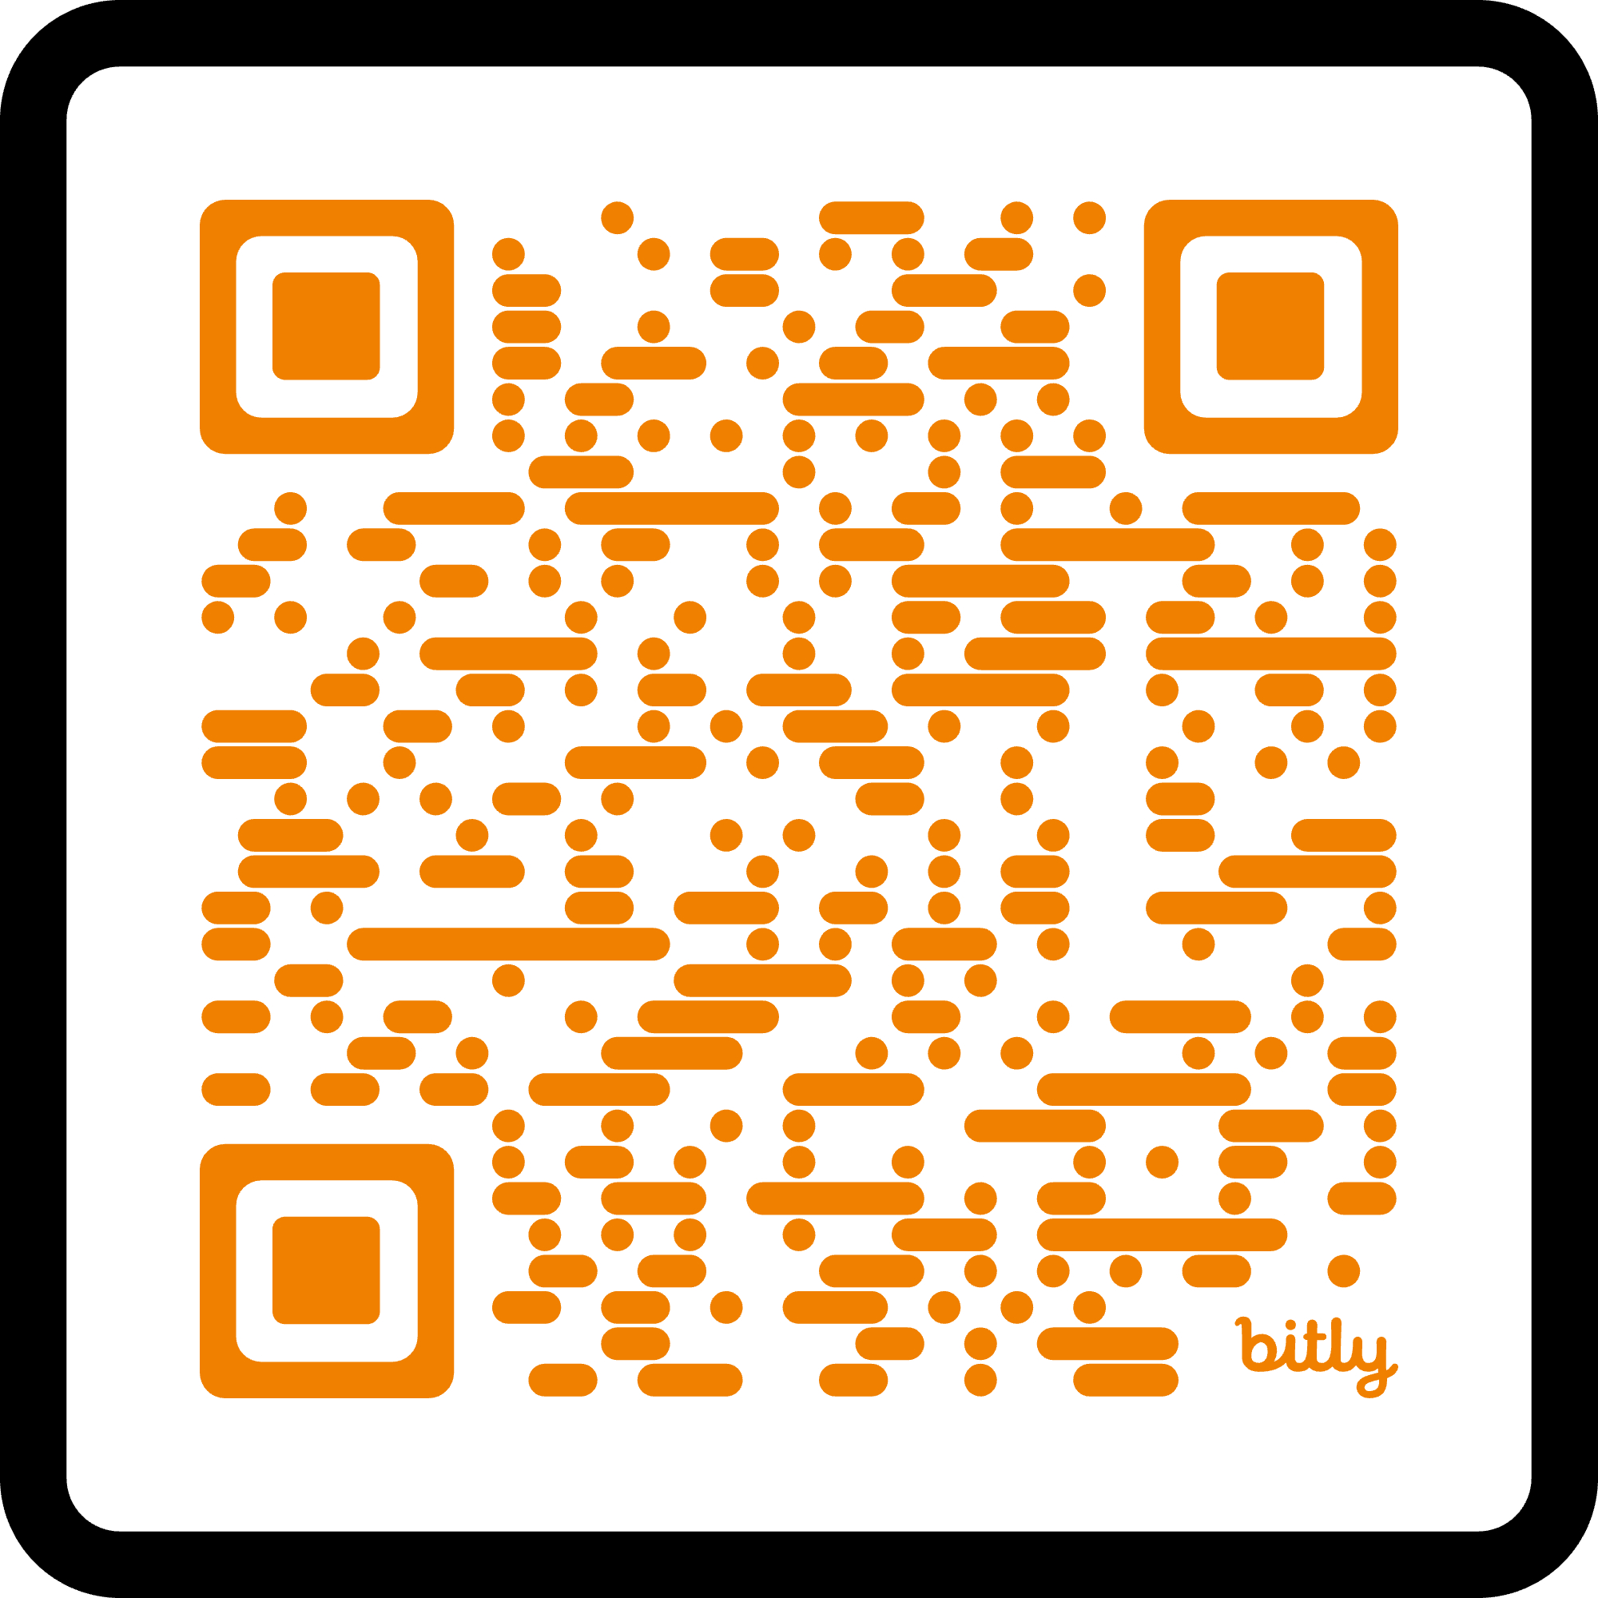
Some housekeeping
This session is being conducted as a Zoom meeting. Please feel free to introduce yourselves in the chat.
There will be a Q&A at the end. If you have any Questions, please send them via Direct Message to Cllr Paul Cassidy in the chat.
We will be recording the session and making it available on our website.
We kindly ask that everyone MUTES themselves during the session, although we do have the power to do that should you forget ☺
If you don’t already receive our Newsletter, please use the QR code and register.

Slide 3

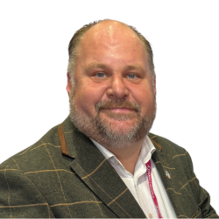


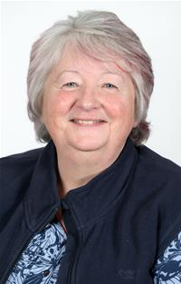

Scaling Cii
Cllr Jim Robbins
Chair, CCIN
Leader, Swindon
Cllr Shanika Mahendran
Milton Keynes City Council
Cllr John Cotton
Birmingham City Council
Cllr Jacky Alty
South Ribble Council
@CoopInnovation

Slide 4
Councillor Paul Cassidy
Vice Chair of CCIN & Vice Convenor Environment and Regeneration Inverclyde Council
@PCassidy29 | @CoopInnovation

Slide 5
Programme
Welcome and Introductions – Cllr Paul Cassidy – Vice Chair of CCIN & Vice Convenor Environment and Regeneration Inverclyde Council
Examples, barriers and emerging lessons for councils – Mili Patel – Chair of CCIN Values & Principles Board and Deputy Leader – Brent Council
Policy asks and what councils can do – Helen Bartlett, Confederation of Cooperative Housing (CCH)
Building Community-Led Housing in Stevenage – Cllr Jackie Hollywell - Cabinet Member - Housing and Housing Development
Discussion/Q&A - Cllr Paul Cassidy
3 pm – Close

Slide 6

Councils who are committed to finding better ways of working with local people
Action focused
Membership-based
Open to all UK councils
Part of the local govt family

Slide 7



117 Members
21 Supporters
43
27
47

Slide 8











































43 Councils 12.04m citizens £20.22bn budget

Slide 9



























Slide 10













































Slide 11









Slide 12

https://www.councils.coop/project/community-led-housing-commission/ - launched March 2018 and led by Croydon Council

Slide 13
Councillor Mili Patel
Chair, CCIN Values & Principles Board and Deputy Leader, Brent Council
@MiliKPatel | @CoopInnovation

Slide 14


CCIN – Scaling Co-operative Housing
Helen Bartlett
Associate Consultant CCH

Slide 15
What is a housing co-operative?
Housing co-operatives are homes collectively owned and or run by their members. They take many forms, but all are based on democratic control, long-term affordability, and a shared commitment to people and place. Guided by the co-operative principles, members make decisions together, share responsibility, and reinvest all surpluses back into the community.

Slide 16

The Confederation of Co-operative Housing (CCH)
The representative body for co-operative housing in the United Kingdom since 1992
CCH promotes the excellent work done by co‑operative housing organisations, fostering communication and serving the sector, and campaigning for quality housing co-operative solutions across the United Kingdom.

Slide 17
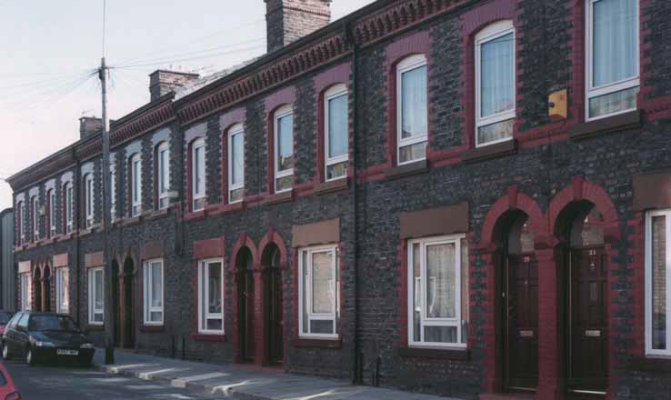
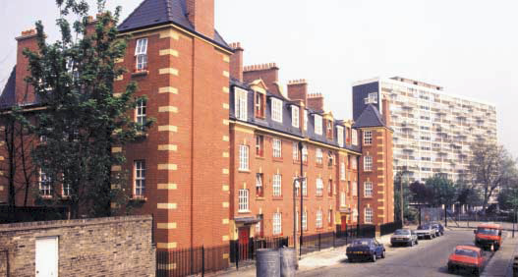

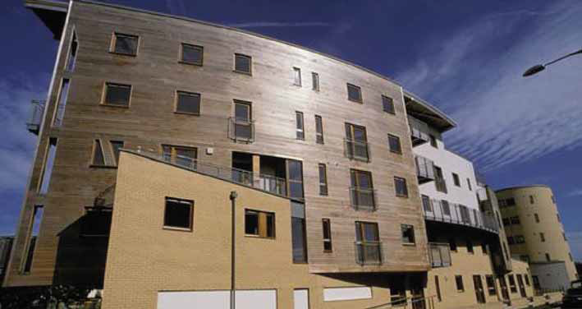
The rich mix of co-operation

Slide 18
Why co-op housing?
Creates permanently affordable homes that kept as long-term community assets
Strengthens communities and builds social capital
Delivers democratic accountability and exceeds regulatory expectations
Adds to housing supply, especially on small or challenging sites
Attracts external funding and spreads financial risk
Keeps homes as long‑term community assets
Can improve scheme viability through mixed‑tenure and market‑facing homes

Slide 19
What councils can do
Provide land and buildings
Shape planning policy to support co-operative and community led development
Offer modest capital grant or access to loan finance
Enable mixed-tenure models to increase viability
Create an enabling environment

Slide 20
Co-operative and Community Led Solutions to the Housing Crisis
Our election Manifesto

Slide 21
CCH 2024 Manifesto for Change – the three key asks
Legislate for a co-operative form of tenure, placing co-operative tenants on the same secure footing as other social housing tenants
Legislate to create a presumption in favour of disposing public land and buildings to co-operatives by amending the Localism Act – creating the opportunity for the co-operative movement to develop homes and community businesses
Invest in creating a financial intermediary to provide access to low-cost capital finance for co-operative housing organisations that are currently priced out of the market by the risk appetite of lenders and institutional investors

Slide 22
Name: Helen Bartlett
Title: Associate Consultant mobile: 07887788338 email: helen@cch.coop www.cch.coop
Notes:
____________________________________________________________________________
____________________________________________________________________________
____________________________________________________________________________
____________________________________________________________________________
____________________________________________________________________________
____________________________________________________________________________
____________________________________________________________________________
____________________________________________________________________________
____________________________________________________________________________
____________________________________________________________________________

Slide 23
Cllr Jackie Hollywell
Cabinet Member - Housing and Housing Development
Stevenage borough council

Slide 24
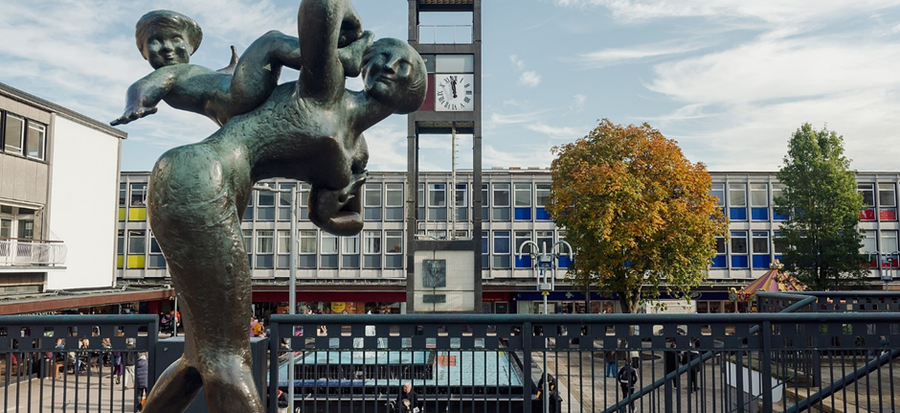
The Stevenage Experience

Slide 25
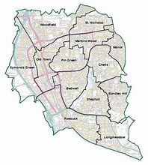
Stevenage – the place
Country’s first new town in 1946
Designed with neighbourhoods at the heart of plan
Urban Borough
1972 - 16% private housing
2024 - 21% Council housing (more than 3 times national average
Good transport links

Slide 26

Stevenage – the people
90000 people
Most deprived authority in Hertfordshire
Ageing population 15% increase since 2011
25.5% of households have disabilities
82.28% white, 17.2% BAME
3.1% of population unemployed

Slide 27
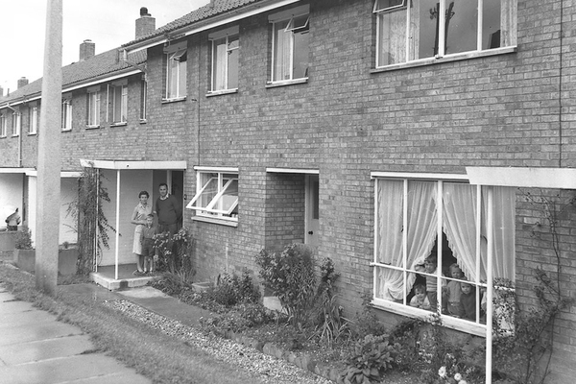

Slide 28
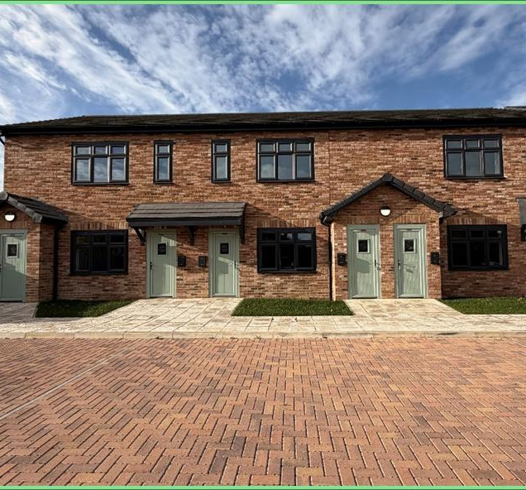
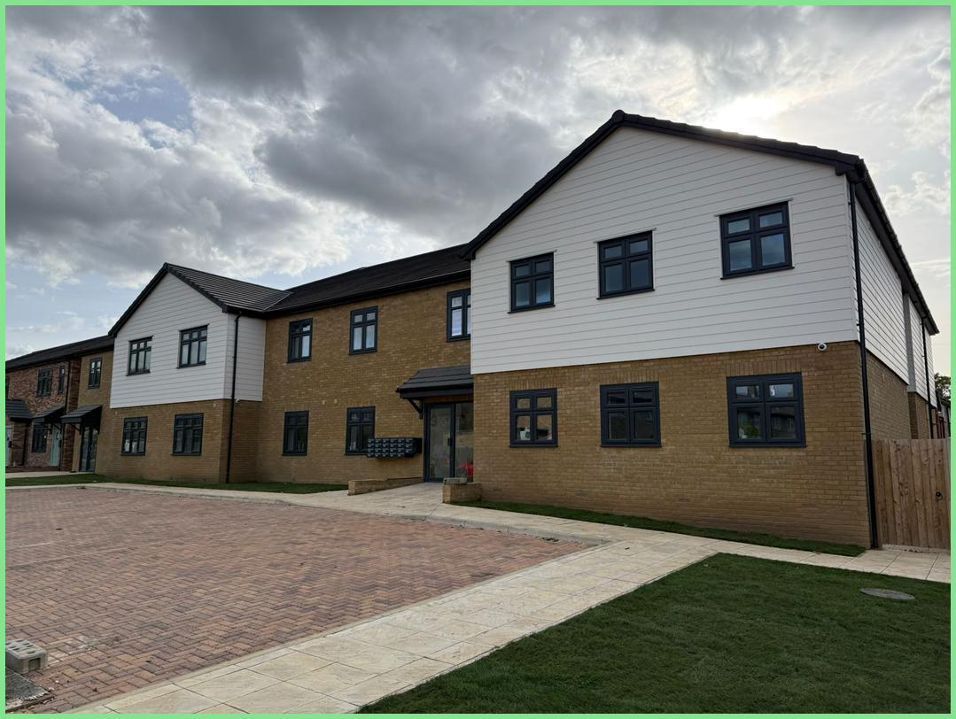
Dunn Close Temporary Housing

Slide 29
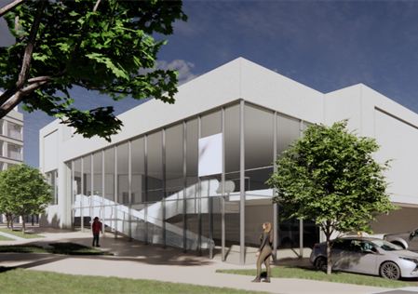
Regeneration of The Oval
Proposed Scheme consists of 327 new homes, new retail, new community and open spaces. Demolition of existing shops.
2 in person events – total 76
attendees
7498 online respondents
Highlighting it was an important local scheme

Slide 30
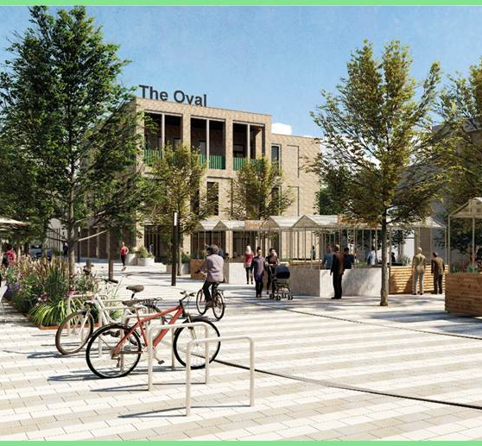
Regeneration of The Oval
  62% agreed with the proposals
  13% in opposition
  25% unsure
Across all elements (retail / community / residential / outdoor spaces) between 86% - 92% were either supportive or neutral about the scheme

Slide 31

“It pays to consult; it's an important discipline to develop and it opens the door for future development that is built on trust.”

Slide 32

Thank You!

Slide 33
Q&A
Chair - Councillor Paul Cassidy
If you have any Questions, please send them via Direct Message to @Cllr Paul Cassidy in the chat.

Slide 34

Thank you
If you don’t already receive our Newsletter, please register here:
https://www.councils.coop/resources/newsletters/newsletter-signup/

