Slide 1
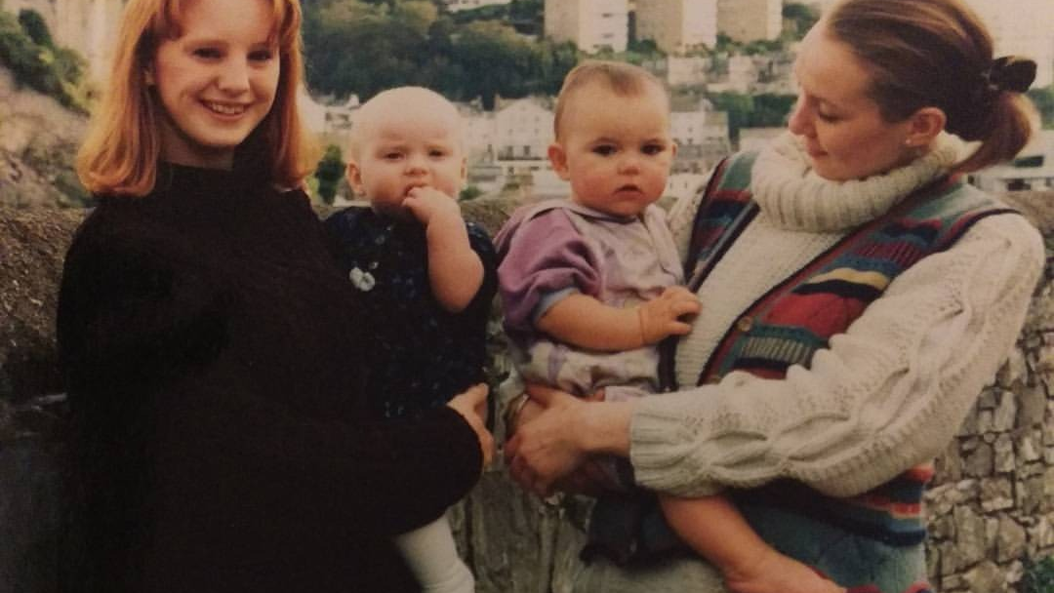
Terry Galloway Protected Characteristics

Slide 2
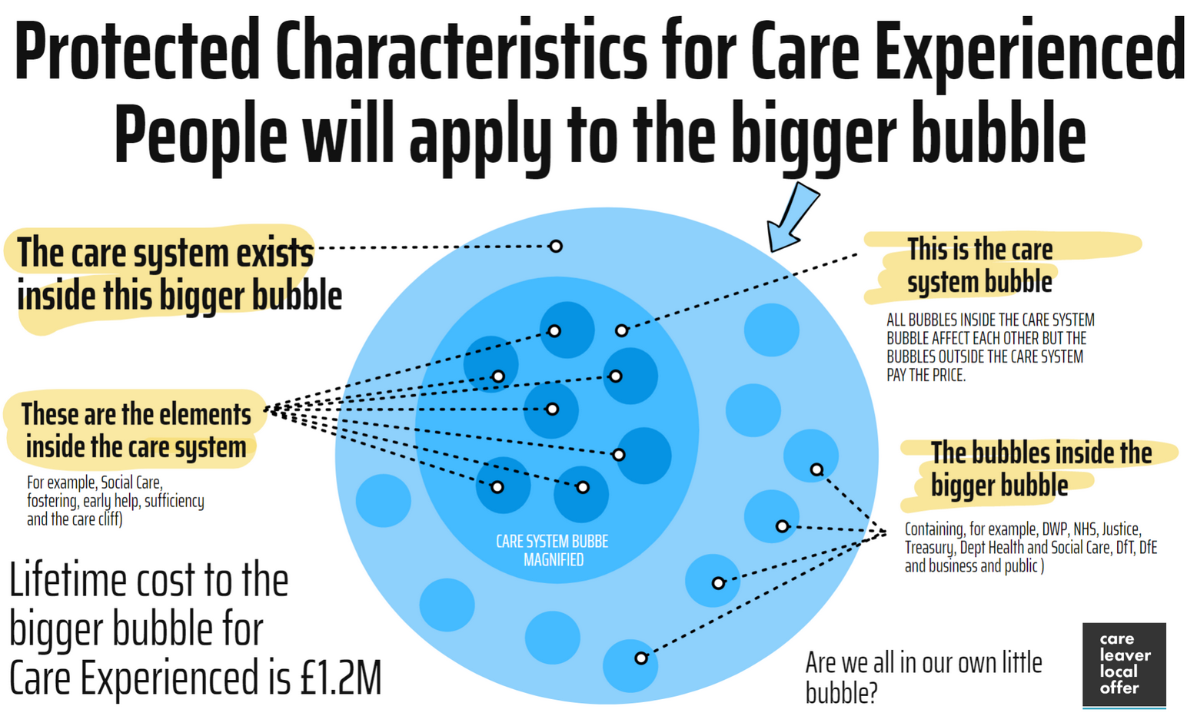

Slide 3


Slide 4

Over 30 Million people now live in an area in the UK where their Local Council Treats Care Experience People as if they had a Protected Characteristic..
Nation | Population | % of Population
England | 30,274,326 | 53.79%
Scotland | 1,179,090 | 21.58%
Wales | 305,418 | 9.69%
Total Population | 31.758,834 | 48.93%
110 Councils have passed the motion

Slide 5
PRACTICAL EXAMPLE of Identify policy/service change
I’m a Housing Association… What do I want to achieve?
Less evictions in social housing, reduction in ASB.
Outcomes
Reduction in cost
Better community cohesion

Slide 6
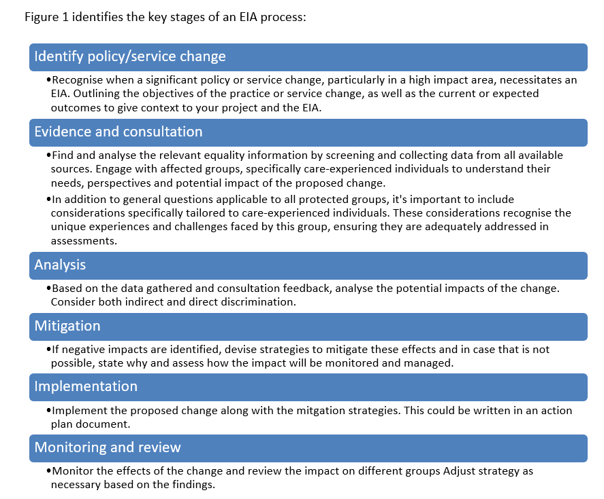
Equality Impact Assessment
Less evictions in social housing, reduction in ASB.
Outcomes
Reduction in cost
Better community cohesion
Identify policy/service change
Look for evidence, collect data and consult
Analysis considering direct and in direct discrimination
Monitor and review the effects of change for impact
Implementation. Make the changes
Create strategies to mitigate negative impacts.

Slide 7
Evidence/Protected Characteristics
Look for evidence, collect data and consult
Age
Disability
Gender reassignment
Marriage and civil partnership
Pregnancy and maternity
Race (includes ethnic or national origins, colour or nationality)
Religion or belief (this includes lack of belief)
Sex
Sexual orientation
Care Experience
More Likely to be evicted and causing ASB
INTERSECTIONALITY

Slide 8
Consultation – VOICE – Being heard
Look for evidence, collect data and consult
Establish a Care-Experienced Advisory Group - A group comprised of all care-experienced individuals (children currently living in care, care leavers and adults who are care-experienced) can provide valuable input into policy decisions and service development. This group should be promoted internally and externally, ensuring that external organisations can access and approach the Group for engagement. Advisory group members should be adequately compensated.
Utilise surveys and interviews - Regular surveys and interviews can help collect in-depth information about the needs and experiences of care-experienced individuals. At minimum, this should include auditing your services and encouraging partners to do the same so that you understand why, when and how care experienced people are accessing your services.
Host focus groups - Focus groups can facilitate discussion and yield rich insights into the needs and preferences of care-experienced individuals. These should also be used to raise awareness internally across the council and externally with partners about the potential and strengths of care-experienced people.
Promote co-production- Encourage and involve care-experienced individuals to participate in co-producing services provided by the local authority. This could involve them in evaluating services or developing resources .
Intersectionality - Intersectionality is a concept that describes the ways in which systems of inequality based on gender, race, ethnicity, sexual orientation, gender identity, disability, class and other forms of discrimination “intersect” to create unique dynamics and effects. For example, a person may experience racism and sexism collectively or individually at different times and in different environments .

Slide 9
Findings and Analysis
Analysis considering direct and in direct discrimination
Lack of appropriate social networks, broken familial relationships leading to disengagement and social isolation;
Leading to vulnerability – susceptible to negative influences and more likely to be evicted or subjected to ASB enquiries.
Example finding
“I was lonely and felt isolated. He offered to paint my kitchen and put the curtains up. He just would not leave and before long his friends were selling drugs from my home. I wish someone would have come around to help me, but I had no-one.” (Stacey age 19 – Now living in supported accommodation)

Slide 10
Mitigation and implementation-
Create strategies to mitigate negative impacts.
To Change evictions and ASB policy to include;
Prevention strategy
Introduction of a Care Leaver Offer to include repairs, curtains, blinds decorating and installations of white goods.
Introduction of a mentoring service for care experienced people.
Work experience and jobs program and pre-employability scheme.
Intervention strategy to include
Multidisciplinary action plan before eviction that includes
Resident / Leaving care / Housing Options / ASB Team / Other

Slide 11
SEVEN YEAR TIMELINE
Equality Impact Assessment Change of policy and trajectory
Carry on indirectly discriminating Care Experienced People - doing the same thing – follow the blue line
£619,664
£27,046
£12,325
£26,564
£6,812
£3,947
Stacey was brought into care at age 14 and lived in various children's homes experiencing several placements. High needs: emotional and behaviour difficulties.
17 incidents of anti social behavior
2 incidents of domestic violence
Housing association complex eviction costs
Homelessness application and 8 weeks relief
Job Seekers allowance fiscal and economical costs Living in Social Housing
From 18 years old
£27,046
Over a 1 Year Period 18 to 19 years old. Stacey moved into social housing and claimed universal credit and housing costs. She struggled with the isolation and loneliness; she developed low self esteem and met a male who she started a relationship with. Her flat became overcrowded with party's and drug dealing. Over the course of the year there were excessive incidents of ASB including domestic violence. The housing association received many complaints from neighbors and Stacey was eventually evicted with rent arrears.
£3,900
From 18 years old
Mentoring Scheme 3 hours per week
Job Seekers allowance fiscal and economical costs Living in Social Housing
£26,564
£31,456
£13,768
£10,508
£54,092
£19,864
2 incidents of domestic violence
2 Court appearances
4 Crimes committed
Alcohol misuse per dependent drinker (NHS)
Job Seekers allowance fiscal and economical
2 years temporary accommodation
£1,500
£5,000
Repairs, curtains, blinds decorating and installations of white goods.
Pre-employability and life skills program and work experience
Over a 2 Year Period Stacey moved into supported accommodation for 2 years because she no longer qualified for social housing because of the eviction and rent arears. She struggled with alcohol dependency and continued her toxic relationship with her boyfriend. Stacey started shoplifting and continued to be a victim of domestic violence.
Within 1 year of leaving care, Stacey learnt the essential skills to sustain her tenancy. She also took part in the housing association mentoring, life skills and employability programs.
Stacey is now in full time employment and has started to develop appropriate relationships.
Total Cost
£232,946
Net Saving
£195,500
Total cost
£37,446
For an additional Spend of
£10,400

Slide 12
Thank you listening Please follow the campaign
Email terry@ngalloway.co.uk
X @terrygalloway
LinkedIn ntgalloway
Phone 07838317574

