Slide 1
Councils’ Cooperative Development Toolkit
Kickstarting Your Cooperative Development
Jonathan Nunn, Policy & Partnerships Lead, Kirklees Council

Slide 2
Introducing me…
Policy & Partnerships Lead at Kirklees Council
CCIN Lead Officer since 2019
MSc in Urban Economic Development from UCL
  Research in Ethiopia on cooperatives and their impact on poverty
8 years working in Brazil
  Community researcher for grassroots NGO in Rio de Janeiro
  National Strategy Advisor for World Vision Brazil
  Both roles included support for social enterprises and/or coops

Slide 3
Background to the Toolkit
CCIN Policy Lab approved in 2022
Match funded by Power to Change
Led by Kirklees with participation from Greenwich, Oldham, Oxford, South Ribble, Stevenage and Sunderland
Contributions from wider group through workshop at 2022 conference
Support from Coop Futures, CMS and Innovation Coop
Input from Cooperatives UK

Slide 4

Turning your cooperative aspirations into action in four steps:
1
  Back to basics: what are cooperatives, their benefits, the evidence for them and related national support.
2
  What can I do? Taking you through the main areas where councils can take action to support cooperative development.
3
  Doing your homework: understanding your local context and objectives.
4
  Taking action: get going by identifying stakeholders, developing a theory of change, finding funding and developing an action plan.

Slide 5
Back to basics
1
What is a cooperative?
Why cooperatives?
What’s the evidence for cooperatives?
National Support Organisations

Slide 6
What can I do?
2
Increasing Awareness and Understanding
Creating a Supportive Policy Environment
Business support
Access to Finance
Direct Commissioning and Externalisation
Create a Dedicated Support Programme

Slide 7
What can I do?
2
Create a Dedicated Support Programme
Increasing Awareness and Understanding
Creating a Supportive Policy Environment
Business support
Access to Finance
Direct Commissioning and Externalisation

Slide 8
Doing your homework
3
Local Context
Local Objectives
Commissioning a Study
Cooperative Commissions

Slide 9
Current Coops in _______________
Top examples:
Coops
Social Clubs

Slide 10




Current Coops in Greenwich
Top examples:
Top examples:
25
Coops
Including
7
Social Clubs

Slide 11
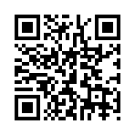
Try it out…
Go to Coops UK Open data page with the QR code
Download Organisation Data
Open data and filter by Registered State/Province
(Column I) selecting your place (e.g. Greenwich)
  Note number of coops (rows)
Filter by FCA Reporting Class (column L) selecting ‘Social Clubs’
  Note number of social clubs (rows)
Remove reporting class filter and browse list

Slide 12
Identifying Priority Objectives: Key strategies
Any high-level local partnership strategy
Economic Strategy or Community Wealth Building Strategy
Joint Strategic Needs Assessment
Health & Wellbeing Plan
Environmental Strategy
Housing Strategy
Transport Strategy
Community Safety Strategy
Council Plan

Slide 13





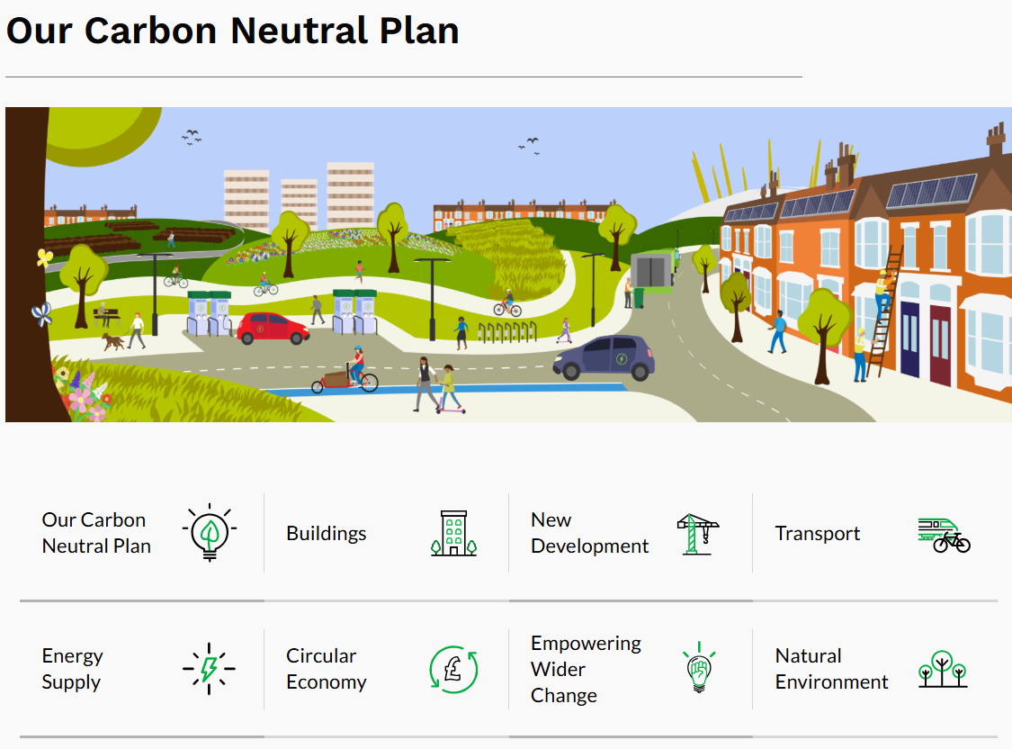
Key Strategies for Greenwich

Slide 14
Key Goals…

Slide 15
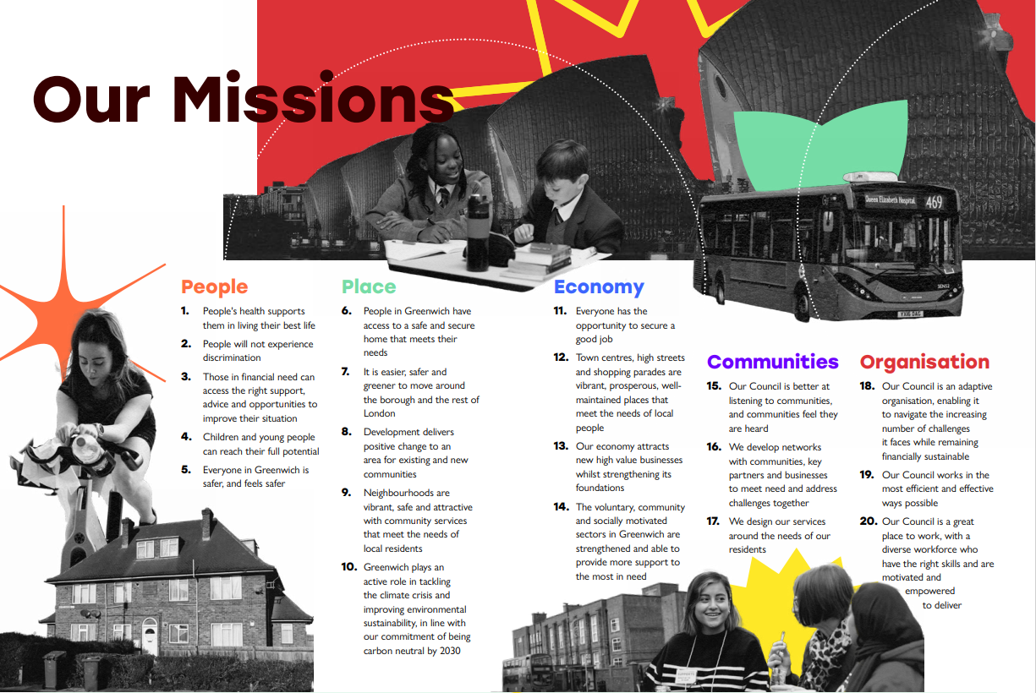
Worker coops
Community-led housing
Community land trusts
Community land trusts
Community Benefit societies

Slide 16
Try it out…
My key strategies…
My key goals…

Slide 17
The Greenwich Economy…
Worker coops / employee ownership
Procurement
Community shops
Smart coop / Worker coop
Care coops
Community-led housing & land trusts

Slide 18
Market Failures
Access to affordable quality food
Access to affordable housing
Access to affordable childcare
Reduction in community spaces
Exploitative employment practices in some sectors
Extractive real estate sector that promotes speculative investment
Increasing rental costs forcing out local retail & leisure businesses

Slide 19
Taking action
4
Who are my stakeholders and partners?
Areas for Action
Theory of Change
Finance
Measuring Impact

Slide 20
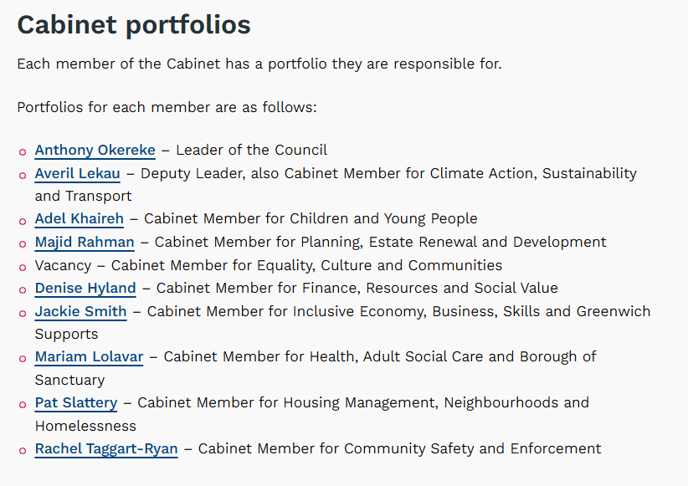
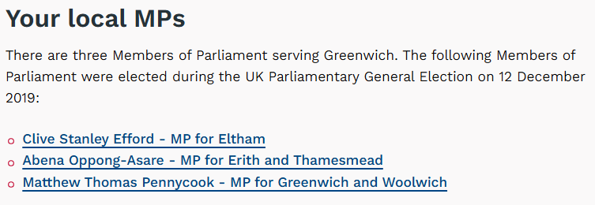





Who are my stakeholders?

Slide 21
Action Plan & Theory of Change
Area
Intervention
Outputs
Outcomes
Assumptions

Slide 22
Action Plan & Theory of Change
Area
Intervention
Outputs
Outcomes
Coop Awareness campaign
Coop option training
Professionals and entrepreneurs with increased understanding
Entrepreneurs consider coop option and/or are encouraged to
Training for social entrepreneurs
Social media campaign
Residents better understand coops and their contribution
Increased local spend with coops and other SEs
Revised policies for procurement, asset transfer, ACV and planning (esp. community-led housing)
More supportive policy environment for coops & social enterprises (SEs)
Higher # of registered ACVs
Policy Review
Higher # of CLH planning apps
Revised approach to business support promoting alternative business models
More appropriate business support for coops & SEs
Higher # of new coops
Business support
Identify opportunities to promote coop development through procurement
New coops developed and coops with public contracts
Increase of public spend £ with coops
Procurement
Assumptions
Legislative context remains broadly similar
People will start coops if they understand them better
Coops able to engage with procurement processes
Professional services sector able to provide support following awareness raising

Slide 23
Q&A
Jonathan Nunn
Policy & Partnerships Lead, Kirklees Council
jonathan.nunn@kirklees.gov.uk

