Slide 1

Welcome AGM starts at 0830

Slide 2


Slide 3

Annual General Meeting
13 February 2025

Slide 4

Cllr Jim Robbins
Chair of the CCIN Leader Swindon Borough Council
@jimrobbins | @jimrobbins.bsky.social @SwindonCouncil

Slide 5
Agenda
Welcome, introductions and apologies
Minutes of the last meeting – 2 November 2023
Review of the Year: Aug 2023 – July 2024
Budget Report 2023/4
Report back from Values & Principles Board
Care Leaver Protected Characteristic
Launch of 2025 funding round
Policy Lab Report Launch
Tackling the Barriers to Developing the Coop Economy
Any Other Urgent Business

Slide 6

Councils who are committed to finding better ways of working with local people
Action focused
Membership-based
Open to all UK councils
Part of the local govt family

Slide 7

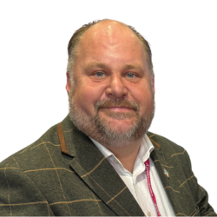
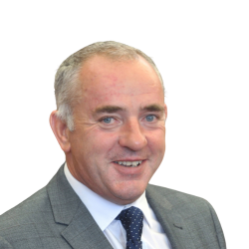
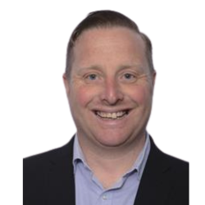

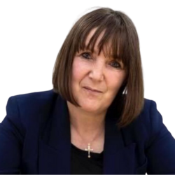


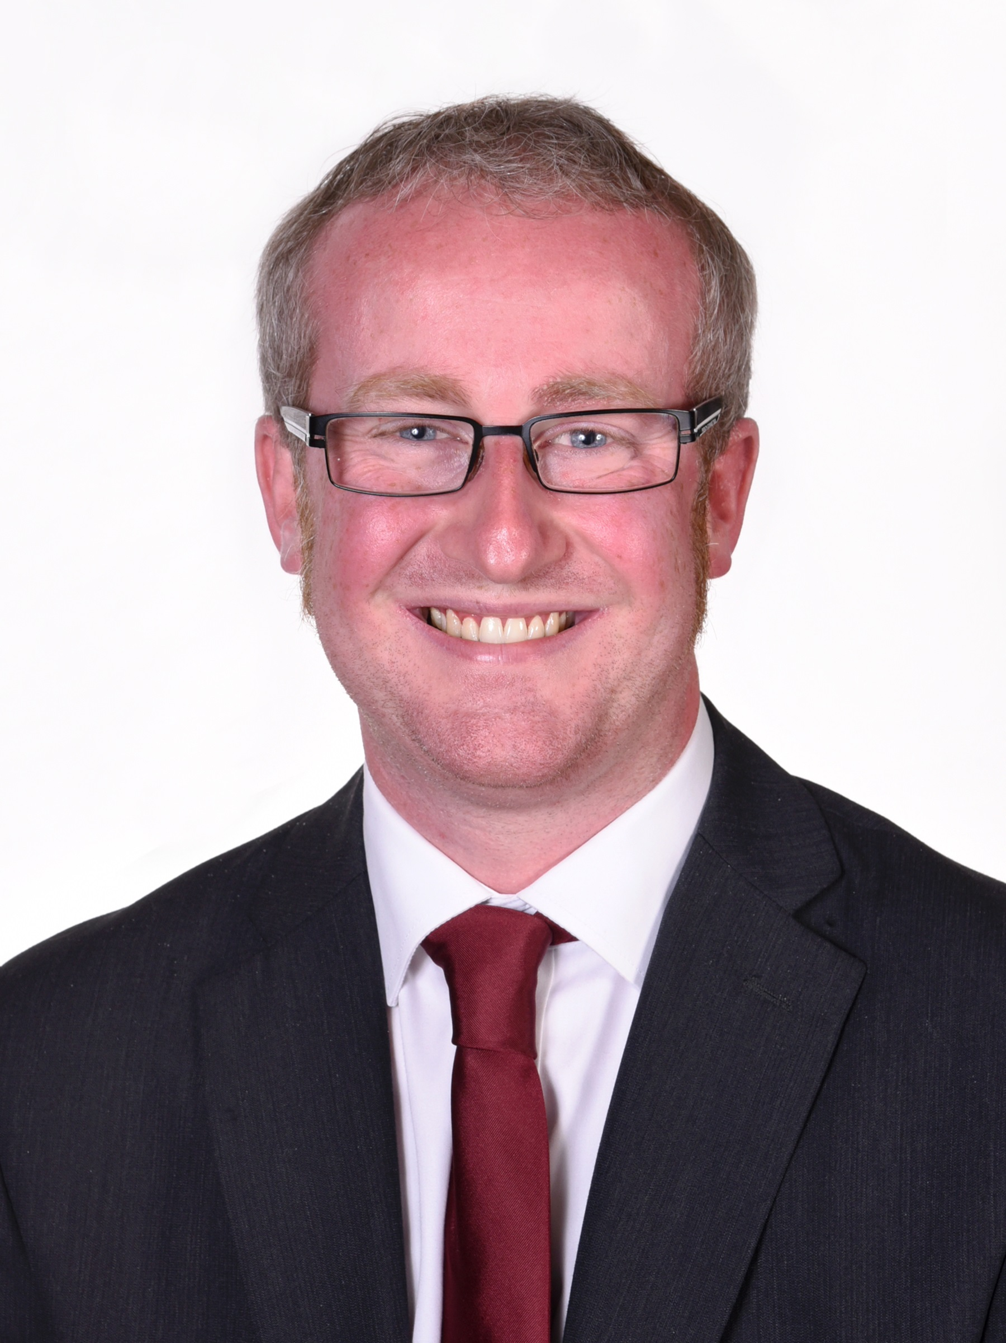
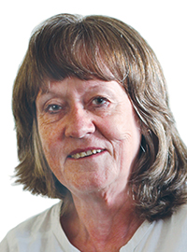
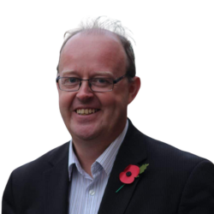
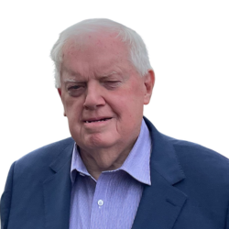

Executive Oversight Committee 2024-6
Cllr Jim Robbins
Chair of CCIN
Swindon Council
Cllr Ernest Gibson
Vice Chair of CCIN
South Tyneside Council
Cllr Peter Bradbury Cabinet Member Cardiff Council
Cllr Sandra Barr
Cabinet Member
Stevenage Borough Council
Cllr Kelly Middleton
Cabinet Member
Telford & Wrekin Council
Cllr Sue Smith
Cabinet Member
Rochdale MB Council
.
Cllr Shanika Mahendran
Cabinet Member
Milton Keynes City Council
Cllr Paul Cassidy
Vice-Convenor
Inverclyde Council
Cllr Barbara Brownridge
Cabinet Member
Oldham Council – Accountable Body
Cllr Mike Stubbs Newcastle Under Lyme Labour Group
Cllr John Fahy
Chair – Greenwich Coop Development Agency
Cllr Mili Patel Chair of V&P
Brent Council

Slide 8
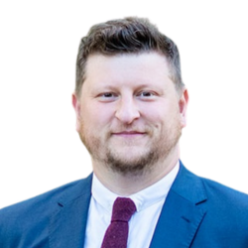

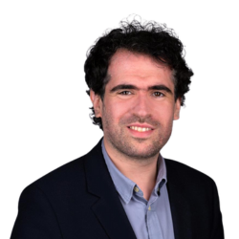
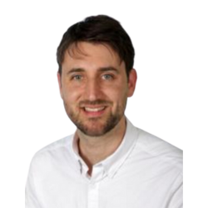
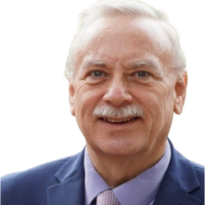
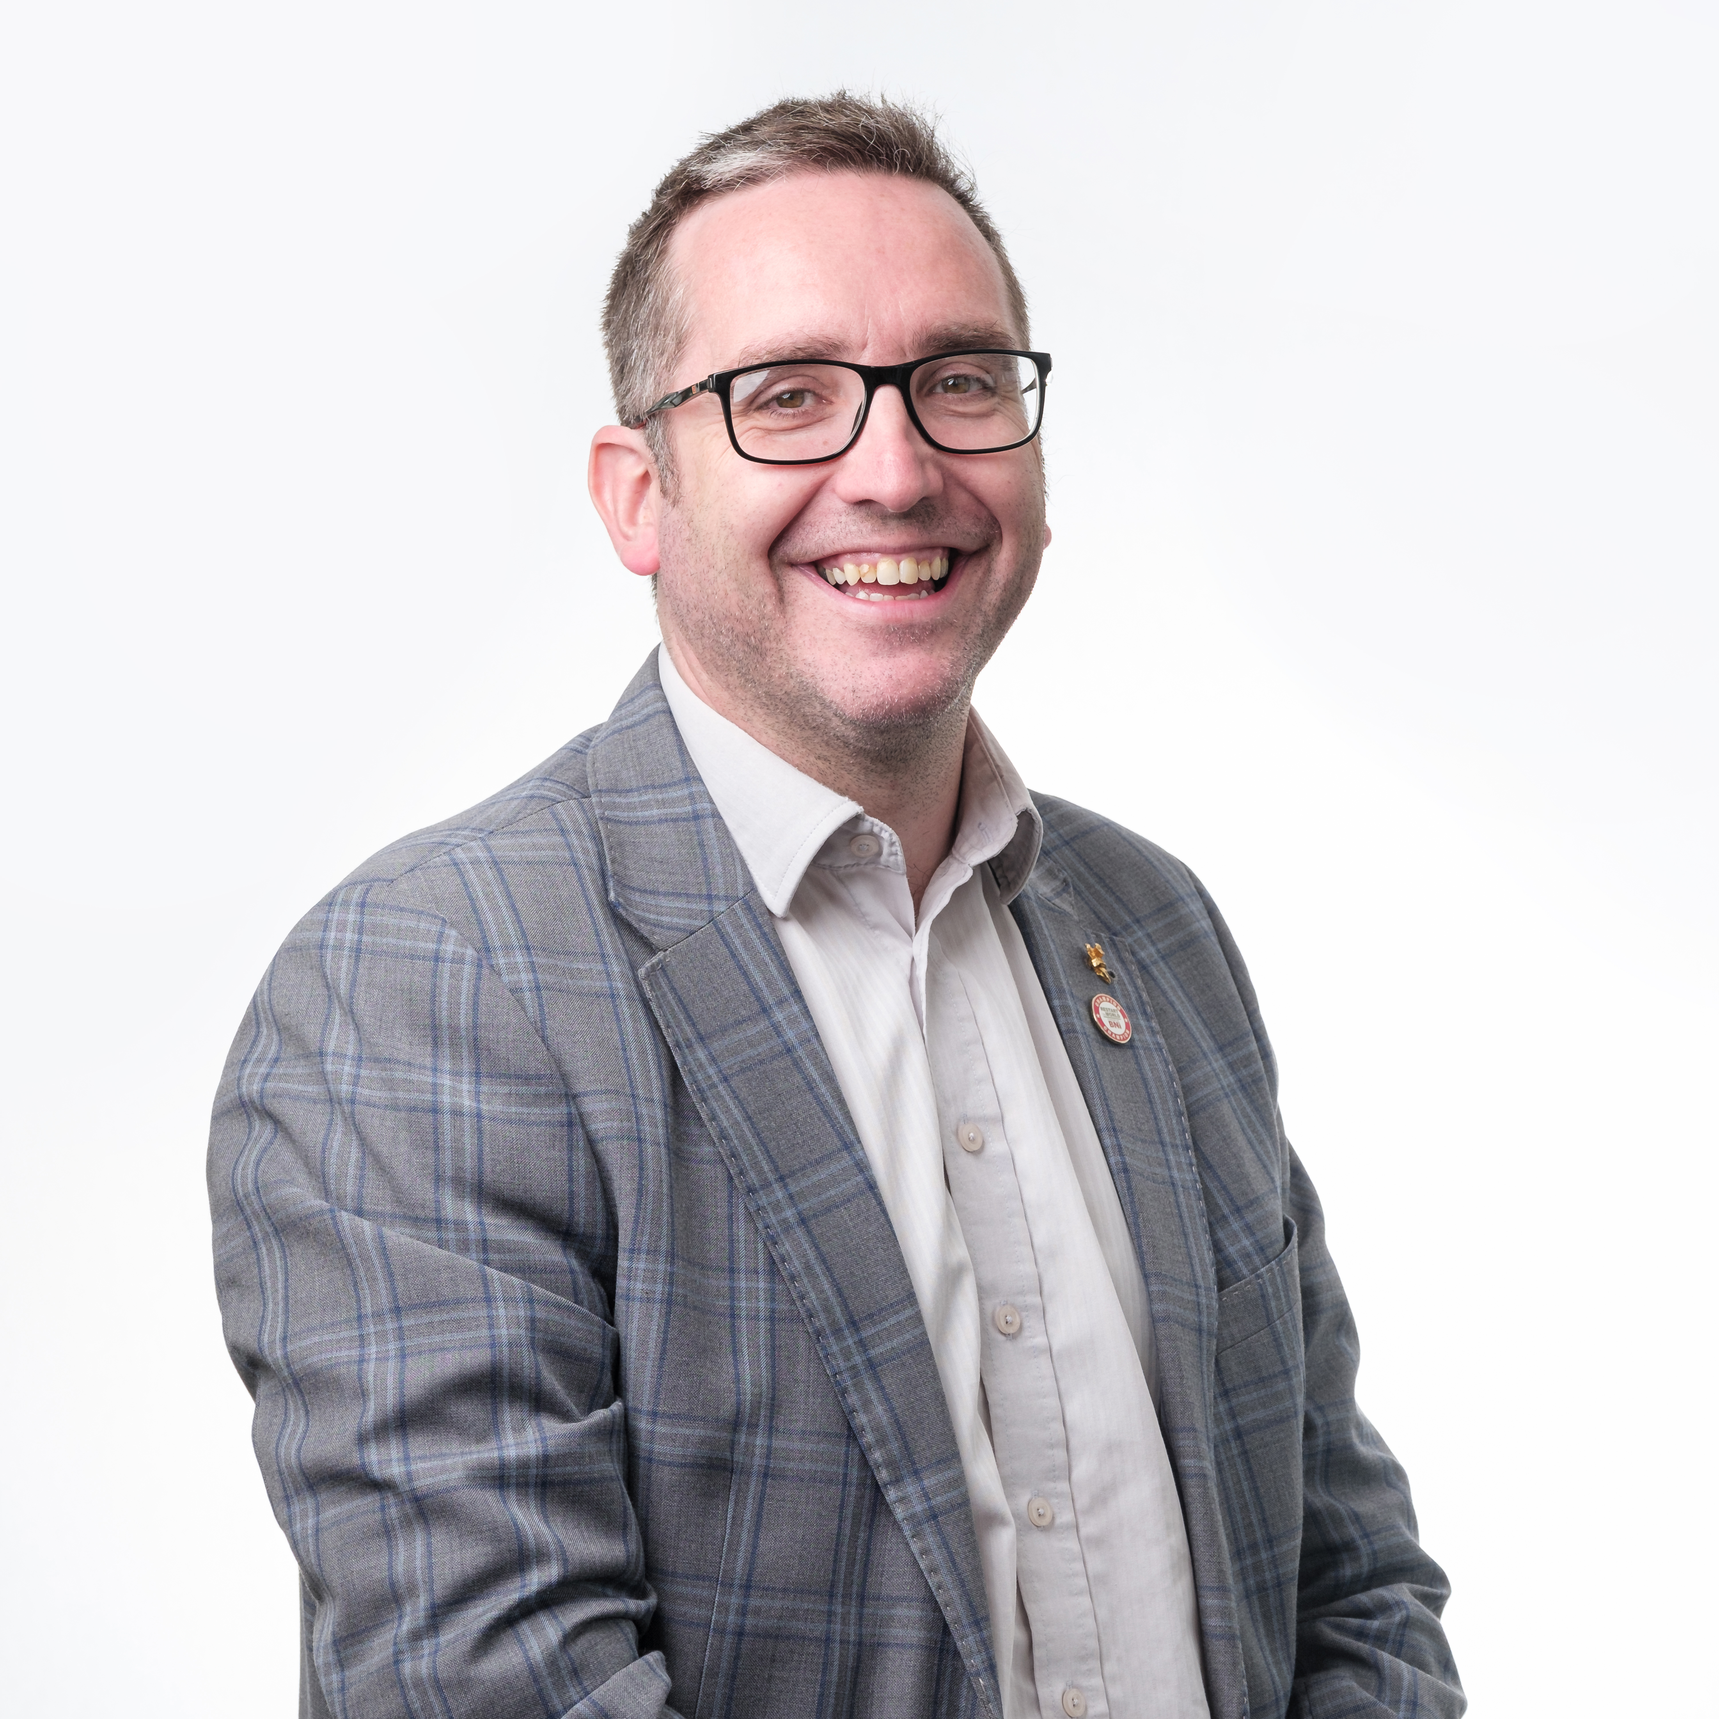
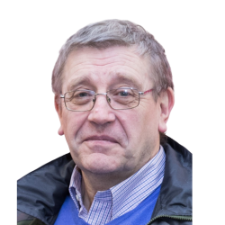
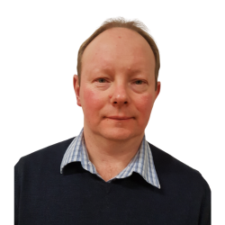
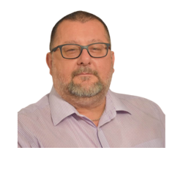
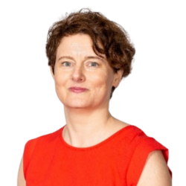
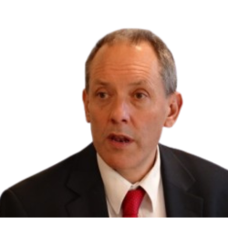





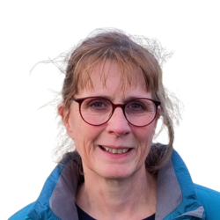
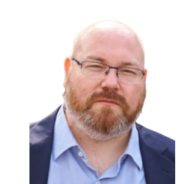
Values & Principles Board 2024-26
Cllr Mili Patel Chair of V&P
Brent Council
Cllr Alistair Willoughby Vice Chair North Herts Council
Cllr Lisa Denson Cheshire West & Chester Council
Cllr Sam Pallis Hackney Council
Cllr Rudi Schmidt Lewisham Council
Cllr Peter Curling Hillingdon Labour Group
Cllr David Darkin
Llanelli Town Council
Cllr Dave Griffiths
South Swindon Parish Council
Cllr Dave Grocott Kidsgrove Labour Group
Cllr Michael Osborne North Warks Labour
Claire Ward Anthony Collins LLP Vice Chair
Jonathan Bland SBI/E3M
Jo Hannon
Your Coop Business
Solutions
Rebecca Harvey
Cooperative News
Liz McIvor
Cooperative Heritage Trust
Cheryl Barrott
Cooperatives UK
Gareth Dowling
Cooperative Party
Jo White
Cooperative Futures
Paul Bell Unison

Slide 9
121 Members 21 Supporters
45
25
51

Slide 10













































45 Councils 12.5m citizens £20.4bn budget

Slide 11
























Slide 12




















































Slide 13
Agenda
Welcome, introductions and apologies
Minutes of the last meeting – 2 November 2023
Review of the Year: Aug 2023 – July 2024
Budget Report 2023/4
Report back from Values & Principles Board
Care Leaver Protected Characteristic
Launch of 2025 funding round
Policy Lab Report Launch
Tackling the Barriers to Developing the Coop Economy
Any Other Urgent Business

Slide 14
Agenda
Welcome, introductions and apologies
Minutes of the last meeting – 2 November 2023
Review of the Year: Aug 2023 – July 2024
Budget Report 2023/4
Report back from Values & Principles Board
Care Leaver Protected Characteristic
Launch of 2025 funding round
Policy Lab Report Launch
Tackling the Barriers to Developing the Coop Economy
Any Other Urgent Business

Slide 15
Highlights from 2023-4
Approved funding for three Policy Labs & five Policy Prototypes
Published a new Case Studies Pack
Published 534 Case Studies on our website: www.councils.coop
Update the Welcome Pack for 2024
Organised a Study Visit to Emilia-Romagna for 25 Councillors, Officers and Affiliate members
launched two Policy Lab Reports
Arts and Culture for Social Cohesion
This is not a Manual on Coproduction

Slide 16
2024 Event Calendar
19 Jan
Westminster City Council - CCIN event
10-11 Feb
Labour Local Government Conference – Warwick University
22 – 24 October
LGA Conference & Exhibition - Harrogate
22 – 25 Sept
Labour Party Conference - Liverpool
11 – 15 March
Study Visit to Emilia-Romagna
3 Dec
Democratic Business Summit Cardiff
14 – 15 June
Cooperatives UK Congress - Birmingham
14 - 17 Sept
Liberal Democrat Party Conference - Brighton
12 Oct
Cooperative Change Manchester
16 July
New Member Welcome online
December
Cooperative Values Driven AI Online
16 Nov
Welsh Labour Conference Llandudno
19 Nov
Coops and the Council event Glasgow

Slide 17

What you can do as a council
Signed the ‘Councils for Fair Tax' Declaration
Pay Real Living Wage
Are part of a Real Living Wage City/Borough/Town
Signed the ‘Modern Slavery’ Charter
Identified a Cooperative Champion (Member &/or Officer) for the council
Actively encourage co-op innovation within staff teams
Playing a central-role in tackling the Climate Emergency

Slide 18
community wealth building
Promote a progressive procurement policy
Support the creation of a regional mutual/community bank by investing
Work with local anchor institutions to buy and recruit local
Regulate rent and rates for ‘local’ businesses in council-owned property
Offer business rate rebates for those businesses that become Living Wage Accredited
Champion Local Employment schemes
Have insourcing Council Services as an objective

Slide 19
cooperative placemaking
Develop a cooperative development strategy
Establish a cooperative development network
Commit to community engagement in local decision making including participatory budgeting
Invest in local community production, particularly those focusing on community energy to tackle the climate emergency
Promote the circular economy
Support local enterprises to convert into coops/worker coops
Have an Asset Transfer policy to manage land and assets which support Community Land Trusts

Slide 20
Active Policy Labs
Tackling Violence Against Women and Girls – Lead: Trafford
Social Value Toolkit for Councils – Lead: CCIN
BEING Cooperative:
towards a model of
brave and inclusive
governance in local
govt Lead: Rochdale
Taking a coop approach to tackling health inequalities – Lead: Westminster

Slide 21
Policy Prototypes 2023
Engaging & Empowering the residents of Woolwich Common Estate – Greenwich Council
Co-operative Community Bank of Kindness – Stevenage Borough Council
Turning Strategic Plans into Art – Inverclyde Council
Cooperative Culture Making in Rochdale – Rochdale Council
Health and wellbeing support delivered via a Community Wellbeing Project – Brent Council

Slide 22
Dynamic Purchasing System
Allows new suppliers to join at any point
Mini Competition must be undertaken when using the DPS, ensuring the CCIN is promoting industry best practice
As pre-checking has already been done, there are no financial limits on the mini-competition process
5-year contract 2020-2025
Councils often need to move quickly and flexibly to be on the front foot when it comes to ‘doing things differently’.
Sometimes it is necessary to bring in extra capacity and specific expertise to be able to do this, and there can also be a need to seek independent challenge to test assumptions and policy design

Slide 23
















DPS Suppliers 2020 - 2025

Slide 24
2023 Event Calendar
28 Jan
North & East & Cumbria Coop Party Regional Conference
17 - 19 Feb
Scottish Labour Conference - Edinburgh
11 - 12 Feb
Labour Local Government Conference - Nottingham
4 – 6 July
LGA Conference & Exhibition - Bournemouth
19 - 20 May
Stir to Action Urban Playground – Trafford, GM
23 - 26 Sep
Liberal Democrat Party Conference - Bournemouth
8 – 11 Oct
Labour Party Conference - Liverpool
12 – 14 March 2024
Study Visit to Emilia Romagna
3 March
National Association of Local Councils (NALC) – London
1 – 2 Nov
Annual Conference & AGM - Sunderland
11 - 12 March
Welsh Labour Conference - Llandudno
17 - 18 June
Cooperatives UK Congress - Manchester
18 June
Coop Party Local Government Conference - Manchester

Slide 25
Agenda
Welcome, introductions and apologies
Minutes of the last meeting – 2 November 2023
Review of the Year: Aug 2023 – July 2024
Budget Report 2023/4
Report back from Values & Principles Board
Care Leaver Protected Characteristic
Launch of 2025 funding round
Policy Lab Report Launch
Tackling the Barriers to Developing the Coop Economy
Any Other Urgent Business

Slide 26
ITEM 4
Jonathan Downs
Corporate Policy Lead Oldham Council
@OldhamCouncil

Slide 27
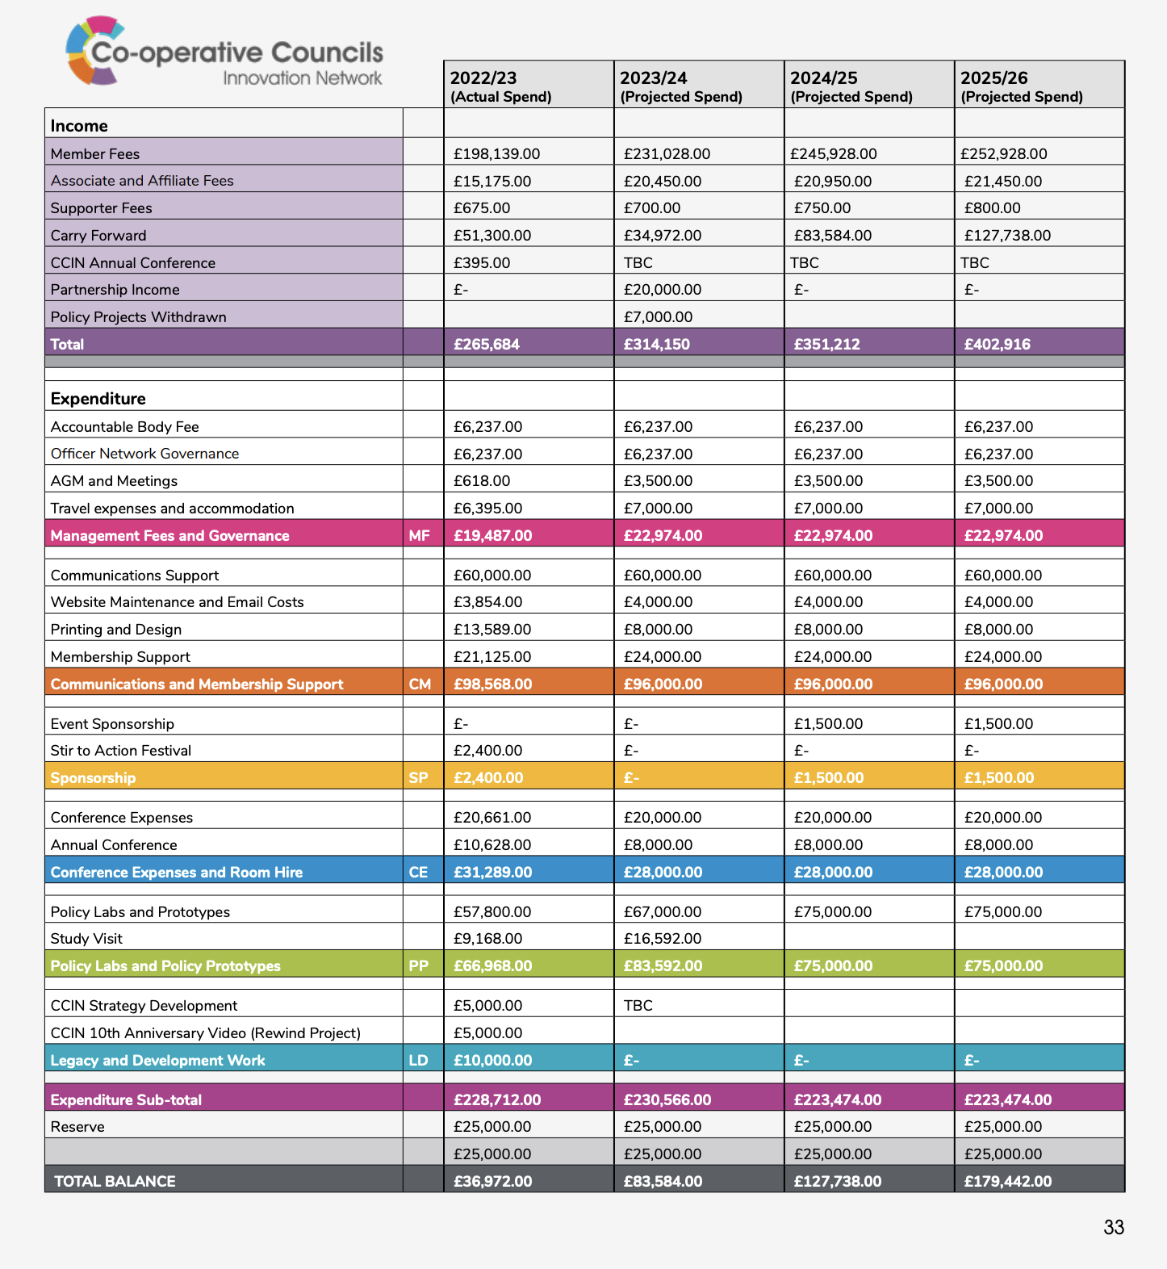
Budget Report 2023/24

Slide 28
Agenda
Welcome, introductions and apologies
Minutes of the last meeting – 2 November 2023
Review of the Year: Aug 2023 – July 2024
Budget Report 2023/4
Report back from Values & Principles Board
Care Leaver Protected Characteristic
Launch of 2025 funding round
Policy Lab Report Launch
Tackling the Barriers to Developing the Coop Economy
Any Other Urgent Business

Slide 29
ITEM 5
Cllr Mili Patel
Chair of Values & Principles Board Deputy Leader – Brent Council
@MiliKPatel | @Brent_Council

Slide 30
Values & Principles Board 2024-26
Cllr Mili Patel Chair of V&P
Brent Council
Cllr Alistair Willoughby Vice Chair North Herts Council
Cllr Lisa Denson Cheshire West & Chester Council
Cllr Sam Pallis Hackney Council
Cllr Rudi Schmidt Lewisham Council
Cllr Peter Curling Hillingdon Labour Group
Cllr David Darkin
Llanelli Town Council
Cllr Dave Griffiths
South Swindon Parish Council
Cllr Dave Grocott Kidsgrove Labour Group
Cllr Michael Osborne North Warks Labour
Claire Ward Anthony Collins LLP Vice Chair
Jonathan Bland SBI/E3M
Jo Hannon
Your Coop Business
Solutions
Rebecca Harvey
Cooperative News
Liz McIvor
Cooperative Heritage Trust
Cheryl Barrott
Cooperatives UK
Gareth Dowling
Cooperative Party
Jo White
Cooperative Futures
Paul Bell Unison

Slide 31

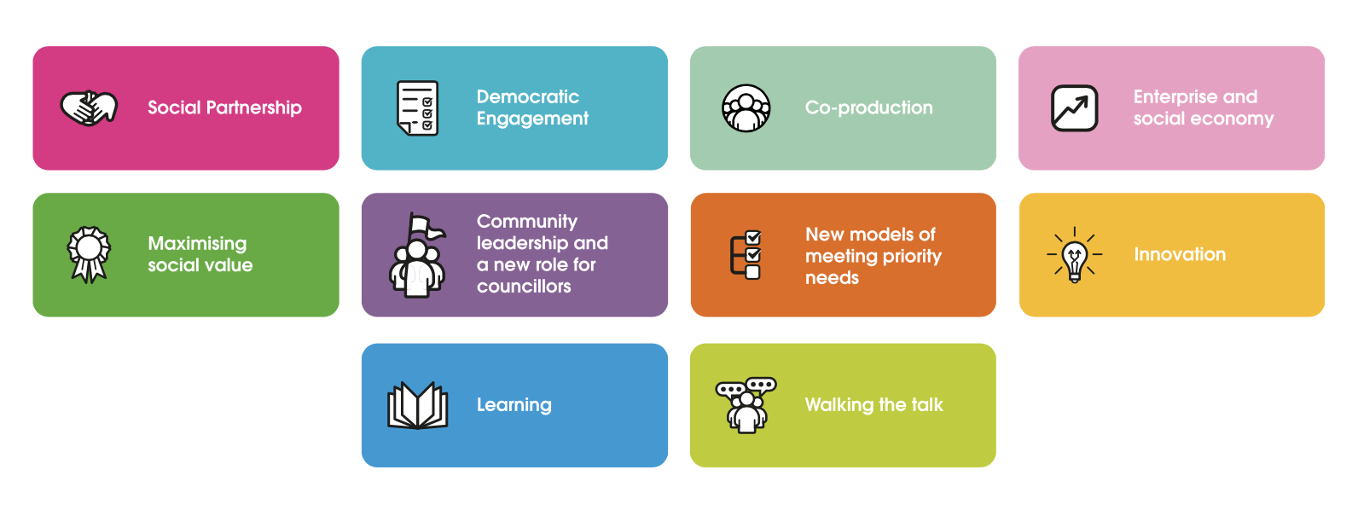

Slide 32
These icons demonstrate how Co-operative Councils are putting our co-operative principles into practice, demonstrating the #cooperativedifference in the work that they are doing.

Slide 33

Item 3
https://bit.ly/CCIN-Review-23-24

Slide 34
Agenda
Welcome, introductions and apologies
Minutes of the last meeting – 2 November 2023
Review of the Year: Aug 2023 – July 2024
Budget Report 2023/4
Report back from Values & Principles Board
Care Leaver Protected Characteristic
Launch of 2025 funding round
Policy Lab Report Launch
Tackling the Barriers to Developing the Coop Economy
Any Other Urgent Business

Slide 35
ITEM 6
Terry Galloway
Care Leaver as a Protected Characteristic

Slide 36
Agenda
Welcome, introductions and apologies
Minutes of the last meeting – 2 November 2023
Review of the Year: Aug 2023 – July 2024
Budget Report 2023/4
Report back from Values & Principles Board
Care Leaver Protected Characteristic
Launch of 2025 funding round
Policy Lab Report Launch
Tackling the Barriers to Developing the Coop Economy
Any Other Urgent Business

Slide 37
Cllr Ernest Gibson
Vice Chair of the CCIN Executive Oversight Committee South Tyneside Council
ITEM 7
@ErnestGibson|@STyne_Council

Slide 38
How to get involved in Policy Labs and Policy Prototype Bids in 2025

Slide 39
CCIN Policy Lab & Prototype funded projects
Member led projects to find co-operative policy solutions to the challenges facing local government. Open to all ideas, the more innovative the better!
Policy Labs - more significant collaborative pieces of work that CCIN members work on together and eligible for between £10,000 - £20,000 of funding.
Policy Prototypes - smaller projects delivered in a specific locality on behalf of the Network and eligible for up to £2,000 of funding.

Slide 40
Key points of 2025 process
Policy Labs –
£60k total budget
24 months to deliver
Policy Prototypes –
£15k total budget
12 months to deliver
Notes:
For Policy Labs We recommend engaging a minimum of three other CCIN members to create a working group to support the development of your project. We welcome applications from all Members, but the application must be submitted and overseen by a Full Member Council. Members will have up to two years to deliver a Policy Lab. Applications will be considered for funding of up to £20,000, dependent on their scale and ambition.
Policy Prototypes are smaller projects for members who want to deliver in their locality on behalf of the Network. This funding is available to councils of all sizes, Opposition Groups and Minority Administrations. Members will have up to nine months to deliver a Policy Prototype. Applications will be considered for funding of up to £2,000.

Slide 41
Timetable for Policy Bids 2024/25
Dates
13 February 2025 | Launch at Annual Conference
13 March 2025 | Closing date for submission of all Bids
19 March 2025 | EOC & V&P Board consider Bids
21-28 March 2025 | Bidders are asked to respond to any further questions raised by Governance
w/b 7 April 2025 | Sign-off of successful bids by EOC
28 April 2025 | Contracts awarded/work starts
For more information visit https://bit.ly/CCINbids25

Slide 42
Agenda
Welcome, introductions and apologies
Minutes of the last meeting – 2 November 2023
Review of the Year: Aug 2023 – July 2024
Budget Report 2023/4
Report back from Values & Principles Board
Care Leaver Protected Characteristic
Launch of 2025 funding round
Policy Lab Report Launch
Tackling the Barriers to Developing the Coop Economy
Any Other Urgent Business

Slide 43

Policy Lab Launch 2025

Slide 44
Tackling Barriers to Building a Cooperative Economy
Policy Lab authors:
Gareth Nash, Co-operative and Mutual Solutions
Jo White, Co-operative Futures
Cliff Mills, Anthony Collins
Graham Mitchell, Innovation.coop

Slide 45
Introduction
We don’t really have a UK cooperative economy
Why not? Giving the wrong answers to key questions:
Why are cooperatives different from other businesses?
What is the value of cooperative ways of working?
How can we go about fostering the right environment for the to thrive?
The barriers?
Coops have a fundamentally different purpose, rather than structure
Lack of understanding, of institutions, of custom and practice to underpin a collaborative economy (trying to do it with market mechanisms)
Fear of asserting a preferable purpose: the common good, not private gain

Slide 46
(more barriers)
Unquestioning faith in market-based mechanisms and profit motive
Projecting cooperatives as “a model”, or “alternative business option”
Limited examples of UK coops radically challenging status quo
Little understanding of what collaborative enterprise looks like
Tools for collaboration under-developed, expertise scarce
Public procurement based on contracting, failing to adopt cooperation
This is intentionally provocative!

Slide 47
Phase 1: desktop survey of best practice
Given barriers, there isn’t any; but some good practice
National, regional and sectoral/thematic programmes can be effective when sufficiently resourced. Often they aren’t
Local LA-supported programmes can foster a culture of cooperation and develop business clusters
Uneven spread of knowledge/expertise. Local access networked into communities of practice can help to keep costs low
Education of intermediaries can build awareness
Fostering a culture of cooperation generates a fertile soil
Cooperative development doesn’t fit neatly into LA org chart
It is multifaceted involving many different parties
Climate crisis; inequality crisis

Slide 48
Phase 2: survey of Council support
Conclusions
Only 2 LAs are explicit in their support for cooperatives
Some mention social enterprise and community businesses in policies and strategies. SE support often alongside support for VC and F
One strand of Community Wealth Building is plural ownership of the economy; some refer to inclusive or plural economy. Coop economy virtually absent
Some coop hotspots (Alston, Lancaster)
Fragmented awareness of coops
Technical support and expertise geographically dispersed. Vital that LAs, anchors and business support is networked with coop advisors/sector

Slide 49
Phase 3: What can local authorities do?
Can’t keep doing the same and expect different results
Need to acknowledge the difficulties and challenges
Must address the barriers
Make the argument: cooperation is better than competition
Identify where and how you can act differently
Take actions that will encourage a cooperative economy
(Toolkit documents)

Slide 50


Questions and Discussion

Slide 51

Thank you

