Slide 1




CCIN Co-operative Case Studies
Blank Template

Slide 2
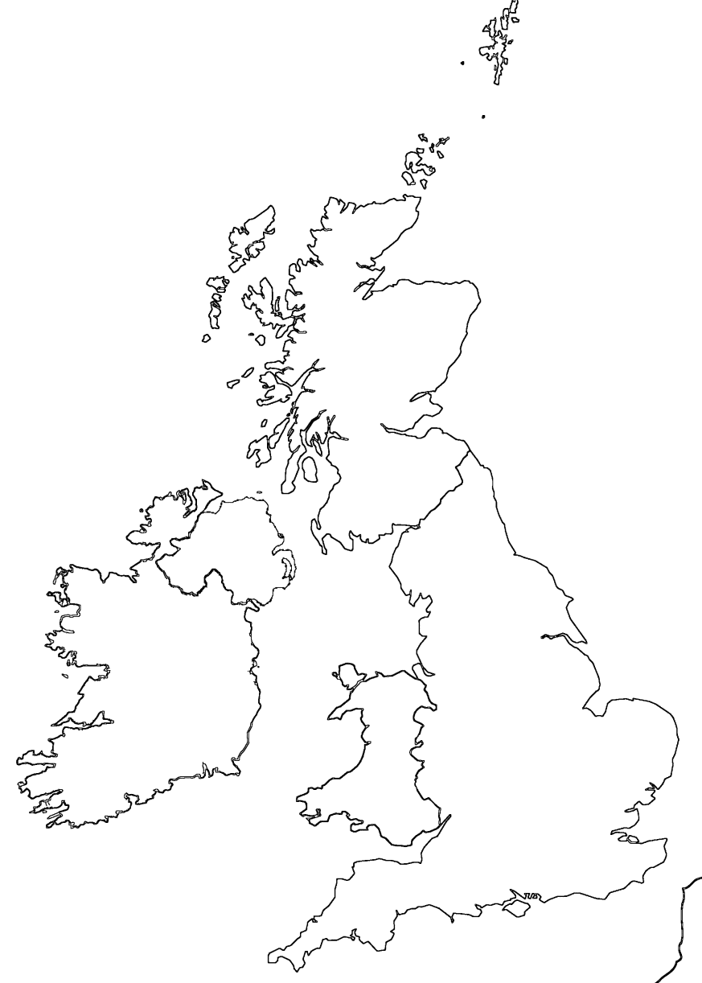
INSERT CO-OP NAME
OVERVIEW
DESCRIPTION
Registered Name
Date of Incorporation
Location
X
Legal Form / Structure
Ownership class
Type
Number of Members | 0
Number of Employees | 0
Number of Volunteers | 0
Turnover (2022/23) | £
INSERT LOGO HERE

Slide 3
KEY MILESTONES
X
X
X
X
X
X
X
X
X
X
BACKGROUND
X: X
X: X
KEY FEATURES
STRUCTURE
DECISION-MAKING
MEMBERSHIP
OPERATIONS

Slide 4
CHALLENGES
X
GROWTH AND/OR REPLICATION
X
X
X
X
X
X
X
SUPPORT
X
X
KEY MESSAGES / TAKEAWAYS
X
RELATIONSHIPS

Slide 5
RELATIONSHIPS

