Slide 1
Cooperative Councils Innovation Network
Discovering your
strategic priorities

Slide 2
About Us
A social enterprise that builds bridges between stories and strategy and commissioning
Using collaborative and participatory approaches
We help commissioners rethink the role of providers and citizens
We help people have open and honest conversations between professionals and communities
Understanding the resources and assets that already exist
Embracing power sharing
We help you to be brave!

Slide 3
This session
What we’ve done
How you work: what we heard and looking forward
Reflections
What you do: what we heard and looking forward
Reflections
Next steps
Notes:
Helen to add numbers

Slide 4
What we’ve done
1 to 1 calls with key people
Look Back, Move Forward online workshop
Survey of members
In-person ‘dreaming’ workshop in Birmingham
2 workshops at Annual conference
Notes:
Helen to add numbers

Slide 5
Who we interviewed:
Councillor Sue Howard – Burntwood Town Council
Jo White – Co-op Future
Michael Curnow – Human Engine
Jonathan Nunn – Kirklees Council
Ron Gregory – Stevenage Borough Council
Councillor Catherine Braun – Stroud District Council
Councillor Paul Cassidy – Inverclyde Council
Charlotte Dale – Lewisham Council
Jonathan Downs – Oldham Council
Notes:
Helen to add numbers

Slide 6
What we heard
Across the various engagement activities we have gathered multiple insights which we will aim to group in to themes here. These sit within two main areas
How you work: the cultures, values and mechanics of how you operate - modelling the future system you are aiming to create
What you do: the stuff to focus on and how to ensure you generate maximum impact from these activities - and the things to stop doing

Slide 7
Vision for CCIN
How: we are growing a movement
Notes:
note - growing a movement not servicing a network

Slide 8
What we heard: Modelling it
Hierarchy within CCIN between local, regional and community councils – may lead to people being reticent about contribute/ lead on work
Self-reliance is hard to put in place within current structures, over-reliance on Nicola, there isn’t always clarity about membership roles and what they should or can do
There is a lack of visible community members within the CCIN structures; also, individual supporters exist in small numbers and are not clearly visible in the network.

Slide 9
What we heard: Deeper not wider
There’s a motivation to join the CCIN from LAs as 25% of UK wide Councils are members and some LAs are concerned that they aren’t a CCIN member
There’s lots of support to people who play an active role in the network
It’s an important link to like-minded officers, Cllrs and individuals
Really interesting mix within the membership (LAs & affiliates) with opportunities to work together and network
Connection and resources often held by 1 or 2 people in the LA who don’t have authority - can mean the CCIN opportunities aren’t filtered into the organisation
Officers are often the people making it happen on the ground - they need to be a greater part of the CCIN offer
‘I’m not sure my colleagues know it’s there’ (Council officer)

Slide 10
What we heard: Deeper not wider
There’s some confusion about what being a Co-operative Council really means. Individuals might be clear, but co-operative principles & values aren’t always known within/ embedded within the organisations
‘It’s not just something we do when we have the time – it should affect admin, staff inductions, HR, etc…’ Council officer
Some Councils see it as community development priority rather than whole organisation so it is not always prioritised effectively
85% survey respondents said that supporting Councils to be more co-operative should be the focus of the CCIN for the next 5 years
‘It’s all about the culture – I don’t know how embedded Co-op principles are in our Council’ Council officer

Slide 11
What we heard: Diversity
There is limited diversity of voices, age, race, lived experience
Ambition is to be cross-party but still very much seen as an Labour Party initiative
England focused which misses insights from Scotland, Wales and Northern Ireland
Political link to Co-operative Labour Party not used enough. Co-op party have regional organisers and regional focus.
Could do more to support regional focus and benefit from learning from regional champions
The CCIN is often seen as too left wing and wouldn’t be a welcoming place for a Tory or Lib Dem cllr (cllr)

Slide 12
What we heard: Spreading the load
Same group of people are often turning up and it’s getting worse
Some people don’t have the time/ depth of knowledge or commitment to the group
Need to find a structure that enables members to take more ownership of the work
Self-help and self-responsibility are strong principles but people aren’t doing that when they become members
It becomes difficult to be involved as you become busier and can’t give the time and attention (affiliate member)

Slide 13
What we heard: Spreading the load
Concern that the current business model does not support the operational management now required to run the network
We need another Nicola! (Council officer)
How much you get from the CCIN often depends on how much you put in but people don’t always find it easy to get more involved
Time constraints was cited as one of the significant reason that respondents felt they couldn’t get involved
There needs to be a lighter touch which is more dynamic such as summaries of papers (affiliate member)

Slide 14
Moving Forward
Modelling it: build culture of councillors, officers and community members working and learning together, not replicating the broken structures that people struggle with in their own councils
Diversity: be proactive and explicit about improving the diversity of voices, age, race, lived experience
Deeper not wider: support existing CCIN members to deepen engagement with co-operative practice throughout their organisation
Spreading the load: explore technology based solutions that enable people to engage in different ways and to self-organise

Slide 15
Reflections

Slide 16
How you work - network or movement
Hub and Spoke Network
Strengths
centralised coordination
efficient and consistent communication
streamlined resource allocation
Weaknesses
capacity to manage and coordinate
lacks shared decision-making and mutual responsibility
collaboration curtailed, or bypasses hub

Slide 17
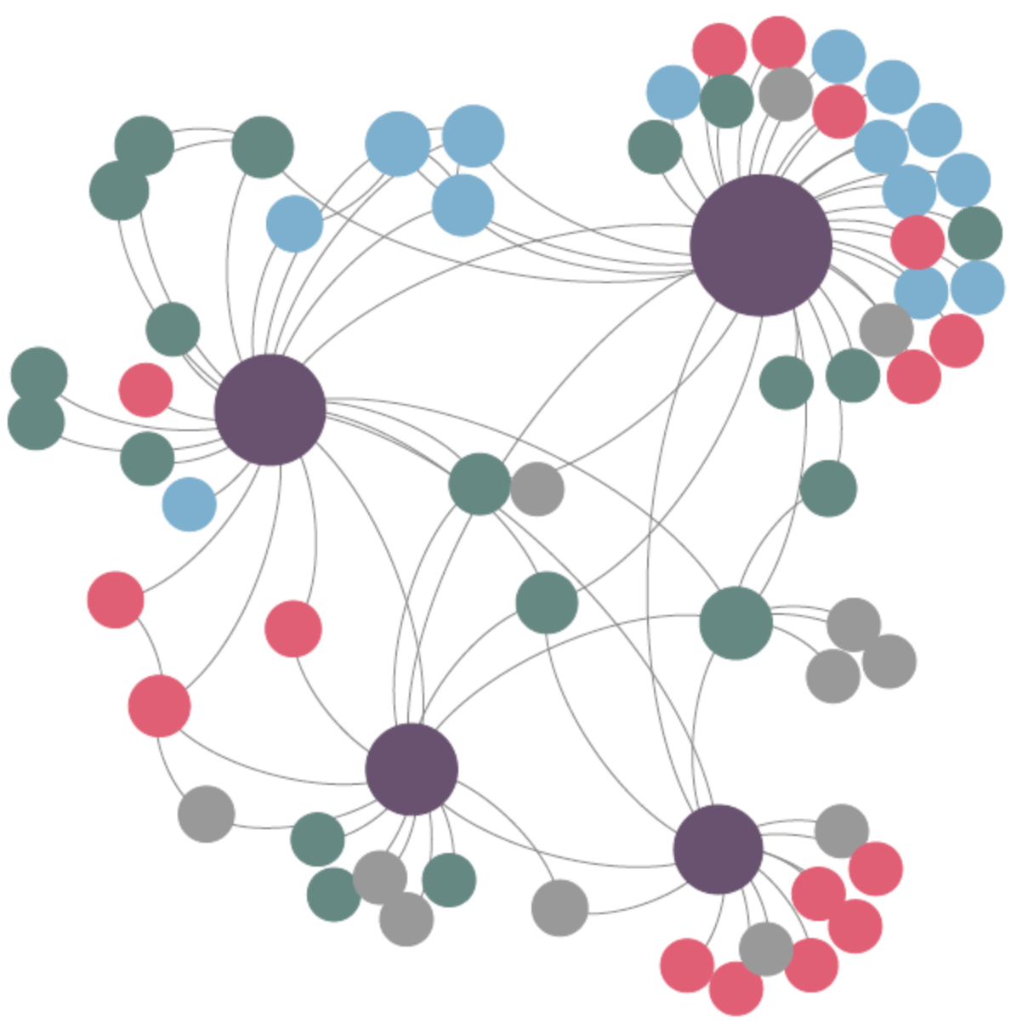
How you work - network or movement
Diversified network approach
Strengths
creates new opportunities for leadership
member driven approach brings new capacity and ideas
action oriented focused on what matters to members
Weaknesses
messy and unpredictable
needs platforms that enable people to connect
harder to track/ attribute impact

Slide 18
Vision for CCIN
What: Co-operation’s the way that we do things round here
Notes:
note - growing a movement not servicing a network

Slide 19
What we heard: Be louder, lobby better
Lots of support for CCIN to influence national policy and campaign on behalf of the members. Over 50% survey respondents agreed with this
Lacking a common, coherent critique of the current system and a strong story of the change needed
we want to change the world not just a few more ‘co-op islands’ (Affiliate member)
Impending general election is a big policy opportunity
Awareness within shadow cabinet increasing - LA cabinet members meet with MP’s and could promote/ endorse membership of the network
Policy needs time to develop ongoing relationships (regional & national)
Nicola used to spend time on policy work but it isn't happening now

Slide 20
What we heard: Be louder, lobby better
Need much bigger impact from the work already done
478 case studies are on the website plus additional downloadable reports
Need to review outcomes from Policy Labs over time, revisiting promising practice and what had developed from this
Need to celebrate the work that’s being achieved over time and track how local policy change flows from practical work already completed
Grow local practice areas that can champion cooperative innovation around specific challenges and can be visited by politicians, press and CCIN members

Slide 21
What we heard: More focussed
Policy Labs provide real life practical experience and action research and often help to jump start other initiatives locally
Enables people to develop something collaboratively and work together - much more engaged and practical than other options (e.g. LGA peer reviews)
Allow collaboration from across UK - very difficult for people to do this through other routes
Total proposals to labs has increased whilst total budget for them hasn’t kept up with growth of membership
Over 60% survey respondents said they’d like to take part in a Policy Lab in the future
Notes:
all about Policy Labs

Slide 22
What we heard: More focussed
Policy Labs were highlighted as useful for action learning but there is support for reworking/ rethinking implementation
Lab application and review processes are too lengthy and bureaucratic
Once funds are allocated there is no control from CCIN on how it’s spent
People unsure about value of case studies created - not used
Needs a total strategic rethink (hopefully this survey is part of that). The model of policy labs needs review - it feels uncoordinated, not joined up, and results in endless reports and case studies (that probably don’t get read or used) rather than building useful practical systems and resources that can save members time and money and accelerate their journey to being successful.

Slide 23
What we heard: More focussed
Currently Policy Labs don’t have national or local policy or practice impact
Survey responses show just over half members haven’t done anything different since being a member of CCIN
People want CCIN to prioritise what it wants to achieve so that members can galvanise around a challenging work area or a regional opportunity
Only 7% survey respondents said they used the dynamic purchasing system
Others concerned that it was an overly bureaucratic
Some highlighted that it doesn’t align with co-operative principles as a methodology

Slide 24
What we heard: Regional working
Over half the survey respondents stated that networking and learning from peers and best practice sites were the most beneficial factors;
Face-to-face sessions and conferences helpful, accessible and provide great opportunities for people to meet each other, build relationships and learn about what else is going on in the UK
Half of survey respondents said they attended the annual conference
English focus of CCIN can present barriers to those from Scotland, Wales and Northern Ireland
Regional devolution is an important theme - need more learning from Scotland and Wales
Need a balance between working at scale but local and regional identities matter to members

Slide 25
What we heard: Rigour and quality
Some confusion about what being a Co-operative council really means - the co-operative principles aren’t always known within organisations
CCIN should drive quality of practice, support internal challenge and critical friends
Tension for CCIN between relational, long-term work and producing lots of ‘new stuff’ - need to find a way to pool experience and focus on effectively measuring the impact of the long-term work

Slide 26
Moving Forward
Be louder, lobby better: Grow policy expertise and capacity and time to develop key regional and national relationships. Develop a strong story of the change you want to see that builds on existing and future Policy Labs
More focussed: Rework the Policy Lab approach. Target major policy areas (e.g. social care, housing), increase timescales for work, grow ‘champions’ who lead on practice and train/ mentor other CCIN members to implement locally. Disband the dynamic purchasing system
Regional working: Develop self-organised regional groups, picking up opportunities around devolution and devolved nations and allowing for local and regional working
Rigour and quality: Share good practice within the network - ongoing themes with regular webinars to deep dive into learning, develop communities of practice and ‘champions’ (areas leading on particular themes)

Slide 27
Reflections

Slide 28
Next Steps

