Slide 1
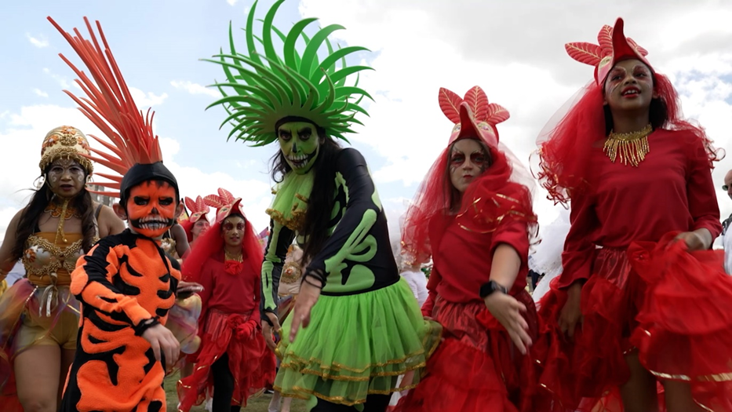
Arts & Culture for Social Cohesion Cllr Alistair Willoughby,
North Hertfordshire Council’s
Executive Member for Community & Partnerships

Slide 2
Why Arts & Culture
to demonstrate how culture and arts can be strong drivers of development, social cohesion, and change.
communities that have poor social cohesion also have poor involvement or access to civic participation, economic opportunity, and social engagement.
supporting the role of arts and culture in our communities we can build better and more meaningful social cohesion.
Cultural projects can be used to help to prevent conflicts within our communities and assist in resolving pre-existing conflict too.

Slide 3
Why Arts & Culture
Art can communicate across language barriers, it empowers people, and it facilitates social cohesion, including among our refugees, migrants, and host communities, which creates a stronger wider community.
It prevents marginalisation of people based on their cultural identity, socio-economic status, age, and other factors.
By increasing cultural offerings in town centres, encourages more people into the area which increases footfall, and the time people spend in our retail, hospitality and leisure businesses as well as other high street amenities.

Slide 4
The aim of our policy lab was to:
Widen engagement with arts and culture offerings by developing an understanding of how to reach a broader range of the community.
Understand what other kinds of arts and culture events/activities we could offer.
Understand which groups and voices were missing and could be better represented within our arts and culture activities (for example, this could include more LGBTQ exhibitions, or history events related to a particular culture)

Slide 5
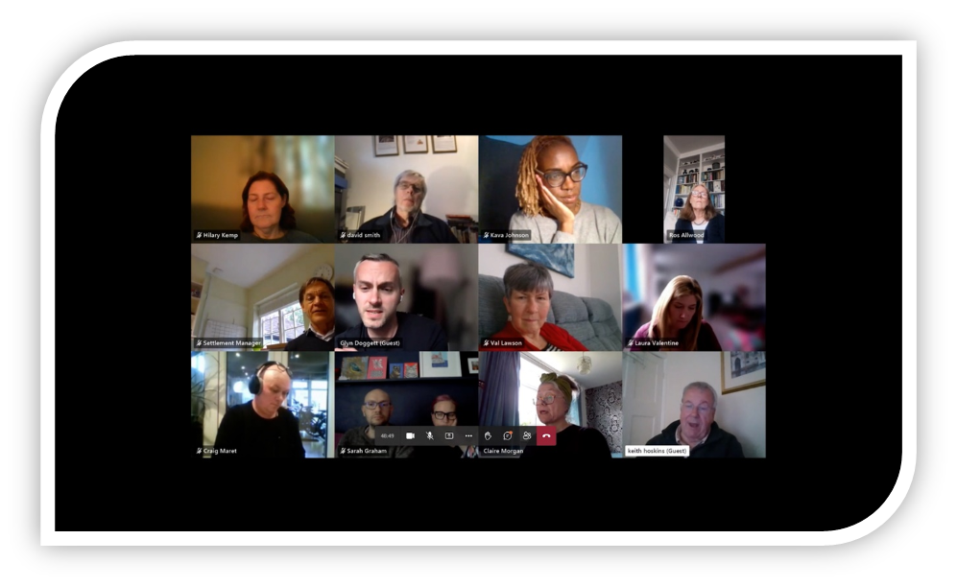
The CCIN Members
working in partnership

Slide 6
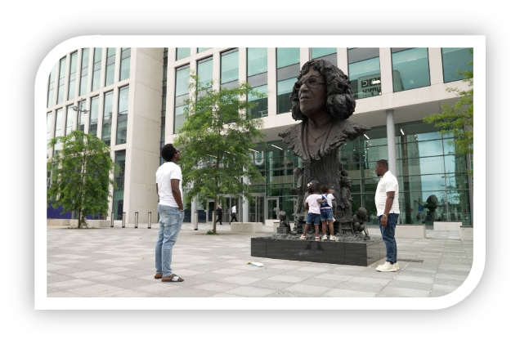
Cardiff Council
Their project centres around cultural activities during refugee week and celebrating the life of Betty Campbell. Betty Campbell was told that a working-class black girl could never succeed, and that her desire to become a teacher would face “insurmountable” problems. She is now immortalised in a statue in Cardiff; Wales' first black headteacher and responsible for putting Black culture and history on Cardiff's curriculum.

Slide 7
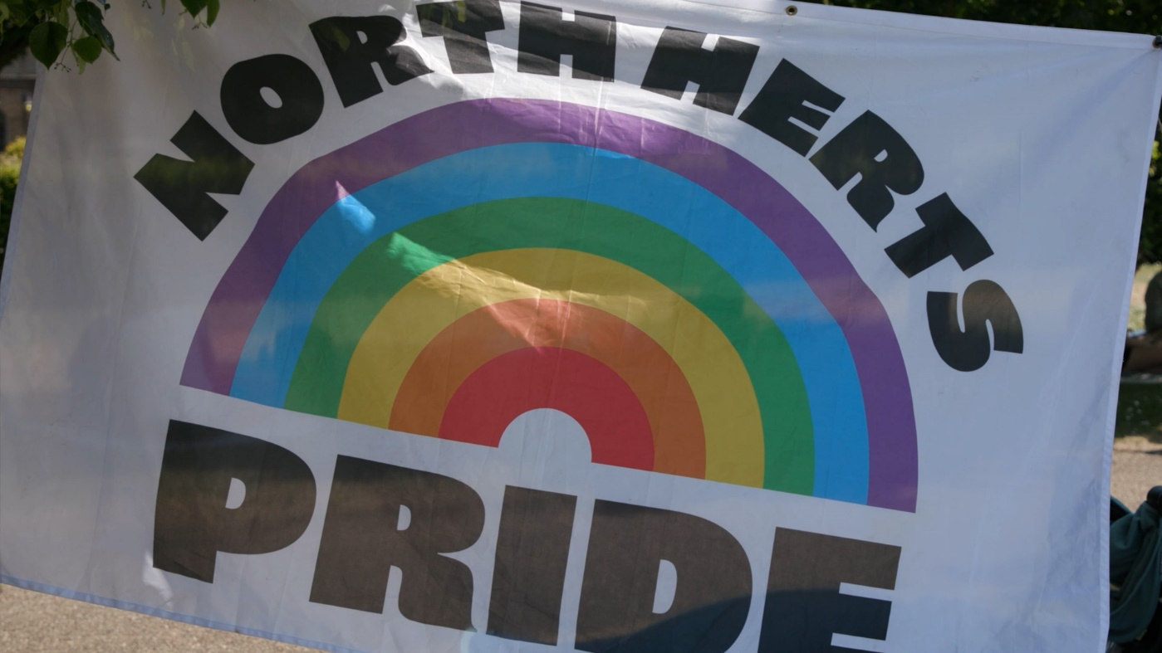
North Herts Council
focused on how our Arts & Culture Network brings people and their creativity together and helps to increase the vibrancy of our town centres. It focuses on the ‘place festival’ in each of our main town centres and highlights our LGBTQ+ community coming together at North Herts Pride

Slide 8
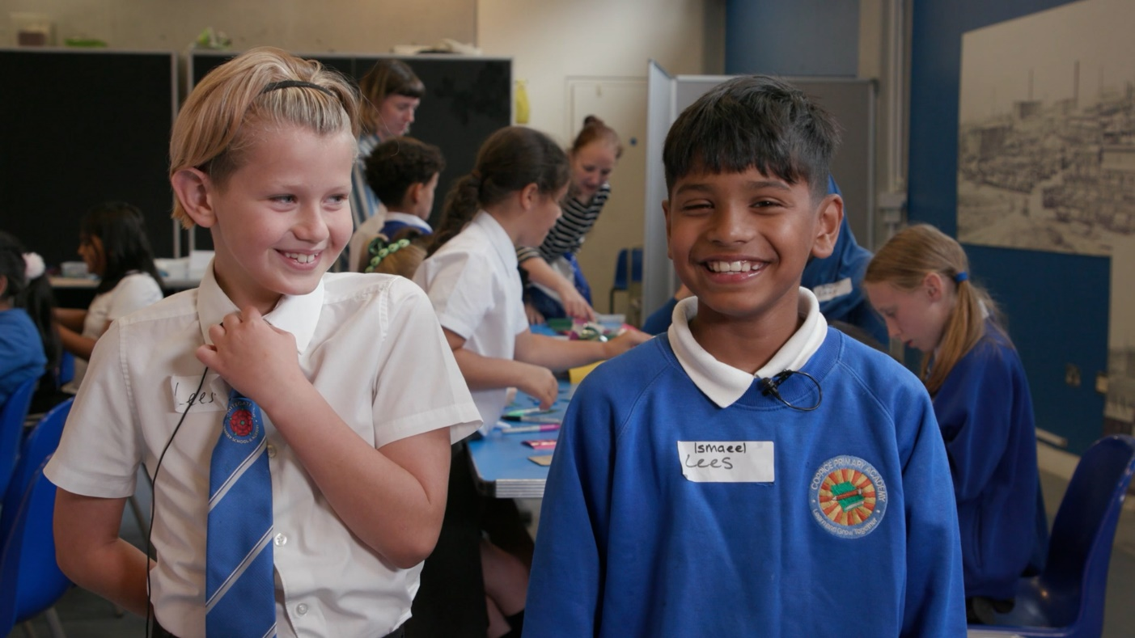
Oldham Council
Outlines the benefits of their Linking Schools Programme and highlights an initiative to bring school children together from different communities to work on arts activities that encourage learning about each other, their differences, and similarities.

Slide 9
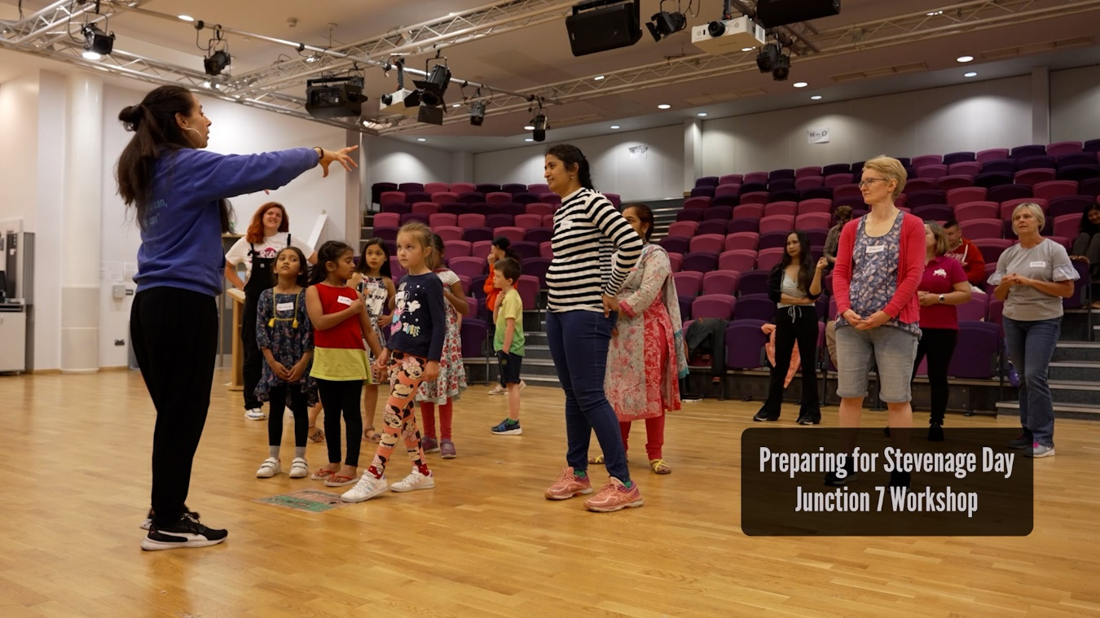
Stevenage Council
Presented their arts and heritage forum and the benefits of Stevenage Day and how it brings all elements of their multicultural communities together to encourage community cohesion and improving mental health.

Slide 10
CCIN Values and principles

Slide 11
CCIN Values and principles
Social Partnership – by demonstrating how the projects have improved social partnerships and bringing communities, groups, and organisations together.
Maximising Social Value – by listening to communities, discovering more about diverse cultures, recognising distinctions between communities, and not making assumptions about what is needed or wanted.
Enterprise and social economy – by providing cultural activities for the community to get involved in, which enables people to feel part of our towns or cities, whilst also encouraging use of retail and hospitality business.

Slide 12
CCIN Values and principles
Learning - Arts, Heritage, and Culture should not be seen as passive. Make it an integral part of everyday life to enable people and our communities to have a sense of their place.
Demographic Engagement - This development opportunity has enabled the authorities to better support the communities which they serve. Equally, the values and principles of the CCIN have enabled the local authorities taking part in the policy lab to better focus their delivery of services through coproduction, engagement, consultation and sharing of knowledge.

Slide 13
Conclusion
Arts & Culture are an integral part of every community
Bringing together the diverse groups that make up our communities allows the use of the arts as a vehicle to share culture and heritage and provide individuals with a sense of place and belonging.
It encourages cohesion within the community and enables groups to share their lived experiences with each other, to learn about each other’s differences and similarities
It helps to integrate those that might otherwise be socially isolated, or not engaging with the wider community
Bringing arts and culture events and activities into Town Centres encourages visitors in otherwise diminishing High Streets
The local councils, museums, businesses, creatives, and community must connect in order to develop a strong sense of belonging and social cohesion in our areas

