Slide 1
Councillor Garry Bridges - Executive Member for Children’s Services
Paul Marshall - Director of Children’s Services
Ruth Denton - Strategic Lead for Our Year

Slide 2
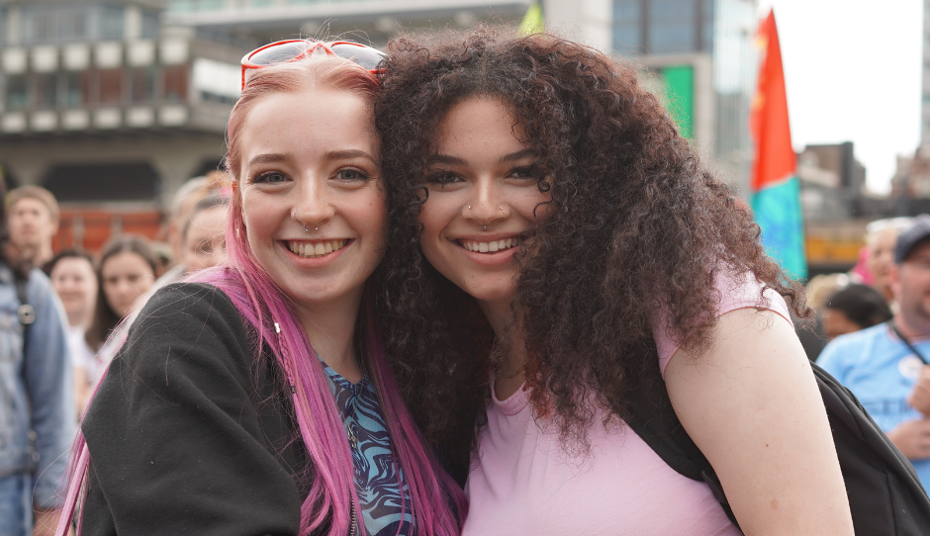
Why did we take the innovative approach of Our Year?
Young people were aware of the challenges they faced but were clear they didn’t want us to focus on them
What they wanted was an opportunity to reclaim their future and for us to provide opportunities and experiences they missed
A year of additional opportunities, fun and exciting things to do and support to look forward to more positive times
We were also aware that the pandemic had a significant impact on our children, young people and families, particularly in areas of educational achievement, wellbeing, social and emotional development, and resilience and financial hardship
‘Young people and children were clear - they did not want to be remembered as the Covid Generation’

Slide 3
What did we do?
With over 2000 children and young people, we designed the Our Year programme around six main themes based on what they said was important to them:
Equal and included
Climate
Connected
Play
and activity
Health and
wellbeing
Safe
and secure

Slide 4
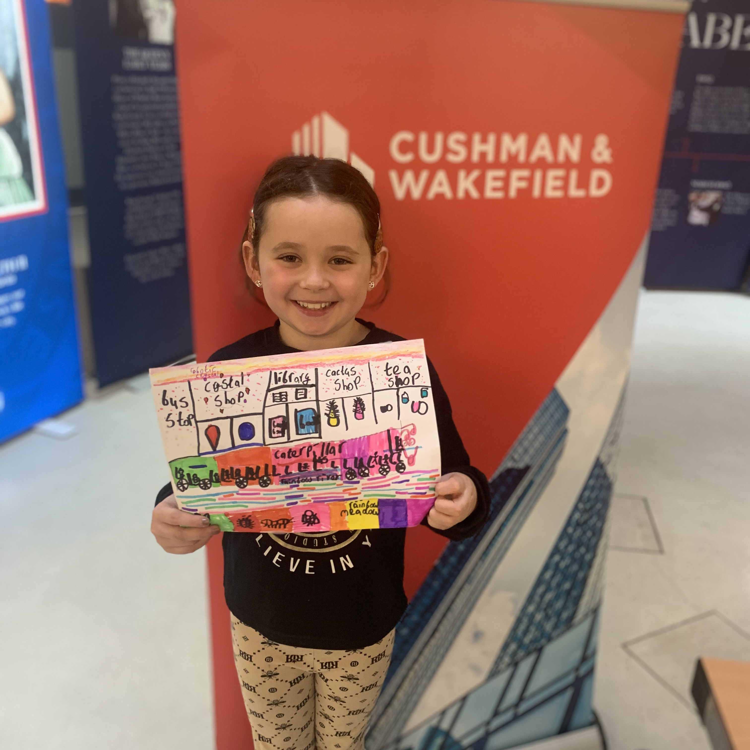
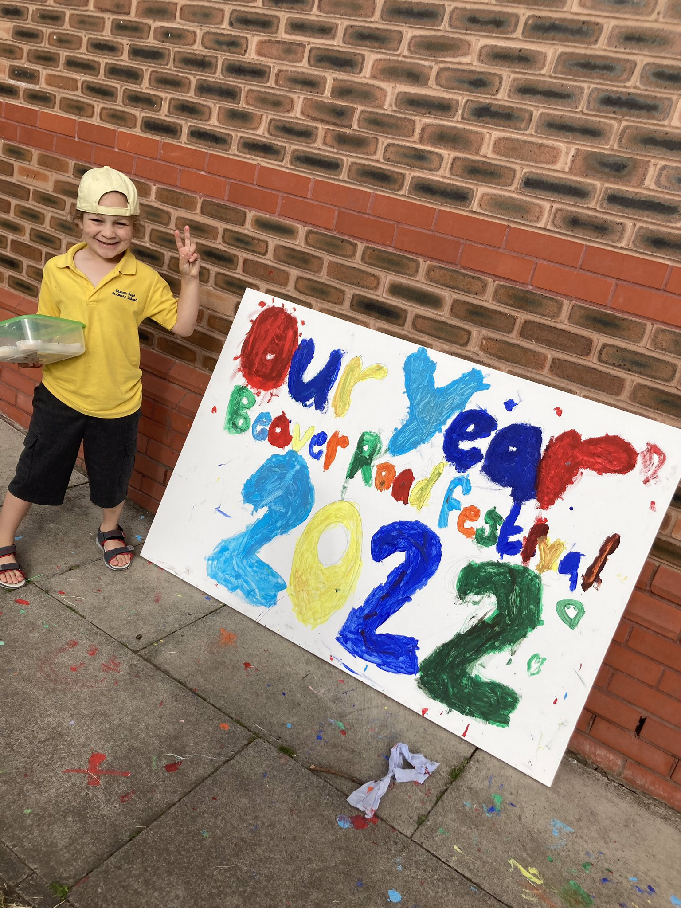
Culture Shift
A top corporate priority for the organisation with leadership demonstrated by the Council’s Strategic Management Team and through every one of the Council’s directorates. We also embedded the approach across partners including Health and the private sector.
Culture-shift, to embed young people’s voices and participation across all we do in Manchester.
Created a movement, which included private sector partners and business leaders, who have become ambassadors for the city.

Slide 5
What did we do? Innovative approaches
DEC 21
Business launch event
JAN 22
Call-to-action week
Launch of Connell College OY art competition
FEBRUARY
Public campaign launch
Launch of library card competition
Accepted onto UNICEF CFC programme
MARCH
Inclusion For My Success event
Youth Parliament elections
Young Carers' Action Day
APRIL
Children's community Iftar
First mentoring walk
Easter enhanced holiday provision
Launch of Green Ideas competition
MAY
'Stories of Care' book launch
'Platinum Picks' launch event
Full Council
Enhanced Holiday Offer
Community Our Year events
Young people leading the IWD parade
Our Year Youth Voice event at Contact Theatre
JUNE
Green Bee Summit
Art Assembly
Manchester Day

Slide 6
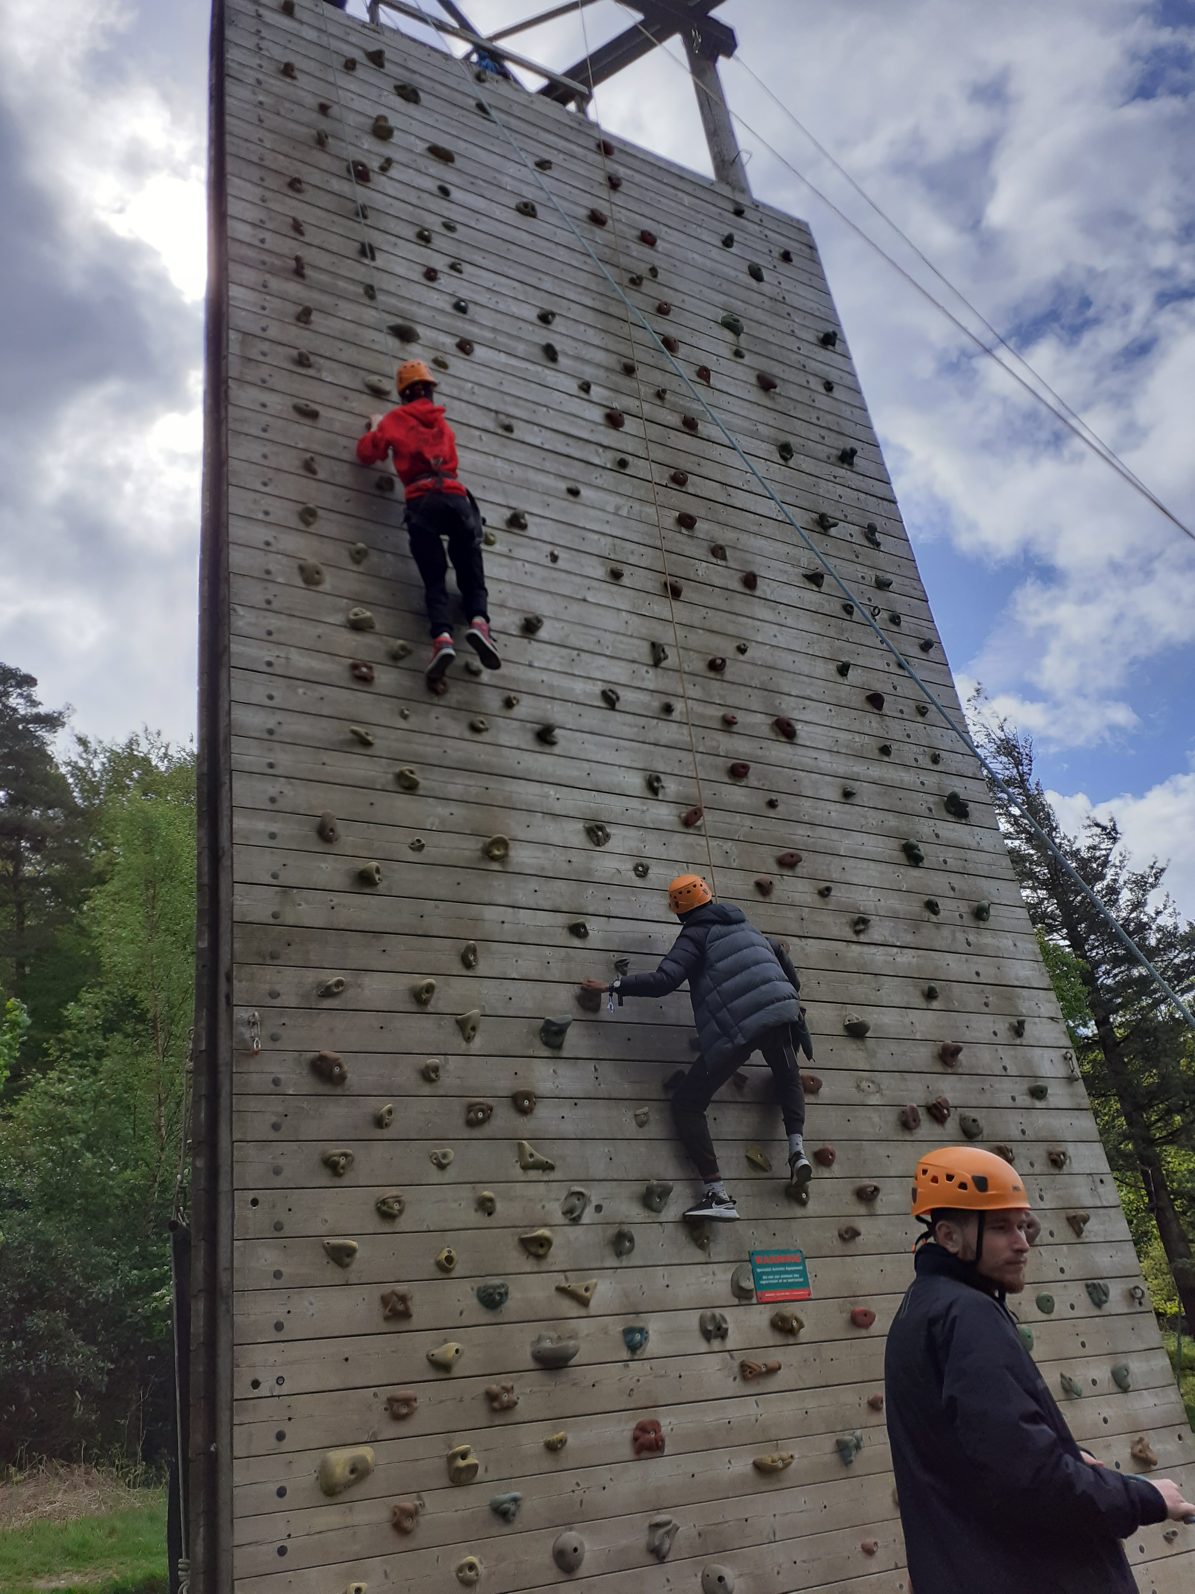
What did we do?
Baby Week
Summer school holiday campaign
Safeguarding conference led by young people
South Asian Heritage Month
Our Year Play Day
School summer holiday campaign
Our year Summer Transition activities
Manchester Pride- young persons involvement
Ukrainian Family Day
Young World 2022 Summit
Wild In Art 'We Made It’ trail
Primary Green Bee Festival
Outdoor education conference
Outdoor Education Conference
Manchester Science Fest
Black History Month
Science Festival
Launched Our Year legacy fund
Care leavers week
UNICEF UK Launch
Youth Climate Conference
Christmas Light Switch on with winners of the illumination competition
End of year 'Our Year' celebration
MYC 10 Year celebration
Full Council with young people
Supported SEND young people to attend a range of festive activities
JULY
AUGUST
SEPTEMBER
OCTOBER
NOVEMBER
DECEMBER

Slide 7
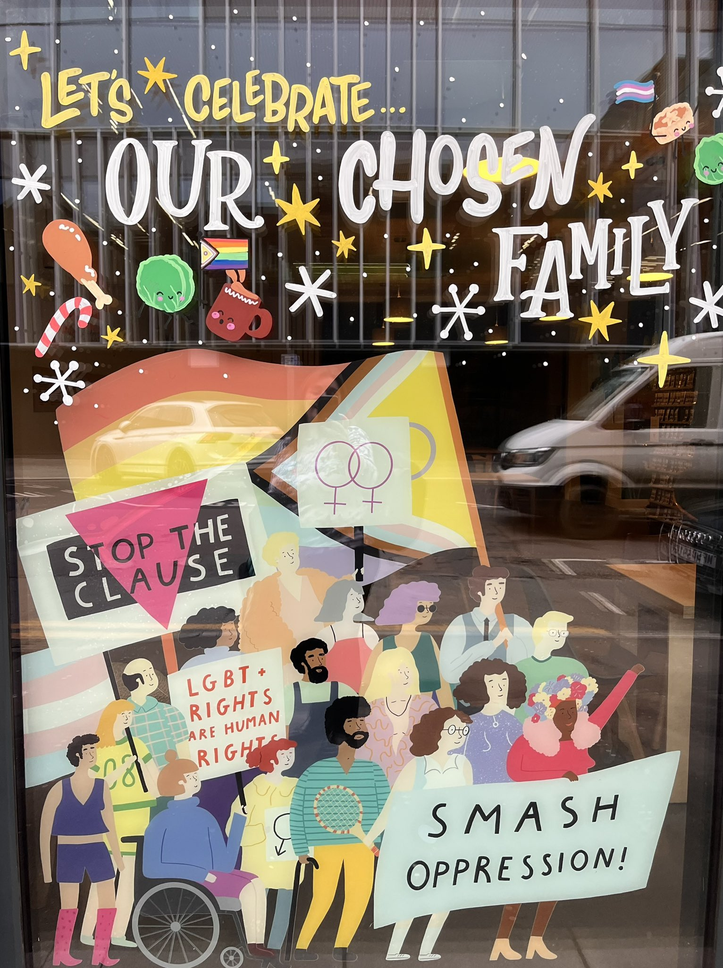
Equal and Included
One of the main themes taken directly from children and young people was ‘Equal and included’​
​
Examples of innovative practice​:
Community Iftar with 120 Care experienced young people​,
Youth Pride activities
Young people led our International women's day celebrations​
Displayed art work across prominent city Centre venues created by young people with additional needs​
Worked with our private sector to open up additional opportunities to theatre, family events at no cost to our SEND young people
Worked closely with our new arrivals team to increase access to recreational and educational activities.

Slide 8
2022 Our Year (Impact)
"Not only did they love the theatre, they were very pleased to have met other young people of similar age (and background) and had the opportunity to experience the theatre together for the first time." International New Arrivals Team
"Being able to go on a weekend away with friends and learning new skills has been amazing!” Youth project in Moss Side
“Our families had an amazing time at the light switch on and the children are so proud of themselves, so thank you again for your support and ensuring SEND young people were included in the programme.” Parent of illumination competition winner
“Being able to talk to business leaders about how they achieved success has really given me some ideas and motivation. It was great to be able to walk up a mountain at the same time, what a great idea.” Fresh Walks participant (aged 17)
“I just love that there are so many children here today from different backgrounds, all playing together. I hope this is something you will do every year.” Parent at Our Year Play Day event

Slide 9
2022 Our 2022 Our Year headlines and achievements (Impact)
6000+ pieces of equipment donated, including sportswear, sports equipment, arts and craft supplies, IT, books. 2000+ young people attended Our Year MCR Day Youth Festival. 1700 attended the launch of Baby Week. 4,038 participants across the week. Enhanced Holiday offer throughout 2022 with 44,019 young people accessing holiday provision across 4829 sessions. An additional 150 neuro-diverse young people were supported to attend the Art Assembly.

Slide 10
2022 Our 2022 Our Year headlines and achievements (Impact and Reach)
55,000+ children and young people have attended an event or opportunity linked to the Our Year programme.
120 young people attended the Our Year community Iftar.
Over 1000 young people took part in the Manchester Day Parade.
3000 people attended the Our Year Play Day event.
300 young people had their artwork displayed in prominent city centre venues.
3000 a further young people recorded their skills development around teamwork, self belief, self management, problem solving and communication.
300 young people accessed an outdoor residential for the first time.

Slide 11
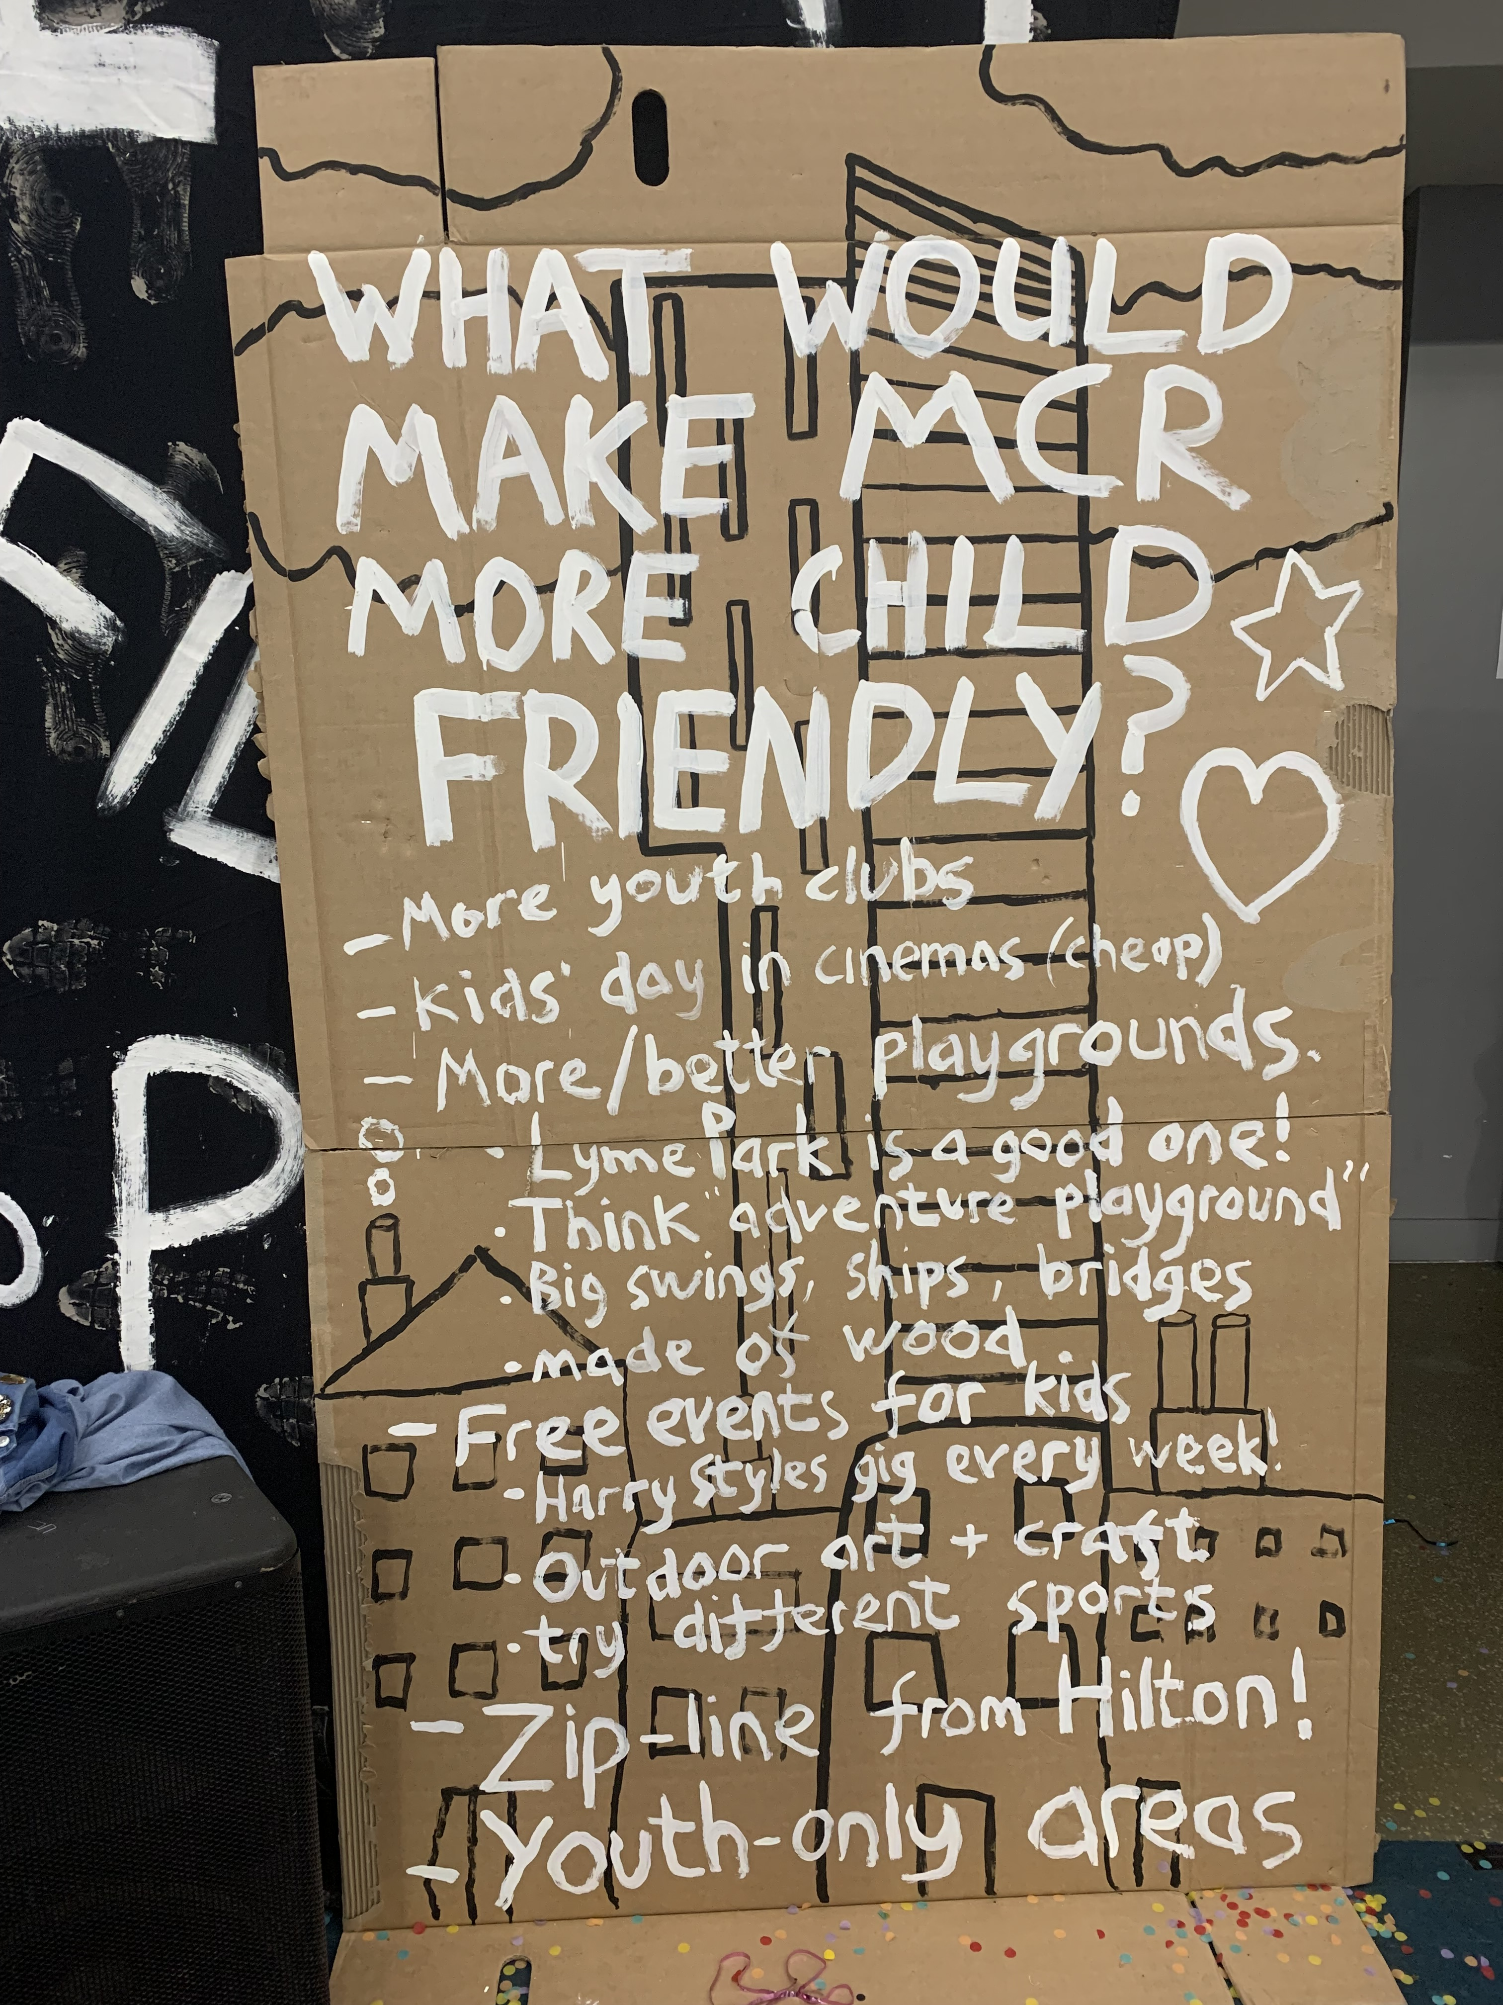
Legacy. Culture shift.
Following the success of Our Year, we have:​
Built in several legacy events​
Regular engagement between senior staff, councillors and young people​
Continued to embed the culture, change the DNA of the city
Started our journey to become a UNICEF UK child friendly city in January 2023
We are currently at Discovery Phase to see where things are going well for children and where things need to change
Based on analysis, we will choose priority areas and, with support from UNICEF UK, achieve progress over the following 3-5 years.
The journey to become a Child Friendly City started in January 2023

