Slide 1


Slide 2


Welcome Conference starts at 1000

Slide 3
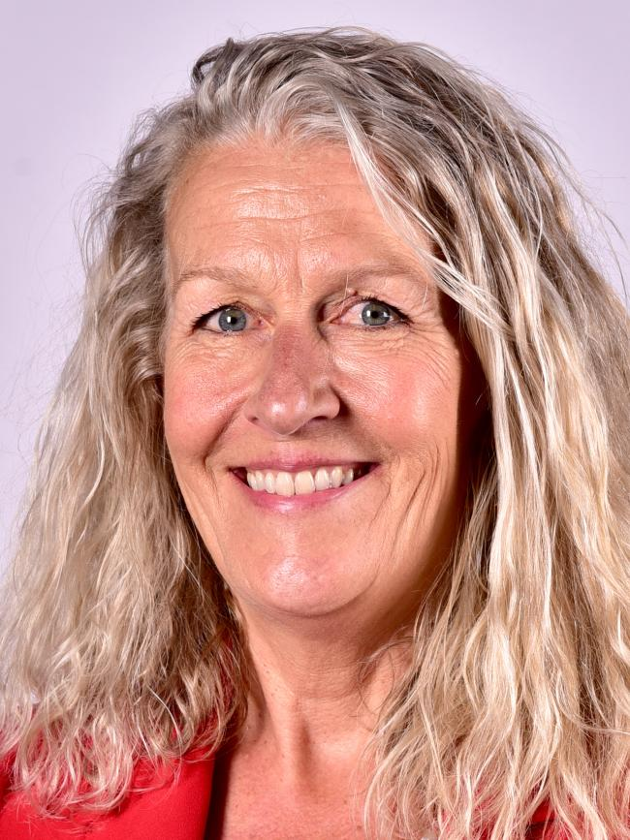
Cllr Louise Gittins
Leader, Cheshire West & Chester Council Executive Oversight Committee Member, CCIN
@Weezegee | @Go_cheshirewest

Slide 4
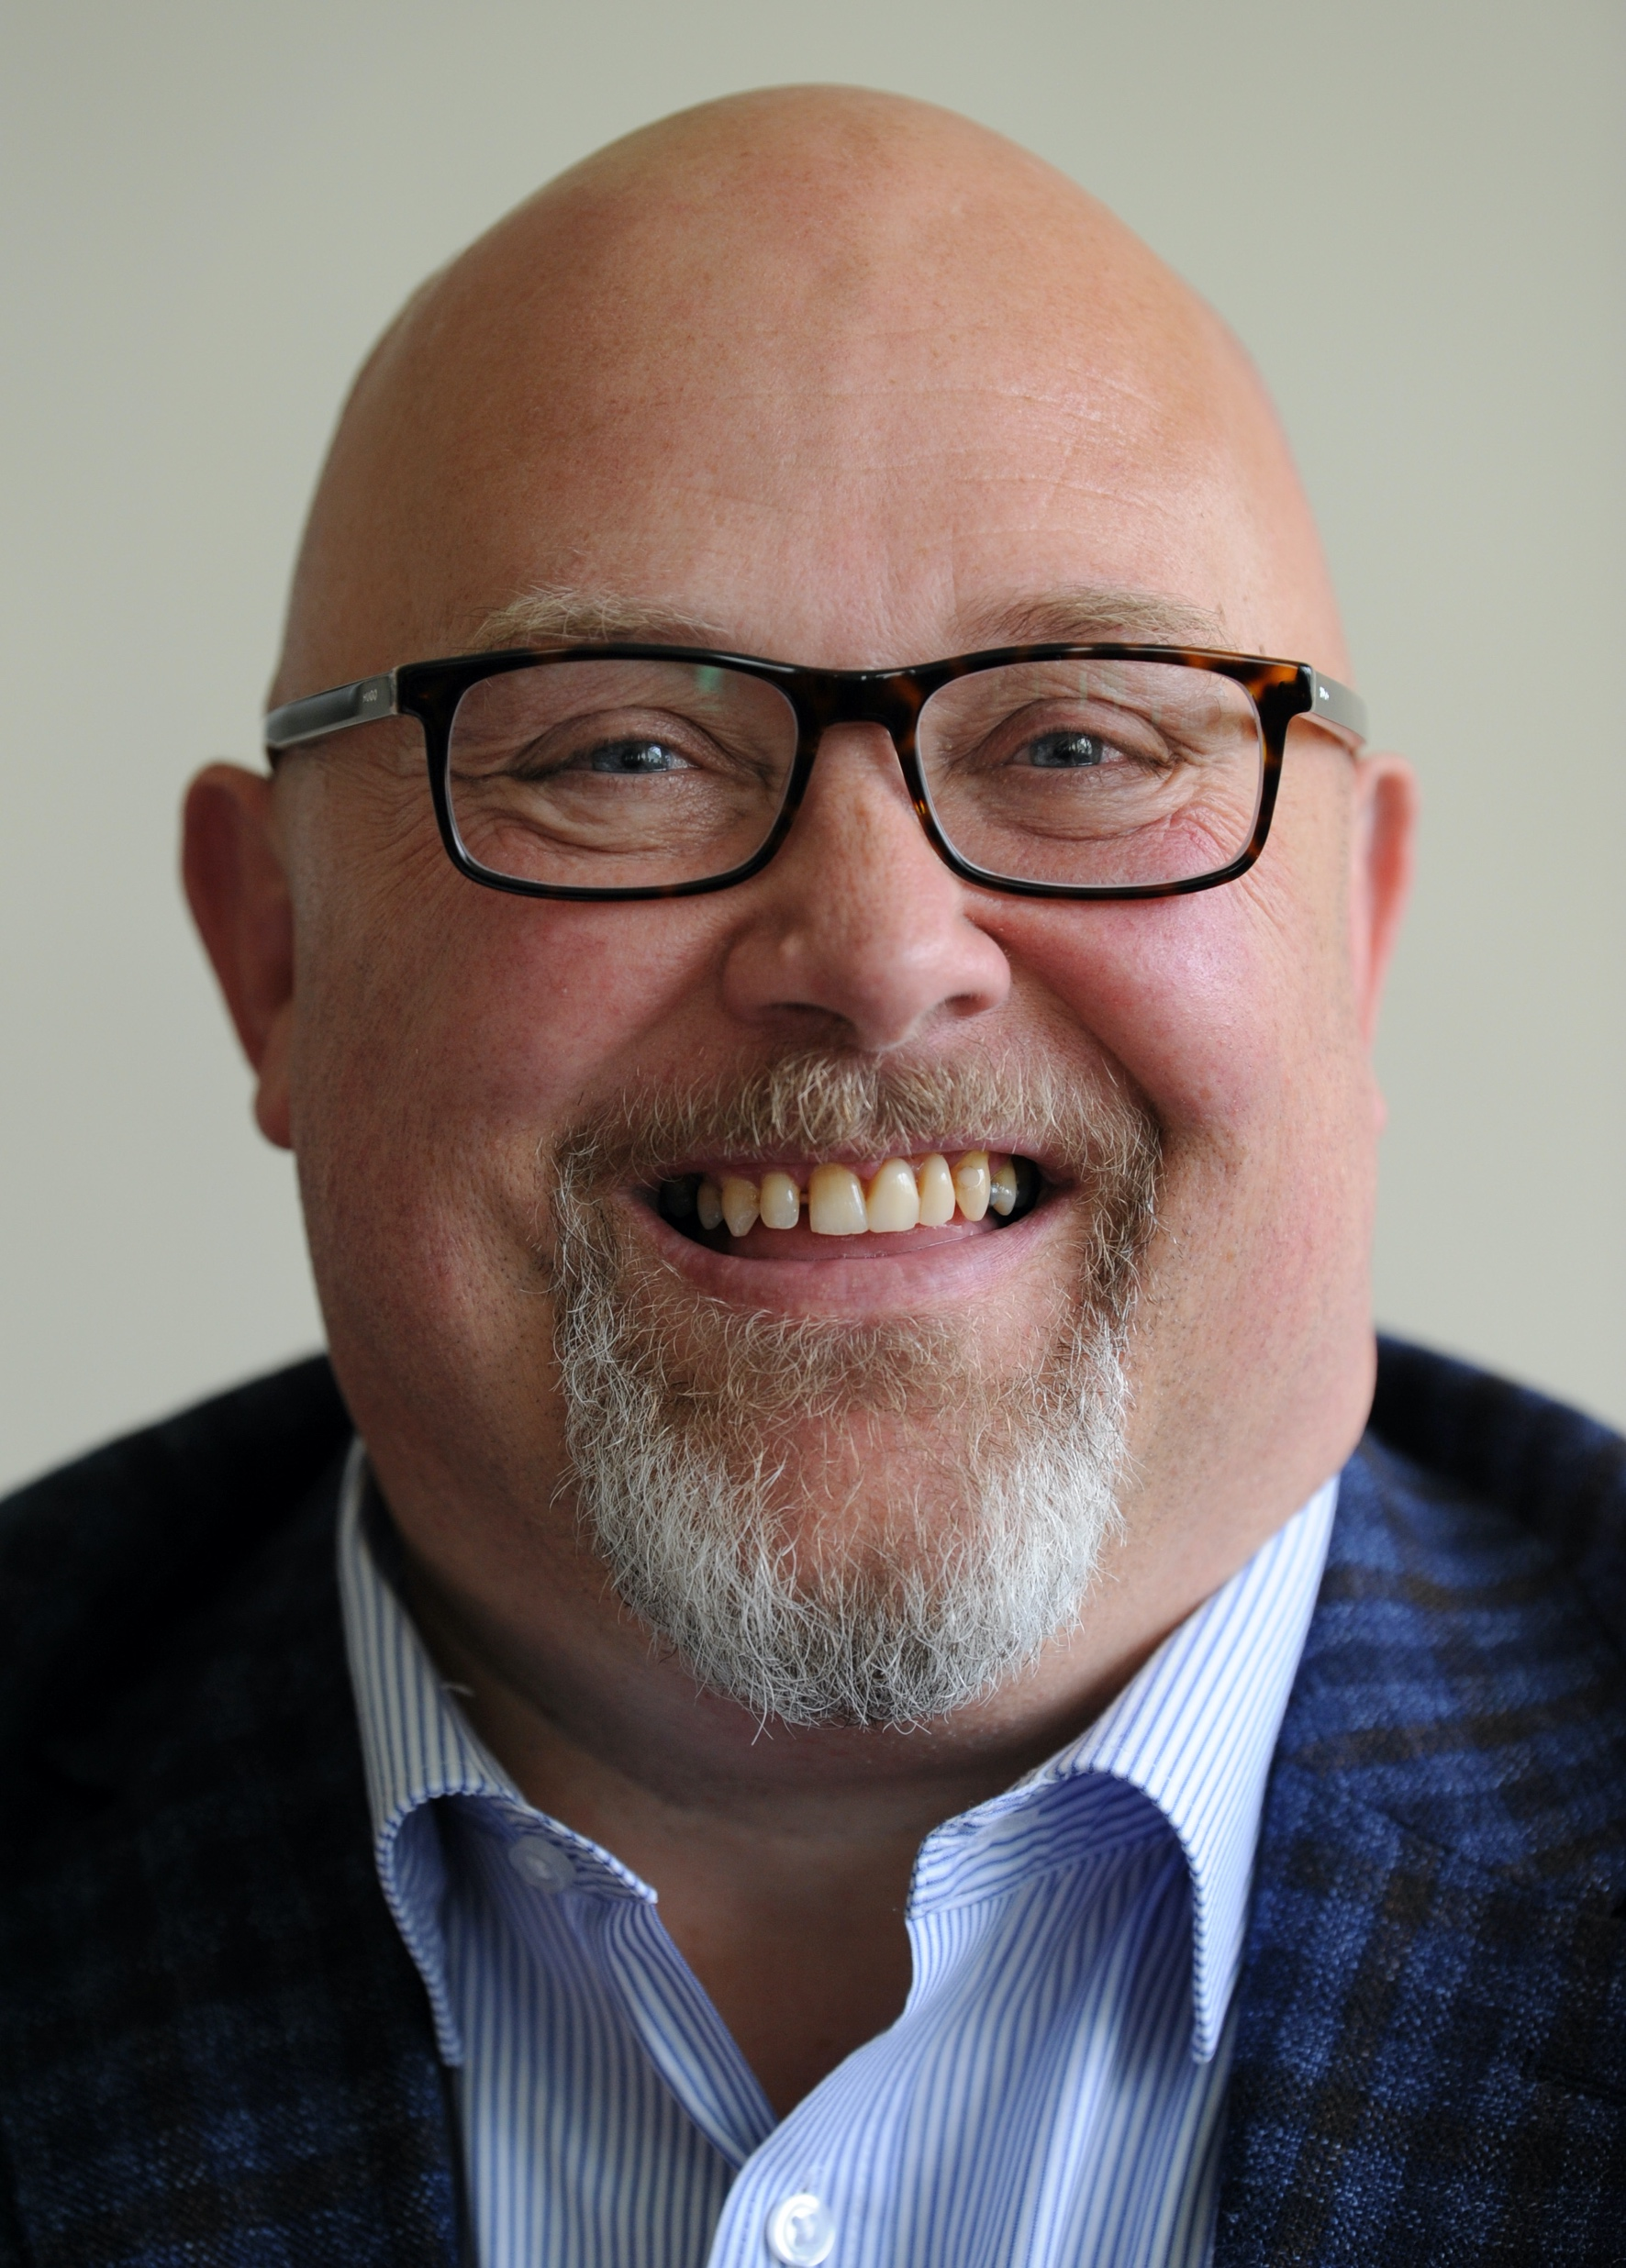
Cllr Graeme Miller
Leader of Sunderland City Council
@GraemeMiller19 | @SunderlandUK

Slide 5

Plenary 1
Supporting Children & Young People the Cooperative Way

Slide 6
Cllr Louise Gittins
Leader, Cheshire West & Chester Council Executive Oversight Committee Member, CCIN
@Weezegee | @Go_cheshirewest

Slide 7
Speakers:
Cllr Susan Dungworth – Chair, Seaton Valley Community Cllr Linda Tock – Cabinet Member for Children’s Services - Hull City Council
Cllr Garry Bridges – Executive Member for Early Years, Children and Young People - Manchester City Council
Karen Creavin – Chief Executive - The Active Wellbeing Society

Slide 8
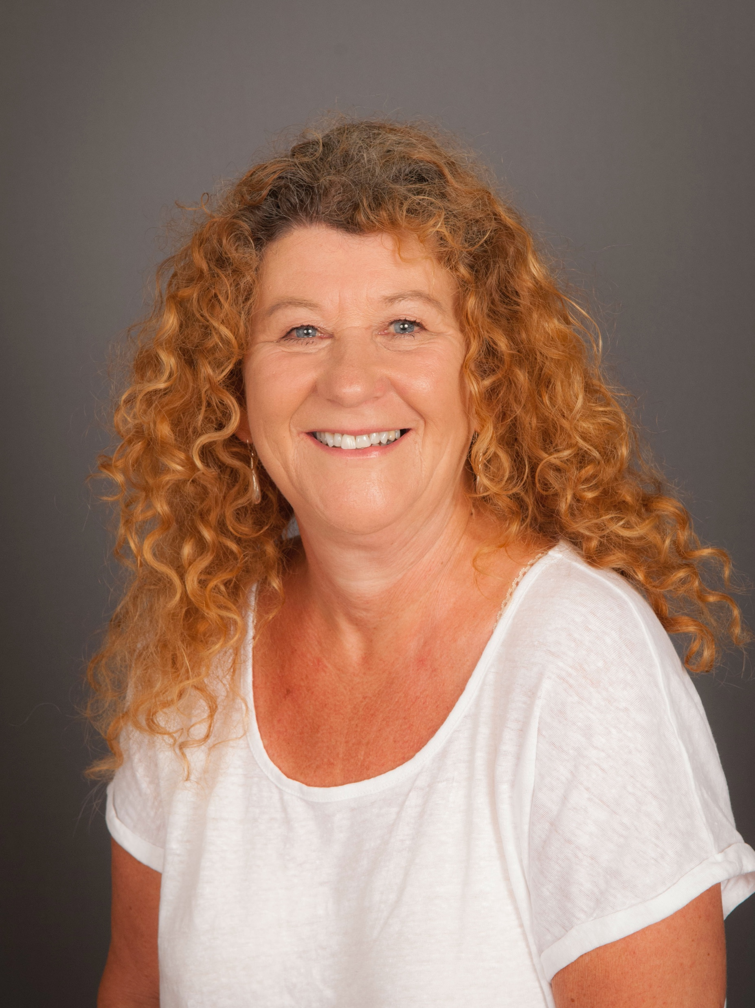


Cllr Susan Dungworth
Chair, Seaton Valley Community Council
@SusanDungworth | @SeatonValleyCC
CoopInnovation
#CCIN2022

Slide 9
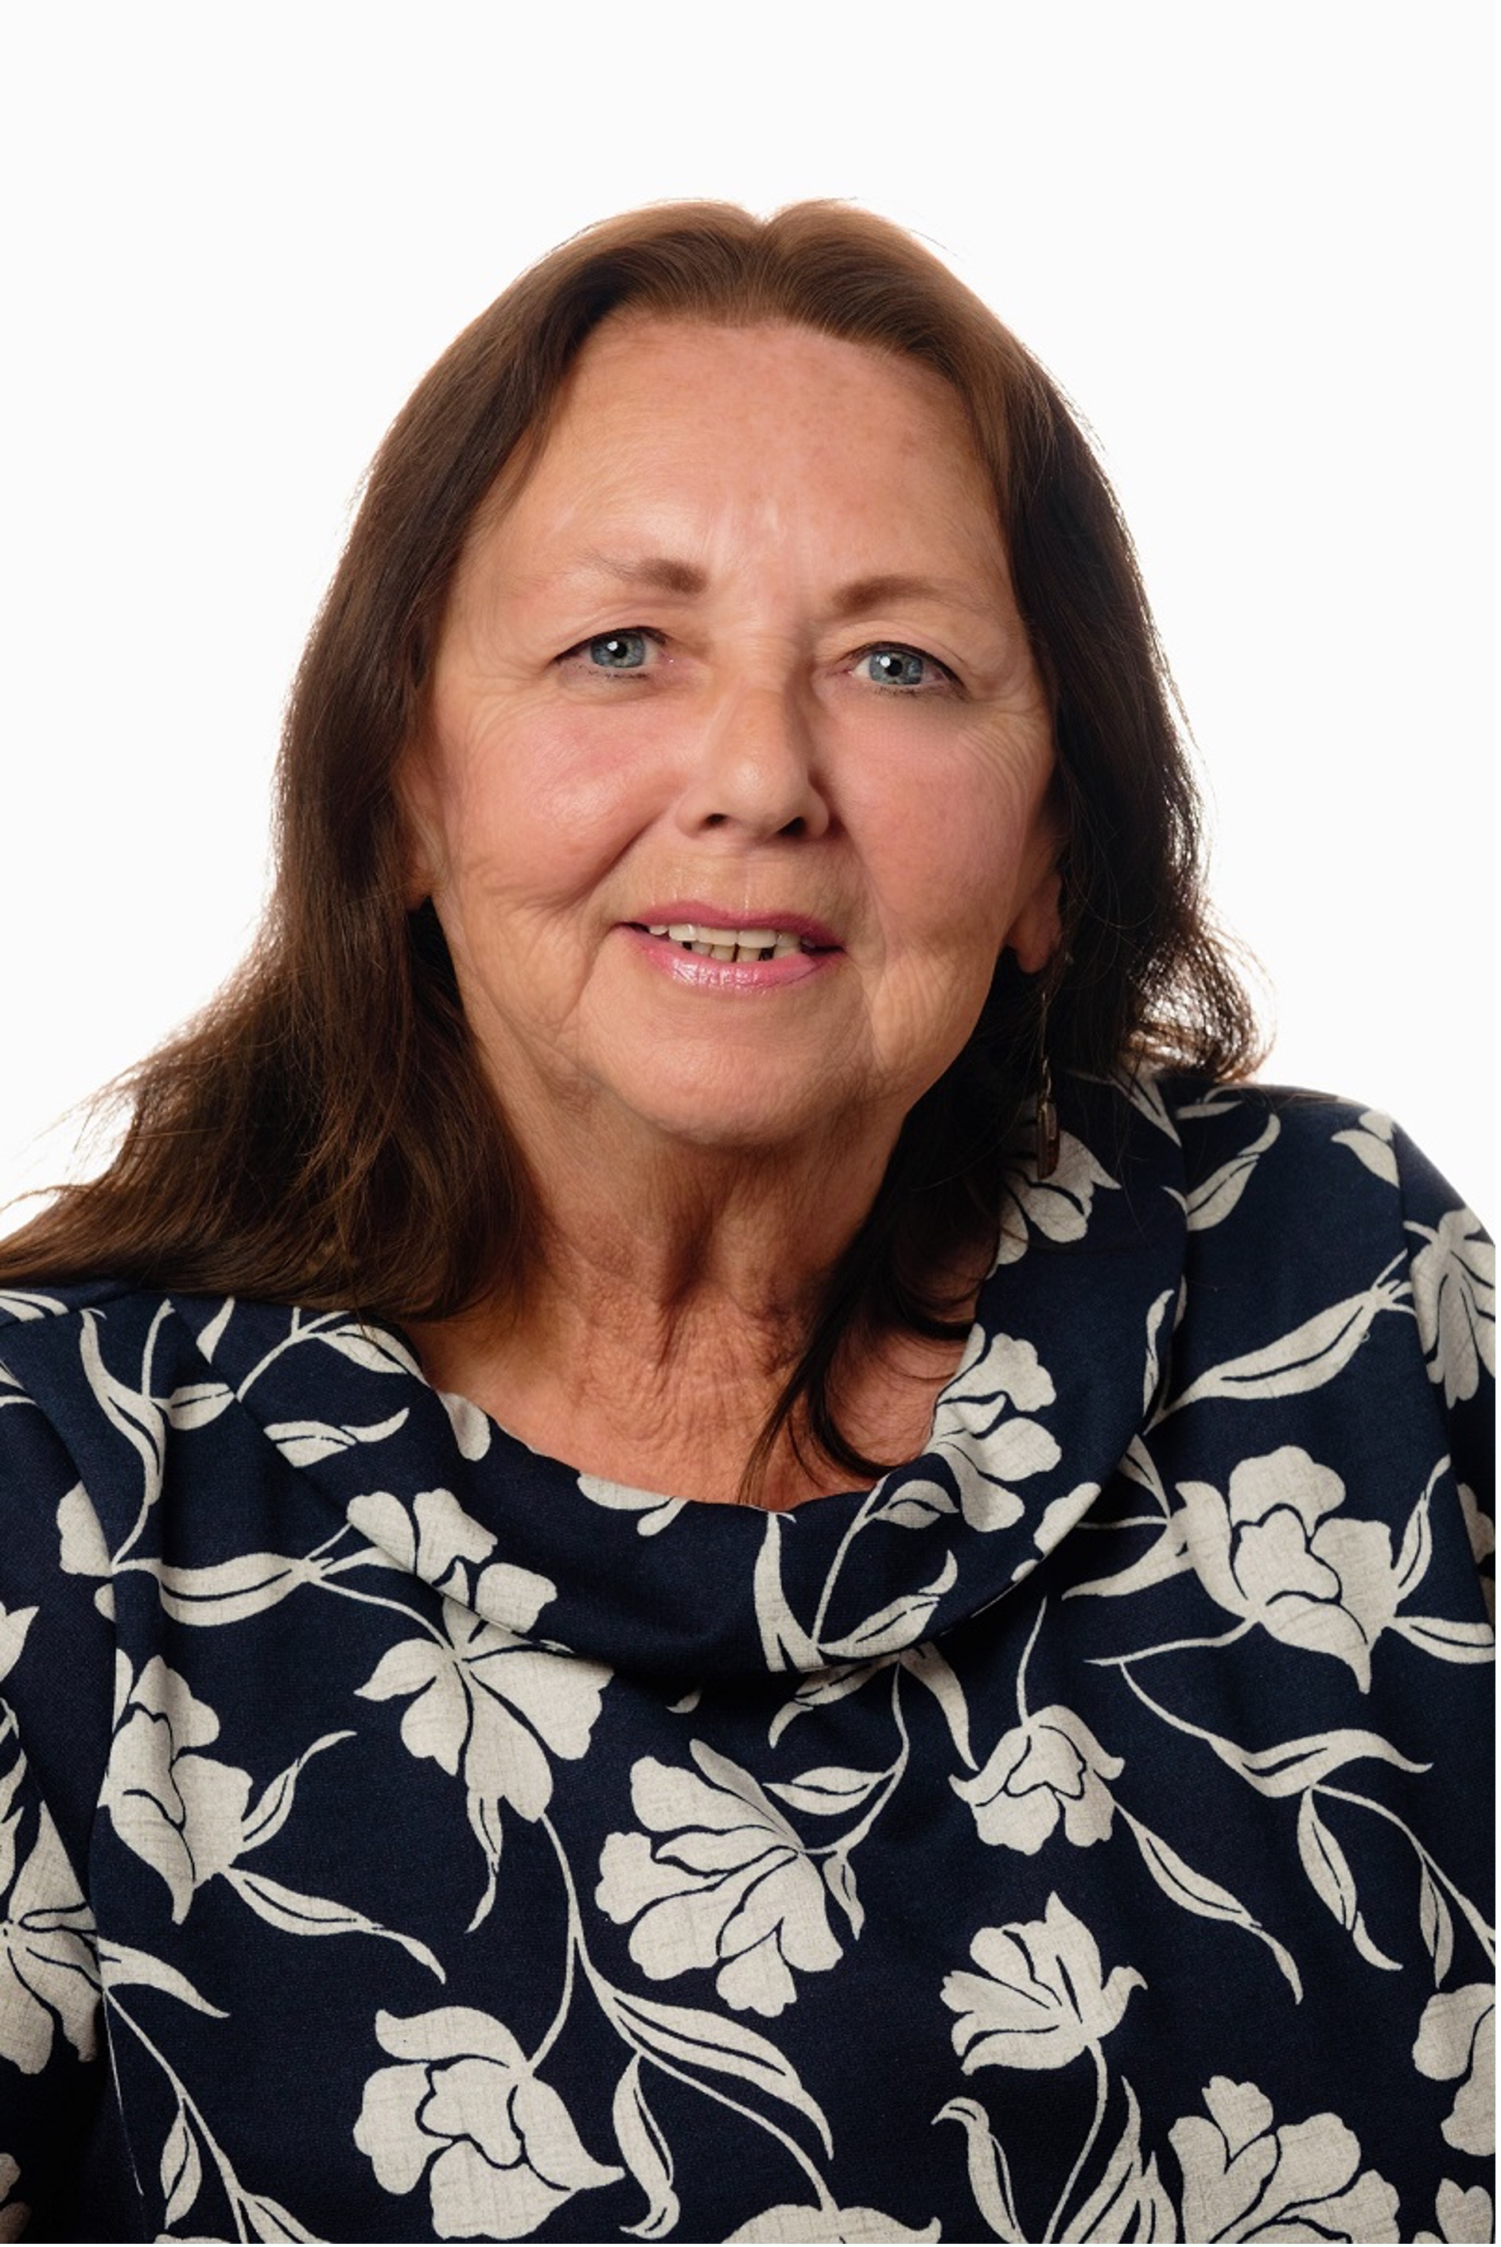
Cllr Linda Tock
Cabinet Member for Children’s Services
@hullccnews
CoopInnovation
#CCIN2022

Slide 10
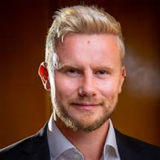
Cllr Garry Bridges
Executive Member for Early Years, Children and Young People
@GarryBridges | @ManCityCouncil
CoopInnovation
#CCIN2022

Slide 11
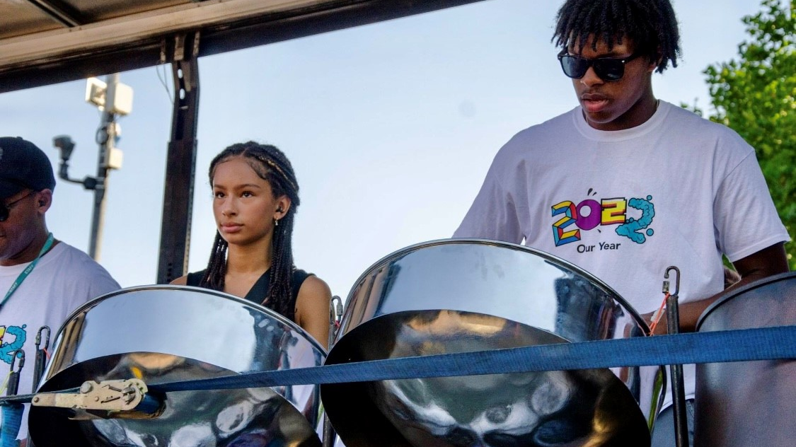


Councillor Garry Bridges - Executive Member for Children’s Services
Paul Marshall - Director of Children’s Services
Ruth Denton - Strategic Lead for Our Year

Slide 12
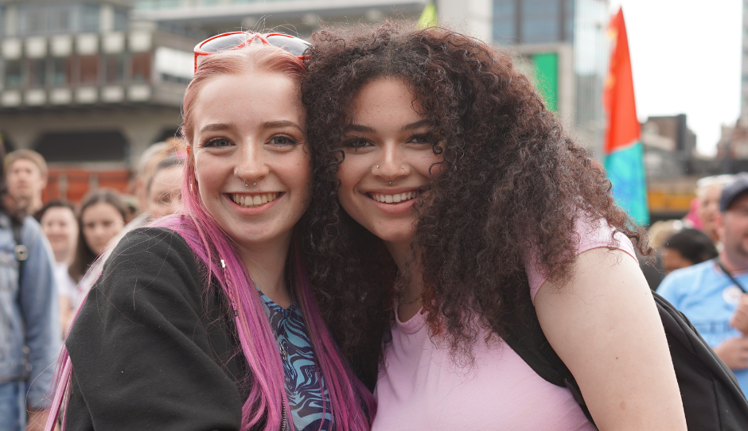
Why did we take the innovative approach of Our Year?
Young people were aware of the challenges they faced but were clear they didn’t want us to focus on them
What they wanted was an opportunity to reclaim their future and for us to provide opportunities and experiences they missed
A year of additional opportunities, fun and exciting things to do and support to look forward to more positive times
We were also aware that the pandemic had a significant impact on our children, young people and families, particularly in areas of educational achievement, wellbeing, social and emotional development, and resilience and financial hardship
‘Young people and children were clear - they did not want to be remembered as the Covid Generation’

Slide 13
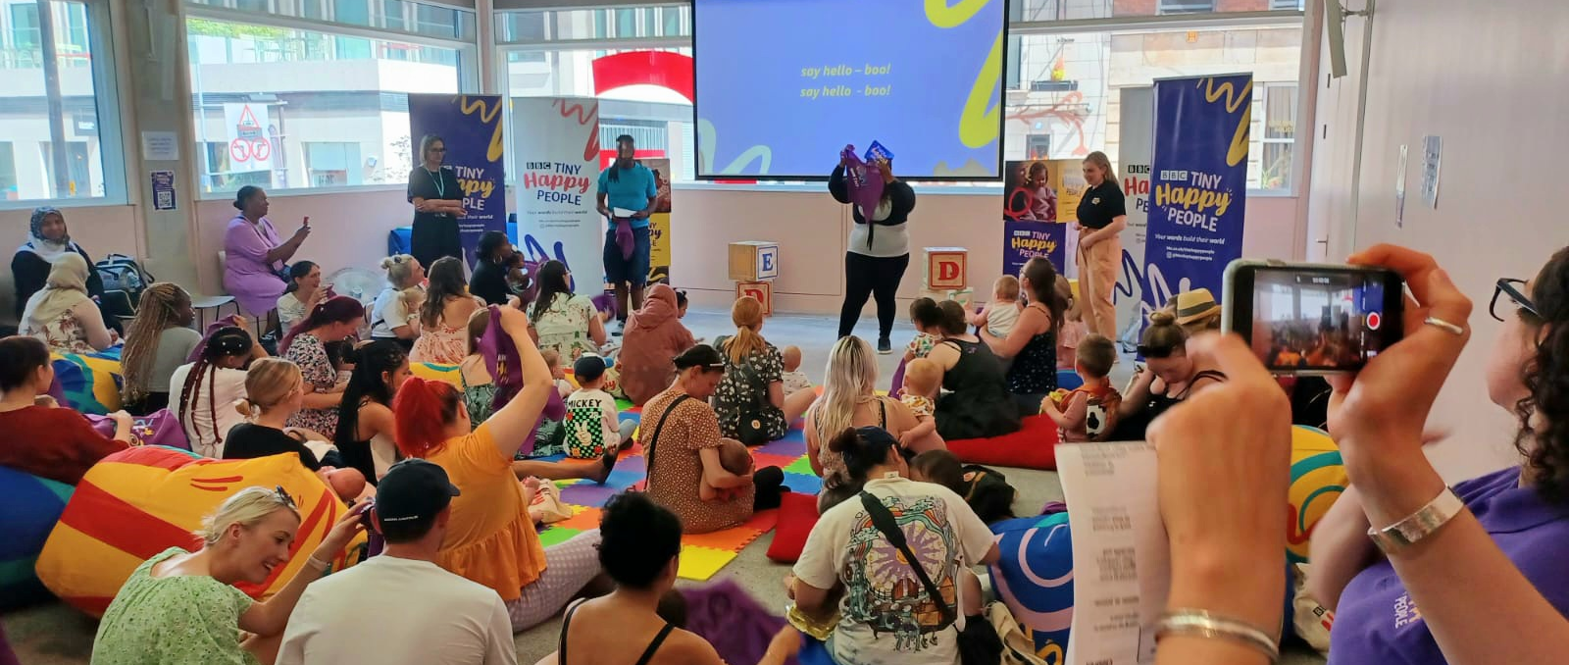
What did we do?
With over 2000 children and young people, we designed the Our Year programme around six main themes based on what they said was important to them:
Equal and included
Climate
Connected
Play
and activity
Health and
wellbeing
Safe
and secure

Slide 14
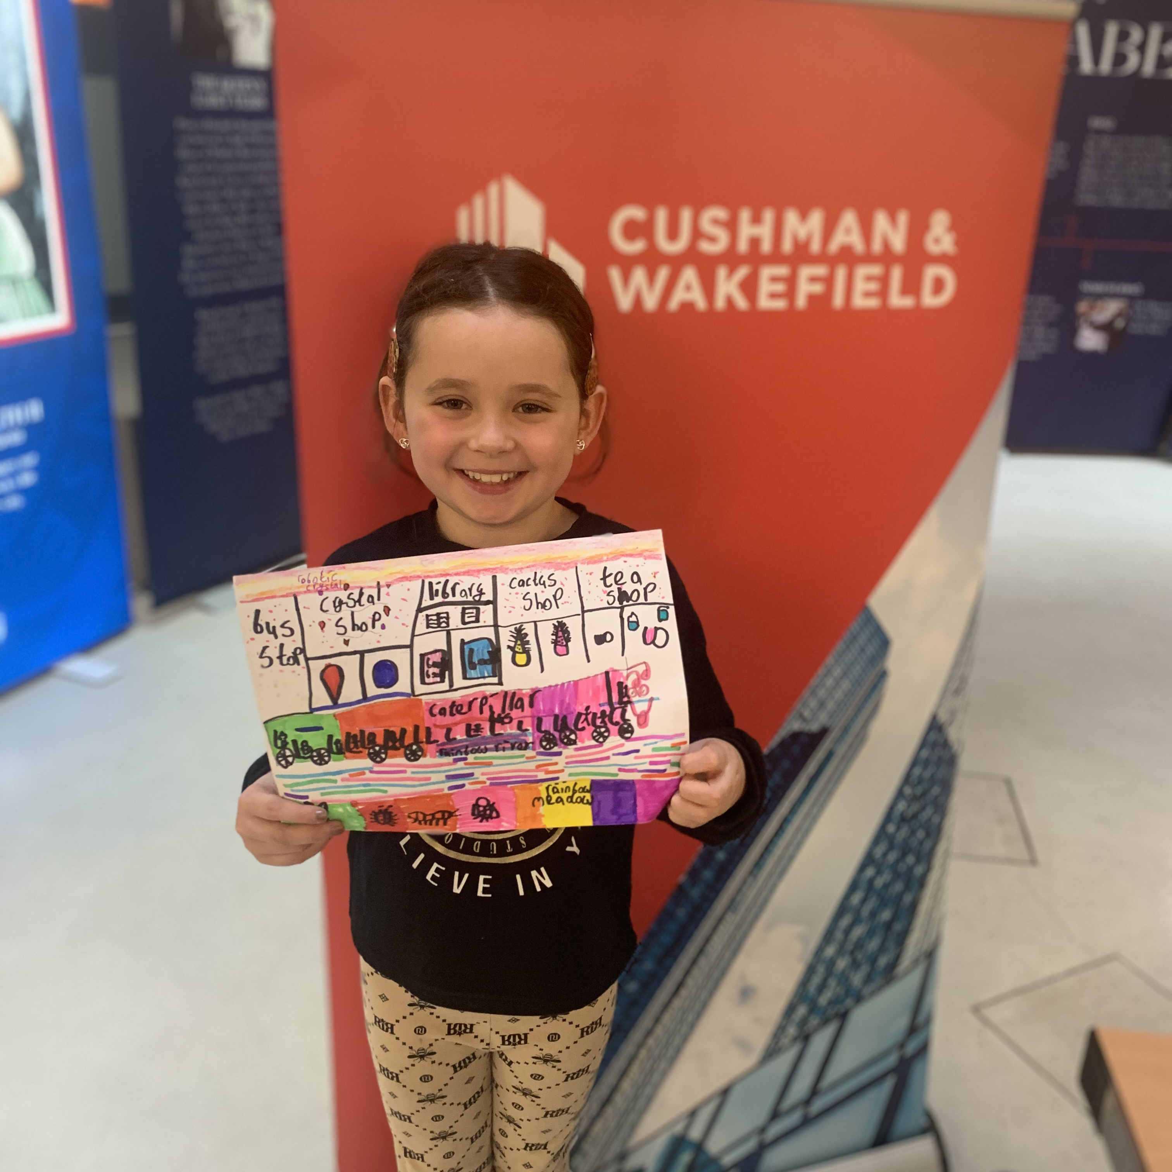
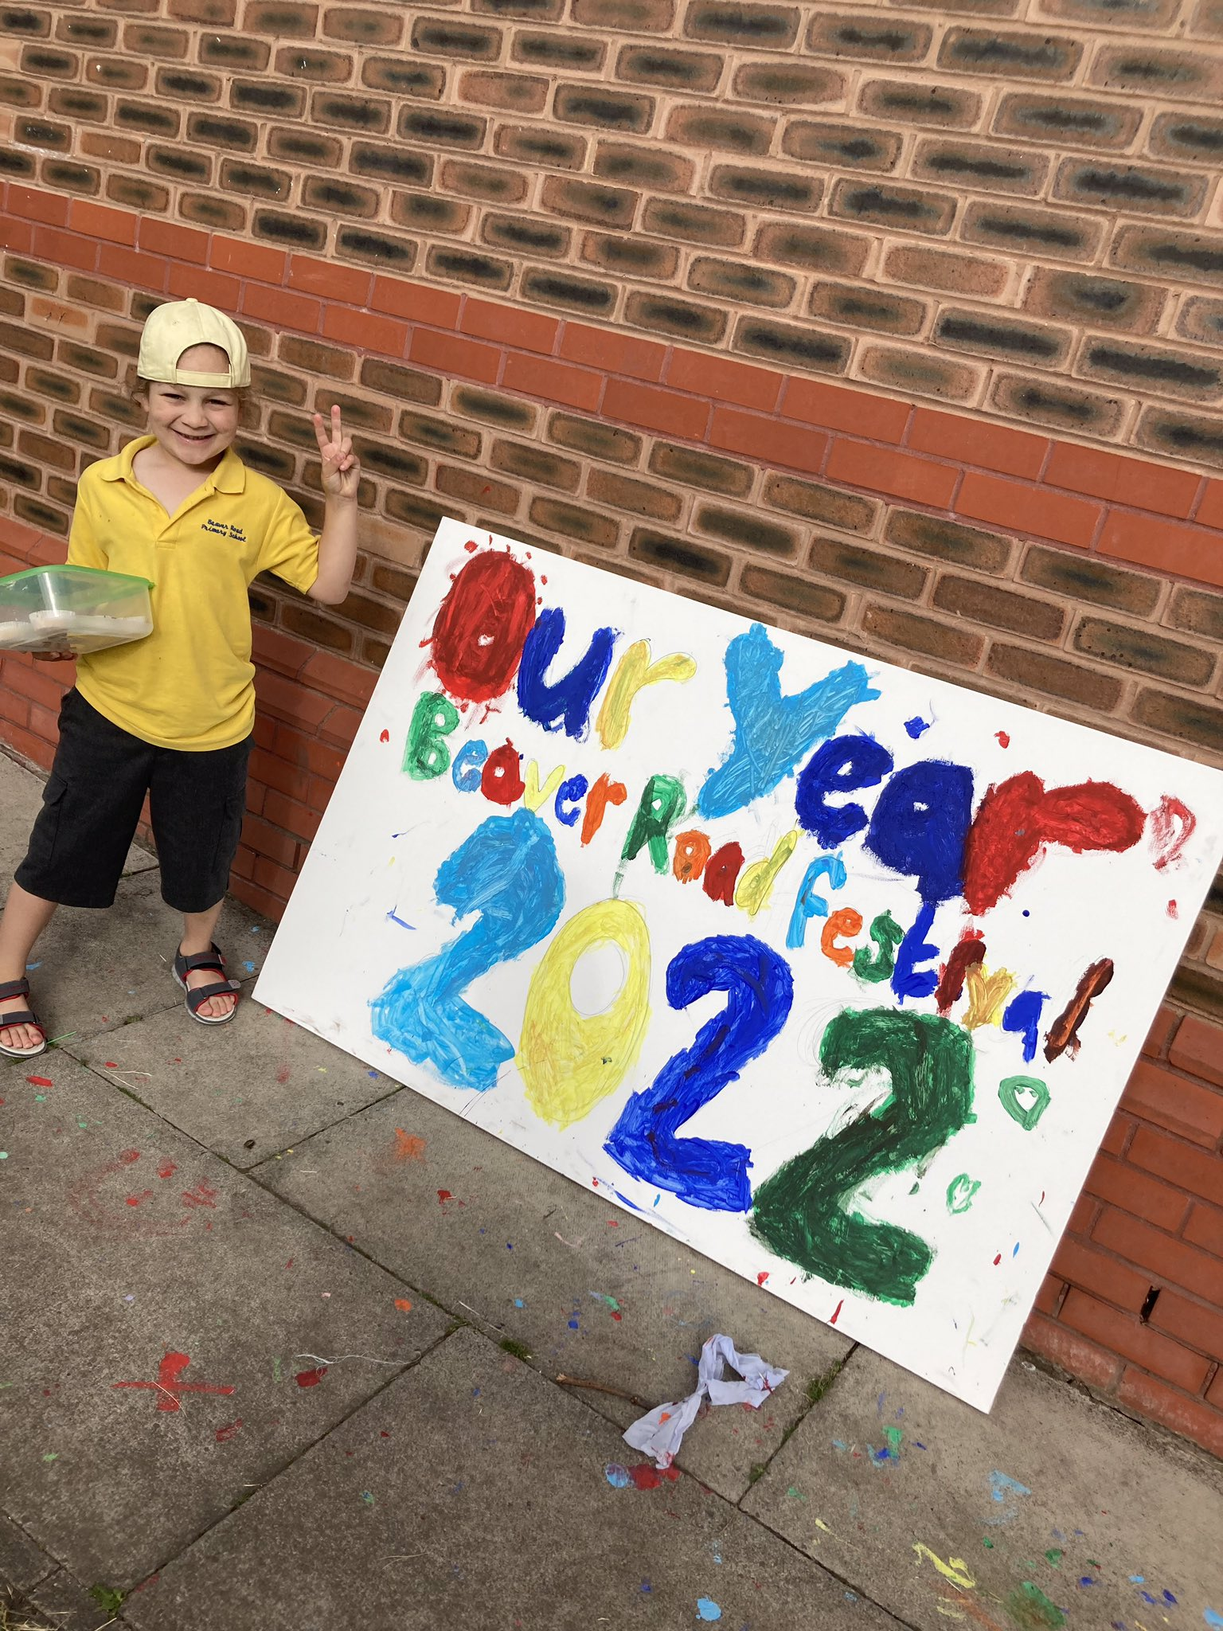
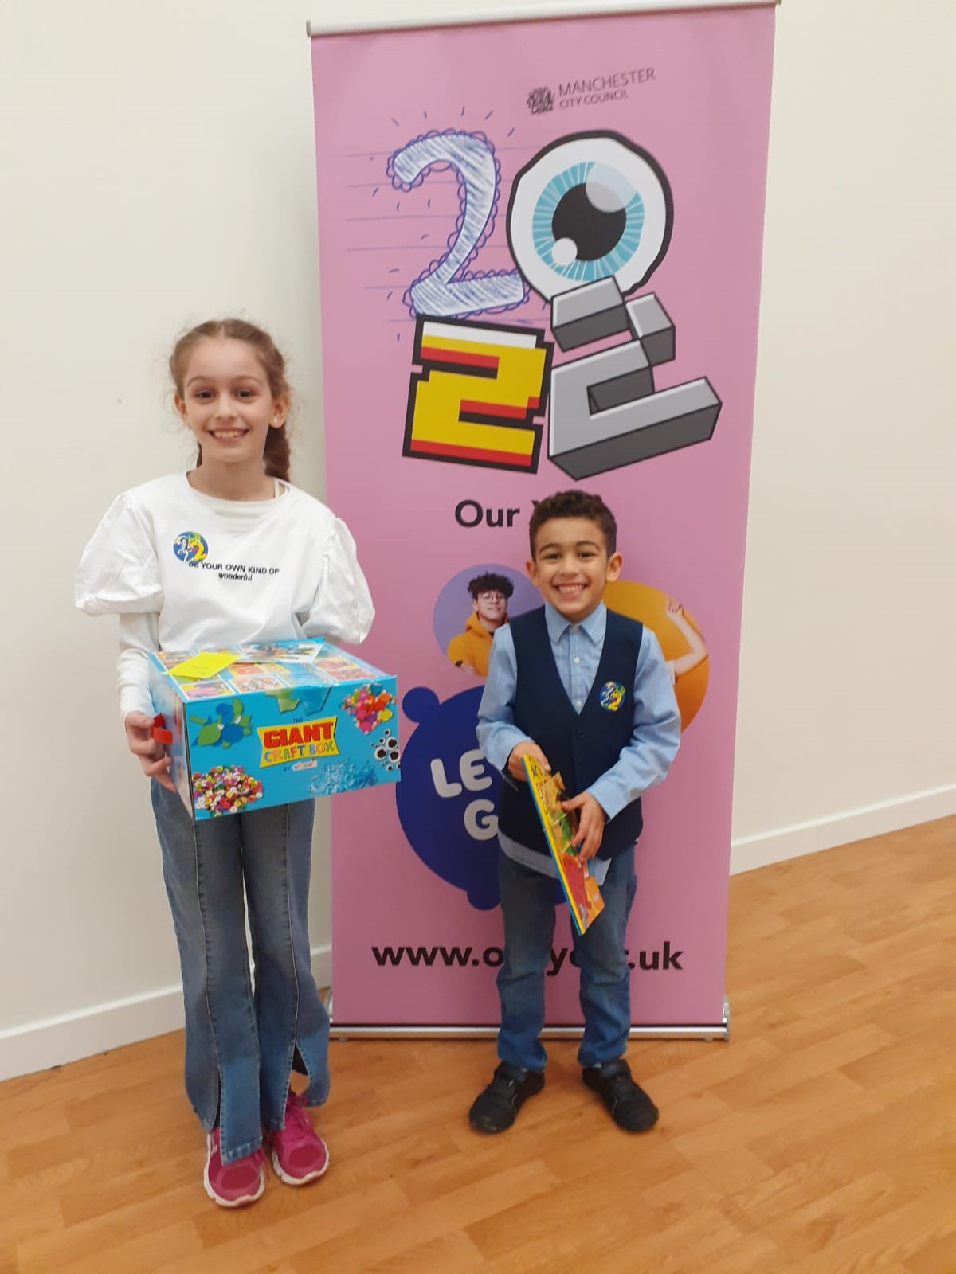
Culture Shift
A top corporate priority for the organisation with leadership demonstrated by the Council’s Strategic Management Team and through every one of the Council’s directorates. We also embedded the approach across partners including Health and the private sector.
Culture-shift, to embed young people’s voices and participation across all we do in Manchester.
Created a movement, which included private sector partners and business leaders, who have become ambassadors for the city.

Slide 15
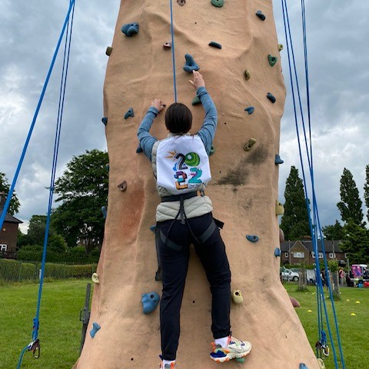

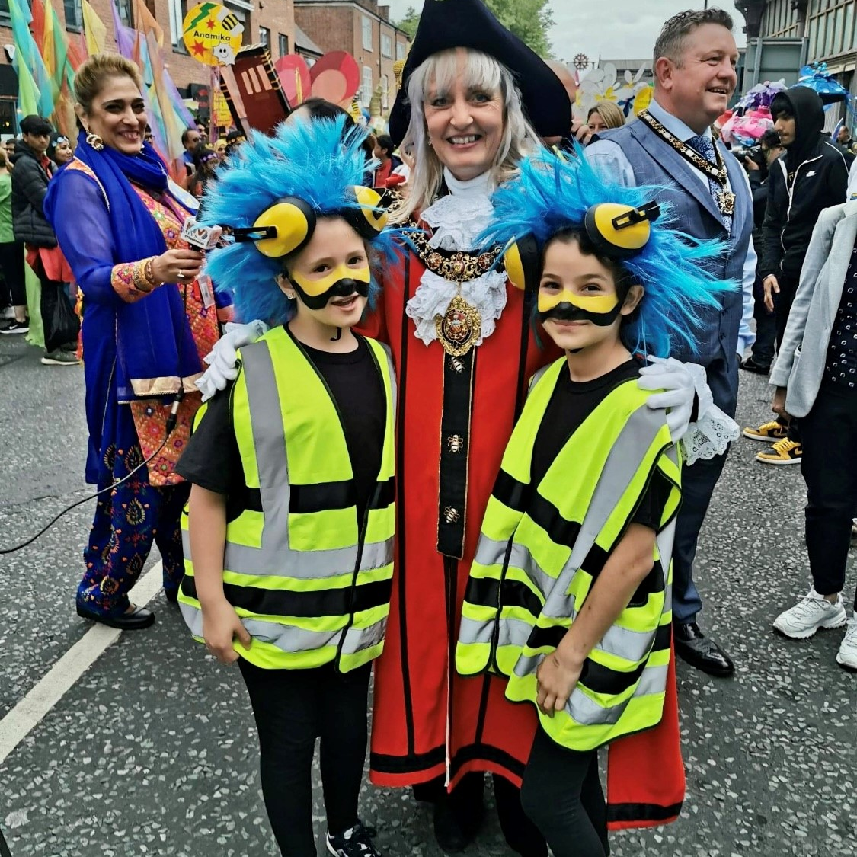
What did we do? Innovative approaches
DEC 21
Business launch event
JAN 22
Call-to-action week
Launch of Connell College OY art competition
FEBRUARY
Public campaign launch
Launch of library card competition
Accepted onto UNICEF CFC programme
MARCH
Inclusion For My Success event
Youth Parliament elections
Young Carers' Action Day
APRIL
Children's community Iftar
First mentoring walk
Easter enhanced holiday provision
Launch of Green Ideas competition
MAY
'Stories of Care' book launch
'Platinum Picks' launch event
Full Council
Enhanced Holiday Offer
Community Our Year events
Young people leading the IWD parade
Our Year Youth Voice event at Contact Theatre
JUNE
Green Bee Summit
Art Assembly
Manchester Day

Slide 16
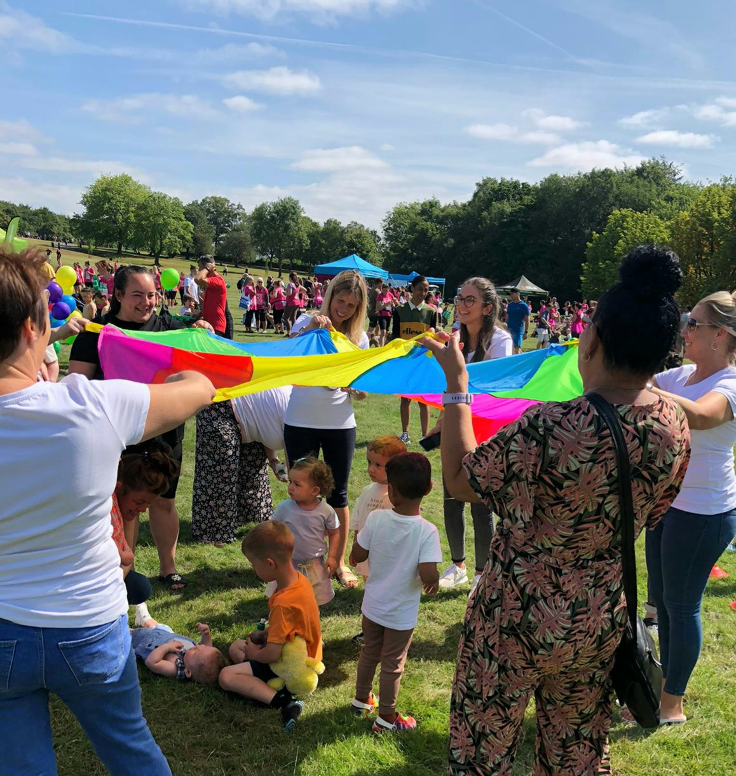
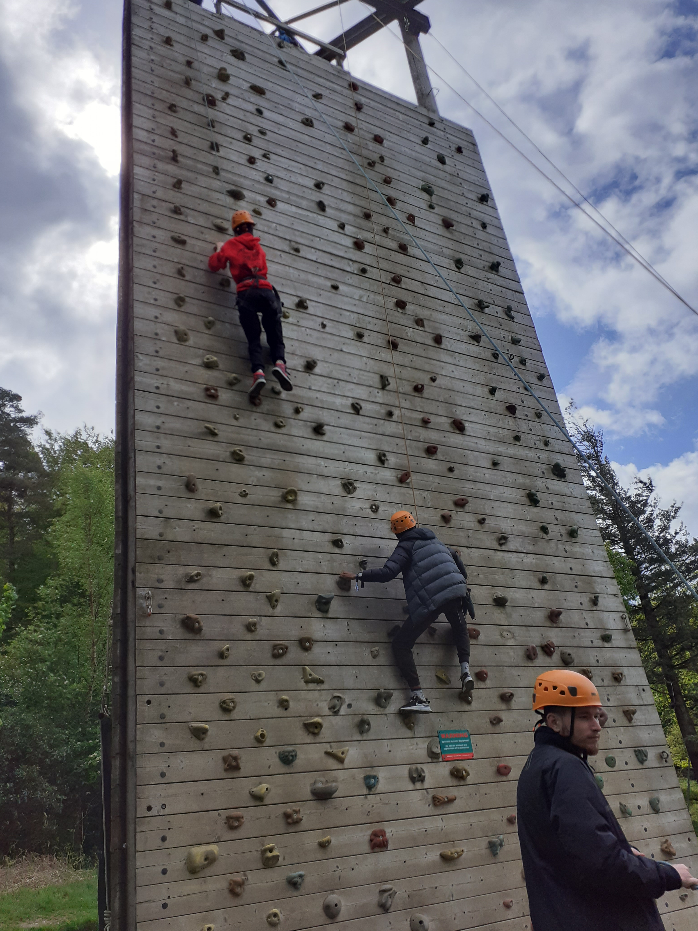
What did we do?
Baby Week
Summer school holiday campaign
Safeguarding conference led by young people
South Asian Heritage Month
Our Year Play Day
School summer holiday campaign
Our year Summer Transition activities
Manchester Pride- young persons involvement
Ukrainian Family Day
Young World 2022 Summit
Wild In Art 'We Made It’ trail
Primary Green Bee Festival
Outdoor education conference
Outdoor Education Conference
Manchester Science Fest
Black History Month
Science Festival
Launched Our Year legacy fund
Care leavers week
UNICEF UK Launch
Youth Climate Conference
Christmas Light Switch on with winners of the illumination competition
End of year 'Our Year' celebration
MYC 10 Year celebration
Full Council with young people
Supported SEND young people to attend a range of festive activities
JULY
AUGUST
SEPTEMBER
OCTOBER
NOVEMBER
DECEMBER

Slide 17
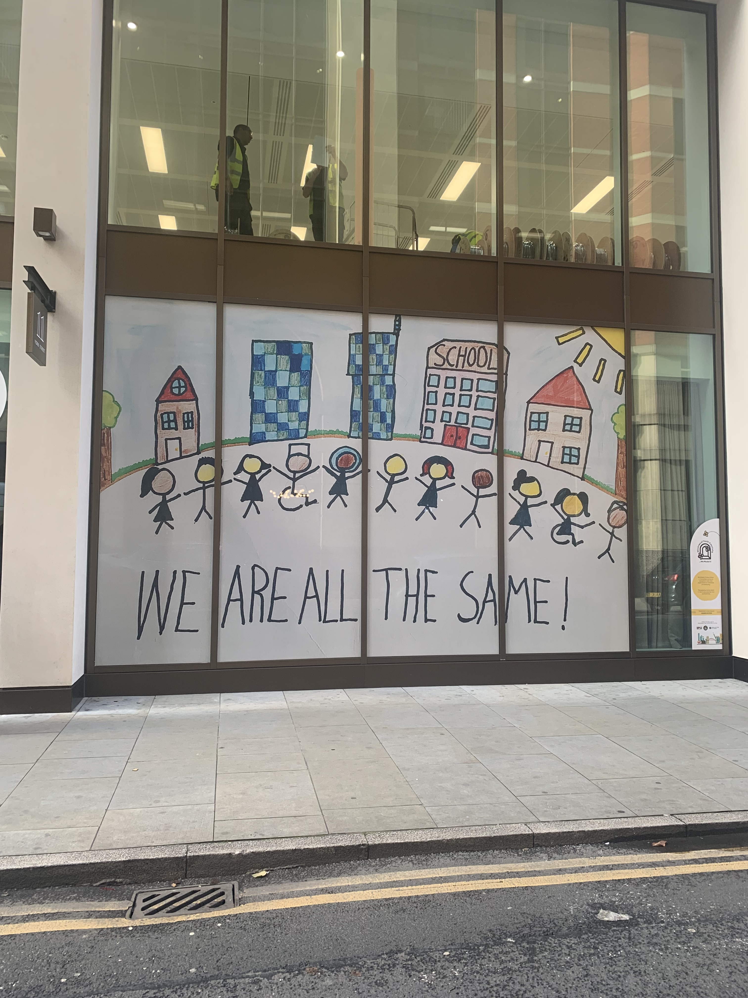
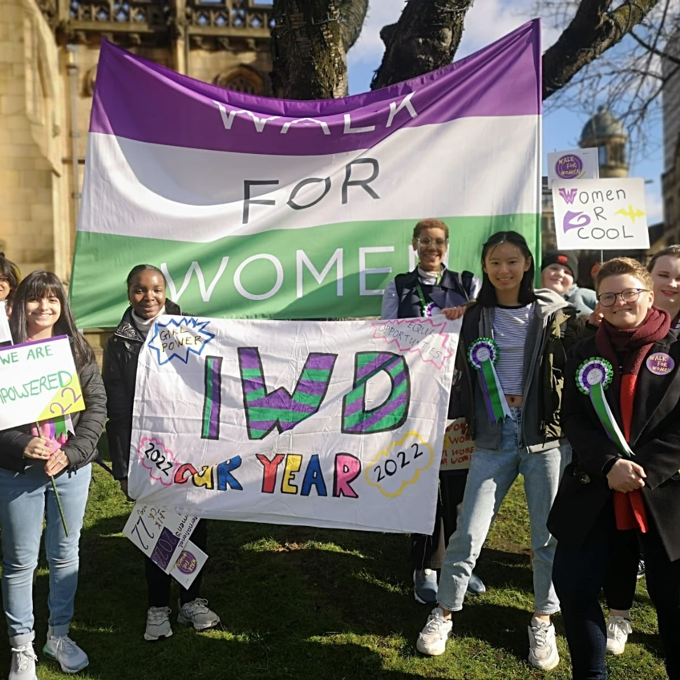
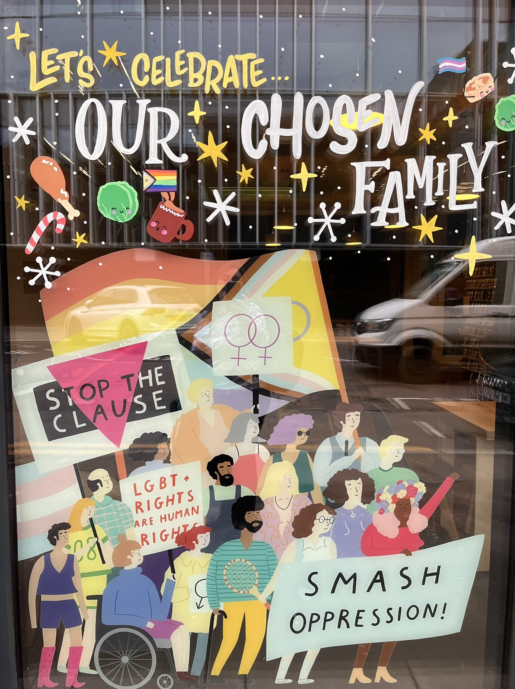
Equal and Included
One of the main themes taken directly from children and young people was ‘Equal and included’​
​
Examples of innovative practice​:
Community Iftar with 120 Care experienced young people​,
Youth Pride activities
Young people led our International women's day celebrations​
Displayed art work across prominent city Centre venues created by young people with additional needs​
Worked with our private sector to open up additional opportunities to theatre, family events at no cost to our SEND young people
Worked closely with our new arrivals team to increase access to recreational and educational activities.

Slide 18
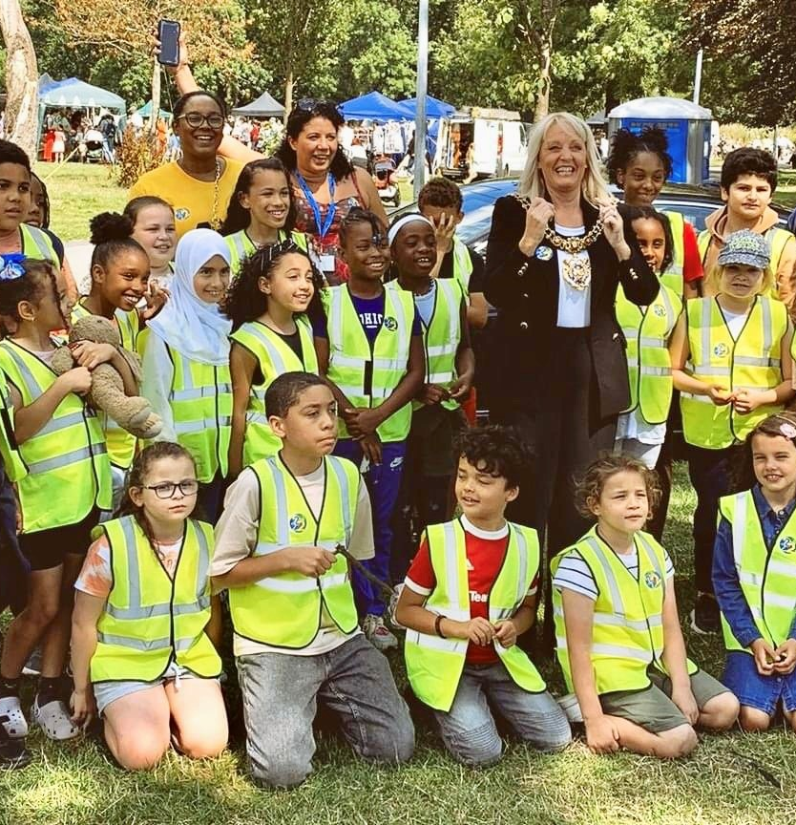
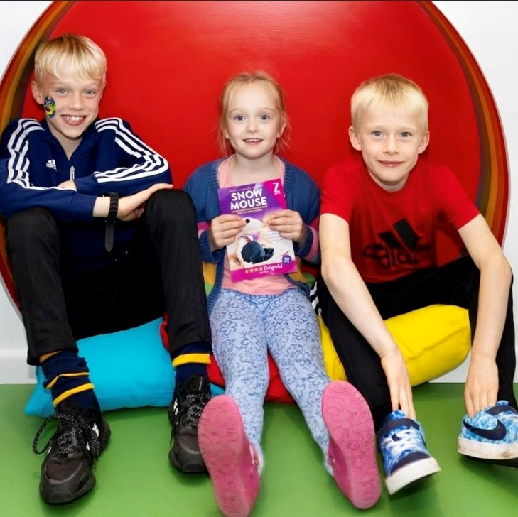
2022 Our Year (Impact)
"Not only did they love the theatre, they were very pleased to have met other young people of similar age (and background) and had the opportunity to experience the theatre together for the first time." International New Arrivals Team
"Being able to go on a weekend away with friends and learning new skills has been amazing!” Youth project in Moss Side
“Our families had an amazing time at the light switch on and the children are so proud of themselves, so thank you again for your support and ensuring SEND young people were included in the programme.” Parent of illumination competition winner
“Being able to talk to business leaders about how they achieved success has really given me some ideas and motivation. It was great to be able to walk up a mountain at the same time, what a great idea.” Fresh Walks participant (aged 17)
“I just love that there are so many children here today from different backgrounds, all playing together. I hope this is something you will do every year.” Parent at Our Year Play Day event

Slide 19
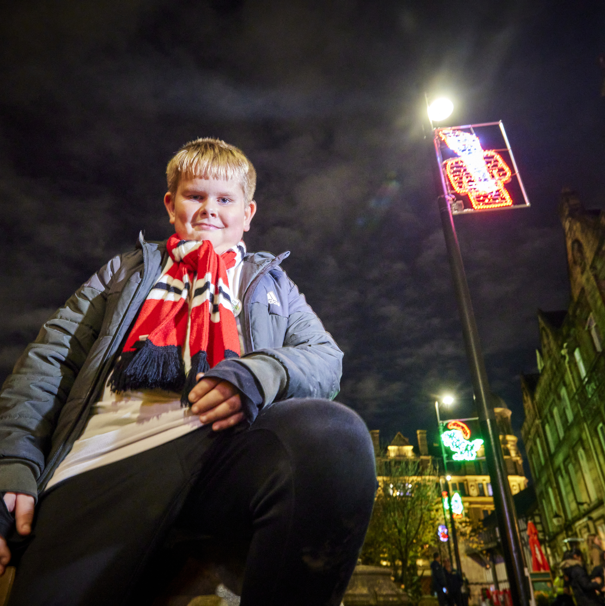

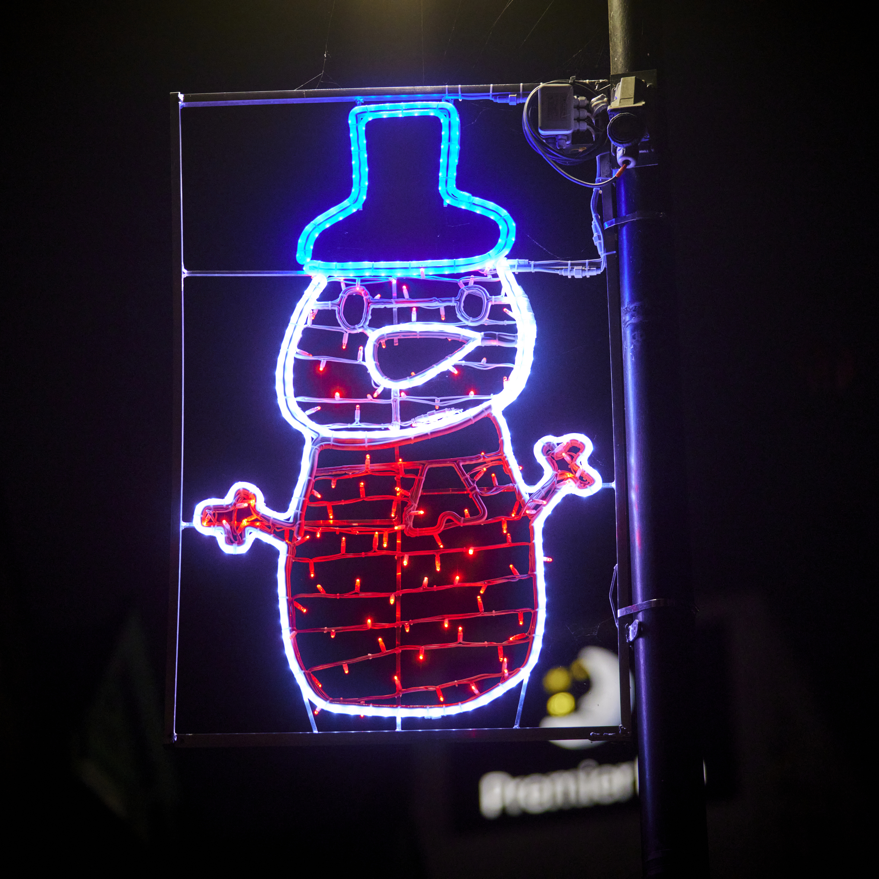
2022 Our 2022 Our Year headlines and achievements (Impact)
6000+ pieces of equipment donated, including sportswear, sports equipment, arts and craft supplies, IT, books. 2000+ young people attended Our Year MCR Day Youth Festival. 1700 attended the launch of Baby Week. 4,038 participants across the week. Enhanced Holiday offer throughout 2022 with 44,019 young people accessing holiday provision across 4829 sessions. An additional 150 neuro-diverse young people were supported to attend the Art Assembly.

Slide 20
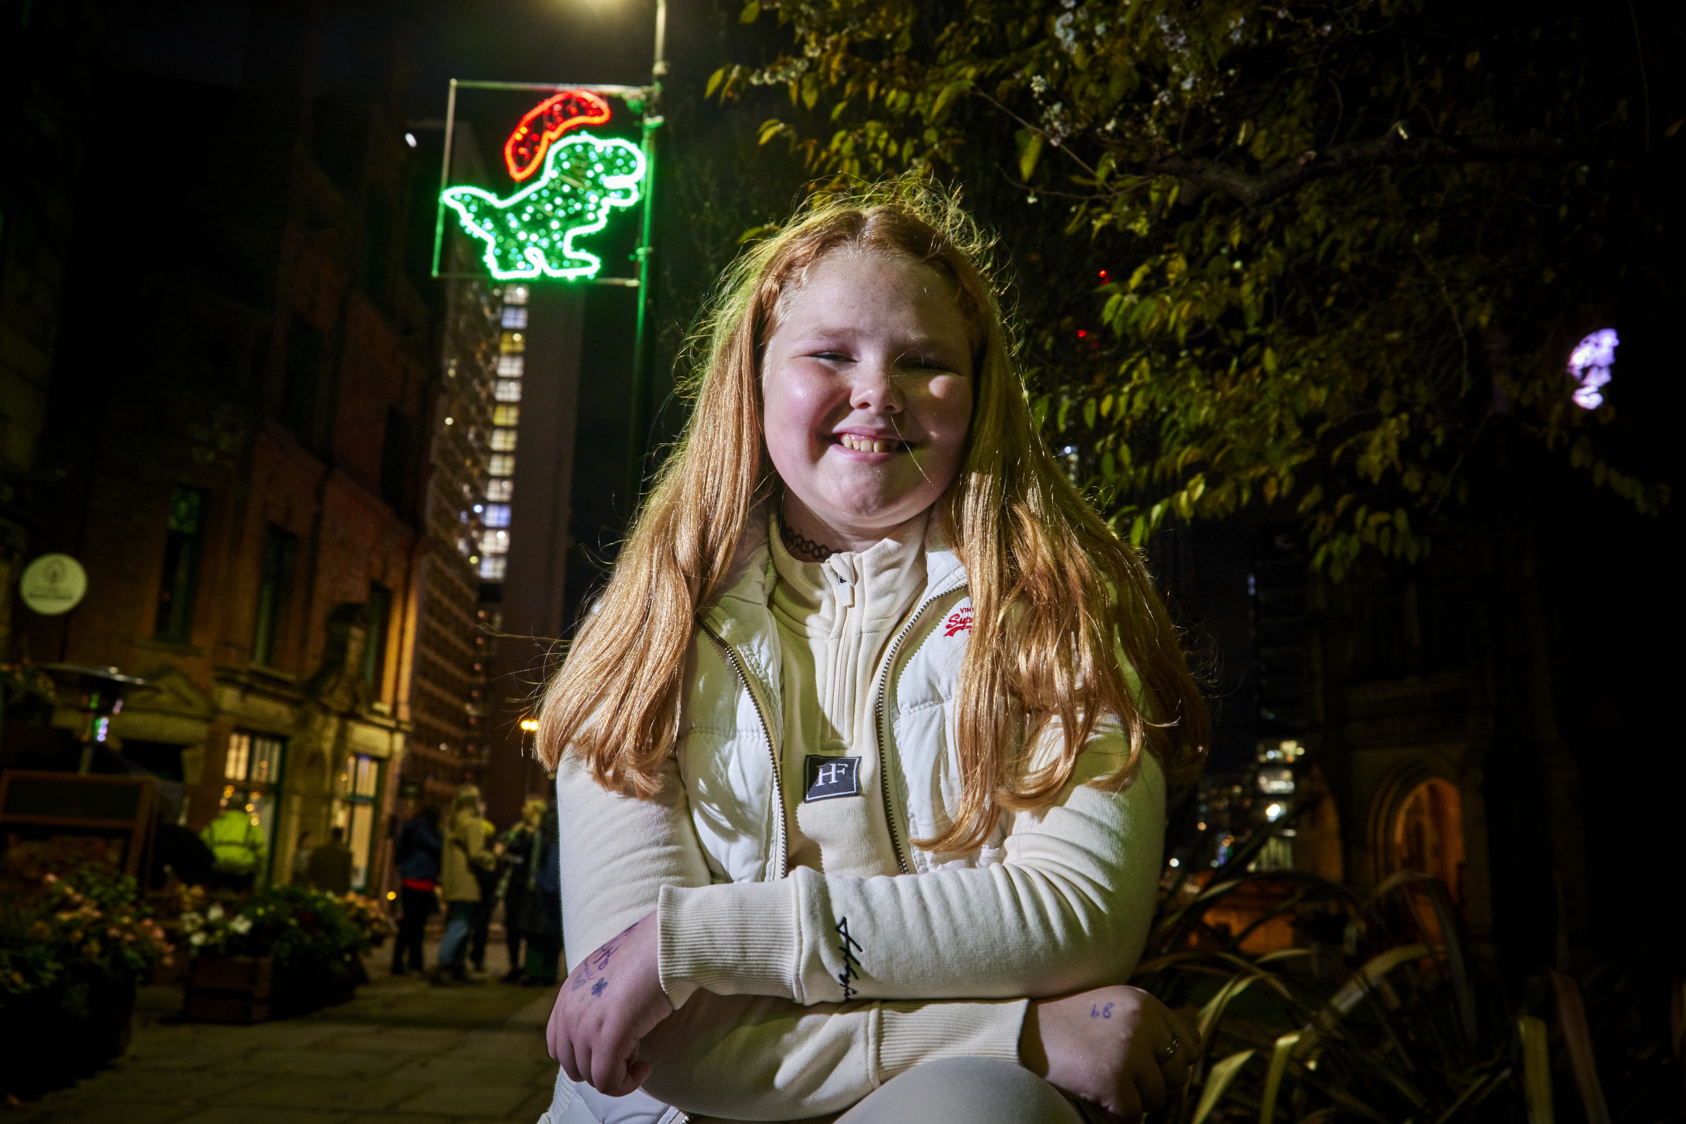

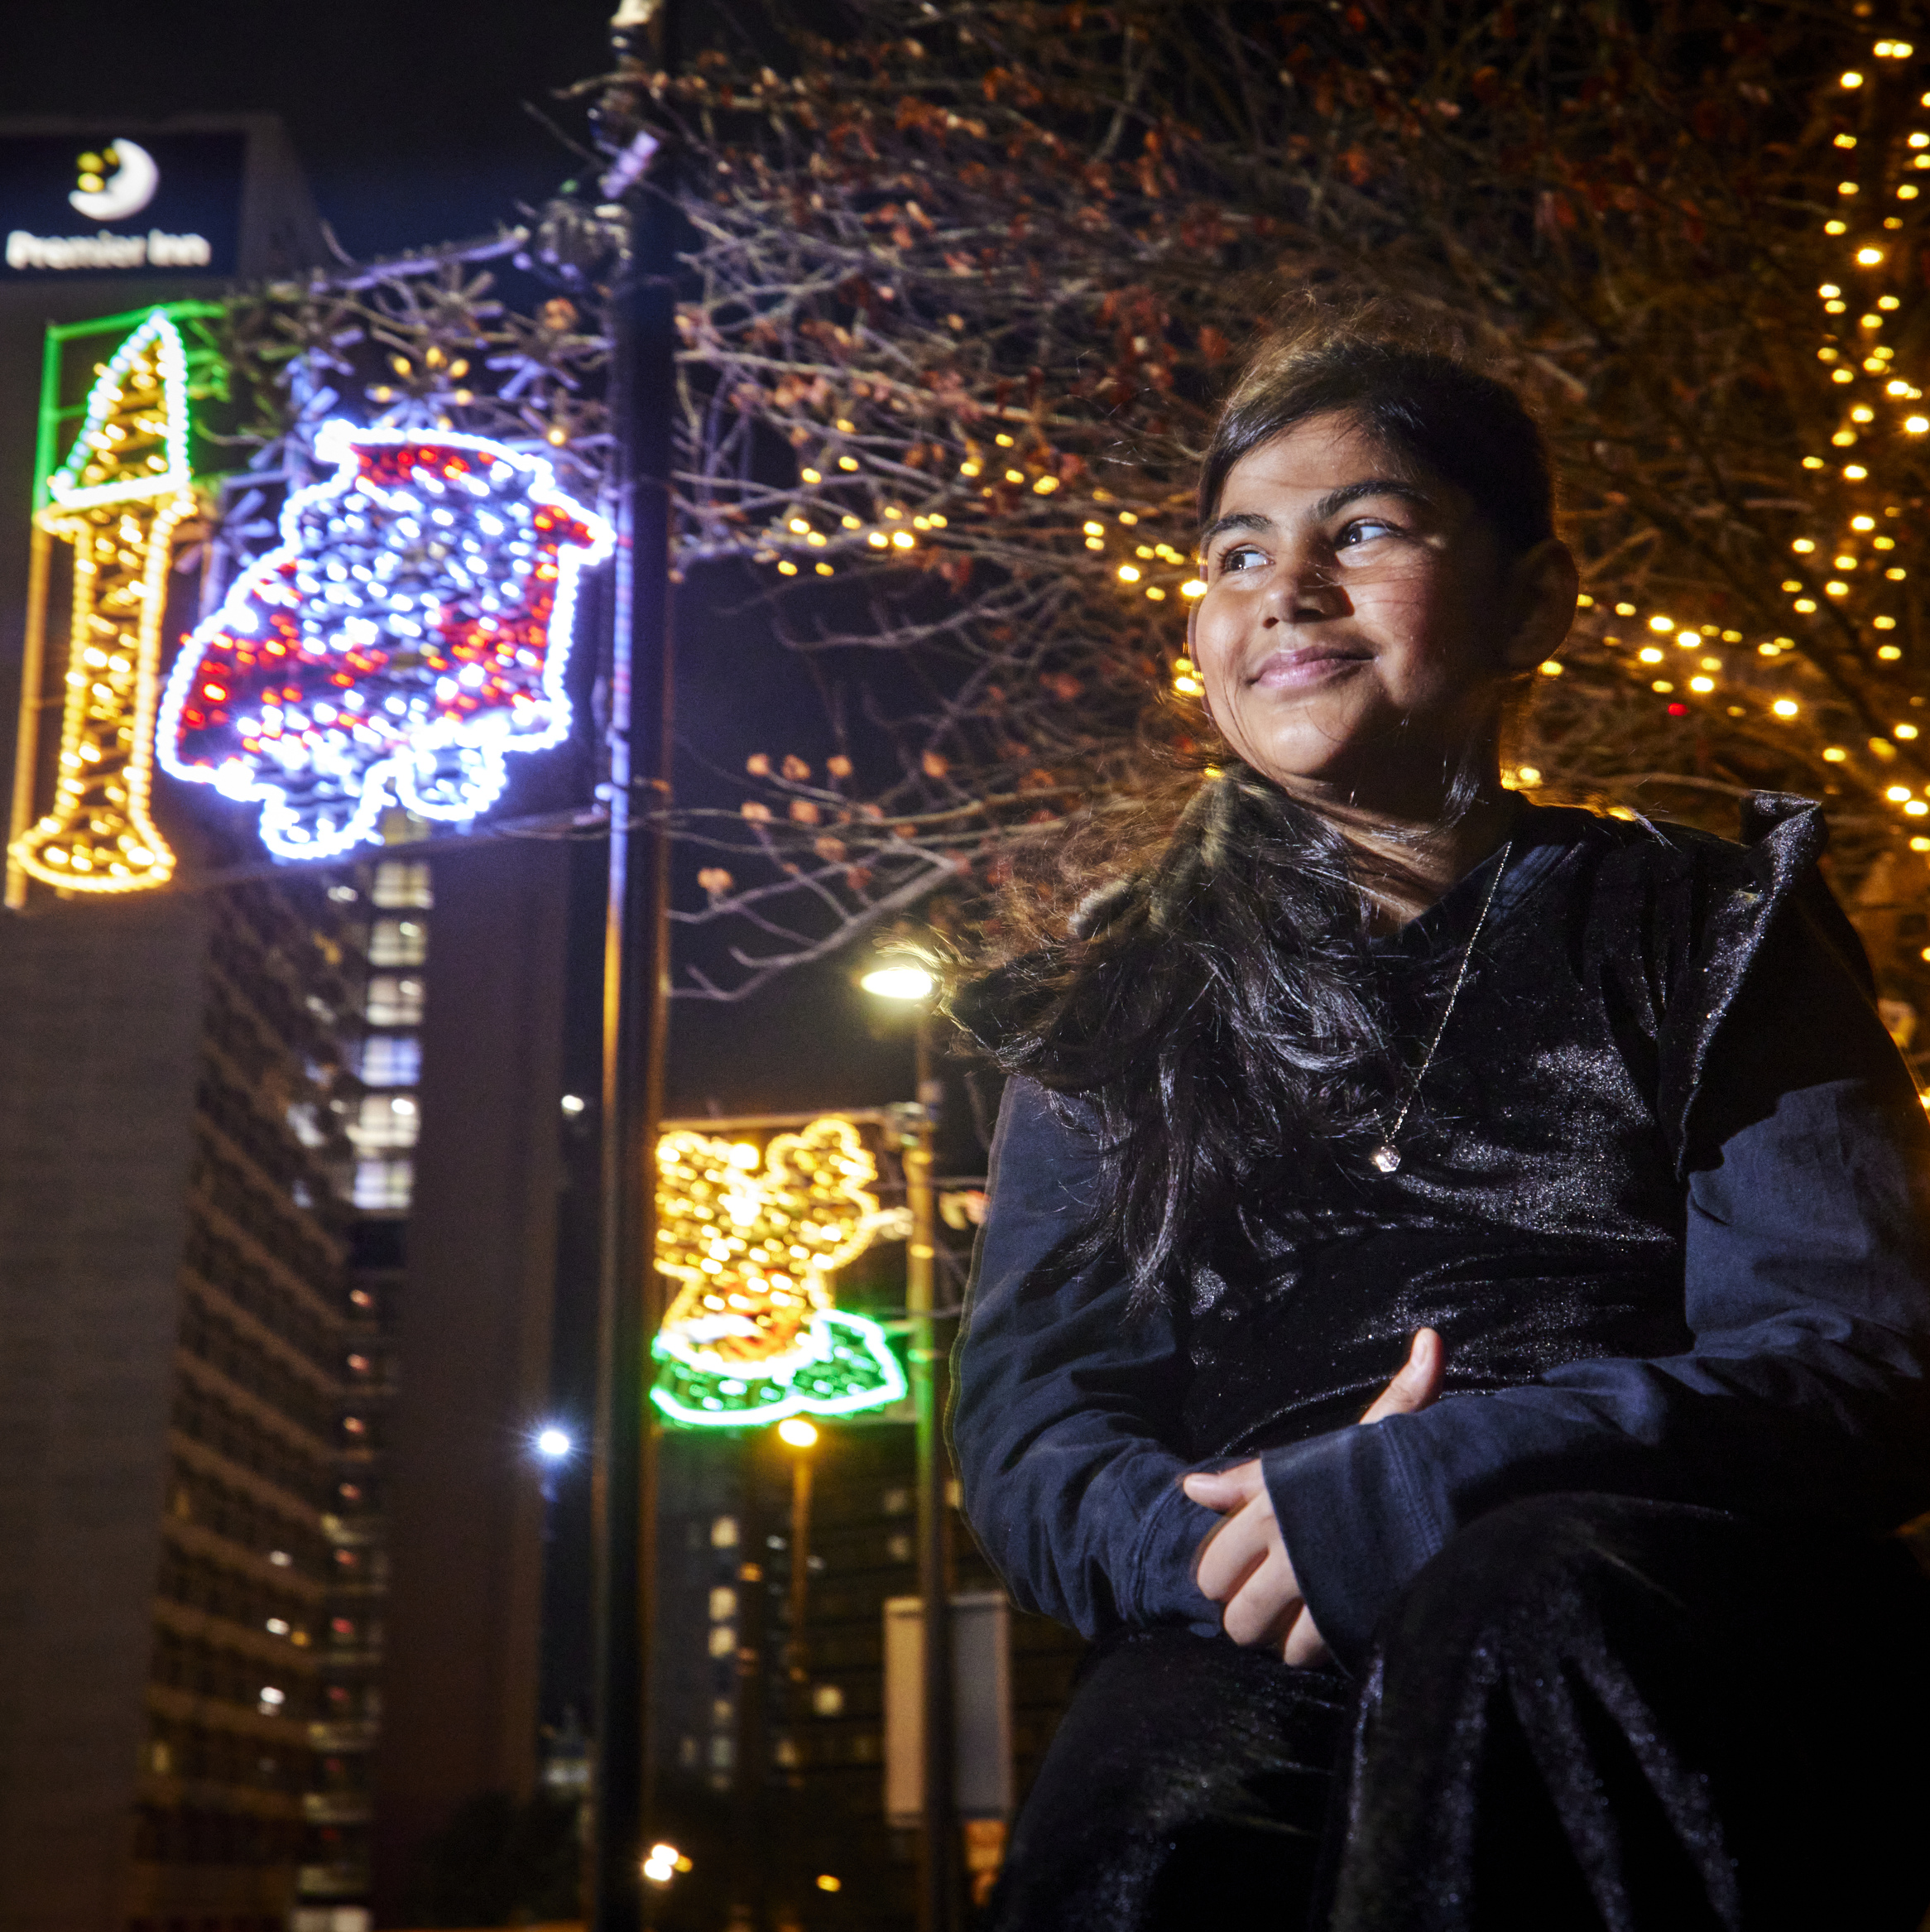
2022 Our 2022 Our Year headlines and achievements (Impact and Reach)
55,000+ children and young people have attended an event or opportunity linked to the Our Year programme.
120 young people attended the Our Year community Iftar.
Over 1000 young people took part in the Manchester Day Parade.
3000 people attended the Our Year Play Day event.
300 young people had their artwork displayed in prominent city centre venues.
3000 a further young people recorded their skills development around teamwork, self belief, self management, problem solving and communication.
300 young people accessed an outdoor residential for the first time.

Slide 21
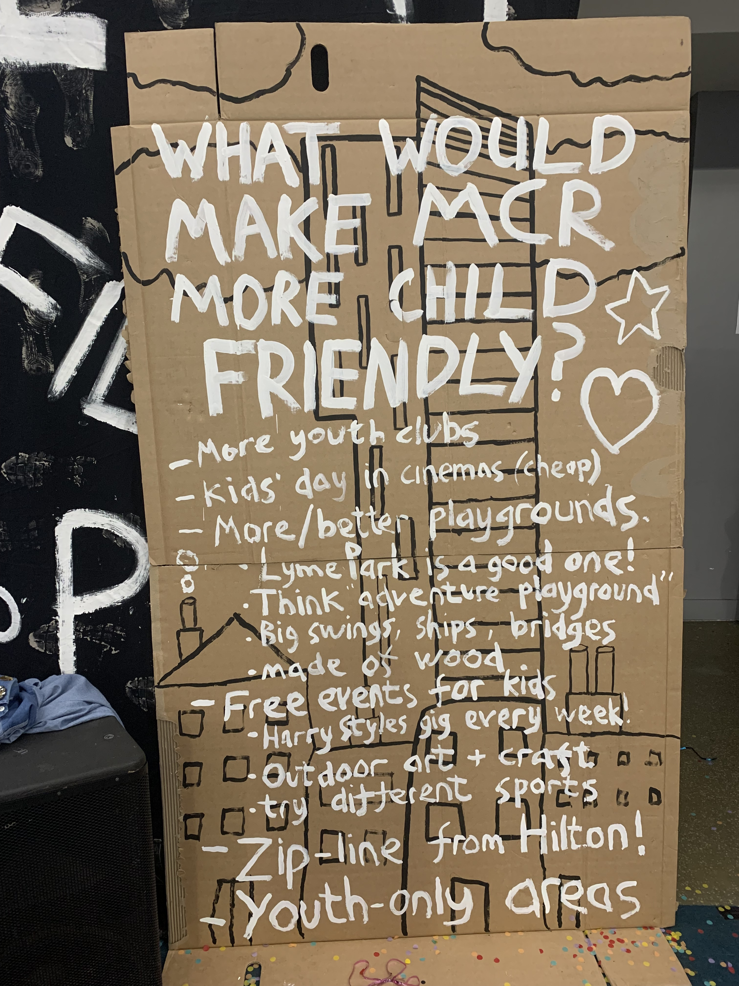
Legacy. Culture shift.
Following the success of Our Year, we have:​
Built in several legacy events​
Regular engagement between senior staff, councillors and young people​
Continued to embed the culture, change the DNA of the city
Started our journey to become a UNICEF UK child friendly city in January 2023
We are currently at Discovery Phase to see where things are going well for children and where things need to change
Based on analysis, we will choose priority areas and, with support from UNICEF UK, achieve progress over the following 3-5 years.
The journey to become a Child Friendly City started in January 2023

Slide 22
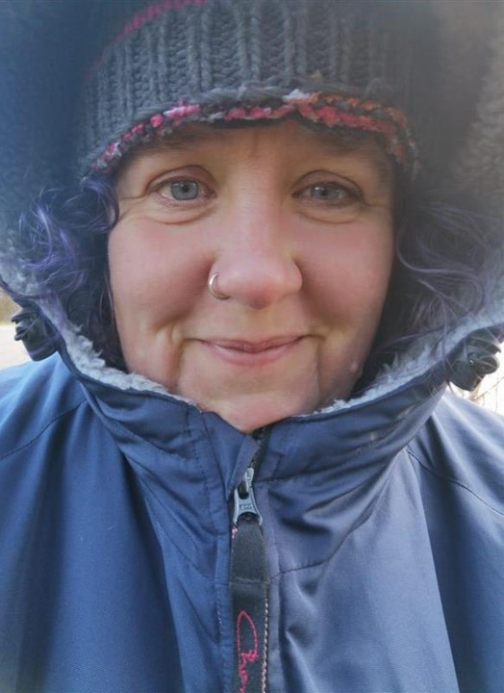
Karen Creavin
CEO, Active Wellbeing Society
@TAWSociety
CoopInnovation
#CCIN2022

Slide 23

Project Brum

Slide 24
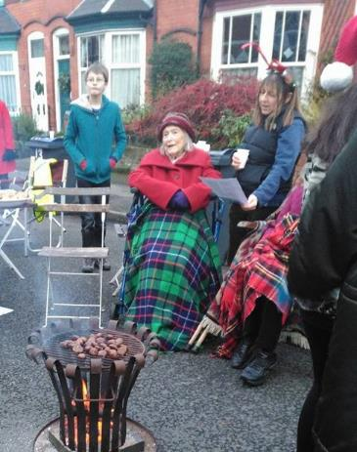
TAWS vision: Healthy, happy people living active and connected lives
Established as a mutual, member led cooperative 2017
Assets locked for community benefit
Part of Birmingham’s aspiration to have a wider civic family
Members are staff and citizens
Working towards a participatory membership approach
Creating a social movement around ‘active citizenship’

Slide 25
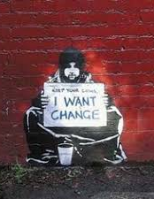
What was the issue we are trying to resolve?
Birmingham is a statistically young city with 408,000 people in a city of 1.1 million living in the top 10% most deprived households in the country
Young people are disproportionately impacted on by the deprivation. Young people’s educational experience and employment prospects hit hard by effects of coronavirus pandemic and the economic recession. Many young people struggle to bridge the gap between education and employment because they lack practical skills and experience within the workplace.
They often have limited access to high worth networks and opportunities and aspirations are impacted upon accordingly
Impact of living in poverty and scarcity on young people impacts on their future and those of their families
We have a responsibility to be the ancestors the future needs, playing our part in educating those coming after us…

Slide 26
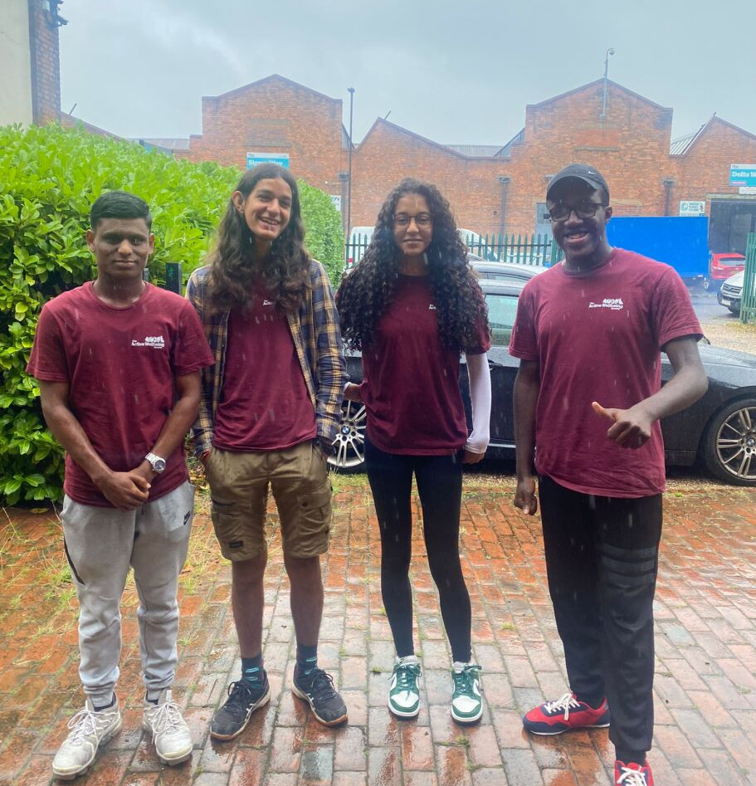
What did we try to do about it
Project Brum is a paid summer placement which runs for 12 weeks from June to September
It has been running in Birmingham since 2017
It aims to support young people to gain skills and experience, and access employment opportunities
The target demographic is young people (aged 16-24) who are not employed or who are studying in school, college, or university.
The programme is particularly designed to benefit young people living in areas of high deprivation from across Birmingham
Since 2020, Project Brum staff have been paid the real living wage
They gain experience working in a community development role supporting a range of outdoor delivery projects as well as working in our operations departments including Marketing, Data and Insight

Slide 27
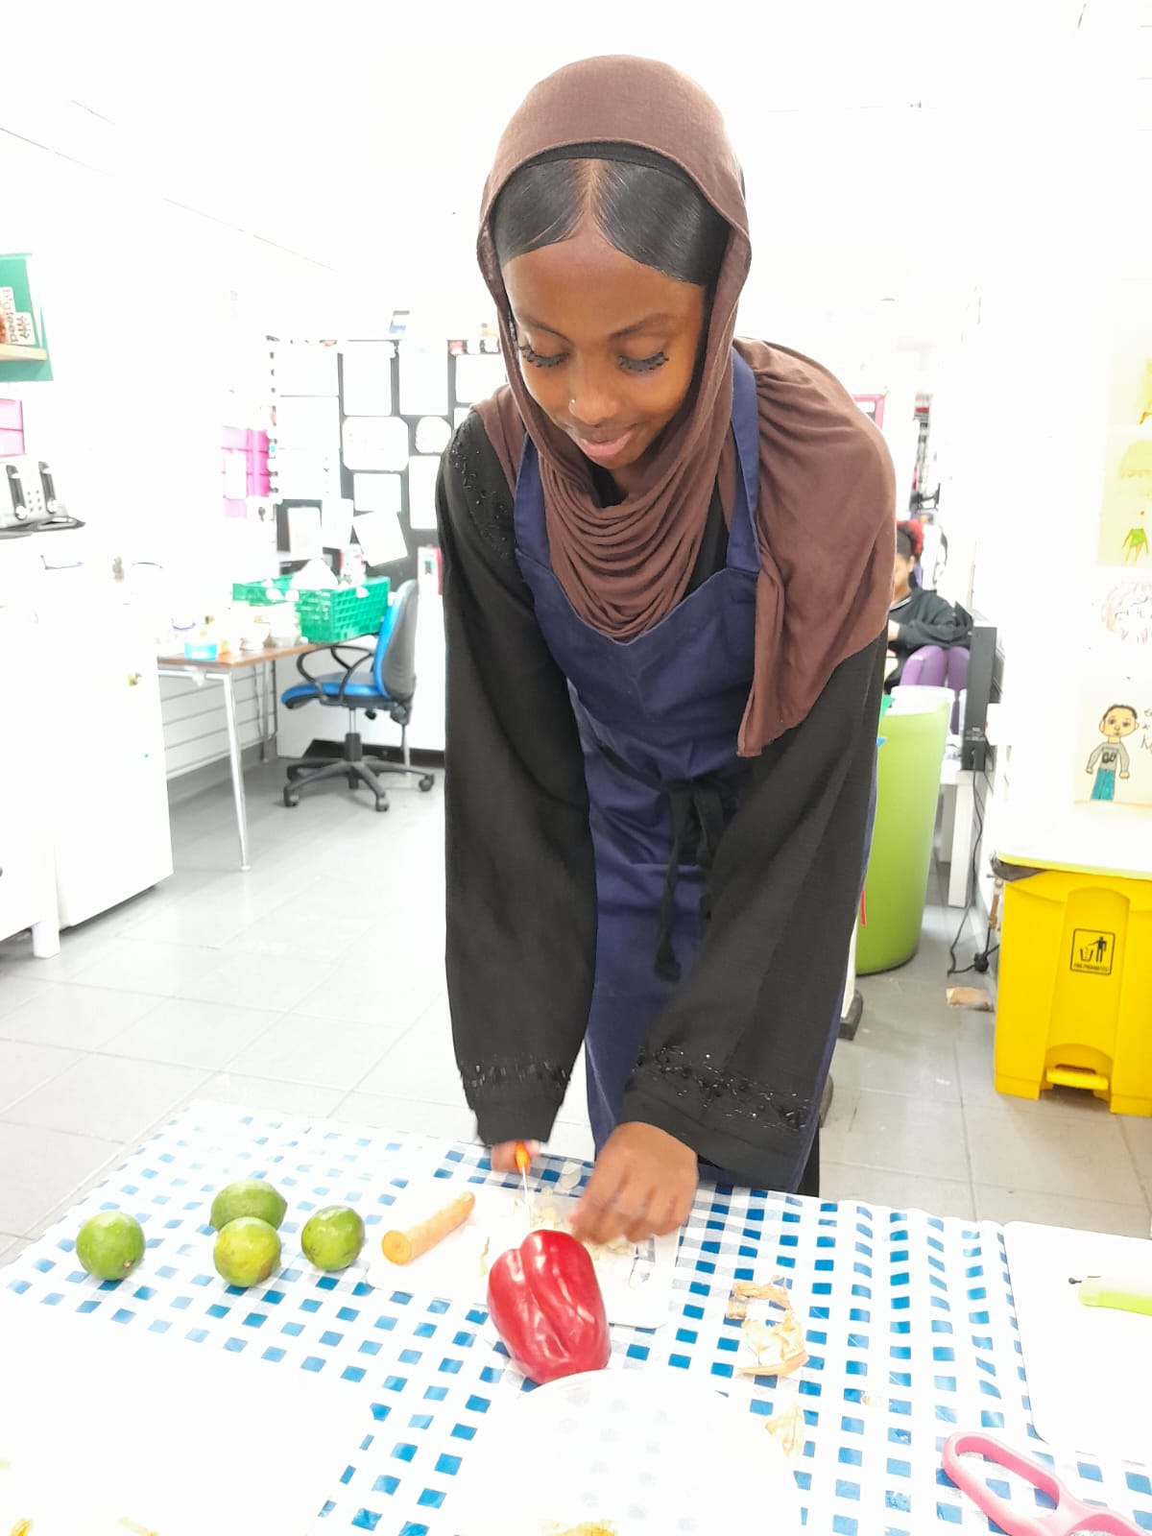
What does that mean in practice
We’ve been able to provide over 300 young people an opportunity to gain invaluable workplace based experience whilst developing skills and building confidence to improve employability prospects since 2017.

Slide 28
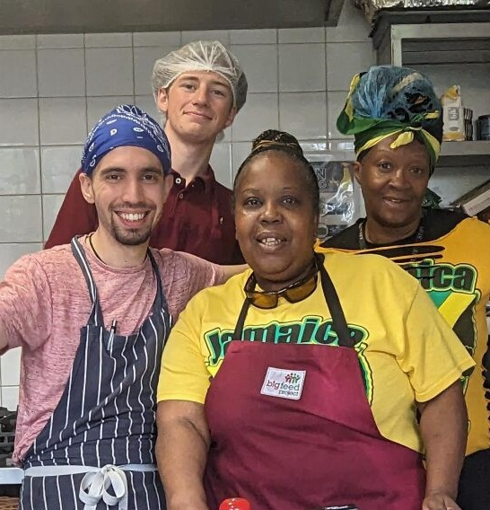
Outcomes
Paid work experience within a medium-large third sector organisation with a wealth of experience in community outreach and engagement as well as other back office experiences
Wide range of placements and training opportunities on offer
Paid, short-term employment which helps bridge the gap between education and employment
Gain demonstrable skills and experience which we help them to write up and share with potential employers
Opportunity to return to work for Project Brum for multiple years, gain skills, and access further training
Peer support and mentor schemes running by and with the young people
Opportunity to join Project Brum Alumni
TAWS has employed over 10 of the young people on a permanent basis

Slide 29
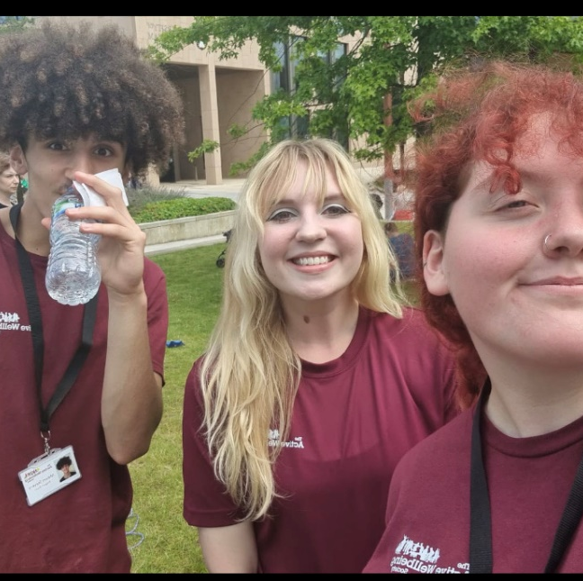
Mason’s story
My name is Mason and over the summer I was part of the Active Streets team… this being my first job, I was very nervous and didn’t know what to expect. Nerves soon died down after a warm welcome at the main office at Hay Hall from all the staff and I settled in pretty much straight away and felt part of the team.
Throughout the summer I enjoyed going to different places, interacting with different people and gaining that experience… This job very much helped me in my own life due to the exposure. I was working in an environment where socialisation was a big factor, whether it be playing with the young children or talking to the adults.
Throughout the job my social skills have come such a long way not just in my work life but in my social life too. It has taught me how to communicate with different people.
Overall, I have really enjoyed my time here at TAWS and have learnt so much about the world and others but most importantly, myself. This job forced me out of my comfort zone and pushed me past limits I didn’t think I could get to, and for that I will be forever grateful to the staff that took me onboard. If I can, most definitely be back next summer for some more work. Thank you, TAWS

Slide 30
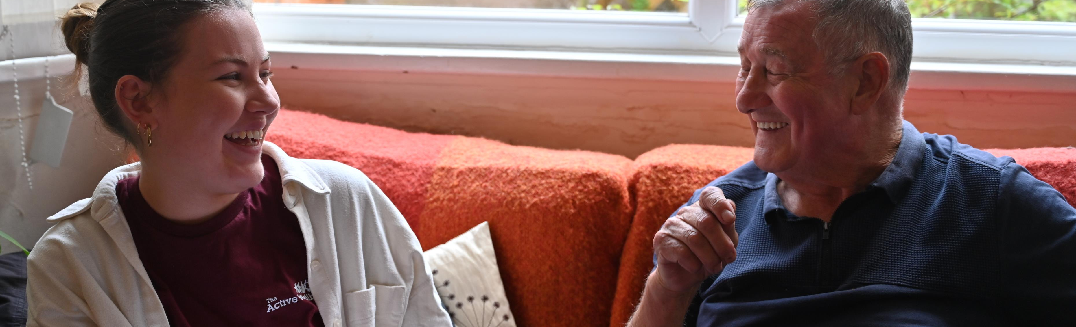
So what…
300+ young people
Paid real living wage
Making their communities a better place
Doing real work in real communities
And getting the chance they deserve in life to learn, grow, and be
On our watch, while we are the grown ups in charge

Slide 31
Q & A
Please raise your hand & we’ll bring you a mic

Slide 32
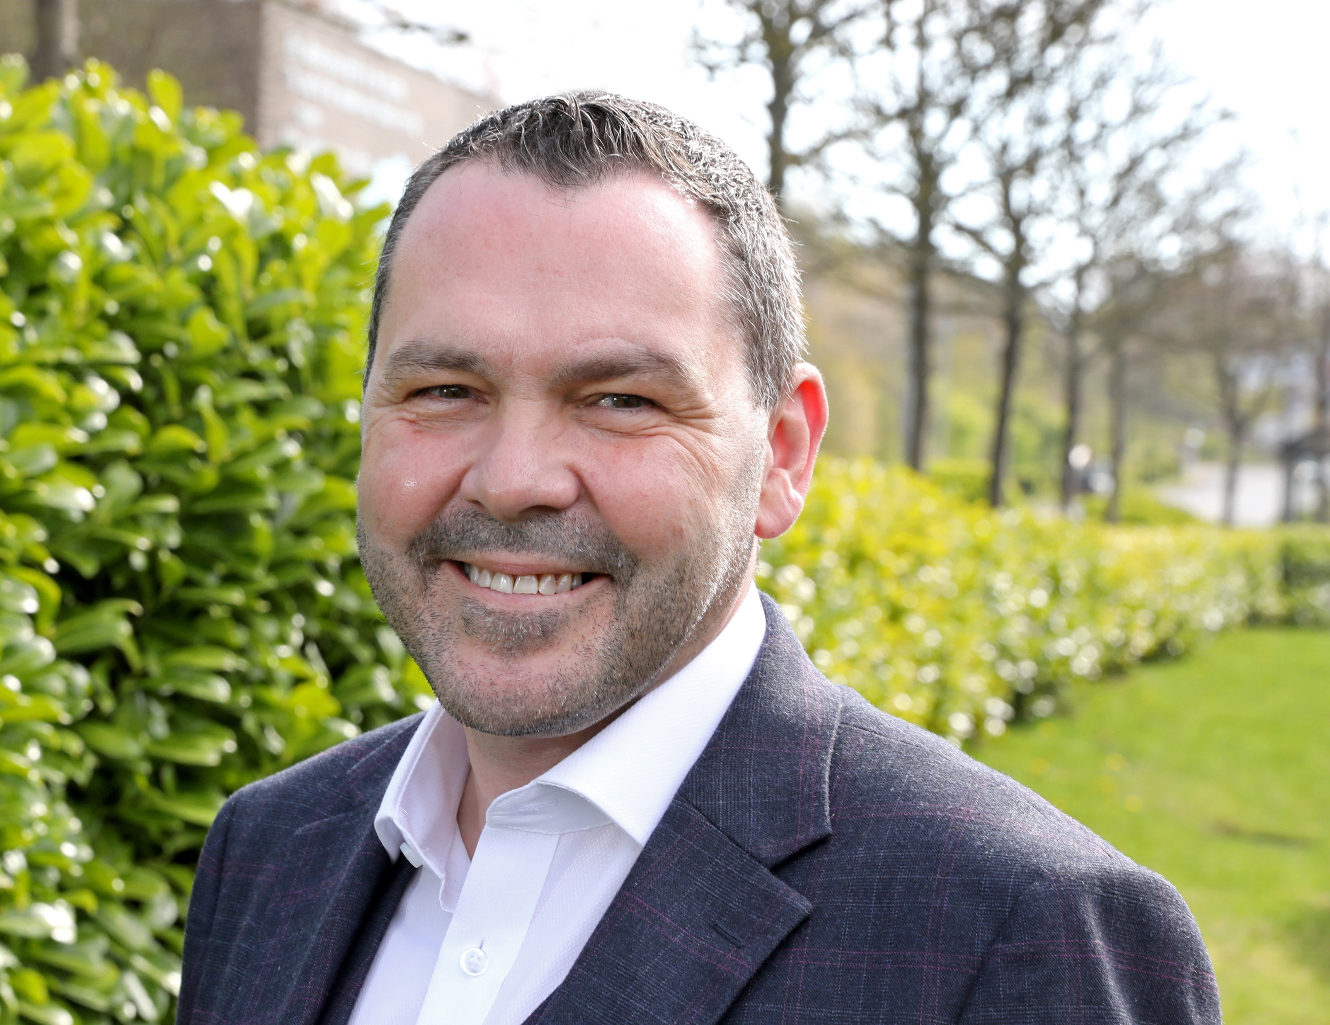
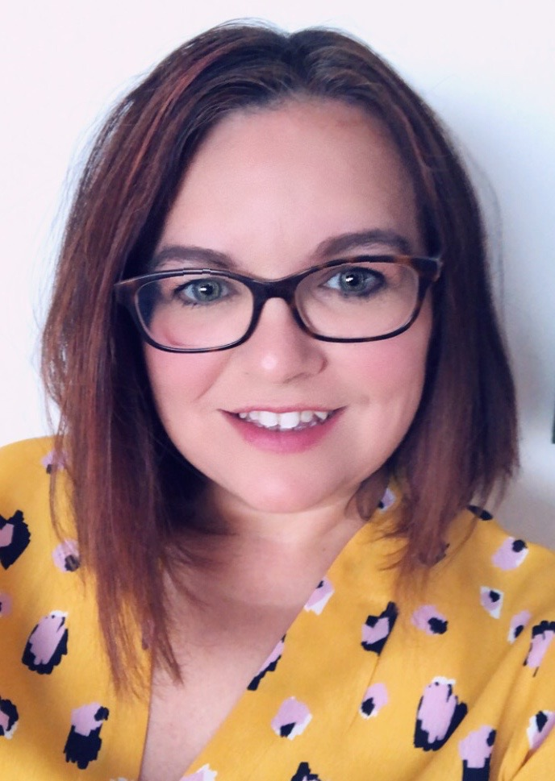
Paul McEldon OBE
Chief Executive – North East BIC
@NorthEastBic
Michelle Booth PhD
Social Enterprise Specialist – North East BIC
@MBSocEnt | @NorthEastBic

Slide 33
Reimagine Sunderland as a Co-operative City
Paul McEldon OBE
Chief Executive
Dr. Michelle Booth PhD
Social Enterprise Specialist

Slide 34
Introducing The BIC
Established 1994
Regions largest business support agency
Supporting start-up and growth of businesses across the region
Provides business advice, support and accommodation
Supported 4000+ businesses, leading to the creation of 7500+ jobs
Over 1000 businesses currently housed over 4 sites
Largest social enterprise team in the country – 12 specialist advisors (North East Centre of Excellence)
Not-for-profit – social enterprise

Slide 35
Introducing the Report/ Commission
Commissioned by Sunderland City Council as part of the Community Wealth Building Agenda to:
Explore the social and co-operative landscape in Sunderland
Map the type of co-operatives resident within the City
Explore best practices (locally, regionally, nationally)
Design a set of recommendations to help to “Reimagine Sunderland as a Co-operative City”

Slide 36
Approaching the Research
PRIMARY RESEARCH
Two Workshops.
Discussions with co-operatives, social enterprises, business advisors, councillors and officers and wider Stakeholders.
SECONDARY RESEARCH
Desk Based Research
Academic, industry and sector reports, Companies House data, Co-operatives UK Directory etc.

Slide 37
Social Enterprise & Co-operative Context in Sunderland
A long history of social and cooperative development
One of the highest per capita concentrations of social businesses in the region
Businesses working across all sectors from care to arts and culture, housing, health food and drink and horticulture

Slide 38
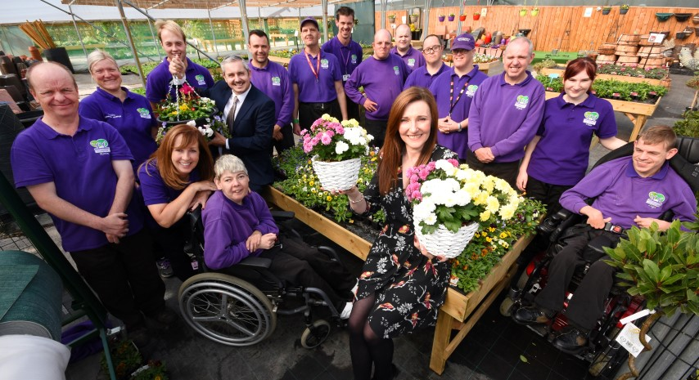
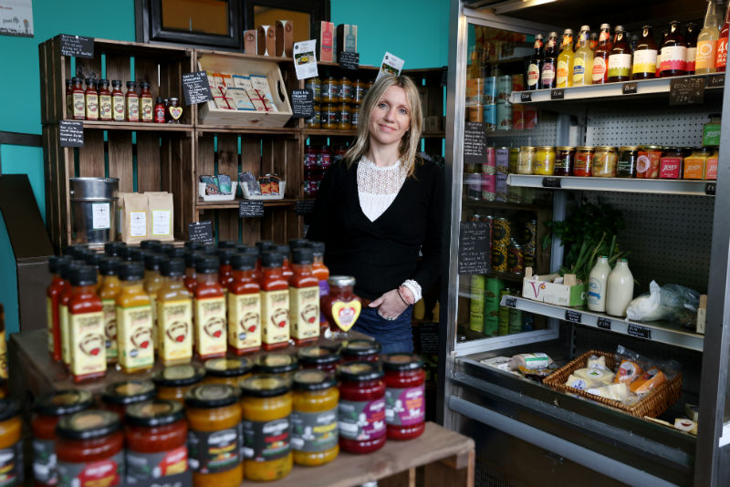

Co-operatives in Sunderland

Slide 39
Research Findings
A solid foundation from which to grow
Opportunities and appetite for collaboration
People see the benefit of change in business and communities
Challenges in changing mindset (focus on profit in business)
Lack of awareness on the co-operative model

Slide 40
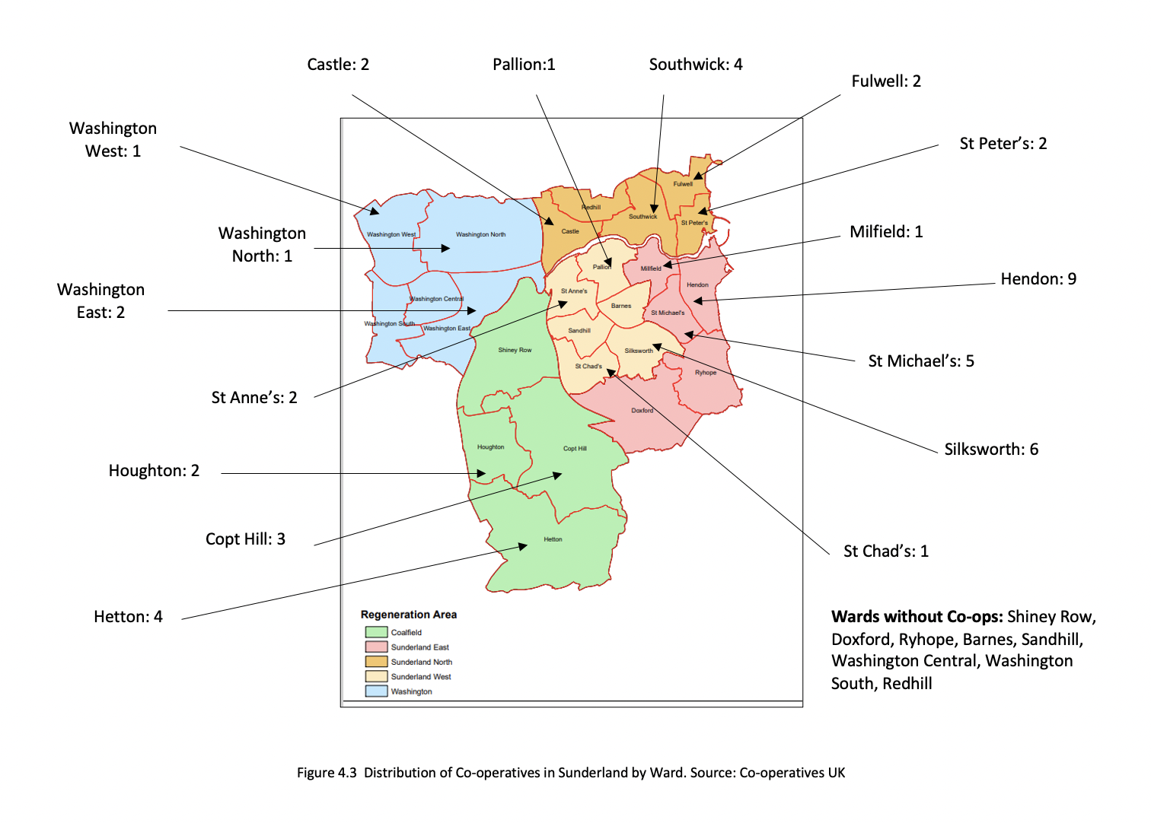
48 Identified Co-operatives– 195 Community Interest Companies Across the City

Slide 41
Social & Clubs
Business Services
Education & Learning
Food & Drink
Arts
Housing
Finance
Leisure
Creatives
Co-operative Sectors

Slide 42
Recommendations
Ecosystem Support
Task Force
Embedding Values
Awareness & Education

Slide 43
Creating an Ecosystem
Ecosystem Model
Policy
Finance
Culture
Supports
Human Capital
Markets
Enterprise Ecosystem Model
Isenberg, 2010

Slide 44
Facilitating the Ecosystem
Feeders
Instigators
Leaders
Ecosystem Model
Feld & Hathaway, 2020

Slide 45
Co-operative Task Force
Cross-sector “Anchors”
Exploring practicalities of developing cooperation and a cooperative mindset in Sunderland
Embedding co-operation across the City
Mobilise the co-operative movement

Slide 46
Developing Awareness: Creating a Buzz
#THINKCo-op

Slide 47
Embedding Co-op Values Into Sunderland
The Co-operative Values
Caring for others
Democracy
Equity
Equality
Honesty
Openness
Self help
Self-responsibility
Solidarity
Social responsibility
Co-operative Values Charter.
Cross-Sector buy-in
Potential to use in procurement processes and tendering

Slide 48
Contacts
Paul McEldon
Paul.mceldon@ne-bic.co.uk
Michelle Booth
Michelle.booth@ne-bic.co.uk

Slide 49
1125 Break
Grab yourself a drink and visit the exhibition
1140 – 1225 Workshops - 1

Slide 50
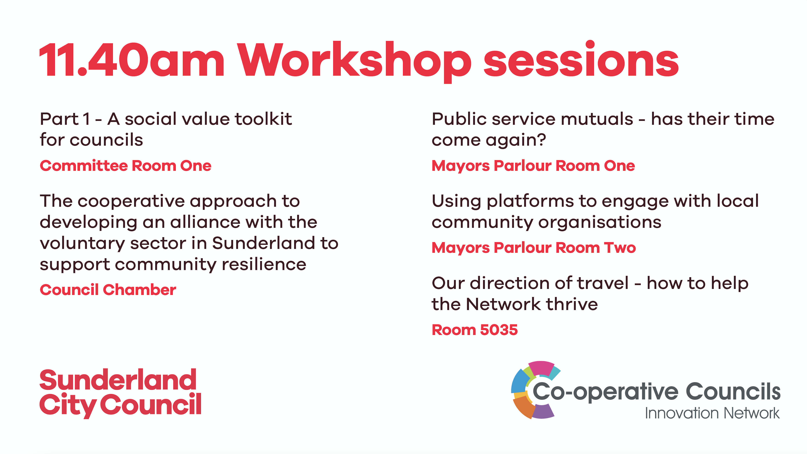
Workshops 1 – 1140-1225

Slide 51
1230 – 1330 Networking lunch & visit exhibitions
1330 - 1415 Workshops - 2

Slide 53
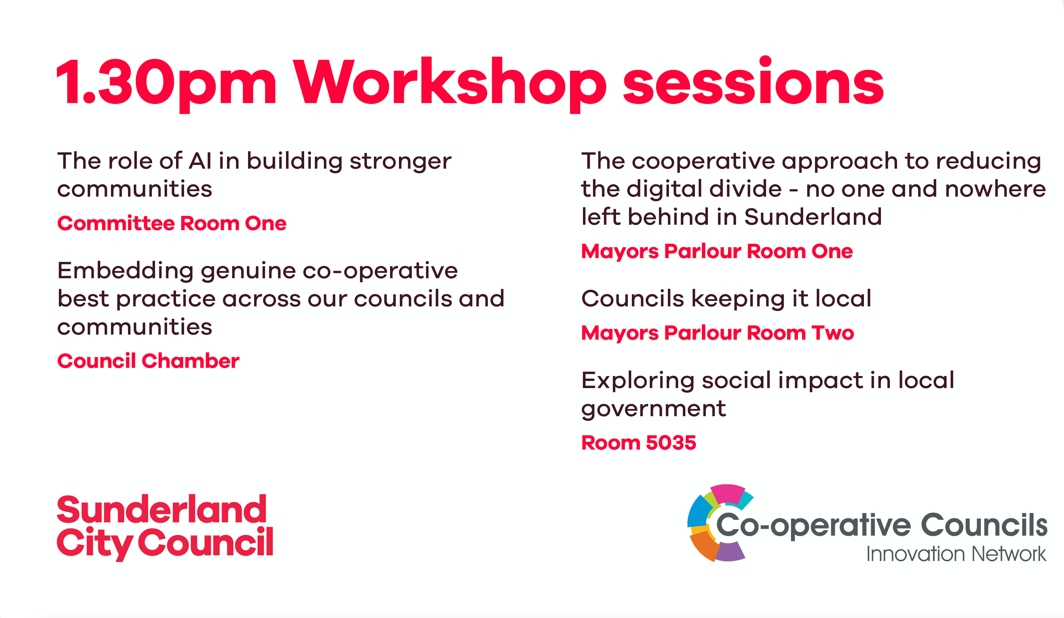
Workshops 2 – 1330 - 1415

Slide 54
1430 Break
Grab yourself a drink and visit the exhibition
1435 – 1520 Workshops - 3

Slide 55
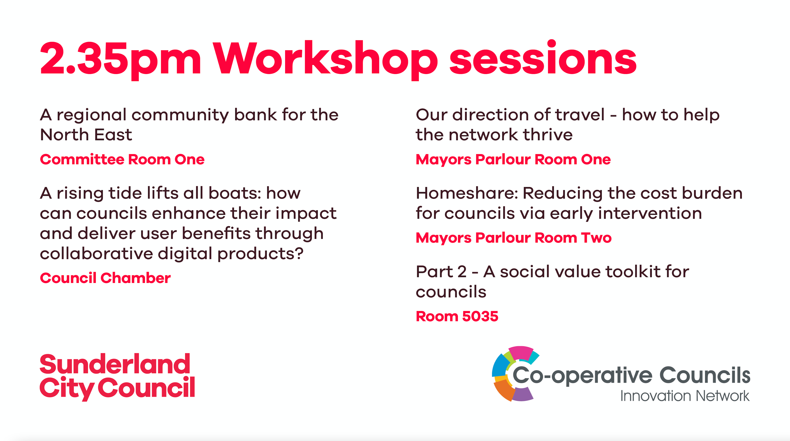
Workshops 3 – 1435-1520

Slide 57
Plenary 2
A Cooperative Council’s Manifesto for the General Election

Slide 58
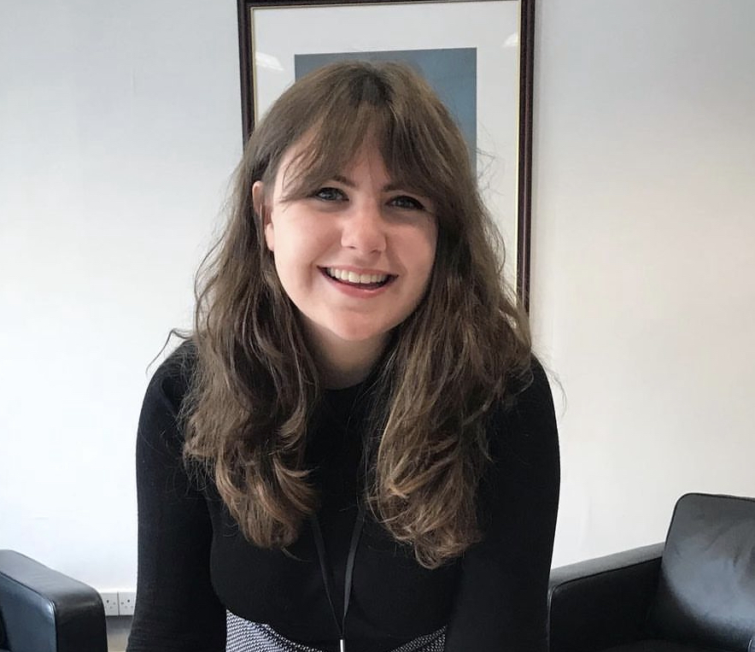
Councillor Sarah Doyle
Chair of V&P Board, CCIN
Cabinet Member for Housing
@srcdoyle | @LPoolcouncil

Slide 59
Speakers:
Cllr Elizabeth Dennis – Leader, North Herts Council
Cllr David Darkin – Leader, Llanelli Town Council
Cllr Zoe Nicholson – Leader, Lewes District Council
Jonathan Bland – Managing Director, E3M/SBI

Slide 60
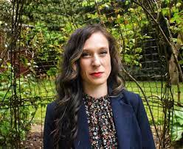
Cllr Elizabeth Dennis
Leader, North Herts District Council
@Cllr_E_Dennis | @NorthHertsDC
CoopInnovation
#CCIN2023

Slide 61
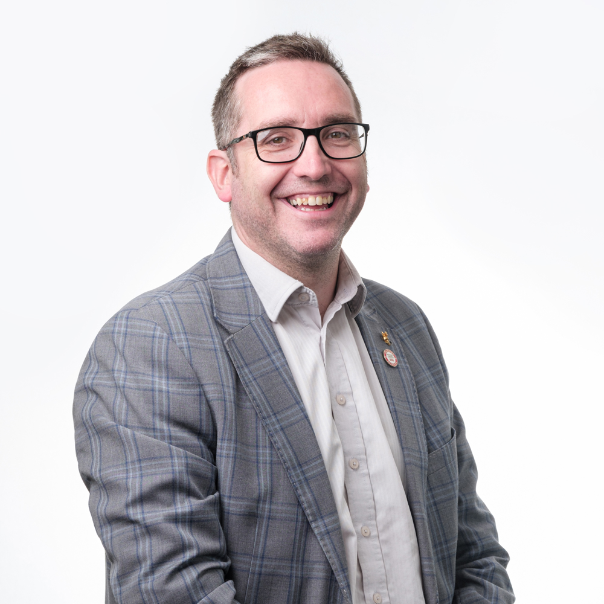
Cllr David Darkin
Leader, Llanelli Town Council
@LrcCommunity
CoopInnovation
#CCIN2023

Slide 62



CYNGOR DRÊF
LLANELLI
TOWN COUNCIL
A Cooperative Council's Manifesto for The General Election
Cllr David Darkin
Leader
Llanelli Town Council
2 November 2023
www.llanellitowncouncil.gov.uk

Slide 63
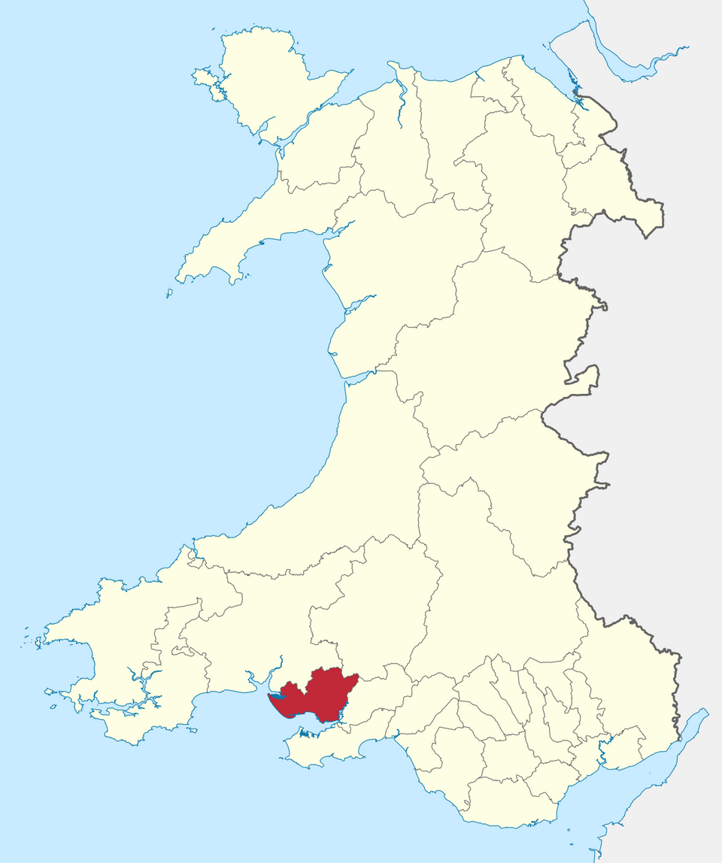


CYNGOR DRÊF
LLANELLI
TOWN COUNCIL
Llanelli
26,225
£1.5m
#CoopDifferences

Slide 64
Values
self-help
self-responsibility
democracy
equality
equity
solidarity
#CoopDifference

Slide 65
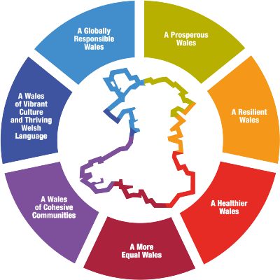
Deddf Llesiant Cenedlaethau'r Dyfodol (Cymru) 2015)
Well-being of Future Generations (Wales) Act 2015
#CoopDifferences

Slide 66
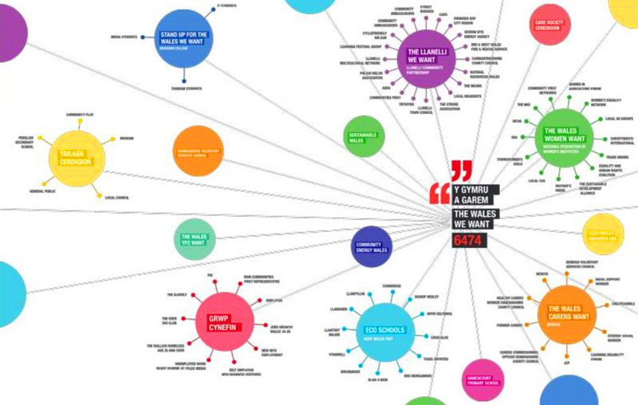
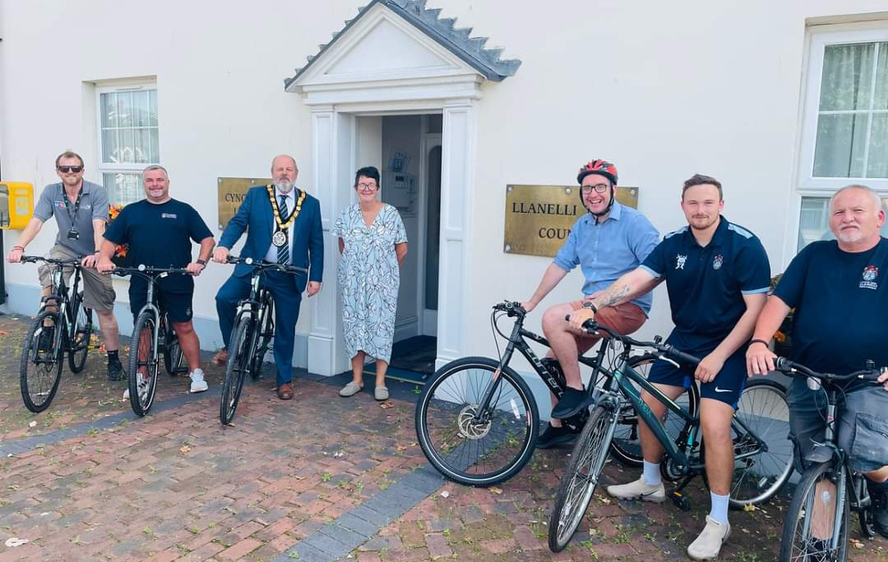
Delivery In Partnership
#CoopDifference

Slide 67
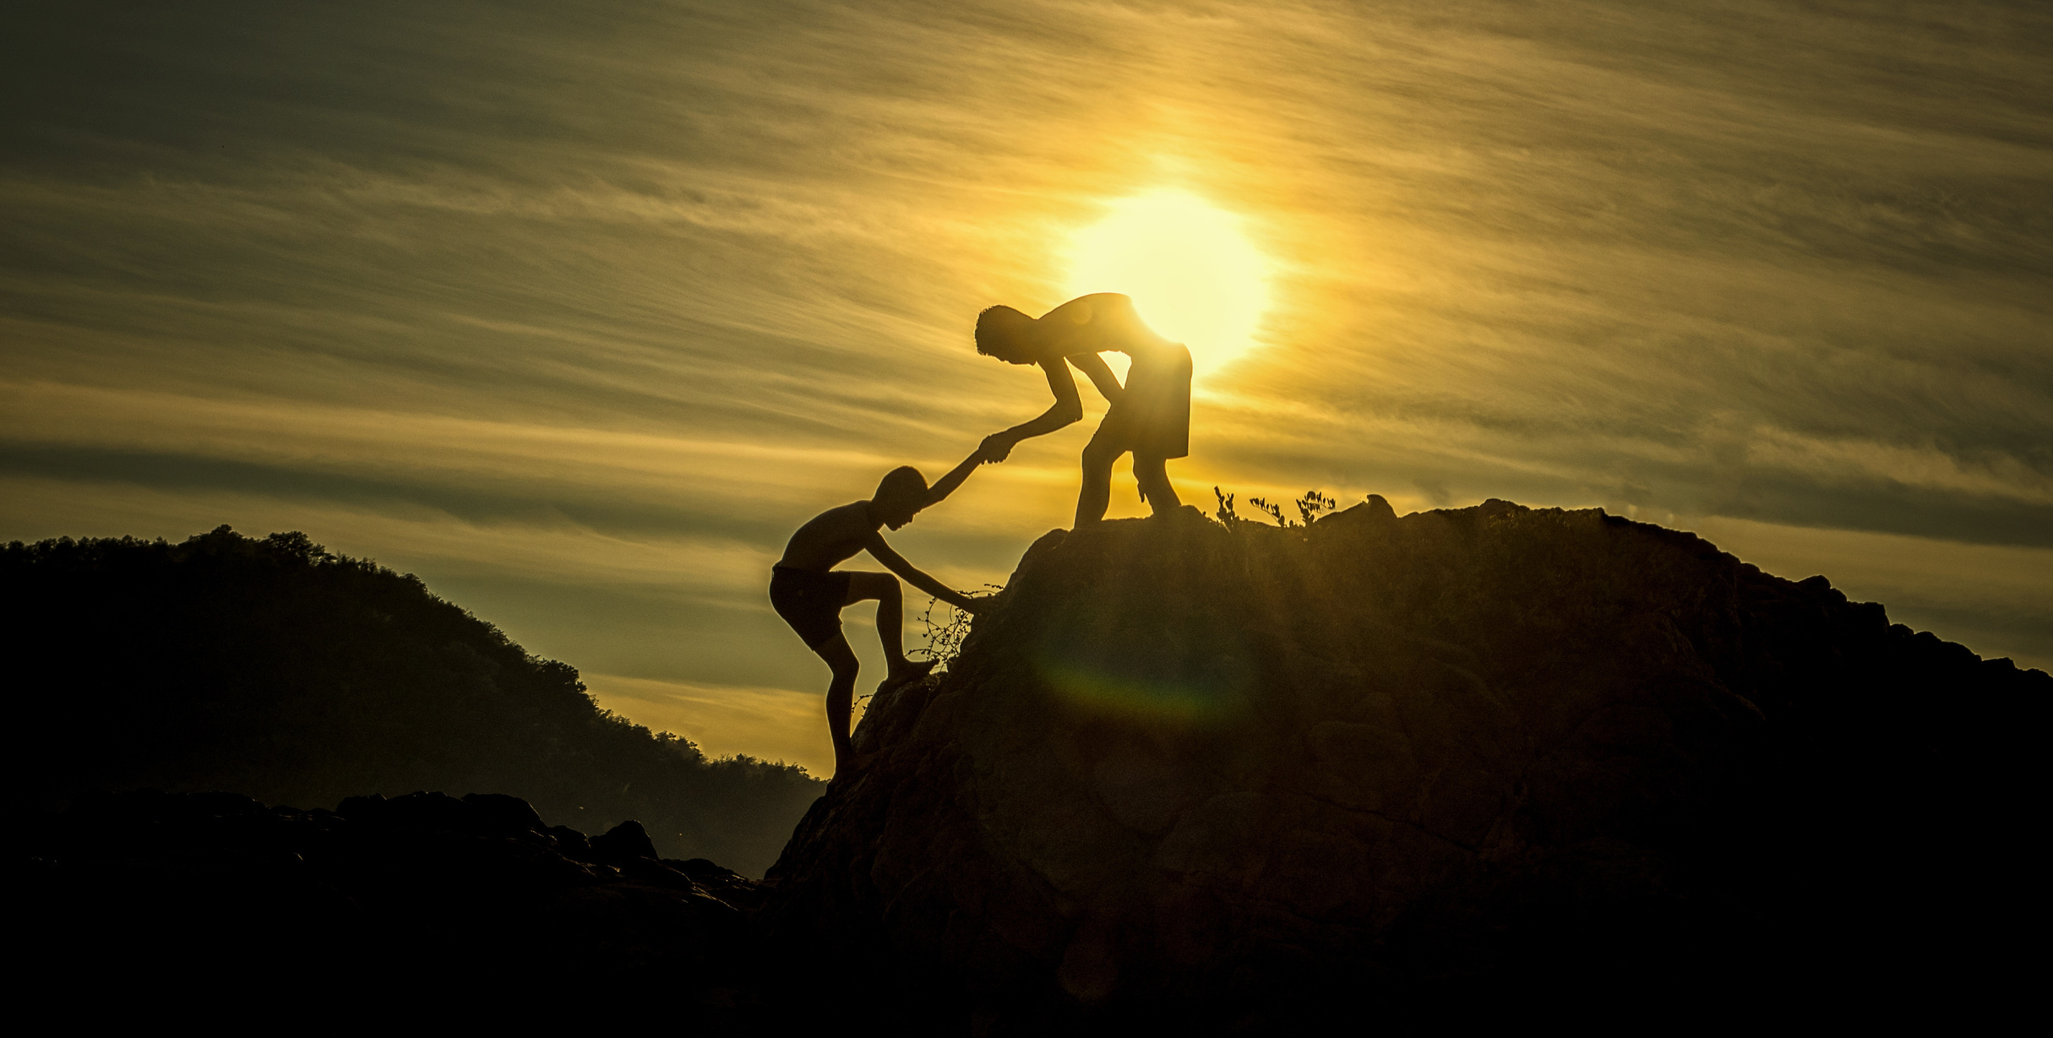
A Cooperative Council's Manifesto for The General Election
#coopdifference

Slide 68
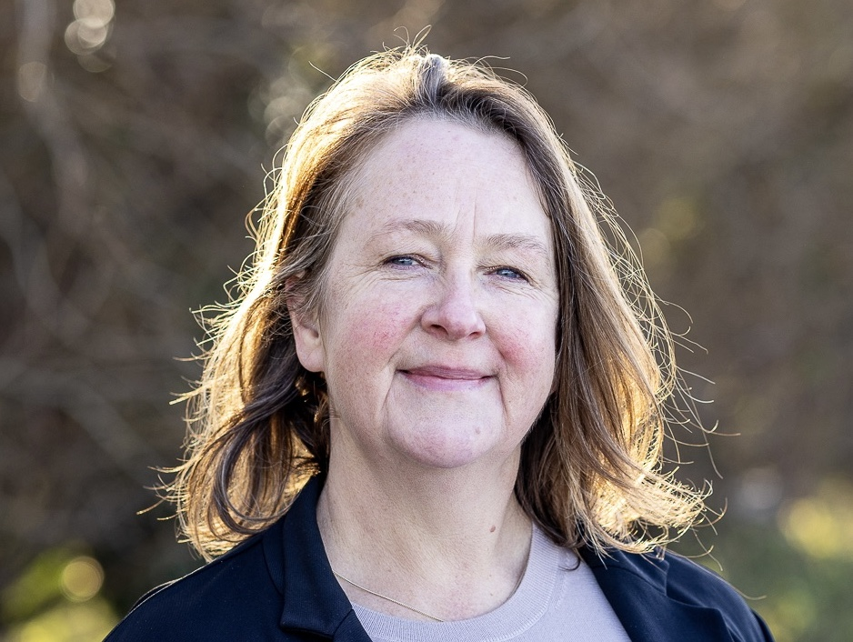
Cllr Zoe Nicholson
Leader, Lewes District Council
@zoenicholson4 | @LewesDistrictCouncil
CoopInnovation
#CCIN2023

Slide 69

Jonathan Bland
Managing Director, E3M/SBI
@JonathanSBI | @E3M_SocEnt
CoopInnovation
#CCIN2023

Slide 70
Q & A
Please raise your hand & we’ll bring you a mic

Slide 71

Cllr Paul Stewart
Sunderland City Council
@SunderlandUK
CoopInnovation
#CCIN2023

Slide 72
Thanks & Close

Slide 73
Have a safe journey home

