Slide 1
Embedding genuine cooperative best practice across our councils and communities
Jonathan Nunn – Kirklees Council
Gemma Maret – Stevenage Council
James Wright – Cooperatives UK
Gareth Nash - CMS

Slide 2
Cooperative Development in Kirklees
Jonathan Nunn – Kirklees Council

Slide 3
Cooperative Development in Kirklees
Coop Devt Toolkit Policy Lab
Coop Option Training
Alternative Business Models West Yorkshire
Practical support for coops

Slide 4
Coop Development Toolkit
Joint funded by CCIN and Power to Change
Councils’ aspirations for more coops but lack of clarity on what to do
Creation of a framework for action and development of tools
Working with Coop Futures, CMS and Platform 6
Greenwich, Kirklees, Oxford, South Ribble, Stevenage and Sunderland councils involved

Slide 5
Coop Option Training
Few council officers or business advisors understand coops and their benefits
Course based on Barefoot Coop Advisor Training
£10k CCIN Policy Lab funding
Delivered by Stir to Action and Coop Culture
Core module with optional deep dives on legal structures and finance
Videos and resources available on the CCIN website

Slide 6
Alternative Business West Yorkshire
£500k UK SPF funded project to promote coops and social enterprises until March 2025
Led by TSL Kirklees with local and national partners inc Coops UK and School of Social Entrepreneurs
The programme will consist of:
  Awareness raising and outreach events with local communities
  Direct relational coaching support to start-up groups and existing co-ops
  Support to new-start ABM enterprises through a workshop programme including legal structure, social impact, governance, and access to finance
  Co-op/social enterprise ‘option’ training
  Co-operative and Social Enterprise scale-up pilots for a small group of high-potential West Yorkshire ABs

Slide 7
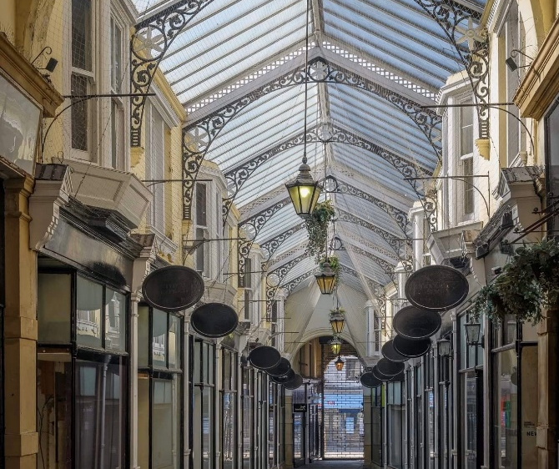
Practical Support for Coops in Kirklees
Including coops and social enterprises in all advice and support
Strong support for Community Asset Transfer
Clear resources on Assets of Community Value
Funding and staff secondment for Cooperative Care Colne Valley
Funded part-time consultant to support the Dewsbury Arcade Group
Supporting Alternative Business West Yorkshire

Slide 8

Pin Green Partnership Agreement Team
A new community partnership
Gemma Maret
Neighbourhood Warden Manager

Slide 9
The project
Voluntary Groups
Sea Cadets & Air Scouts
Small Business
Clare’s Little Bears
Hiring Pin Green site for 3 years.
Estates
Housing Development
Have been in buildings for 40+ years.
Are not choosing to move, land sold for development.
Volunteer run
Operates forest school and pre school
Looking to expand due to demand
Play service closed to save on costs and building costs.
Need to achieve commercial rent for site.
Need to achieve 0 cost to SBC as soon as possible
Need to sell the land to pay for social housing development in area.
Existing buildings no longer fit for purpose
No lease held by either group.
Notes:
Sea Cadets and Air Scouts Background
Building adjacent to lakes.
Highly militaristic structure
Very insular
Do not want to move
Politically sensitive
Clares little bears

Slide 10
Co-operatives Deep Dive
Small step from working
co-operatively to forming a
co-operative
Formalisation options are all shapes and sizes
You are not alone
Notes:
All shapes and sizes not one size fits all
Small step from cooperative working to cooperative formation
There’s help - nhscvs co op uk

Slide 11
Legal Frameworks Deep Dive
Exploring different formalisation models
Fair representation on boards
Try before you buy.
Notes:
Exploring different formalisation models
Choice tool - what’s best fit
Fair representation
Trial and error, see how it goes and iron out the problems before bite the bullet, easier to see if everyone can work together than change legal structures if they cant.
It’s not quick

Slide 12
Finance Deep Dive
Someone who knows or training available for groups
Financial obligations can be scary
Trial and error doesn’t work … ask for help.
Notes:
Someone who knows or training internal accountant
Blinded by complexities
Trial and error doesn’t work here

Slide 13
Future Steps
Year 1
Unincorporated Association: learning to work together
Year 2
Formalise into appropriate format
Year 3
Long term funding for new build and lease extension.
Notes:
3 year lease
Extension if show lease can be met and partnership working

Slide 14

TWO CCIN Policy Labs
Barriers to Building a Co-operative Economy
A Co-operative Development Framework

Slide 15
Barriers to Building a Co-operative Economy
Co-operative Development Framework
Led by Oldham Council
Delivery team
  Anthony Collins Solicitors
  Co-operative Futures
  Co-operative Networks
  Co-operative and Mutual Solutions
Led by Kirklees Council
Delivery team
  Co-operative Futures
  Co-operative Networks
  Co-operative and Mutual Solutions

Slide 16
Barriers to Building a Co-operative Economy
Methodology
Conclusions
Toolkit
Refresher on co-operation
Some simple actions
Co-operative approaches (pipeline)
Development Pathway

Slide 17
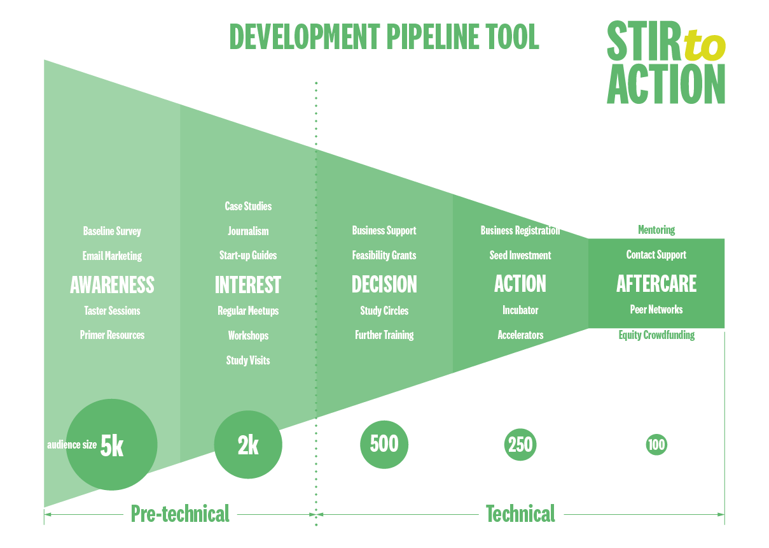

Slide 18
Co-operative Development Framework
Methodology
Findings
Framework

Slide 20
Tackling Barriers to Building a Cooperative Economy
Gareth Nash – CMS
Cliff Mills – Anthony Collins Solicitors
Graham Mitchell – CBN
Jo White – Co-operative Futures

Slide 21
The Barriers to a coop economy
Within Cooperation | Beyond Cooperation
Slow to recognise it’s about purpose, not structure; poor at expressing it | UK lacks the understanding, knowledge, institutions, customs and practices
Reluctance to claim more appropriate purpose than private benefit | Blind faith in market-based approach
Flawed business development approach Search for capital Promotion of models or alternative structures Seeing change of structure as the goal Procurement focus | Domination by investor-owned business, marginalisation of cooperation

Slide 22
Desktop analysis of best practice
Some findings
Hard to call it best practice
National, regional and sectoral programmes can be effective
Local programmes ditto
Knowledge and expertise not evenly spread
Some reflections
Opportunistic, and consequently fragmented and disjointed
Step change not been achieved
Some good initiatives:

Slide 23
Developing Cooperative Economies - NW
Some of the conclusions
Only GMCA and Preston expressly support cooperatives
Social enterprise support often alongside Voluntary, Community and Faith
Community Wealth Building and plural ownership adopted by some
Some coop hotspots: Alston, Lancaster
Awareness of cooperation is fragmented
Technical support and expertise geographically dispersed

Slide 24
Toolkit
Pipeline document
To identify fruitful areas
Examples and support links
Pathway development document
Stages in developing new ventures
What is involved and needed at each stage
How a Council can support
Enabling Councils to optimise opportunities for development

Slide 25
The Evidence for Action
James Wright – Cooperatives UK

Slide 26
Evidence and data: what do we have?
The right KPIs?
GVA? Firm births/deaths?
Fair pay? Inequalities? Wellbeing?
EO Knowledge Programme: productivity, pay, decarbonization
Co-operative and Mutuals Economy Report: resilience, propensity to create jobs
Understanding the Community Shares Market: financial performance, resilience
Impact
Outcomes
Outputs
Evaluations: Empowering Places, South Yorkshire Ownership Hub, Boosting Community Business London
Communities doing it for themselves: supporting community investment in high IMD
Co-operative and Mutuals Economy Report: census data, trends, comparisons between nations and regions

Slide 27
Evidence and data: what’s missing?
Impacts
Performance and efficacy key types of co-operative (e.g. community, consumer, B2B)
Local economic and social impacts of key types of co-operative
The distributive impacts of key types of co-operative
The wellbeing impacts of key types of co-operative
Enablers
The most effective ways of increasing understanding, interest in, and exploration of, co-operative options at critical junctures
The right balance between ‘pre-technical’ and ‘technical’ co-operative development
The most effective ways to supporting the financing of new and growing co-operatives, of different types
The most effective ways of helping existing co-operatives thrive and reach their potential

