Slide 1
A rising tide to lift all boats
How can councils enhance their impact and deliver user benefits through collaborative digital products?

Slide 2
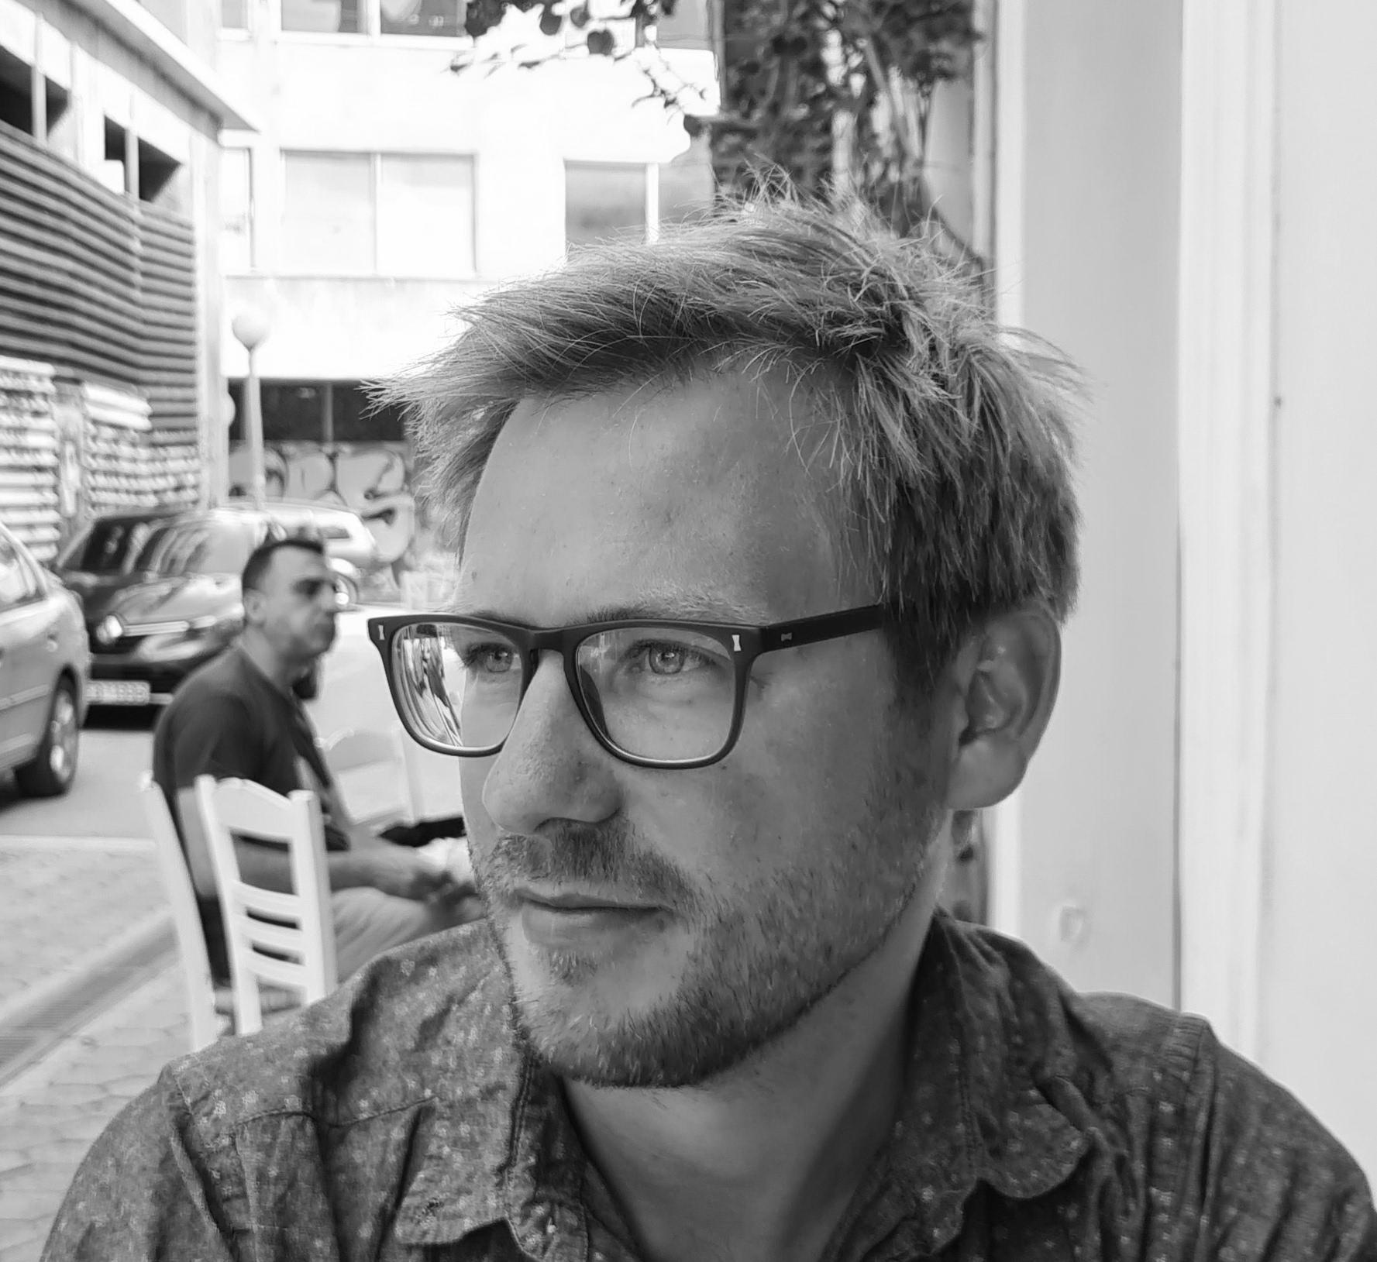
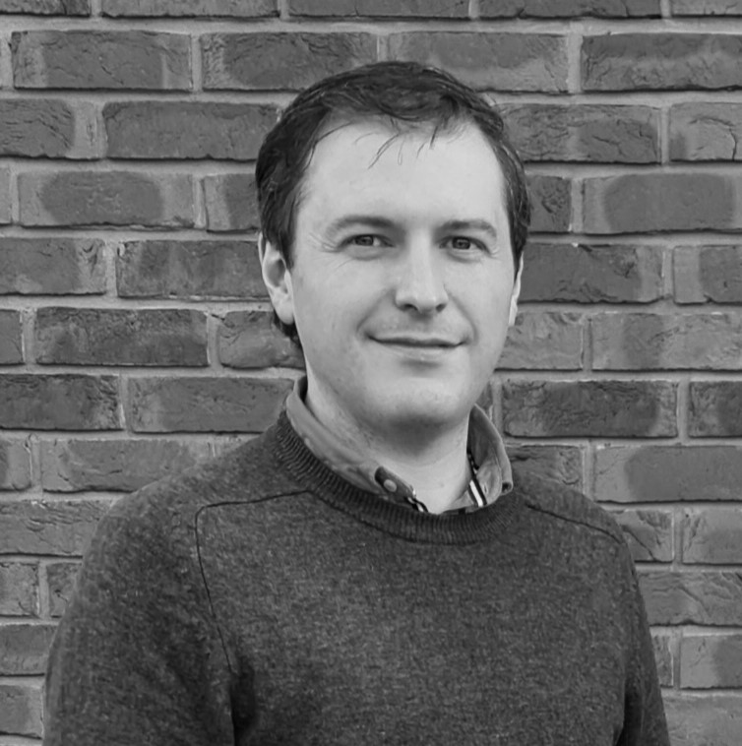
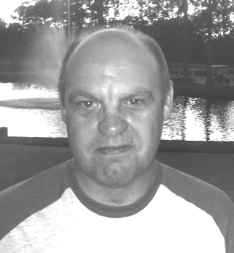
Who we are
Aaron Hirtenstein
Community Lead LocalGov Drupal
Michael Brown
Website Manager
Newcastle City Council
Duncan Miller
Service Improvement Lead (Planning)
Newcastle City Council

Slide 3
What is LocalGov Drupal and Open Digital Planning?

Slide 4
LocalGov Drupal
Modular open source publishing platform created by councils for councils
Child theme
Base theme
Guides
Subsites
Directories
Step by step
Events
News
Search (Waltham Forest)
‘Service’ pages
Forms (Croydon)
Drupal core
HTML Publications
(Hammersmith & Fulham)
8500 contributed modules
4000 UK developers
Notes:
Aaron

Slide 5
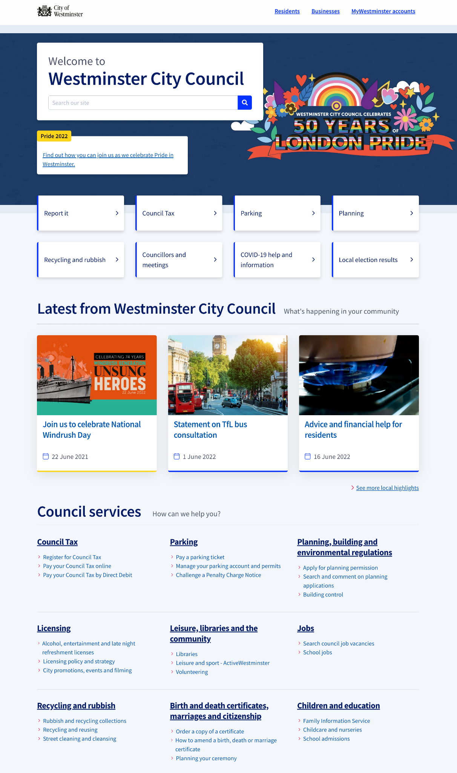
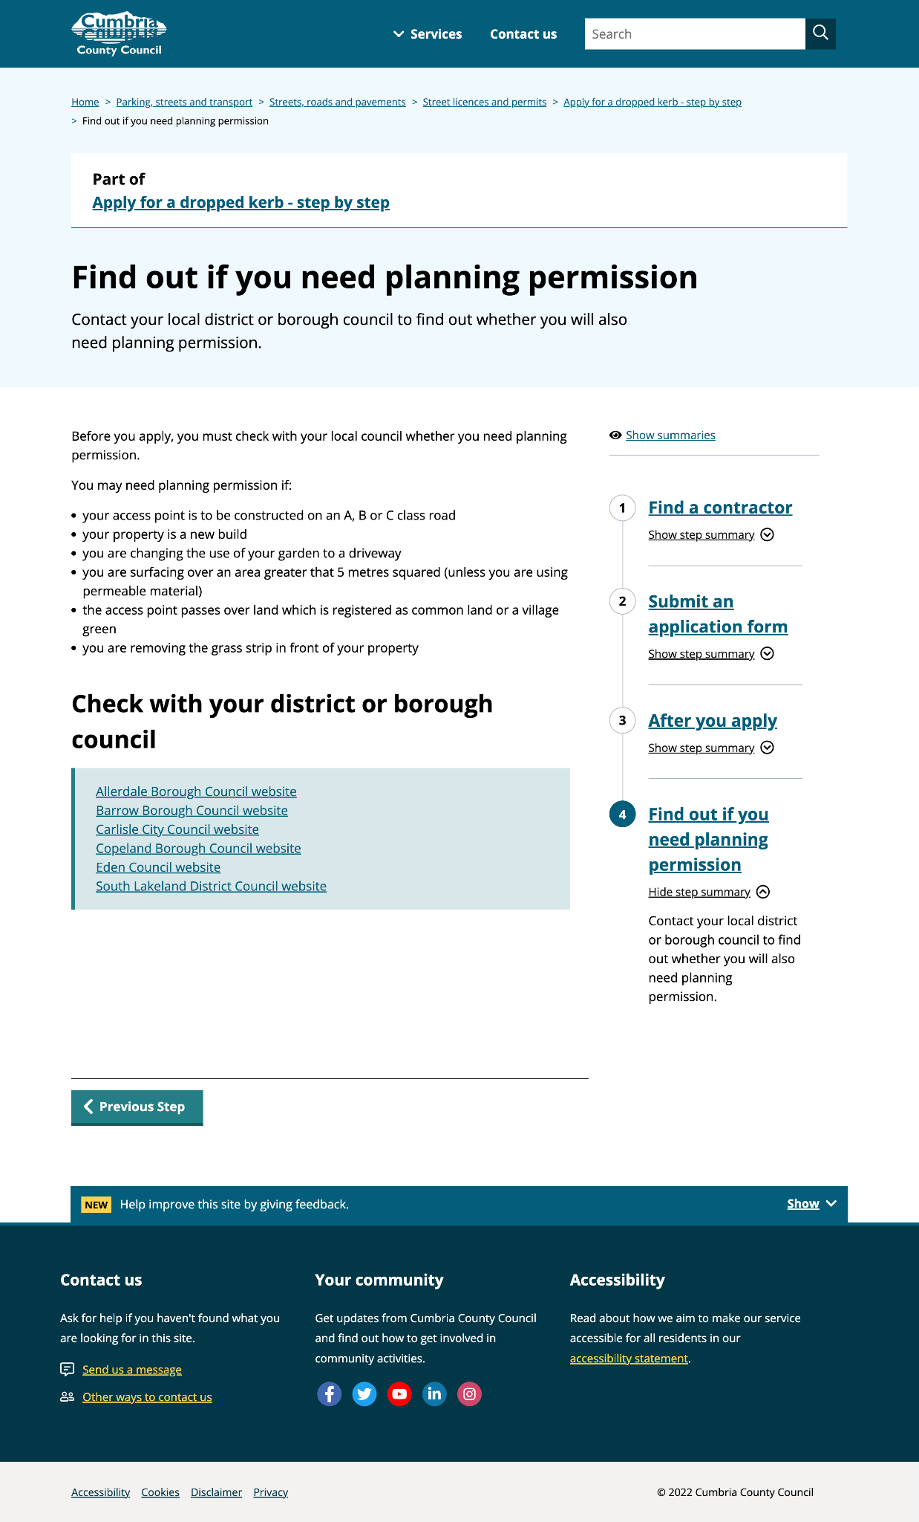
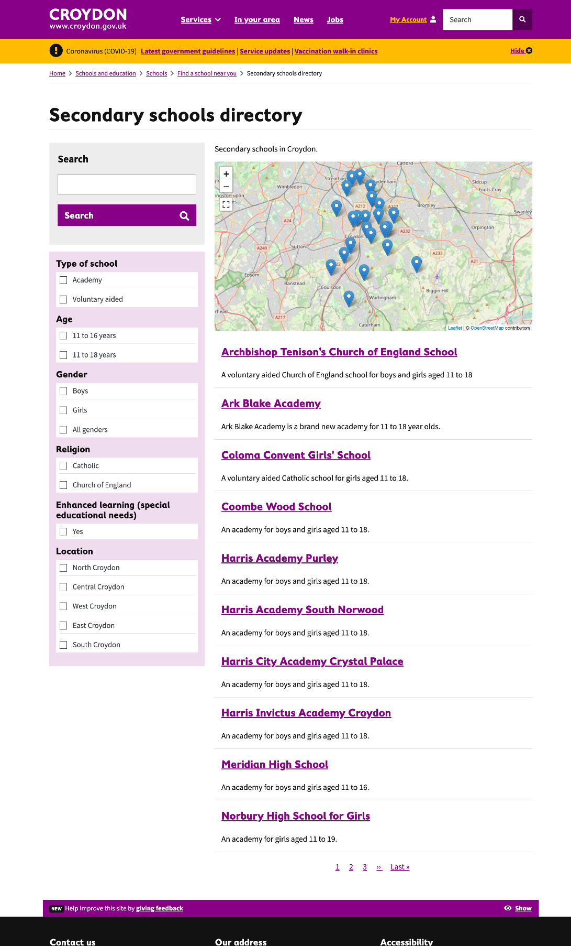
Notes:
Aaron

Slide 6
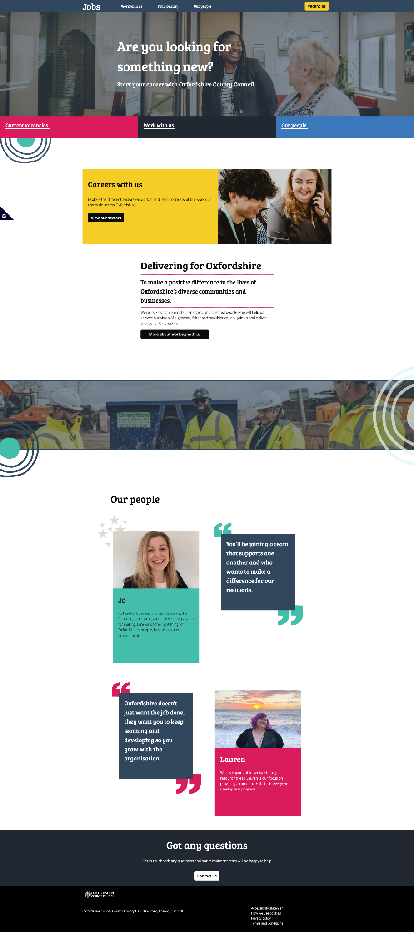
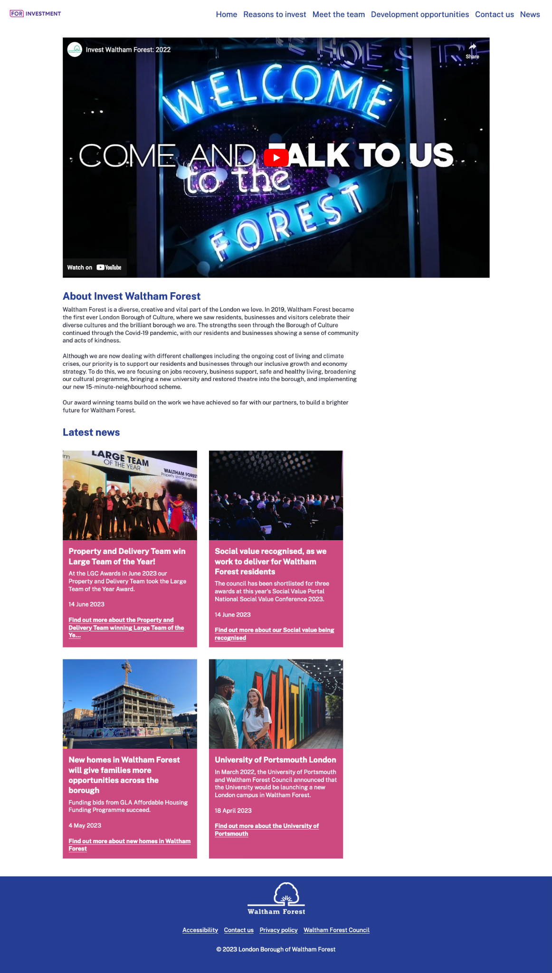
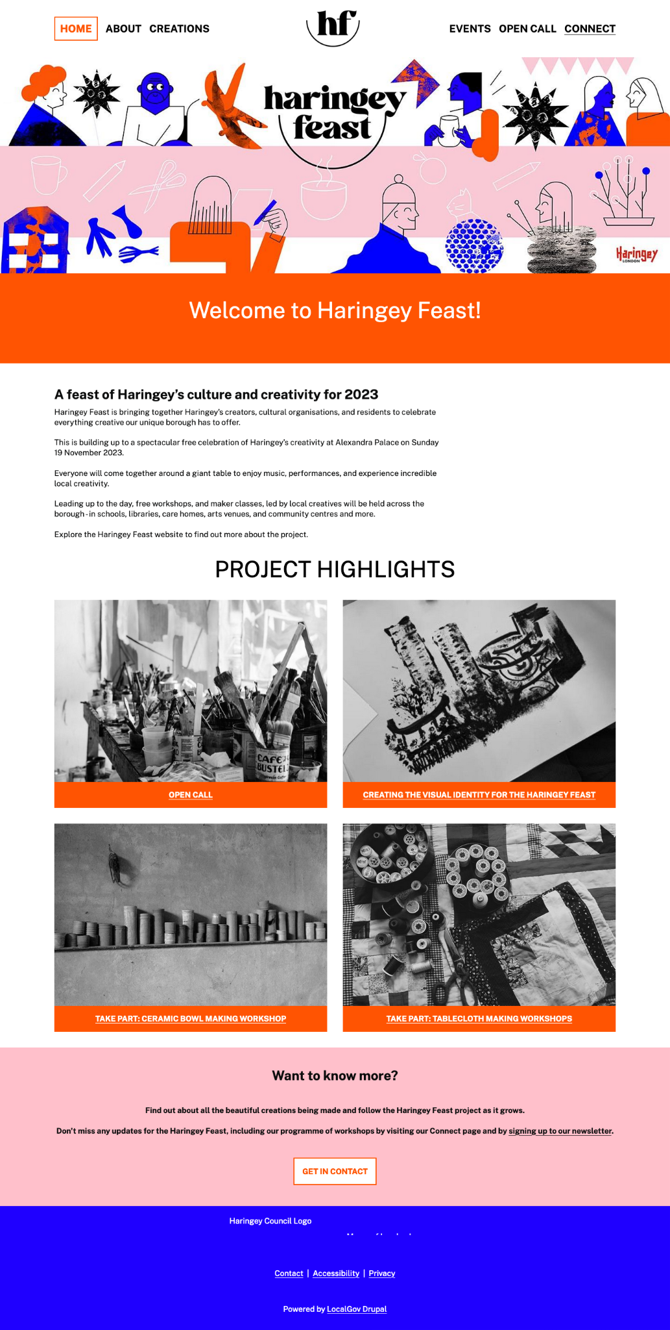
Microsites
One install, make as many spin off sites as you like
Oxfordshire Jobs
Invest Waltham Forest
Haringey Feast

Slide 7
Open Digital Planning
Planning services designed by planners
A community of forward thinking Local Planning Authorities working together to transform the planning system.
Faster, smarter and simpler local government planning services.
Our purpose
To transform planning from an approach reliant on documents and physical maps to a data-driven, digital system. We collaborate to share expertise and design better planning service to benefit everyone.
Our goals:
better equipped planning teams
better served residents, applicants and planning professionals
better technology to support faster planning decisions
Notes:
A move towards a modular planning ecosystem where data standards are applied, systems are interoperable and data can be exchanged more freely but is still secure.

Slide 8
Open Digital Planning
Notes:
Screenshots of some of the products we are working on ….. IMAGE 1 Advice and guidance services FOIYPP (a novice can draw a red line boundary, answer a series of relevant questions they can receive information pertinent to the request - this tells them whether they need planning permission and what to do next) , IMAGE 2 application/submission service using Plan X (Plan X is GDS based tool that enables users to apply online for planning permission for a Lawful development Certificate (in future we anticipate that they will be able to apply for all types of planning permission) - shows the flow builder - partners can use this to collaborate and build their own services using this easy to use tool. For example we are prototyping a validation checklist which turns a 67 page doc into a comprehensive flow which will take a customer minutes to complete. IMAGE 3 A significant part of the project involves developing assessment services (Back Office Planning Systems commonly known as BOPS) - this enables planning officers to quickly determine (LDC) applications.

Slide 9
The journey (as a project and community)

Slide 10
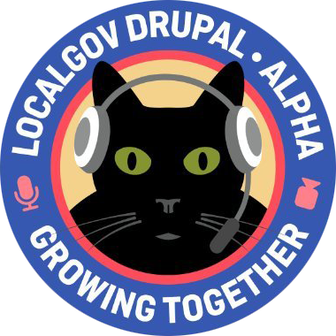
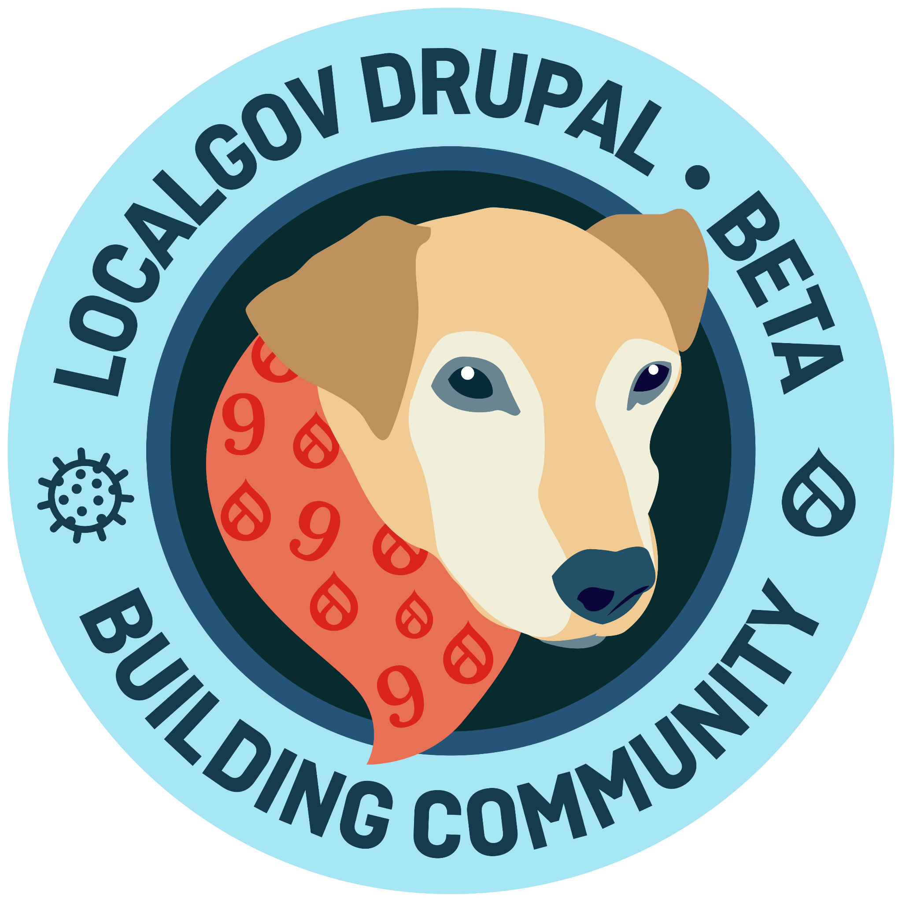
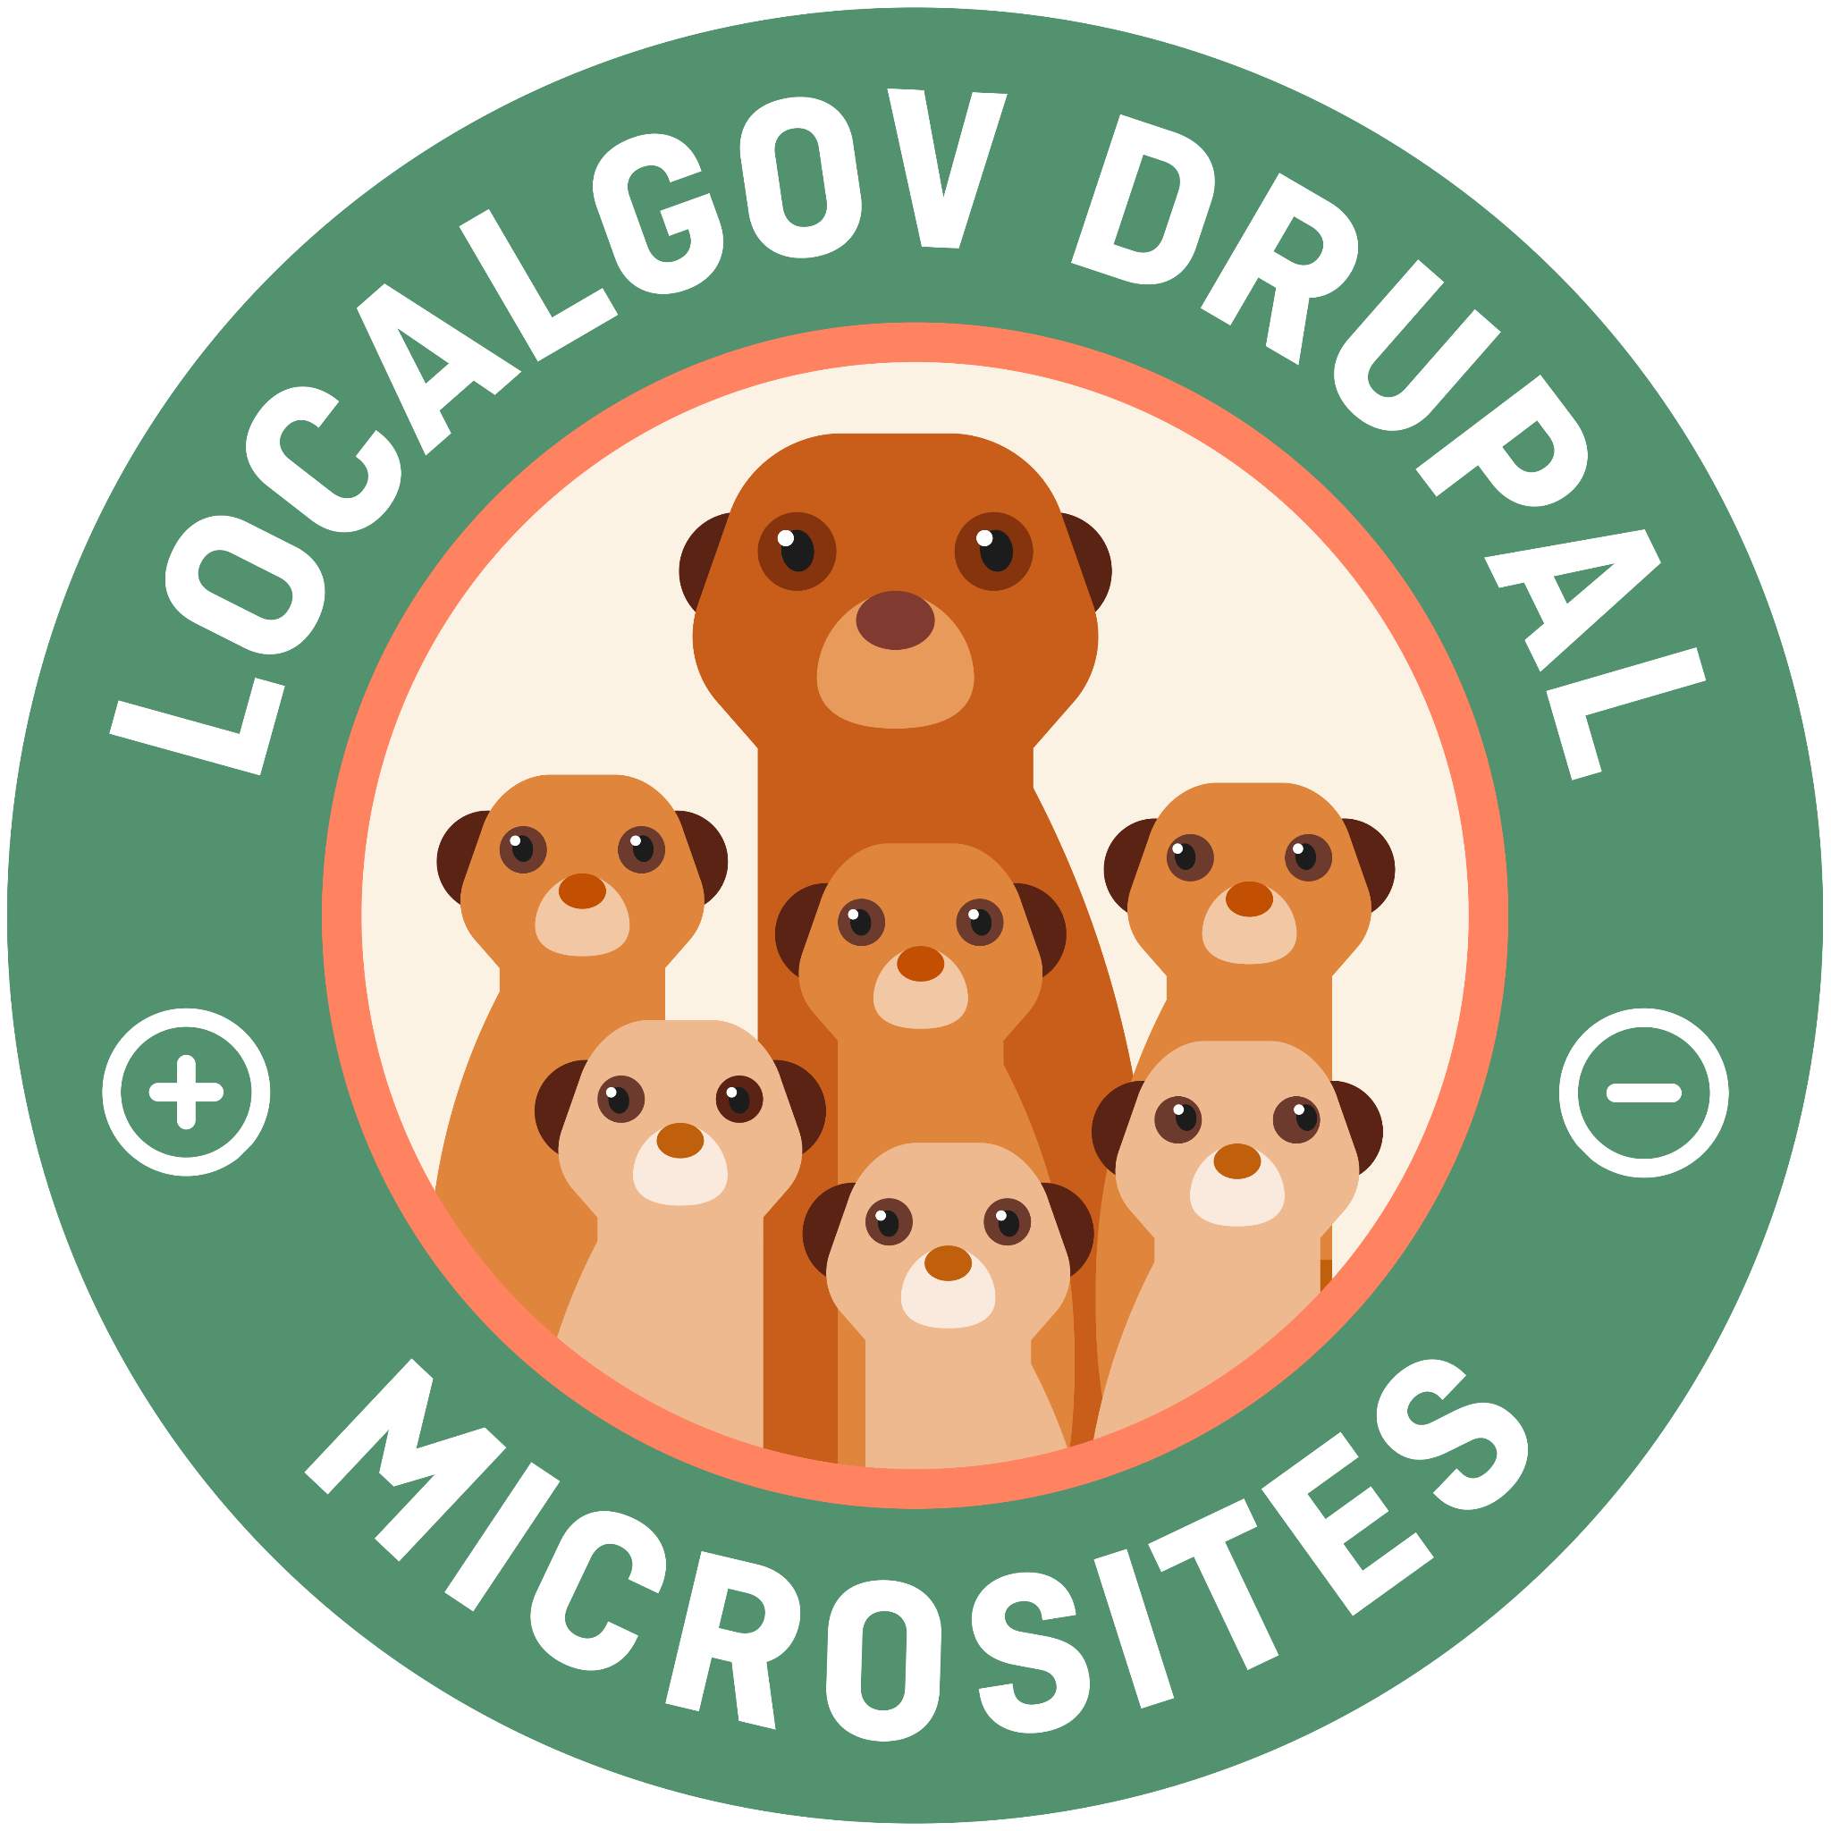
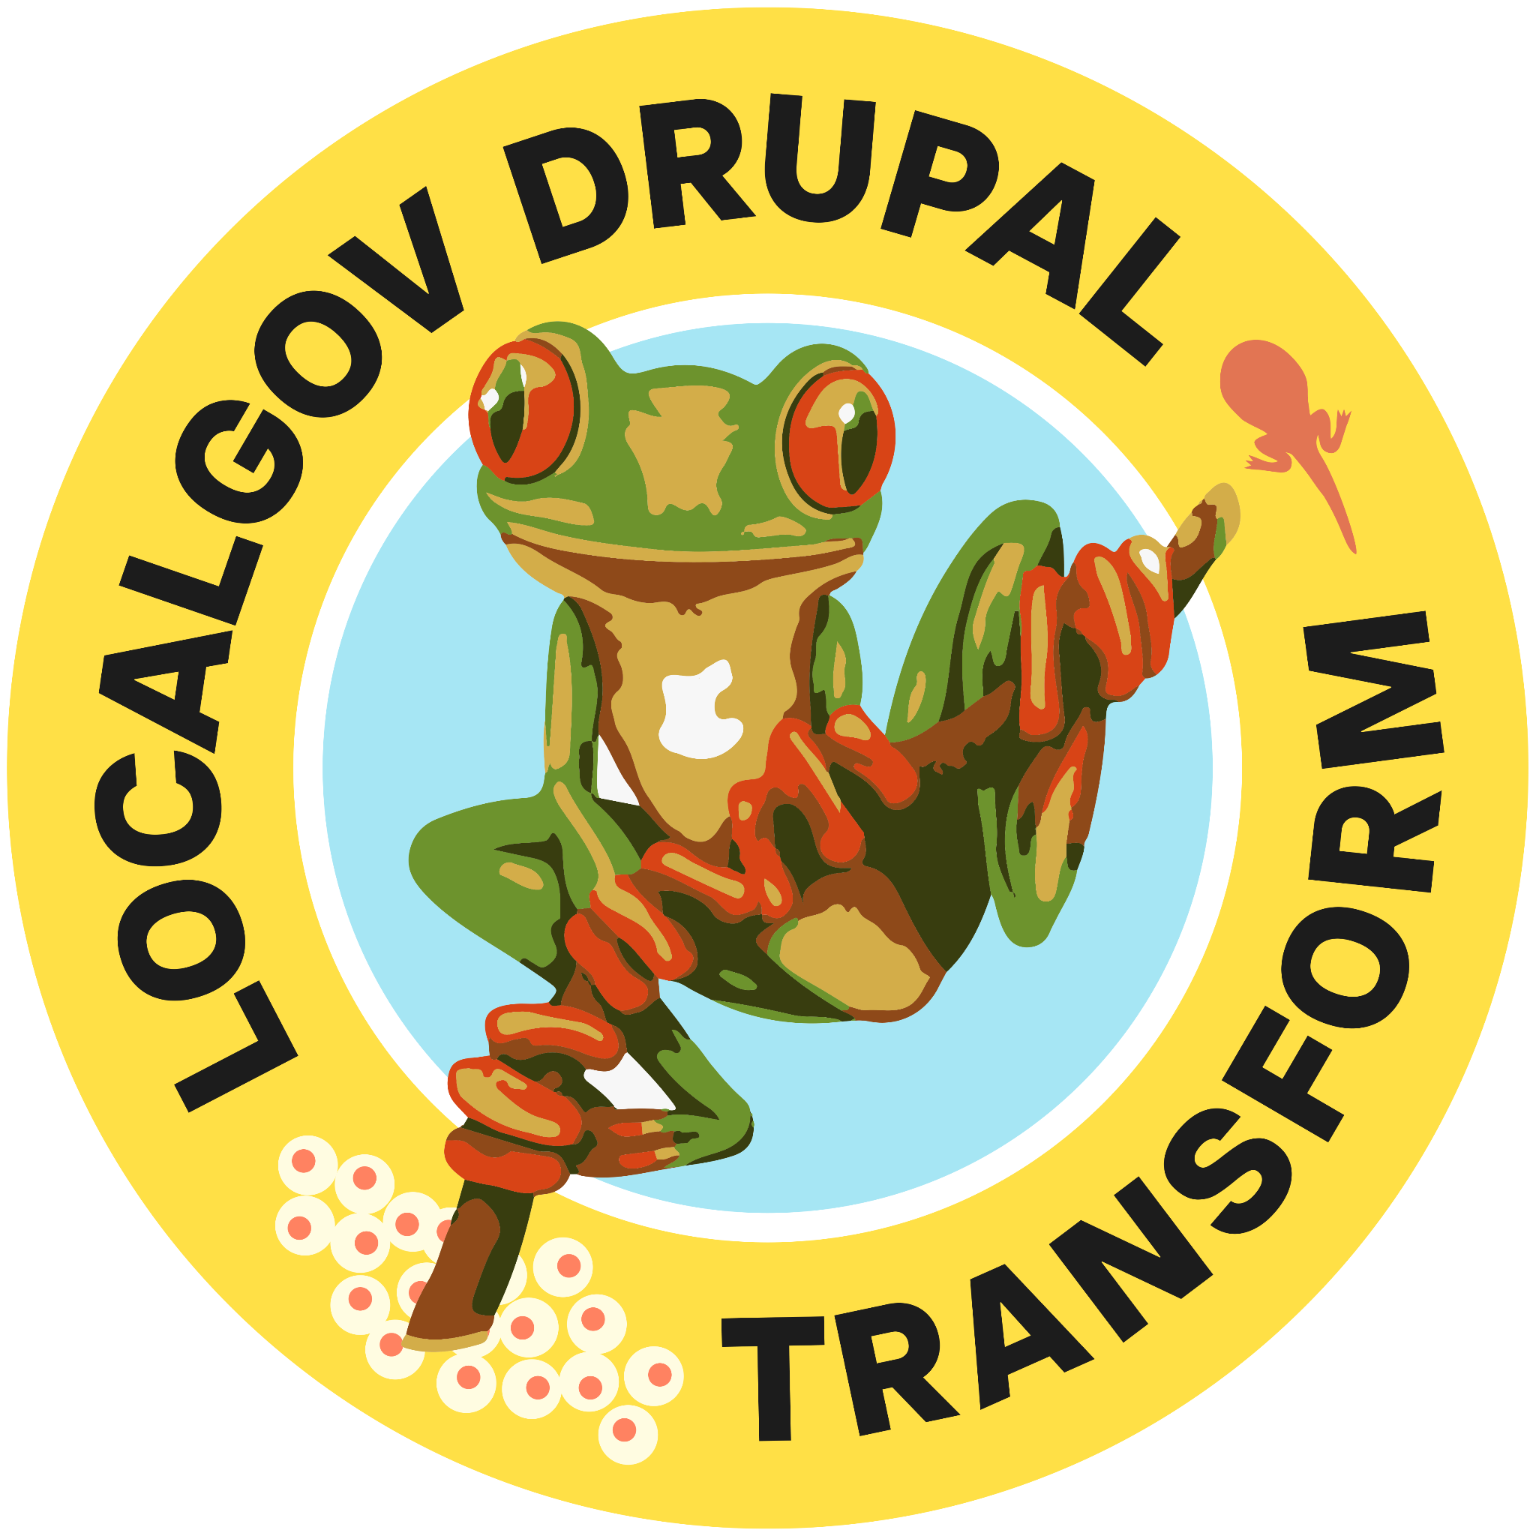
2019
Discovery £75k: Do councils want to share Drupal code? YES
2020
Alpha £100k: Refactoring code, establishing governance
2021
Beta £350k: Adding more features, scaling, business model
2022
Microsites £200k: Tools for creating and maintaining a long tail of websites
Explore sustainability £200k: Business model and governance discovery
2022
2023
Self funded cooperative Open Digital Cooperative safeguards code and collaboration

Slide 11
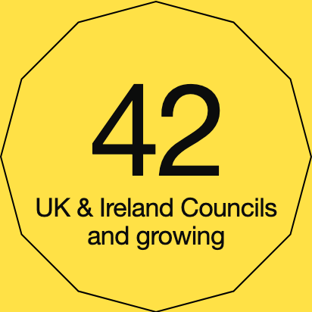
Participating councils

Slide 12
Our evolution
Core Team
Subscribers Group How to grow and stay happy
Product Group
What to build
Technical Group How to build it
Content Group Direct input from council content designers
Accessibility
Future working group

Slide 13
From explorers to communities
Explorers
2019
Pioneers 2022
Settlers 2023
Communities 2024…
Three councils,
DLUHC, two software providers
under RIPA and BOPS - development and adoption of some guidance, application and assessment services.
Eight councils,
two software providers, DLUHC (under
Open Digital Planning - ODP). Greater adoption of live services, with development and expansion of full services with integrations.
27 councils,
numerous software providers, DLUHC under ODP - adopting live services, developing new services, data standards and new integrations.
New funding round will lead to X amount of councils working together with software providers, ODP and Central Government
Notes:
Explorers were the brave souls who knew nothing about the environment they were going into. Pioneers followed behind and figured out how to make the most of the environments they found themselves in. The settlers were those who figured out how to efficiently and effectively exploit the environment. The community is the place and the process whereby we can support the beginning of a thousand flowers to bloom

Slide 14
How we work
Informed and underpinned by Agile Project management methodologies and the Local Government Digital declaration.
We work in small product teams that take part in research, design and testing activities. Depending on their level of involvement councils may also prioritise the features that are built and help direct the overall strategy for ODP.
We use the collective wisdom of council officers with a deep knowledge of local planning so that our products better meet the needs of council planning teams.
Our work is prioritised into two-week sprints and when we reach a milestone we test and release. In this way, we continuously improve our products. Some of our best thinking takes place in retrospective meetings - spaces for reflection that ensure we stay critical.
Our services are designed to meet user needs, ensure security, and promote openness, all while adhering to modern technology standards. We're creating flexible software with better access to underlying planning data, allowing information to move seamlessly and helping to automate routine processes.
A combination of the above led ODP to be the 2023 Winner of Government Project delivery profession awards for Digital Change Project of the Year Award
Notes:
Informed and underpinned by Agile Project management methodologies and Local Government Digital declaration
We work in small product teams that take part in research, design and testing activities. Depending on their level of involvement councils may also prioritise the features that are built and help direct the overall strategy for ODP.
Council partners are also responsible for the day-to-day running of the services in their local authorities.
We use the collective wisdom of council officers with a deep knowledge of local planning so that our products better meet the needs of council planning teams.
Our work is prioritised into two-week sprints and when we reach a milestone we test and release. In this way, we continuously improve our products. Some of our best thinking takes place in retrospective meetings - spaces for reflection that ensure we stay critical.
Our services are designed to meet user needs, ensure security, and promote openness, all while adhering to modern technology standards. We're creating flexible software with better access to underlying planning data, allowing information to move seamlessly and helping to automate routine processes.
Future legislation seeks to encourage this move to more modular technology.
A combination of the above led ODP to be the 2023 Winner of Government Project delivery profession awards for Change Project of the Year Award

Slide 15
What impact have we had?

Slide 16
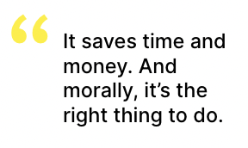
Council feedback

Slide 17
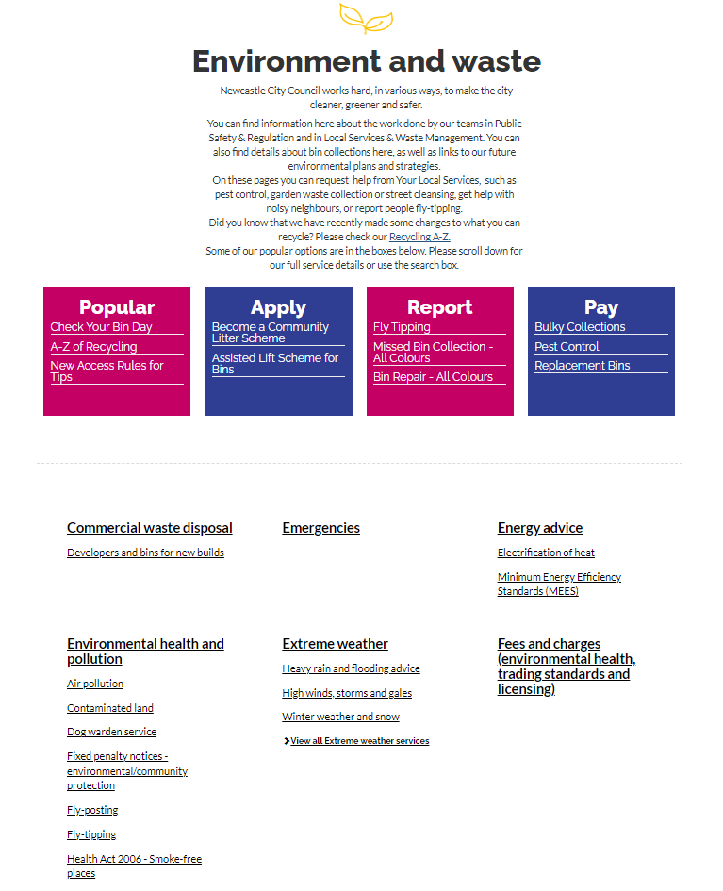
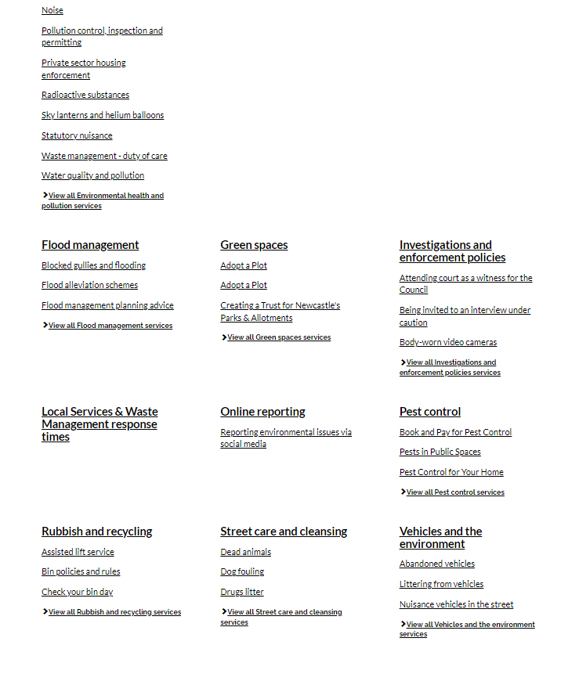

Slide 18
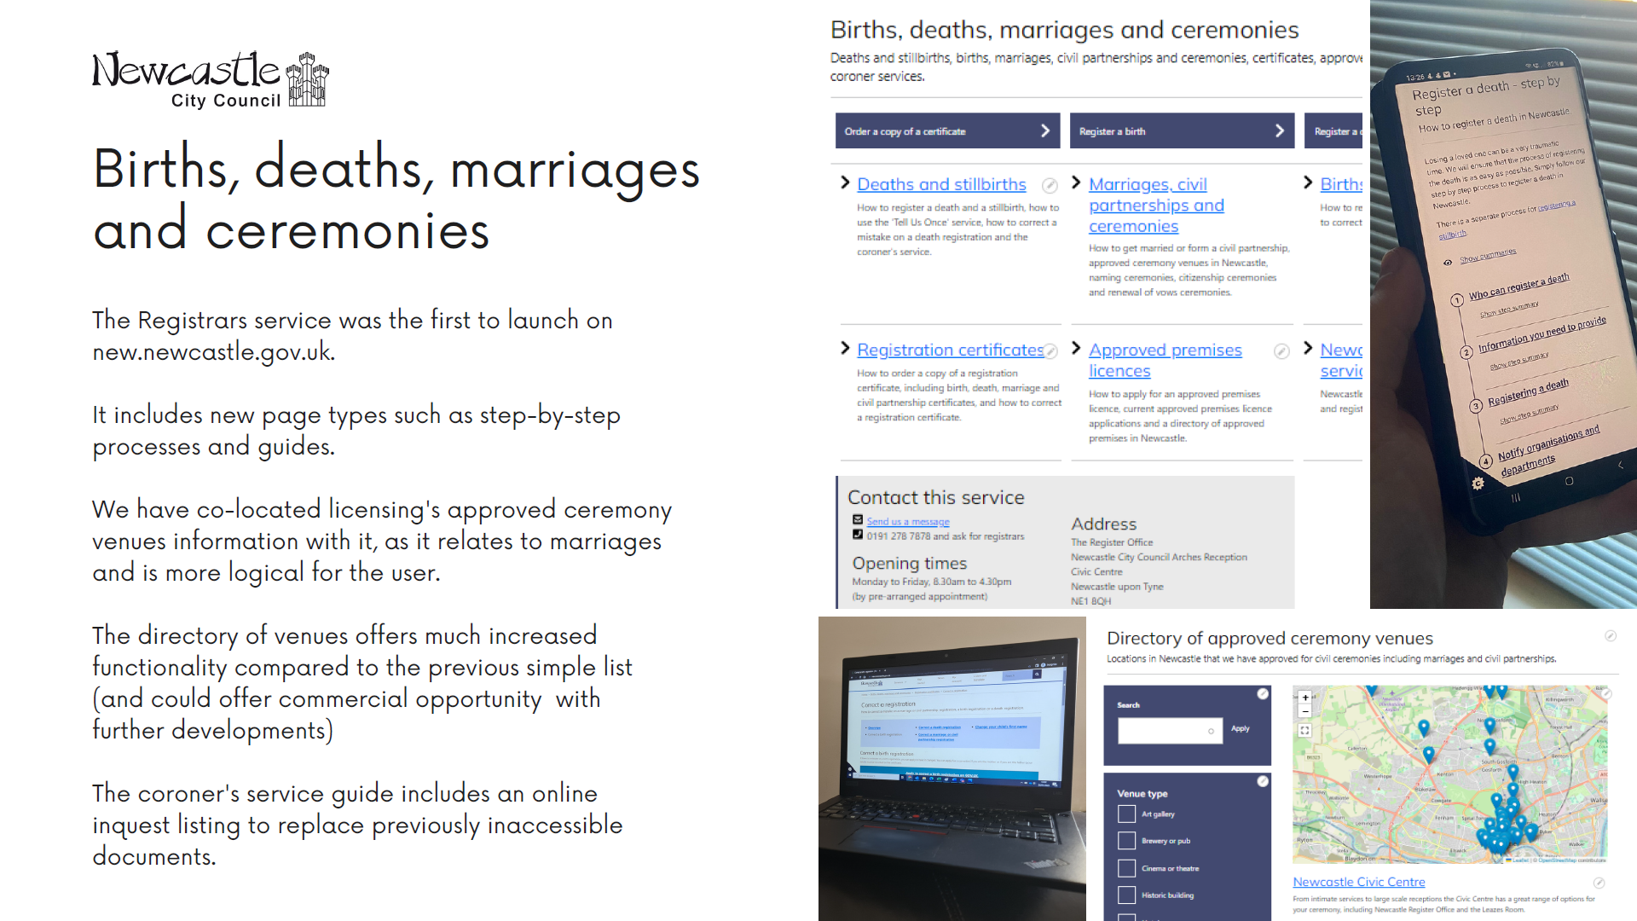

Slide 20
North East Community Forest
A distinct identity, supporting a major cross-council project

Slide 21
Our impact
Faster smarter services
On average, up to 50% of planning applications are invalid when a council receives them. Good quality data publishing to the National Planning Data Platform, coupled with a submission service such as PlanX, which helps applicants to make sense of planning rules relevant to their project, make it more likely that a planning application will be valid.
Reduction of errors making the chance of a “first time” valid submission higher - minimising bounce back, saves time both for the customer and council
Continuous improvement, informed by evidence
Early results suggest that the time taken to validate an application is reduced by around 38% when validating a planning application using BOPS. PlanX is currently demonstrating a 20% reduction in the number of Lawful Development Certificate applications that are invalid on submission.
We believe that with better online guidance and better-quality applications received, planning officers will spend less time working through minor issues, and can focus on higher-value planning work.
Notes:
On average, up to 50% of planning applications are invalid when a council receives them. Good quality data publishing to the National Planning Data Platform, coupled with a submission service such as PlanX, which helps applicants to make sense of planning rules relevant to their project, make it more likely that a planning application will be valid.
Common errors related to the site location plan, the application form and planning fees can be reduced through services designed with the user experience in mind. For example, we estimate that PlanX can prevent as much as 71% of invalid planning applications.
Continuous improvement, informed by evidence
Good product development is led by evidence. All project partners contribute to an active metrics working group. We keep a close eye on the performance of services to understand where improvements can be made and to support the business case for adoption.
All partners have benchmarked their data and we are collecting information about live services to test our assumptions. We aim to publish updates on what we are learning as we go, including the results from improvement projects with established software providers in the future.
Our early results suggest that the time taken to validate an application is reduced by around 38% when validating a planning application using BOPS. PlanX is currently demonstrating a 20% reduction in the number of Lawful Development Certificate applications that are invalid on submission.
We believe that with better online guidance and better-quality applications received, planning officers will spend less time working through minor issues, and can focus on higher-value planning work.

Slide 22
Local Perspective
Better understanding of “what good looks like”.
Helped us to mitigate the challenge of “many problems, scarce resources” by identifying common problems and needs that we need to be addressed. This can be by done by selecting our level of participation in developments from initiator/leader/active partner/product tester/keen watcher/interested adopter, etc.
Support and encouragement from ODP and DLUHC peers has expanded our ability to collaborate internally and externally as we more readily connect the dots e.g. data, software, planning, relationship management and funding.
Principles and ways of working have supported us to consciously focus our energies on impact and effort, so that this is proportionate and delivers tangible benefits to our users.
Exposure to agile methodologies, the multi-disciplinary nature of the work and the benefits of this in relation to outputs/outcomes and the “feel good” factor for employees has led us to model this good practice and encouraged us adopt and deploy our learning to other areas.
Notes:
Better understanding of “what good looks like”
Helped us to mitigate the challenge of “many problems and scarce resources” by identifying common problems and needs that we need to be addressed. This can be by done by selecting our level of participation in developments from initiator/leader/active partner/product tester/keen watcher/interested adopter, etc
Support and encouragement from ODP and DLUHC peers has expanded our ability to collaborate internally and externally as we more readily connect the dots e.g. data, software, planning, relationship management and funding
Principles and ways of working have supported us to consciously focus our efforts on impact and effort, so that this is proportionate and delivers tangible benefits to our users
Exposure to agile methodologies, the multi-disciplinary nature of the work and the benefits of this in relation to outputs/outcomes and the “feel good” factor for employees has led us to model this good practice and encouraged us adopt and deploy our learning to other areas. For example alongside a number of other LPA’s we have set up and established a national group of LPA’s who all use the same planning system - doing so has enabled us to list out collective needs and priorities so we can focus our energies on the things that matter to us and resolve these through sharing best practice or having a single voice/collective dialogue with the service provider.

Slide 23
How can collaborative projects raise expectations of what is possible?

Slide 24
Actively interested in common needs

Slide 25
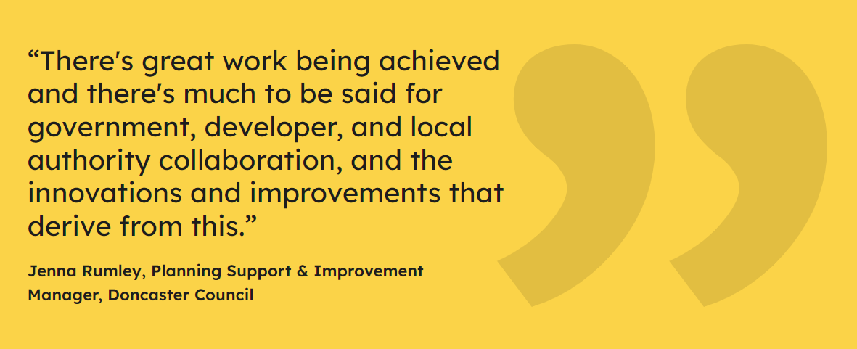
Actively interested in common needs
“A huge benefit for Medway is collaborating with a great team with a
vast range of skills, knowledge, and experience. We can share ideas
and best practice in a friendly, open and transparent environment.”
Lisa M, Head of Business Development and Specialist Service,
Medway Council

Slide 26
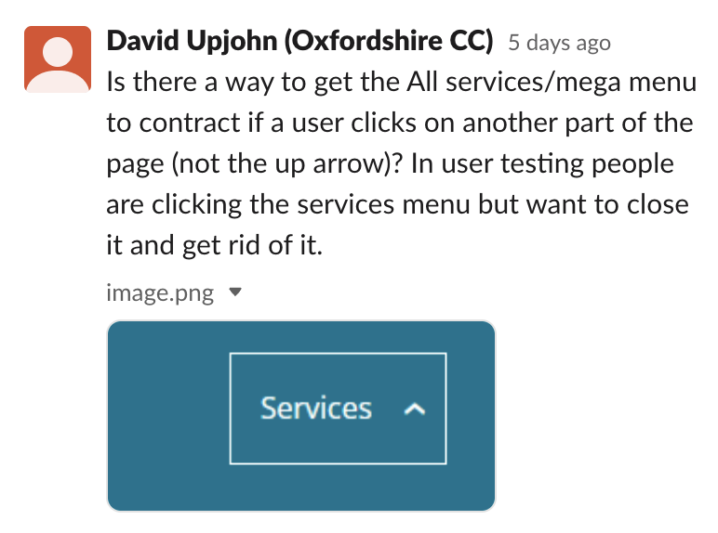
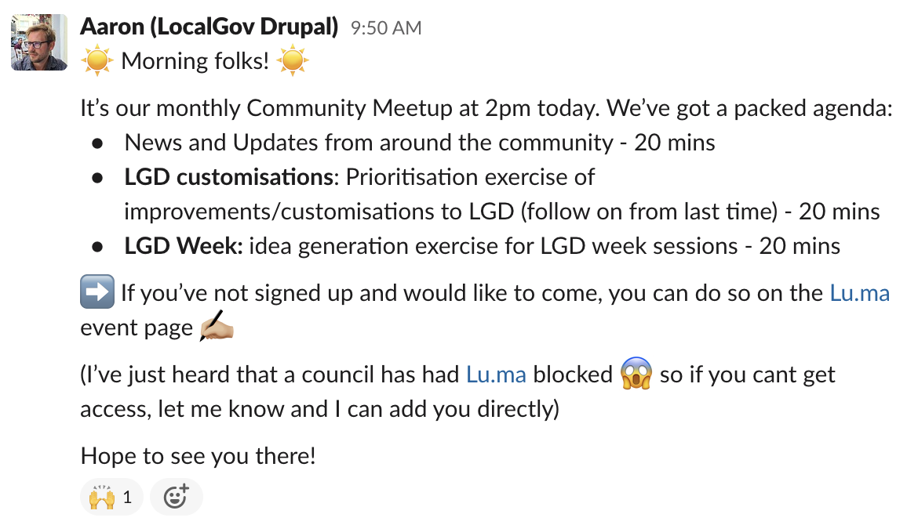
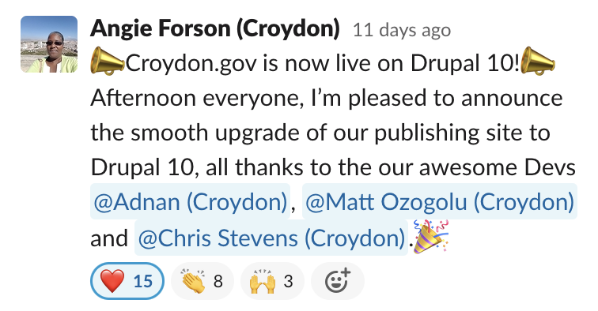
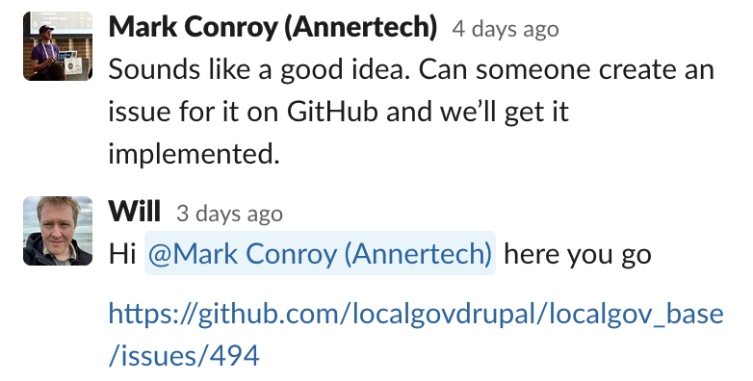
A helpful community

Slide 27
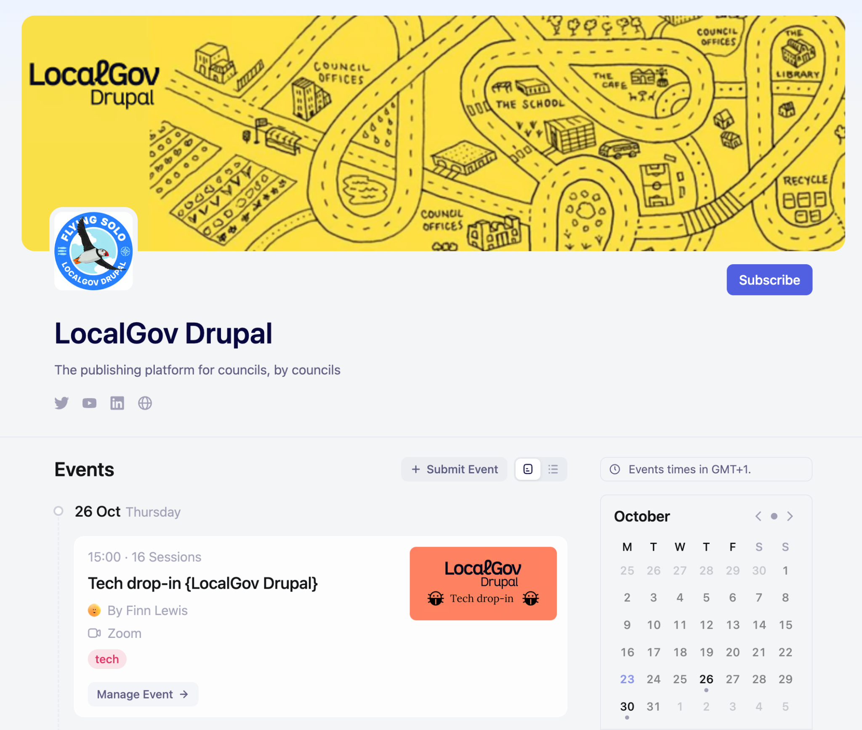
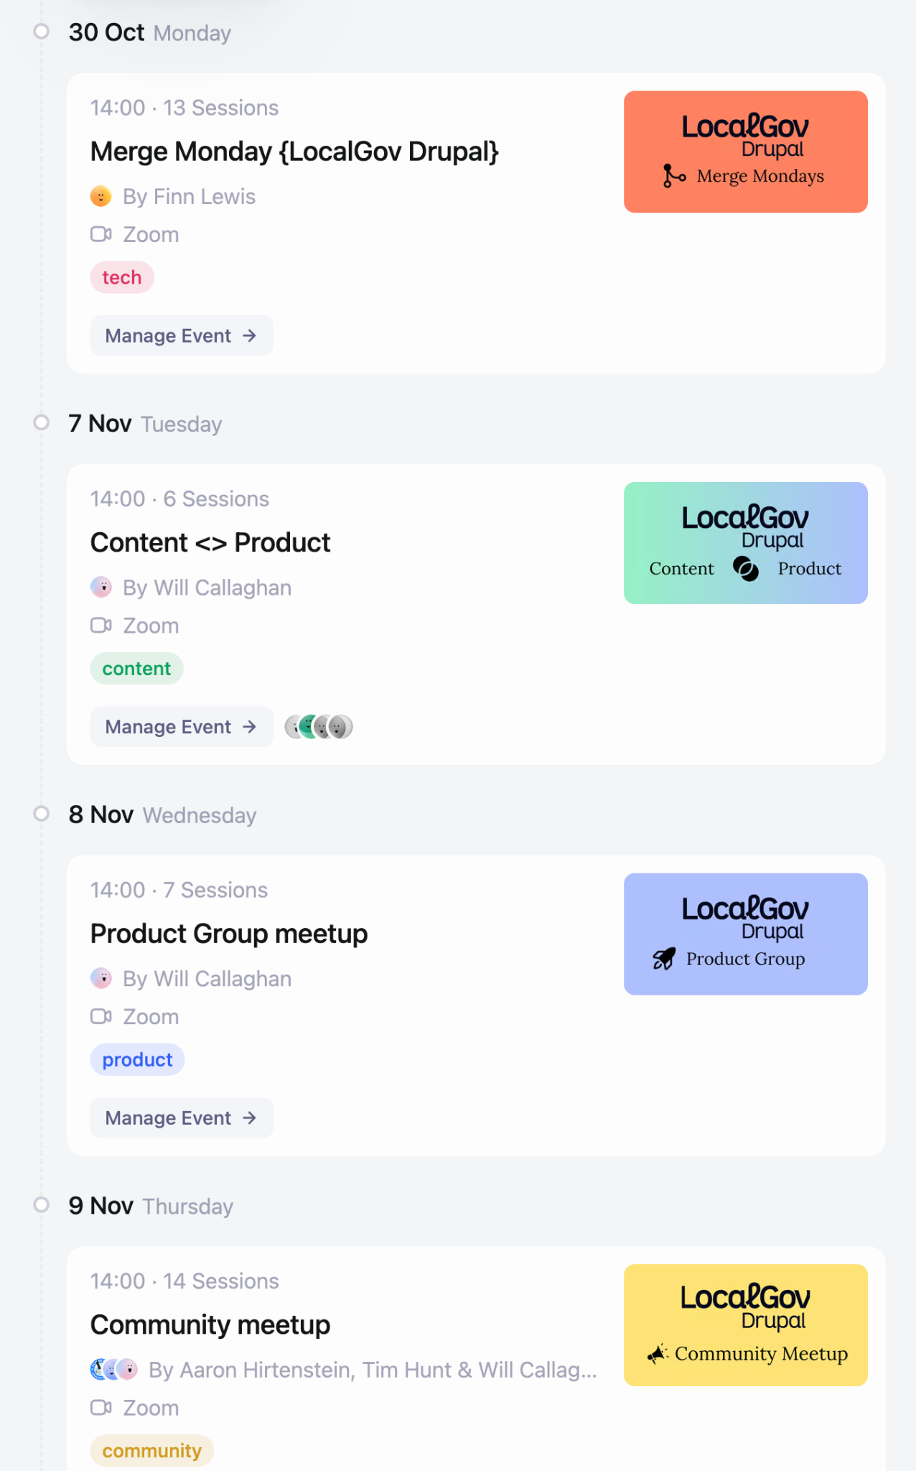
A collaborative community

Slide 28
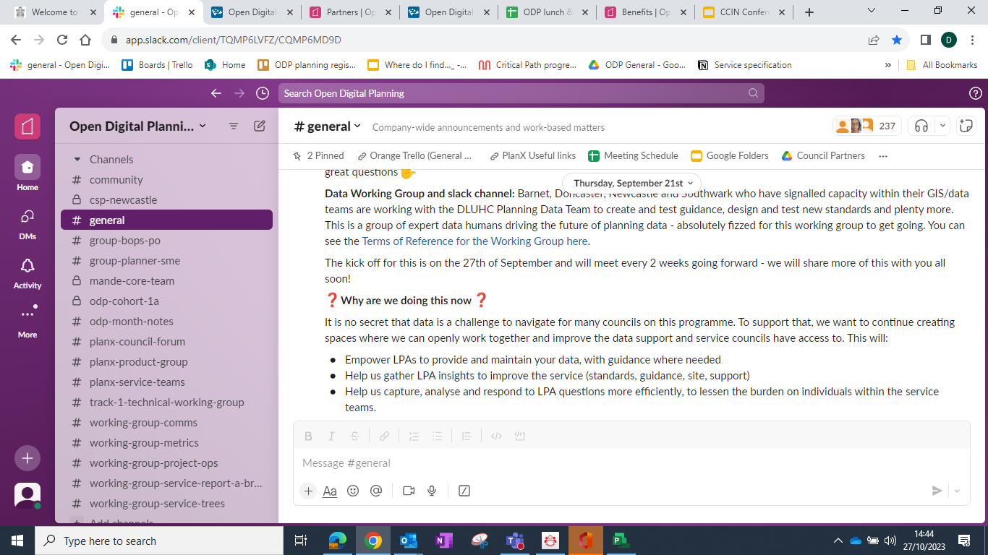
A helpful community
Data Working Group and slack channel: Barnet, Doncaster, Newcastle and Southwark who have signalled capacity within their GIS/data teams are working with the DLUHC Planning Data Team to create and test guidance, design and test new standards and plenty more. This is a group of expert data humans driving the future of planning data - absolutely fizzed for this working group to get going.

Slide 29
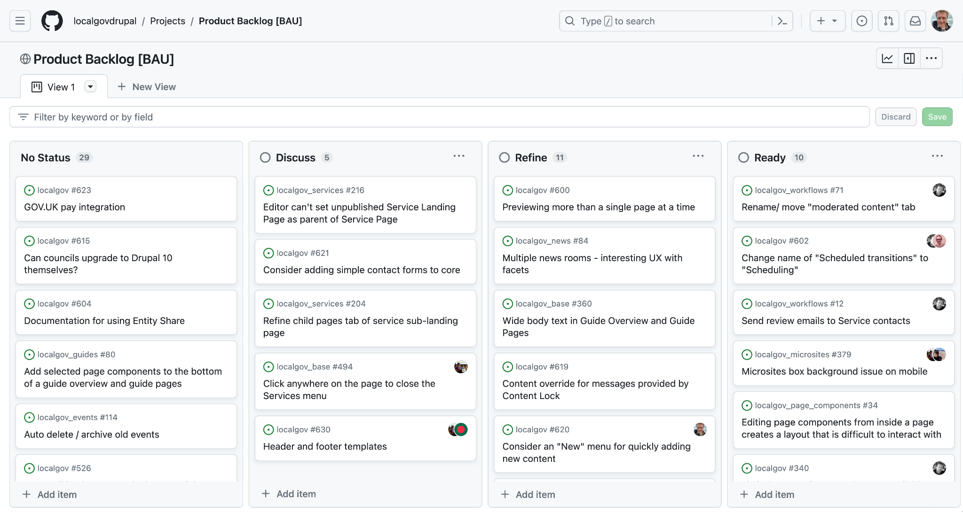
We make collaboration with other councils straightforward, saving time and money
We work in the open encouraging councils, suppliers and the wider Drupal community to get involved

Slide 30
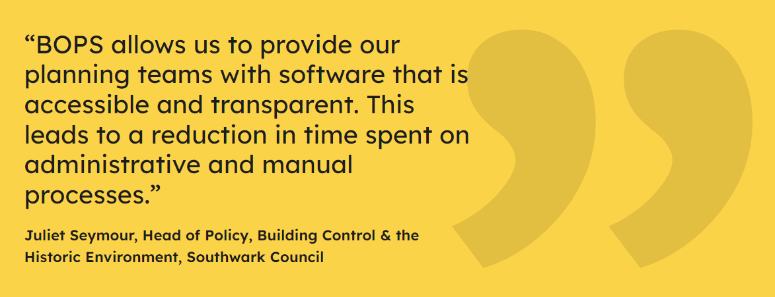
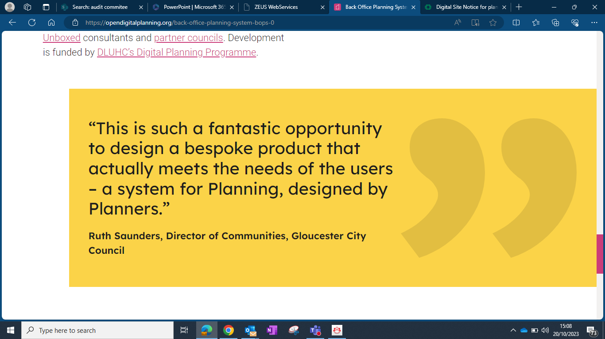
We make collaboration with other councils straightforward, saving time and money
Notes:
Tailored to ODP

Slide 31
Any questions?

Slide 32
How could it be applied to other problems?

Slide 33
Thank you!
LGD: hello@localgovdrupal.org
ODP: ODP@levellingup.gov.uk

