Slide 3
Opening round
Who are you?
Your organisation?
How are you arriving today?
Pass to someone who hasn’t been

Slide 4
What we’ll cover today
The difference between legal form and organisational type
The scope of legal forms used by co-operatives and community businesses in the UK?
The factors affecting the choice of legal form
Where do charities fit in?

Slide 5
Voluntary Community and Social Enterprise (VCSE)
How does this fit together?
Co-operative
Charity
Social Enterprise
Community Business

Slide 6
Another way to look at this
Conventional business model
Alternative business model
Charity
Social enterprise
Community business
Co-operative
Employee owned business
Democracy

Slide 7
Common understanding
In your groups:
List the different types of legal structure in the UK
Link to JamBoard

Slide 8
Legal form vs. organisational type
Legal form
Company
Society
Partnership
etc.
Organisational type
Co-operative
Social enterprise
Community business
Not for profit
B Corp
Land Trust
etc.

Slide 9
Charity
Established for charitable purposes
Subject to charity law jurisdiction
Tax benefits
Restrictions on use of assets
Restrictions on payments to people involved in the governance
Charity

Slide 10
Voluntary Community and Social Enterprise (VCSE)
How does this fit together?
Co-operative
Charity
Social Enterprise
Community Business

Slide 11
Incorporation
The process of formation and registration of a new legal person
Incorporation

Slide 12
What’s wrong with being unincorporated?
Free
Easy
Less regulation
Can get a bank account
Can get grant funding
No separate legal identity
Cannot enter into contracts
Cannot easily own assets
Unlimited personal liability

Slide 13
The pros and cons of incorporation?
Limited Liability
More options for finance
Can more safely enter into contracts
Can own stuff collectively
Cost
More administration
Regulation

Slide 14
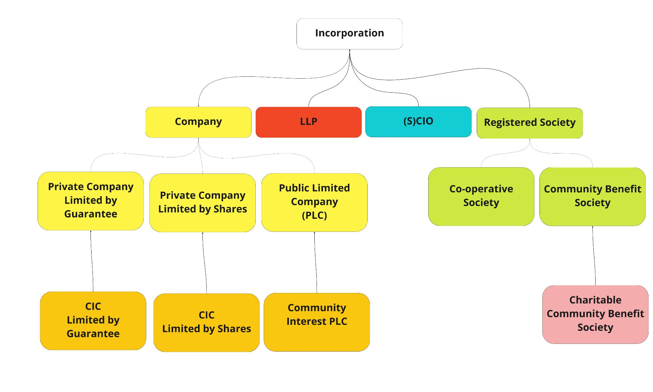
I

Slide 15
I

Slide 16
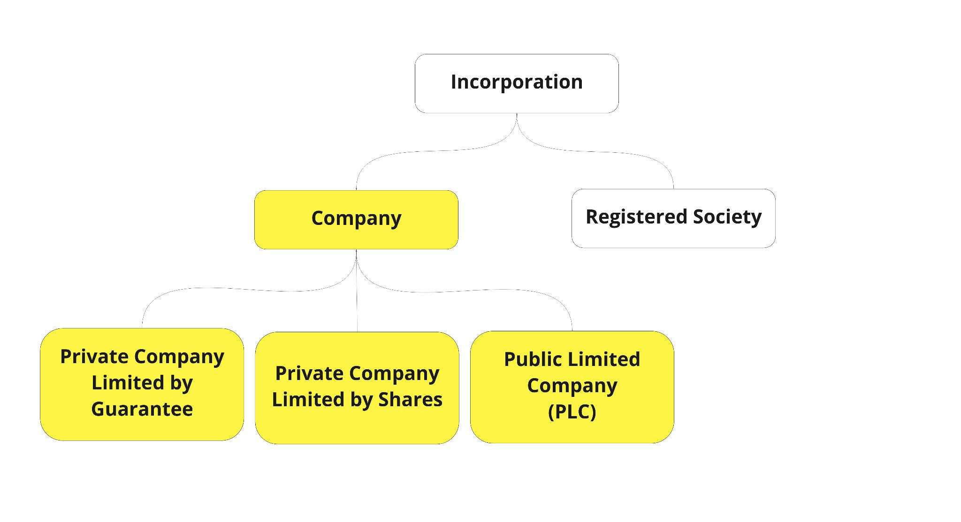

Slide 18
OrganicLea
Update - now a CIC
Notes:
Worker | London | ex council nursery | Social prescribing

Slide 19
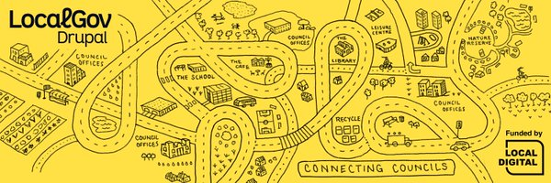
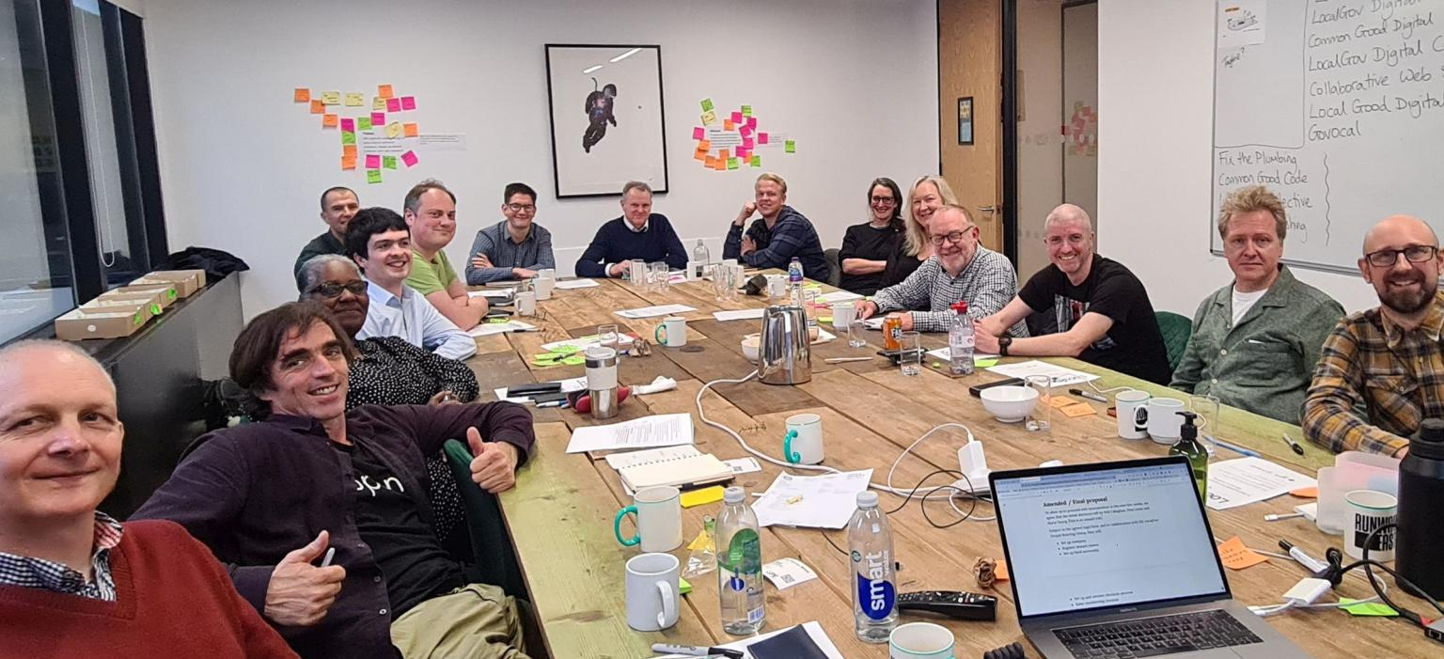
Open Digital Co-op Limited
Notes:
Multi-stakeholder - could have been consortium of enterprises but chose to involve councils
| Digital Services | Saving councils money & ensuring citizens are able to access services | 34 councils participating acros Uk and Ireland
https://localgovdrupal.org/news/2022/new-era-localgov-drupal

Slide 20
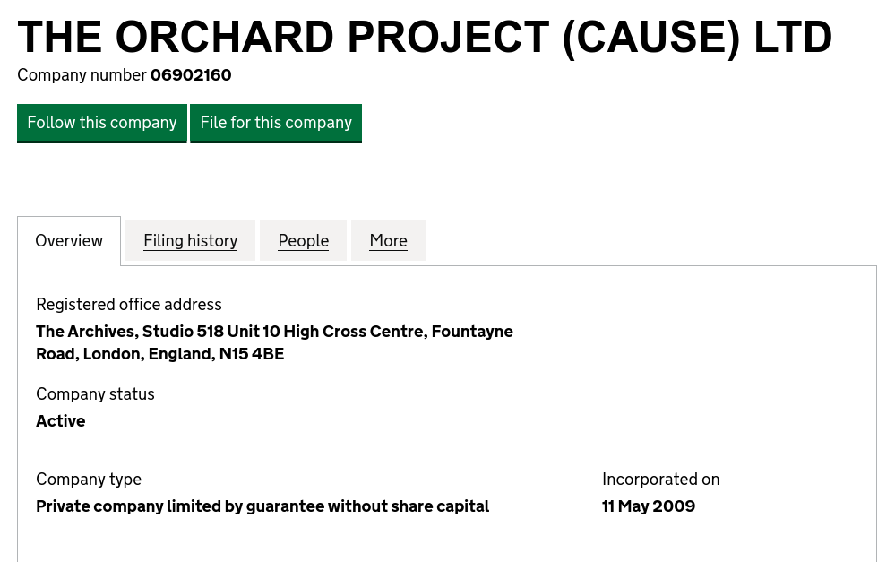
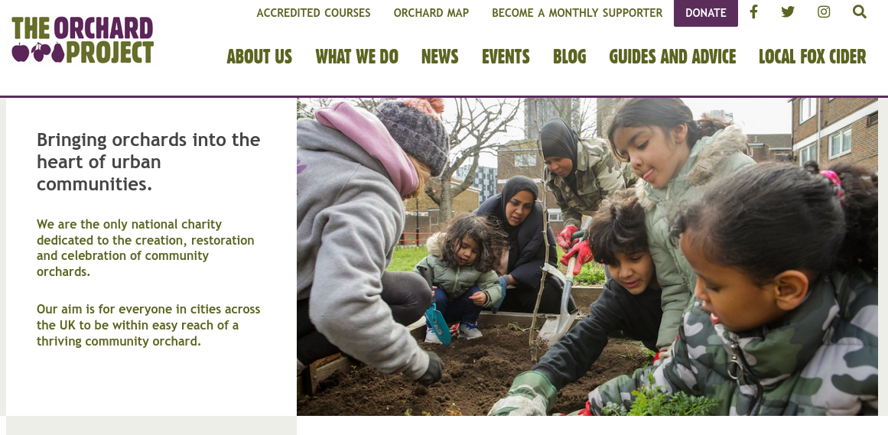
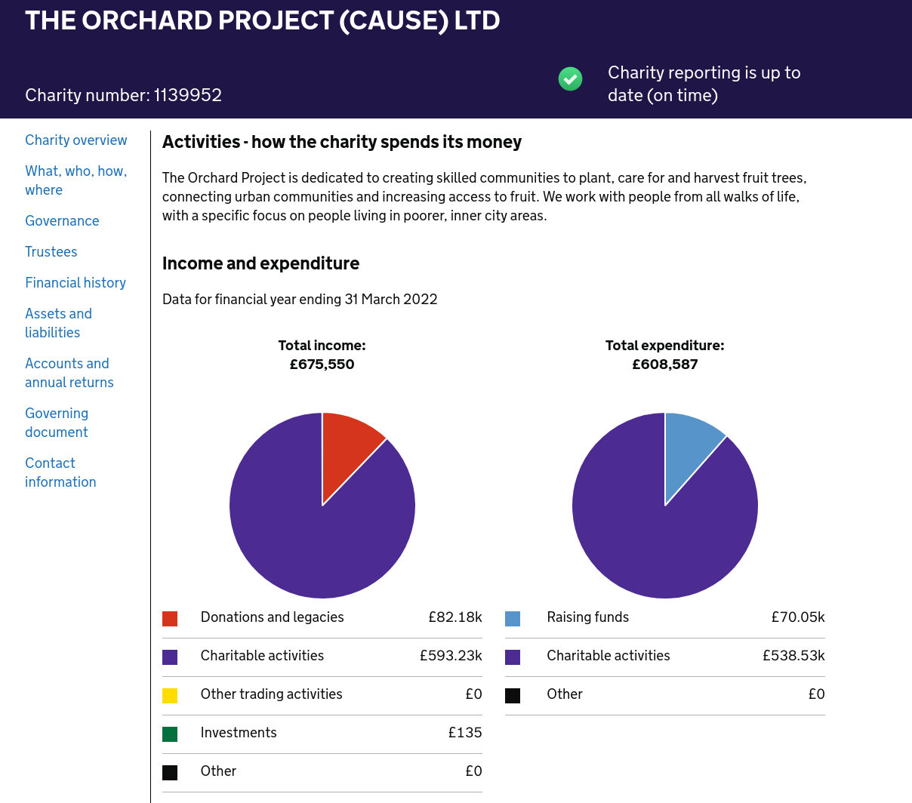
Charitable Company

Slide 21
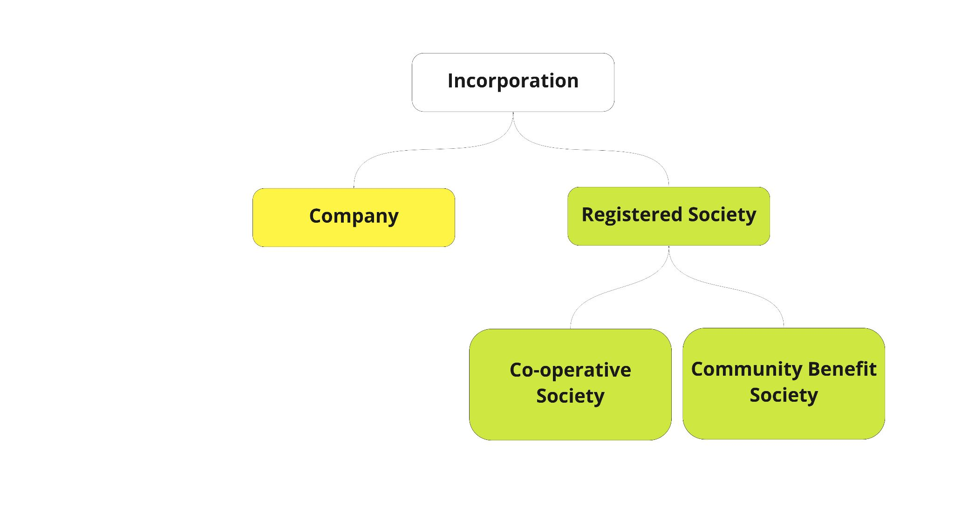

Slide 22
15 minute comfort break

Slide 23
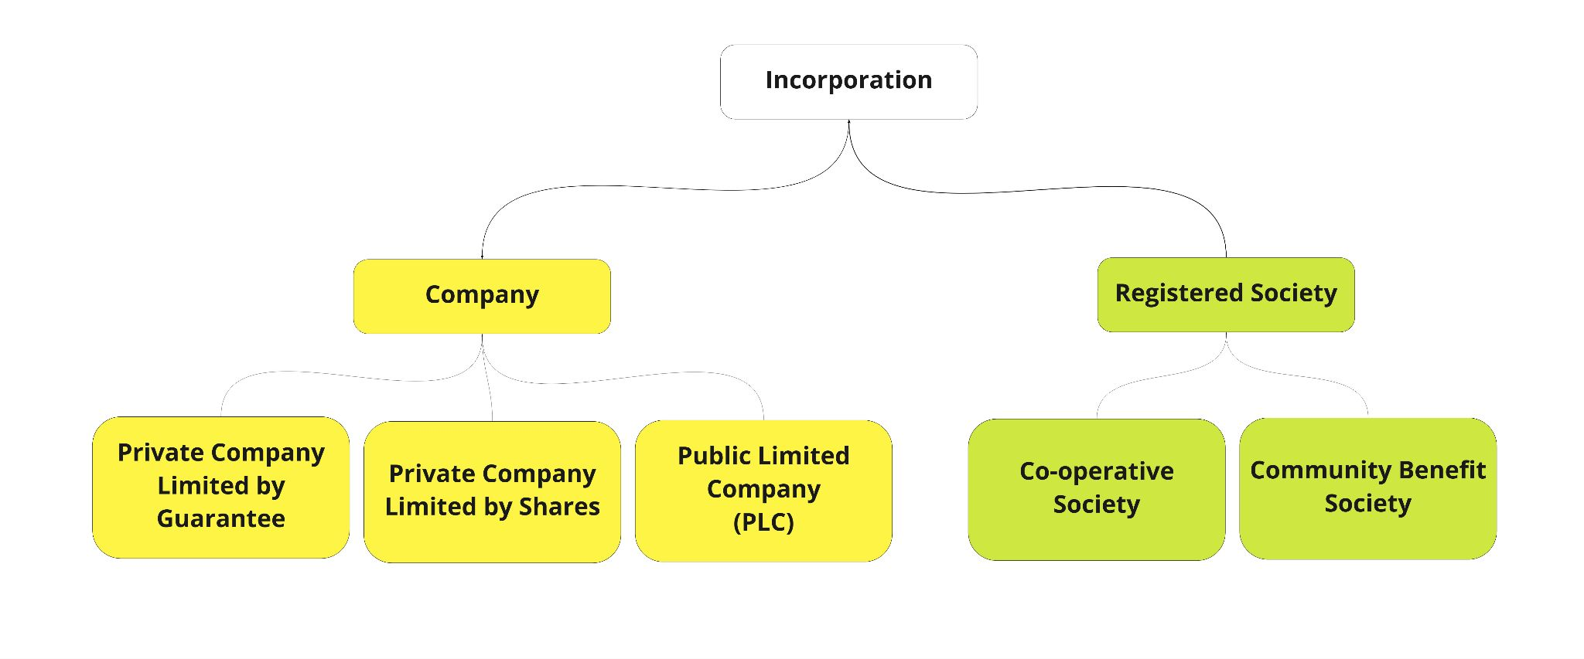

Slide 24
Notes:
Community co-operative | Investor members | Member benefit - preservation of asset of community value

Slide 25
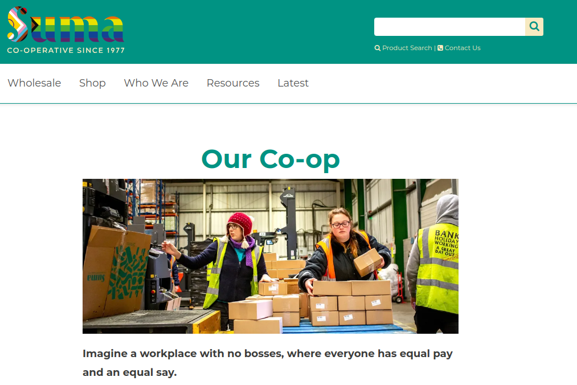
Suma
Notes:
Worker | Equal pay | sustainable livelihoods

Slide 26
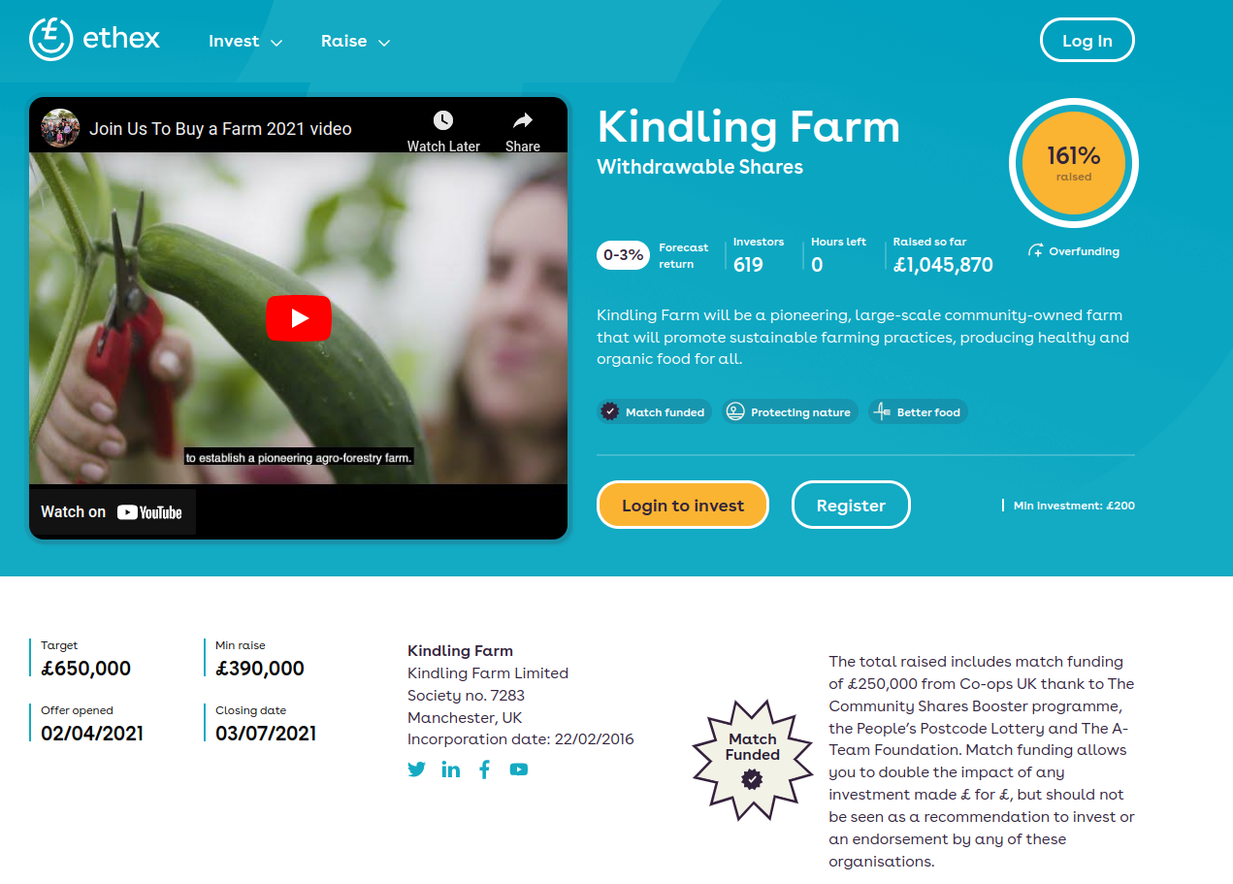
Kindling Farm
Notes:
Multi-stakeholder | Community Farm | Part of a GM ecosystem of ABMs

Slide 27
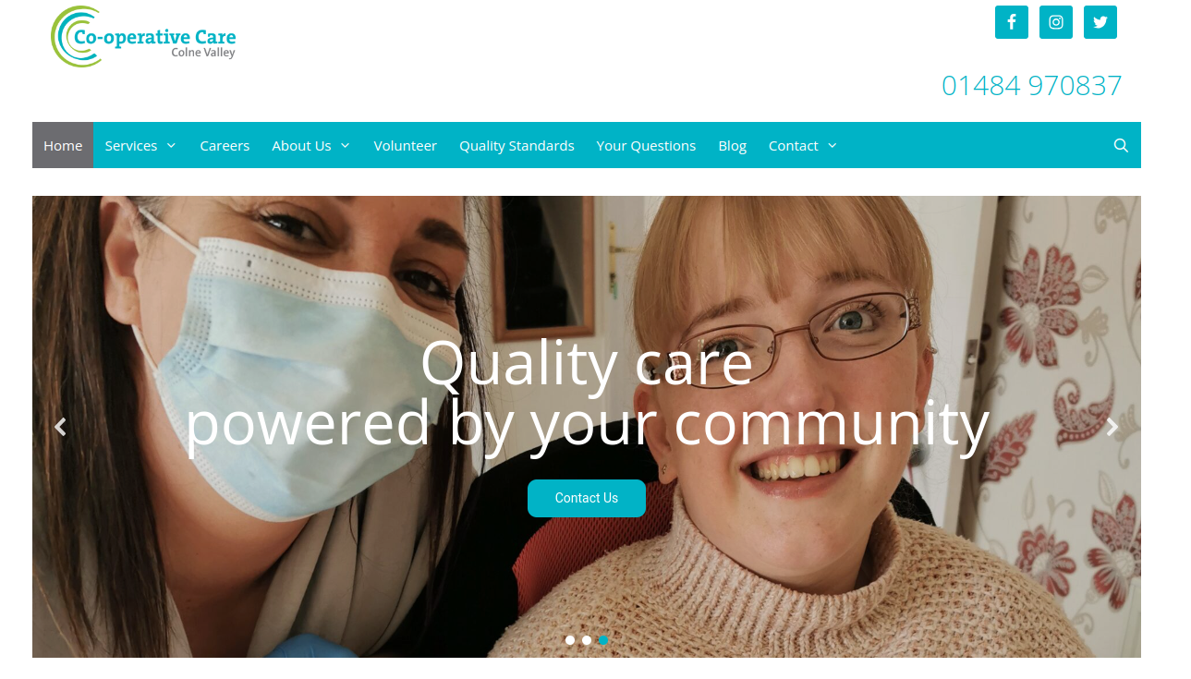
Colne Valley Care
Notes:
Multi-stakeholder | Quality care | Quality employment T&Cs | Carried out community share offer

Slide 28
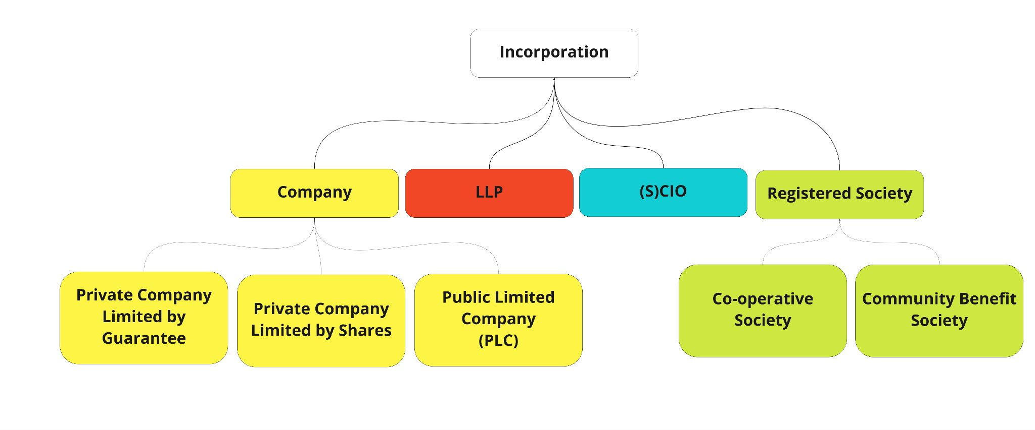

Slide 29
CIO example - Glasgow Tool Library

Slide 31
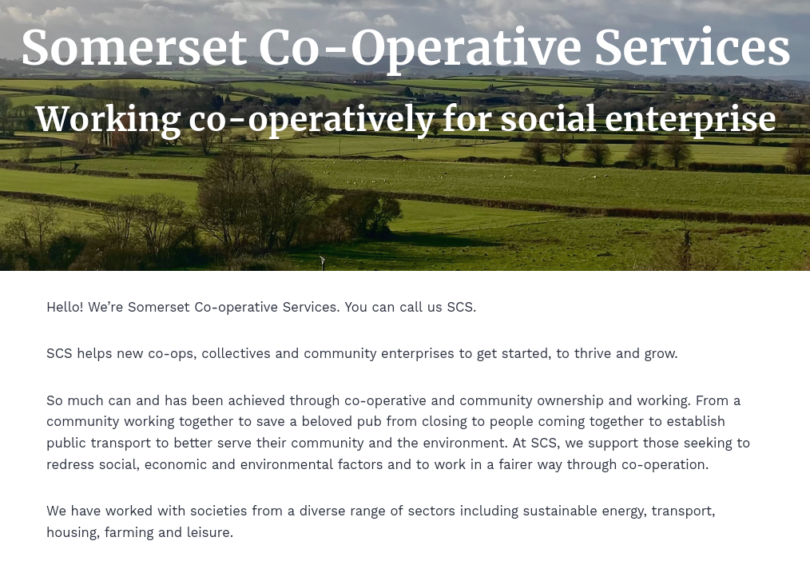
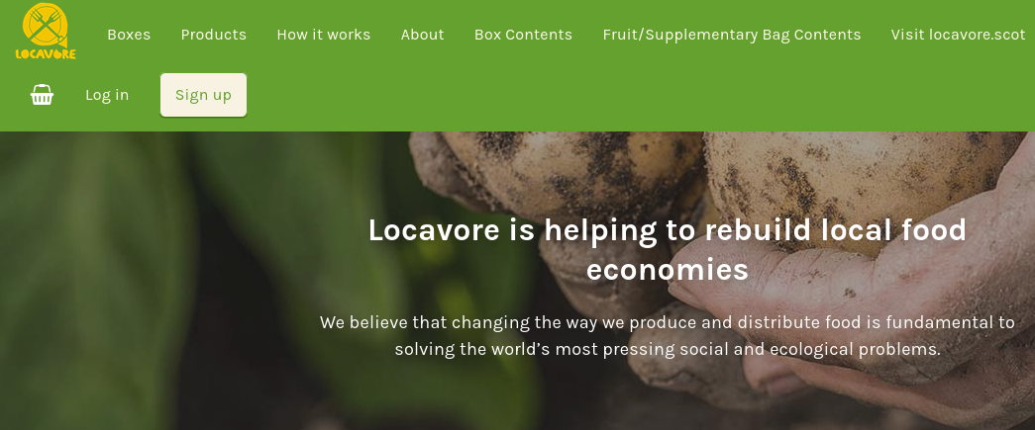
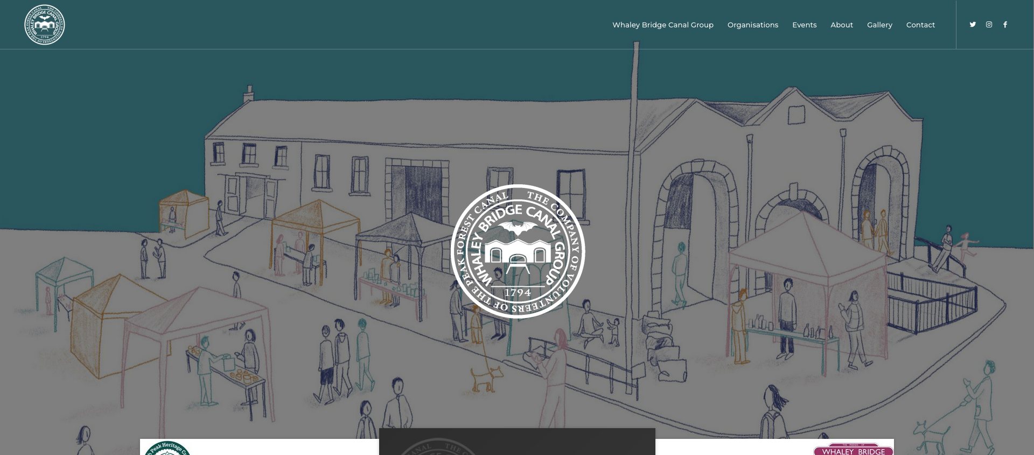
CIC examples

Slide 32
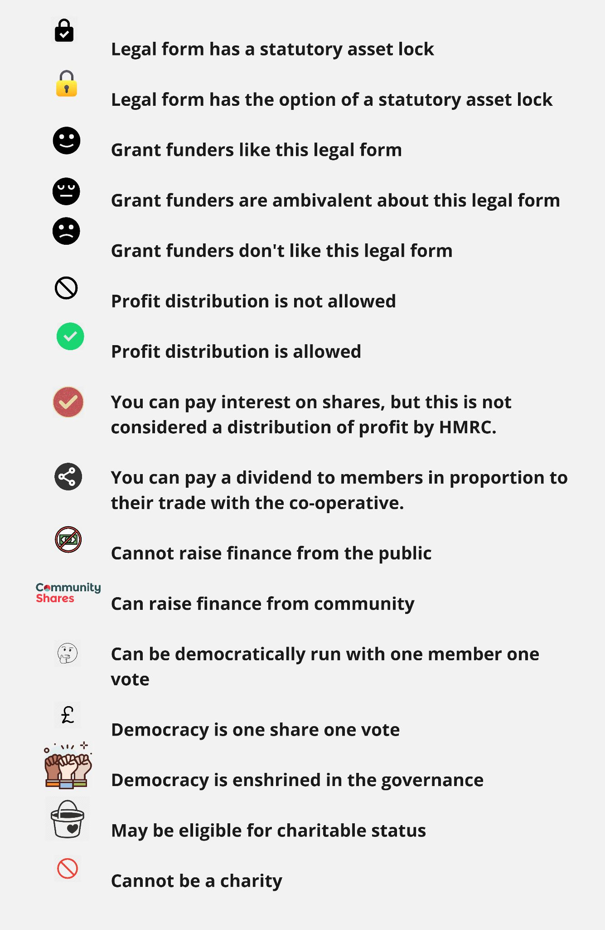
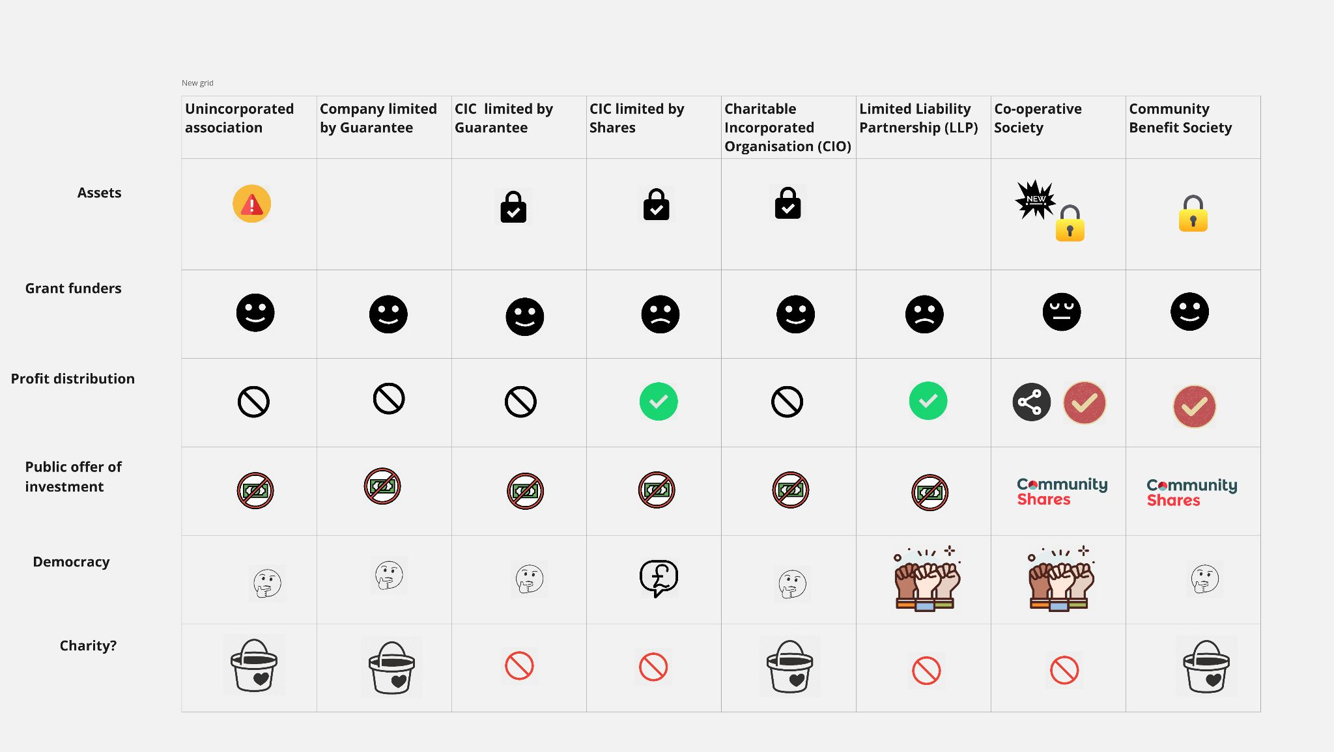

Slide 33
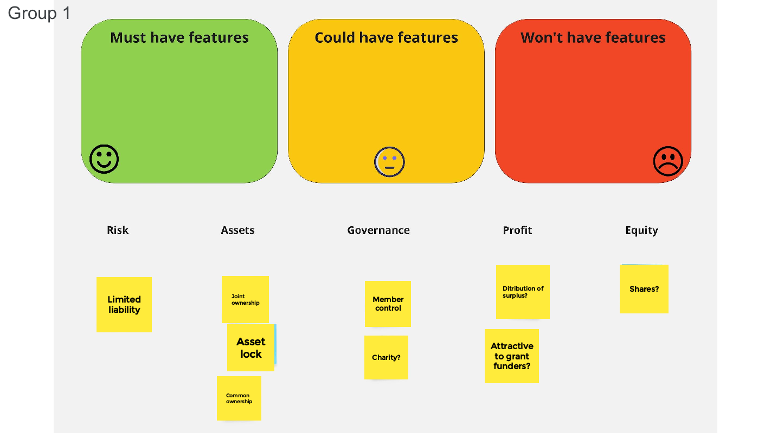
Group work
How we work with groups to choose their legal form

Slide 34
Questions

