Slide 3
Opening round
Who are you?
Your organisation?
How are you arriving today?
Pass to someone who hasn’t been

Slide 4
What we’ll cover today
What types and sources of capital are available to businesses in the UK?
What is unique about co-ops and community business finance?
What type of capital is available to what legal forms?
How do we chose the best types and sources of finance?

Slide 5
Voluntary Community and Social Enterprise (VCSE)
How does this fit together?
Co-operative
Charity
Social Enterprise
Community Business

Slide 6
Another way to look at this
Conventional business model
Alternative business model
Charity
Social enterprise
Community business
Co-operative
Employee owned business
Democracy

Slide 7
Common understanding
In your groups:
List the different types and sources of capital finance available to Business in the UK
Link to JamBoard

Slide 8
Types and Sources of Capital
Types of Capital
Non-returnable capital e.g. Grants, Donations, Sponsorship
Work best if there are wider or charitable beneficiaries
If the financial return is not great, then you will need to look at theses.
Can you sell the idea to the public? Or is it best to go to institutions
Tax treatment is complex!!!
The accounting treatment of grants can affect the ability to repay finance..

Slide 9
Types and Sources of Capital
Types of Capital
Equity – Share Capital invested at risk with no obligation to repay, with or without interest (but only if the co-op can afford to do so), confers membership rights.

Slide 10
Types and Sources of Capital
Types of Capital
Debt – Money lent through a contractual relationship, may or may not be secured, may or may not attract interest, will have to be paid back, doesn’t confer membership.
Bonds /Loan stock /Debentures – money repaid at the end of the loan (maturation date)
Reducing balance loans – Money repaid monthly
Credit and Overdrafts – A flexible facility that enables you to owe up to a limit, can be paid down at any time.

Slide 11
Types and Sources of Capital
Sources of capital
Equity
Share Capital
Existing members
a public share offer (community shares)
Retained earnings

Slide 12
Types and Sources of Capital
Sources of capital
Debt
Loan stock offer/ Bond Issue/ Debentures
The public/ supporters/ members/ mature co-ops
Mortgage & Bridging loans
Banks and ethical lenders https://www.goodfinance.org.uk/investors-advisors
Overdraft
Banks and ethical lenders
Credit
Suppliers

Slide 13
Types and Sources of Capital
Sources of capital
Non-returnable
Grants
Grant giving bodies – Try infrastructure bodies, local voluntary service
Sponsorship
Local or mission aligned businesses
Donations
The public, crowd-funder, kick starter etc.

Slide 14
Types and Sources of Capital
Cost of capital
Equity – You usually have to pay interest on shares
Debt – You have to pay interest on debt
Suppliers – You may be able to get interest free credit
Bridging loans/ overdraft – Overdrafts can be interest free, bridging loans usually attract interest
Grants - Free
Retained earnings - Free

Slide 15
What is unique about Co-operative Finance
The Co-operative Difference………..
“In Co-ops and Community Businesses capital is used to further the aims of the co-op or community business rather than the business being used to generate return on capital”

Slide 16
What is unique about Co-operative Finance
Restrictions
A limit to the return on capital (interest or dividend)
They remain at par value (unless written down)
They do not imply a share in the residual value of the co-op
They don’t carry votes in proportion to the amount of shares held

Slide 17
What is unique about Co-operative Finance
Advantages
An additional type of share capital that is unique to Societies (Withdrawable Shares)
Exemptions from some of the financial promotion regulations

Slide 18
What is unique about Co-operative Finance
Withdrawable shares
An additional type of share capital that is unique to Societies
Can’t be bought and sold, but can be withdrawn if the society can afford to allow it.
Can attract interest (if the society can afford to pay it)
Maximum investment £100,000 (unless as society is investing in another society)
Confers membership, but is based on the principle of OMOV
Exempt from the FSMA regulations.

Slide 19
15 minute comfort break

Slide 20
What capital is available to what legal structure?
Things we must consider:
Is the form of capital allowable to the structure?
Does the capital confer membership
Is the advertising of that capital to the public allowed under the Financial Services and Markets Act 2000?

Slide 21
What capital is available to what legal structure?
Is the form of Capital allowed to the legal structure?
Equity
Withdrawable Shares – Unique to societies so only Co-op Societies and Bencoms
Transferable Shares - Also allowed for societies, but is also an option for CIC’s and Companies Ltd by Shares. The main difference for our purposes is that in CIC’s and other companies, 1 share = 1 vote.

Slide 22
What capital is available to what legal structure?
Is the form of Capital allowed to the legal structure?
Debt
Both reducing balance loan and loan stock/ bonds are available for all legal structures.

Slide 23
What capital is available to what legal structure?
Does the form of capital confer membership?
Equity
If a co-op wanted to offer equity to outside investors then:
It must be a society (to prevent investors gaining control through a 1 share 1 vote mechanism)
It would need to be a multi-stakeholder co-op.

Slide 24
What capital is available to what legal structure?
Does the form of capital confer membership?
Equity
This is a good form of capital for Bencom’s that can have a wider community membership.
Debt
Debt does not confer membership and so is available to all forms.

Slide 25
What capital is available to what legal structure?
Is the advertising of that capital to the public allowed under the Financial Services and Markets Act 2000?
The FSMA 2000 and associated orders, regulate the advertising of financial instruments (including debt and equity) to the public.

Slide 26
What capital is available to what legal structure?
Is the advertising of that capital to the public allowed under the Financial Services and Markets Act 2000?
It is only the advertising to the public that is regulated by this, so advertising to existing members, supporters with a genuine interest in the performance of the organisation and high net worth individuals are not covered by this act.
Most public offerings are regulated with some exceptions

Slide 27
What capital is available to what legal structure?
Is the advertising of that capital to the public allowed under the Financial Services and Markets Act 2000?
Equity
The advertising of Withdrawable shares by societies is exempt.
Debt
The advertising of loan stock or bonds by societies is exempt.

Slide 28
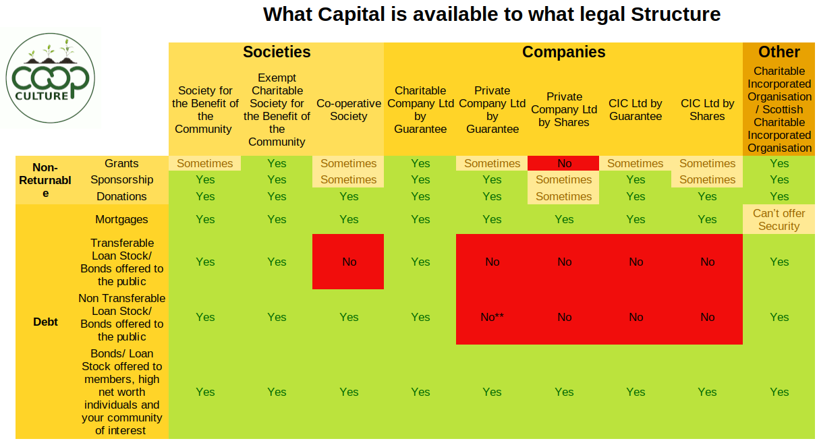

Slide 29
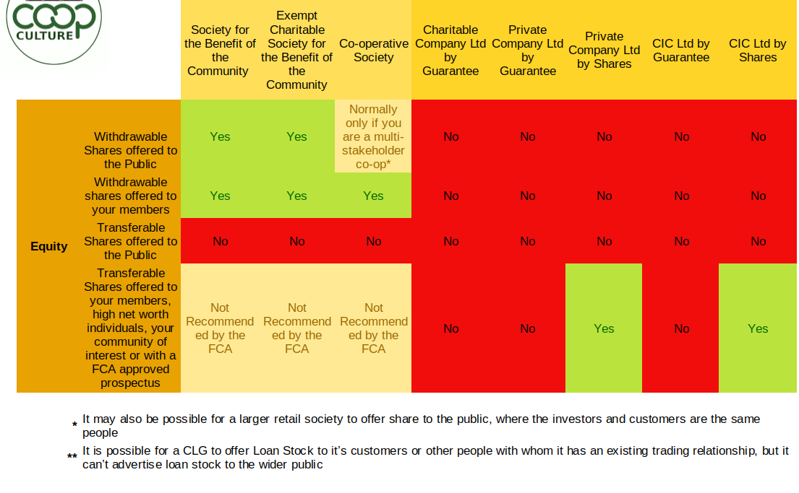

Slide 31
Raised £409,000 of Comm Sahres in 2019 and a further £150,000 in 2022

Slide 32
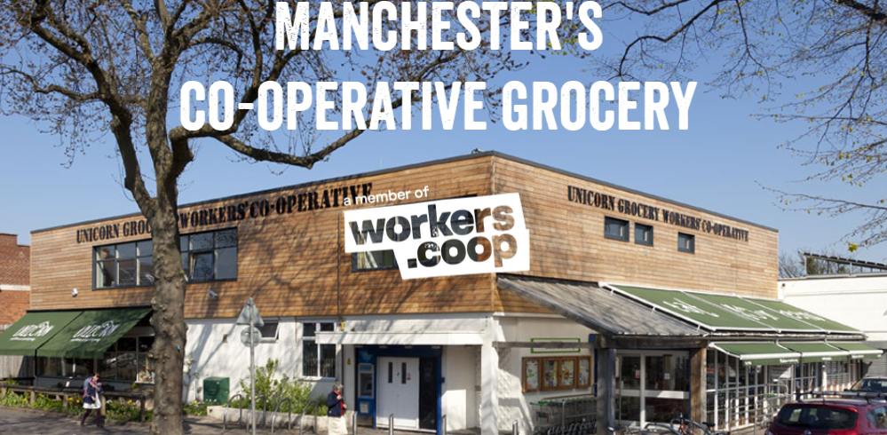
Raised - £100,000 of loan-stock in 2003 to buy the store

Slide 33
Raised - £150,000 of loan-stock in 2022 to buy this house

Slide 35
What is the best type and source of capital?
Who are the beneficiaries?
The more charitable/ the wider the beneficiaries, the more likely you are to be able to secure non-returnable capital or semi non-returnable capital
How profitable is the business?
The more the social returns and the less the financial returns the more likely you will need to secure non-returnable capital or semi non-returnable capital

Slide 36
What is the best type and source of capital?
How is the current balance sheet?
Does the society already have too much debt?
(Check the Debt to Asset Ratio and EBIT to Interest Payable Ratio.)
Is the society over capitalised?
(Check the Debt to Equity Ratio)

Slide 37
What is the best type and source of capital?
How open is the membership?
Closed membership means, that unless you have rich members, you will need debt.
Open membership means equity is an option.
How secure are you in your financial projections?
The less confident you are, the more risky taking on debt will be and the more likely you will need equity

Slide 38
What is the best type and source of capital?
What is the capital for?
If a fixed asset you can consider secured debt/ unsecured debt and equity
If working capital – bridging loan, overdrafts and extended credit should be considered along with Equity.

Slide 39
What is the best type and source of capital?
What does the cash flow look like?
If the cash flow is tight then long term patient capital – Equity or Loan stock/ Bonds are good.
If the cash flow isn’t tight then reducing the cost of capital by a reducing balance loan could be better
(obviously check the interest rate difference…….)

Slide 40
What is the best type and source of capital?
What legal form does the business have?
If a society it can advertise to the public
If a company it is more likely to have to go to institutions
Again what security does it have?
The less the security the more likely you will need to go to the public, or if institutional finance it will cost a lot more.

Slide 41
What is the best type and source of capital?
What social networks do the group have?
Is this an idea that is an easy sell to the public, with wider social benefits, innovative or disruptive?

Slide 42
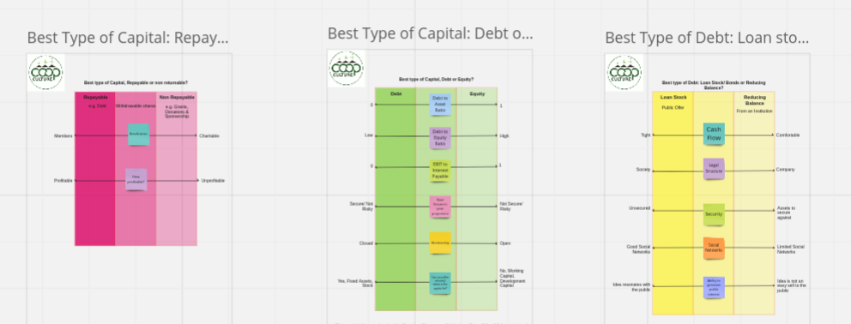
https://miro.com/app/board/uXjVNfjHJCk=/?share_link_id=54541137654
https://docs.google.com/document/d/1Ff_W6SeVgpiUMURtX-UTo6ZrFDVAGqj_KpqvXGOdtS8/edit?usp=drive_link

Slide 43
Questions

