Slide 1
Performance Framework and ‘Golden Thread’
Jon Power

Slide 2
“I understand how my role contributes to the Council’s priorities”
92%
2020 Employee Survey
91%
2022 Employee Survey
CCIN

Slide 3


Clear strategic planning framework
CCIN

Slide 4

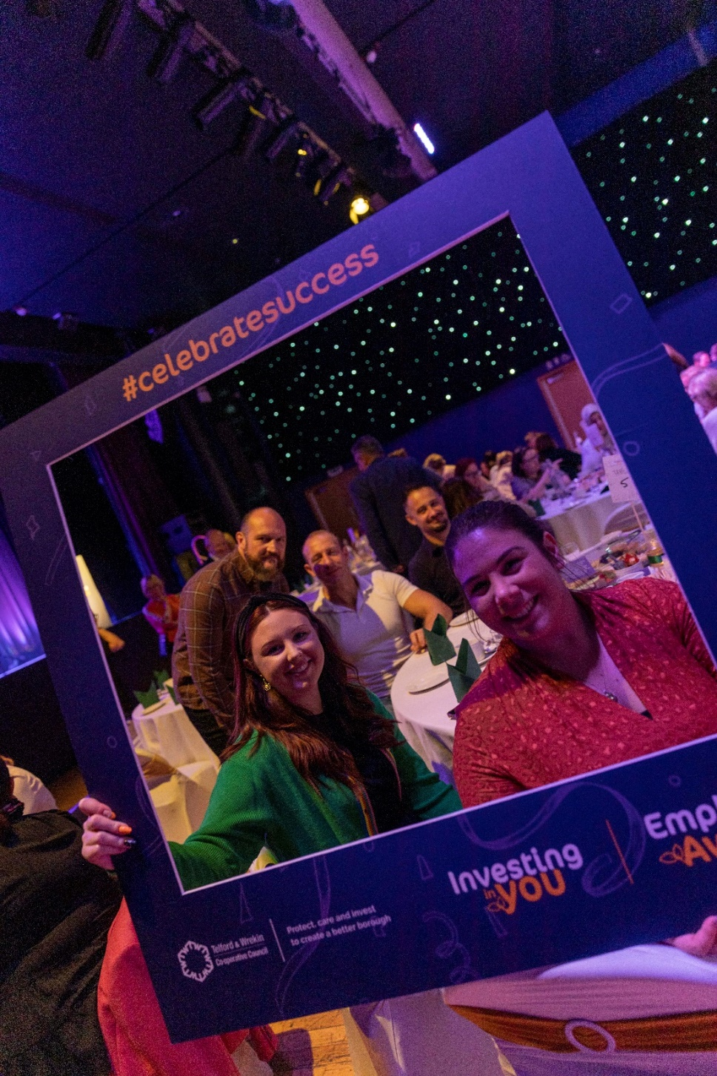
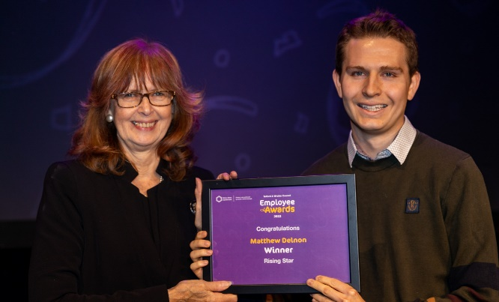
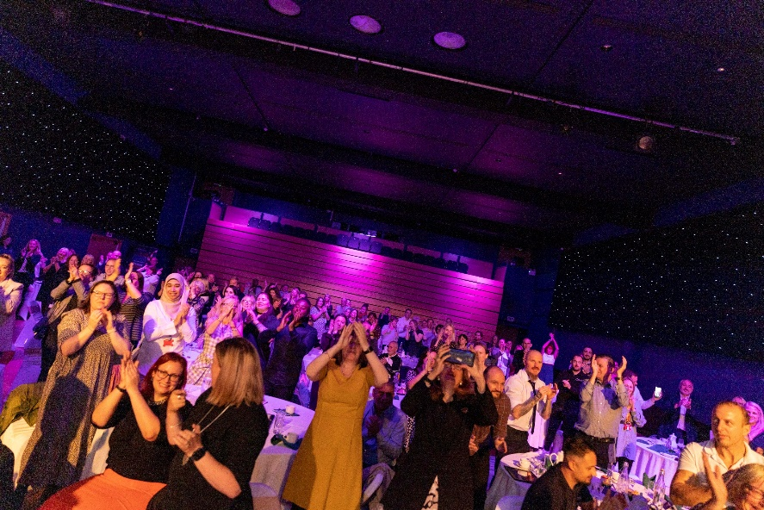

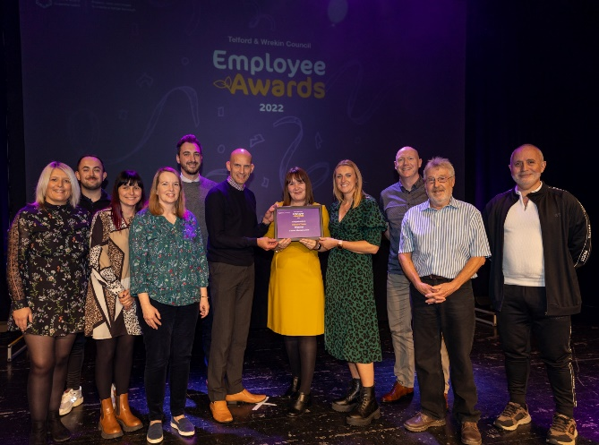


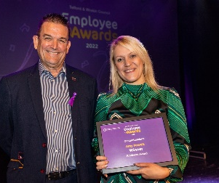
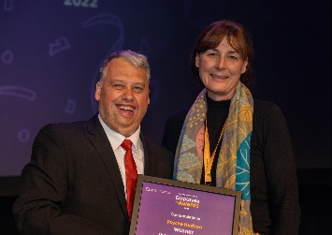

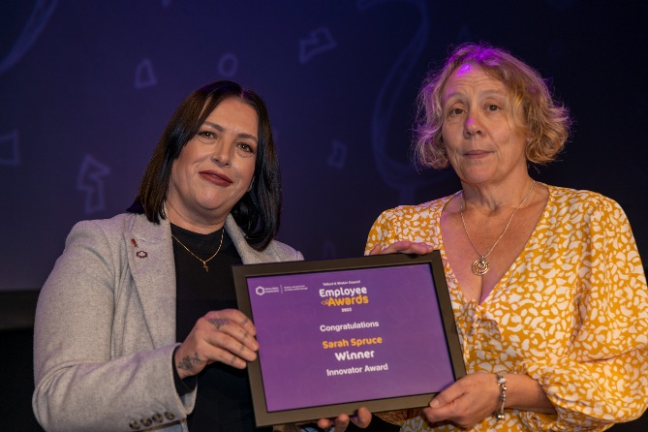


Slide 5

Presentation title
Our values
Insert Values poster
Notes:
Results form the survey back this up

Slide 7
Performance Culture
Robust strategic framework
Committed to evidence-led decision making
Excellent insight and performance products
Leadership & ownership:
  Monthly SMT performance discussion informed by a “Priority Dashboard”
  Driven by exception reporting
  “Deep dive” into one or two specific issues
  Open, trusted conversation
  Collective responsibility to drive improvement
CCIN
Notes:
We know what our priorities are! They were developed with our Cabinet & SMT are owned by our Cabinet & SMT and driven by our Cabinet & SMT.
We have finite resources and so have to ensure that we expending them on the right things. Very strong commitment and leadership from our Chief Executive

