Slide 3
Opening round
Who are you?
Your organisation?
How are you arriving today?
Pass to someone who hasn’t been

Slide 4
What we’ll cover today
What do we mean by alternative business models (with examples)?
How they compare and contrast to “conventional business models”
How does developmental support to them differ?
What support is available to them?

Slide 5
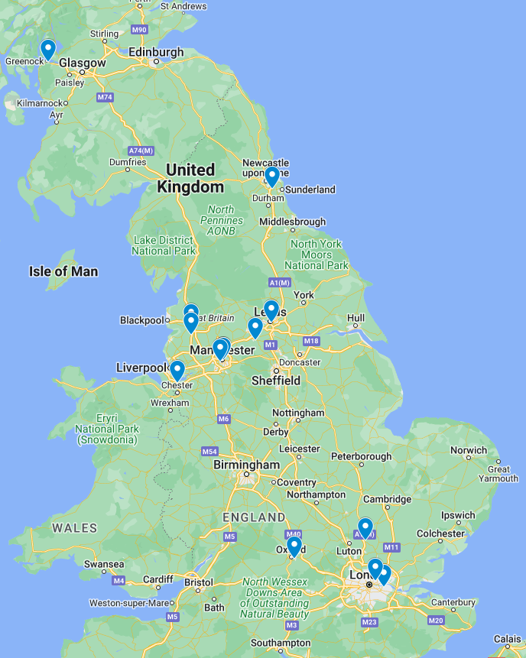
Who’s in the room?
Link to live map

Slide 6
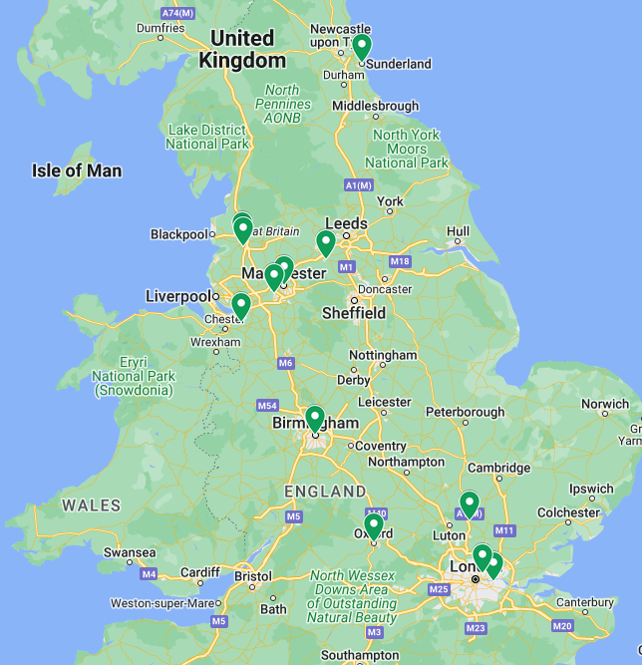
Who’s in the room?
Link to live map

Slide 7
How would you describe your role?
Face-to-face business support
Policy
Other

Slide 8
What is your experience of ABMs?
Lots of experience
Moderate experience
Little to no experience
What are alternative business models?

Slide 9
Common understanding
In your groups:
List (using post-its) the key features of the following terms:
Co-operative
Social Enterprise
Charity
Community business
Please add any other terms that you think might need defining in this context
Link to JamBoard

Slide 10
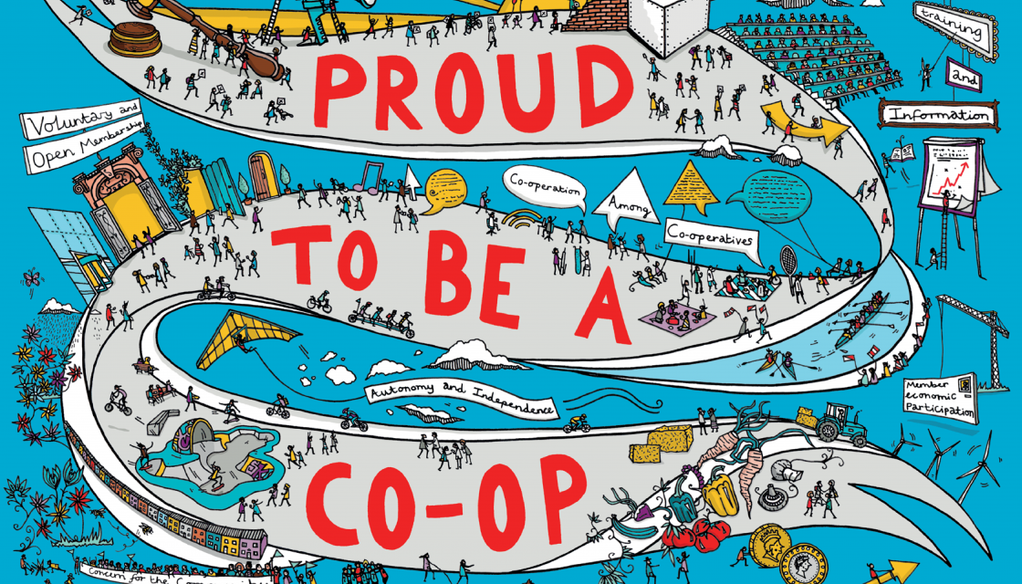
Co-operative
A co-operative is a business or organisation that’s democratically owned and controlled by its members, to meet their shared needs. The members can be its customers, workers, residents, service users or suppliers.

Slide 11
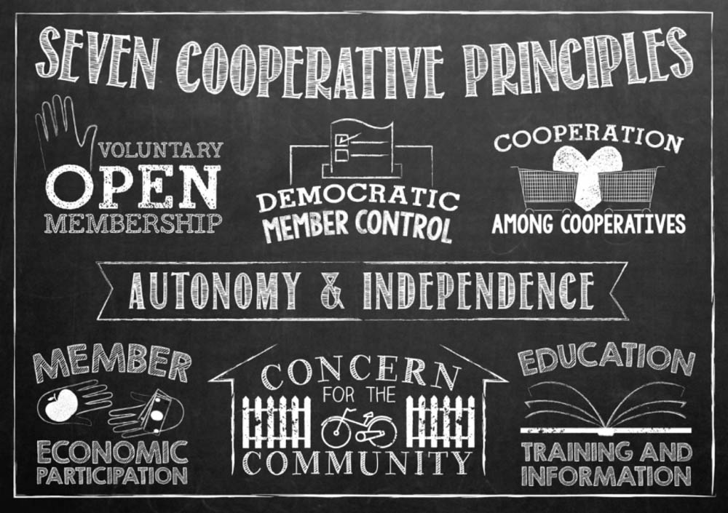

Slide 12
Social Enterprise
An organisation that:
Trades for a social purpose
Principally reinvests any profit
Restricts the use of its assets to that social purpose

Slide 13
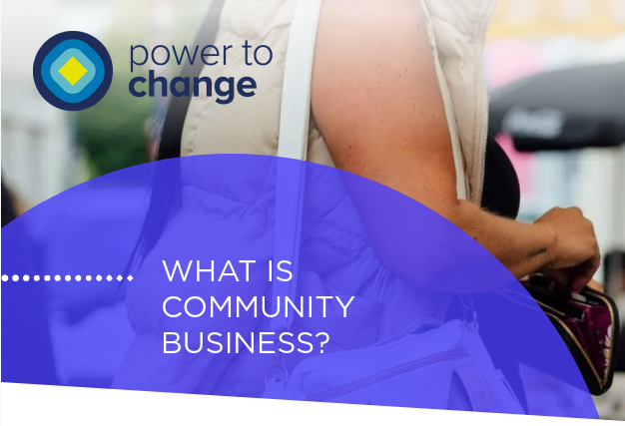
Community Business

Slide 14
Charity
Established for charitable purposes
Subject to charity law jurisdiction
Tax benefits
Restrictions on use of assets
Restrictions on payments to people involved in the governance

Slide 15
Voluntary Community and Social Enterprise (VCSE)
How does this fit together?
Co-operative
Charity
Social Enterprise
Community Business

Slide 16
Another way to look at this
Conventional business model
Alternative business model
Charity
Social enterprise
Community business
Co-operative
Employee owned business
Democracy

Slide 17
Notes:
Community co-operative | Investor members | Member benefit - preservation of asset of community value

Slide 18
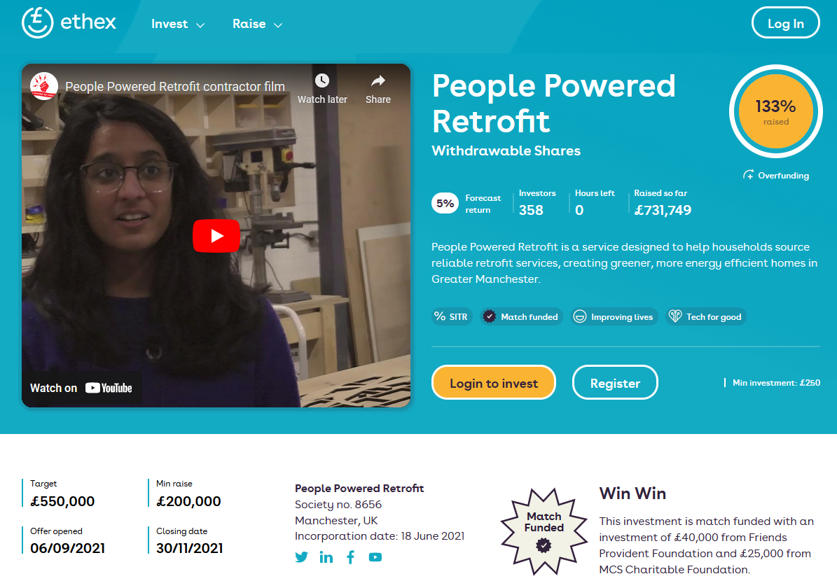
Notes:
Community co-operative | Investor members | Member benefit - combating climate change, green jobs creation. Note a lot of community co-ops save assets such as pubs, shops, post offices

Slide 19
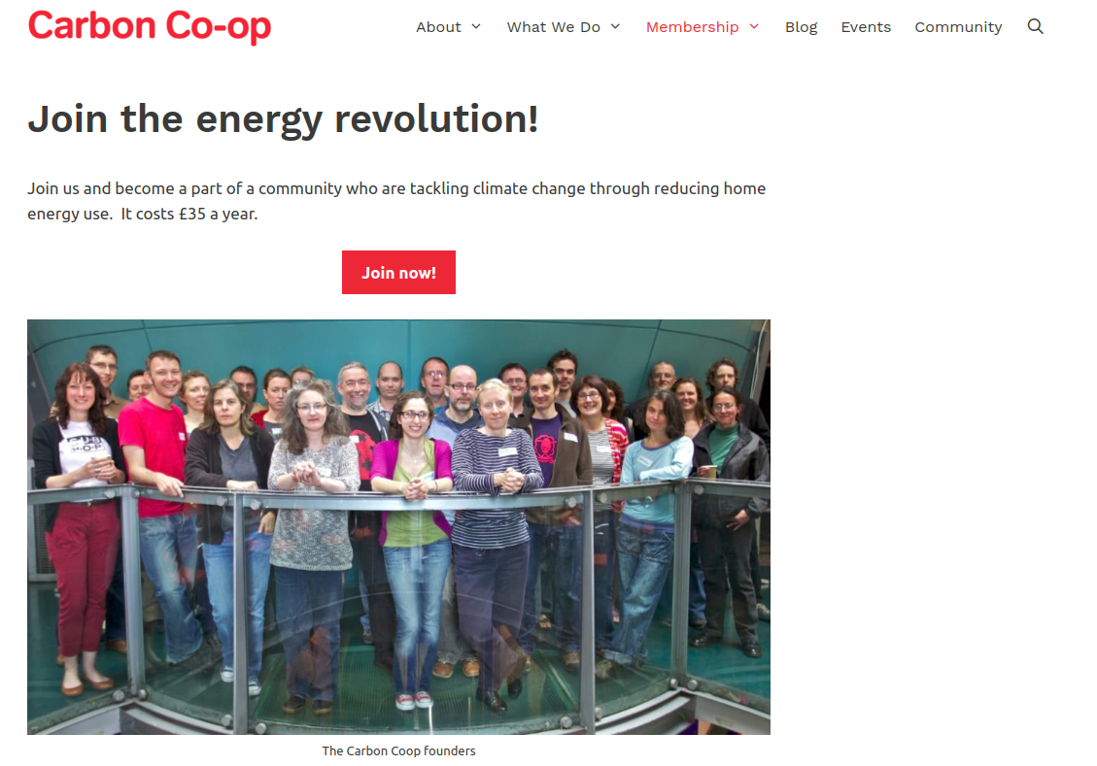
Notes:
Householders | Manchester | member benefit - access to help, support professionals and cheaper materials

Slide 20
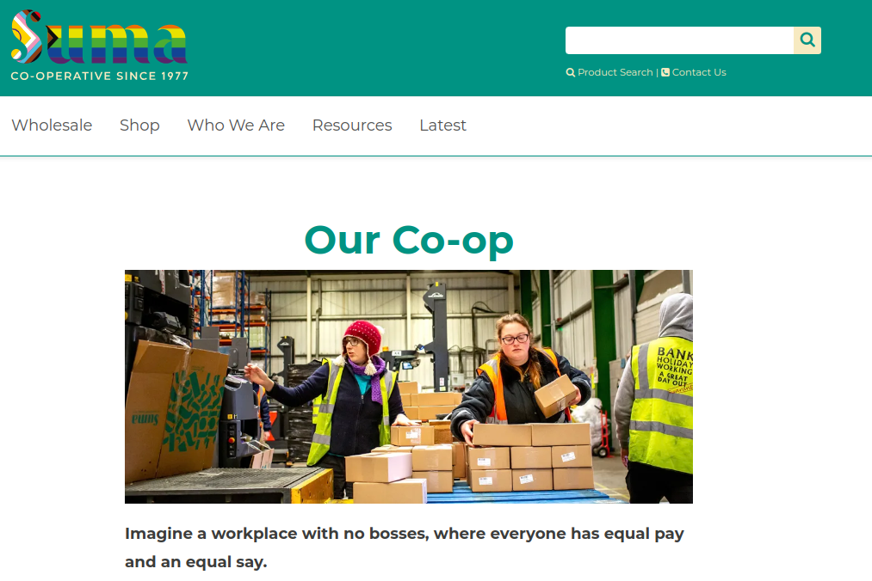
Suma
Notes:
Worker | Equal pay | sustainable livelihoods

Slide 21
OrganicLea
Notes:
Worker | London | ex council nursery | Social prescribing

Slide 22
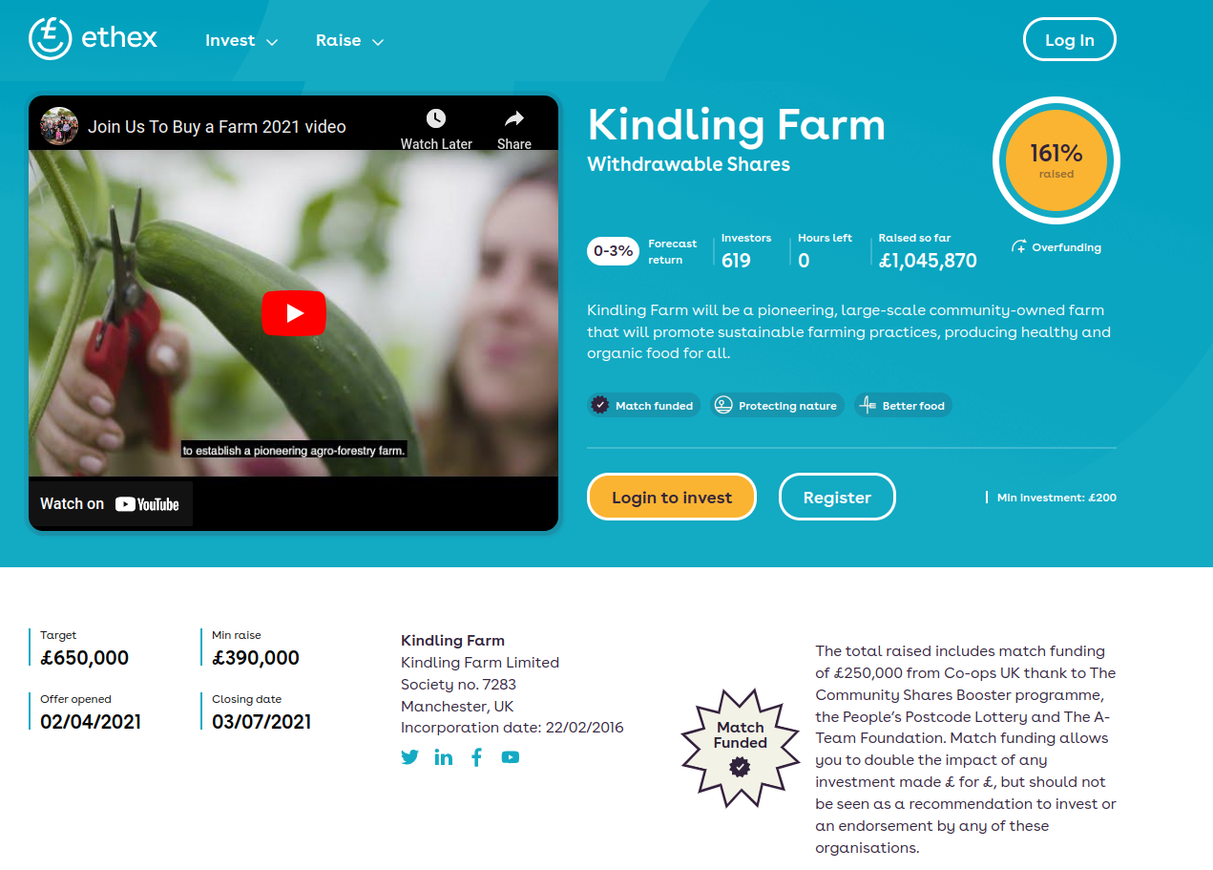
Kindling Farm
Notes:
Multi-stakeholder | Community Farm | Part of a GM ecosystem of ABMs

Slide 23
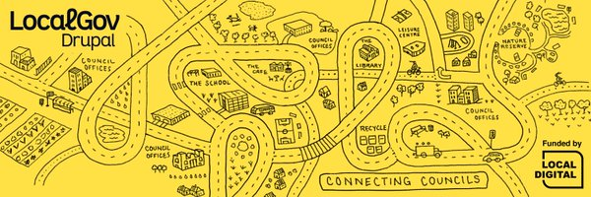
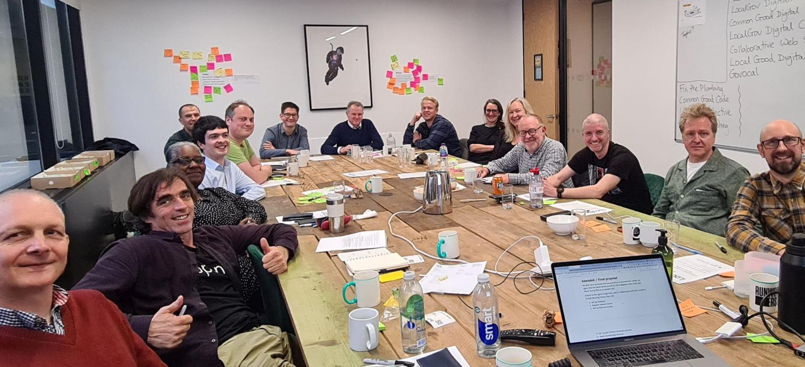
Open Digital Co-op Limited
Notes:
Multi-stakeholder - could have been consortium of enterprises but chose to involve councils
| Digital Services | Saving councils money & ensuring citizens are able to access services | 34 councils participating acros Uk and Ireland
https://localgovdrupal.org/news/2022/new-era-localgov-drupal

Slide 24
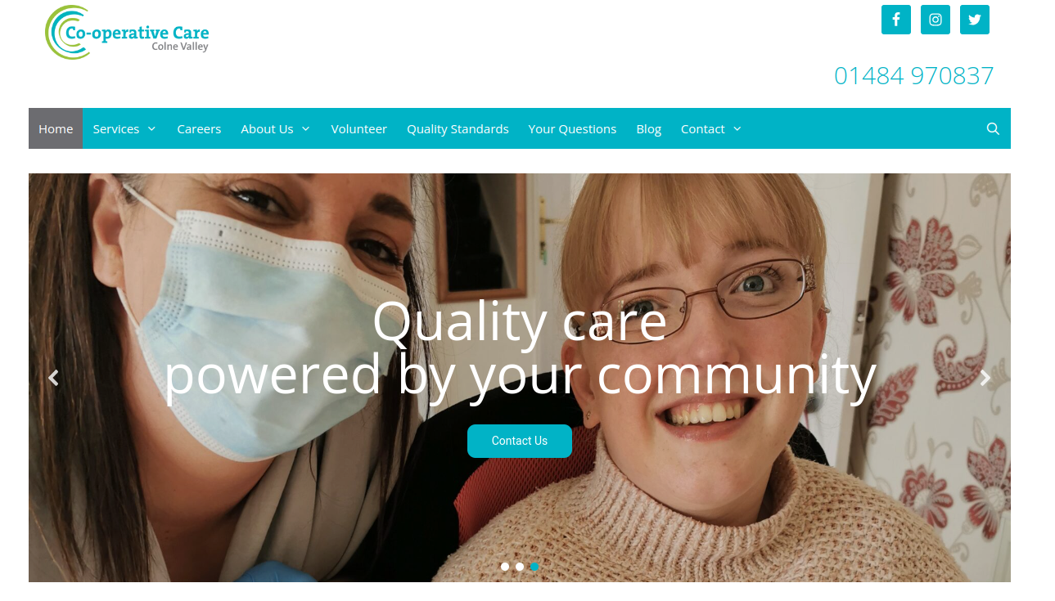
Colne Valley Care
Notes:
Multi-stakeholder | Quality care | Quality employment T&Cs | Carried out community share offer

Slide 25
Comfort break

Slide 26
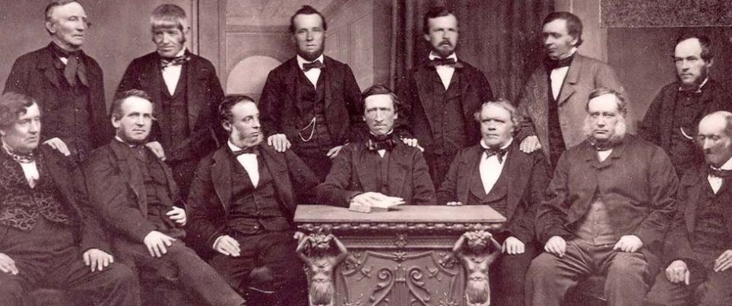
A bit of history

Slide 27
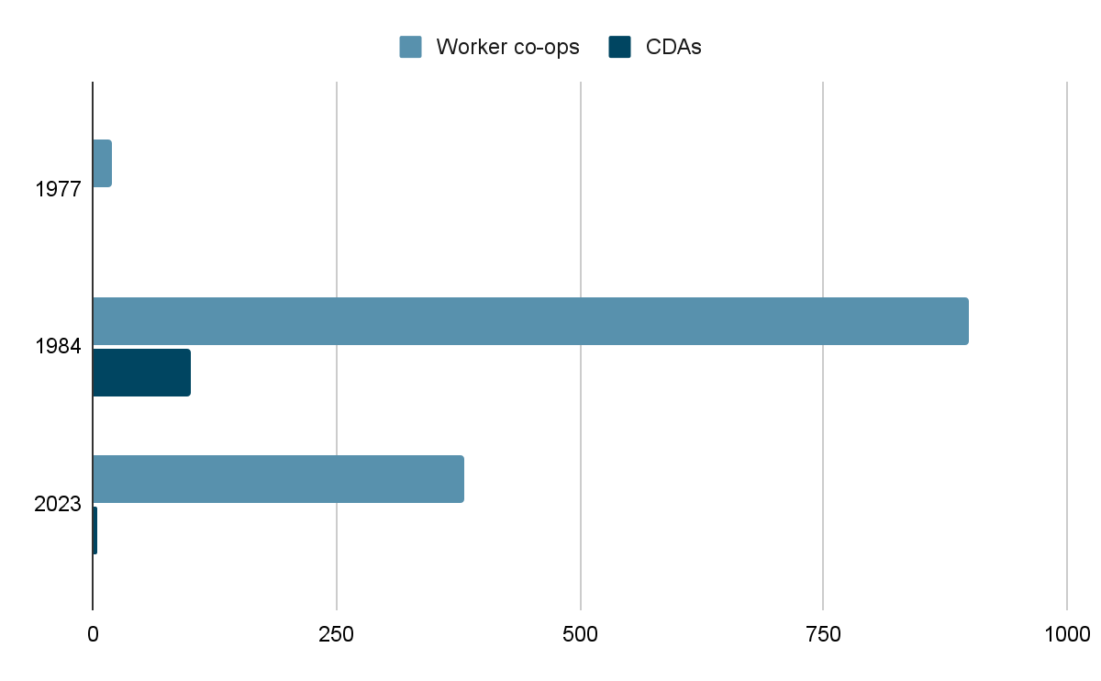
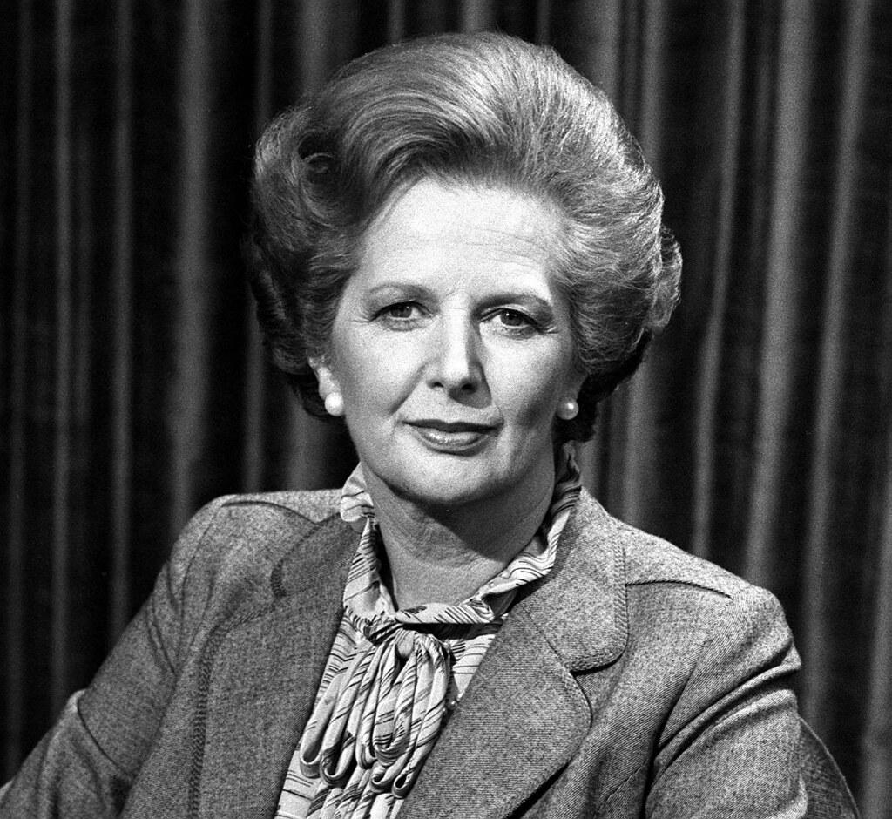
1970s/80s CDAs
1 to 100 between 1977 and 1984
Half employed full-time staff
Worker co-ops 20 to 900 over same period
(include CDAs local to attendees)

Slide 28
90s / 2000s
Social Enterprise
New legal forms - CIC
National Lottery

Slide 29
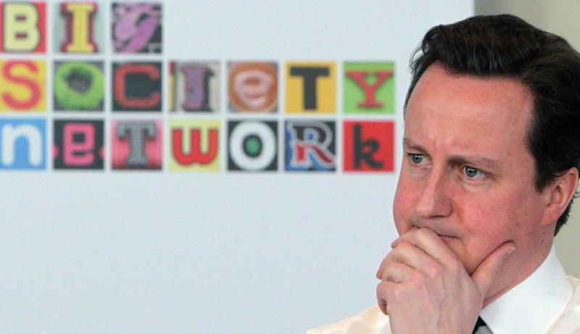
Big Society
Social Investment
Social Impact
New support programmes
New capital funds

Slide 30
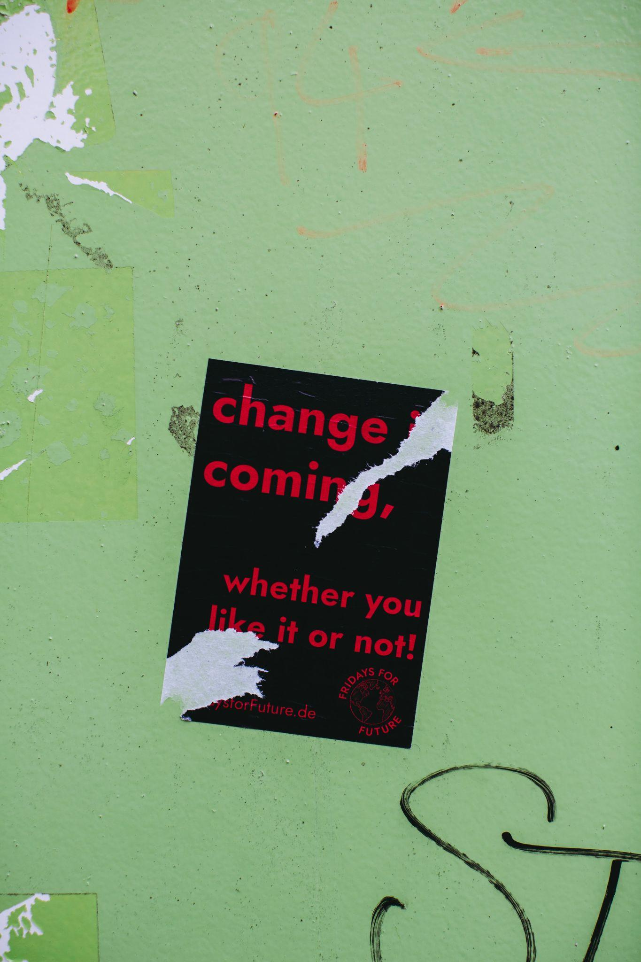
1980s | 100+ CDAs
1990/2000s | Social enterprise
2010s | The Big Society
A bit of history

Slide 31
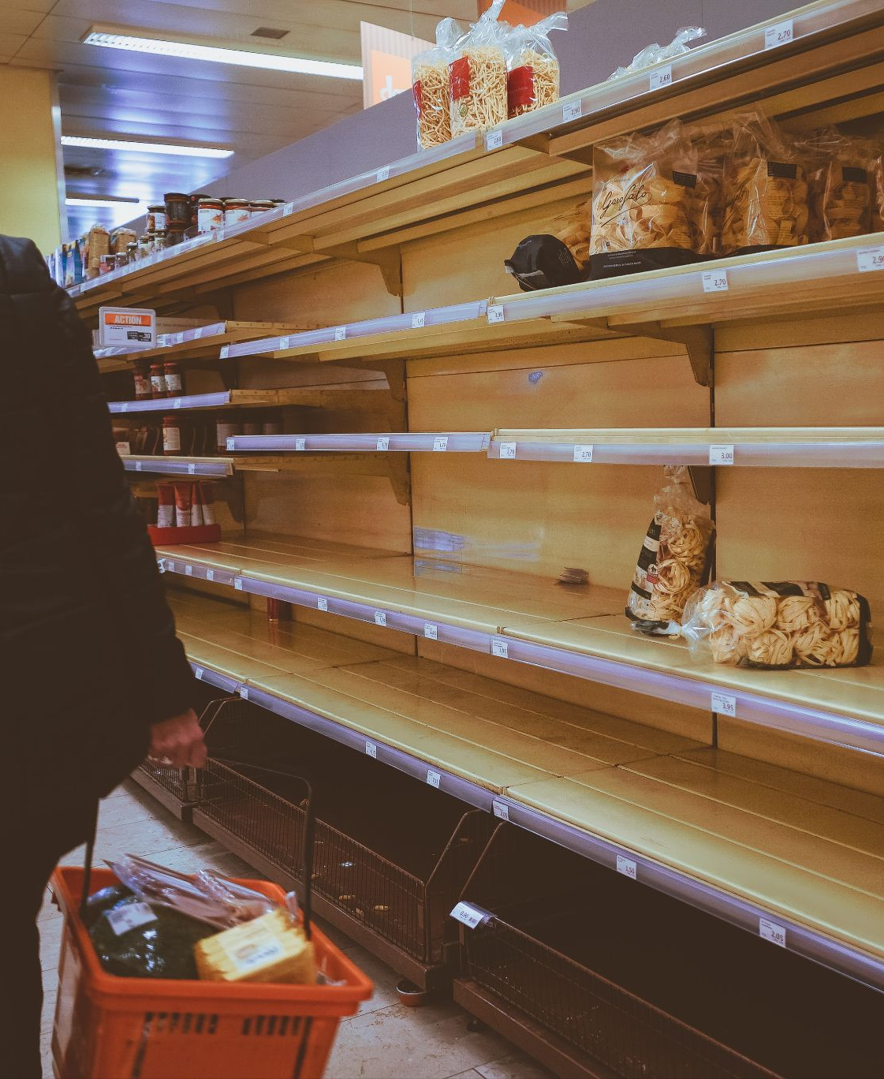
2023
Austerity
Levelling Up
EU money
Landscape Recovery
Community Investment
Co-operation Town initiatives
New municipalism
CCIN
Alternatives in the gig economy
Platform co-operatives
Comprehensive review of co-operative legislation

Slide 32
What does the support
of ABMs look like?
The same:
Marketing/Business plan
Financial projections
What’s different:
Group entrepreneur
More options around governance and legal form
Different options around finance
More options around support
Very different growth models

Slide 33
Group Entrepreneur
Group work:
What challenges or problems might you face working with a business being established or developed by a group rather than a sole entrepreneur?
Link to JamBoard

Slide 34
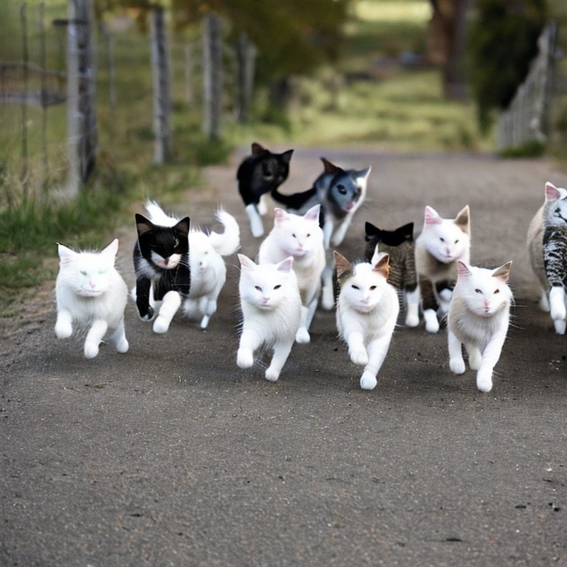
Group Entrepreneur
Share the load
Lack of capacity
More tortoise, less hare?
Often still need “leaders”
Does your contact have a mandate?
Notes:
Tag team / relay
The right contact? Is there really a group?

Slide 35
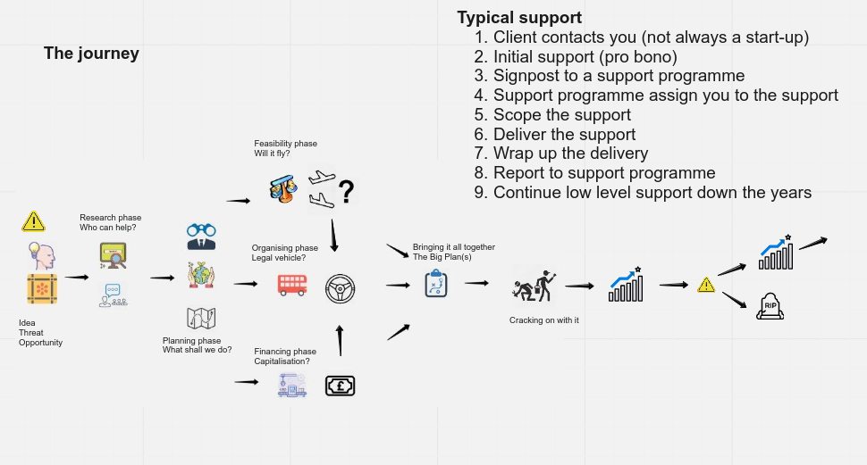

Slide 36
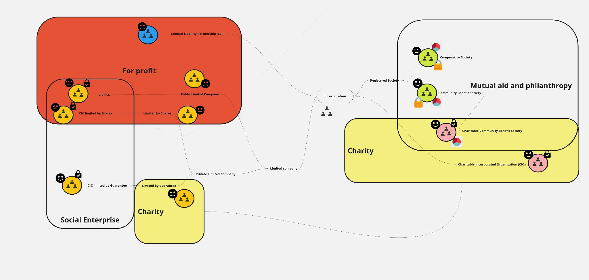
Governance & Legal Form
Many legal forms
Many features and benefits
Can be quite complex
See separate workshop

Slide 37
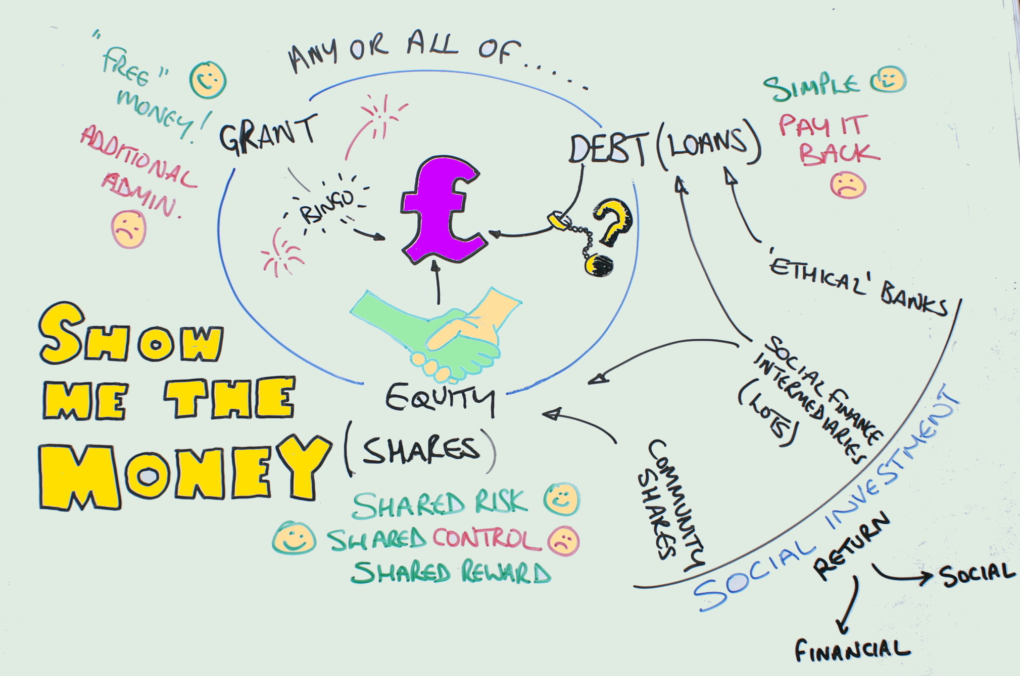
Finance
Doesn’t automatically leverage ownership, control and dividend
Community investment
Social investment
Debt and Equity

Slide 38
Equal Care UK
Growth Model
Equal Care Yorkshire
Equal Care London
Equal Care Calderdale
Equal Care Leeds
Equal Care Hackney
Equal Care Walthamstow
Replication and federation rather than expansion
Co-operation rather than competition

Slide 39
Wolves Lane Consortium
Growth Model
Ubele
Organiclea
Organiclea
Black Rootz
Occupiers
Replication and federation rather than expansion
Co-operation rather than competition
Notes:
Wolves Lane| Organiclea obtained site then became a steward member alongside Ubele and other user groups rather than expand Organiclea

Slide 40
Support Model (dynamic)
Notes:
Run through the organisations here highlighting the sectors supported and the type of support available including:
Payment of development costs
Mentoring
Finance including match investment

Slide 43
Questions

