Slide 1
Using platforms to engage with local community organisations
Formerly Time to Spare

Slide 2
A platform shared by frontline organisations, VCS infrastructure, commissioners, residents and funders.
plinth.org.uk
Notes:
Tom to introduce the aim, where we’re trying to get to.
Tom to ask Charlotte, “just to check we’re on the same page here, is that how you see it?”

Slide 3
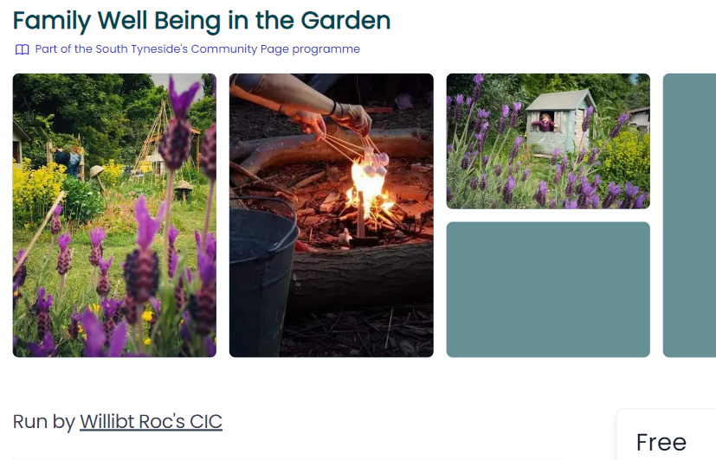
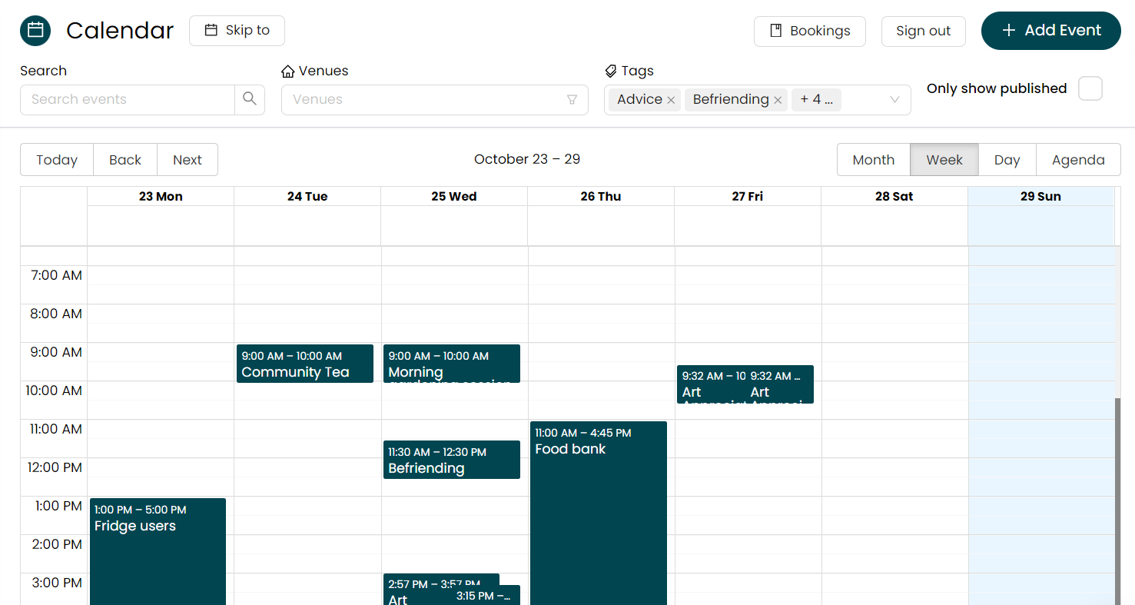
Residents
VCS organisations
Infrastructure & Council
Across multiple VCS organisations:
Manage their details
Search for services
Book onto activities
Across all their service users, volunteers and funders:
Manage client details
Take bookings, registers and manage calendars
Collect impact data with public and funders
Across all their different programmes:
Measure engagement with VCS and impact in real time
Analyse which communities are engaging with services.
Notes:
This is what it looks like in practice. But finish with “but we don’t want to spend too much time on these details, better to speak about how setting up something like this has happened in practice”

Slide 4
How we got here, and what we’re looking to achieve.
plinth.org.uk
Context
The Problem
Previous Work
The Opportunity
Relationships
Work so far
Work to come

Slide 5
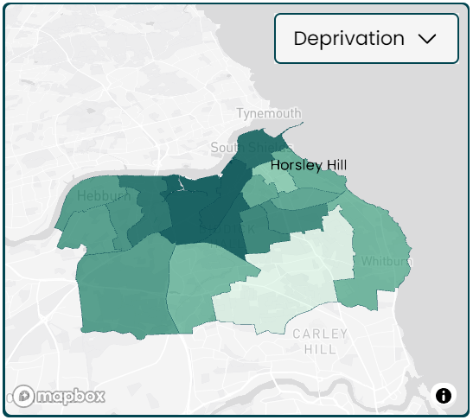
Context: South Tyneside
Challenges
Particularly high levels of health inequalities and long term health conditions
Community Strength:
Social fabric
Natural assets
plinth.org.uk
Notes:
“Can you say a bit about the community in South Tyneside, and how your VCS sits within that?”

Slide 6
Context: Plinth
Up to now
Worked with Councils, CVSs and foundations to collect and connect data from multiple VCS organisations
But:
Primarily in London
Still very small
plinth.org.uk
- Strategic Grant Fund
- Advice Network
- Food Network
- Regeneration programme
- Social value targets
- Holiday Activities and Food
- Participatory grantmaking
Notes:
Tom to talk about work done previously with charities and funders in London – to ask “were there any worries about working with us, or reasons to be excited?”

Slide 7
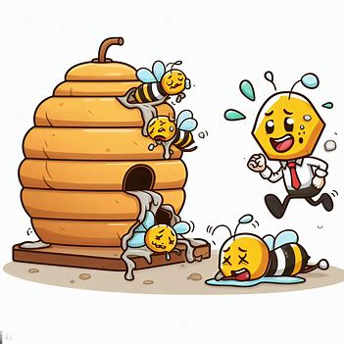
VCS closures and reductions could go unnoticed until this causes a crisis for the public sector.
Agile and Fragile
Particularly small groups
Funding slowdown post Covid and Cost-of-Living
The “beehive”
plinth.org.uk
Notes:
Tom to say “What was great was how there was a really clearly defined problem: Charlotte, could you explain?” Tom to compare to other areas or Charlotte to ask about other areas?

Slide 8
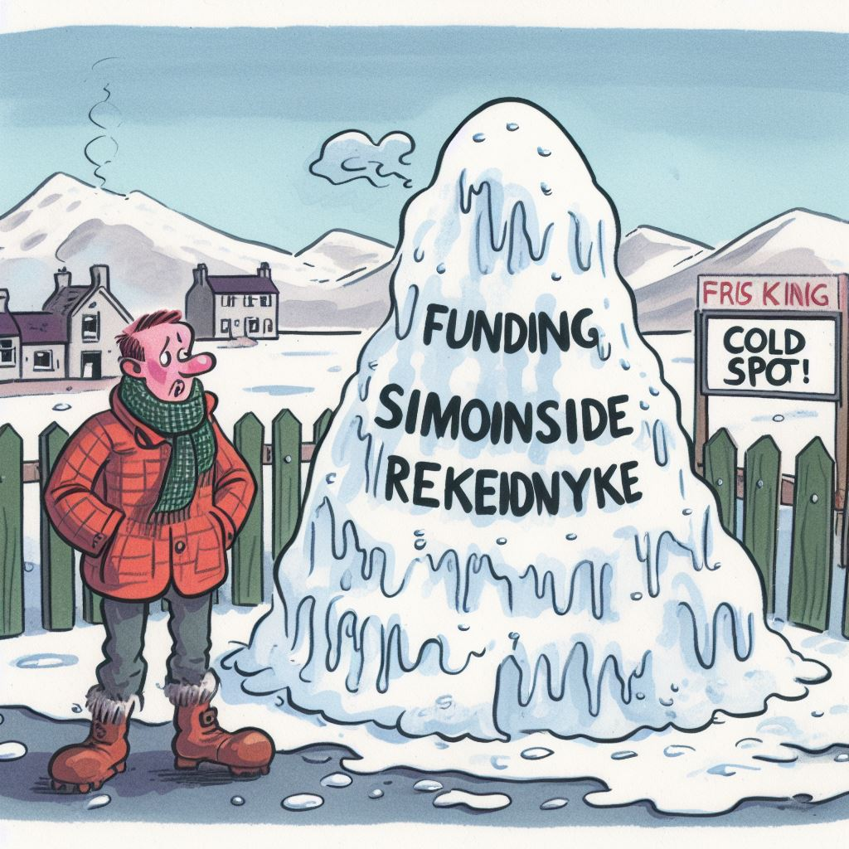
This problem had been identified from previous mapping work
South Tyneside mapping, identified missing pieces of data
Deeper focus on Simonside and Rekendyke
Building initial relationships
plinth.org.uk
Notes:
You’d done some previous work on this topic, could you explain what that was exactly South Tyneside wide map– opportunity for more neighborhood based working, but quite difficult to support with lack of data on engagement
Deeper focus in an area of a cold spot – Simonside and Rekendyke
Not particularly successful in footfall, but the ones that did attend, did all sign up to Plinth
Initial relationships built

Slide 9
Catalysts
Arrival of new Senior Leadership in the Council
The Council’s Children’s Services Ofsted report
CCG moving to an ICS
Challenges:
Changes in people and relationships
The Opportunity
Notes:
Pher Charlotte to talk about this being a catalyst to getting it started
Tom to talk about how it doesn’t work without a push
Funding – board agreed to use own resource
Senior Leadership new arrival in Council
Council Ofsted report on Children’s Services
CCG moving to ICB
Energy – depending on where the energy is
But also difficulty with churn

Slide 10
Key relationships:
Niki and
Early Champions
Charlotte and commissioners
plinth and
Inspire
plinth.org.uk
Notes:
A little bit serendipitous, but also opportunities driving change - agility and network.
Systems leadership way of working. Quite matrixed – would other people be able to do that?

Slide 11
Rollout: the plan and the reality
Initially planned for a cohort-based approach
Spreading further from the initial group
Getting creative with the outreach strategies
Building a South Tyneside identity for the platform
Creating network tools
plinth.org.uk
Notes:
Went with a plan for a cohort at a time
But that’s expanded
Now people are coming to us with “can it do this” type questions
Every conversation we’ve been having is something new – driving its own South Tyneside life
Mini-pilot with some jealousy. Hesitancy, and then that org got on board
“When can other groups that aren’t in the first rollout start using it”? – Tom to talk about how that’s similar in Camden
Smaller organisations see huge benefit, but have limited capacity.
Piggybacking plinth onto things like funders fair, 12 out of 60 signed up to Plinth there and then.
Get the national lottery in the room.
Smarter about how you reach out to groups you know will have the biggest impact, not just emailing.

Slide 12
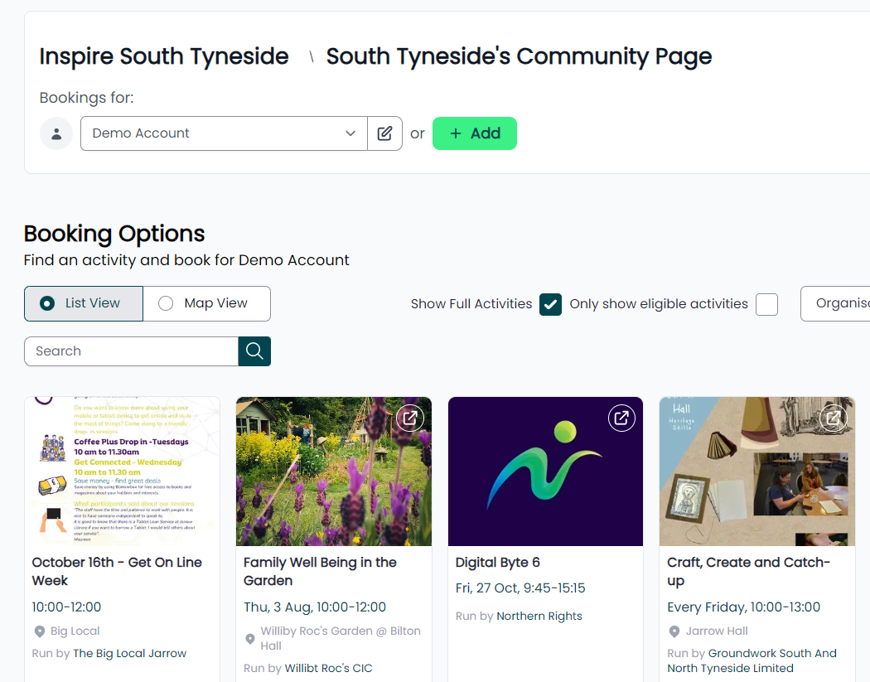
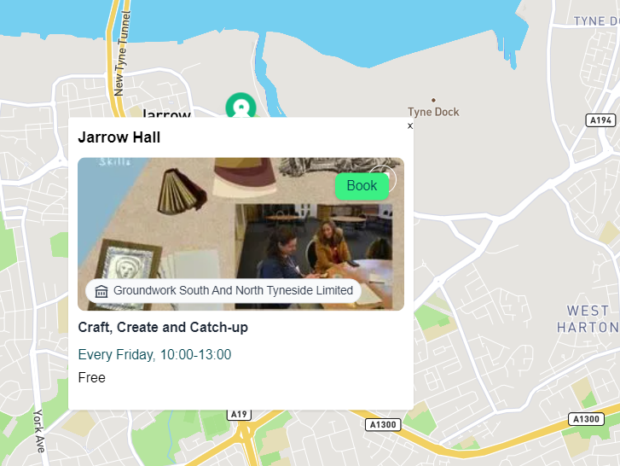
Public pages
A central place where residents can search and book all the activities in their local area.

Slide 13
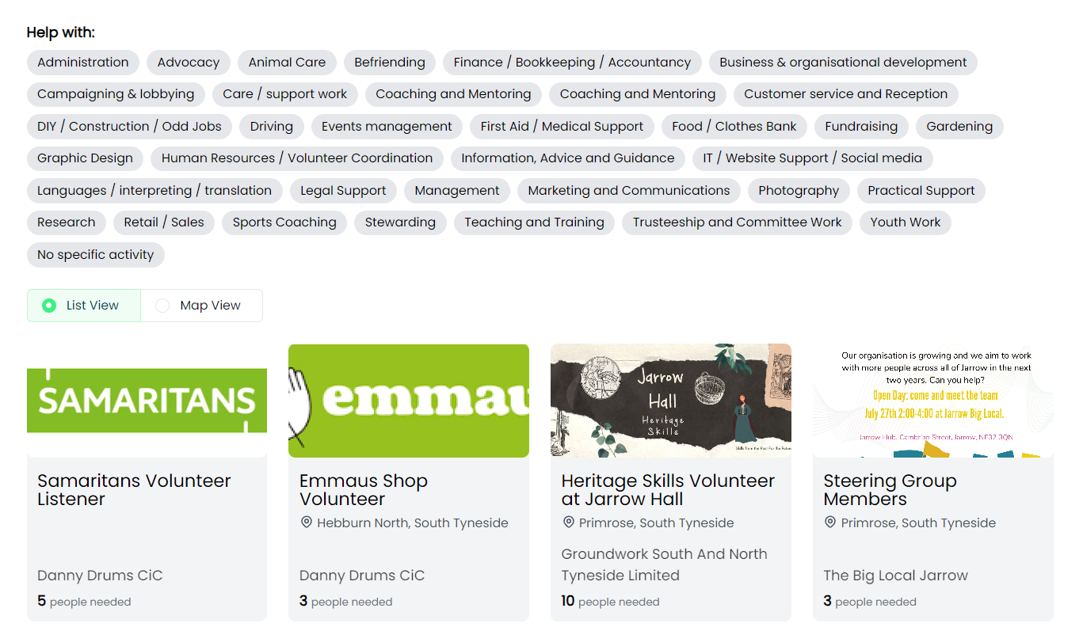
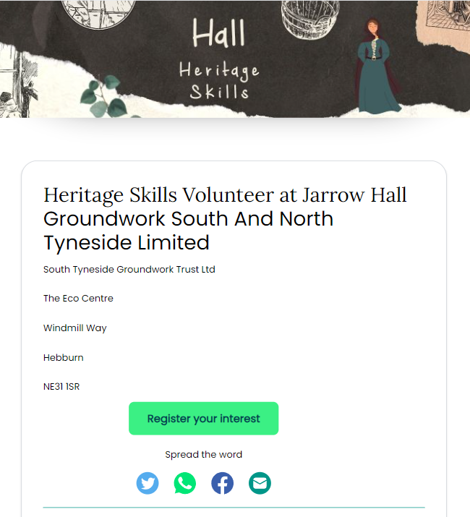
Volunteering
A place where VCS organisations can list volunteer opportunities and volunteers can build up engagement profiles.

Slide 14
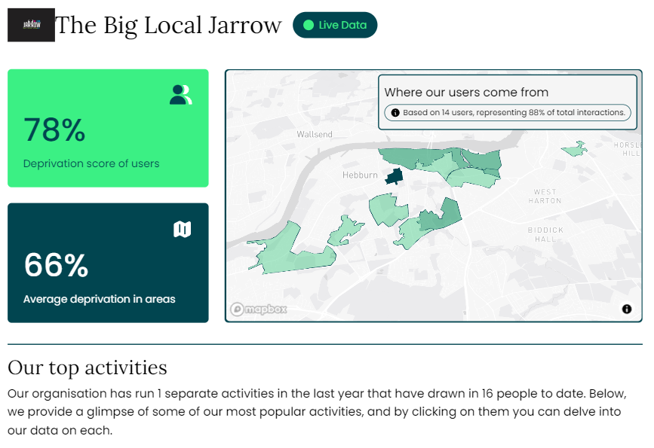
Impact data
Live insight on the interaction individuals are having with VCS activities.

Slide 15
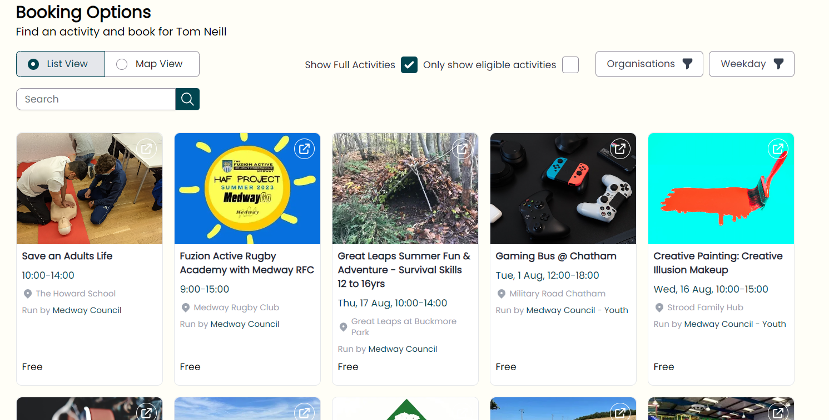
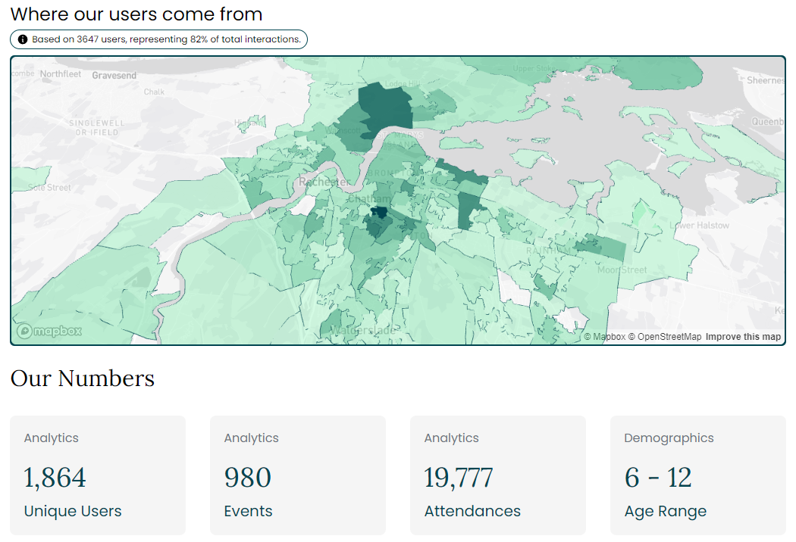
Further work to come:
plinth.org.uk
Holiday Activity and Food Programme
Public Impact Data
Analysis of referral pathways

Slide 16
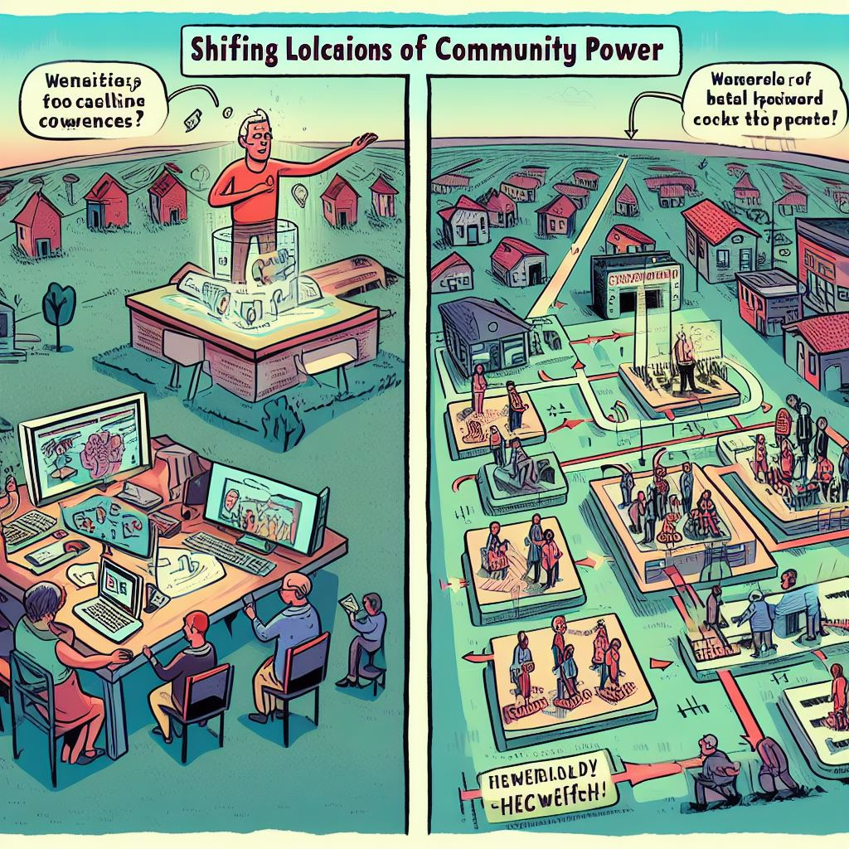
What does it all mean?
Greater understanding of the work done by the voluntary sector
Changing the power dynamics?
plinth.org.uk
Notes:
Enough of an immediate return to get organisations on board, but much bigger return to come.

Slide 17
Lessons Learnt
Problem - have one! Make sure it’s clearly defined
Previous Work - Try to understand the key issues and main people involved.
Opportunity - Look for change: new funding, new strategies etc
Relationships - Find the right people, work out who is going to champion it.
Working - Mix the quick wins with the long term aims, and don’t be scared of the big vision.
Notes:
Charlotte to talk about this being a catalyst to getting it started
Tom to talk about how it doesn’t work without a push

Slide 18
Questions

Slide 19
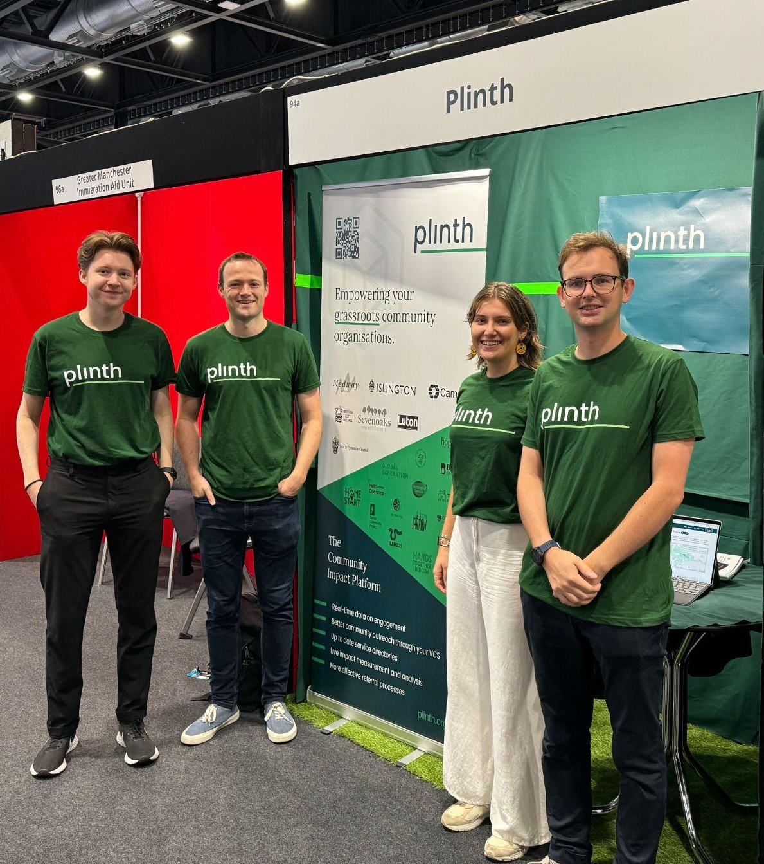
tom@plinth.org.uk
Let’s work together?
Contact us

