Slide 1
Working cooperatively within Sunderland to support Links for Life in Sunderland

Slide 2
Agenda our workshop
Reflecting on last three years
Co-production of community support offer – Links for Life
Funding sources and how we are supporting sustainability
Working cooperatively with the Sunderland VS Alliance

Slide 3
Reflecting on the last few years
Global
Carbon Reduction
War in Afghanistan
War in Ukraine
COVID19
Digital innovation
Ageing populations
Digital revolution
National
Local
Fuel/food poverty and cost of living crisis
Integrated Care Transformation
Social isolation and loneliness
Digital divide and continued health inequalities
City Plan
Partnerships and initiatives providing solutions
Sunderland VCS Alliance
Local Grants
Social Value

Slide 4
Learning from COVID hubs and warm & welcome spaces
March 2020 – we’ve never been the same since!
Cost of living crisis – piling pressure on top of pressure – breaking point
Working together and extending service offer
Reaching out to residents – moving to welcoming warm spaces
Short-term funding – but measuring impact
Community Buildings – state of repair

Slide 5
Notes:
Helen

Slide 6
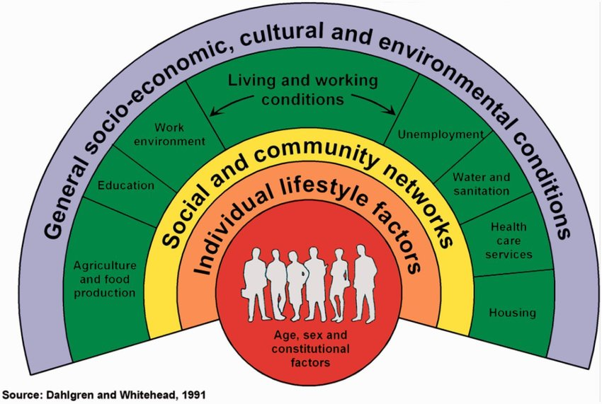

Slide 7
Why do residents access community support?
Why people approach community services ? The top three main reasons are Mental Health , Social Isolation , Weight Management but once meeting with VCS, residents often have a range of support needs
How are people supported ? - People's needs are met by a really diverse range of services to suit the person . Over the last 12 months the GP Alliance Social Prescribing team made 4000 onward referrals to over 300 community-based services across the city
It makes a big difference – 66% of people's life satisfaction improved , 63% felt more worthwhile, 69% reported improved happiness and 57% reported reduced anxiety

Slide 8
Links for Life – the Sunderland approach to social prescribing
All organisations working together to ensure best outcome for the ‘resident’
Making sure access is simple - entry points - service provision – ongoing sustained engagement in community life
Links for Life identity developed – working on how we formally roll this out
Digital Platform development in progress to make sure everyone has the information they need
Charter development in partnership with VCS
Looking for what works well and what we could do better
Working towards full implementation of the model from April 2024

Slide 9
Links for Life – it’s already happening in our communities
https://youtu.be/h8EizBukS40

Slide 10
Things for the sector to consider
Digital access – could it be improved?
Maximising use of space and ensuring income – potential to invite partners to deliver from spaces
Making your spaces accessible and welcoming for all

Slide 11
Funding opportunities – we are reviewing
Social Value – cash and in-kind – working with businesses and investors
City-wide funding applications to meet the needs identified
Contracts and commissioning – support from Council Procurement team
Area Committee – Call for Projects (ongoing)
UK Shared Prosperity Funding
Supporting the sector to ensure they secure funds to deliver services – Real Living Wage, running costs and being paid for delivery (not just scrabbling for breadcrumbs!)

Slide 12
Welcome Tracy
Tracy Hassan
Sunderland Voluntary Sector Alliance Manager

Slide 13
How long have you worked with the Voluntary sector?
What motivated you to want to lead the development of the Sunderland VCS Alliance?
What are your aspirations for the future of the Alliance?

Slide 14
What have been some of the challenges for the voluntary sector to grow a community support programme, such as Links for Life?
How did you work around this, and which actions helped the most?
Finally … with the benefit of hindsight would you do it all again?

Slide 15
Any questions?

