Slide 1
Building a Financial Heart in our Communities

Slide 2
Money Makes the World Go Round

Slide 3
Banks Makes the Money Go Round

Slide 4
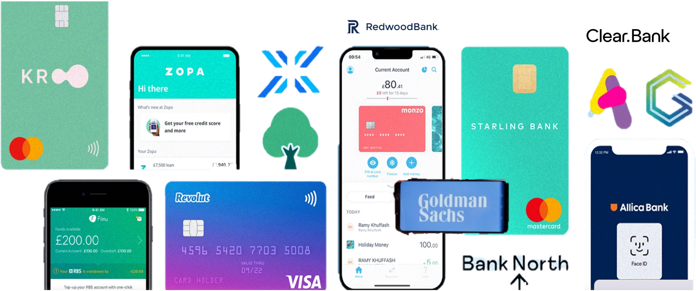
Another New Bank?

Slide 5
Customer Owned North East Retail Bank
Notes:
.

Slide 6
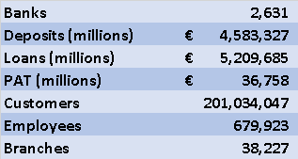
We’re Odd

Slide 7
Building a Financial Heart for the North East
Talent and Equality of Opportunity
Banks are the Financial Heart
How to Get your Own Bank

Slide 8
Talent & Equality of Opportunity

Slide 9
Equality of Opportunity for What?
A Living Income
Somewhere Decent to Live
Financial Security
Here

Slide 10
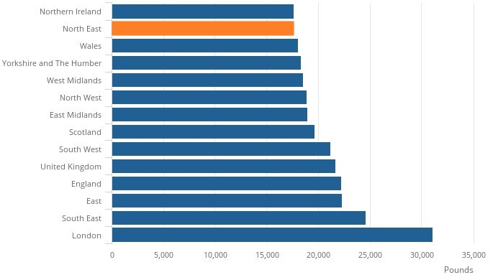
Inequality Between Regions

Slide 11
British Businesses

Slide 12
Where are the SMEs?

Slide 13
Inequality Between Regions Widening

Slide 14
The Value of SMEs Directors Homes Matters
“ Small business owners worldwide use their personal assets, and often their house, to back loans to their firms.
In the UK, just under half of new loans to firms with less than 250 employees are financed this way. Of course, this makes a minor mockery of the limited liability that firms are supposed to enjoy. Yet, small firms are often opaque, reliant on a few key people, and lack their own tangible assets or steady cash flows to pledge to lenders. So personal housing wealth, which is a simple asset to borrow against, ends up greasing the financial wheels of smaller enterprises”.

Slide 15
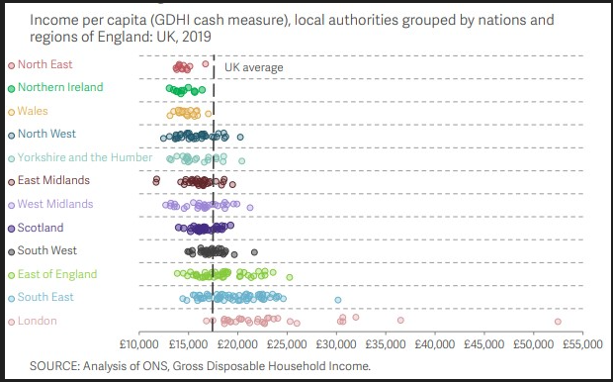
Inequality Within Regions

Slide 16
Inequality Within Widening

Slide 17
Banks are the Financial Heart
Notes:
.

Slide 18
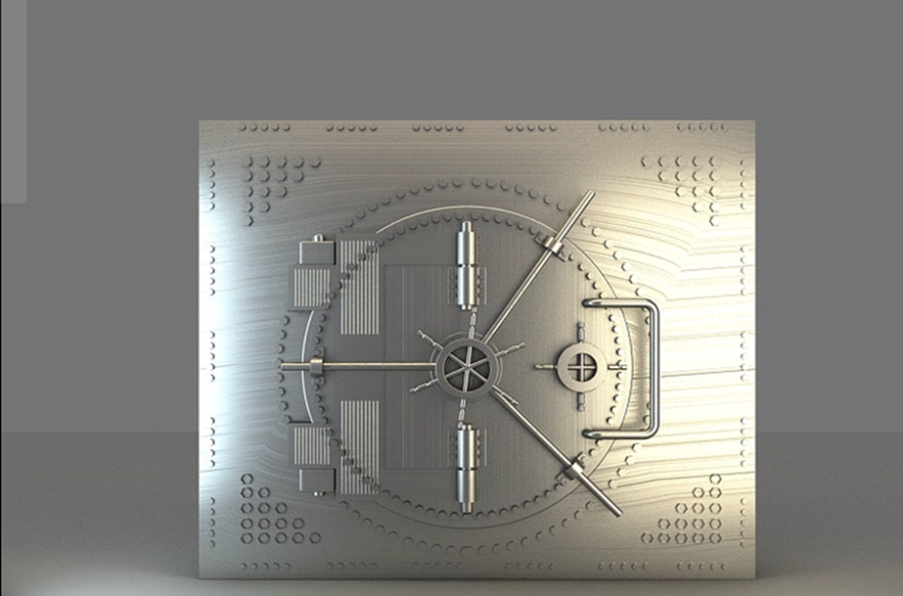
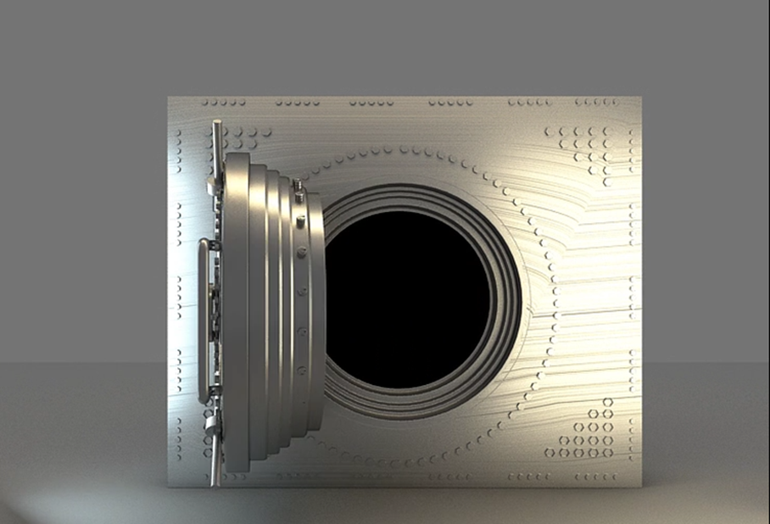

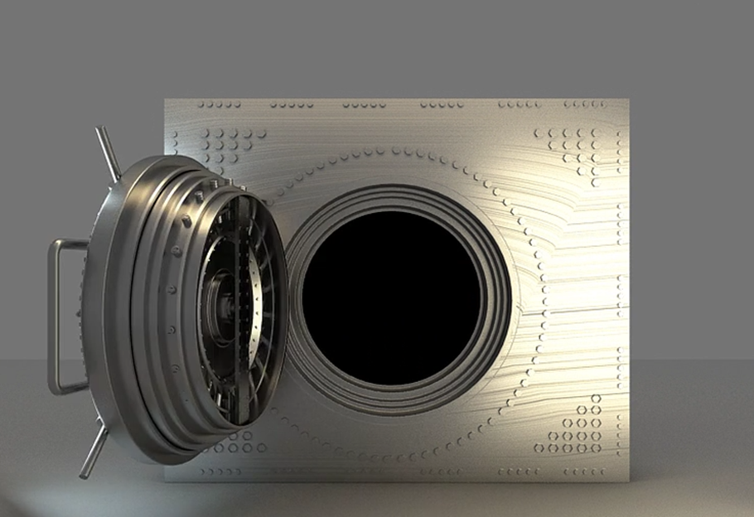
Banks are the Financial Heart
Owns all the non-cash money
Controls the Payment System
Decides Who Gets Loans
Decides Where Gets Loans

Slide 19
How to Get Your Own Bank

Slide 20
How to Get Your Own Bank
You’ve Got to Want To
Know What Sort of Bank
Find the Right People
Create all the Plans & Technology Needed
Raise the Money
Get Permission from the Bank of England
Be Useful
Earn Mutual Trust Day after Day after Day

Slide 21

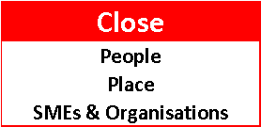
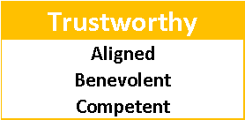
Our Sort of Bank

Slide 22


Trust
Competent
Benevolent
Aligned

Slide 23
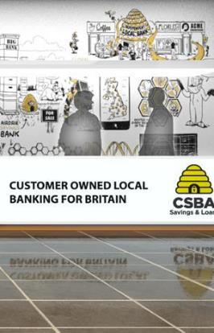


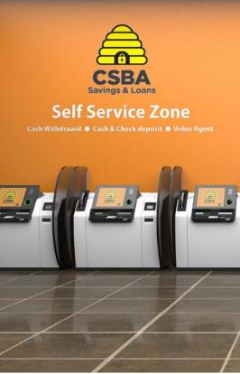

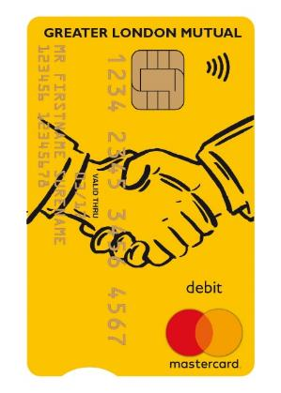

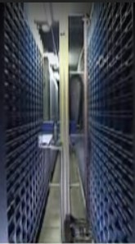
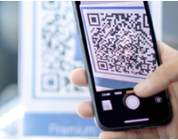


Being Useful
Staffed branches
Bank Pods
Digital channels
Safe deposit box
Current accounts
Local Payments
Your Bank
Your BANK
Local Branch director
Local knowledge
Transactional Banking
Call centre video link
Web, mobile, tablet fully integrated
Automated safe deposit box service
Simple & transparent charges: £5 personal, £10 business pcm
QR Based
Local Payments

Slide 24
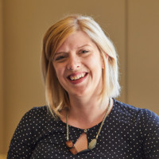
Create Plans
Dr Gemma Bone Dodds
Director of Insights and Policy at Scottish National Investment Bank

Slide 25














Create Plans -Bank in a Box

Slide 26
Core Technologies
Augmented
Video
Conference
Augmented
Reality
Cloud Core
Banking
CSBA
Pilot
Bank
Biometrics
Robotics
APIs

Slide 27
Core Technologies
Augmented
Video
Conference
Augmented
Reality
Cloud Core
Banking
CSBA
Pilot
Bank
Biometrics
Robotics
APIs

Slide 28
There Are Two Routes
Start-Up
Conversion
You Get Exactly What you Want
You Have to Find the Right People
You Have to Convince the Bank of England
It takes 2 yrs. and £28m
You Have a Legacy Culture and IT Systems
You Have to Find the Right Institution
You Have to Convince the Bank of England
It takes 18 months and £23m

Slide 29
What Do You Get ?
A Bank Based In, Working for & Accountable to the NE and nowhere else
Key Decision Makers Across the NE
Wider Financial Inclusion
A Useful, Inclusive Anchor Institution
£400m of Local Deposits Into Local Loans
A Bank the Knows its SMEs
Approximately 90 FT Jobs
A Key Component of Community Wealth
A Financial Heart for the North East

Slide 30
Building a Financial Heart for the North East

