Slide 1

Community Economic Development Plans as a tool for fostering co-operative working between councils and the community
Policy Lab 2021-2022
Karolina Medwecka-Piasecka, Birmingham City Council

Slide 2
Why did we set up the Policy Lab
Explore how can councils effectively utilise Community Economic Development Planning?
Demonstrate best practice for Councils in developing and implementing CEDPs
Report produced to assist CCIN member councils in working with and empowering local communities to create CEDPs - 10 case studies analysed

Slide 3
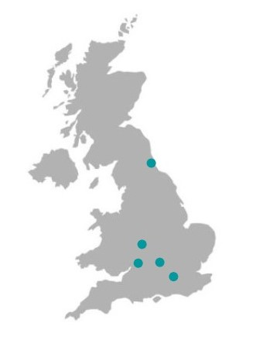
Who did we work with
Gloucester City Council Labour Group
Croydon Council
Milton Keynes Council
Sunderland Council
colleagues at the Co-operative Futures
West Midlands partners (BCC, WMCA, GBSLEP, CLES, Development in Social Enterprise CIC)

Slide 4
What is community economic development?
Depending whom you ask!
(Phillips and Pittman) “Most practitioners think of community [economic] development as an outcome – physical, social, and economic improvement in a community
while most academics think of community [economic] development as a process – the ability of communities to act collectively and enhancing the ability to do so.”

Slide 5
Attempts at definition:
(Green and Haines) “Democratic efforts to build assets that increase the capacity of residents to improve the quality of life in their locality.”
(Cawley) "...a deliberate, democratic, developmental activity focusing on an existing social (/economic) and geographical grouping of people who participate in the solution of common problems for a common good."
(Darby and Morris) "...an educational approach which would raise levels of local awareness and increase the confidence and ability of community groups to identify and tackle their own problems.
(Dunbar) "...a series of community improvements which take place over time as a result of the common efforts of various groups of people. Each successive improvement is a discrete unit of community development. It meets a human want or need."
(Huie) "...the process of local decision-making and the development of programs designed to make their community a better place to live and work.“
(Long) "...an educational process designed to help adults in a community solve their problems by group decision making and group action.“

Slide 6
The definition we used:
The overall focus is the economy. CED is all about re-shaping the underlying economic system in a place, rather than working on improving people’s capacity to live well within the existing environment
The economy is a means to an end, not an end in itself. Rather than emphasising economic growth as the end goal of local economic development, a CED approach is interested in economic development which generates human wellbeing within environmental limits, at a community level
It is led by the community. In CED, the power to drive the change rests within the community of residents, local businesses, local service providers, community groups and voluntary sector organisations with a direct stake in the economic health of that area
Co-operatives UK – Community Economic Development – Lessons from two years action research
ran from April 2015 to May 2017

Slide 7
Growth implies quantitative change, development emphasizes qualitative improvements.
Growth vs Development
Growth means more of the same … more jobs, more income, etc.
Development means using resources to enhance human welfare
Development can include growth, but not necessarily vice versa
Doughnut Economics (Kate Raworth)

Slide 8
Community Economic Development Plans
can test:
Where the real appetite/readiness capacity is?
What the parameters are – is it possible at all? Is political support achievable?
What’s seen as a value (i.e. community empowerment may be difficult to embrace in power struggle scenarios)
Assess transferability of examples – Heart of Hastings (local people using a co-op model to own and control commercial property for local economic benefit), Collyhurst Big Local (seeking to disrupt top-down regeneration, gain control and unlock more opportunities for local people, focusing on local entrepreneurship and social enterprise), US (Cleveland Ohio cooperative model http://www.evgoh.com/ ), Italy (Turin see CO4Cities http://commoning.city/co-cities-experimentations/co-city/).

Slide 9

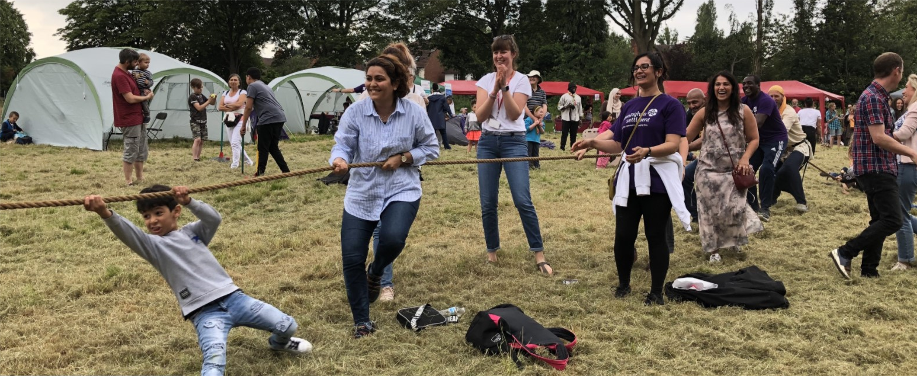
Community Economic Development Plans – Playing Field by the Reservoir
“Our vision is to create a secure space that will host a programme of wellbeing activities and provide access to shelter and to make the field a much more flexible space and enable the community to access it on a more ongoing basis.”

Slide 10
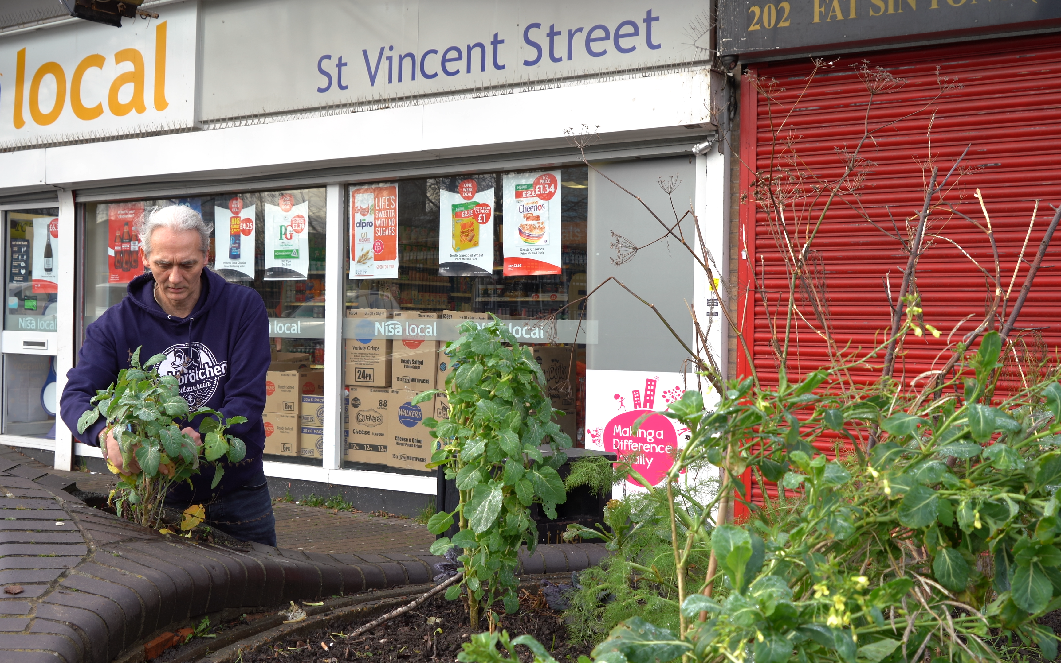

Community Economic Development Plans - EatMakePlay
“Eat Make Play was to provide everyday opportunities for the people of Ladywood to connect through sharing, learning, making, and doing together, involving activities around practical skills like food preparation, growing, art, crafts, sewing and DIY and also social activities and events which cost nothing to attend. We have an emphasis on making good use of resources, sharing, and improving our environment while reducing waste. Our project aims to benefit all of the residents of Ladywood working with them to shape the programme and development of the organisation to meet the needs and aspirations of our community.”

Slide 11
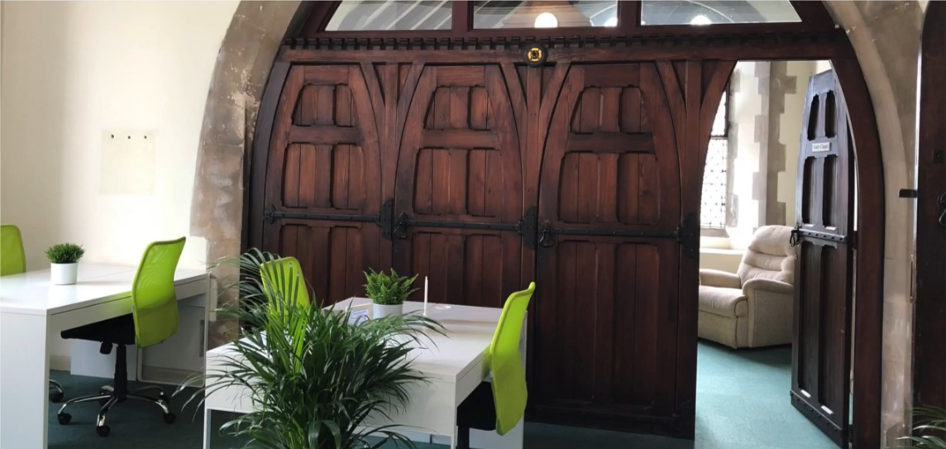

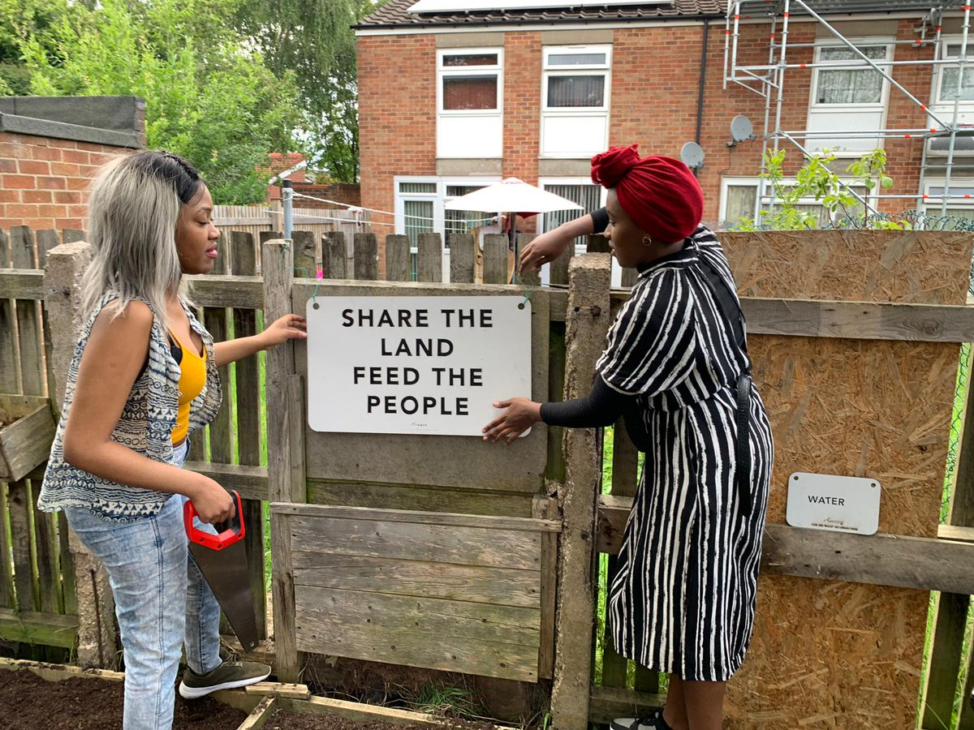

Community Economic Development Plans – ChangeSpaces
In early 2020, Smethwick ChangeSpaces was launched. This was a co-working office based in the old vestry chapel of Holy Trinity Church previously known mostly of their foodbank (one of the busiest in West Midlands)

Slide 12

Community Economic Development Plans –Soho and Jewellery Quarter
Two main areas of work:
Maximising benefits from Anchor Institutions & supply chains
Enterprise spaces, maker spaces and marketplaces

Slide 13
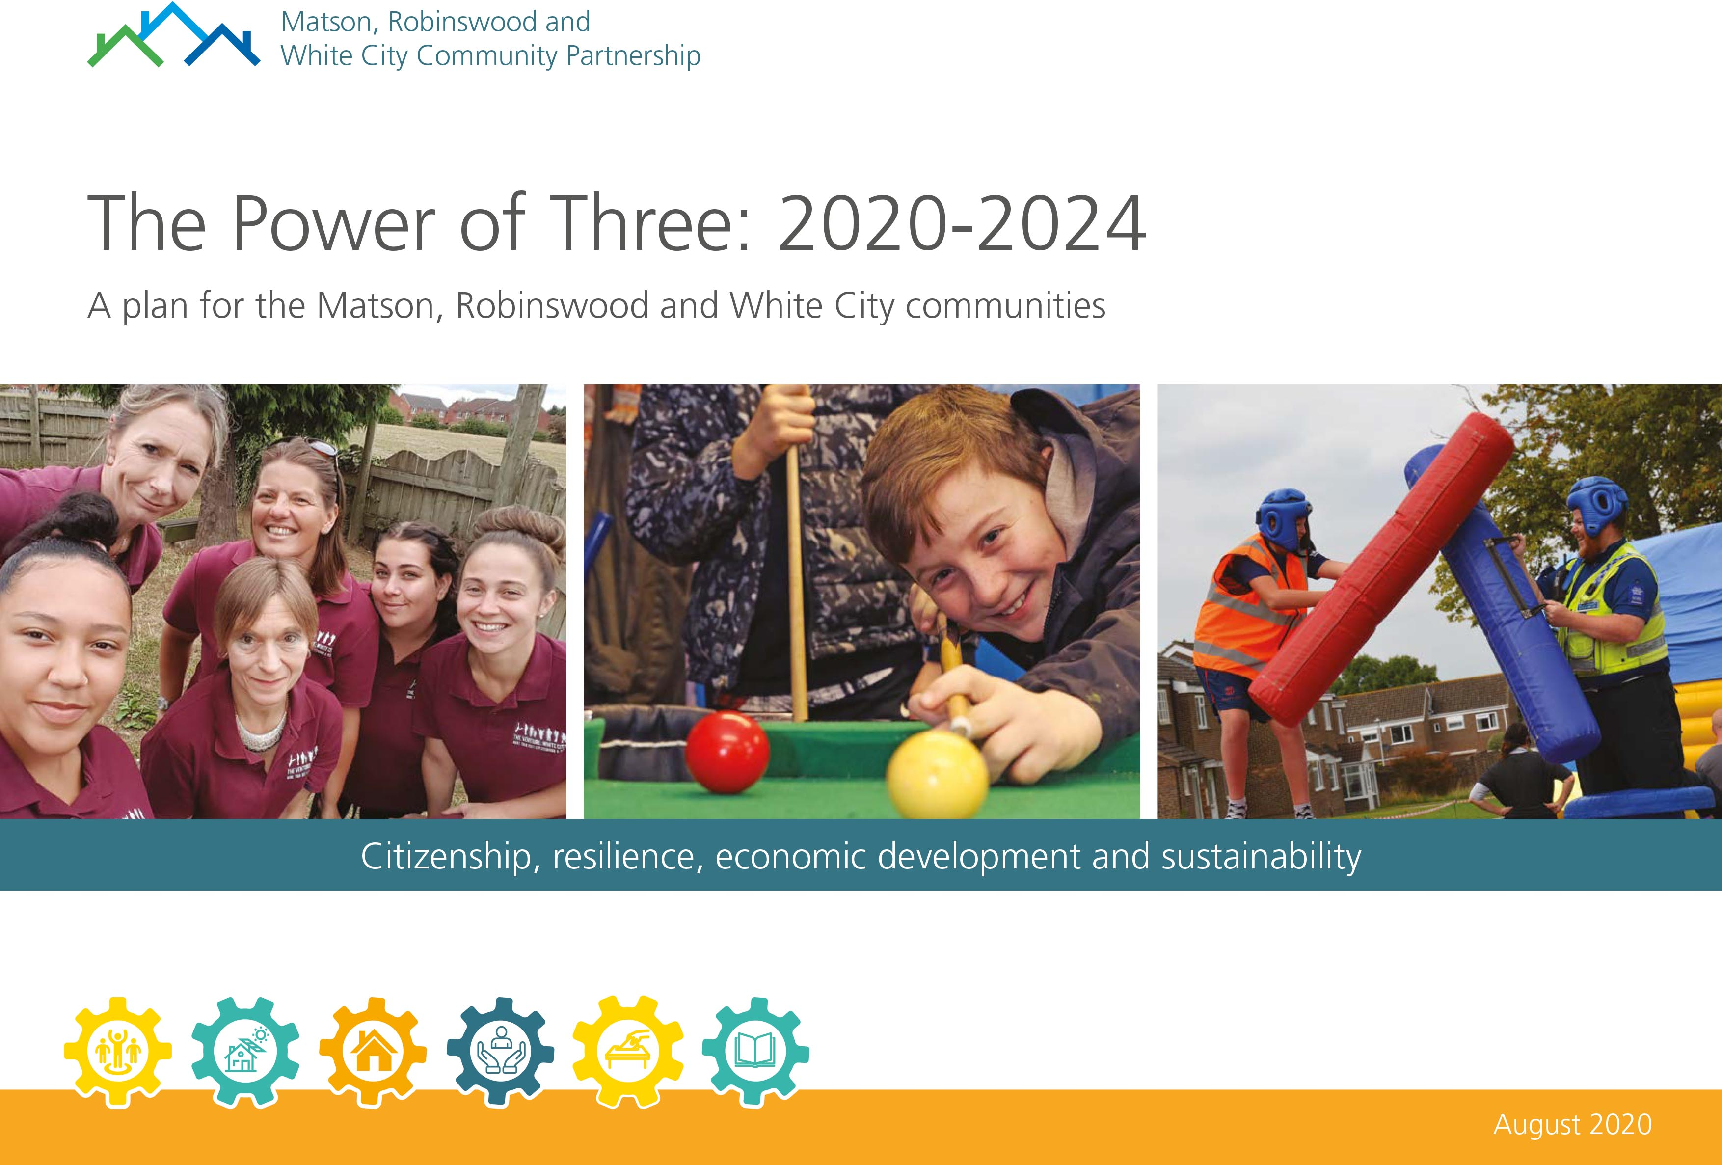
Community Economic Development Plans - Power of Three
“The top priorities of the first phase remain: reputation, leadership, transport, flexible care, community assets, housing, education and skills, and local businesses; but rather than seeing them as distinct issues to be tackled just from within the ward, the revised plan sees them as part of a richer tapestry of concerns that are on the agenda of the local authorities, the Health Commissioners, the Local Economic Partnership, elected officials, the University, social housing providers, providers of primary, secondary and tertiary education.”

Slide 14
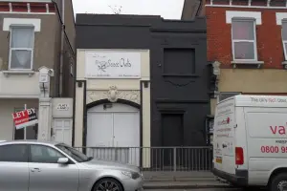
Community Economic Development Plans – We Love SE25
Socco Cheta Community Hub CIC successfully bid to run and renovate the Socco Cheta building owned by Croydon Council
The hub has three key aims that have been developed with the community:
Everyone has a place and can take part
To bring the community together
To support people in their lives and to make positive life choices

Slide 15

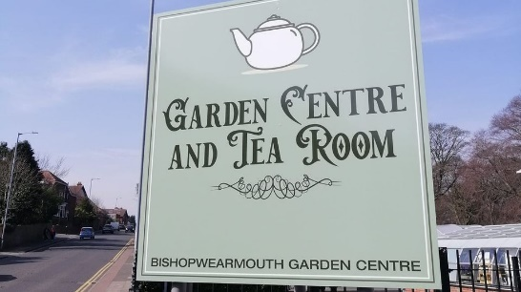
Community Wealth Building –
Sunderland City Council
Elemore Green Space, a former golf course which closed 7 years ago is being repurposed.
Sunderland City Council are now committed to developing the site and supporting the creation of a social enterprise, that will coordinate the running and activities held within the site.

Slide 16
Regeneration and Devolution - Milton Keynes
‘The community-led regeneration and estate renewal programme is an opportunity for residents to work with the Council and its partners to improve the lives of local people.’
Milton Keynes Council are pioneering the devolution of some services to Parish and Town Councils.

Slide 17
“Going through the process was more useful than the outcomes of the process itself.”
Gareth Brown, Smethwick CAN
“In terms of successes, the CEDP has galvanised people and given them the confidence to believe that they can affect change.”
Karolina Medwecka, Birmingham City Council
“It has created a framework and a forum for things to be progressed and discussions about where we can make a difference.”
Cllr Clive Fraser, Croydon Council
“The most important thing is time; it takes a lot of investment in time to build up trust, work out the dynamics of relationships, and actually start to write the plan.”
Dawn Barnes, The Venture

Slide 18
CED and the art of trust
Community organisation
Neighbourhood Forum
Community Development Trust
Community Land Trust
Neighbourhood Planning
Community owned business i.e. community energy, housing
Community engagement through arts, events, etc.
Community Research
Community organising
Local procurement/spend
CED
Power
Public sector
Community
Community Wealth Building

Slide 19
Learning 1: enabling policies
Community economic development planning compliments other activities that Local Authorities are undertaking. It is a powerful tool for change but can only perform this function if it is embedded within wider policies, strategies, and plans.

Slide 20

Learning 2: system thinking
Local Authority support in community economic development planning can enable systems change to take place, rather than small scale activities.
The community is a complex system => a systems thinking approach is required

Slide 21
Learning 3: trust
The knowledge of what is needed within a community is known by the people and organisations within those communities themselves and so they best understand what those areas need to be able to reach their full potential and thrive.

Slide 22
Learning 4: support the development of skills
The support provided in developing the plans provides communities with the skills and confidence to take a lead in continued community economic development planning. This has led to a change in the way communities engage with Local Authorities, they are better placed to advocate for themselves and enable constructive conversations.

Slide 23
Thank you!

