Slide 1
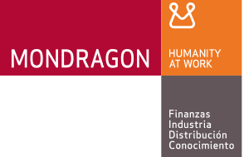

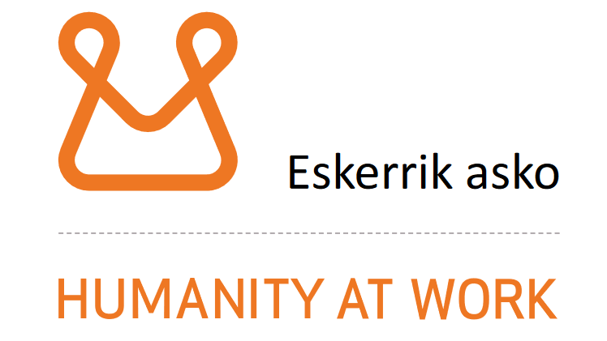
CCIN Policy Lab - Mondragon Study Visit

Slide 2
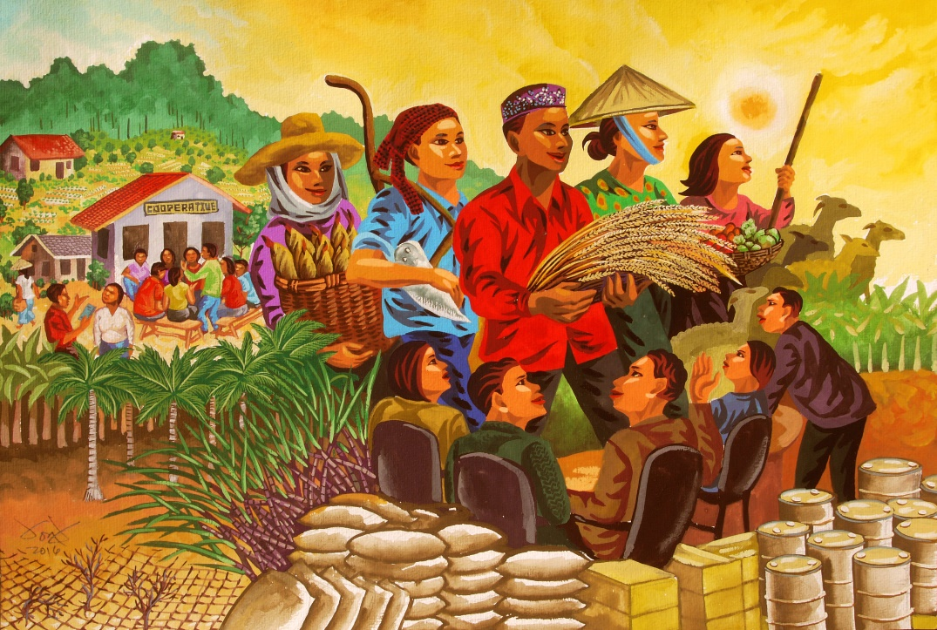
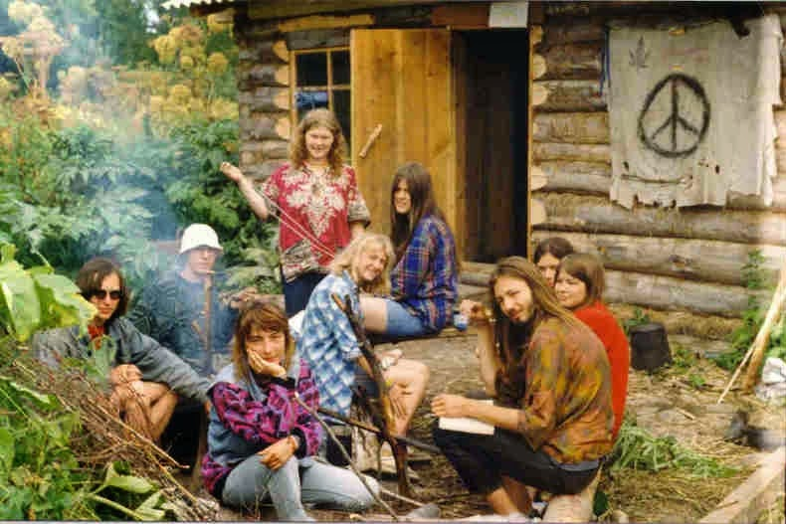
Cooperatives in popular imagination
Inefficient
Small
Unable to innovate
Slow to exploit opportunity
Can’t attract talent
“Maybe you think cooperatives are about some freaky people doing some nice things together?” Ander Extebaria, Arrasate
Limits the potential for cooperatives in the economic mainstream
Notes:
From my vantage point, cooperatives haven’t (re)entered mainstream economic development discourse in much of the UK
Those of us looking to promote the function of coops in our local economies often meet a wide range of prejudices ranging from inefficiency to perception of cooperativsm as a ‘lifestyle choice’
Mondragon directly counters these perceptions:
- Capitalist managerial discipline, with socialist distribution of profits

Slide 3
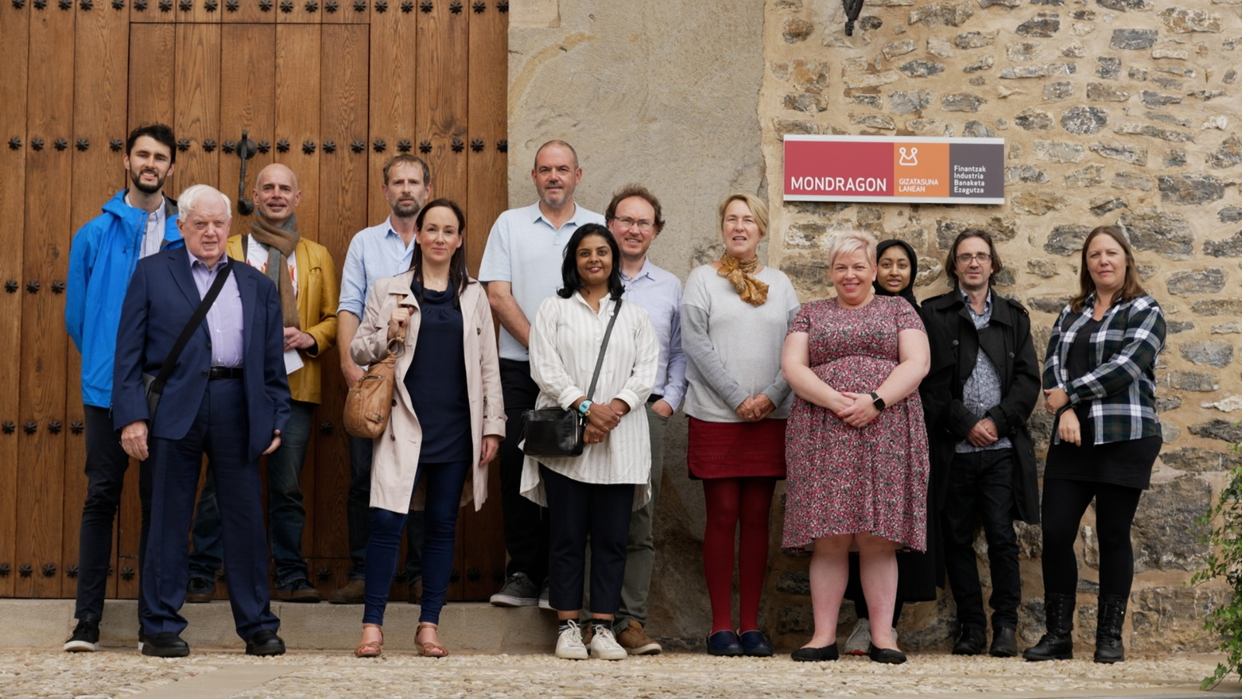
Photo at fagor
Notes:
Study visit took delegation of 12 (councillors and officers) and Nicola to town of Arrasate to visit the Mondragon cooperative corporation and included sessions at:
Otalora - Management Development centre
Fagor - Industrial Cooperative
Ikerlan – technology R&D centre
Mondragon University

Slide 4
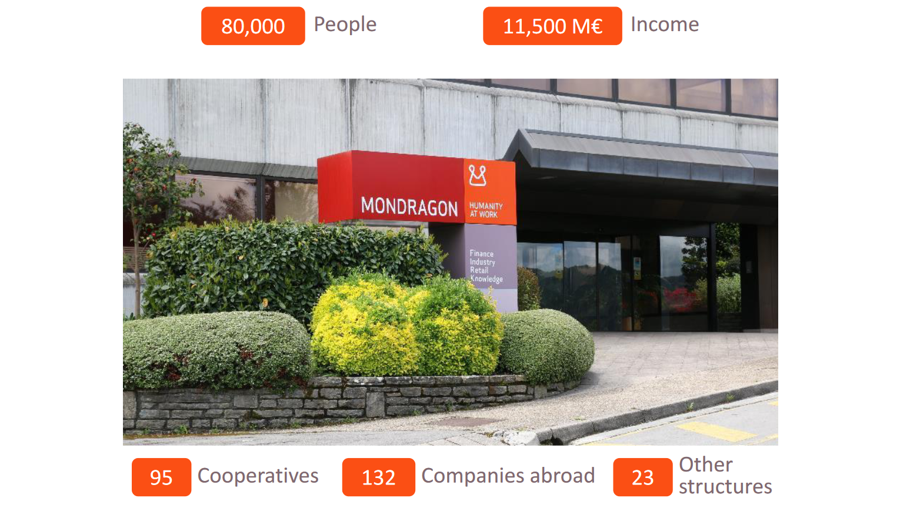
Notes:
Fundamentals
Scale
Global

Slide 5
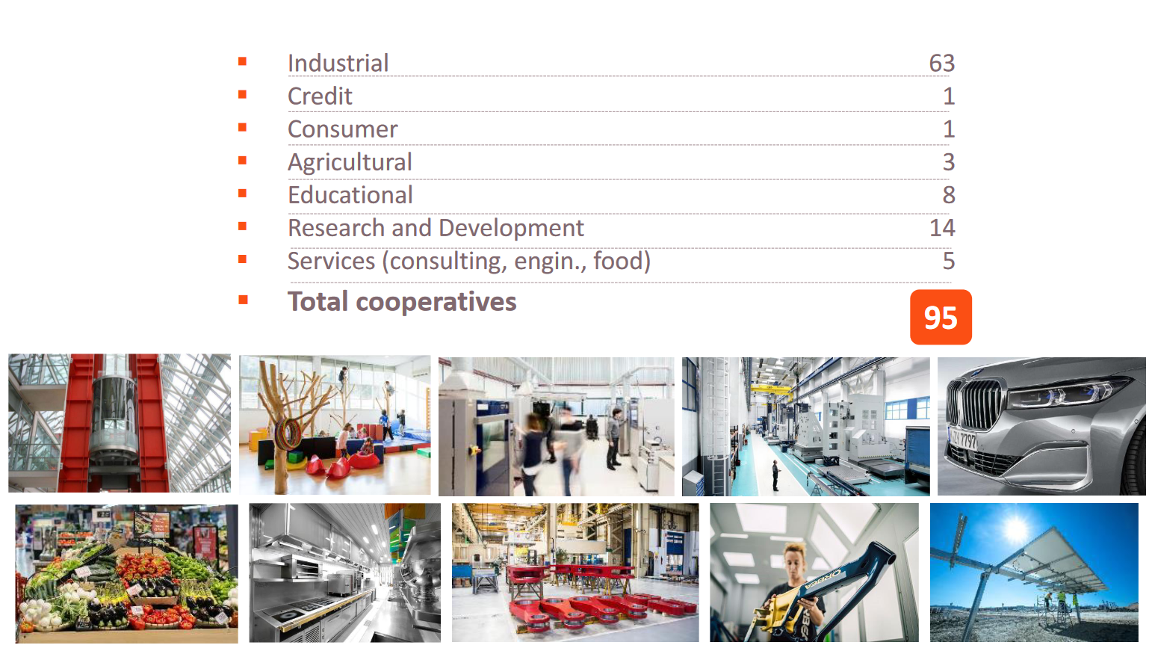
Notes:
Range from high tech manufacturing to retail and distribution
Eroski Supermarket chain - One of the largest in Spain. Multi-stakeholder model
Region’s second largest financial institution
Cooperative university
Cooperative R&D centre - Ikerlan

Slide 6
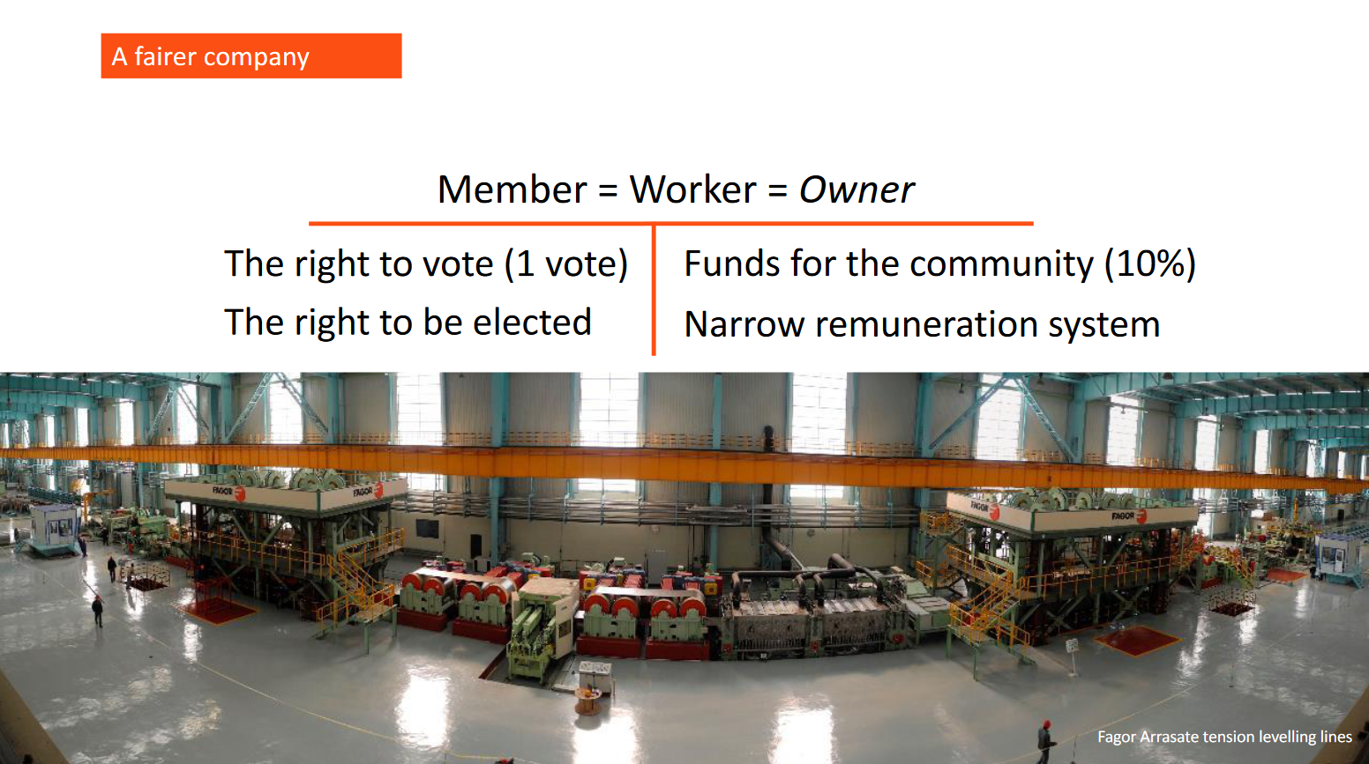
Notes:
Core principles
1 member 1 vote
1:7 wage ratio across members
Members buy an equal share in the company with voting rights on key decisions

Slide 7
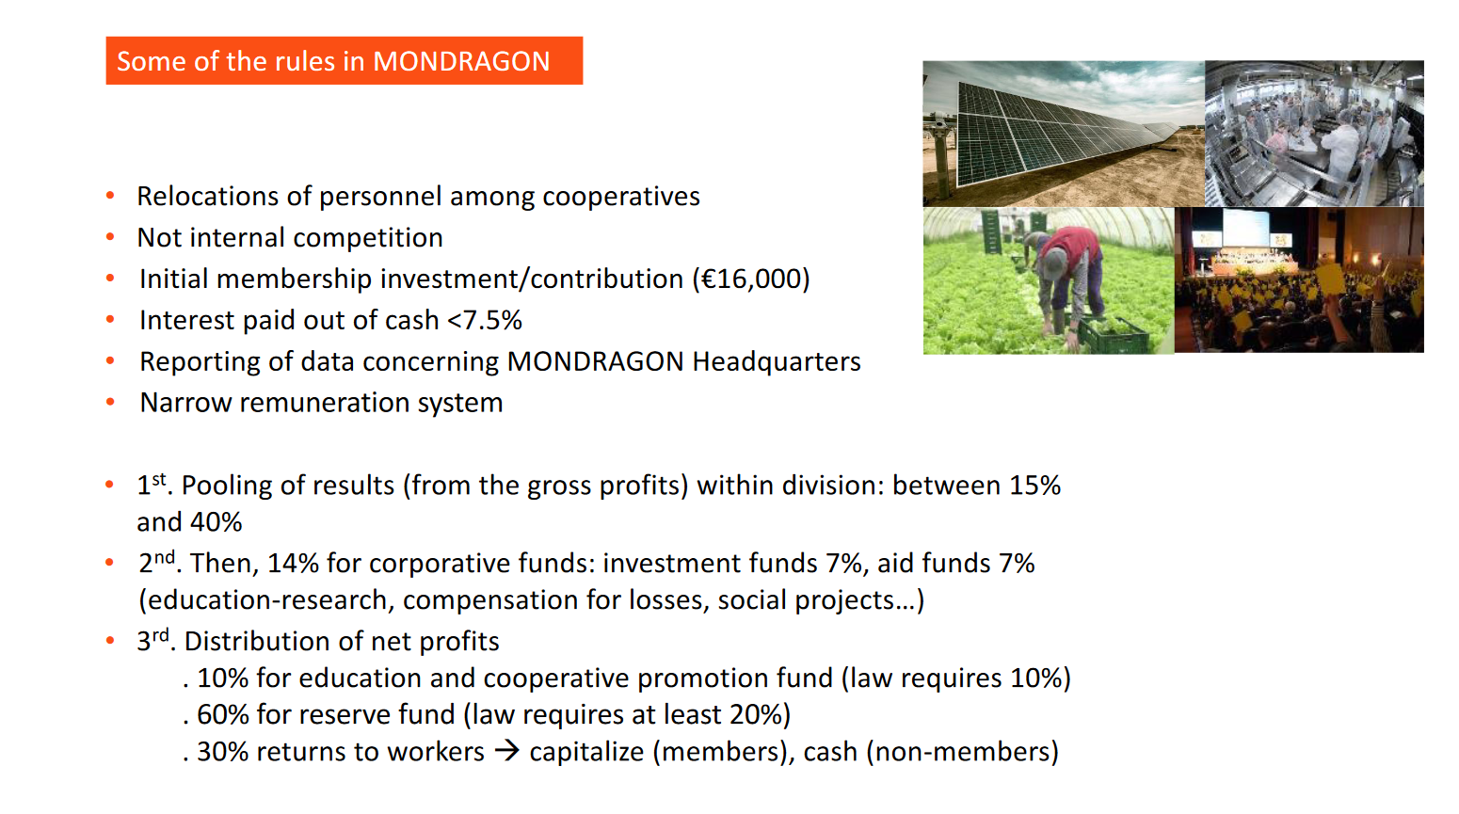
Notes:
Membership bought through 16000 euro investment in cooperative – paid back through salary sacrifice over 2 years.
16000 euros earns interest from profits but not returnable until member leaves the company
Provides pool of capital for capital investment for firms
Profits pooled and reallocated to investment, aid, members, non-members
Members have a capital stake in the company and benefit long term from its successes

Slide 8
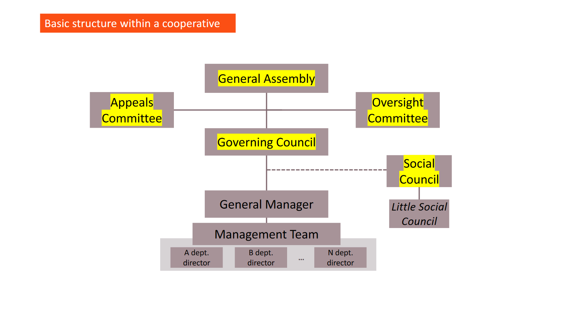
Notes:
Structure of each cooperative
Representative rather than direct democracy in decision making – reduces ‘transaction costs’ commonly found in coops
Compulsory service
General Assembly – elects the governing council – meets once a year
Governing council chooses the management team
General assembly/social council can vote to remove managers
Social council represents worker interests to governing council and management

Slide 9
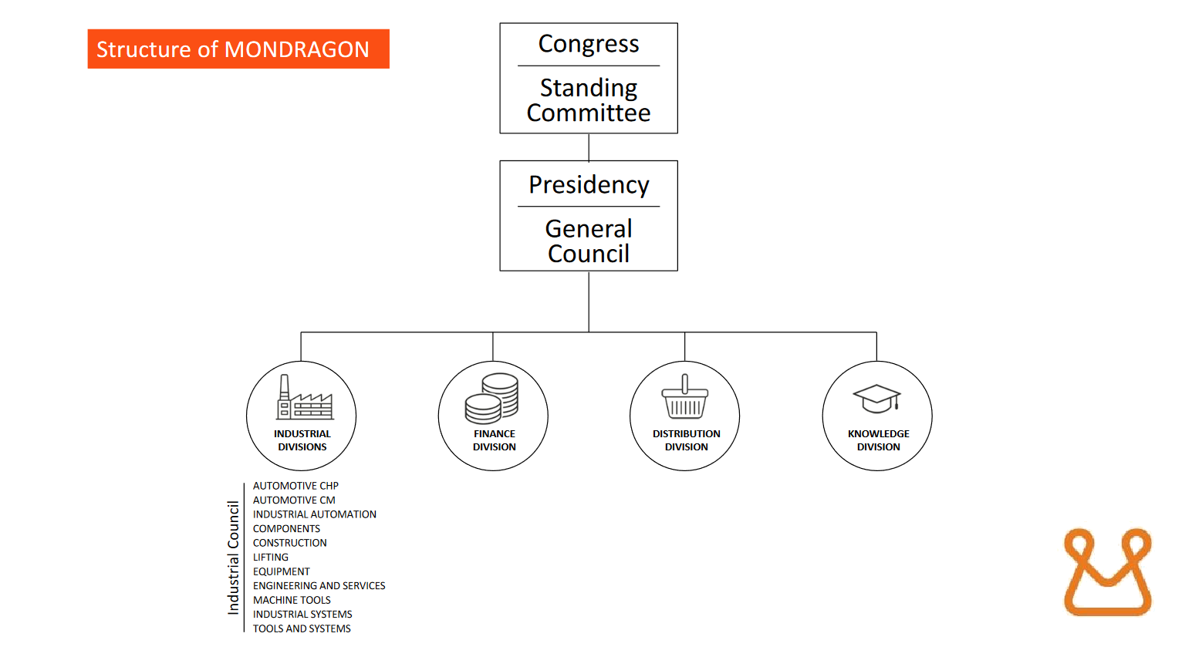
Notes:
Structure
Congress and general council elected by members
Members not directly involved in managerial decision making but decisions are transparent and accountable (members can vote out managers)
Members have capital stake in the fortunes of the business and recognise need for difficult decisions
Tensions exist:
Pressure on wage ratios
Large number of non-members
Offshore production
Challenges recruiting specialisms
Not a utopia – “It’s a system for creating good jobs”

Slide 10
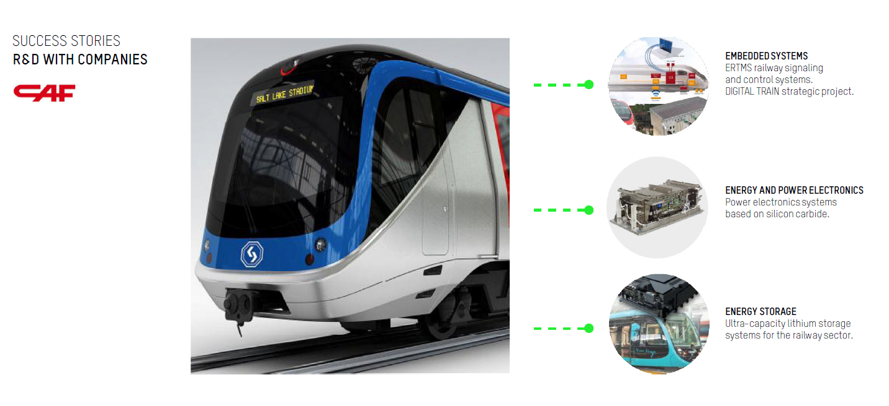
Mondragon structure avoids commonly perceived ‘problems with coops’
Inefficient
Small
Unable to innovate
Slow to exploit opportunity
Can’t attract talent
Notes:
Inefficient – highly effective management and continuous improvement embedded. remains globally competitive. Employee engagement and direct stake reduces some of the need for management controls
Small – individual coops often small but benefit from scale of overarching structure.
Unable to innovate – embedded R&D, continuous improvement of structures and practices
Slow to exploit opportunity – draws on financial muscle and business acumen within group
Can’t attract talent – grow your own, Ikerlan research centre, University, loosened wage ratios for short term contractors

Slide 11
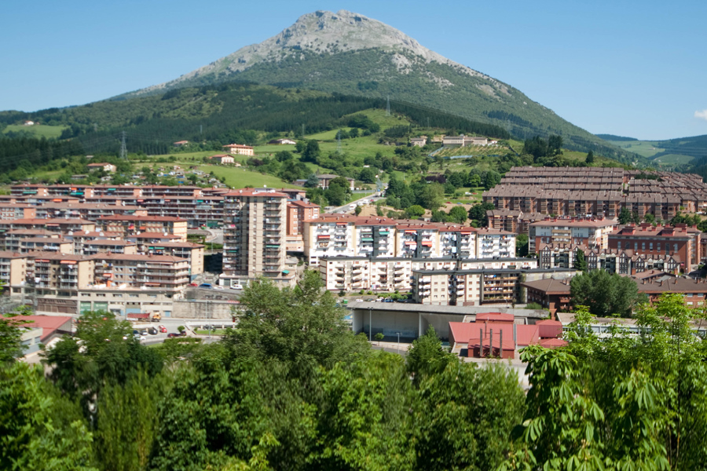
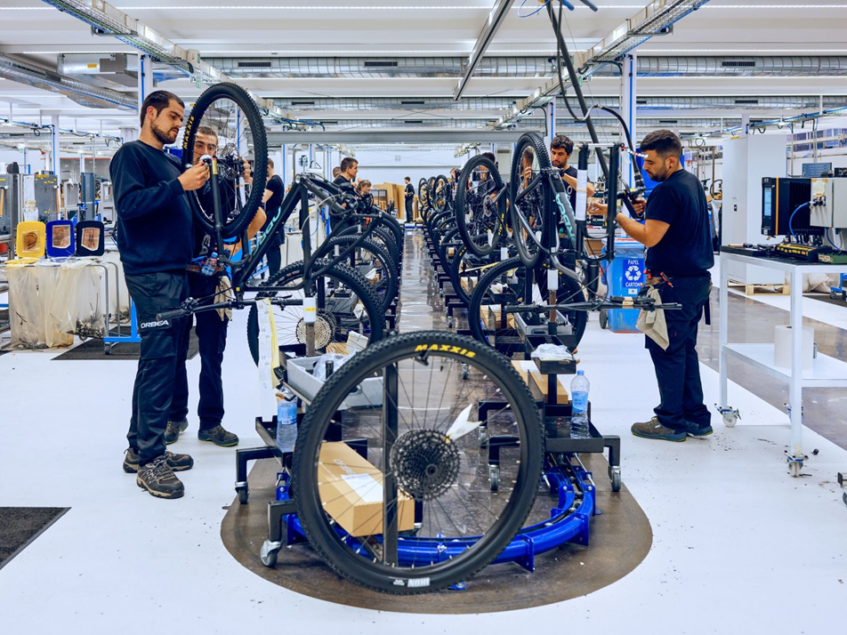
Socio-Economic Impact
“The objective of the cooperative is not to produce rich people, it’s to produce rich societies. We don’t have a lot of rich people — or not very rich — but on the other hand, we also don’t have poor people.” Igor Herrarte, Engineer, Mondragon Assembly
Economic security
Resilience
Reduced inequality
Greater agency
Notes:
Economic security
Jobs – lowest unemployment in region
Wages – 1:7 ratio between lowest and highest earners
Compared to average of 1:105 for IBEX corporations
Capital growth – pension and healthcare provided through Lagun Aro
Redeployment and retraining
Resilience
Redundancies very rare, coops rarely close despite recent financial crises in Spain and globally
Ability to reduce wages, redeploy workers or cross-subsidise from profitable coops
Reduced inequality
Large middle – few extremes of wealth (Spirit Level)
0.24 on Gini Index – comparable to Norway and Finland but without high taxation
Key determinant of health and wellbeing – mental health
Limited studies to demonstrate wider wellbeing impact of Mondragon at local level
Greater agency
Participation in decision making
Direct capital stake in company’s success
Development of management and negotiation skills through social council

Slide 12

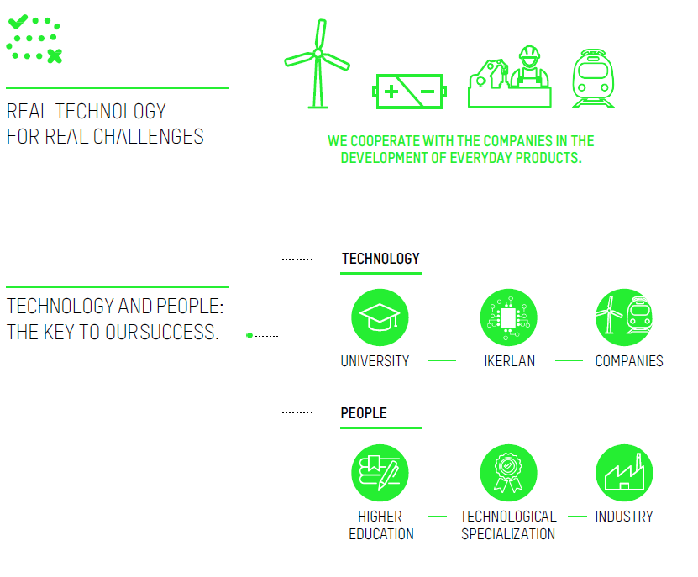
Take home messages
Globally competitive and innovative whilst being more equal and equitable
Contrasts with other ‘economic success stories’ - Silicon Valley
Prerequisites to success at scale:
Culture of cooperativism
Education and training
Innovation and flexibility
Financial independence
National and local policy support

Slide 13
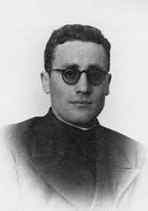
Don Jose Maria Arrizmendarrieta
“There can be no cooperation without co-operators. People do not normally become co-operators spontaneously, they have to be taught – the soil may be fertile but it has to be cultivated”
Notes:
Founding father of Mondragon – radical priest moved to Mondragon in 1941, assigned to supporting young people within Union Cerrajera. Developed technical college to train skilled workers, then with graduates set up first coop ULGOR in 1956 manufacturing.

Slide 14
Cultivating local soils…
Embedding cooperative culture
University courses
Finance and Investment
Public Loans
Pension funds
Policy Support
Entrepreneurship training
Communication campaigns
Coop Development Agencies
Mutual Banks
Community Impact Bonds
Freight consolidation
Engage and incentivise emerging growth sectors
Tilt procurement assessments to coop strengths
Commitment to reserving contracts
Business rates exemptions for social purpose
Retrofit
Renewable Energy
Electric Vehicle Manufacture
Lobby for creation of mutual banks and tax incentives
Notes:
Can’t replicate the conditions of post civil war Spain but could build on current gaps:
Embedding cooperative culture – university courses, entrepreneurship training, communication campaigns, Coop Development Agency
Finance and Investment – public loans, pension fund investments, mutual banks, Community Impact Bonds
Policy support – procurement against key cooperative benefits, reserve contracts, business rates exemptions for social purpose
Engage and Incentivise future growth sectors – e.g. Freight Consolidation, Retrofit, Renewable Energy, Electric Vehicle Manufacture
Future Policy labs – cooperative toolkits, procurement frameworks

Slide 15
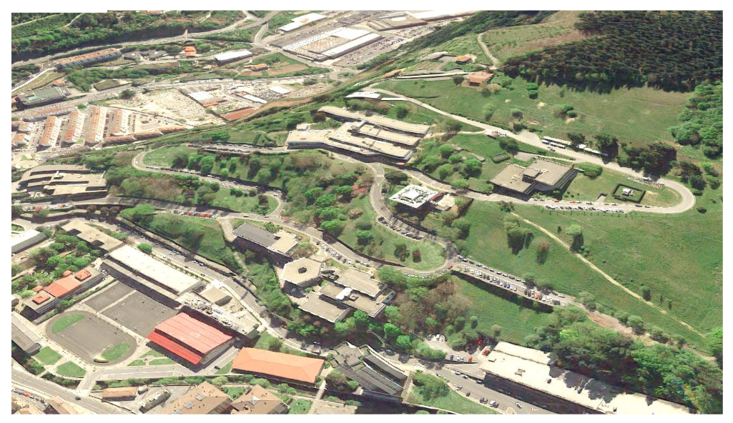
Discussion

Slide 16
Further reading Mondragon
Press
https://www.theguardian.com/world/2013/mar/07/mondragon-spains-giant-cooperative
https://www.bloomberg.com/news/features/2022-06-30/worker-owned-business-model-in-spain-is-keeping-inequality-in-check
https://ussen.org/2015/06/30/interview-mondragon-corporation-a-manufacturer-of-equality/
Academia
https://blogs.lse.ac.uk/usappblog/2014/08/23/a-genuine-economic-democracy-would-provide-the-efficiency-of-the-market-system-without-the-associated-injustice/
https://www.academia.edu/20082162/Mondragon_in_five_points_advantages_and_challenges_of_worker_cooperatives

