Slide 1

Annual General Meeting
24 November 2022

Slide 2

Baroness Taylor of Stevenage
@SharonStevenage | @CoopInnovation

Slide 3
Agenda
Welcome, introductions and apologies
Minutes of the last meeting – online 16 February 2022
Review of the Year: Aug 2021 – July 2022
Budget report 2021/22
Report back from Values & Principles Board
Revised CCIN Constitution
Launch of 2023 funding round
Governance Elections Dec 2022 – Dec 2024
Any Other Business

Slide 4

Councils who are committed to finding better ways of working with local people
Action focused
Membership-based
Open to all UK councils
Part of the local govt family

Slide 5
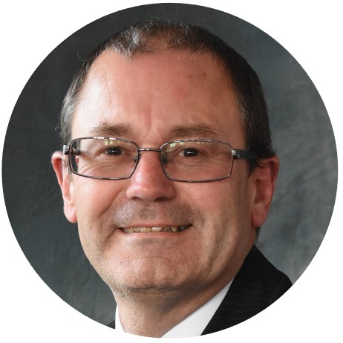
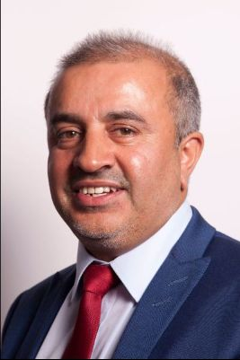
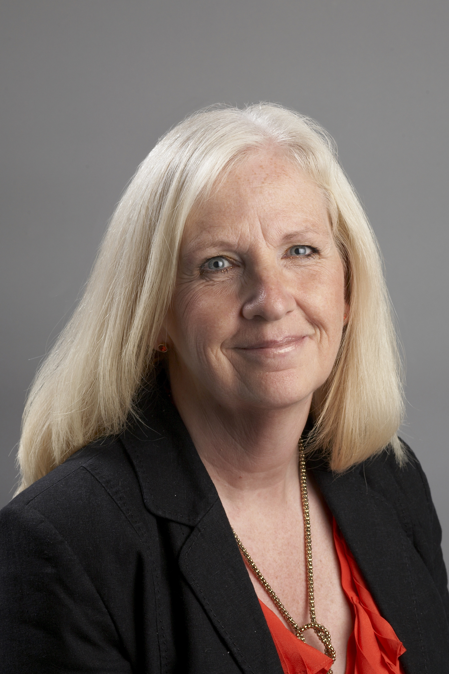
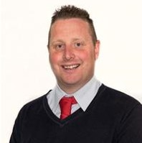
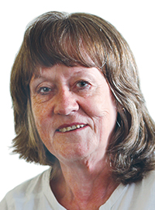
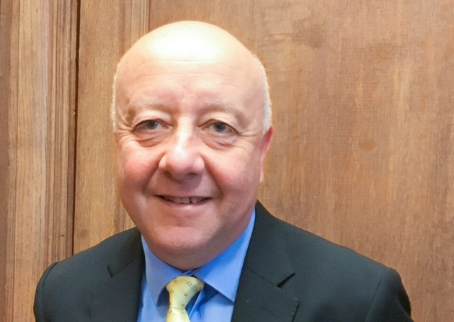
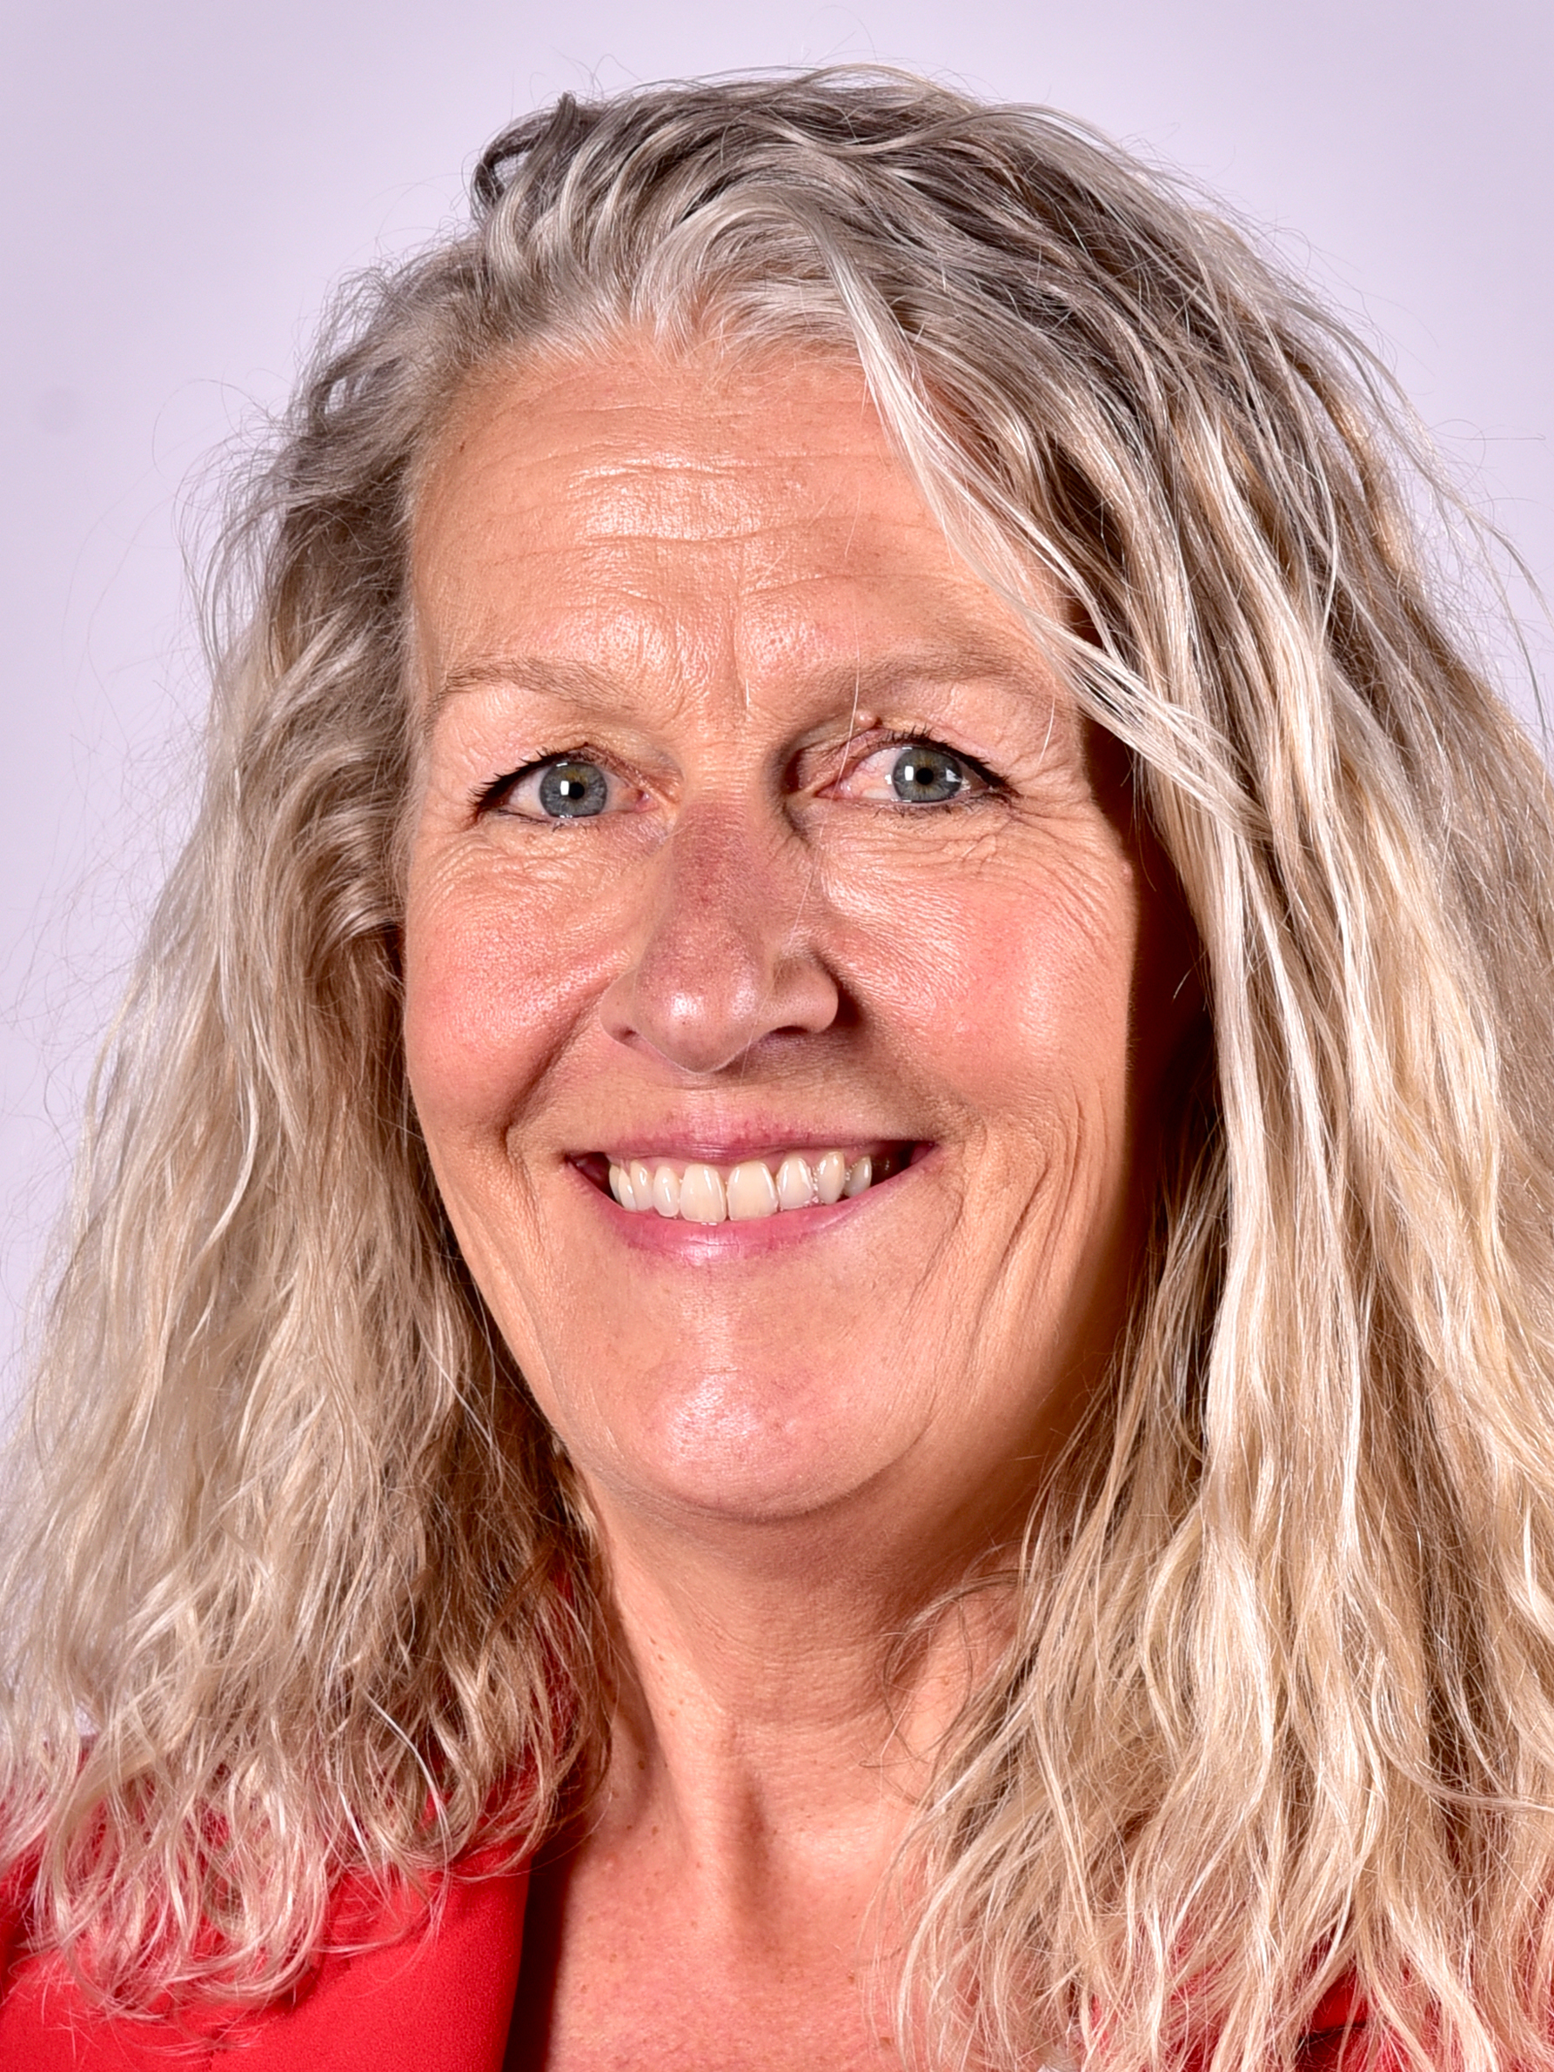
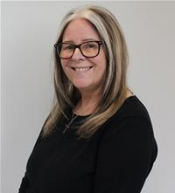
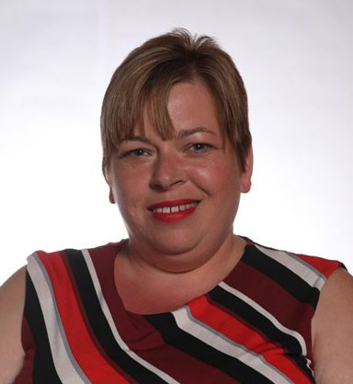
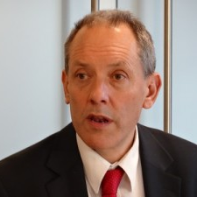
Executive Oversight Committee 2021-22
Cllr Paul Stewart
Cabinet Member
Sunderland City Council
Cllr Shabir Pandor
Leader
Kirklees Council
Cllr Sharon Taylor OBE
Chair of CCIN
Leader, Stevenage Borough Council
Cllr Peter Bradbury
Vice Chair of CCIN Cabinet Member Cardiff Council
Cllr Barbara Brownridge
Cabinet Member
Oldham Council
Cllr Steve Darling
Leader
Torbay Council
Vacancy
Cllr Louise Gittins
Leader
Cheshire West & Chester Council
Cllr Sue Smith
Cabinet Member
Rochdale MB Council
Cllr Clare Gamble
Chair
Billingham Town Council
Jonathan Bland
Managing Director – Social Business International/E3M
Vacancy
Chair of V&P Board (Ex Officio)

Slide 6
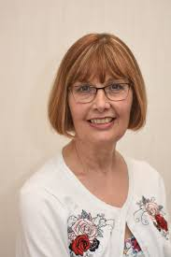
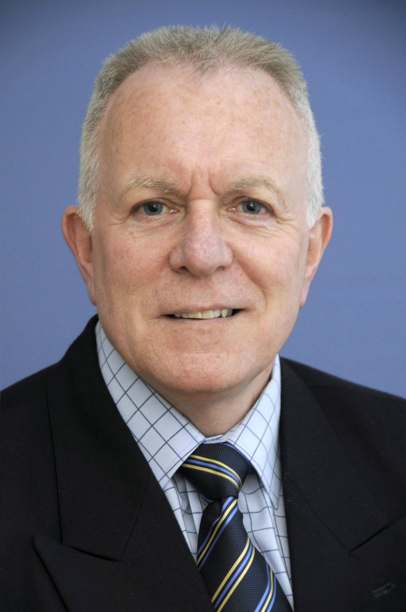
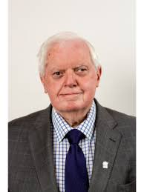
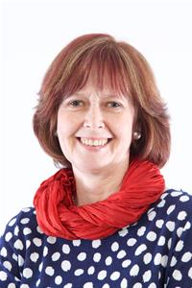
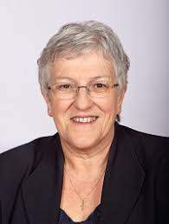
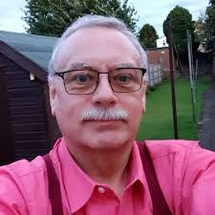
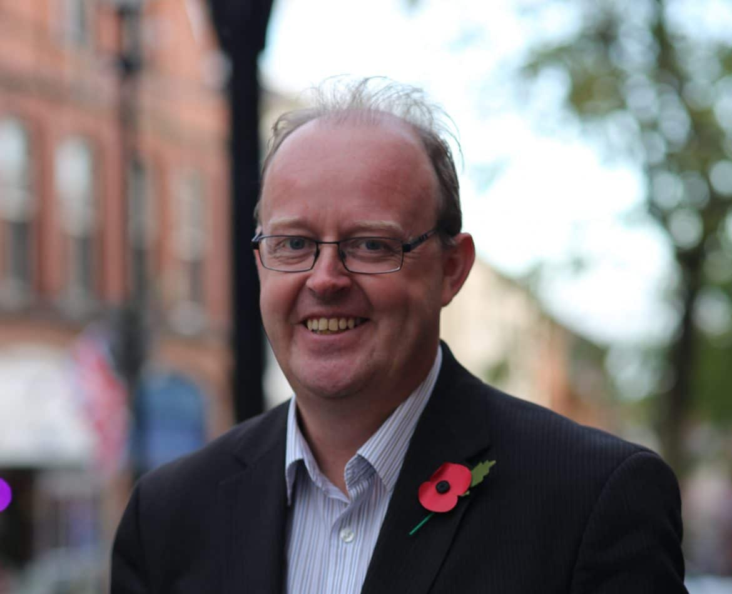
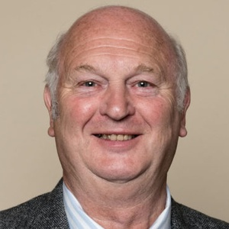
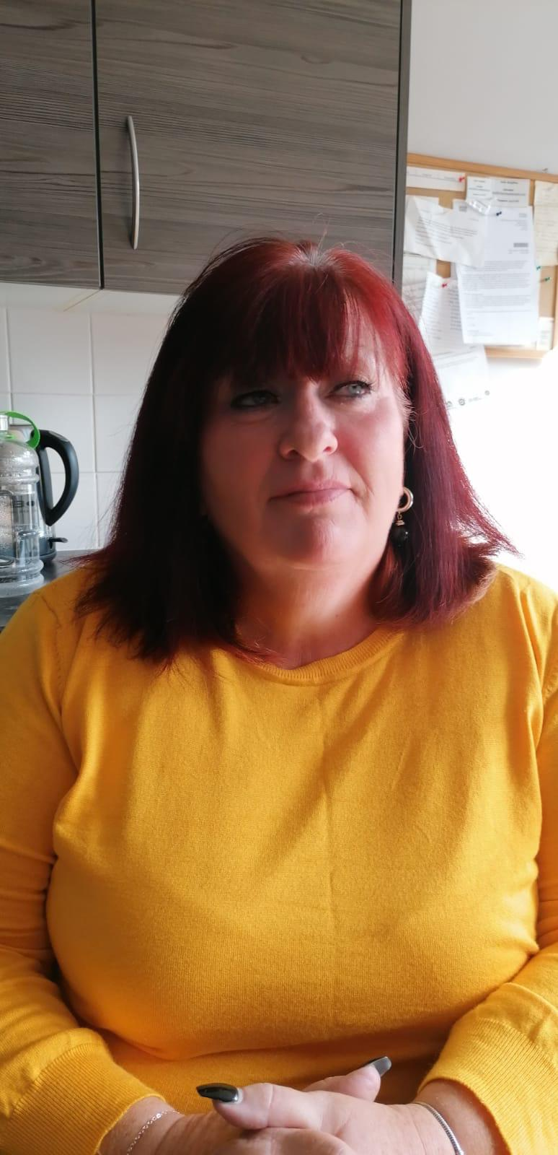
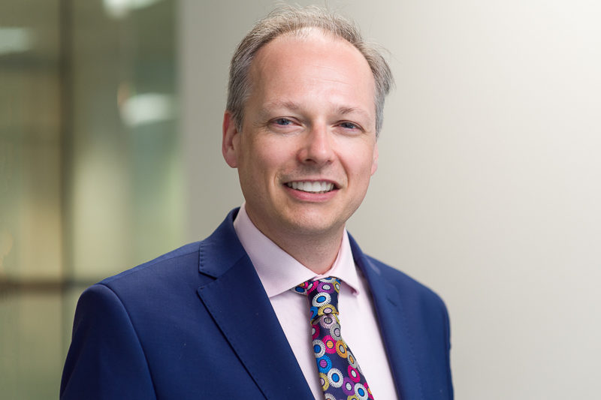
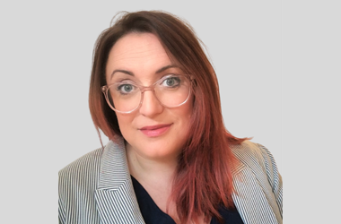
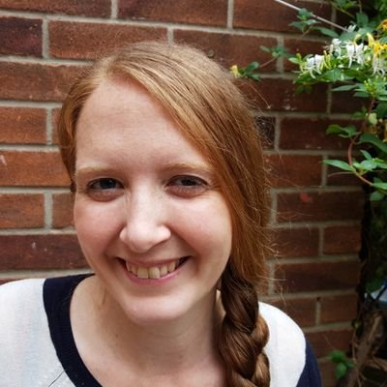
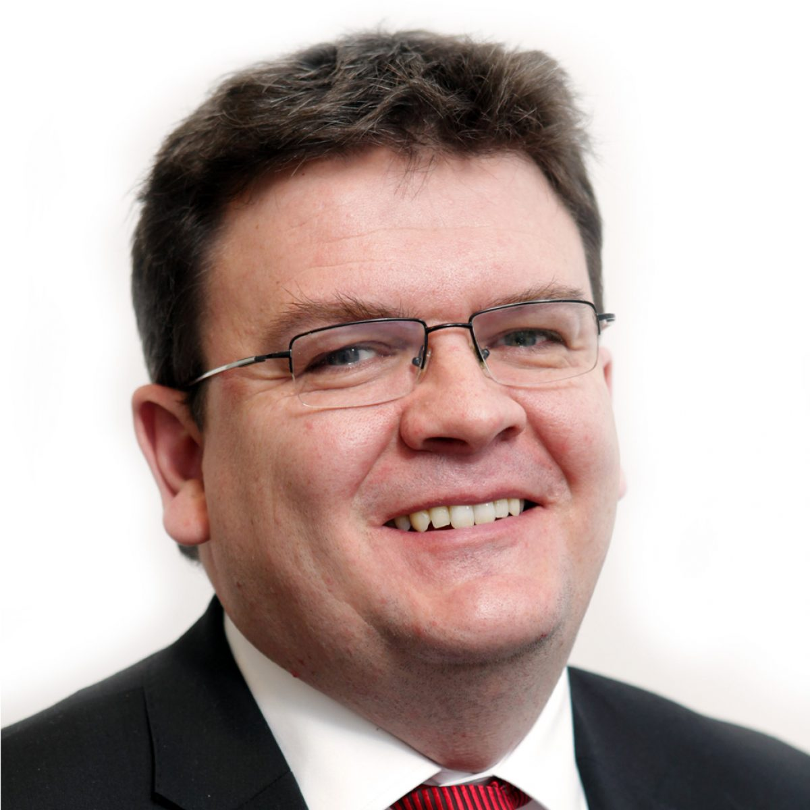
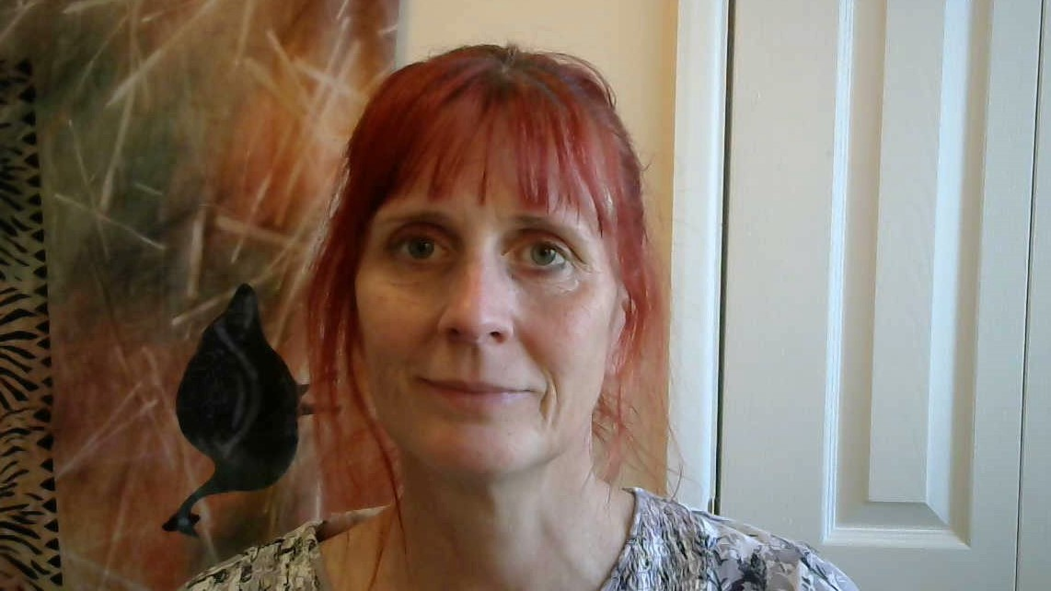
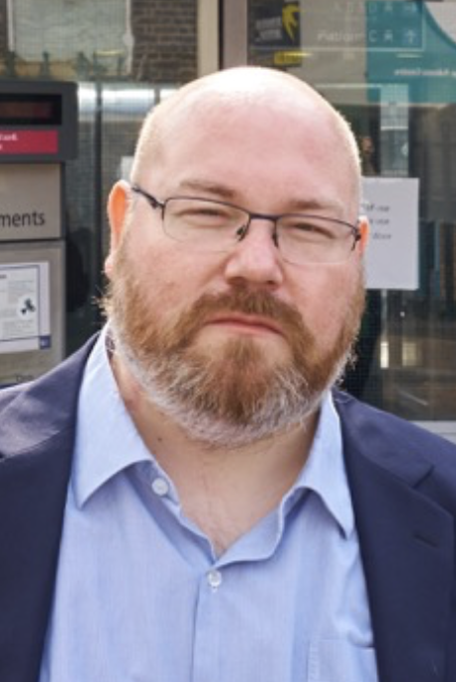
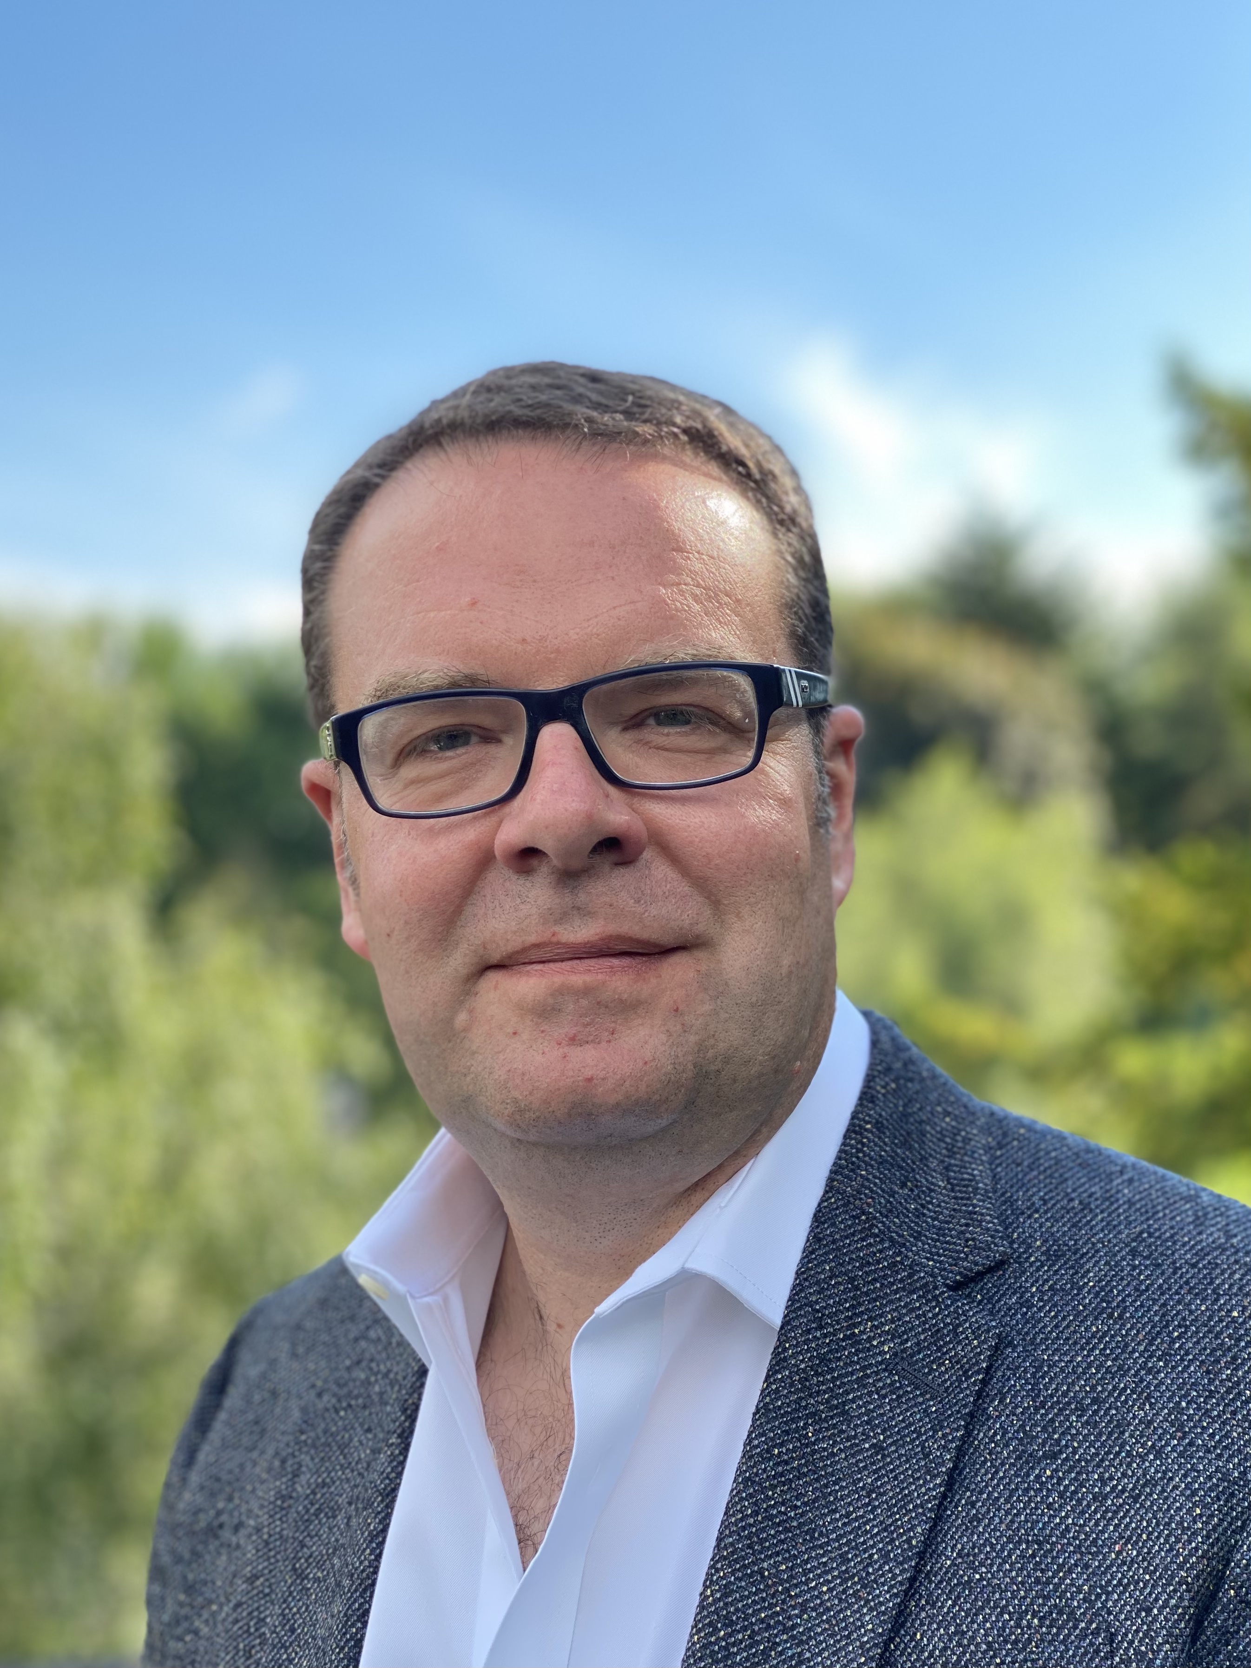
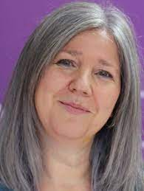
Values & Principles Board 2021 – 2022
Cllr Joyce Welsh South Tyneside Council
Cllr Frank Walsh
Knowsley MB Council
Vacancy
Cllr John Fahy Vice Chair of V&P Royal Borough of Greenwich
Cllr Rae Evans Telford & Wrekin Council
Cllr Sue Woodward
Vice Chair of V&P Burntwood Town Council
Cllr Peter Curling Hillingdon Labour Group
Cllr Michael Stubbs Newcastle-U-Lyme Labour & Coop Group
Cllr Hayden Philips North Warks Labour & Coop Group
Cllr Donna Fuller Woughton Community Council
Gus Della Porta Vice Chair of V&P
Bates Wells
Rachael Walker Trueman Change
Vacancy
Rebecca Harvey
Co-operative News
Neil Calvert
Co-operative College
Cheryl Barrott
Co-operatives UK
Richard McCready
Co-operative Party
Jo White
Co-operative Futures
Paul Bell Unison

Slide 7
103 Members 21 Supporters
36
23
44

Slide 8


































36 Councils 9.6m citizens £17bn budget

Slide 9













































Slide 10























Slide 11
Agenda
Welcome, introductions and apologies
Minutes of the last meeting – online 16 February 2022
Review of the Year: Aug 2021 – July 2022
Budget report 2021/22
Report back from Values & Principles Board
Revised CCIN Constitution
Launch of 2023 funding round
Governance Elections Dec 2022 – Dec 2024
Any Other Business

Slide 12
Agenda
Welcome, introductions and apologies
Minutes of the last meeting – online 16 February 2022
Review of the Year: Aug 2021 – July 2022
Budget report 2021/22
Report back from Values & Principles Board
Revised CCIN Constitution
Launch of 2023 funding round
Governance Elections Dec 2022 – Dec 2024
Any Other Business

Slide 13

ITEM 3

Slide 14
Highlights
Positioned the CCIN as the fastest-growing cross-party Network in local government
The Leaders and Cooperative Leads Group articulated what it means to be a Cooperative Council
Session to promote regional cooperative banks
Launched new website
Approved four Policy Labs and one Policy Prototype in Sept 2022
Shared over 420 Case Studies with a new Case Studies Pack
Launched three Policy Lab Reports
Understanding the Digital Divide
Cooperative Approaches to Reaching Net Zero
Cooperative Difference in Care
Produced a pamphlet for events introducing the CCIN and its Policy Labs
Approved revised CCIN Constitution

Slide 15
Being a Cooperative Council
#OurCoopDifference

Slide 16

What you can do as a council
Sign the ‘Councils for Fair Tax' Declaration
Pay Real Living Wage
Are part of a Real Living Wage City/Borough/Town
Sign the ‘Modern Slavery’ Charter
Actively encourage co-op innovation within staff teams
Playing a central-role in tackling the Climate Emergency

Slide 17

What you can do with the CCIN
Encourage Members and Officers to undertake CCIN certified training modules
Offer CCIN accredited training courses for member and officer development
Actively participate in the CCIN Officer Network
Join the CCIN governance
Engage in Policy Labs and / or Prototypes
Engage in WhatsApp Groups
Submit regular Case Studies for inclusion on CCIN website
Engage with CCIN social media channels
Use the CCIN Dynamic Purchasing System to bring in capacity & expertise

Slide 18
community wealth building
Develop an Inclusive Economy Charter
Promote a progressive procurement policy
Support the creation of a regional mutual/community bank by investing
Work with local anchor institutions to buy and recruit local
Regulate rent and rates for ‘local’ businesses in council-owned property
Offer business rate rebates for those businesses that become Living Wage Accredited
Champion Local Employment schemes
Have insourcing Council Services as an objective

Slide 19
cooperative placemaking
Develop a cooperative development strategy
Establish a cooperative development network
Commit to community engagement in local decision making including participatory budgeting
Invest in local community production, particularly those focusing on community energy to tackle the climate emergency
Promote the circular economy
Support local enterprises to convert into coops/worker coops
Have an Asset Transfer policy to manage land and assets which support Community Land Trusts

Slide 20
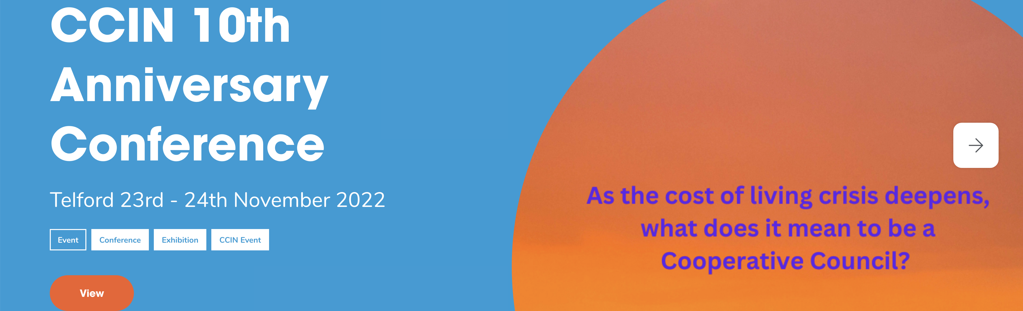
New website
Launched in February 2022
It focuses on what it means to be a Coop Council
Easier to navigate and content is fully searchable
Our Values and Principles icons illustrate the policy work being delivered
Funded Projects can be searched by Member, Date and Principles supported
Functionality for members to upload their Case Studies and Events

Slide 21

62 Case Studies illustrating some of the many ways that Co-operative Councils are working with local people to build strong and resilient neighbourhoods. www.councils.coop/case-studies
420 Case Studies

Slide 22



Launched 3 Policy Reports in Feb 2022

Slide 23

New brochure to promote our funded projects https://bit.ly/CCIN-projects

Slide 24
POLICY LABS 2022
Democratising Policy Solutions Lead: Rochdale MBC Participants: Burntwood TC, Cheshire West & Chester, South Tyneside, Sunderland, Tameside MBC, Wigan
Equipping Councils for Cooperative Development Match funded by P2C Lead: Kirklees Participants: Coop Futures, Coops UK, Innovation Coop, Oldham Council, Oxford City Council, Power to Change, South Ribble Borough Council, Stevenage Borough Council, Sunderland City Council
Arts & Culture for Social Cohesion
Lead: North Herts District Council Participants: Oldham Council, Stevenage Council
CCIN Study Visit to Mondragon
10 & 11 October 2022

Slide 25
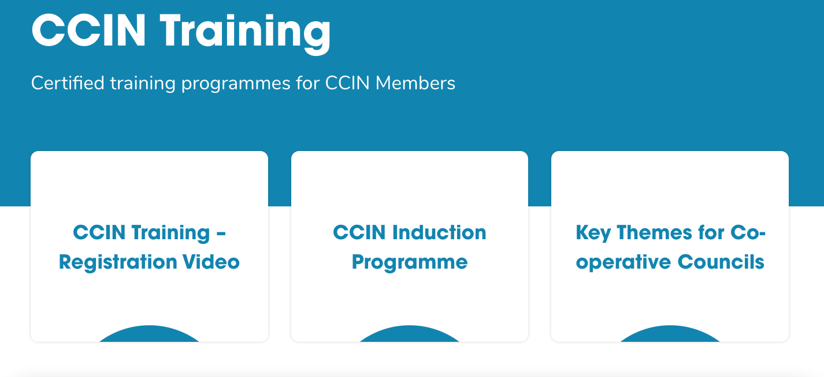
Online Training courses
https://www.councils.coop/training/ccin-training/

Slide 26
Dynamic Purchasing System
Allows new suppliers to join at any point
Mini Competition must be undertaken when using the DPS, ensuring the CCIN is promoting industry best practice
As pre-checking has already been done, there are no financial limits on the mini-competition process
5-year contract 2020-2025
Councils often need to move quickly and flexibly to be on the front foot when it comes to ‘doing things differently’.
Sometimes it is necessary to bring in extra capacity and specific expertise to be able to do this, and there can also be a need to seek independent challenge to test assumptions and policy design

Slide 27














DPS Suppliers 2020 - 2025

Slide 28
Events Calendar2022
11 June
Cooperative Party Local Government Conference - London
17–18 June
Cooperative Congress - Birmingham
18–19 June
Labour Local Government Conference - Warwick
28–30 June
Local Government Association Conference & Exhibition - Harrogate
12–14 July
Playground for the New Economy Festival Devon
17–20 Sep
Liberal Democrat Party Conference - Brighton
24–29 Sep
Labour Party Conference - Liverpool
9–10 Oct
Study Visit to Mondragon
7 Nov
National Association of Local Councils (NALC) – London
23-24 Nov.
CCIN Annual Conference Telford
15-16 Feb
CCIN Annual Conference Online

Slide 29
Agenda
Welcome, introductions and apologies
Minutes of the last meeting – online 16 February 2022
Review of the Year: Aug 2021 – July 2022
Budget report 2021/22
Report back from Values & Principles Board
Revised CCIN Constitution
Launch of 2023 funding round
Governance Elections Dec 2022 – Dec 2024
Any Other Business

Slide 30
ITEM 4
Jonathan Downs
Corporate Policy Lead - Oldham Council
CCIN Accountable Body
@Downs_Jonathan | @OldhamCouncil

Slide 31
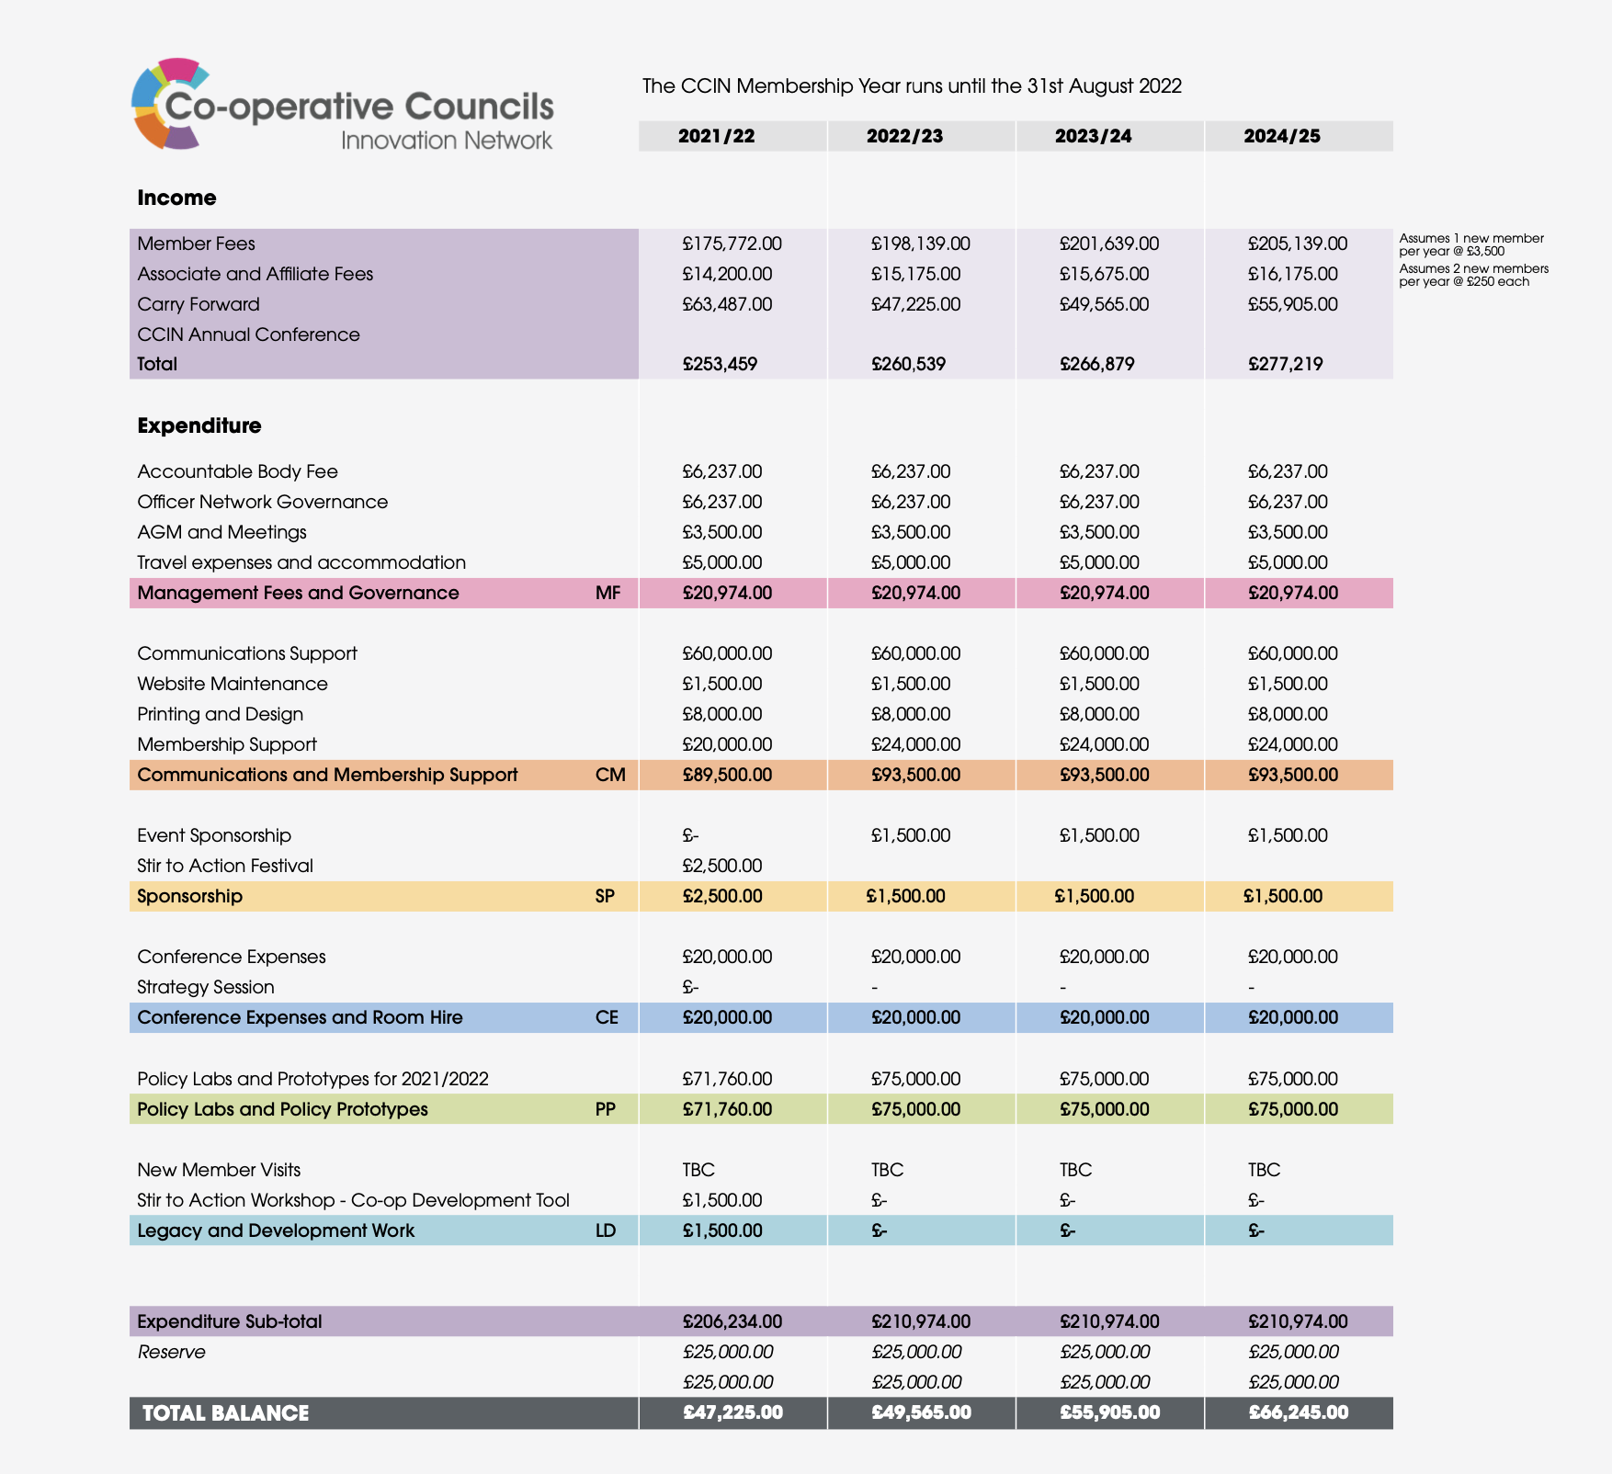
Budget Report 2021/22

Slide 32
Agenda
Welcome, introductions and apologies
Minutes of the last meeting – online 16 February 2022
Review of the Year: Aug 2021 – July 2022
Budget report 2021/22
Report back from Values & Principles Board
Revised CCIN Constitution
Launch of 2023 funding round
Governance Elections Dec 2022 – Dec 2024
Any Other Business

Slide 33
ITEM 5
Cllr John Fahy
Vice Chair of Values & Principles Board Royal Borough of Greenwich
@CllrJohnFahy | @Royal_Greenwich

Slide 34
Values & Principles Board 2021 – 2022
Cllr Joyce Welsh South Tyneside Council
Cllr Frank Walsh
Knowsley MB Council
Vacancy
Cllr John Fahy Vice Chair of V&P Royal Borough of Greenwich
Cllr Rae Evans Telford & Wrekin Council
Cllr Sue Woodward
Vice Chair of V&P Burntwood Town Council
Cllr Peter Curling Hillingdon Labour Group
Cllr Michael Stubbs Newcastle-U-Lyme Labour & Coop Group
Cllr Hayden Philips North Warks Labour & Coop Group
Cllr Donna Fuller Woughton Community Council
Gus Della Porta Vice Chair of V&P
Bates Wells
Rachael Walker Trueman Change
Vacancy
Rebecca Harvey
Co-operative News
Neil Calvert
Co-operative College
Cheryl Barrott
Co-operatives UK
Richard McCready
Co-operative Party
Jo White
Co-operative Futures
Paul Bell Unison

Slide 35
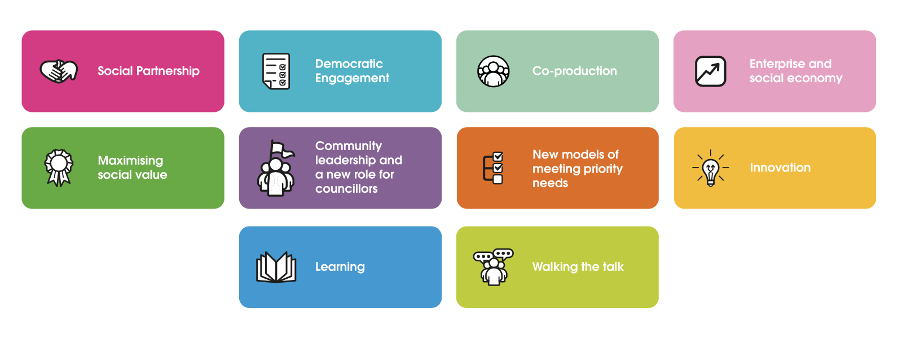
Our Principles
https://www.councils.coop/about-us/values-and-principles/

Slide 36

These icons demonstrate how Co-operative Councils are putting our co-operative principles into practice, demonstrating the #cooperativedifference in the work that they are doing.

Slide 37
Agenda
Welcome, introductions and apologies
Minutes of the last meeting – online 16 February 2022
Review of the Year: Aug 2021 – July 2022
Budget report 2021/22
Report back from Values & Principles Board
Revised CCIN Constitution
Launch of 2023 funding round
Governance Elections Dec 2022 – Dec 2024
Any Other Business

Slide 38
CCIN Constitution
First written in 2012, its Terms of Reference were last reviewed in 2016
Members agreed a revised constitution in February 2022
BUT it excluded reference to a Quorum for the AGM
Proposing 20% of members (we have 100 members so therefore that is 20 people)

Slide 39
Agenda
Welcome, introductions and apologies
Minutes of the last meeting – online 16 February 2022
Review of the Year: Aug 2021 – July 2022
Budget report 2021/22
Report back from Values & Principles Board
Revised CCIN Constitution
Launch of 2023 funding round
Governance Elections Dec 2022 – Dec 2024
Any Other Business

Slide 40
Cllr Peter Bradbury
Vice Chair of CCIN Cabinet Member of Tackling Poverty, Equality and Public Health – Cardiff Council
ITEM 7
@PEBradbury| @CardiffCouncil

Slide 41

Policy Labs and Prototypes 2023

Slide 42
CCIN Policy Lab & Prototype funded projects
Member led projects to find co-operative policy solutions to the challenges facing local government. Open to all ideas, the more innovative the better!
Policy Labs - more significant collaborative pieces of work that CCIN members work on together and eligible for between £10,000 - £20,000 of funding.
Policy Prototypes - smaller projects delivered in a locality on behalf of the Network and eligible for up to £2,000 of funding.

Slide 43
Key points of 2023 process
Policy Labs –
£60k total budget
24 months to deliver
Policy Prototypes –
£15k total budget
9 months to deliver
Max Bid of £20k per project
Max Bid of £2k per project
Notes:
For Policy Labs We recommend engaging a minimum of three other CCIN members to create a working group to support the development of your project. We welcome applications from all Members, but the application must be submitted and overseen by a Full Member Council. Members will have up to two years to deliver a Policy Lab. Applications will be considered for funding of up to £20,000, dependent on their scale and ambition.
Policy Prototypes are smaller projects for members who want to deliver in their locality on behalf of the Network. This funding is available to councils of all sizes, Opposition Groups and Minority Administrations. Members will have up to nine months to deliver a Policy Prototype. Applications will be considered for funding of up to £2,000.

Slide 44
These are some ideas that were suggested last year but not taken forward
1. Covid-19 Recovery
2. Sharing Data with 3rd Sector Organisations
3. Tackling Inequality
4. Co-operative Approaches to Levelling-up
Notes:
Covid-19 Recovery
Though Covid-19 Recovery was a thematic area in 2021, this is still a topic that all local authorities are wrestling with.
We would like to fund projects that involve local communities in co-designing co-operative initiatives that would help our members and their communities to recover from the impacts of the pandemic.
Sharing Data with 3rd Sector Organisations
Following the pandemic, many local authorities are thinking about how they can better support their local VCSFE sector, including through the development of investment strategies.
However, key to this approach is how we work with the VCFSE sector, for example, through sharing data and intelligence about local communities.
We would like to fund projects that aim to promote greater collaboration between local authorities and the VCFSE sector, with models of co-operation that can be replicated across the Network.
Tackling Inequality
Many CCIN councils represent areas and communities suffering with high levels of inequality and deprivation (9 of the top 30 councils listed in the Multiple Indices of Deprivation are CCIN members).
We would like to fund projects that aim to develop partnership projects to tackle poverty and inequality, helping our members to build back fairer from the pandemic.
Co-operative Approaches to Levelling-up
The levelling-up agenda is gaining momentum across the country, with many local authorities considering how they can access funding to support their town centres, create jobs, and grow their local economies.
We would like to fund projects that take a co-operative approach to levelling-up, considering how we can encourage good economic growth, that benefits everyone in our communities.

Slide 45
We want to hear your ideas

Slide 46
Get involved in 2023
There is no limit to the number of Policy Labs you are engaged in BUT you can only lead on one

Slide 47
Timetable for 2023
Date
24 Nov | Launch
28 Feb | Closing date for submission of all Bids
6 March | V&P Board consider Bids
13 March | EOC consider EOIs/Bids
31 March | Contracts awarded/work starts
Notes:
Much shorter process than the last round as we will not be straddling the election period.

Slide 48
Deadline for Bids is Tuesday 28th February 2023
For more information visit https://bit.ly/CCINbids23

Slide 49
Agenda
Welcome, introductions and apologies
Minutes of the last meeting – online 16 February 2022
Review of the Year: Aug 2021 – July 2022
Budget report 2021/22
Report back from Values & Principles Board
Revised CCIN Constitution
Launch of 2023 funding round
Governance Elections Dec 2022 – Dec 2024
Any Other Business

Slide 50
ITEM 4
Jonathan Downs
Corporate Policy Lead - Oldham Council
CCIN Accountable Body
@Downs_Jonathan | @OldhamCouncil

Slide 51
Governance Elections – Executive Oversight Committee
Held every two years
Seeking nominations for EOC from December 2022 to December 2024.
Any member organisation can have one representative on the CCIN Governance, either on the EOC or on the Values and Principles Board. Once we have elected members to the EOC, we will seek nominations for the V&P Board.
EOC is responsible for overseeing the day-to-day running of the Network and making key decisions around the CCIN’s strategic direction and budget.
Nominations and Self-nominations for candidacy are open to Leaders and/or Portfolio Holders from Full Member Councils and representatives from Associate and Affiliate members.

Slide 52
Membership of the Executive Oversight Committee
a minimum of 6 and a maximum of 8 Representatives from the CCIN’s Full Membership
1 Representative from the Accountable Body (The Accountable Body oversees the CCIN’s budget, legal structure and procurement requirements)
1 Representative of the Associate Membership
1 Representative of the Affiliate Membership
1 Representative of the Values and Principles Board (non-voting)

Slide 53
Role of Chair
Our new Chair must be a Leader from one of our Full Member Councils. They will be a champion for a growing Network and understand the role of impartiality when presenting to a cross-party audience.
A confident communicator, the Chair will work with us at the LGA Conference and relevant political conferences, actively supporting opportunities to grow the Network. And in their own Council, they will be a staunch advocate for driving their own cooperative agenda and #CooperativeDifference.

Slide 54
Deadline for applications
Friday, 25th November 12 noon
The nomination form can be found at: https://bit.ly/CCINeoc

Slide 55
Agenda
Welcome, introductions and apologies
Minutes of the last meeting – online 16 February 2022
Review of the Year: Aug 2021 – July 2022
Budget report 2021/22
Report back from Values & Principles Board
Revised CCIN Constitution
Launch of 2023 funding round
Governance Elections Dec 2022 – Dec 2024
Any Other Business

Slide 56
Any Other Business
ITEM 8

Slide 57

Thank you

