Slide 1
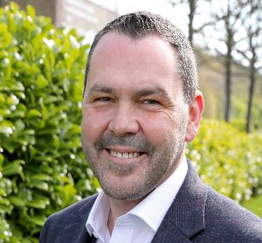

Paul McEldon OBE
Chief Executive – North East BIC
@NorthEastBic
Michelle Booth PhD
Social Enterprise Specialist – North East BIC
@MBSocEnt | @NorthEastBic

Slide 2
Reimagine Sunderland as a Co-operative City
Paul McEldon OBE
Chief Executive
Dr. Michelle Booth PhD
Social Enterprise Specialist

Slide 3
Introducing The BIC
Established 1994
Regions largest business support agency
Supporting start-up and growth of businesses across the region
Provides business advice, support and accommodation
Supported 4000+ businesses, leading to the creation of 7500+ jobs
Over 1000 businesses currently housed over 4 sites
Largest social enterprise team in the country – 12 specialist advisors (North East Centre of Excellence)
Not-for-profit – social enterprise

Slide 4
Introducing the Report/ Commission
Commissioned by Sunderland City Council as part of the Community Wealth Building Agenda to:
Explore the social and co-operative landscape in Sunderland
Map the type of co-operatives resident within the City
Explore best practices (locally, regionally, nationally)
Design a set of recommendations to help to “Reimagine Sunderland as a Co-operative City”

Slide 5
Approaching the Research
PRIMARY RESEARCH
Two Workshops.
Discussions with co-operatives, social enterprises, business advisors, councillors and officers and wider Stakeholders.
SECONDARY RESEARCH
Desk Based Research
Academic, industry and sector reports, Companies House data, Co-operatives UK Directory etc.

Slide 6
Social Enterprise & Co-operative Context in Sunderland
A long history of social and cooperative development
One of the highest per capita concentrations of social businesses in the region
Businesses working across all sectors from care to arts and culture, housing, health food and drink and horticulture

Slide 7
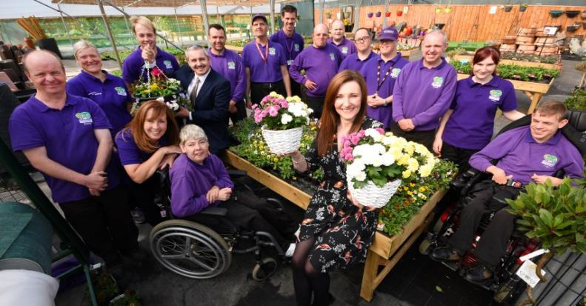
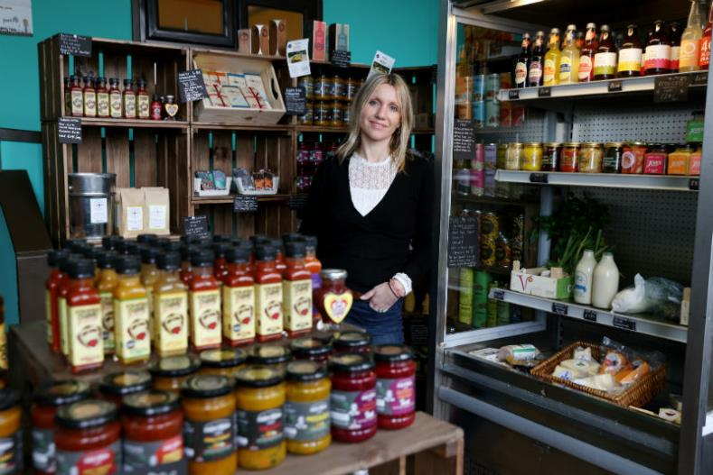

Co-operatives in Sunderland

Slide 8
Research Findings
A solid foundation from which to grow
Opportunities and appetite for collaboration
People see the benefit of change in business and communities
Challenges in changing mindset (focus on profit in business)
Lack of awareness on the co-operative model

Slide 9
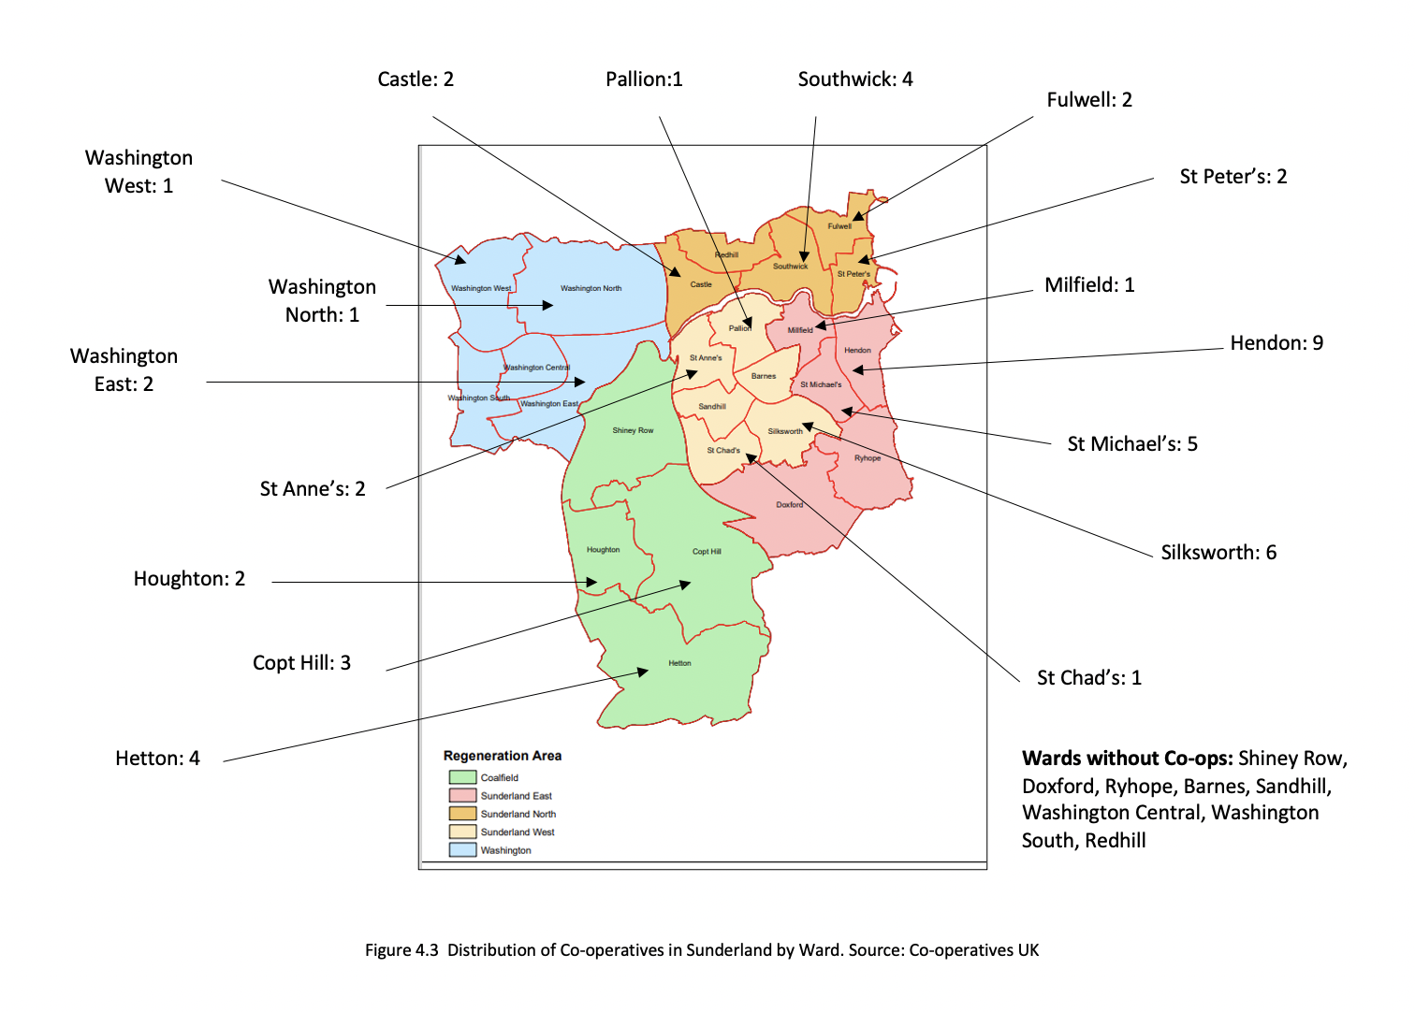
48 Identified Co-operatives– 195 Community Interest Companies Across the City

Slide 10
Social & Clubs
Business Services
Education & Learning
Food & Drink
Arts
Housing
Finance
Leisure
Creatives
Co-operative Sectors

Slide 11
Recommendations
Ecosystem Support
Task Force
Embedding Values
Awareness & Education

Slide 12
Creating an Ecosystem
Ecosystem Model
Policy
Finance
Culture
Supports
Human Capital
Markets
Enterprise Ecosystem Model
Isenberg, 2010

Slide 13
Facilitating the Ecosystem
Feeders
Instigators
Leaders
Ecosystem Model
Feld & Hathaway, 2020

Slide 14
Co-operative Task Force
Cross-sector “Anchors”
Exploring practicalities of developing cooperation and a cooperative mindset in Sunderland
Embedding co-operation across the City
Mobilise the co-operative movement

Slide 15
Developing Awareness: Creating a Buzz
#THINKCo-op

Slide 16
Embedding Co-op Values Into Sunderland
The Co-operative Values
Caring for others
Democracy
Equity
Equality
Honesty
Openness
Self help
Self-responsibility
Solidarity
Social responsibility
Co-operative Values Charter.
Cross-Sector buy-in
Potential to use in procurement processes and tendering

Slide 17
Contacts
Paul McEldon
Paul.mceldon@ne-bic.co.uk
Michelle Booth
Michelle.booth@ne-bic.co.uk

