Slide 1

Annual General Meeting
16 February 2022

Slide 2

Cllr Sharon Taylor
Chair of the CCIN | Leader of Stevenage Borough Council
@SharonStevenage | @CoopInnovation

Slide 3
Agenda
Welcome, introductions and apologies
Minutes of the last meeting – online 8 October 2020
Review of the Year 2019/20
Budget report 2021/22
Report Back from Values & Principles Board
Revised CCIN Constitution
Launch of 2022 funding round
Any other business

Slide 4


Slide 5
Other Highlights
Positioned the CCIN as the fastest growing Network in local government
Funded 13 Policy Labs & Prototypes delivered by our Members
Shared over 350 Case Studies
Launched five publications
CCIN Action Learning Set from Covid-19
Beyond Asset Transfer report
Understanding the Digital Divide
Co-operative Approaches to Reaching Net Zero
Co-operative Difference in Care
Launch of CCIN Induction online training programme
Established a Leaders and Cooperative Leads Group sharing practical ways to build the co-operative economy
Reviewed the CCIN Constitution

Slide 6

Committed to finding better ways of working with local people
Action focused
Membership-based
Open to all UK councils
Part of the local govt family

Slide 7
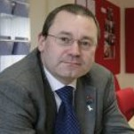
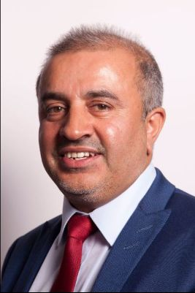
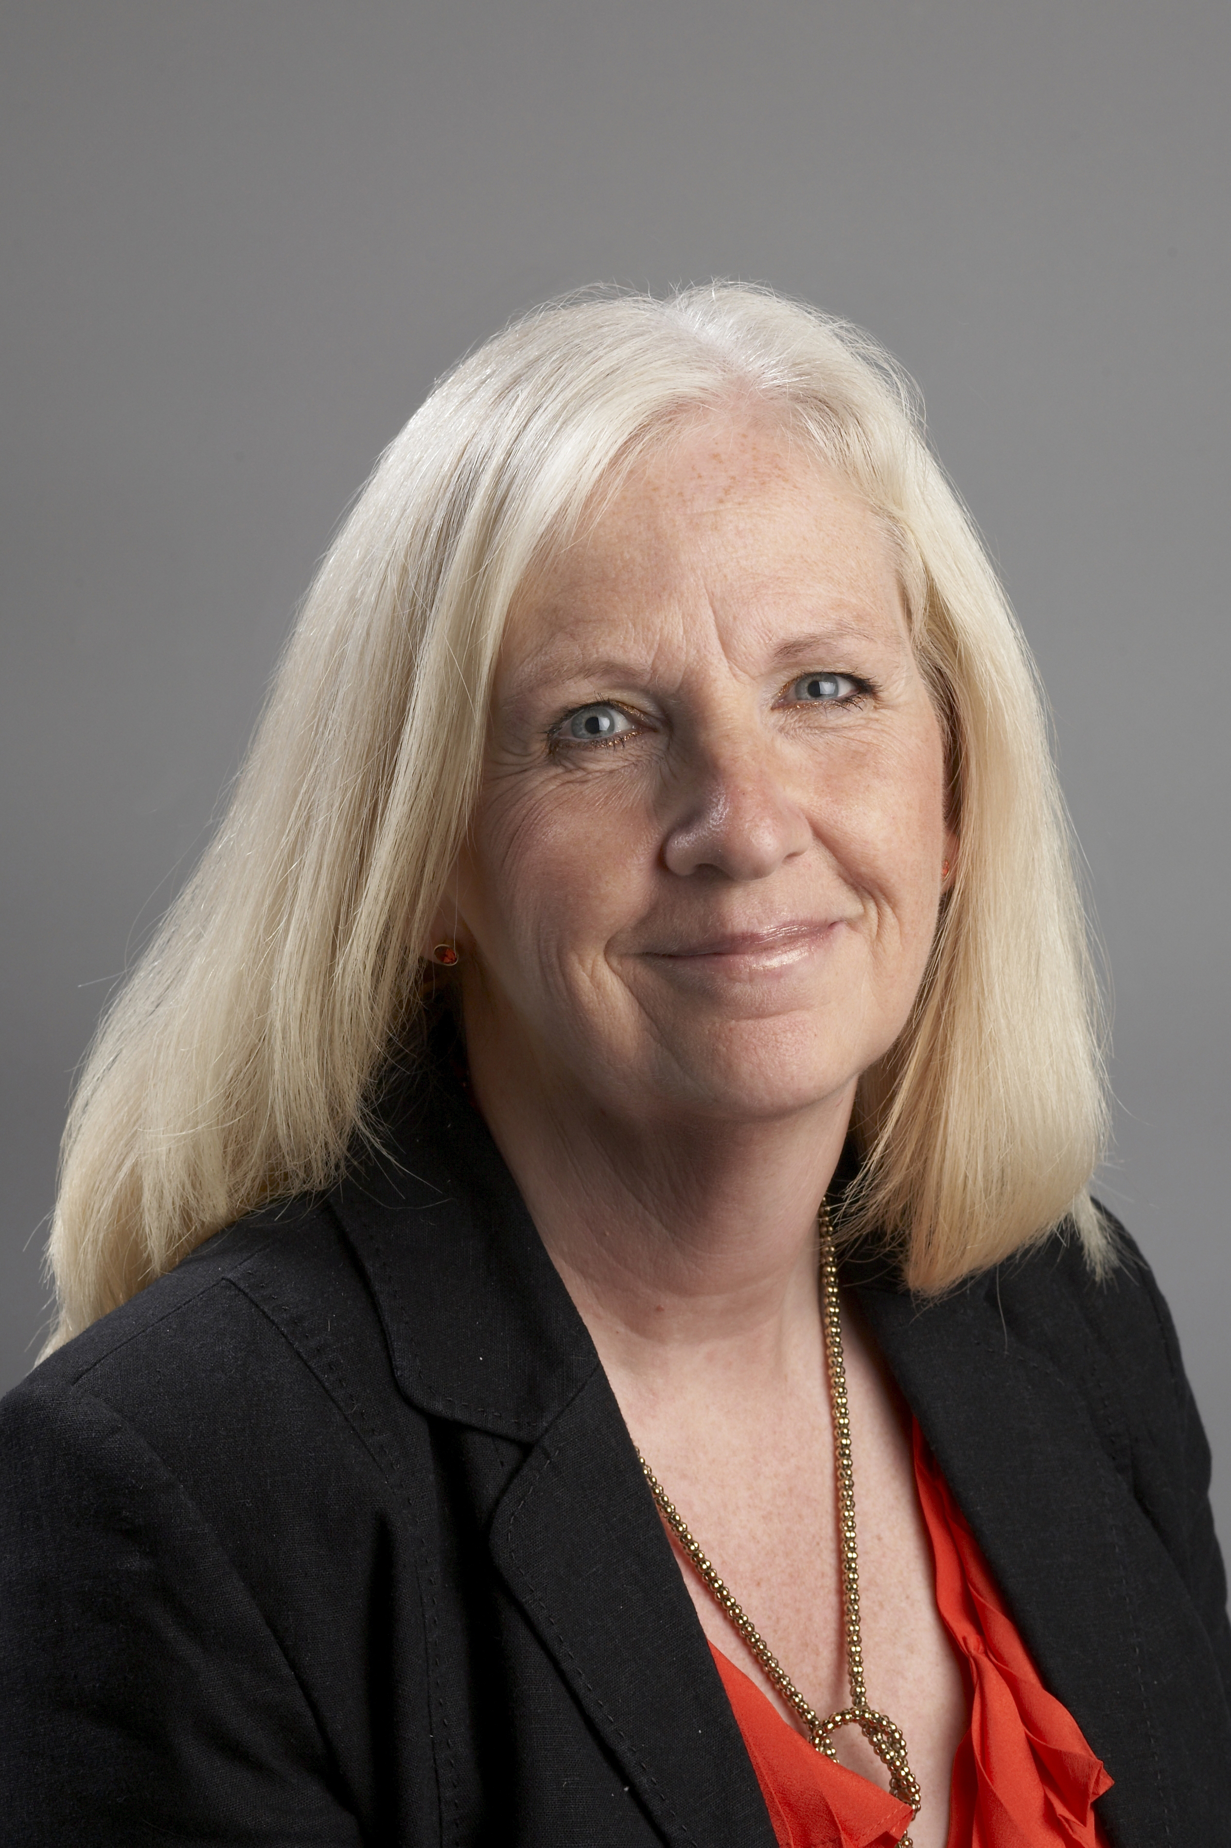
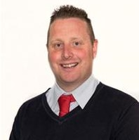
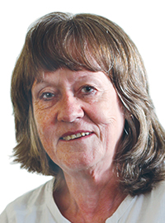
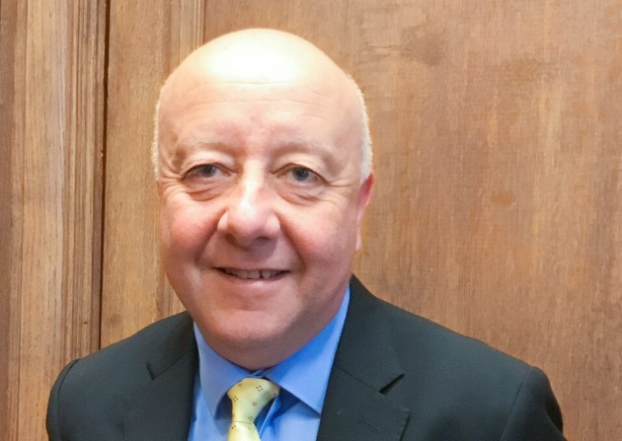
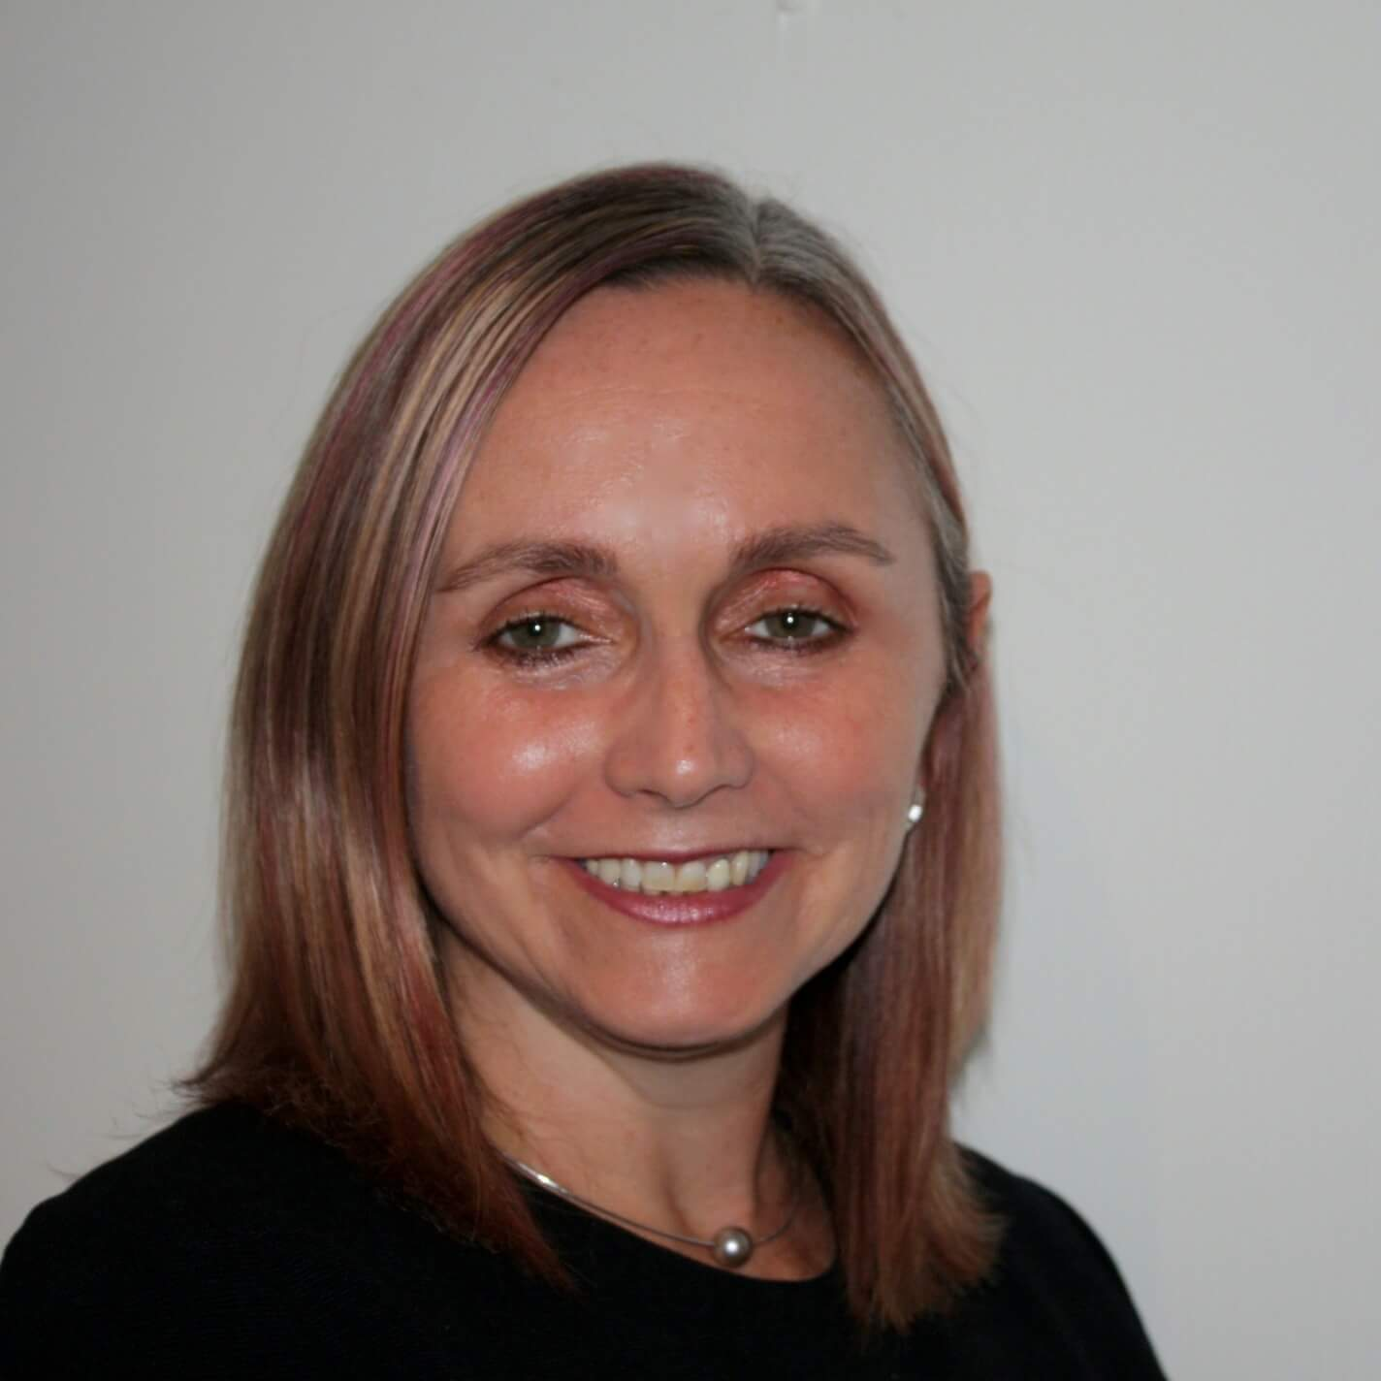
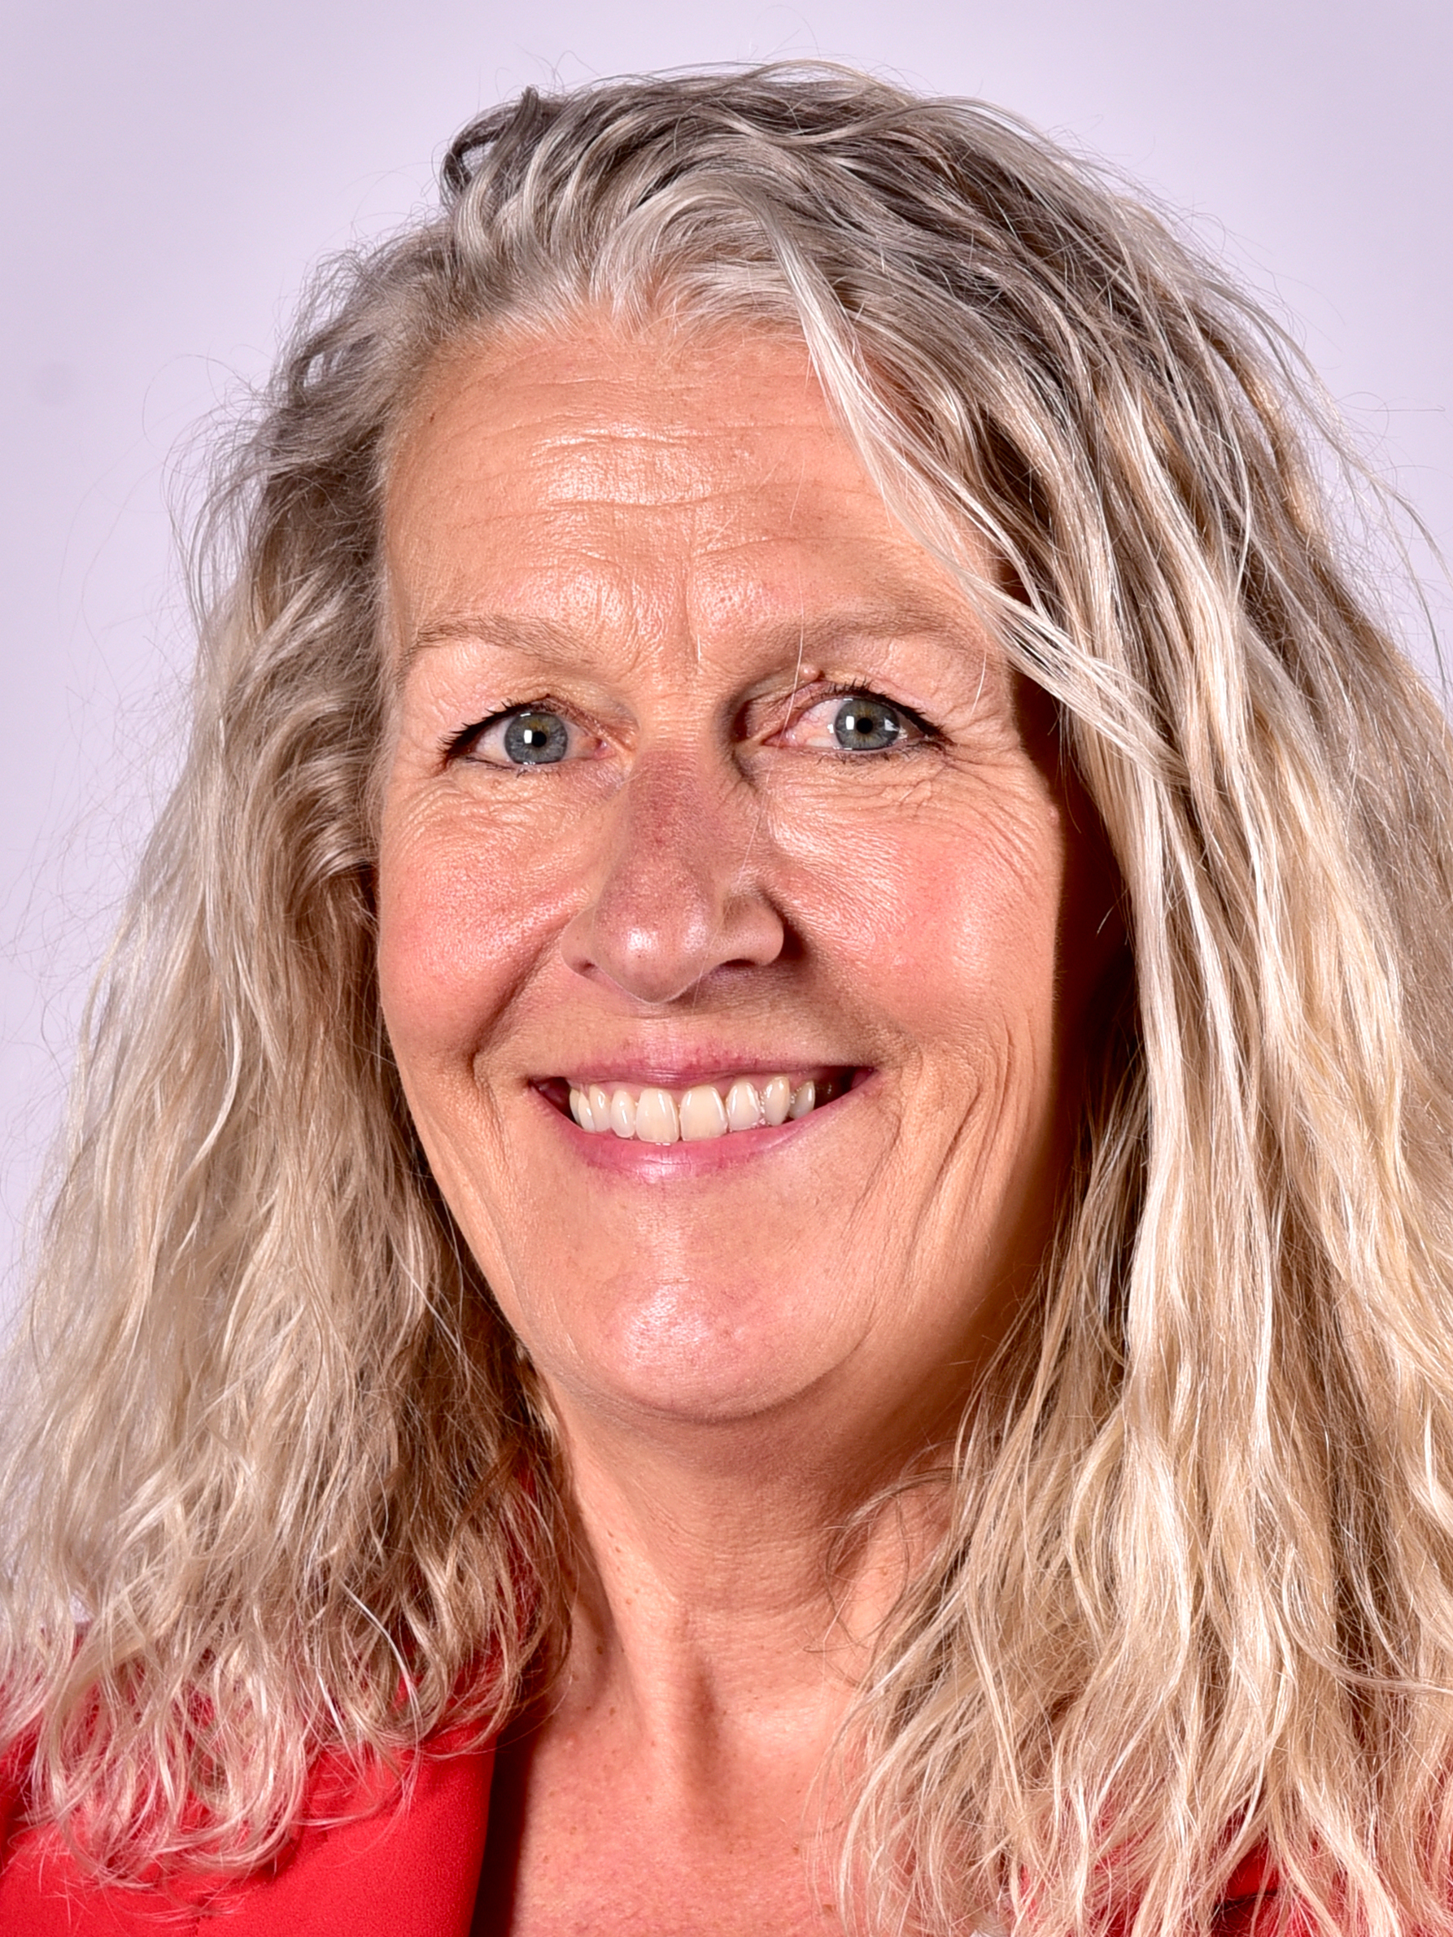
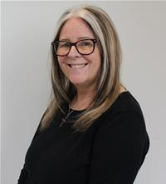
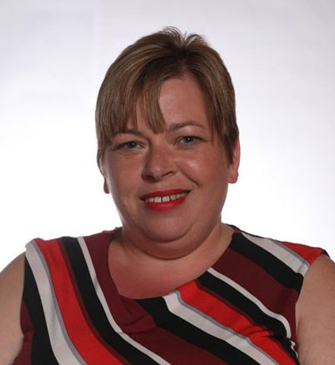
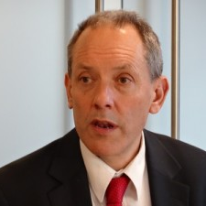
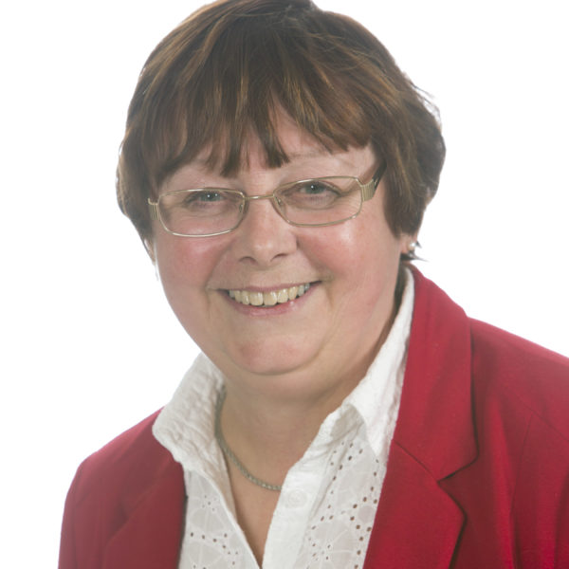
Executive Oversight Committee 2021-22
Cllr Paul Stewart
Cabinet Member
Sunderland City Council
Cllr Shabir Pandor
Leader
Kirklees Council
Cllr Sharon Taylor OBE
Chair of CCIN
Leader, Stevenage Borough Council
Cllr Peter Bradbury
Vice Chair of CCIN Cabinet Member Cardiff Council
Cllr Barbara Brownridge
Cabinet Member
Oldham Council
Cllr Steve Darling
Leader
Torbay Council
Cllr Leanne Feeley
Cabinet Member
Tameside Council
Cllr Louise Gittins
Leader
Cheshire West & Chester Council
Cllr Sue Smith
Cabinet Member
Rochdale MB Council
Cllr Clare Gamble
Chair
Billingham Town Council
Jonathan Bland
Managing Director – Social Business International/E3M
Cllr Joyce McCarty
Newcastle City Council
Chair of V&P – Ex-Officio

Slide 8
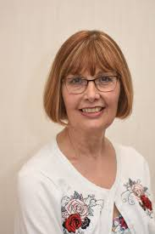
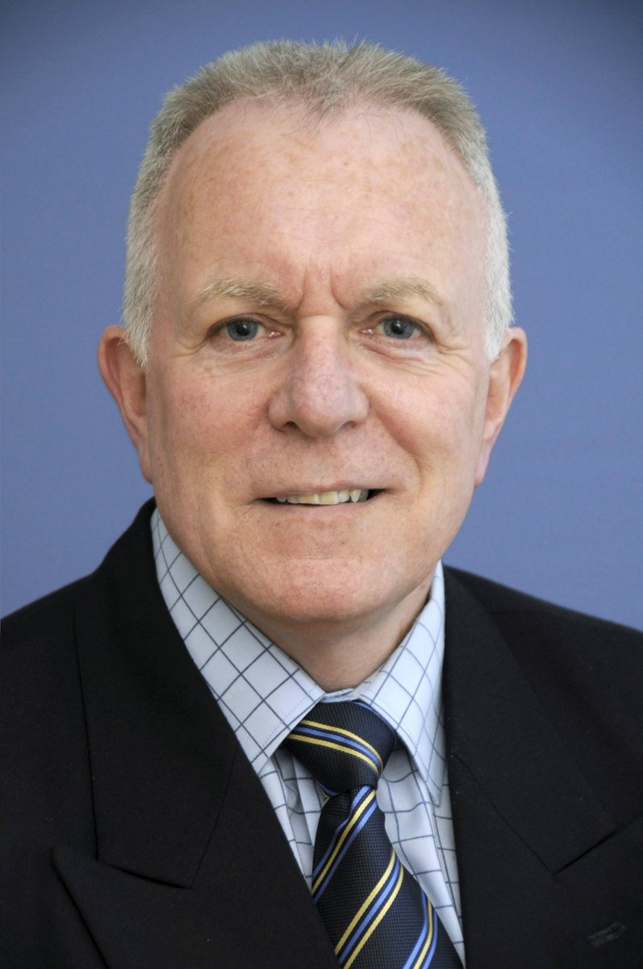
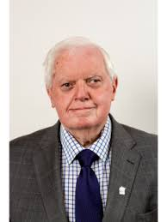

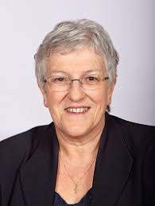

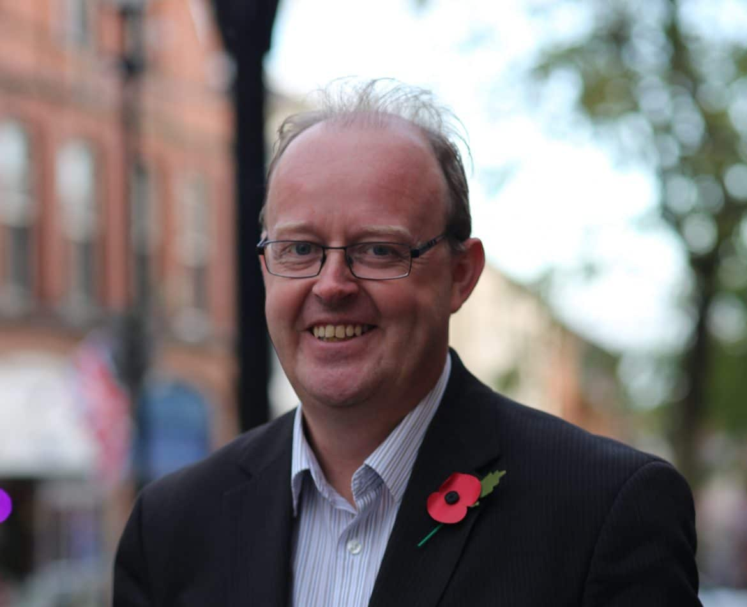
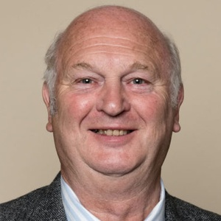
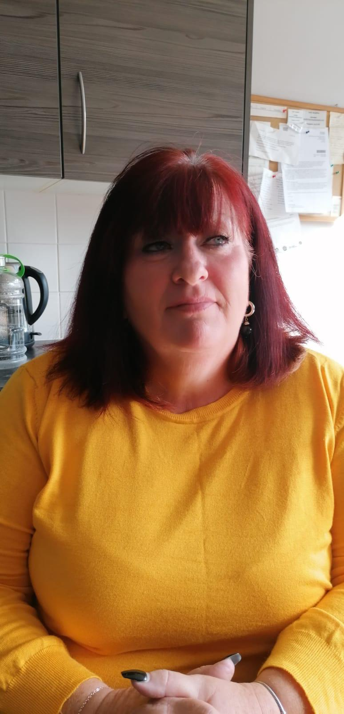
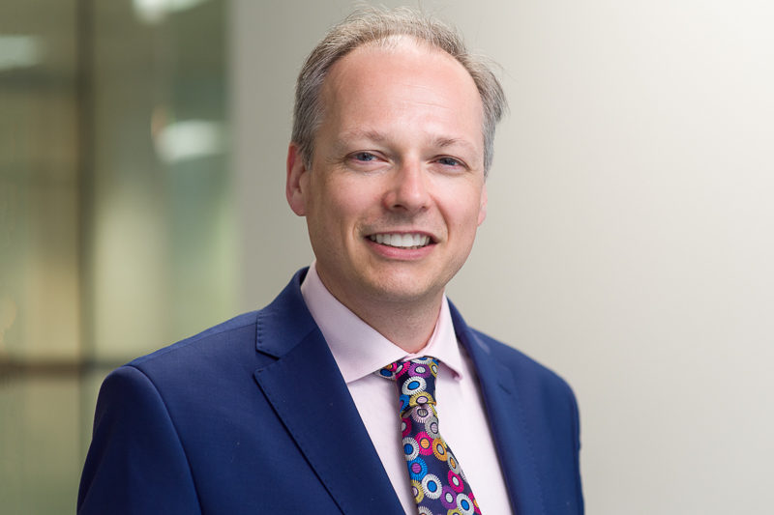

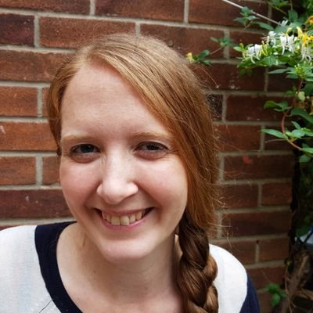
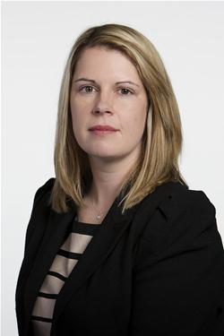
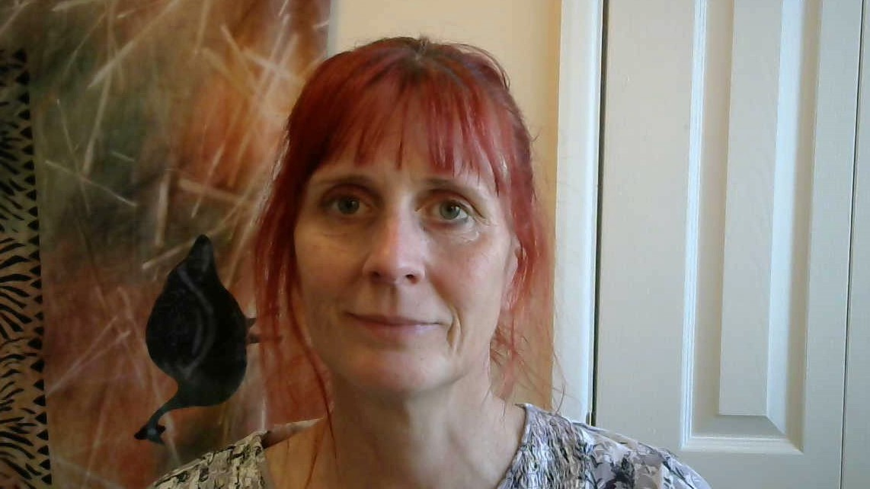
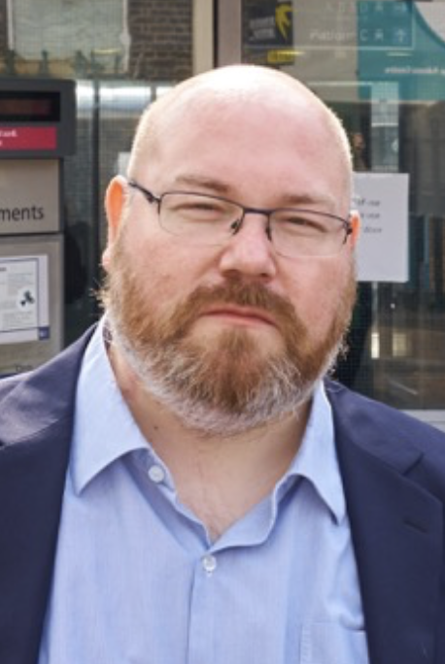
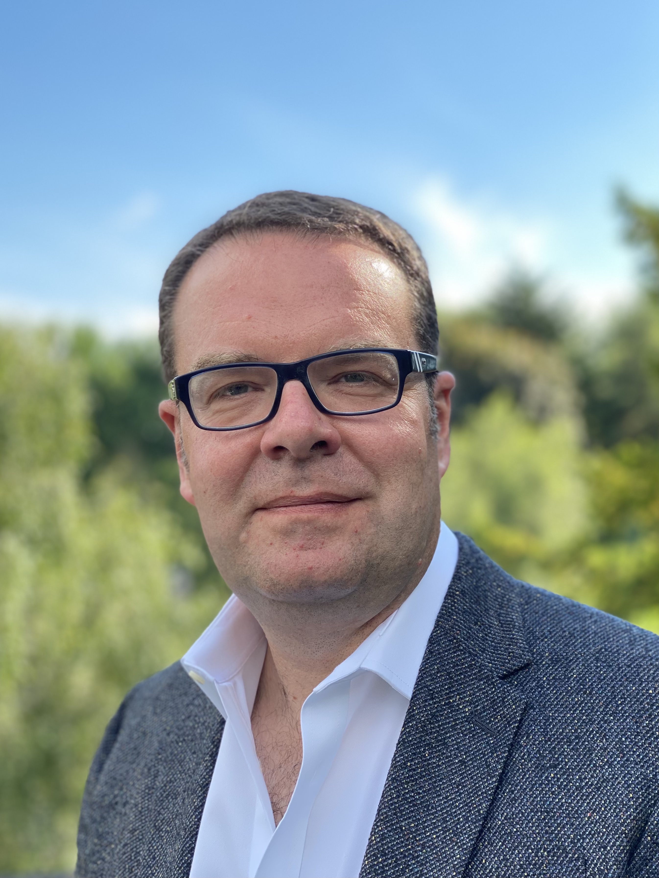

Values & Principles Board 2021 – 2022
Cllr Joyce Welsh South Tyneside Council
Cllr Frank Walsh
Knowsley MB Council
Cllr Joyce McCarty
Chair of V&P Newcastle City Council
Cllr John Fahy Vice Chair of V&P Royal Borough of Greenwich
Cllr Rae Evans Telford & Wrekin Council
Cllr Sue Woodward
Vice Chair of V&P Burntwood Town Council
Cllr Peter Curling Hillingdon Labour & Coop Group
Cllr Michael Stubbs Newcastle-U-Lyme Labour & Coop Group
Cllr Hayden Philips North Warks Labour & Coop Group
Cllr Donna Fuller Woughton Community Council
Gus Della Porta Vice Chair of V&P
Bates Wells
Michael Curnow Peopletoo
Vacancy
Rebecca Harvey
Co-operative News
Neil Calvert
Co-operative College
Cheryl Barrott
Co-operatives UK
Emma Hoddinott
Co-operative Party
Jo White
Co-operative Futures
Paul Bell Unison

Slide 9
94 Members 23 Supporters as at 14 Feb
33
22
39

Slide 10































33 Councils 9m citizens £14.6bn budget

Slide 11
























Slide 12








































Slide 13

Our Values are what we believe in: Co-operatives are based on the values of:
• self-help
• self-responsibility
• democracy
• equality
• equity
• solidarity
In the tradition of their founders, co-operative members believe in the ethical values of honesty, openness, social responsibility and caring for others.
Our Principles guide the way we and our members put our values into action.
The CCIN endorses the principles of the ICA:
• voluntary and open membership
• democratic member control
• member economic participation
• autonomy and independence
• education, training and information
• co-operation among co-operatives
• concern for community
In acknowledging that Councils are not in themselves registered co-operatives, we and our members have developed principles that have grown from those of the International Co-operative Alliance and are relevant within the context of local government.

Slide 14
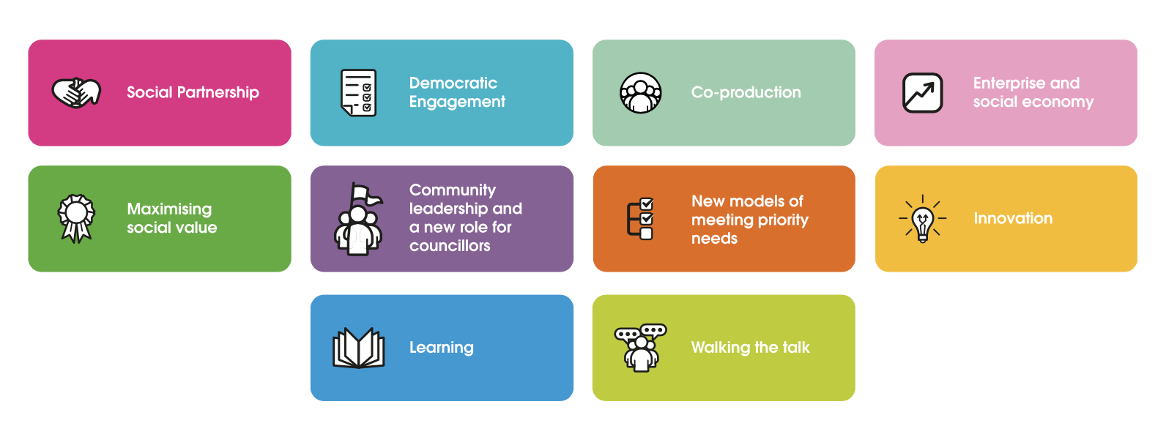


Slide 15
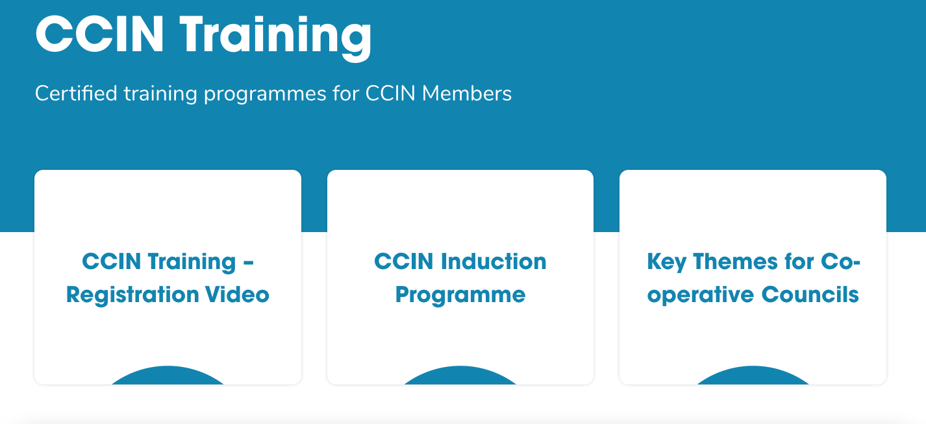
Online Training courses

Slide 16

375 Case Studies
https://bit.ly/2021-case-studies

Slide 17
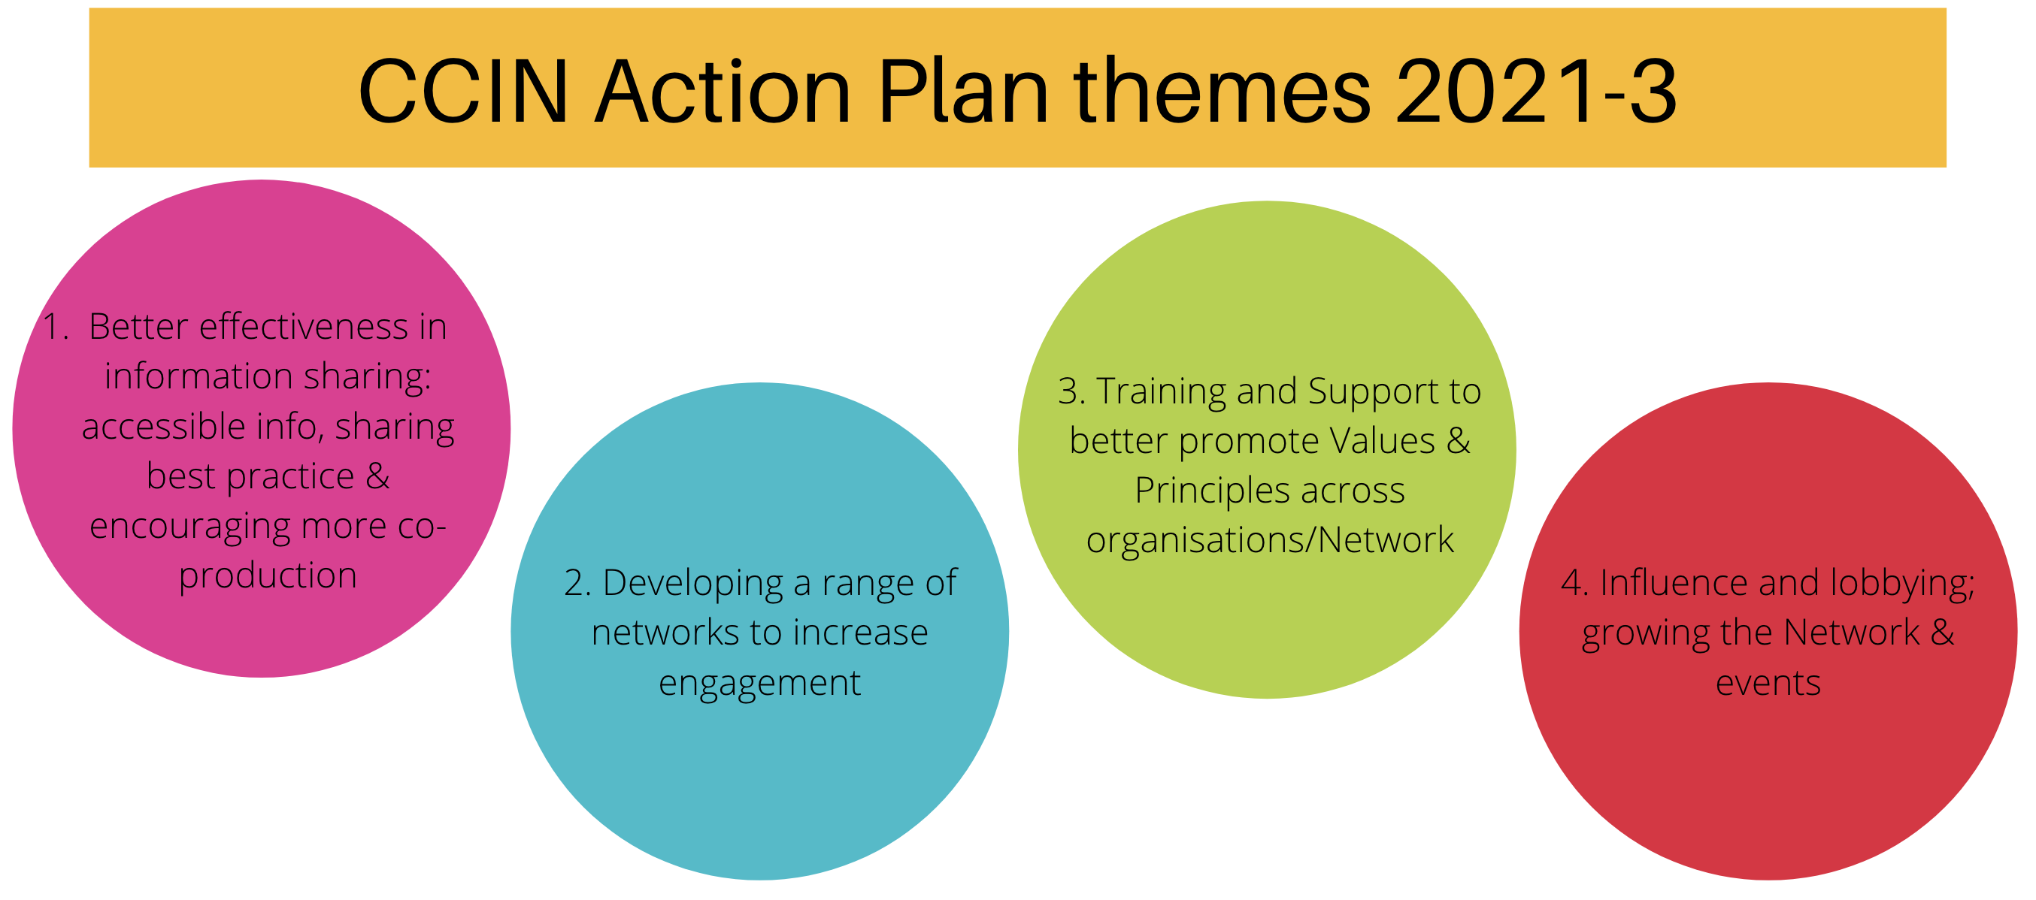
https://www.councils.coop/about-us/governance/strategy-2021-2023/

Slide 18
Dynamic Purchasing System
Allows new suppliers to join at any point
Mini Competition must be undertaken when using the DPS, ensuring the CCIN is promoting industry best practice
As pre-checking has already been done, there are no financial limits on the mini-competition process
5-year contract 2020-2025
Councils often need to move quickly and flexibly to be on the front foot when it comes to ‘doing things differently’.
Sometimes it is necessary to bring in extra capacity and specific expertise to be able to do this, and there can also be a need to seek independent challenge to test assumptions and policy design

Slide 19















DPS Suppliers 2020 - 2025

Slide 20
ITEM 4
Jonathan Downs
Corporate Policy Lead Oldham Council
CCIN Accountable Body
@Downs_Jonathan | @OldhamCouncil

Slide 21
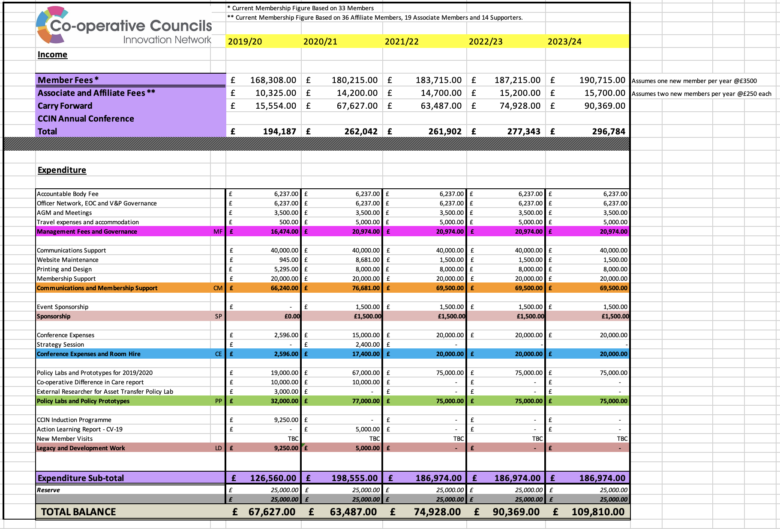
Budget Report 2021/22

Slide 22
ITEM 5
Cllr Joyce McCarty
Cabinet Member for Inclusive Economy Newcastle City Council Chair, CCIN Values & Principles Board
@JoyceMcCarty | @NewcastleCC

Slide 23
Values & Principles Board 2021 – 2022
Cllr Joyce Welsh South Tyneside Council
Cllr Frank Walsh
Knowsley MB Council
Cllr Joyce McCarty
Chair of V&P Newcastle City Council
Cllr John Fahy Vice Chair of V&P Royal Borough of Greenwich
Cllr Rae Evans Telford & Wrekin Council
Cllr Sue Woodward
Vice Chair of V&P Burntwood Town Council
Cllr Peter Curling Hillingdon Labour & Coop Group
Cllr Michael Stubbs Newcastle-U-Lyme Labour & Coop Group
Cllr Hayden Philips North Warks Labour & Coop Group
Cllr Donna Fuller Woughton Community Council
Gus Della Porta Vice Chair of V&P
Bates Wells
Michael Curnow Peopletoo
Vacancy
Rebecca Harvey
Co-operative News
Neil Calvert
Co-operative College
Cheryl Barrott
Co-operatives UK
Emma Hoddinott
Co-operative Party
Jo White
Co-operative Futures
Paul Bell Unison

Slide 24
Policy Lab projects 2021
Understanding the Digital Divide – Cheshire West & Chester Council
Green Recovery, Carbon Reduction and Climate Change – Kirklees Council
Supporting co-operatives in areas of deprivation – Oxford City Council
Tackling the Barriers to Building a Co-op Economy – Oldham Council / GMCA
Community Economic Development Plans as a tool for fostering co-op working between councils & the community – Birmingham City Council
Development of an accredited CCIN online training programme – Co-operative College

Slide 25
Policy Prototype projects 2021
4-week summer holiday activity programme – Billingham Town Council
To implement a new model of Early Year help in Torbay – Torbay Council
One Stop Shop to deal with mental health issues – South Ribble Borough Council
SafeSpace – Preston City Council
Youth Development – Hard to Reach Groups – Preston City Council
Development of a Social Return on Investment Tool – Woughton Community Council

Slide 26

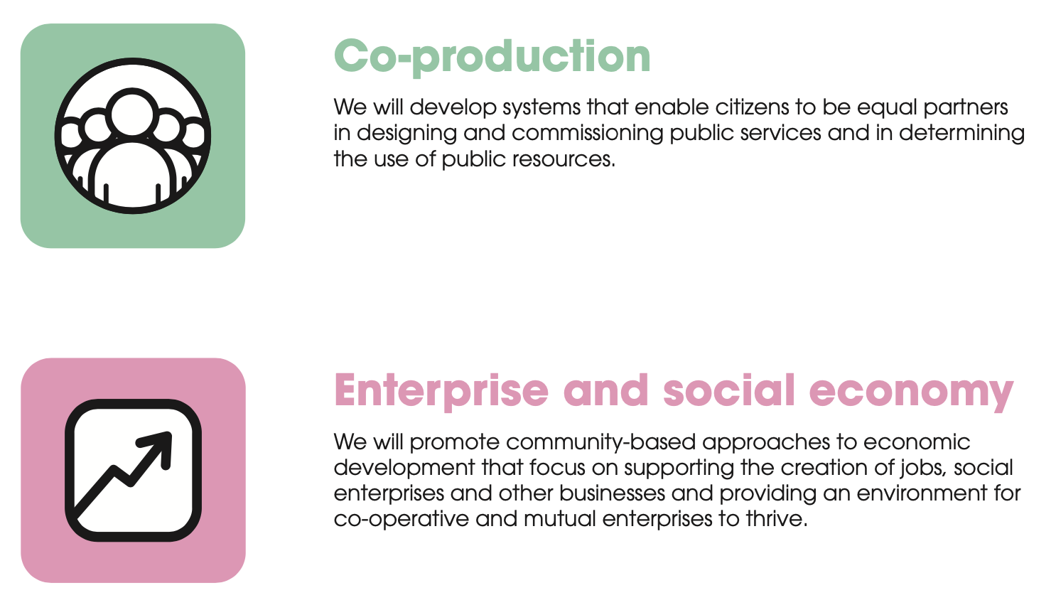

Slide 27
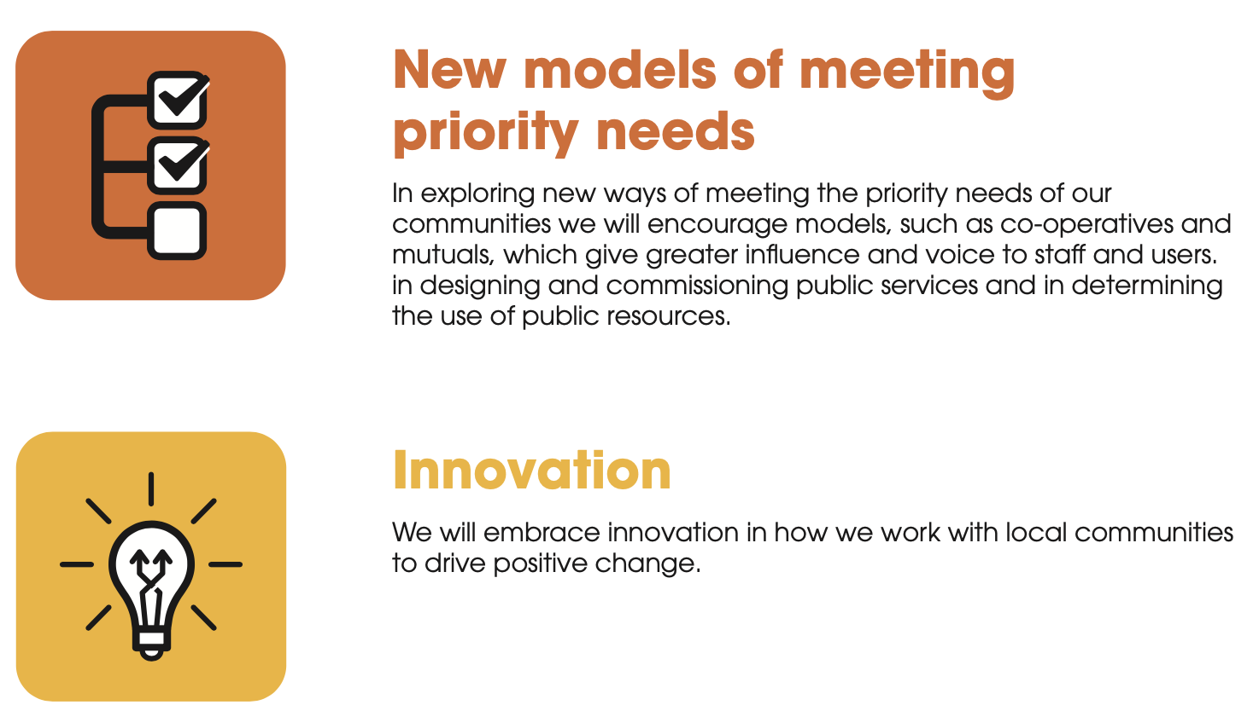


Slide 28
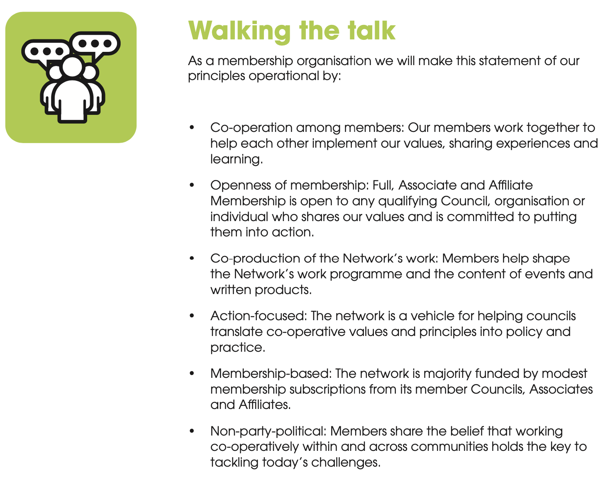


Slide 29
Revised Constitution
ITEM 6

Slide 30
ITEM 7
Cllr Louise Gittins
Leader of Cheshire West & Chester Council Member of the CCIN Executive Oversight Committee
@Weezegee | @Go_CheshireWest

Slide 31
CCIN Policy Lab & Prototype funded projects
Member led projects to find co-operative policy solutions to the challenges facing local government. Open to all ideas, the more innovative the better!
Policy Labs - more significant collaborative pieces of work that CCIN members work on together and eligible for £10,000 to £20,000 of funding.
Policy Prototypes - smaller projects delivered in a locality on behalf of the Network and eligible for up to £2,000 of funding.

Slide 32
Key points of 2022 process
Policy Labs –
£60k total budget
12 months to deliver
funding supports research, collaboration and implementation of co-operative initiatives that involve multiple Network members
Policy Prototypes –
£15k total budget
9 months to deliver
smaller projects that members may want to deliver in their locality on behalf of the Network

Slide 33

Draft Themes for Policy Labs and Prototypes 2022

Slide 34
1. Covid-19 Recovery
Covid-19 Recovery
Though Covid-19 Recovery was a thematic area in 2021, this is still a topic that all local authorities are wrestling with.
We would like to fund projects that involve local communities in co-designing co-operative initiatives that would help our members and their communities to recover from the impacts of the pandemic.

Slide 35
2. Sharing Data with 3rd Sector Organisations
Following the pandemic, many local authorities are thinking about how they can better support their local VCSFE sector, including through the development of investment strategies.
However, key to this approach is how we work with the VCFSE sector, for example, through sharing data and intelligence about local communities.
We would like to fund projects that aim to promote greater collaboration between local authorities and the VCFSE sector, with models of co-operation that can be replicated across the Network.

Slide 36
3. Tackling Inequality
Many CCIN councils represent areas and communities suffering with high levels of inequality and deprivation (9 of the top 30 councils listed in the Multiple Indices of Deprivation are CCIN members).
We would like to fund projects that aim to develop partnership projects to tackle poverty and inequality, helping our members to build back fairer from the pandemic.

Slide 37
4. Engaging Communities in Local Democracy
As Co-operative Councils’, we are committed to finding new ways of engaging our communities in the democratic process.
We would like to fund projects that help develop inclusive models of engagement, especially focusing on groups who are traditionally disengaged from local democracy.

Slide 38
5. Co-operative Approaches to Levelling-up
The levelling-up agenda is gaining momentum across the country, with many local authorities considering how they can access funding to support their town centres, create jobs, and grow their local economies.
We would like to fund projects that take a co-operative approach to levelling-up, considering how we can encourage good economic growth, that benefits everyone in our communities.

Slide 39
6. Your ideas

Slide 40
Timetable for this funding round
Date
16 Feb | Launch
1 April | Submission of Project ideas
2 May | Confirm partners for Policy Labs
1 June | Closing date for submission of EOI for Policy Labs & Prototypes
June | EOC consider EOIs/Bids
June | Follow-up questions
1 July | Contract awarded/work starts

Slide 41
Any Other Business
ITEM 8

Slide 42

Thank you

