Slide 1

Welcome Conference starts at 1000
Wi-Fi Code is TICUK

Slide 2
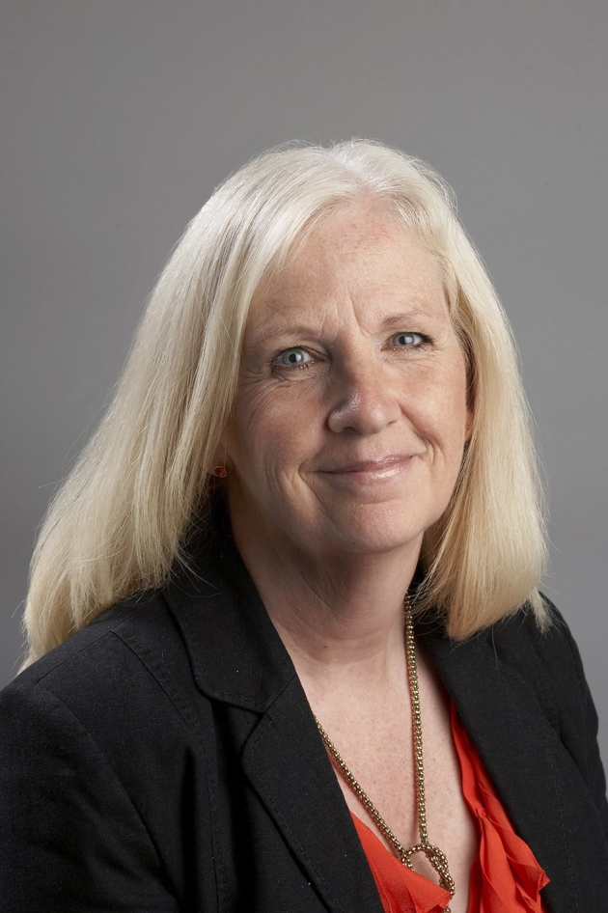
Baroness Taylor of Stevenage
Chair of CCIN
Leader of Stevenage Borough Council
@SharonStevenage

Slide 3
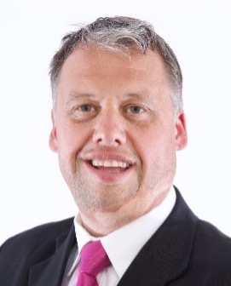
Cllr Richard Overton
Deputy Leader of the Council & Cabinet Member for Housing, Enforcement and Transport
@TelfordWrekin

Slide 4
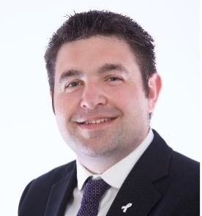
Cllr Shaun Davies
Leader of the Council
@CllrShaunDavies | @TelfordWrekin
Welcome to Telford

Slide 6
Baroness Taylor of Stevenage
Chair of CCIN
Leader of Stevenage Borough Council
@SharonStevenage

Slide 7
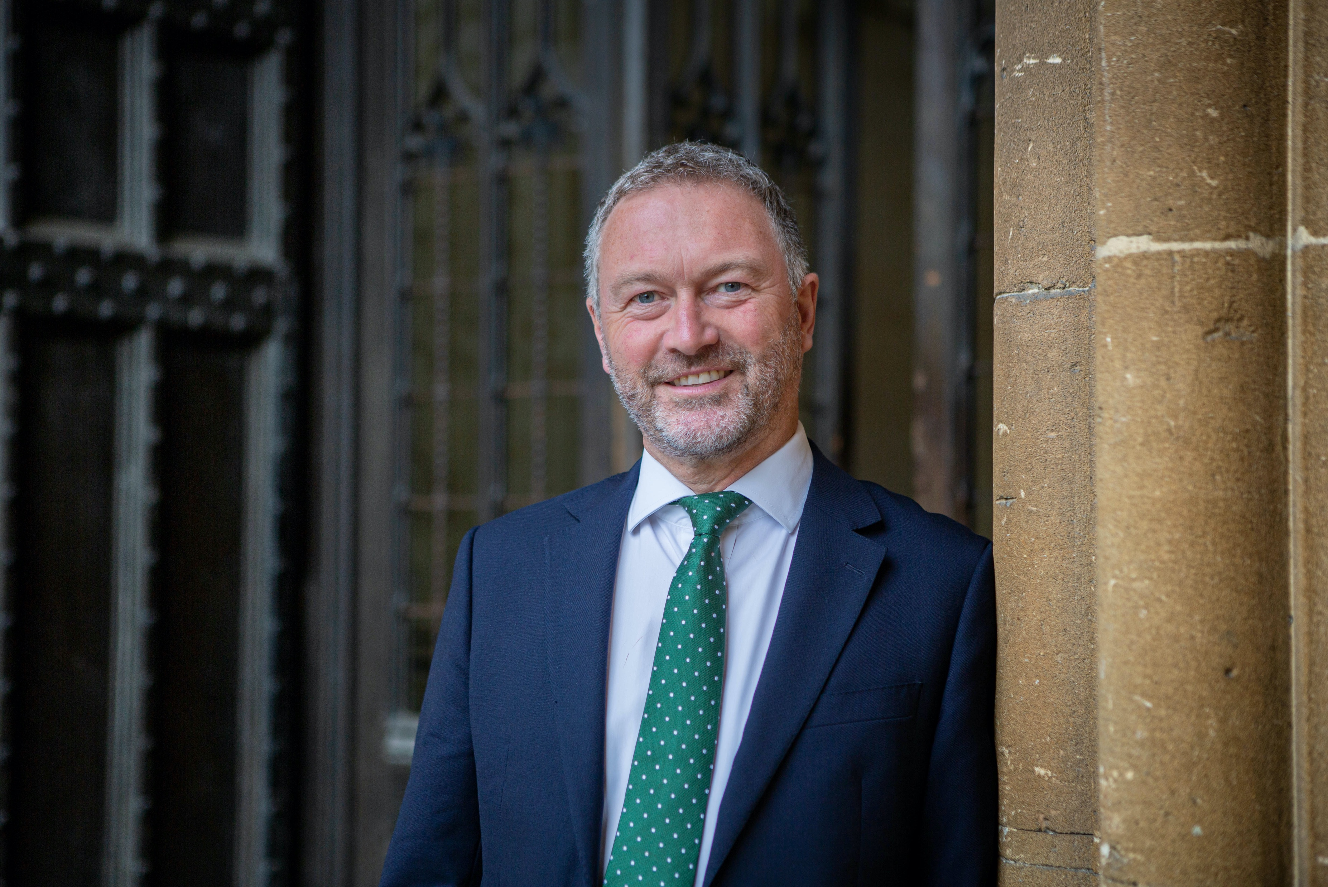


Steve Reed OBE, MP
Shadow Secretary of State for Justice
Vice President of the CCIN
@SteveReed
CoopInnovation
#CCIN2022

Slide 8
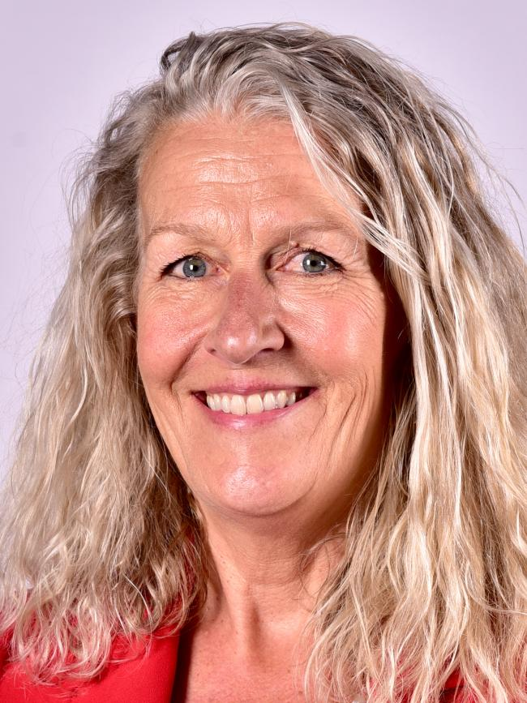
Councillor Louise Gittins
Leader, Cheshire West & Chester Council
Executive Oversight Committee Member, CCIN
@Weezegee | @Go_cheshirewest

Slide 9
Q & A
Please raise your hand & we’ll bring you a mic

Slide 10
Plenary 1
Cooperative Economies in Action

Slide 11
Baroness Taylor of Stevenage
Chair of CCIN
Leader of Stevenage Borough Council
@SharonStevenage

Slide 12
Speakers:
Cllr Paul Foster – Leader, South Ribble Borough Council
Mark Hooper – Project Lead, Banc Cambria
Derek Walker – CEO, Cwmpas
Rose Marley – CEO, Co-operatives UK
Cllr Shabir Pandor – Leader, Kirklees Council
Cllr Lee Carter – Cabinet Member for Neighbourhood Services, Regeneration & the High Street, Telford & Wrekin Council

Slide 13
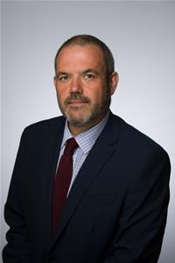
Councillor Paul Foster
Leader, South Ribble Council
@SRLabourLeader | @SouthRibbleBC
Lessons from Mondragon –
Building a Coop Economy in the UK
CoopInnovation
#CCIN2022

Slide 14
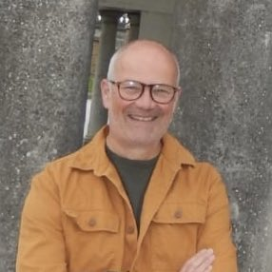
Mark Hooper
Project Lead, Banc Cambria
@markjhooper | @banccambria
Community Bank for Wales
CoopInnovation
#CCIN2022

Slide 15


Slide 16
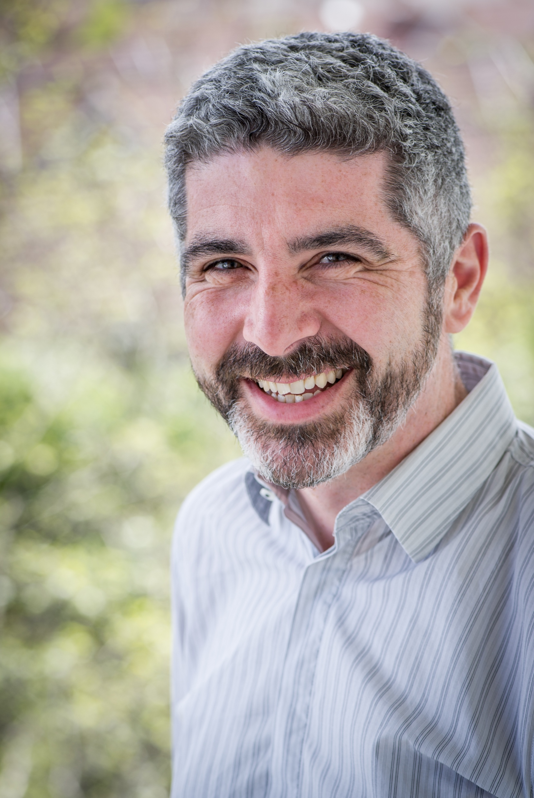
Derek Walker
CEO, Cwmpas
@derekwalker_ | @Cwmpas_coop
Community-Led Housing
Communities Creating Homes
CoopInnovation
#CCIN2022

Slide 17


Slide 18
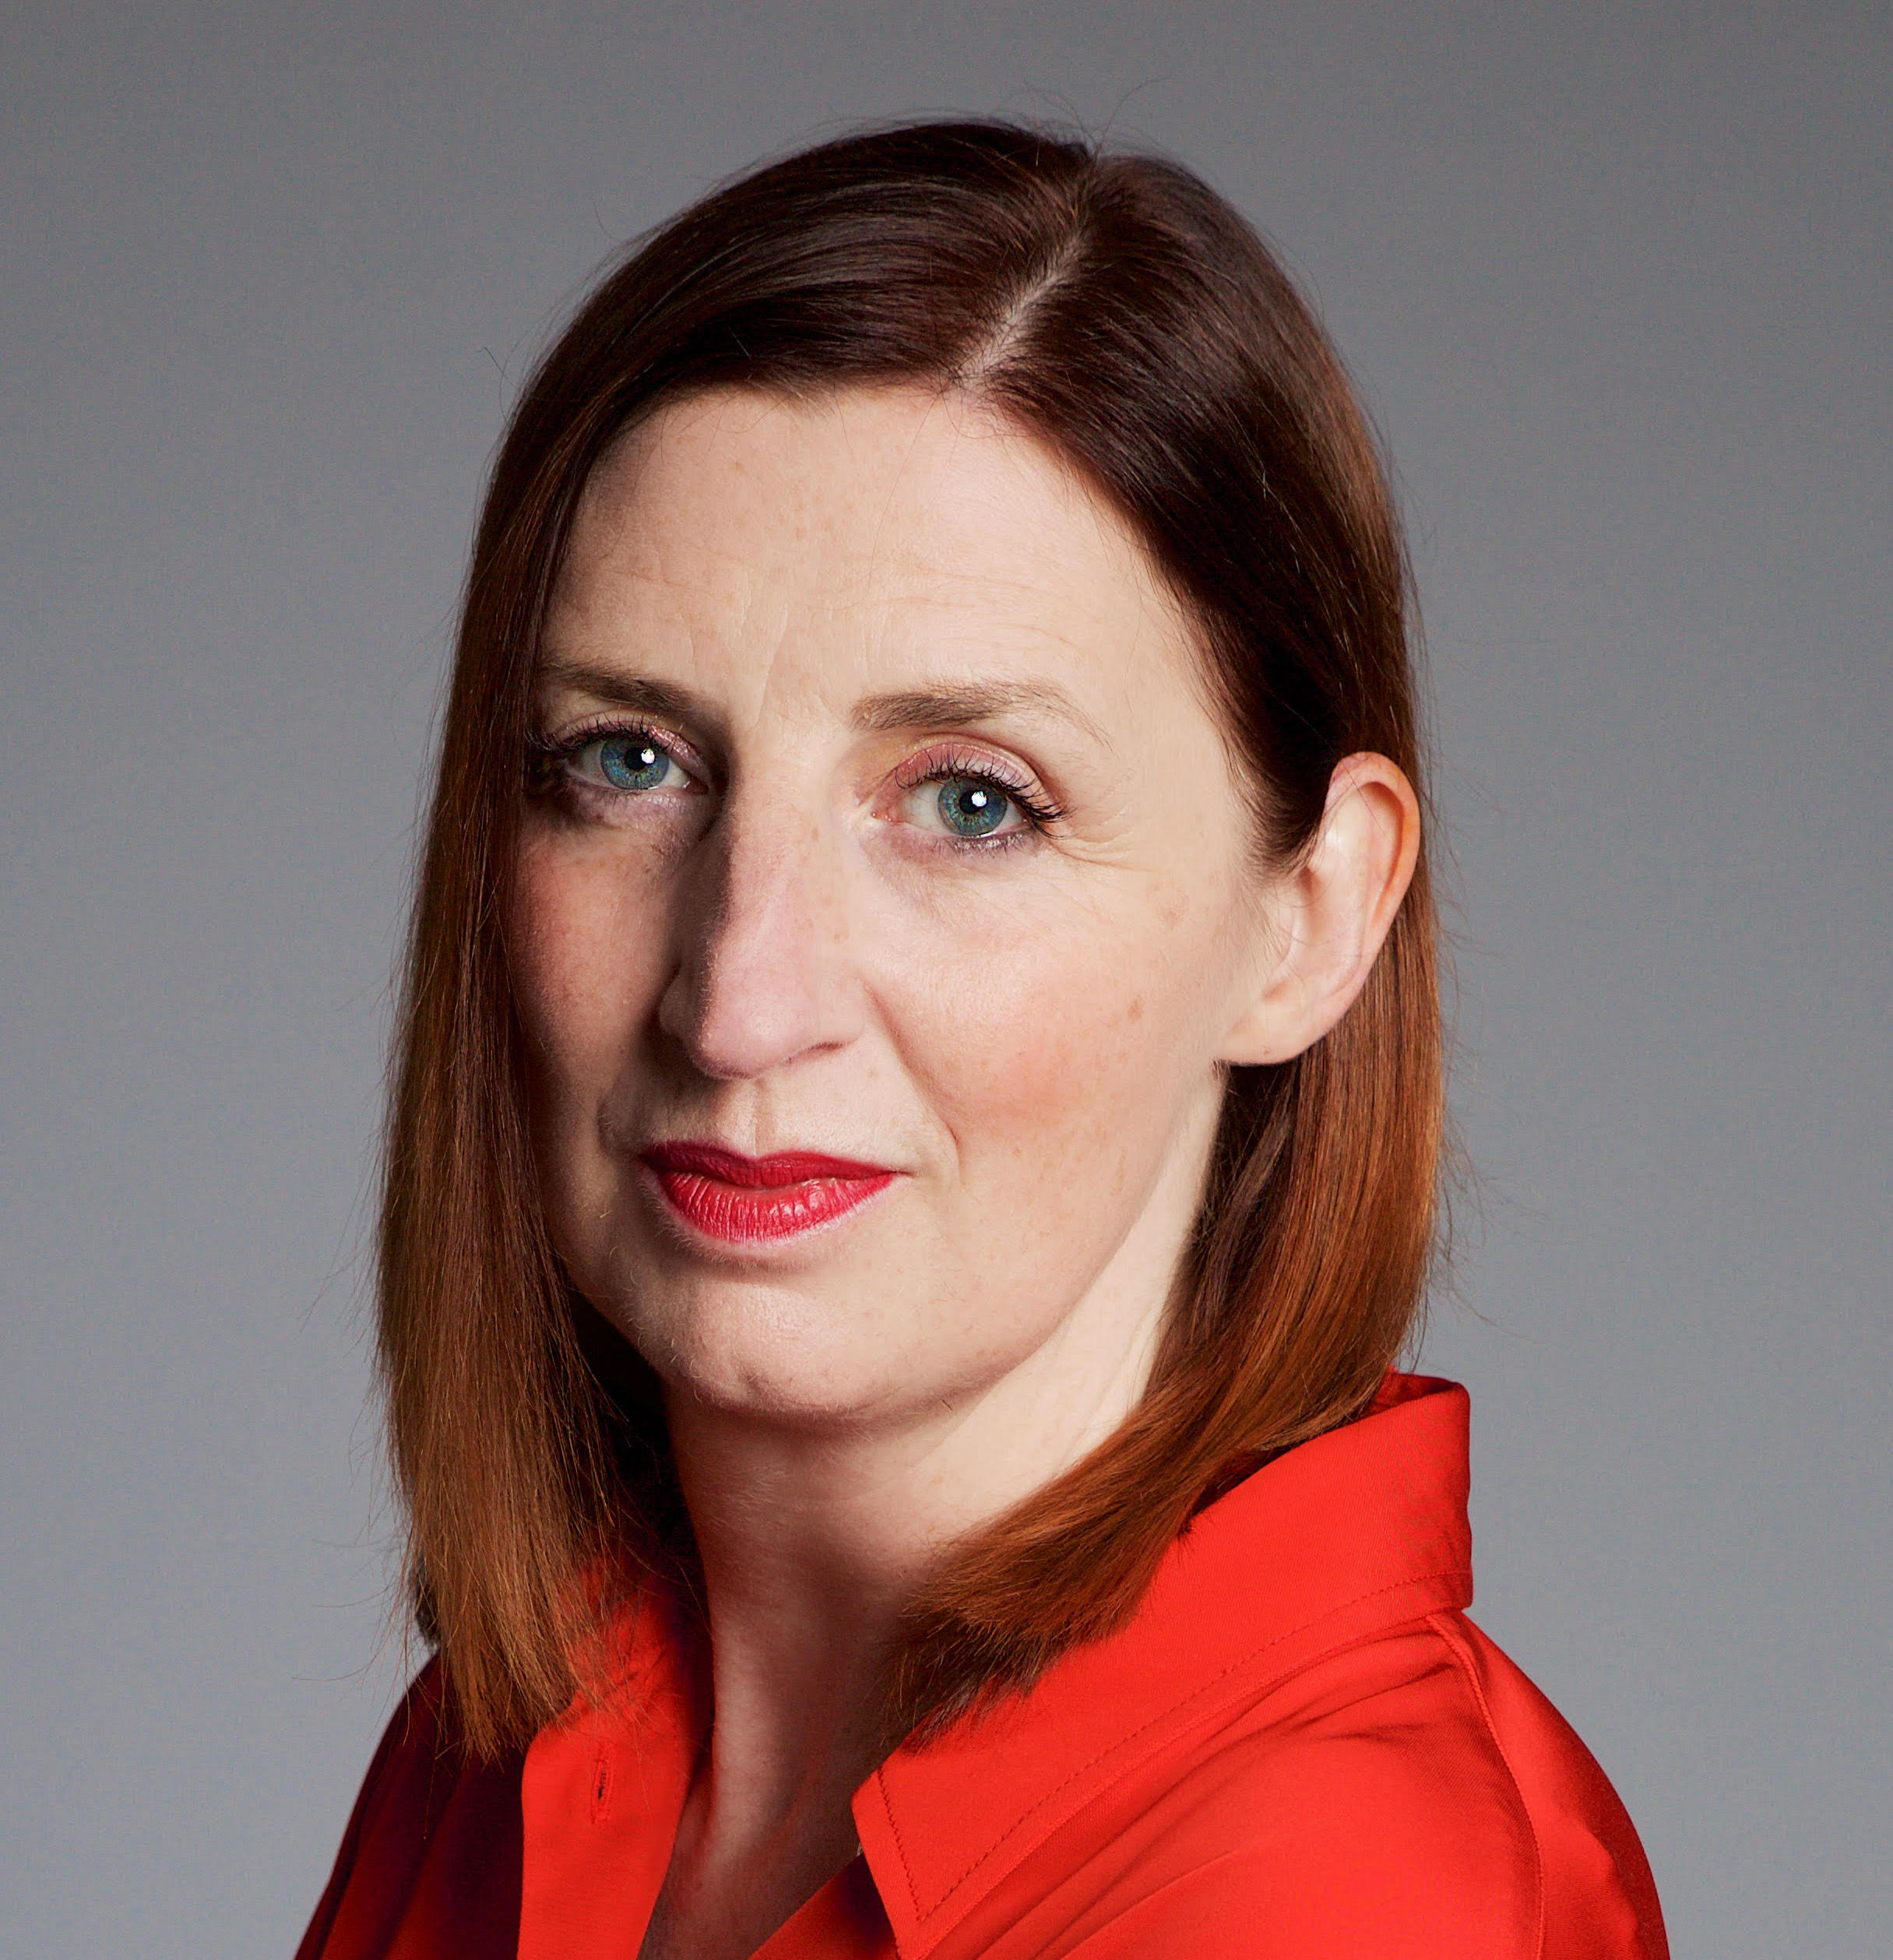
Rose Marley
CEO, Co-operatives UK
@rosemarley1 | @CooperativesUK
Cooperative Development Opportunities in the UK
CoopInnovation
#CCIN2022

Slide 19


Slide 20
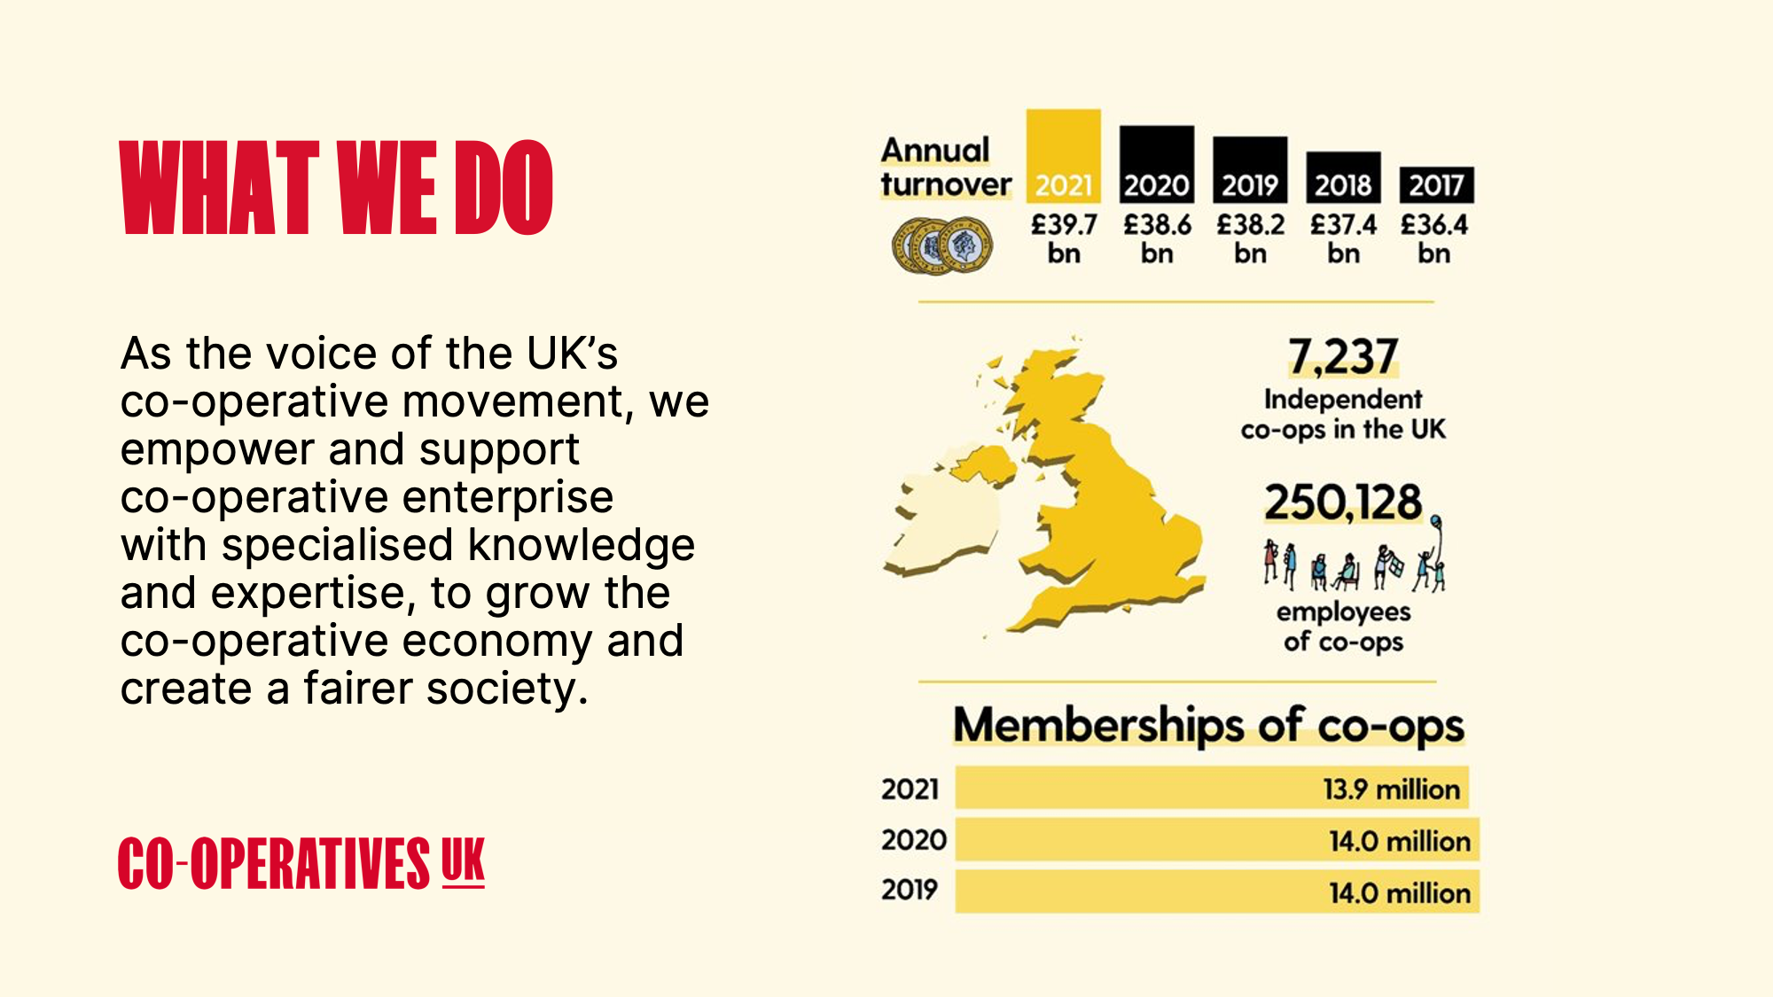

Slide 21
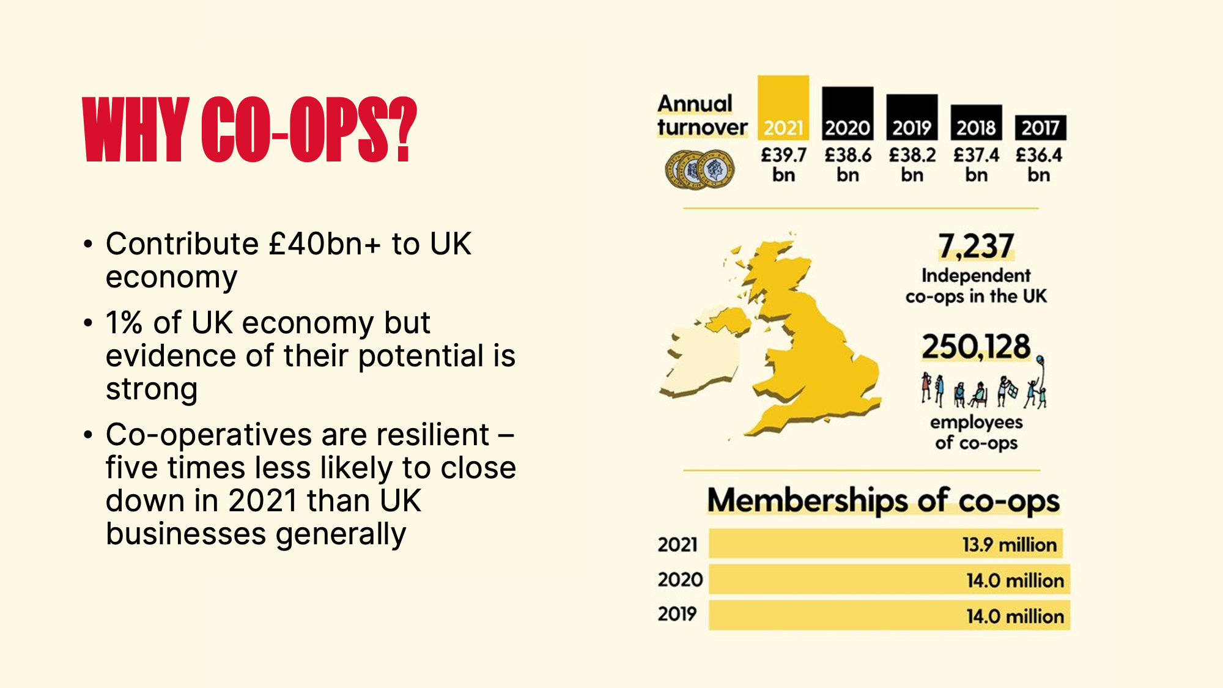
Notes:
CUK OVERVIEW:
950 members and the voice for a network of 7000+ co-ops
Expert advice
Co-op development and business support programmes
Policy
Innovation
NEXT SLIDE: WHY CO-OPS – £40bn and resilience stats

Slide 22
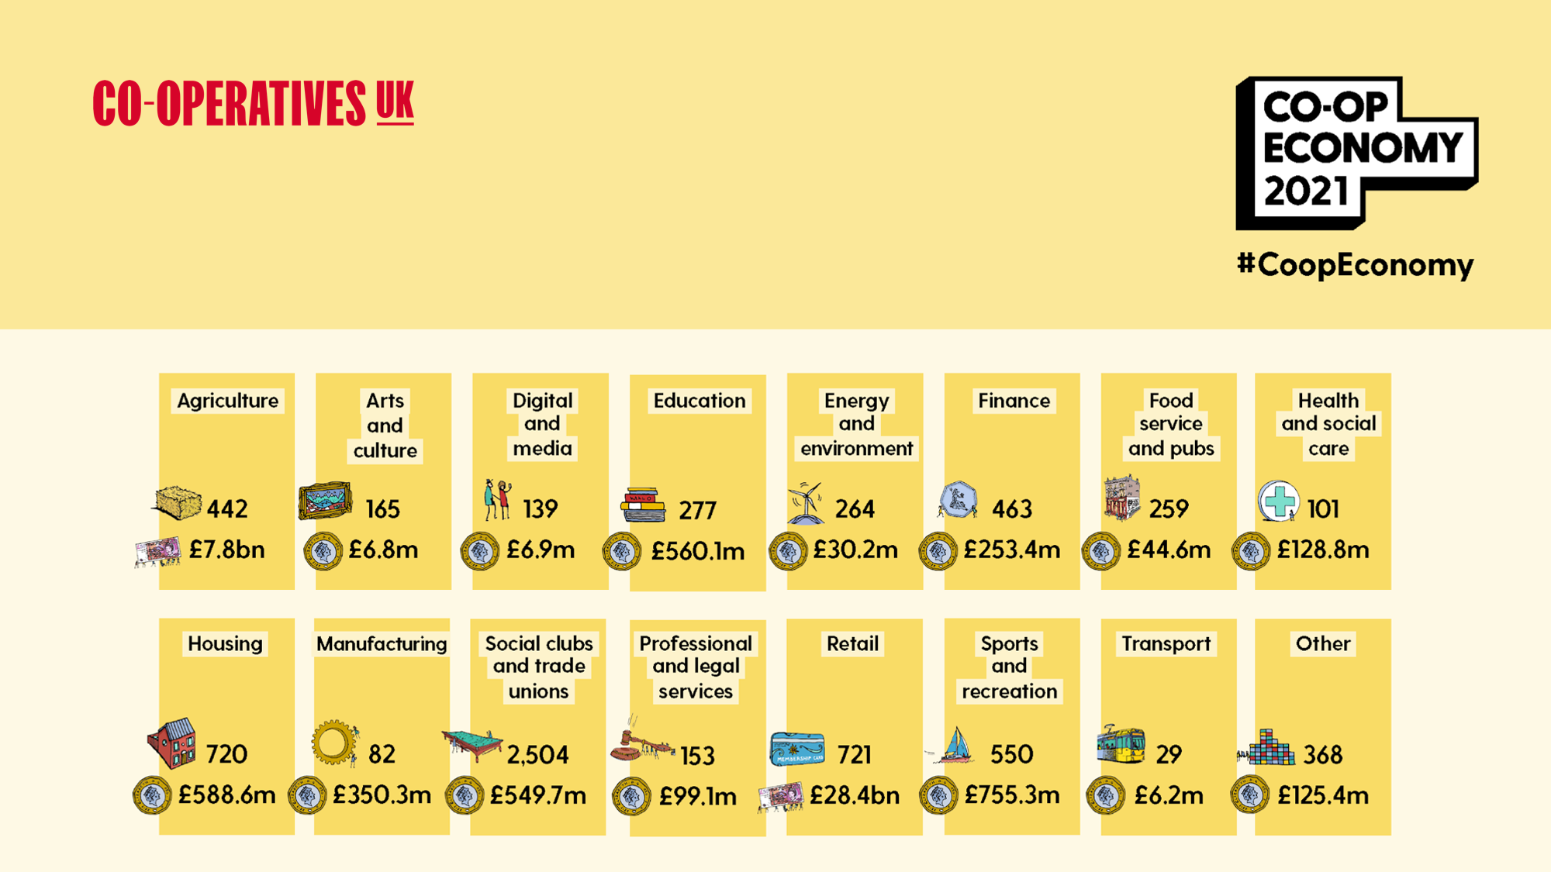

Slide 23
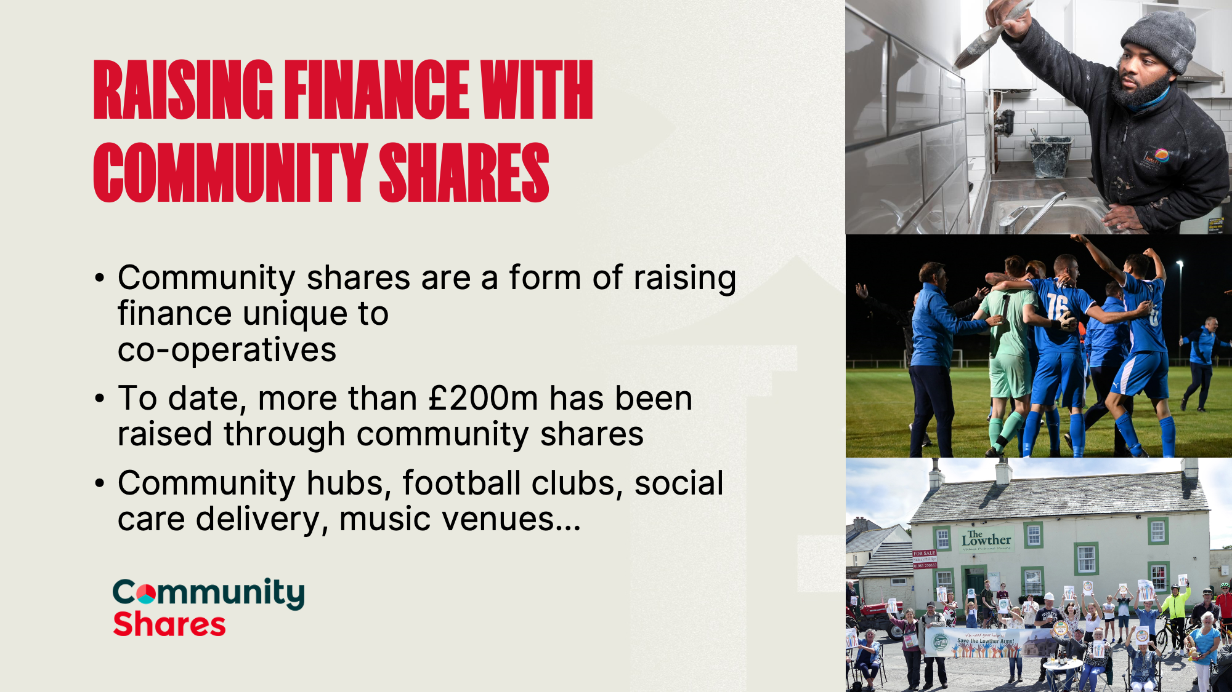
Notes:
LATCH (Leeds Action to Create Homes) is turning derelict houses into homes and transforming lives.
The properties provide supported housing for people who are homeless or in housing need and are ready to make a positive change in their lives – and they’re safe to live there until they’re ready to move on, making space for new people who are in need.
Renovation work is done by Latch staff and volunteers. Some have building trade experience already, while others learn new skills as they work on site.
Wythenshawe AFC
The fan owned club has raised almost £100,000 to support its clubhouse extension, junior pitch drainage, car park improvements and other infrastructure developments at its Hollyhedge Community Stadium.
Lowther Arms, Cumbria
Local people from a Cumbrian parish raised the funds to keep their local pub going – and preserve a cherished focal point for their community.

Slide 24
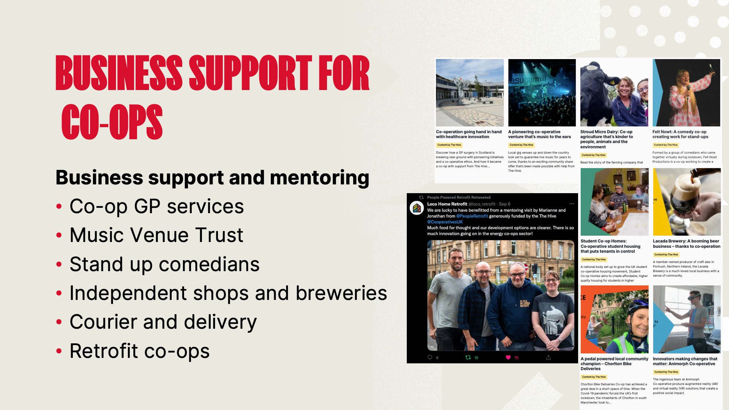
Notes:
All BANK FUNDED through current Hive programme
BLACK IMAGE: Tweet about peer mentoring between People Powered Retrofit (Manchester) and Loco Home Retrofit (Glasgow) funded through The Hive.
Whitfield Surgery GP, Dundee: When the lead GP retired at the Whitfield Surgery in Dundee, the local health board took over and kept it going using locum and salaried doctors. It wasn’t the ideal way to run a healthcare service. It’s now breaking new ground with pioneering initiatives and a co-operative ethos.
MUSIC VENUE TRUST: Local gig venues up and down the country look set to guarantee live music for years to come, thanks to an exciting community share offer that’s been made possible with help from The Hive.
FELT NOWT COMEDY: Formed by a group of comedians who came together virtually during lockdown, Felt Nowt Productions is a co-op working to create a thriving comedy scene in the North East of England.
LACADA BREWERT: A member-owned producer of craft ales in Portrush, Northern Ireland, the Lacada Brewery is a much-loved local business with a sense of community.

Slide 25

Notes:
Platform co-ops are emerging in sectors where providers and receivers of services are feeling let down by current public or private services. Often in platform co-ops both the workers and the receivers of a service are members of the co-op (multistakeholder co-ops). As a result, the business and the platform is built for and by the all the stakeholders.
We are running another tech accelerator for emerging digital businesses in 2023, It’s a 10 week accelerator giving people setting up a new platform all the tools they need to set up and launch in the best way. Applications will be open by the new year.

Slide 26
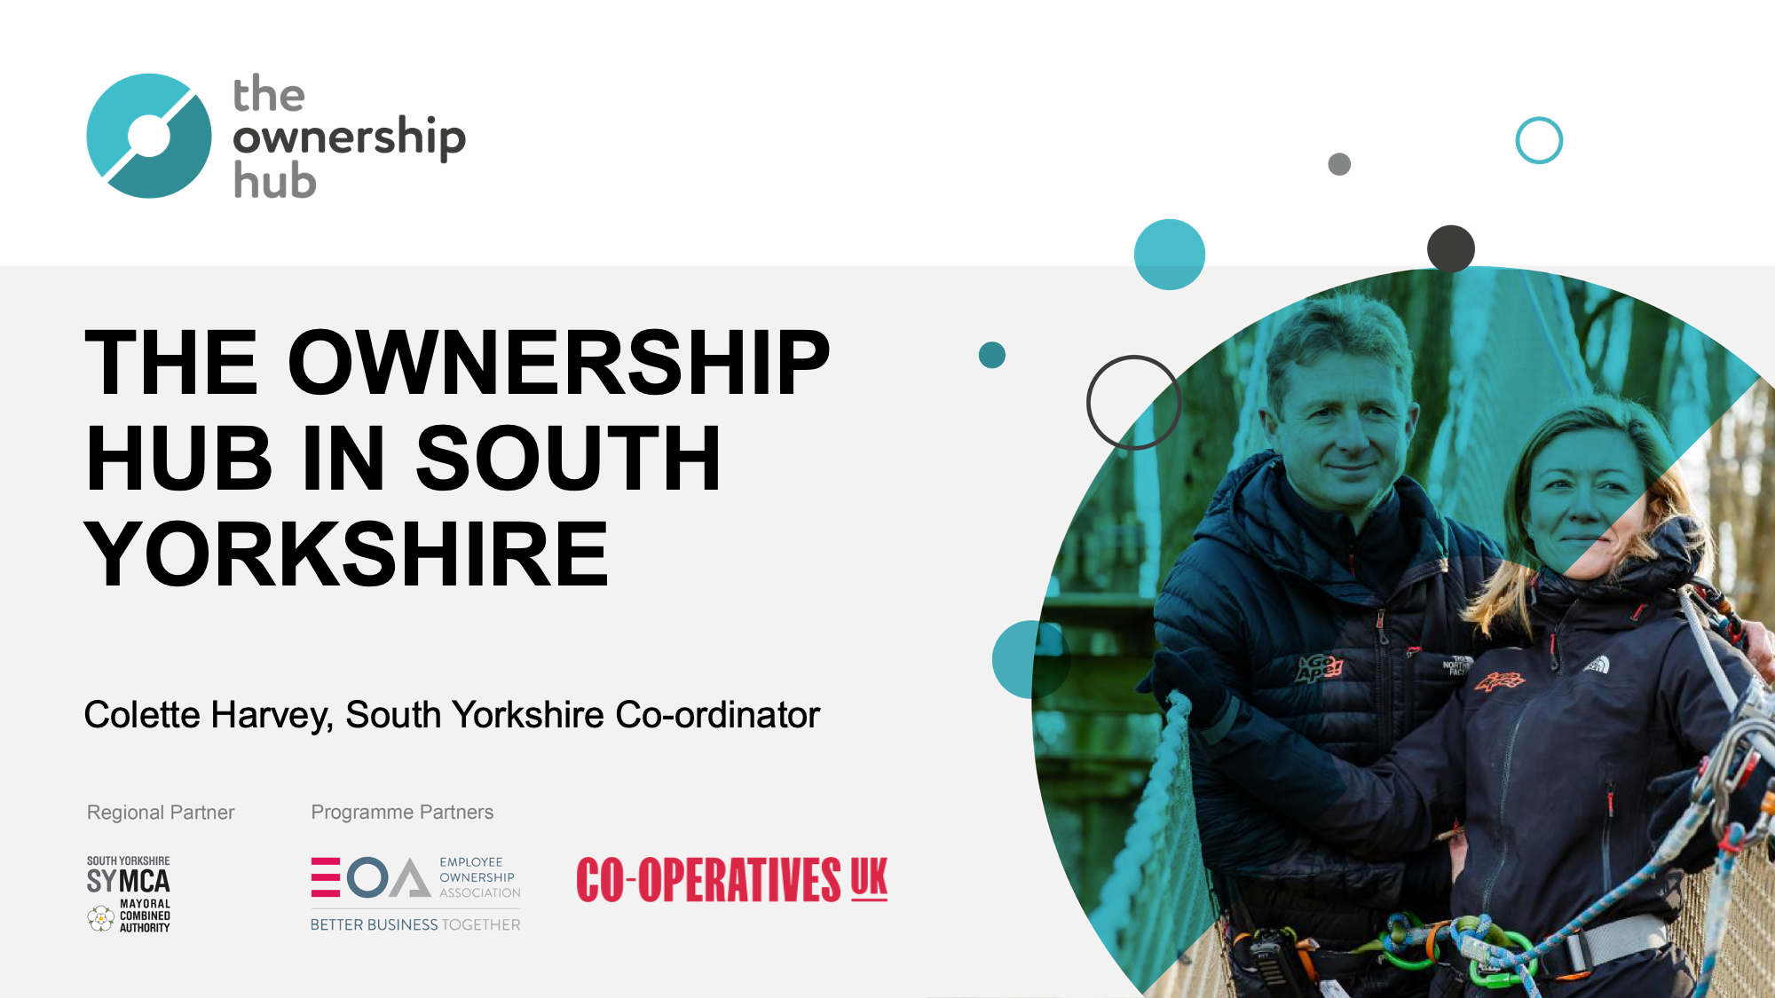

Slide 27
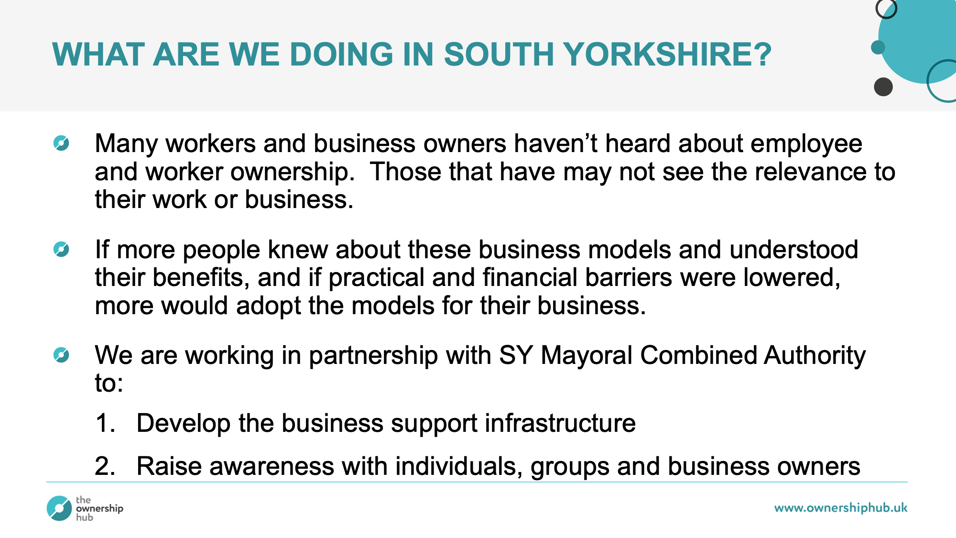
Notes:
SYMCA are interested in the OH from a CWB perspective, as a way of keeping business ownership and profits local.
We’re working in SY to do 2 main activities:
Raising awareness of employee and worker ownership with entrepreneurs and business owners
Developing the business support infrastructure so that local advisors and support programmes understand and are able to assist both worker coops and EOBs, and know where to signpost people to more specialist sources of support

Slide 28
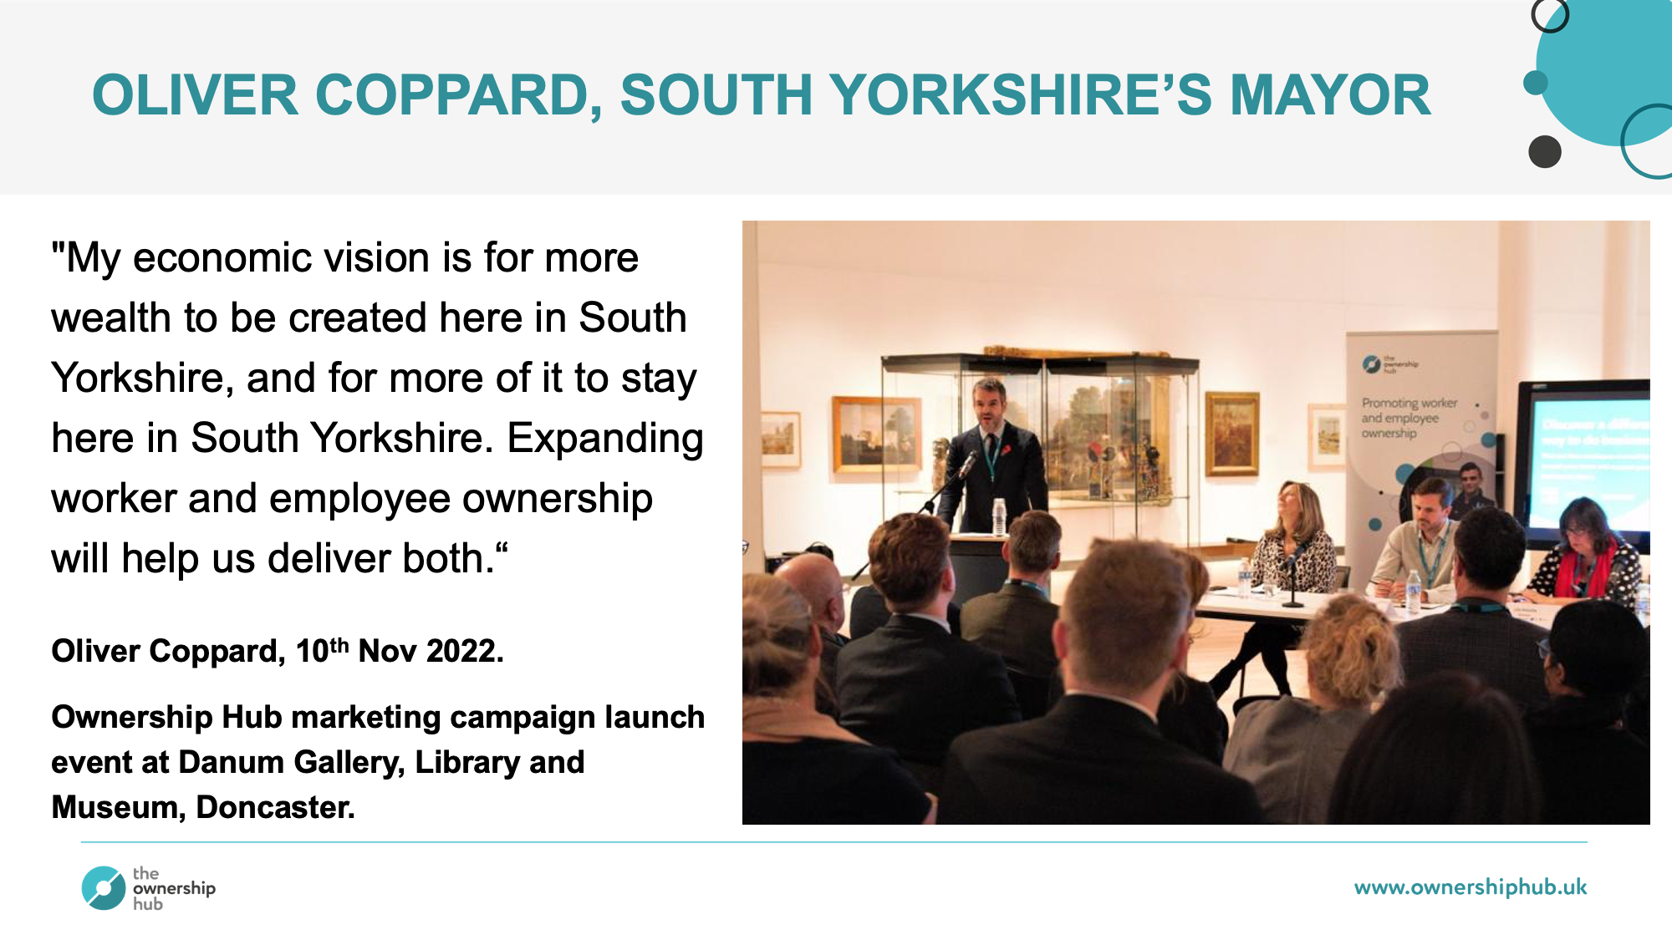

Slide 29
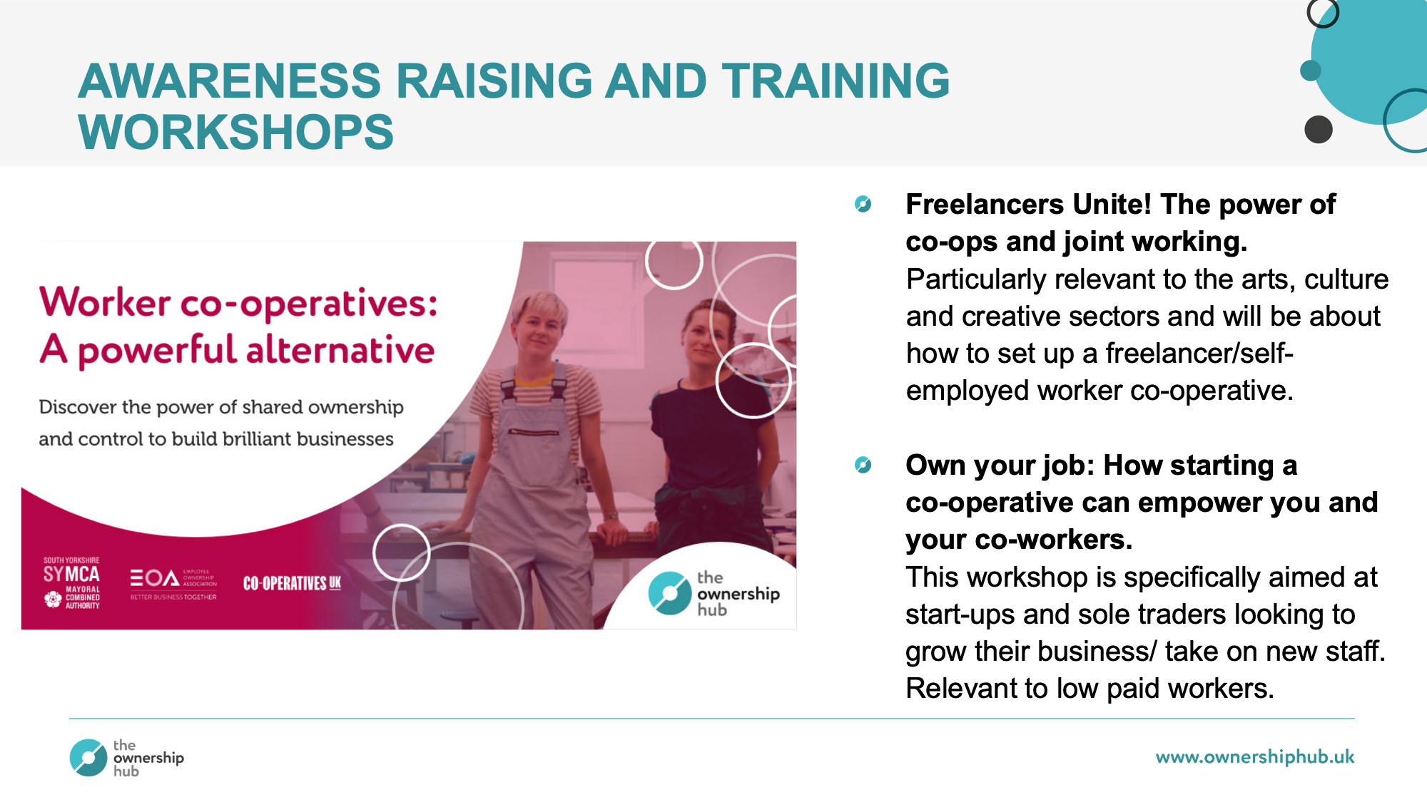

Slide 30


Slide 31
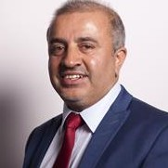
Cllr Shabir Pandor
Leader, Kirklees Council
Executive Oversight Committee Member, CCIN
@cllrSPandor | @KirkleesCouncil
The Kirklees Approach to developing a Cooperative Economy
CoopInnovation
#CCIN2022

Slide 32
Growing an Inclusive Economy in Kirklees
Cllr Shabir Pandor, Leader of Kirklees Council
CCIN Conference 2022
Co-operative Economies in Action
Notes:
Good morning, everyone.
Thank you, Baroness Taylor, for this opportunity to talk about our work in Kirklees that we’re so proud of.

Slide 33
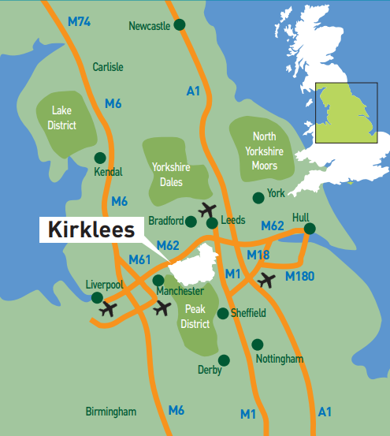
About Kirklees
Population of 433,000
Vibrant town centres
Historic villages
36% of children living in poverty
Notes:
For those that don’t know,
Kirklees is a district of 433,000 people at the heart of the north.
It’s the 12th most populous local authority area in England.
We have vibrant town centres that reflect the diversity of our communities
And further out we have villages steeped in local history.
Kirklees is a brilliant place to live, work, and study.
But we face economic challenges.
Even before the current cost of living crisis,
36% of children in Kirklees were living in poverty.
That’s why we’ve been pursuing an inclusive economy in Kirklees since 2018

Slide 34
Inclusive Economies in Kirklees
Spend for local impact
Understanding local impact
Good employment
Kirklees Inclusive Economy
Housing
Assets
Just transition
Tackling poverty
Grassroots
Notes:
There are eight areas of work to highlight that form part of our inclusive economy approach:
…

Slide 35
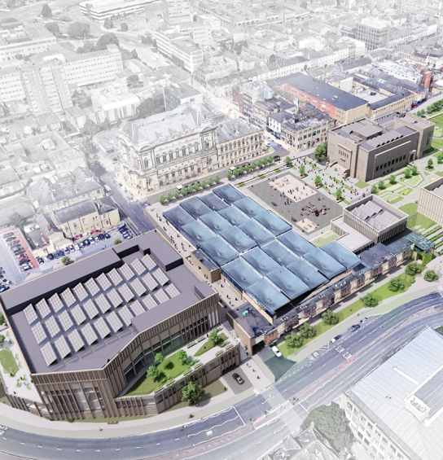
Spend for local impact
Direct budget of £330m
Influence over £1bn of spend
New Procurement Strategy
New Social Value Policy
SV approach in £210m Huddersfield Cultural Heart
Notes:
In Kirklees we have great potential to drive local economic benefits with a direct budget of £330m and influence over £1bn of spend.
We’ve just signed off a new Procurement Strategy that puts social value and inclusive procurement at its heart
But also a new Social Value Policy that goes well beyond procurement
We’re applying this in our major projects including the £210m Huddersfield Cultural Heart town centre redevelopment
Our social value approach means these investments will transform the job market for our residents, as well as the appearance of our town centres.
That said we’re still on a journey and have much more to do.

Slide 36
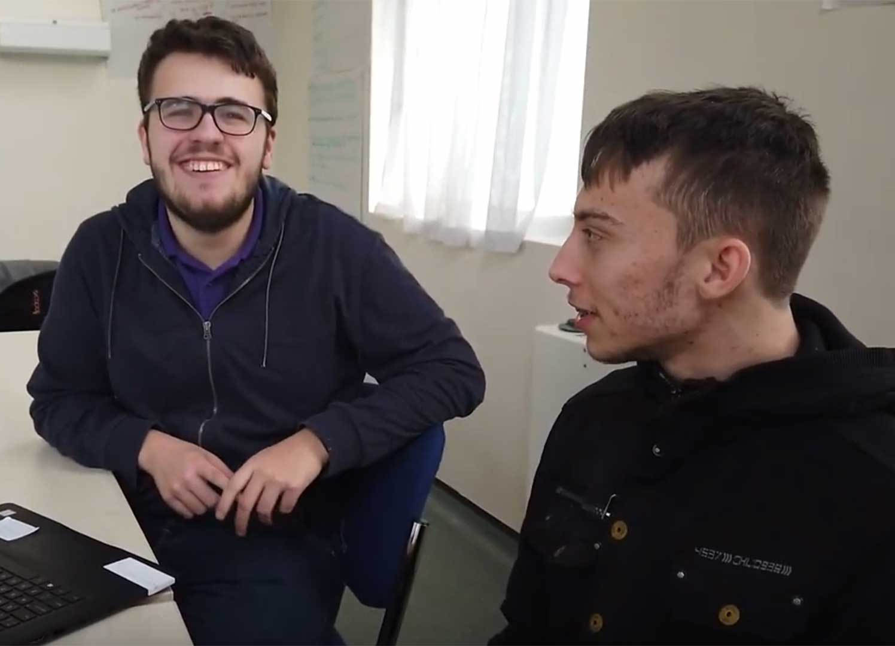
Good employment
Inclusive employer and employer of choice
Name blind recruitment
Guaranteed interview schemes
Project Search
Virtual work experience for targeted schools
Kickstart intermediary
Kirklees Apprenticeships for All
West Yorkshire Mayor’s Fair Work Charter
Notes:
Good local employment is key.
We’re working hard to be an inclusive employer and an employer of choice for our residents
We’ve introduced name blind recruitment
and guaranteed interview schemes for care leavers and veterans, as well as those with disabilities.
While Project Search has supported young interns with learning disabilities and autism to secure permanent employment with us,
We’ve launched virtual work experience focused at schools in areas of high deprivation,
become an intermediary for the Government's Kickstart programme
and created the Kirklees Apprenticeships for All programme.
The Council is also closely involved in development of the West Yorkshire Mayor’s Fair Work Charter.

Slide 37
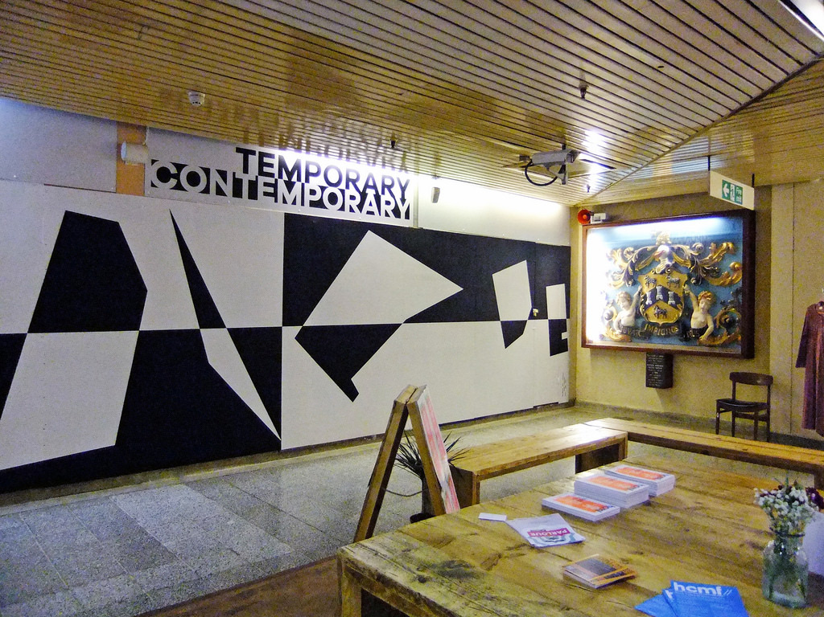
Assets
Asset transfers since 2010
23 assets transferred
Flexible use of assets in town centres
Temporary Contemporary initiative supporting local creatives
Notes:
Asset transfers play an important role in securing community assets for the future and empowering community organisations.
We’ve now transferred 23 assets including community centres, libraries, civic halls and green spaces protecting them from new austerity measures.
We’ve also used assets in Huddersfield town centre to house the Temporary Contemporary initiative
Providing space - in partnership with the University of Huddersfield and others - for local creatives to perform and exhibit.

Slide 38
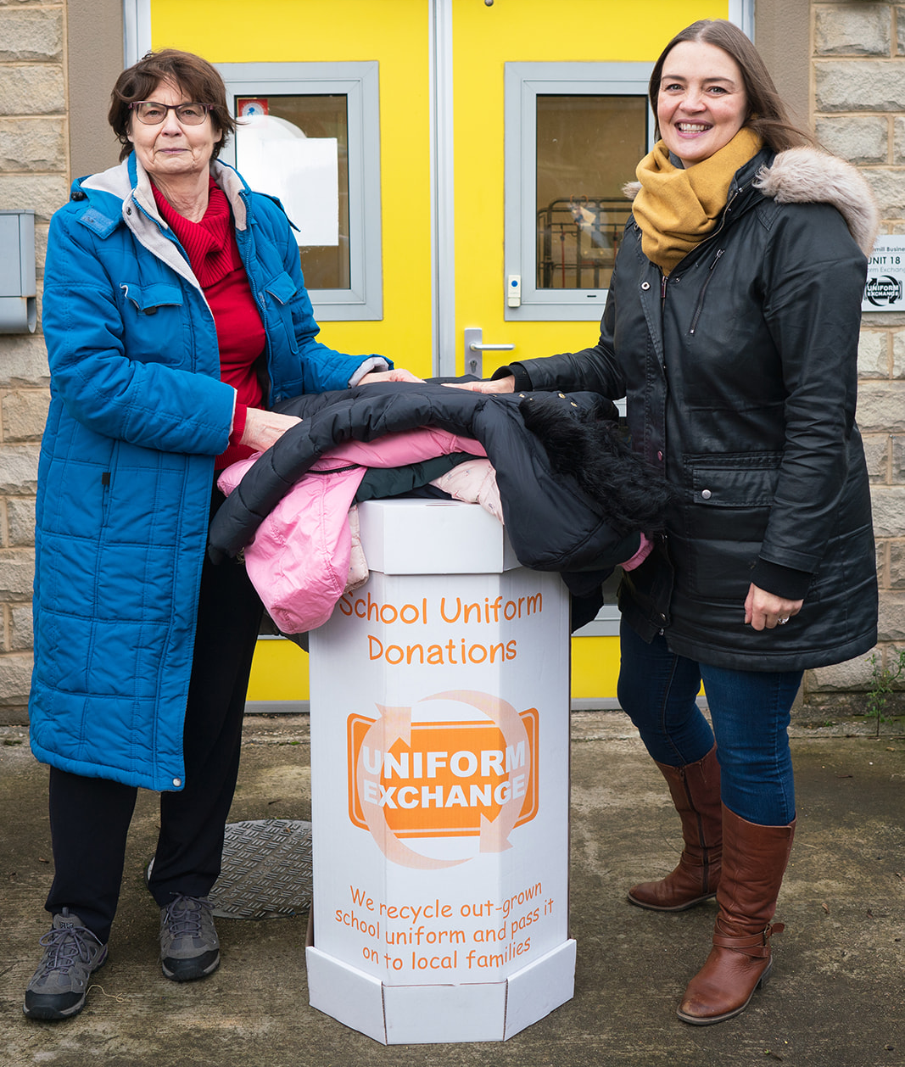
Tackling poverty
Formation of Tackling Poverty Partnership
Development of Food Aid Network
Access to white goods and furniture, school uniform and more through VCS partners
Notes:
Tackling poverty has always been a key element of our inclusive economy approach
We began forming a tackling poverty partnership shortly before COVID
One of its key initiatives was to develop a food aid network
When COVID hit this happened in a matter of days bringing together food banks and smaller food aid groups to share good practice and resources
Other initiatives provide access to white goods and furniture, school uniform and much more.

Slide 39

Grassroots
Co-developed VCSE Investment Strategy
Supporting cooperative and social enterprise development
  Social Enterprise Competition
  Cooperative Care Colne Valley
  Community run Dewsbury Arcade
  Cooperative Development Toolkit Policy Lab
  Worker coops for SME business succession
Notes:
To ensure our VCSE sector is sustainable for the future, we’ve co-developed the Kirklees VCSE Investment Strategy which commits to:
Invest to build trust and transparency
Invest in whoever is best placed to provide the service or support and
Invest to increase VCSE capacity, resilience and sustainability.
We’re also committed to supporting the development of cooperatives and social enterprises in Kirklees.
We’ve partnered with our third sector to run a Social Enterprise Competition.
Our Adult Social Care service supported the creation of Cooperative Care Colne Valley – now a CCIN member.
The council is refurbishing the Dewsbury Arcade and supporting a local community group to take on its management
which will make it the first community run shopping centre in the country.
As well as leading the Cooperative Development Toolkit Policy Lab,
following the Mondragon study visit we’re investigating the potential for worker coops as a solution to the succession challenges faced by many of our 15,000 SMEs.

Slide 40
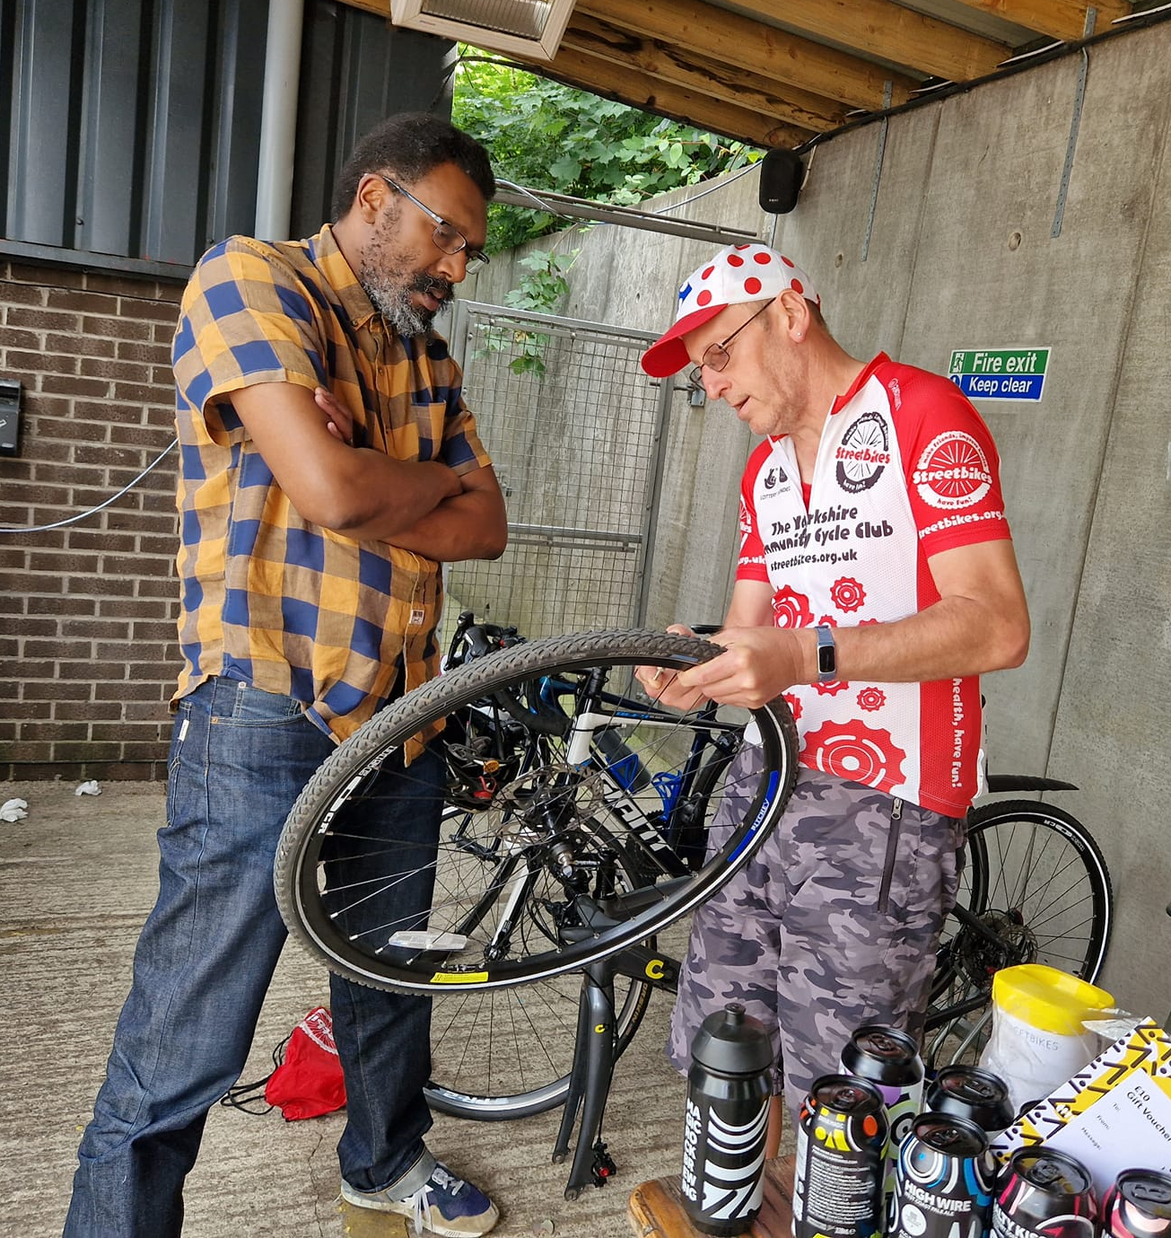
Just transition
Council net zero by 2030,
district by 2038
Avoiding negative impacts on those already disadvantaged
Promoting circular economy with Leeds University
Abbey Road retrofit programme for highly energy efficient council housing and local skills
StreetBikes CIC cycle repair workshops and pop up shop
Notes:
We are committed to reaching net zero as a council by 2030, and as a district by 2038.
But this transformation mustn’t be allowed to have negative impacts on those already disadvantaged.
We’ve worked with Leeds University to promote circular economy approaches that are better for our planet, but also create entry level jobs.
Our Abbey Road retrofit programme is transforming our council housing stock
into highly energy efficient homes while also developing local skills.
Cycling is a fantastic way to get about, but not everyone can afford a new bike.
We’ve supported local social enterprise StreetBikes to offer repair workshops around the borough
and run a half term pop up shop in one of our town centre assets.

Slide 41
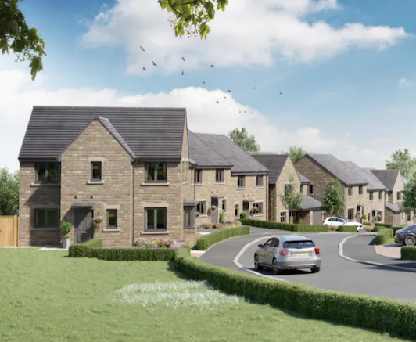
Housing
Affordable and sustainable homes
Soothill, Batley
  Partnership with Keepmoat Homes
  319 homes on council land
  65 affordable homes 15 first homes
100 home Passivhaus social housing pilot
Ten 2-bed bungalows in Fernside for older people under occupying family homes
Notes:
In all of our housing growth projects we’re focused on maximising the number of affordable homes
and making them as sustainable as possible so they are cheap, comfortable places to live.
We’re working in partnership with Keepmoat Homes to develop 319 homes on land the council owns in Soothill, Batley, including 65 affordable homes and 15 first homes scheme plots with the first homes completed next spring.
We’re also developing a Passivhaus pilot of 100 homes for social housing.
While in Fernside, ten 2-bed bungalows are being built using off site construction. targeting older people who are under occupying family homes.

Slide 42

Understanding local impact
>10,000 people engaged through Place Standard exercises
Currently Living in Kirklees survey in partnership
Community Champions
Notes:
We have to drive forward everything we’re doing based on the views of our residents.
We’ve carried out 27 Place Standard engagement exercises
involving over 10,000 people to understand their views of their communities.
Our latest Currently Living in Kirklees – or CLiK – survey was conducted in partnership with local anchor organisations.
This shared evidence base compliments national statistics and answers questions that are important to us locally.
Community Champions is another example; recruited by our VCS Community Anchors they engage with local people on important issues such as fighting myths about the COVID vaccine or to understand digital exclusion.
As we head into the winter months,
The cost of living crisis will be felt even more harshly.
In Kirklees we will continue to support our foodbanks, our affordable food schemes, and our warm spaces will welcome residents in.
But this is a short-term response.
To avoid a repeat of this next winter, we need significant government support.
But in the meantime, we’ll continue progressing our inclusive economy agenda.
We’re proud of what we’ve achieved but we’re eager to do more.
The proof of our achievements will be to hear and see residents reach their full potential in Kirklees.

Slide 43
Thank you!
Cllr Shabir Pandor
Leader of the Council, Kirklees Council

Slide 44
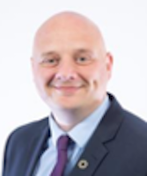
Cllr Lee Carter
Cabinet Member for Neighbourhood Services, Regeneration & the High Street
@TelfordWrekin
A Cooperative Council response to the cost-of-living crisis
CoopInnovation
#CCIN2022

Slide 45
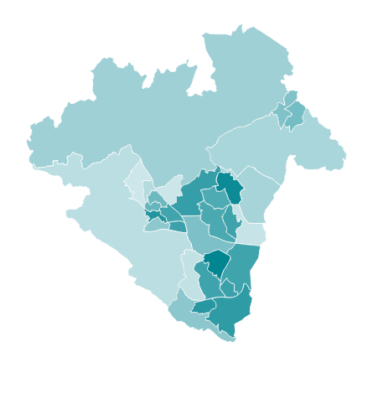
Impact of the cost of living crisis in Telford & Wrekin
Telford & Wrekin population - >185,000 and rapidly growing
More than a third of households have an annual income under £20,000
1 in 5 children living in poverty
Significant increase in demand for services since April 2022
Notes:
First of all, I’d like to welcome you all to Telford & Wrekin. Before I talk about our response to the cost of living crisis, I’d like to give some background about how the cost of living crisis is affecting our borough.
Whilst Telford & Wrekin is a thriving, attractive place, with a growing population and reputation, it is also a borough of contrasts, with social, economic and health inequalities that we are working hard to address.
We have nearly twice the national average of households with an annual income below £20,000, and so we know that our community will be particularly badly hit by the cost of living crisis. In some areas, more than 50% of households are in this position, as shown by the darker colours on the map on the right. in fact, the venue we are in today is located in the ward with the highest percentage of low income households.
But this crisis is not just affecting those on the lowest incomes. Two thirds of our households, some 52,000, have an annual income under £40,000, well below what the Joseph Rowntree Foundation have said is needed for a minimum acceptable standard of living.
And we are already seeing the impact locally. To give just a few examples:
More than a 100% increase in applications for emergency welfare assistance
More food parcels given out by August 2022 than in the whole of the 2021
Citizens advice dealing with a 160% increase in demand for help with energy costs

Slide 46

Our Cooperative Council response
Cost of living strategy:
  Directly providing targeted support to those most affected
  Working in partnership to coordinate support locally
  Raising awareness of support available
  Making the case to Government for sustained investment
Extensive package of support with significant local funding
Notes:
Whilst we can’t solve this crisis without action from the Government, we, as Cooperative Councils can play a vital role in reducing the worst impacts at a local level. At Telford & Wrekin Council, we are committed to protect, care and invest to create a better borough. Working cooperatively to reduce inequalities has been at the heart of our work for more than a decade, and has enabled us to quickly mobilise additional support throughout the many unprecedented challenges we have faced, including the Covid pandemic, flooding, and now the cost of living crisis.
We published our cost of living strategy last month, which has 4 key elements, as set out on the slide. The strategy sets out an extensive package of existing support, as well as additional help to be delivered over the next 6-12 months. Today, I’m going to focus on the 2nd element, and share some examples of cooperative working in action in Telford & Wrekin.
However, I just want to first touch on the direct support the Council is providing. We are investing £5.8 million of our own resources into our cost of living package, funding everything from a 2 year Council Tax freeze to the ‘every little helps’ things like free swimming for everyone under 25, and much more.

Slide 47
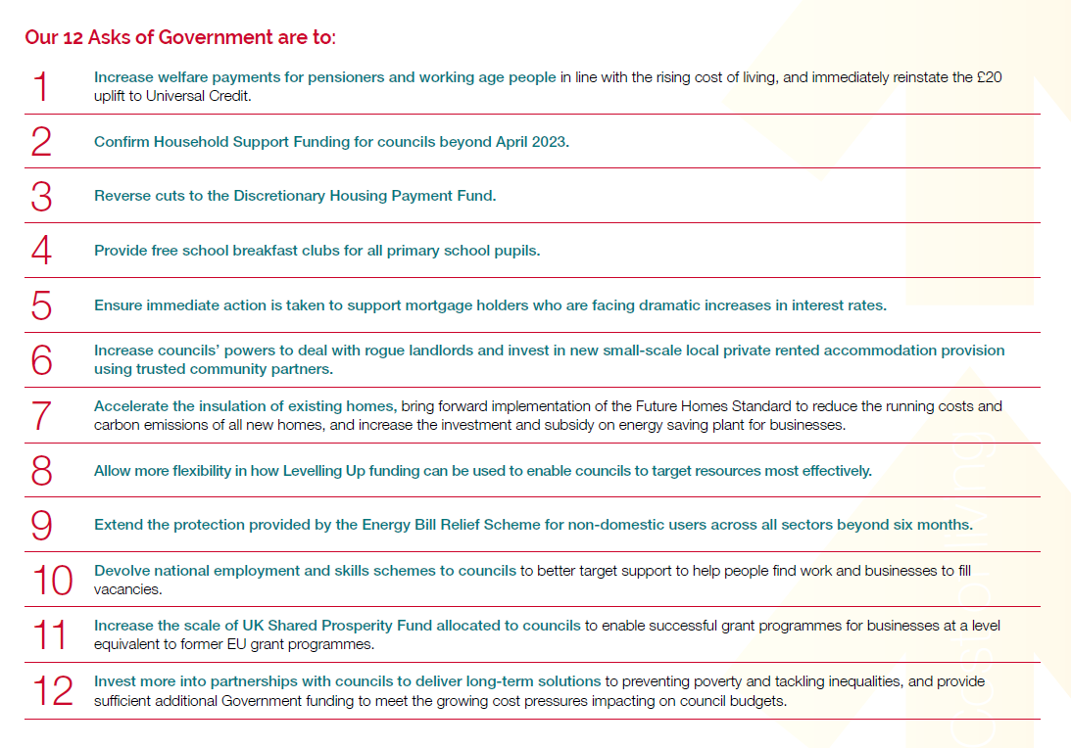
12 Asks of Government
Notes:
The strategy also includes our 12 Asks of Government, and it’s positive that a couple of these have already moved forward, however most of our asks remain. Linked to this, the Council has also just passed a motion to declare a cost of living emergency. I would urge you all to do the same, if you haven’t already, so that we can collectively lobby the Government to work with us on long-term solutions to poverty and inequality.

Slide 48
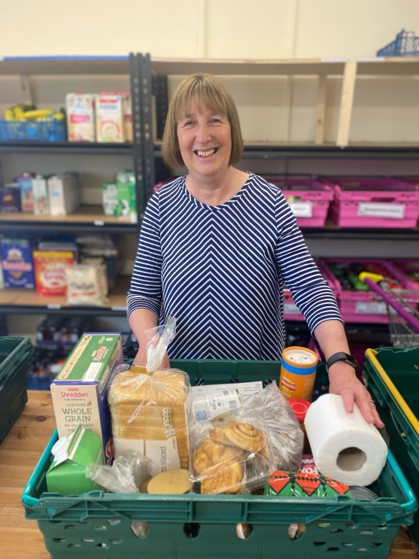
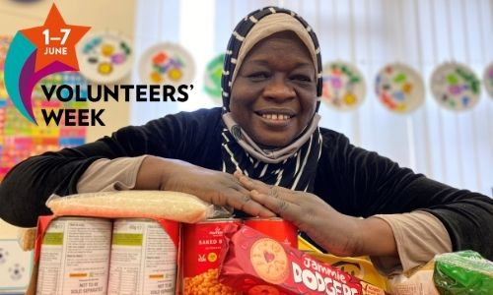
Cooperative working in action – help with food and other essentials
Telford Crisis Support
3-year partnership agreements delivering:
  7 day a week foodbank provision, including cultural and special dietary needs
  Breakfast boxes
  Baby and toddler bank
  School uniform, coats and shoes
  Refugee support
Telford and Wrekin Interfaith Council
Notes:
I mentioned earlier that being a Cooperative Council meant that we already had the relationships in place at the start of the Covid pandemic to step up support very quickly. As the pandemic continued, our focus was not only on recovery, but also on building a lasting legacy to the amazing work done by the community.
A good example of this is help with food, which is once again a struggle for many families. Working with a range of community groups during the pandemic, we extended existing foodbank provision, and supplemented this with additional support, including a borough-wide breakfast box scheme, and a winter coat project.
It was clear that we needed to find a way to sustain and grow this, and so we have put in place 3-year partnership agreements with the two organisations shown on the slide who over the last 6 months between them have provided 160,000 meals, as well as the other support listed.
Whilst we continue to part fund this provision, this is gradually being stepped down, as the organisations source other funding, and build up their volunteer capacity. A great example is Sania, pictured on the slide. Sania, a Sudanese refugee, benefited from breakfast boxes when she first came to Telford. Sania has gone on to become a volunteer for the Interfaith Council, preparing food parcels, which is also helping to learn English.

Slide 49

Cooperative working in action – cost of living grants
The Anstice Community Trust have received a grant for their Winter Warm-Up
Grants for local community centres to provide food and activities
Provision across the borough from the end of November
Match funding providing added value
Council helping to co-ordinate local offers
Notes:
Another great legacy of our work during the pandemic has been stronger relationships with local community centres. This has enabled us to quickly put in place a new community cost of living grant scheme.
Voluntary and community groups and Town & Parish Councils have been encouraged to apply for grants of up to £5,000 to provide warm, welcoming spaces with hot food, activities, and signposting to cost of living support until the end of March. We have deliberately chosen not to call these warm banks in order to prevent any stigma.
We have had an amazing response, resulting in a number of centres already up and running, with a further 27 opening by the end of the month, giving coverage across the borough. Many applicants had also secured additional match funding, a win-win situation where organisations are able to help more residents, whilst also benefiting from extra help towards their own running costs. There is something for everyone, from film afternoons to youth activities, and more targeted offers, such as for families with disabled children and people with substance misuse issues.
Where we received more than one application for a particular area, we have connected organisations together to co-ordinate their provision, for example covering different days or targeting different age groups. We have also worked in partnership with Citizens Advice to align their new enhanced outreach offer with these community hubs.

Slide 50

Cooperative working in action – support with energy costs
Free impartial advice through Telford Energy Advice (TEA) partnership
Fitting LED bulbs for those most in need through trusted partners
Investing in loft insulation to supplement Government schemes
Notes:
Finally, I want to highlight how we are supporting people with their energy costs, working in partnership with Marches Energy Agency to deliver the Telford Energy Advice service, covering everything from accessing grants to switching suppliers.
Given the urgency of the situation, we decided that we couldn’t solely rely on Government funded grant schemes to help our residents. Existing schemes such as the local authority delivery scheme simply do not benefit enough households quickly enough.
We considered a range of shorter-term options, including warm packs with blankets, gloves etc. However, we were keen to address the cause of the issue and not the symptoms and so we are rolling out two alternative schemes.
The first is fitting LED light bulbs in the homes of those on low incomes, leading to an immediate saving on electricity bills of up to 10%. We are delivering this in partnership with two organisations: Shropshire Fire and Rescue Service and Wrekin Housing Group, the largest registered social landlord in the borough. The Fire Service are fitting bulbs at the same time as smoke alarms, and are also signposting residents to other support, including the warm spaces. We are also investing our own climate change funding to install loft insulation in at least 500 properties by the end of March, via referrals from Telford Energy Advice to target those in greatest need, and using local installers.
I hope that these examples have given you an insight into our approach and we would be happy to share our strategy more widely.

Slide 51
Q & A
Please raise your hand & we’ll bring you a mic

Slide 52
1145 Break
Grab yourself a drink and visit the exhibition
1205 – 1250
Breakout session 1

Slide 53
1250 – 1340 Networking lunch & visit exhibitions
1340 - 1430
Breakout session 2

Slide 54


Slide 55
Awards

Slide 57
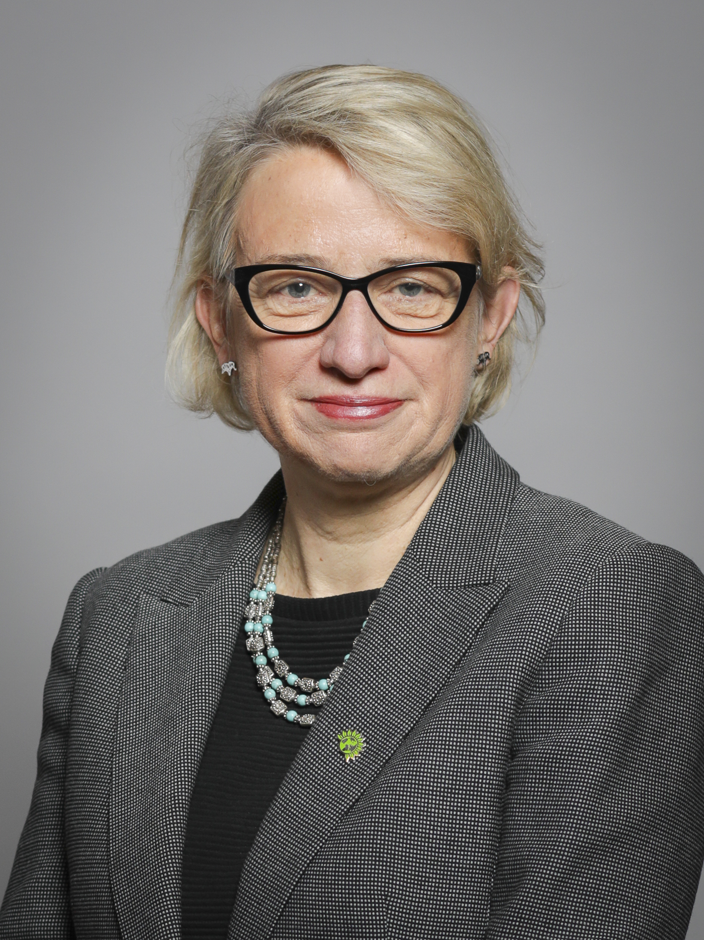
Baroness Bennett of Manor Castle
Green Party Peer
@natalieben
CoopInnovation
#CCIN2022

Slide 58
Baroness Taylor of Stevenage
Chair of CCIN
Leader of Stevenage Borough Council
@SharonStevenage

Slide 59
Q & A
Please raise your hand & we’ll bring you a mic

Slide 60
Plenary 2
Report Launches
Developing the Cooperative Economy

Slide 61
Councillor Louise Gittins
Leader, Cheshire West & Chester Council
Executive Oversight Committee Member, CCIN
@Weezegee | @Go_cheshirewest

Slide 62
Speakers:
Cllr John Cotton – Cabinet Member for Social Justice, Community Safety & Equalities, Birmingham City Council
Cllr Sue Woodward – Leader, Burntwood Town Council
Cllr Ajaz Rehman – Inclusive Economy Champion & Simon Grove-White – Principal Economic Development Officer – Community Wealth Building, Oxford City Council

Slide 63
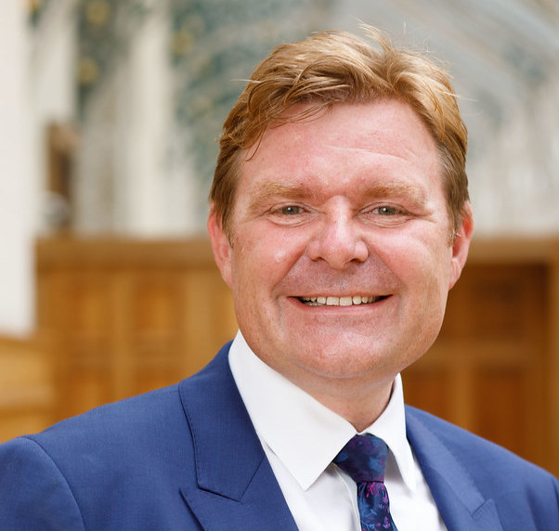
Cllr John Cotton
Cabinet Member for Social Justice, Community Safety and Equalities Birmingham City Council
@cllrJohnCotton | @BhamCityCouncil
Community Economic Development Plans
CoopInnovation
#CCIN2022

Slide 64
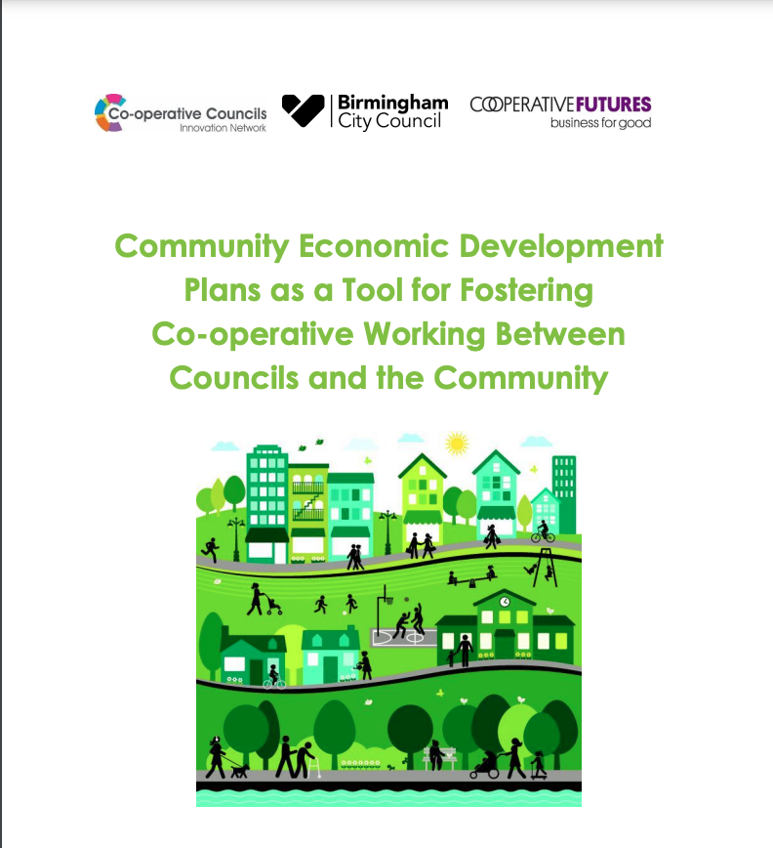

Slide 65
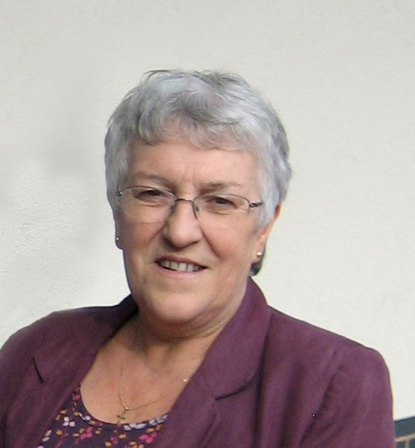
Cllr Sue Woodward
Leader, Burntwood Town Council
@SueWoodward | @BurntwoodTC
Cooperation at the Grassroots
CoopInnovation
#CCIN2022

Slide 67
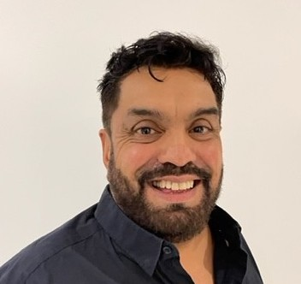
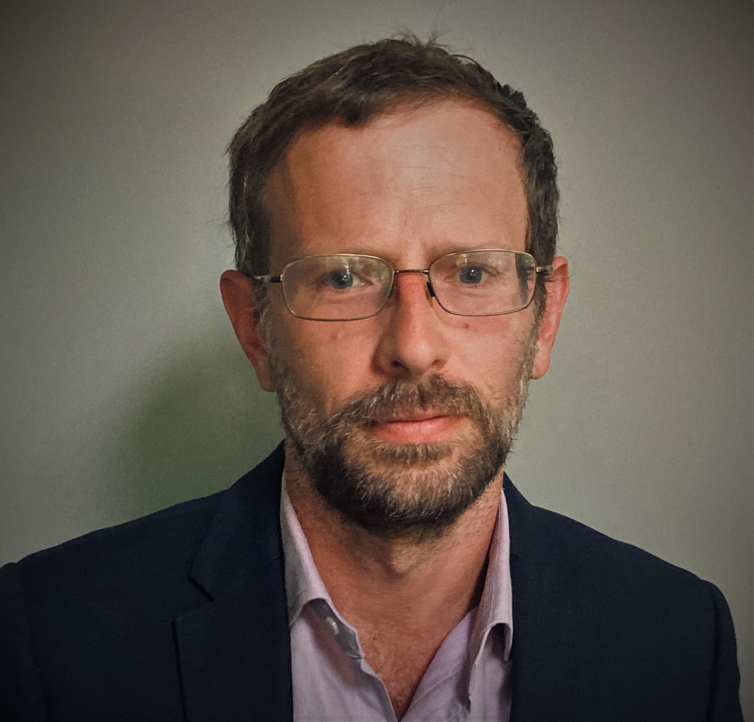
Cllr Ajaz Rehman
Inclusive Economy Champion
@AjazRehman2 | @OxfordCity
Simon Grove-White
Principal Economic Devt Officer
Growing an inclusive Cooperative Economy
CoopInnovation
#CCIN2022

Slide 68

Notes:
Ajaz – Introduce self – Inclusive economy champion, successful small business owner, labour and cooperative party member
Firstly want to thank you the CCIN for funding these exploratory pieces of work. Being able to take risks and try new things is something that local government has struggled to do over recent years and without flexible funding like this, we might struggle to commit resources to explore and innovate around these ambitions.
The policy lab has spun out a number of exciting developments in Oxford and we’re excited by what this means for the council’s ambition to build a truly Inclusive local Economy.
I’m going to introduce the policy lab report then hand over to Simon to talk in a bit more detail about the work he’s been involved in within Oxford. Then we’ll discuss the things we’re doing as a result of the work started by the policy lab….

Slide 69
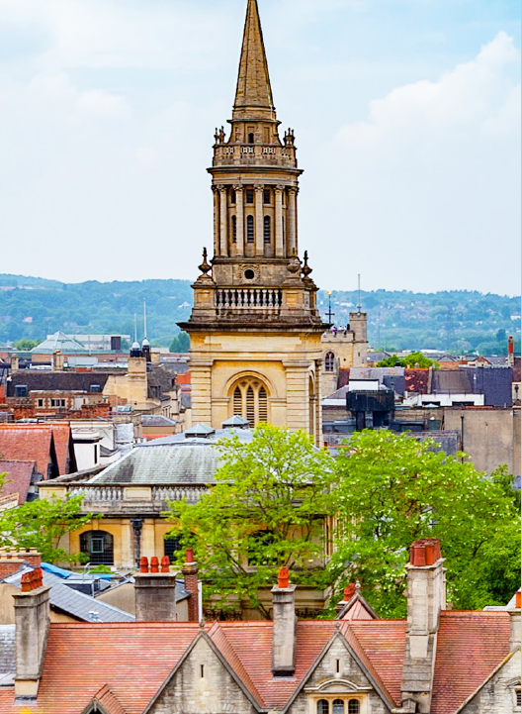
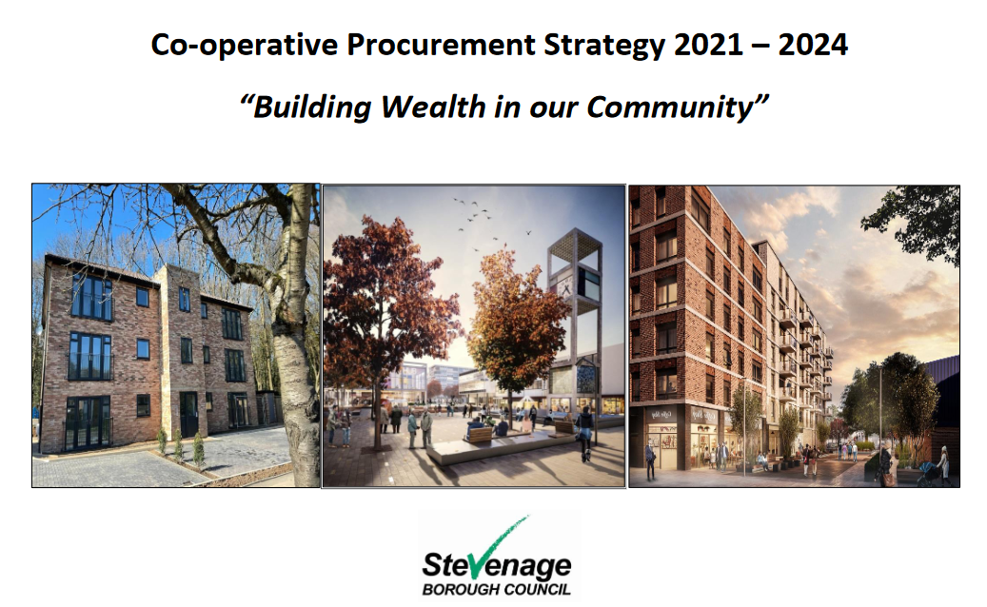
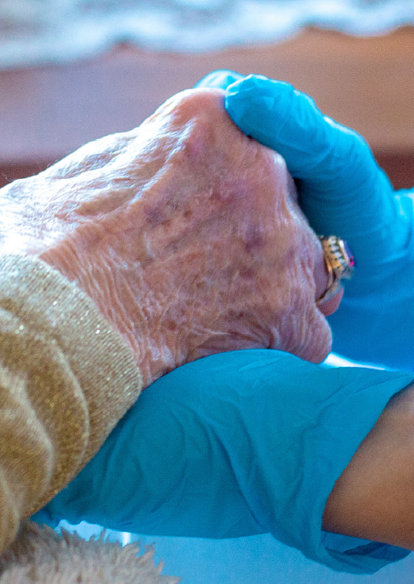
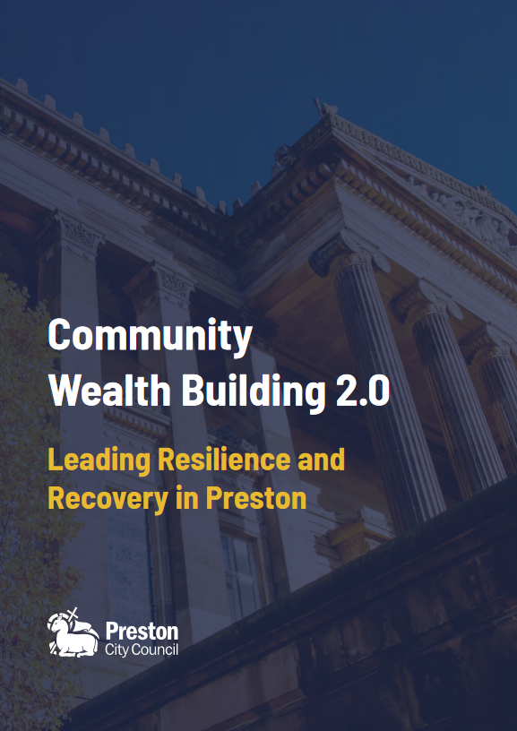
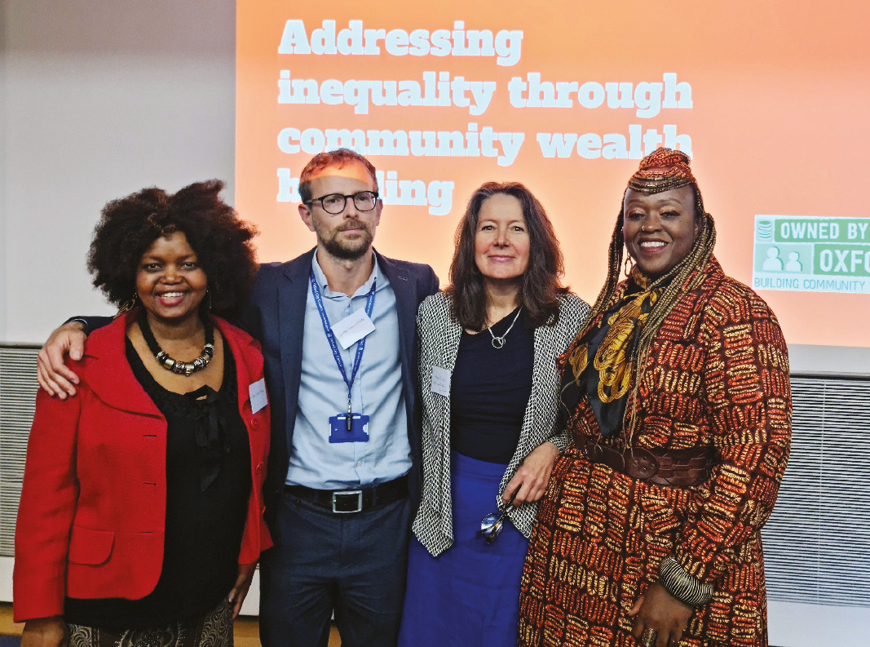
Notes:
Policy lab covered three different councils at different stages of cooperative development and with different strategic priorities. Steer and input was also provided by Preston and the Development Cooperative in an advisory capacity…
Each council pursued its own path but the case studies highlight a number of the challenges and opportunities for growing locally owned and shared ownership organisations in the economic development space.
All case studies were looking to find ways to leverage public spend to support the growth of cooperatives in the area:
Stevenage were looking to understand the potential to grow cooperatives within the area through their cooperative procurement strategy.
Oxford developed a map of coops and community businesses in the areas of the city targeted by its Owned by Oxford Project, a grassroots-led community wealth building pilot.
Torbay also looked at the baseline cooperative activity within their area and explored the potential to grow cooperative approaches within the social care sector
Stevenage’s research identified that the number of cooperatives is low in the local area but identified scope to grow it in particular sectors.
Oxford found that although the city contains a relatively high number of cooperatives, they tend to cluster in small geographical areas and are a distinct network of likeminded people.
They weren’t present in the target areas of the Owned by Oxford project which formed the core of the case study.

Slide 70
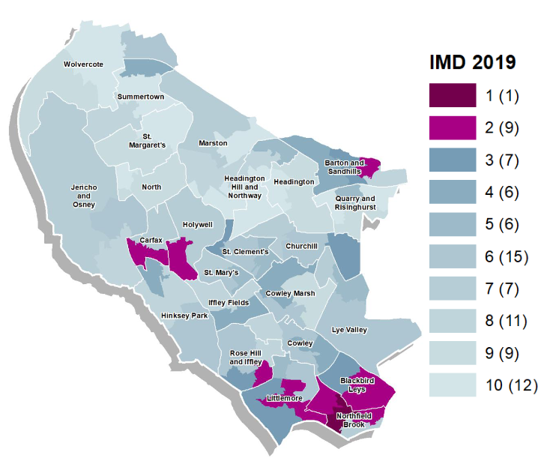


Owned by Oxford – Case study
Growing locally-led, community-owned businesses
Integrating strengths-based, community economic development with the purchasing power and assets of larger organisations
Place-based, city-wide with a focus on Blackbird Leys, Barton, Rose Hill and Littlemore
https://ownedbyoxford.org.uk/

Slide 71
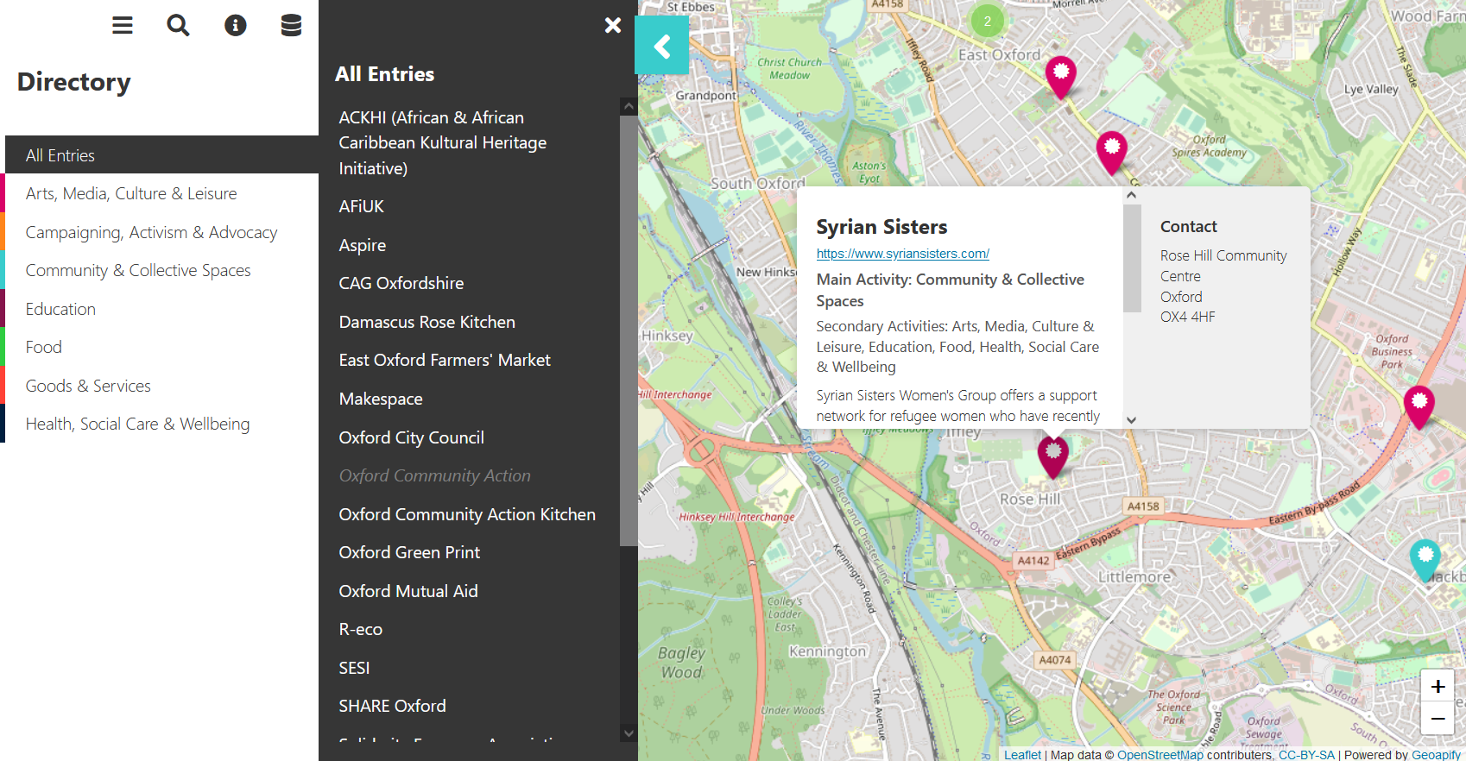

Slide 72

Key findings
Mapping/directories need scale to be useful to commissioners
Low awareness of coops among target demographics
Many not accessing mainstream business support either
Need to embed understanding of value of cooperatives within anchor organisations
Procurement needs long term strategic approach
Use of reserve contracts and innovation partnerships

Slide 73





Building on the learning
Invested ARG funding in local Coop Development Agency
Coop Social Value for TOMs – CCIN Prototype
Mainstream channels – LEPs, universities, start-up networks
Closer working with Donut Economics Action Lab – toolkit for business
Inclusive Economy Fund or Regional Bank
Oxfordshire-wide supplier directory
Notes:
AJAZ - Next steps
As we’ve progressed we’ve refined our approach and tried to address gaps and integrate the learnings from the pilot with networks and partners including Economic Growth Steering Board, Oxfordshire Inclusive Economy Partnership and others
To address the gap in appropriate business support, Coop Futures we now have a coop development worker, working closely with the Owned by Oxford project and providing coop development support for new and existing initiatives
They’re already building links with the likes of Oxford Brookes Business School, giving the entrepreneurs of tomorrow more opportunities to engage with these models.
And the Council are leading conversations with wider stakeholders including the LEP, Oxford Innovation, and other Economic Growth Board Partners to get these models better understood and embedded in mainstream business support settings – Mondragon has provided a helpful case study to show that coops can be innovative and world leading – which is where many in Oxford like to see themselves!
We’re also reaching out to Donut Economics Action Lab, who have developed fantastic materials on the importance of businesses becoming ‘distributive by design’
And we’re developing a further CCIN funded prototype which we think can better recognise the benefits of cooperatives in our assessments of social value when tendering
Finally, we’ve taken on board the learning from the mapping pilot, and are looking at developing something that works over a wider area, leveraging the scale of interest in our inclusive economy partnership

Slide 74
Q & A

Slide 75

Cllr Paul Watling
Cabinet Member for Safer & Stronger Communities – Telford & Wrekin Council
@TelfordWrekin
Thanks and Close
CoopInnovation
#CCIN2022

Slide 76
Have a safe journey home

