Slide 1

Being a Cooperative Council
#OurCoopDifference
24-6-2022

Slide 2

What you can do as a council
Signed the ‘Councils for Fair Tax' Declaration
Pay Real Living Wage
Are part of a Real Living Wage City/Borough/Town
Signed the ‘Modern Slavery’ Charter
Identified a Cooperative Champion (Member &/or Officer) for the council
Actively encourage co-op innovation within staff teams
Playing a central-role in tackling the Climate Emergency

Slide 3

What you can do with CCIN
Encourage Members and Officers to undertake CCIN certified training modules
Offer CCIN accredited training courses for member and officer development
Actively participate in the CCIN Officer Network
Member of the CCIN governance
Engaged in Policy Labs and / or Prototypes
Engaged in WhatsApp Groups
Submit regular Case Studies for inclusion on CCIN website
Engage with CCIN social media channels
Use the CCIN Dynamic Purchasing System to bring in capacity & expertise

Slide 4
community wealth building
Develop an Inclusive Economy Charter
Promote a progressive procurement policy
Support the creation of a regional mutual/community bank by investing
Work with local anchor institutions to buy and recruit local
Regulate rent and rates for ‘local’ businesses in council-owned property
Offer business rate rebates for those businesses that become Living Wage Accredited
Champion Local Employment schemes
Have insourcing Council Services as an objective

Slide 5
cooperative placemaking
Develop a cooperative development strategy
Establish a cooperative development network
Commit to community engagement in local decision making including participatory budgeting
Invest in local community production, particularly those focusing on community energy to tackle the climate emergency
Promote the circular economy
Support local enterprises to convert into coops/worker coops
Have an Asset Transfer policy to manage land and assets which support Community Land Trusts

Slide 6

Our Values
Whilst not a registered cooperative, the CCIN has adopted the Cooperative Values developed by the ICA:
Cooperatives are based on the values of self-help, self-responsibility, democracy, equality, equity and solidarity.
In the tradition of their founders, cooperative members believe in the ethical values of honesty, openness, social responsibility and caring for others.

Slide 7
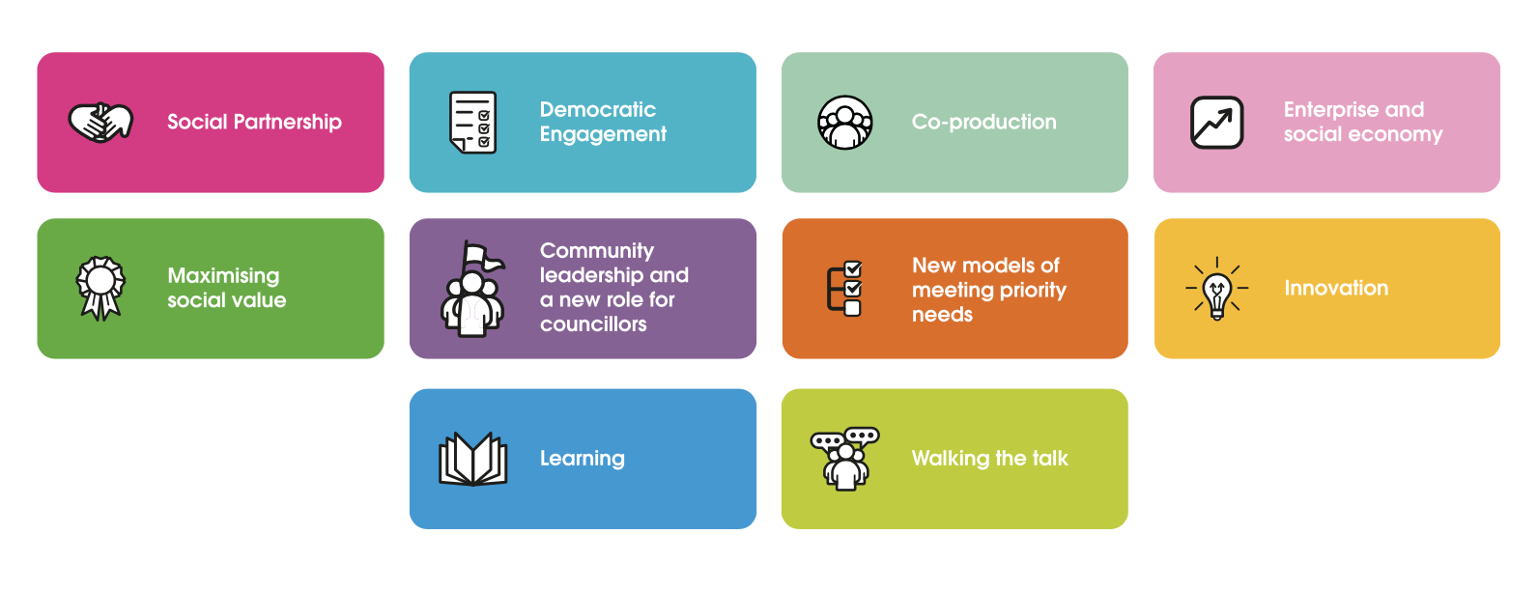
Our Principles

Slide 8

These icons are used to demonstrate how cooperative councils are putting our cooperative principles into practice, demonstrating the ‘cooperative difference’ in the work that they are doing

