Slide 1
Early Help Partnership
Cllr Steve Darling, Leader of Torbay Council

Slide 2
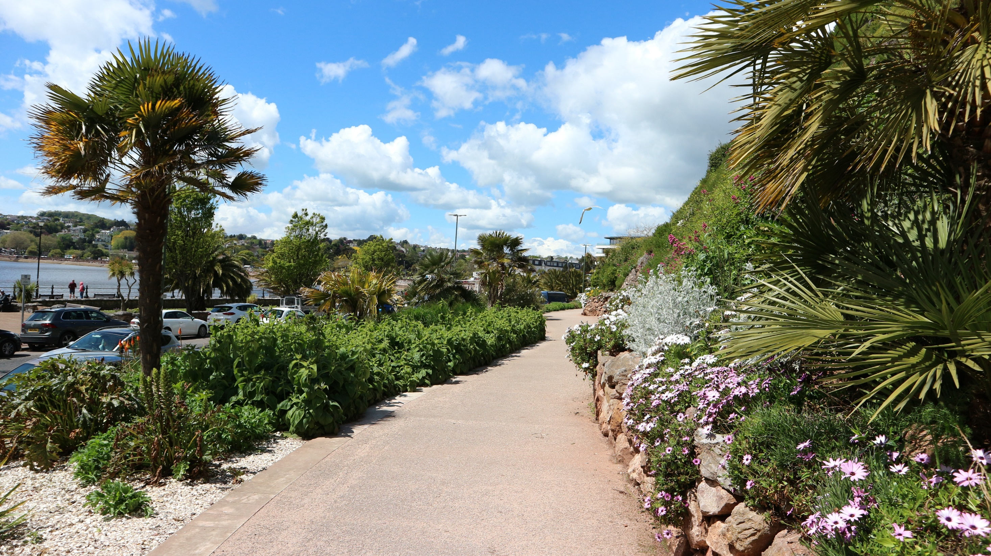

Where we were:
The English Riviera
High levels of poverty and deprivation
Our ambition: A Thriving Torbay

Slide 3

Where we wanted to be:
Avoid preventable escalation to statutory services – and support families through step down
Locality based integrated partnerships
Utilise our vibrant community sector at a very local level

Slide 4

How we got there:
Removed barriers to engagement
Embraced digital ways of working
Made better connections
Photo by Belinda Fewings on Unsplash

Slide 5

Where we are:
Collective vision and aspiration for Early Help
Built on our success of working virtually
Partners making a real difference in their communities
Photo by Helena Lopes on Unsplash

Slide 6

Our future:
Widening the Early Help remit
Development of family and community hub
Torbay Promise

