Slide 1


Growing an Inclusive Cooperative Economy Policy Lab
April 21-22

Slide 2
CCIN Policy Lab projects
Member led projects to find co-operative policy solutions to the challenges facing local government. Open to all ideas, the more innovative the better!
Policy Labs - more significant collaborative pieces of work that CCIN members work on together and eligible for up to £10,000 of funding.
Policy Prototypes - smaller projects delivered in a locality on behalf of the Network and eligible for up to £1,500 of funding.

Slide 3





Growing an Inclusive Cooperative Economy Policy Lab-
Working Group Members
4 Councils
1 Affiliate

Slide 4
Growing an Inclusive Cooperative Economy Policy Lab-
Roles & Responsibilities
Member
Role
Lead, Test & Learn Pilot
Member, Test & Learn Pilot
Advisory Members

Slide 5
Growing an Inclusive Cooperative Economy Policy Lab-
Brief
Task | Description | Start | End | Owner
Collate Case Studies, learning and place based approaches | Each of the Partner CCIN members and Affiliate Member commit to attend a bi-monthly working group meeting to share learning and case studies. OCC as Lead reaches out to other CCIN members for good examples | Mar 21 | Apr 21 | Oxford City Council to facilitate, partners contribute
Analyse collated approaches and shortlist tools and case studies | Analysis of approaches and agree shortlist of developed tools to test. Once tried and tested these tools will be shared and promoted in the Toolkit at the end of Policy Lab project. | May 21 | May 21 | Oxford City Council to facilitate, partners contribute
Milestone 1: Delivery of Test and Learn Pilots | Pilots tested in 3 areas, delivery phase; 6 months | June 21 | Nov 21 | Oxford/Torbay/Stevenage partners to agree and test pilot tools
Plan workshops | Develop the design of the workshops including the audience and content. | Nov 21 | Nov 21 | Oxford City Council to lead, partners contribute
Milestone 2: Workshops Delivery | Delivery of the workshops as designed. | Dec 21 | Jan 22 | Oxford City Council to lead, partners contribute
Develop toolkit | Collate all contributions into a toolkit that supports councils to replicate and transfer learning from the test and learn pilots. | Dec 21 | Jan 22 | Oxford City Council to lead, partners contribute
Write Report | Drafting of a report describing the intentions, process and outcomes of this project to accompany the toolkit. | Jan 22 | Feb 22 | Oxford City Council to lead, partners contribute
Develop comms plan | Development of a communications plan to promote the toolkit and report to member and non-member councils, community groups and audiences. | Jan 22 | Jan 22 | Oxford City Council to lead, partners contribute
Milestone 3: Publish and promote Toolkit and Report | Implementation of the comms plan to coincide with the publication of the report and toolkit. | March 22 | March 22 | Oxford City Council to lead, partners contribute

Slide 6
Growing an Inclusive Cooperative Economy Policy Lab-
Risks/Challenges
Potential Risk | Description of Risk | Proposed Mitigation
COVID-19 Impacts: | Despite the national announcement of the roadmap to emerge from Lockdown it is expected that continued risks to delivery caused by the stop-start nature of lockdown and isolation measures will continue and will affect the project at stages throughout esp. on timescales projected here. | A focus on delivery of workshops and test and learn pilots online via zoom, teams and equivalent media will therefore be assumed with live face to face interaction locally hoped for where appropriate/required but not expected.
Diversion of resource: | Diversion of constrained resources to support recovery activities and delivery of potential upcoming national programmes. This could result in the programme for the pilot being pushed back. | Each Local Authority or Partner to appoint an officer or lead to designate time to the project. An example In Oxford of this will be both the lead officer and also support from our newly appointed Community Wealth Building Officer.

Slide 7
Growing an Inclusive Cooperative Economy Policy Lab-
Progress to Date
Launch of Oxfordshire Inclusive Economy Partnership
April 2021
Launch of Owned by Oxford
June 2021
Launch of Social Value & Procurement WG
May 2021
Draft Inclusive Economy Charter
June 2021 (Revised Jan 22)
Owned By Oxford Mapping April 2021 onwards
Draft Social Value Directory Test & Learn Pilot
July 2021
Inclusive Economy Event
Dec 2021 (Rescheduled due to CV-19)
Torbay Test & Learn Pilot Launch
June 2021 onwards
Stevenage Test & Learn Pilot Launch
June 2021 onwards
Meanwhile In Oxfordshire-
Community Asset Utilisation

Slide 8
Case Study: Oxford
Aim of project
To create a directory of purposeful businesses delivering in Oxford’s areas of deprivation that can be disseminated to procurement teams in local authority, anchor institutions and large employers in order to prioritise their tenders to promote social value, community wealth building and inclusive growth.
Outputs:
To produce a ‘Social Value Suppliers’ directory
To disseminate the directory to procurement teams in target anchor institutions, including large employers, local authorities
To create the directory as a pilot, ‘early intervention’ on behalf of the Oxfordshire Inclusive Economy Partnership’s Social Value and Procurement Task and Finish Group
To trial the directory as a ‘test/learn’ pilot as part of a ‘Growing an Inclusive Cooperative Economy’ Policy Lab on behalf of the Cooperative Councils Innovation Network (CCIN)
Test & Learn Pilot

Slide 9
Case Study: Oxford
The Oxfordshire Inclusive Economy Partnership brings together over a hundred organisations - employers, business, education, community groups and local government.
We are working together because Oxford is the second most unequal place in the UK, in terms of income, housing affordability and life expectancy. Education attainment is below average affecting all generations. These problems extend across the whole of Oxfordshire.
We are working to create opportunities for all people in Oxfordshire, making use of everyone’s potential, so that we can all benefit from Oxfordshire’s success. Our aim is to create an environment and communities that can adapt to change, a region that is resilient in the face of shocks in the economy and a workforce that responds to different needs and different kinds of work in the future.
We are a county-wide group, working to share knowledge, expertise and resources to address some of our greatest challenges. This is not a short-term initiative, but a long-term endeavour. Our vision is an Oxfordshire that creates opportunities and benefits for all communities and people within our region.
Oxfordshire Inclusive Economy Partnership

Slide 10
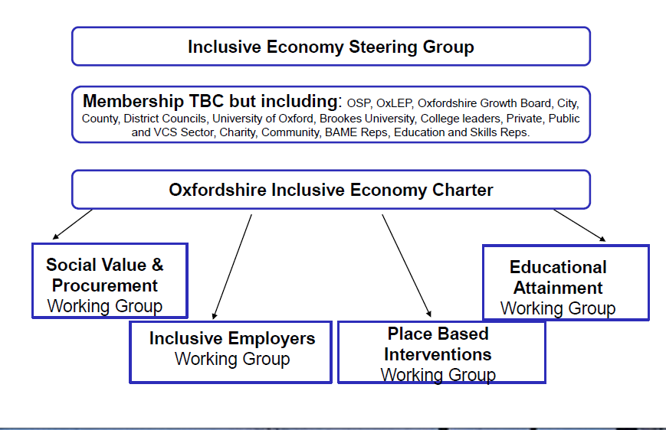
Case Study: Oxford
Oxfordshire Inclusive Economy Partnership

Slide 11

Webinar 21st July 2021
Notes:
Anna

Slide 12
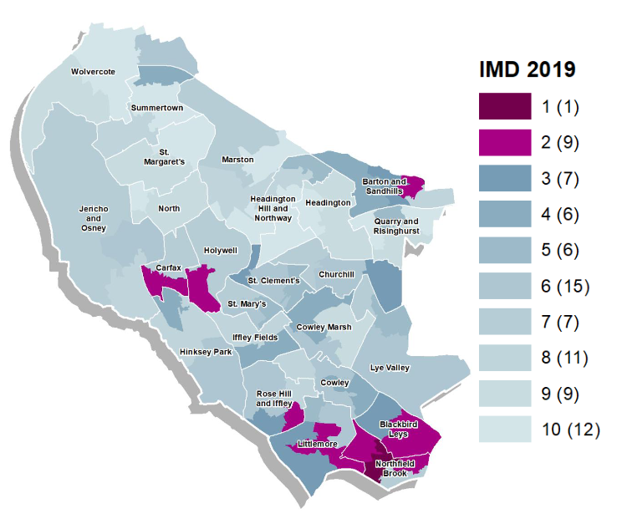


Owned by Oxford - the approach
Growing locally-led, community-owned businesses
Integrating strengths-based, community economic development with the purchasing power and assets of larger organisations
A commitment to authentic community engagement
Place-based, city-wide with a focus on Blackbird Leys, Rose Hill and Littlemore
Ambition to share our learning widely and to cement a partnership that can be scaled for lasting impact

Slide 13
what we’re doing
1. Mapping and Community Research
2. Embedding CWB practice in anchor organisations
3. Locally targeted programme of support
Strength based community asset mapping
Expanding network of anchors
Training democratic business champions and mentors
Open Source web tools
Complementary strategy and policies
Supporting early stage organisations through mentoring, training and small grants scheme
Assessment of Community strengths and opportunities
Toolkits for commissioners
Support and toolkits for businesses seeking space acquisition
Blogs and asset mapping toolkit
Identifying procurement and asset opportunities
Growing community enterprise and cooperative sector in target areas

Slide 14
Mapping the local inclusive/ cooperative economy

Slide 15
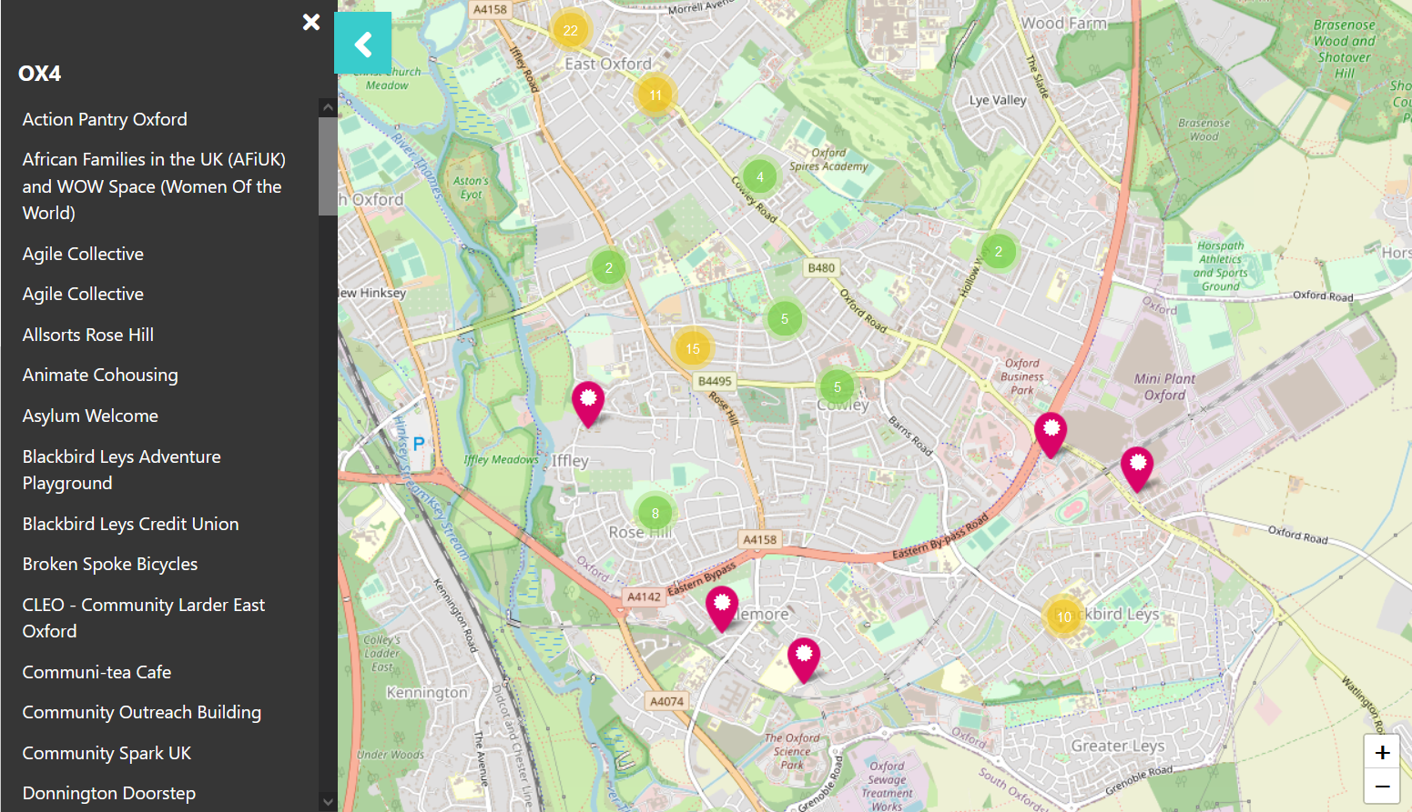
Mapping Community Wealth
Purpose:
Make purposeful community activity more visible to anchors
Support the development of solidarity networks through linking likeminded organisations
Provide a supplier directory for small spend limits
Combines data from public sources (e.g. dotcoop) with inputs from local Airtable CRM
Open source tools can be adapted to other geographies

Slide 16
Growing Coop Economy: Challenges and opportunities
No existing touch point for ‘coop-curious’ early stage organisations
Strong Social Enterprise support sector
Microgrant process to support orgs with ‘intention to become democratic’
Coordinating different scales – establishing the ‘food chain’
Inclusive Economy Partnership
Setting anchor ambitions around cooperative and social enterprise economy
Procurement pipeline mapping identifying future incubation opportunities e.g. retrofit, cleaning

Slide 17
For more info…
Map and grants launching soon on https://www.cagoxfordshire.org.uk/owned-by-oxford
Contact Simon (Sgrove-white@oxford.gov.uk) or Anna (Anna@cagoxfordshire.org.uk) for more info on the project

Slide 18
Webinar 21st July 2021
Notes:
Anna

Slide 19
Case Study: Torbay
Community Wealth Building Approach

Slide 20
Case Study: Torbay
Aim of project
To develop a Social Care Workers Co-operative
Outputs:
An Options Analysis to recommend an appropriate model
To pilot the recommended model as part of a ‘Growing an Inclusive Cooperative Economy’ Policy Lab on behalf of the Cooperative Councils Innovation Network (CCIN)
Test & Learn Pilot

Slide 21

Case Study: Torbay
The Windmill Centre, Torquay
Personal Assistant Project - independent support workers register
Challenge
Health and social care sector in Torbay – 25% of employment
Rate of turnover of staff within the social care is around 31%
Perceived low status, pay, training and in-work support affect recruitment and retention in sector
Difficult to attract and retain staff that have the right skills and values.
The challenge is exasperated by an ageing population
Pay and terms of employment within the social care sector need to be addressed.
Care Partner

Slide 22
Shared Learning
Discussion Prompt 1:
What are the barriers to developing an Inclusive Co-operative Economy in your Council/Area of work?
Discussion Prompt 2:
What are the opportunities or solutions you’ve found to develop an Inclusive Co-operative Economy in your Council/Area of work?

Slide 23


Thank you

