Slide 1
Councillor Louse Gittins Leader of Cheshire West and Chester Council
Understanding the Digital Divide
Notes:
Introduction
Recognise the irony of talking about digital exclusion at an on-line conference but also that without the ability to meet virtually this conference probably would not have happened.
The importance of digital access has been growing for years, with calls for broadband to be designated as an essential utility
The COVID-19 pandemic has highlighted the importance of digital access, but also the gap between the haves and the have nots

Slide 2
Notes:
I’m sure we all recognise a screen like this
Virtual meetings are something that have gone from novelty to norm over the past couple of year
Working on line – working from home where possible (this pic is a recent meeting of the Cheshire and Merseyside Marmot Community Advisory Board)
Learning on line - Schools closing to pupils who are not either the children of key workers or who are vulnerable
Socialising on line - Family and friends socialising on line
Digital access was increasingly vital before the pandemic. COVID19 has highlighted that fact

Slide 3
The Digital Divide
Build a more robust understanding of:
who is experiencing digital exclusion;
where they are;
what their barriers are to accessing services and social contact online; and
interventions to address those barriers
Notes:
The digital divide is the gap between those who can confidently and conveniently do what they need to do on-line and those who can’t
This Policy Lab focused on understanding that gap
Who is excluded
Where they are
The specific barriers to them being confidently on line
The intervention that can be taken, and targeted towards those people

Slide 4
The Digital Divide
Notes:
Important not to think of this as an absolute – it’s not binary
The same people can be digitally enabled in some circumstances but not others – able to attend a zoom meeting but not complete an online form
Many of us are comfortable being on-line, but would need support to set up a device, an internet connection or a new router
Equally, circumstances can change.
Dropping – breaking – your one internet ready device could be a disaster

Slide 5
Cooperative Partners
Notes:
Really collaborative process
Eight authorities working to understand and tackle digital exclusion in their local area
All at different stages
Shared learning, been a really positive experience working together
Developed a useful, practical toolkit to help authorities and organisations looking to understand and tackle digital exclusion in their area

Slide 6
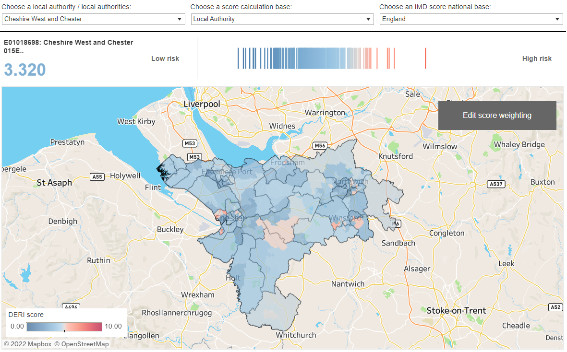
Digital Exclusion Risk Index
Notes:
There is no single national data set on digital exclusion
Lots of pieces of information and we’re all working to understand them
Digital exclusion risk index
Developed by the Greater Manchester Combined Authority – Do it once for everyone
New tool covering every LSOA in England and Wales, and every data zone in Scotland
Uses demography, access to broadband and deprivation data
Gives a likelihood – risk – of households being excluded
Fabulous, free tool and the obvious place to start when considering local digital exclusion issues
Dive down to wards and LSOA – lower super output areas (a standard geographic tool for reporting small area statistics)
Also a range of other national data sets that can be interrogated that are explored in the report
There is no single recognised data on this, but there is a lot of useful information, and the toolkit helps you recognise where to start

Slide 7
Developing Local Intelligence
The three most common reasons given in Cheshire West and Chester
no interest in the internet
do not have the skills to use internet
concerns about privacy/security
Notes:
All authorities highlighted importance of undertaking local qualitative surveys to better understand exclusion. Examples of questionnaires are included in the report for authorities to borrow from, along with a discussion of approaches taken and their usefulness.
Local data gathering in Cheshire West found that the most common reasons people are not online are
They’re simply not interested in what it has to offer
They don’t know how to go about it
They’re concerned about their security on-line and all the stories
Alongside these top three, there are those who are financially excluded - people not having an appropriate device, or access to data to get online – and those who are excluded due to infrastructure – the place that they live not being adequately served by broadband connections.

Slide 8
Data means people
Gus Cairns
Local volunteer
Isolated during lockdown
Digitally literate, but new to zoom
Completed 42 online courses in 6 months
Attends the digital buddies club at Storyhouse
Notes:
There’s always a danger when talking about data of forgetting that we’re really talking about people
Gus is a hugely engaged local volunteer but also felt isolated during lockdown
Chairs boards, member of the Poverty Truth Advisory Board
One of the more digitally literate members and already owned a device – some others need more support to get online
Attend the digital buddies club – an intergenerational project bringing people together local students and older people to share their digital skills, help each other and reduce social isolation, run by a local social enterprise but hosted by the Storyhouse

Slide 9
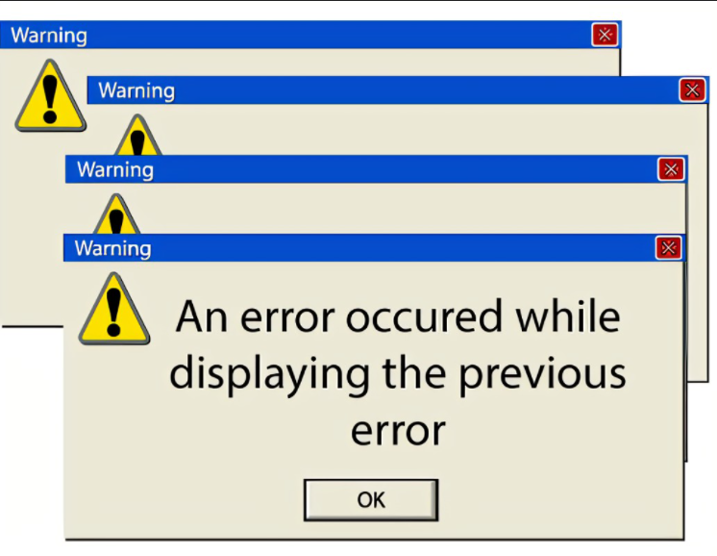
Digital Skills Courses
How to talk people through getting on line
How to learn online skills online?
‘What’s in the box?’ Telephone call
Notes:
The teaching of digital skills was the area of work most impacted on by the pandemic – both in terms of how to teach someone to use the internet virtually but also capacity issues as new clients on furlough look for more advanced courses. The report sets out useful approaches to advertising courses but this is an areas that could benefit from further work.
This work also highlights good practice such as a ‘what’s in the box’ telephone call to explain to people how to charge, turn on and connect a device. As well as follow up calls to ensure devices are being used and not just sitting on a shelf.

Slide 10
Access to Devices and Data
Libraries and community centres
Device lending libraries
Low cost purchase schemes
Notes:
Different contributors developed different approach to provide access to devices and data and these are explored in the report, with links provided to further information.
One key route is libraries, with Cheshire West and Chester providing 120 computers across 22 libraries. Including Storyhouse in Chester which has the longest opening hours of any UK public library and is open til 11pm every day.
Many authorities are working within their partnerships to collect and recycle unused digital devices – either through lending schemes or low-cost purchase schemes. Lending schemes aren’t just for those who cannot afford equipment, but are a chance for people to ‘try before they buy’ and understand the potential benefits of being online

Slide 11
Digital Inclusion Partnerships
Notes:
All contributors recognised the importance of their local digital exclusion partnership in taking forward this work.
Reflected under each outcome with different partners supporting consultation, training and device lending. As in so many areas, good partnerships are key
This experience is not explored in depth in the report but the toolkit does include the terms of reference of a number of different partnerships.

Slide 12
Toolkit
National Data Sources
Digital Exclusion Risk Index
Residents Survey Questions
Device Lending Process and Forms
Digital Inclusion Partnership ToRs
Signposting other toolkits
Notes:
Borrow, build on and re-share

Slide 13
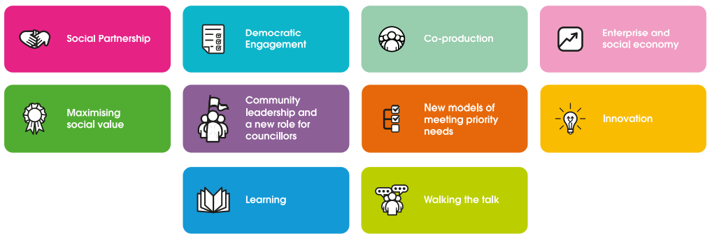
The Cooperative Difference
Notes:
Clear benefits to the way that all the Councils involved have worked together on this policy lab
Very much a cooperative approach
Really positive experience and we are all continuing to share learning and developments

