Slide 1

Community Economic Development Plans as a tool for fostering co-operative working between councils and the community
Birmingham City Council, Gloucester City Council Labour Group, Croydon Council, Milton Keynes Council, Sunderland City Council and Co-operative Futures

Slide 2
The Policy Lab
Explore how can councils effectively utilise Community Economic Development Planning.
Demonstrate best practice for Councils in developing and implementing CEDPs.
A report and framework will be produced to assist CCIN member councils in working with and empowering local communities to create CEDPs.
To compile learning from the UIA funded project Unlocking Social and Economic Innovation Together (USE-IT) and compare it with learning from other places in the UK

Slide 3
How do you build social capital in places with none?
Community organisation
Neighbourhood Forum
Community Development Trust
Community Land Trust
Neighbourhood Planning
Community owned business i.e. community energy, housing
Community engagement through arts, events, etc.
Community Research
Community organising
CEDP
Power
Public sector
Community
Community Wealth Building

Slide 4
Community Economic Development Plans
are a tool that can test:
Where the real appetite/readiness capacity is?
What the parameters are – is it possible at all? Is political support achievable?
What’s seen as a value (i.e. community empowerment may be difficult to embrace for young democracies scared by Communism)
Assess transferability of examples – Heart of Hastings (local people using a co-op model to own and control commercial property for local economic benefit), Collyhurst Big Local (seeking to disrupt top-down regeneration, gain control and unlock more opportunities for local people, focusing on local entrepreneurship and social enterprise), US (Cleveland Ohio cooperative model http://www.evgoh.com/ ), Italy (Turin see CO4Cities http://commoning.city/co-cities-experimentations/co-city/).

Slide 5
What is community economic development?
Depending whom you ask!
(Phillips and Pittman) “Most practitioners think of community [economic] development as an outcome – physical, social, and economic improvement in a community
while most academics think of community [economic] development as a process – the ability of communities to act collectively and enhancing the ability to do so.”

Slide 6
Attempts at definition:
(Green and Haines) “Democratic efforts to build assets that increase the capacity of residents to improve the quality of life in their locality.”
(Cawley) "...a deliberate, democratic, developmental activity focusing on an existing social (/economic) and geographical grouping of people who participate in the solution of common problems for a common good."
(Darby and Morris) "...an educational approach which would raise levels of local awareness and increase the confidence and ability of community groups to identify and tackle their own problems.
(Dunbar) "...a series of community improvements which take place over time as a result of the common efforts of various groups of people. Each successive improvement is a discrete unit of community development. It meets a human want or need."
(Huie) "...the process of local decision-making and the development of programs designed to make their community a better place to live and work.“
(Long) "...an educational process designed to help adults in a community solve their problems by group decision making and group action.“

Slide 7
The definition we used:
The overall focus is the economy. CED is all about re-shaping the underlying economic system in a place, rather than working on improving people’s capacity to live well within the existing environment
The economy is a means to an end, not an end in itself. Rather than emphasising economic growth as the end goal of local economic development, a CED approach is interested economic development which generates human wellbeing within environmental limits, at a community level
It is led by the community. In CED, the power to drive the change rests within the community of residents, local businesses, local service providers, community groups and voluntary sector organisations with a direct stake in the economic health of that area
Co-operatives UK – Community Economic Development – Lessons from two years action research
ran from April 2015 to May 2017

Slide 8
Some background:
Growth implies quantitative change, development emphasizes qualitative improvements.
Growth vs Development
Growth means more of the same … more jobs, more income, etc.
Development means using resources to enhance human welfare
Development can include growth, but not necessarily vice versa
Doughnut Economics (Kate Raworth)

Slide 9
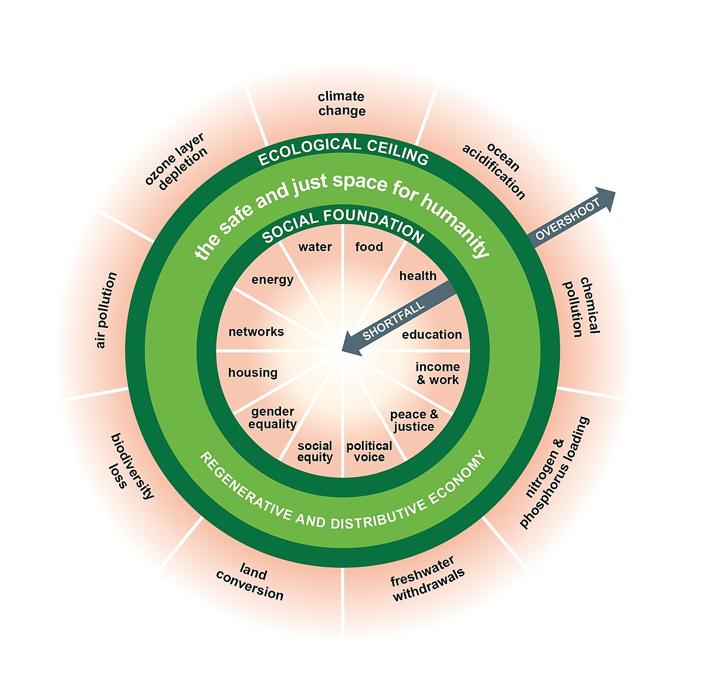
A “Triple Bottom Line” Approach? → Doughnut Economics (Kate Raworth)
Community Economic Development
Economics
Economics
Community
Environment

Slide 10
The Goal:
Living within environmental limits
- Resources
- Money /investment
- Decision-making
- Institutions
Economic activity at a scale to maximise social, environmental benefits.
Well-being
Notes:
If we are to strengthen the economy – we have to be clear on the overall goal - what outcomes are we trying to support with the plan at the outset
It is not enough to talk about supporting the economy to grow – this is not an end in itself – the economy is a means to an end
The purpose of an economy should be to support high levels of well-being for all, and be organised to ensure we live within our environmental limits
When we talk about strengthening the local economy under Community Economic Development we mean:
Making decisions about how resources, money and investment is made, the institutions (including businesses, financial institutions, community enterprises) we create and the decision-making processes – we are aiming to create economic activity at a scale to maxmise the positive social and environmental benefits.

Slide 11
Strong Local Economy
High levels of well-being for all within ecological limits
Positive local economic outcomes
Promoting a diverse, low carbon economy with equitably shared returns
Positive social outcomes
Promoting a fair, equal society, supporting high levels of well-being
Positive environmental outcomes
Safeguarding natural resources, living within ecological limits
Characteristics
Distinctive identity Good jobs Strong local multiplier Diversity of sectors & ownership A balanced regional economy Appropriate scale of production of goods and services | Well-being Shared ownership & control over key economic resources Ability to effect change Equality Interdependence – degree of linkage / collaboration | Ecology & biodiversity Efficient resource use Adaptation to climate change
Notes:
(Slide option1 or)
A strong local economy supports positive social and environmental outcomes
We understand this to be across a triple bottom line – positive local economic, social and environmental outcomes
This has implications – how we judge success
We recognise a strong local economy by a number of characteristics
Economic: diversity, distinctiveness, balance, appropriate scale. Importantly a strong local economy should support good jobs.
Good jobs =
Provides a decent income – enough to participate actively in society, and pursue a fulfilling life
Job satisfaction and opportunity for career progression
Secure, with reasonable working hours
Does not threaten environmental sustainability
Reducing environmental impact – opens up new economic opportunities
Environmental transformation of infrastructure – designed around accessibility to cheap fossil fuels
- Declining availability of fossil fuels – opens up new opportunities for local renewables, more localised food systems, transport and waste
- Increasing resource efficiency means – keeping resources in use for as long as possible, extract the maximum value from them whilst in use (circular economy).

Slide 12
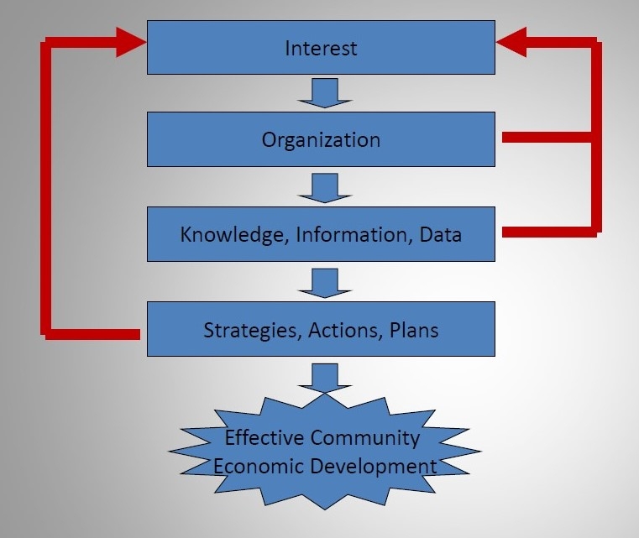
There must be a balance between the process of community economic development and the quality of the content of the educational programming.
In the end we aim to help the community make more informed decision: information is research based knowledge and making the decision is the process.

Slide 13

The community is a complex system and a systems thinking approach is required.
Its impossible to work on the whole puzzle at once, you need to focus on parts but keep the whole puzzle in mind.

Slide 14

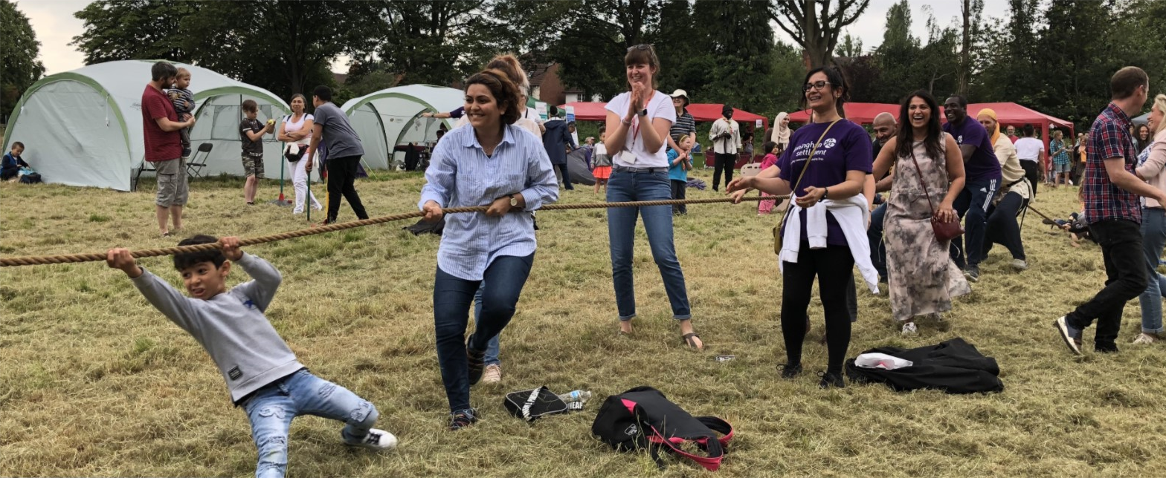
Community Economic Development Plans – Playing Field by the Reservoir
“Our vision is to create a secure space that will host a programme of wellbeing activities and provide access to shelter and to make the field a much more flexible space and enable the community to access it on a more ongoing basis.”

Slide 15
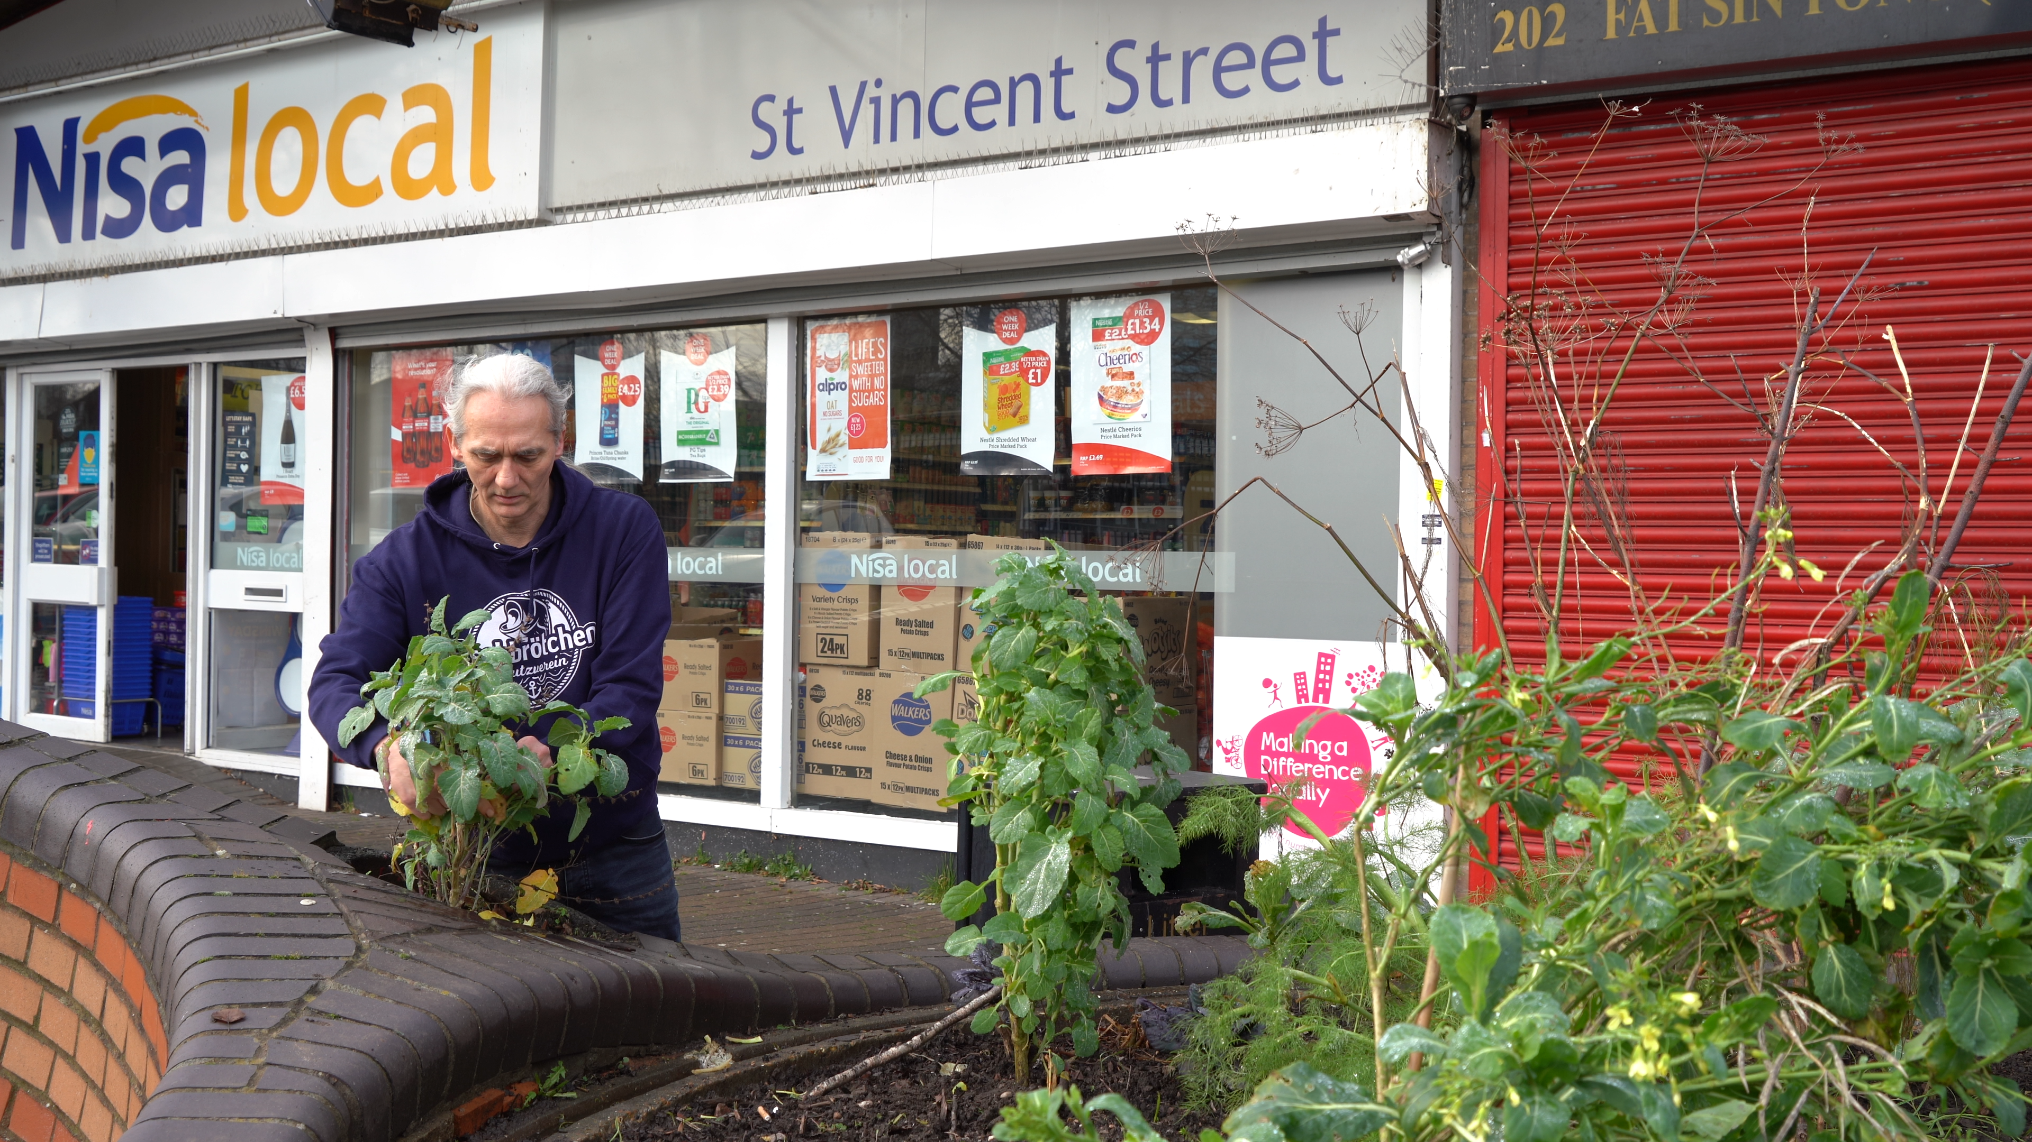

Community Economic Development Plans - EatMakePlay
“Eat Make Play was to provide everyday opportunities for the people of Ladywood to connect through sharing, learning, making, and doing together, involving activities around practical skills like food preparation, growing, art, crafts, sewing and DIY and also social activities and events which cost nothing to attend. We have an emphasis on making good use of resources, sharing, and improving our environment while reducing waste. Our project aims to benefit all of the residents of Ladywood working with them to shape the programme and development of the organisation to meet the needs and aspirations of our community.”

Slide 16
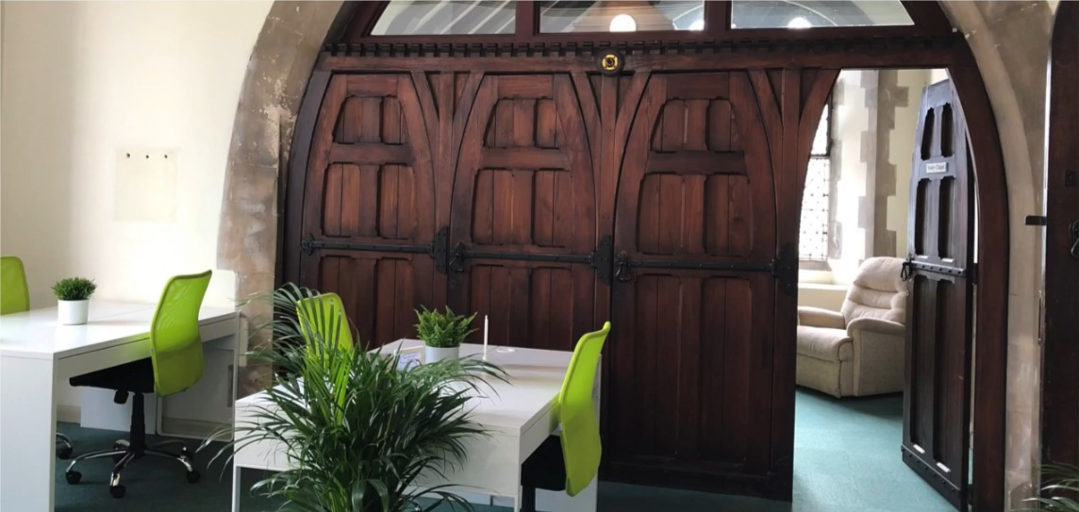

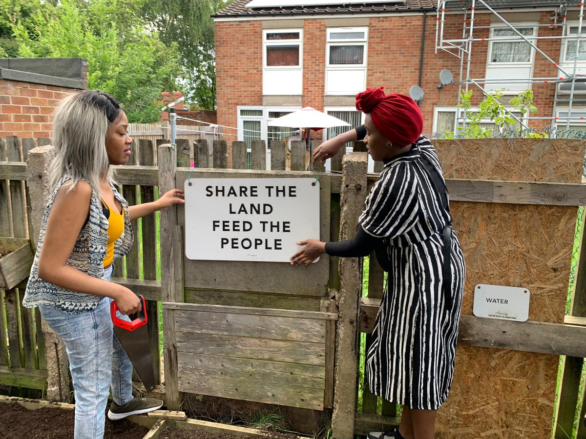

Community Economic Development Plans – ChangeSpaces
In early 2020, Smethwick ChangeSpaces was launched. This was a co-working office based in the old vestry chapel of Holy Trinity Church previously known mostly of their foodbank (one of the busiest in West Midlands)

Slide 17

Community Economic Development Plans –Soho and Jewellery Quarter
Two main areas of work:
Maximising benefits from Anchor Institutions & supply chains
b) Enterprise spaces and marketplaces

Slide 18
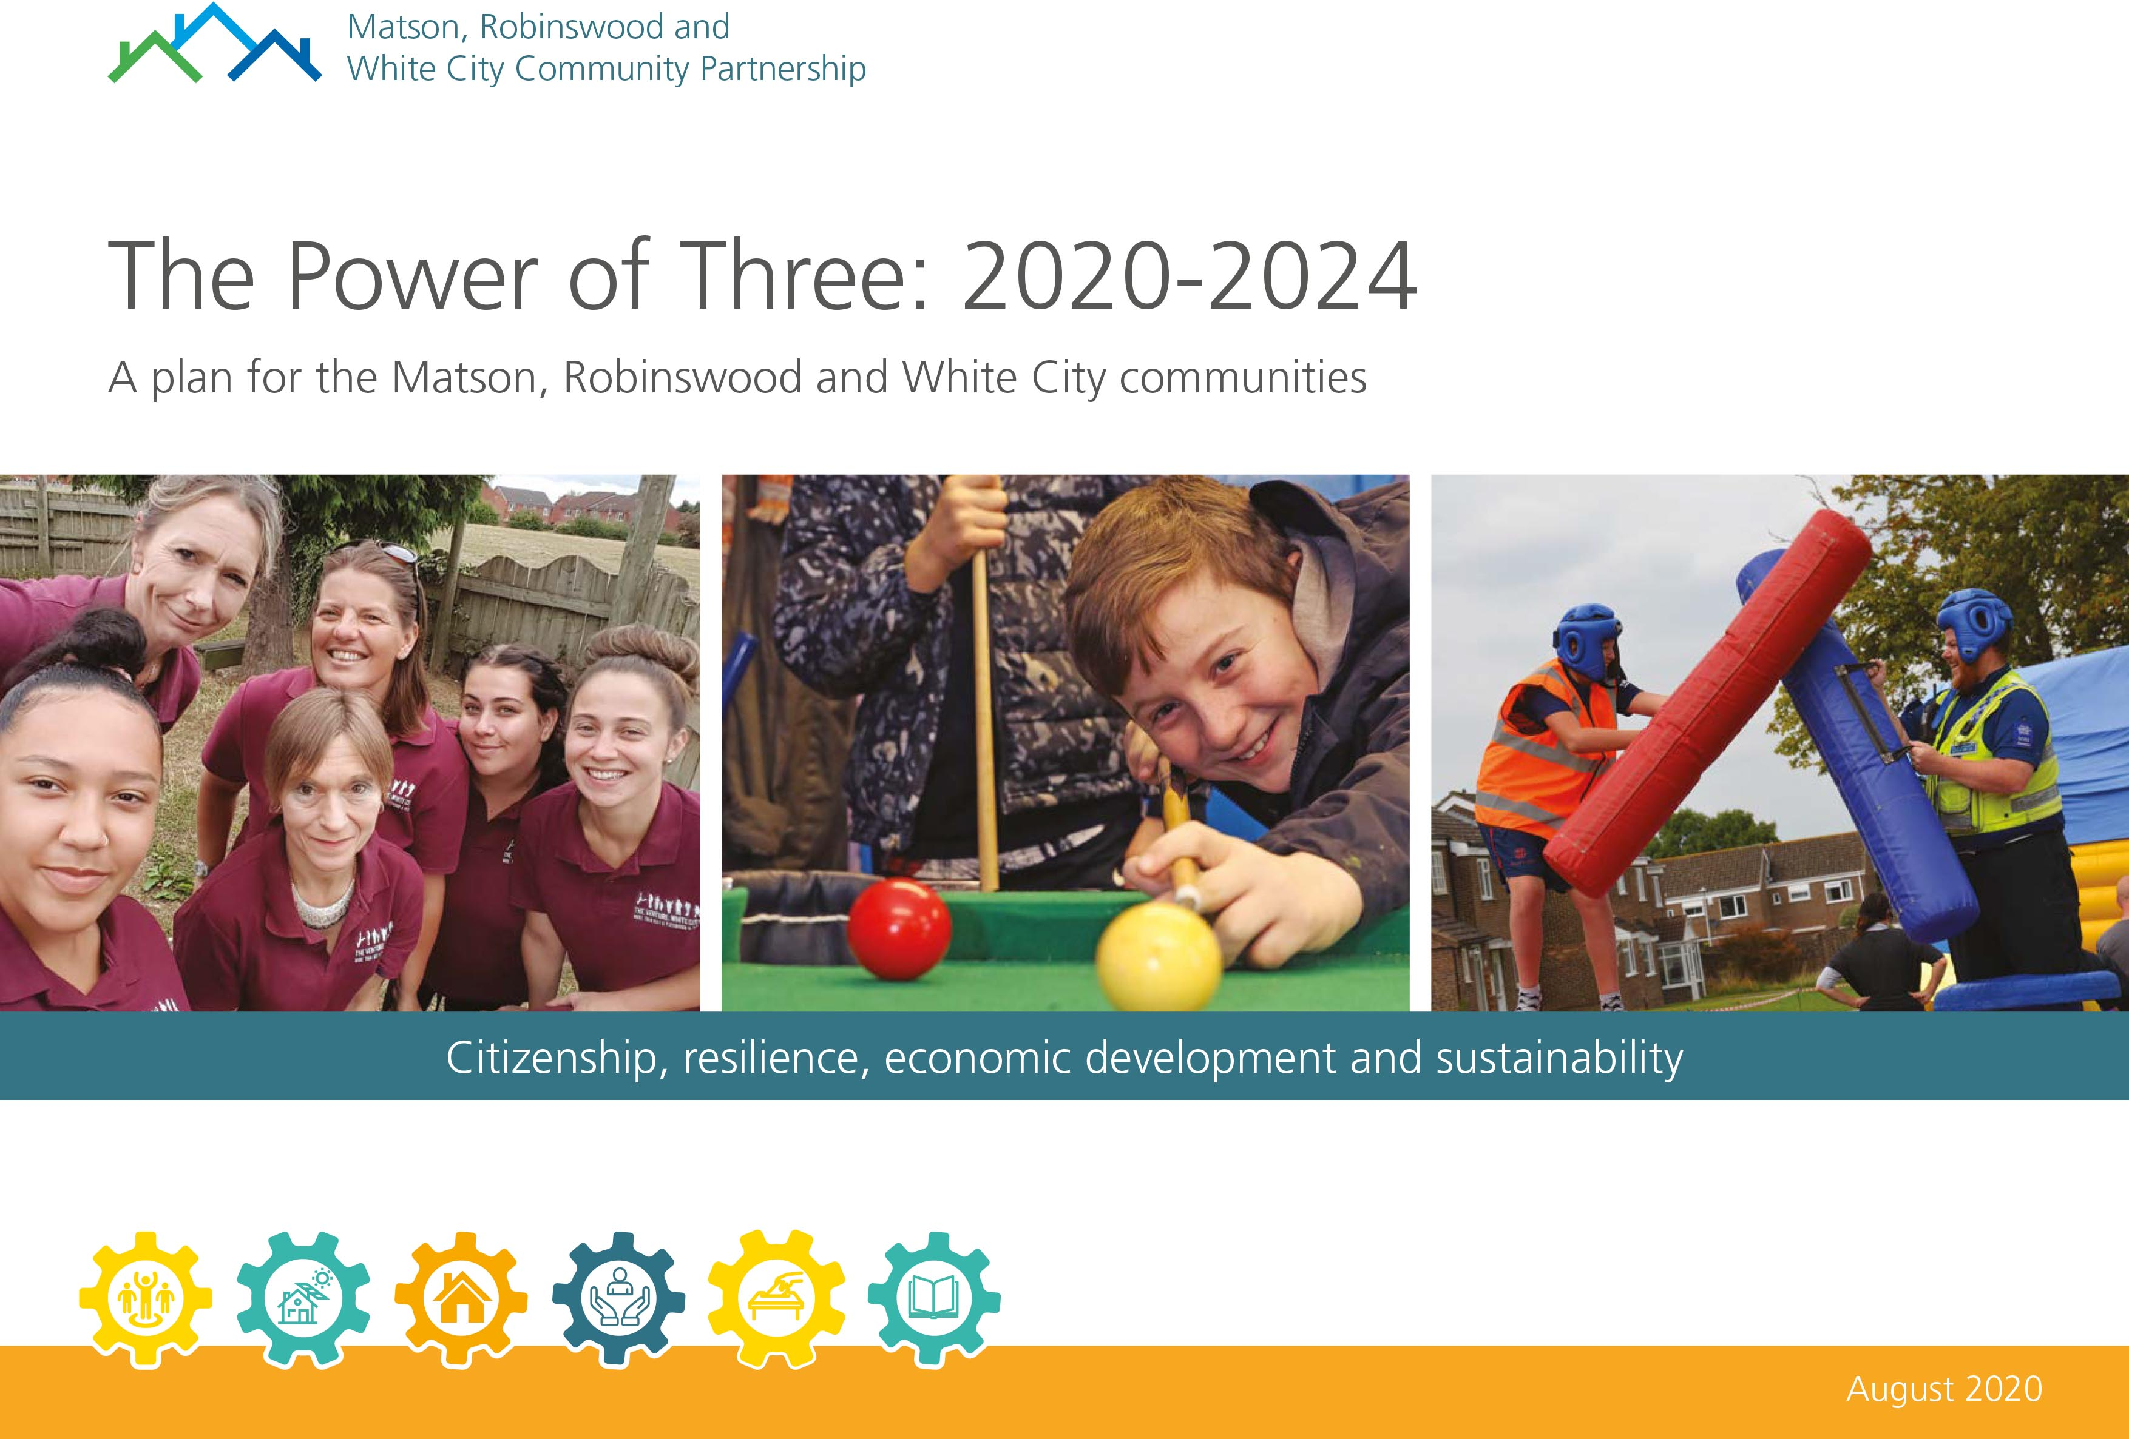
Community Economic Development Plans - Power of Three
“The top priorities of the first phase remain: reputation, leadership, transport, flexible care, community assets, housing, education and skills, and local businesses; but rather than seeing them as distinct issues to be tackled just from within the ward, the revised plan sees them as part of a richer tapestry of concerns that are on the agenda of the local authorities, the Health Commissioners, the Local Economic Partnership, elected officials, the University, social housing providers, providers of primary, secondary and tertiary education.”

Slide 19
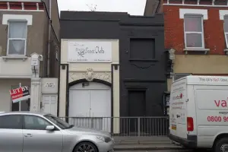
Community Economic Development Plans – We Love SE25
Socco Cheta Community Hub CIC successfully bid to run and renovate the Socco Cheta building owned by Croydon Council
The hub has three key aims that have been developed with the community:
Everyone has a place and can take part
To bring the community together
To support people in their lives and to make positive life choices

Slide 20
“In terms of successes, the CEDP has galvanised people and given them the confidence to believe that they can affect change.”
Karolina Medwecka, Birmingham City Council
“Going through the process was more useful than the outcomes of the process itself.”
Gareth Brown, Smethwick CAN
“It has created a framework and a forum for things to be progressed and discussions about where we can make a difference.”
Cllr Clive Fraser, Croydon Council
“The most important thing is time; it takes a lot of investment in time to build up trust, work out the dynamics of relationships, and actually start to write the plan.”
Dawn Barnes, The Venture

Slide 21

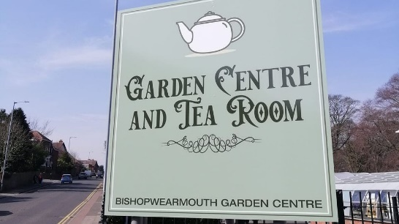
Community Wealth Building –
Sunderland City Council
Elemore Green Space, a former golf course which closed 7 years ago is being repurposed.
Sunderland City Council are now committed to developing the site and supporting the creation of a social enterprise, that will coordinate the running and activities held within the site.

Slide 22
Regeneration and Devolution - Milton Keynes
‘The community-led regeneration and estate renewal programme is an opportunity for residents to work with the Council and its partners to improve the lives of local people.’
Milton Keynes Council are pioneering the devolution of some services to Parish and Town Councils.

Slide 23
Learnings:
The knowledge of what is needed within a community is known by the people and organisations within those communities themselves and so they best understand what those areas need to be able to reach their full potential and thrive.
The support provided in developing the plans provides communities with the skills and confidence to take a lead in continued community economic development planning. This has led to a change in the way communities engage with Local Authorities, they are better placed to advocate for themselves and enable constructive conversations.
Local Authority support in community economic development planning can enable systems change to take place, rather than small scale activities.
Community economic development planning compliments other activities that Local Authorities are undertaking. Community economic development planning is a powerful tool for change but can only perform this function if it is embedded within wider policies, strategies, and plans.

Slide 24


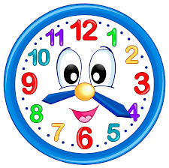

Elements of successful community economic development planning

