Slide 1
Support to the CCIN Green Recovery, Climate Change and Carbon Reduction Policy Lab
Update to Steering Group
Fanny Olsson & Elle Dodd
August 2021

Slide 2
Project overview
1: Identify
June
2: Explore
July
3: Develop
August - September
Meetings with Steering Group
Final Toolkit
Desk research & review of Climate Action Plans
Finalise themes & draft toolkit outline
Workshop 2: Transport and active travel
Workshop 4:
Homes, buildings and energy
Meeting with Steering Group
Workshop 1: Partnership and Engagement
Workshop 3:
Waste and circular economy
Draft first iteration of toolkit
Notes:
Purpose “To collate the climate plans of member councils and their constituent initiatives to consider the role cooperative values and principles have played in the development of these plans and initiatives and opportunities to strengthen this in their further development and implementation.”

Slide 3
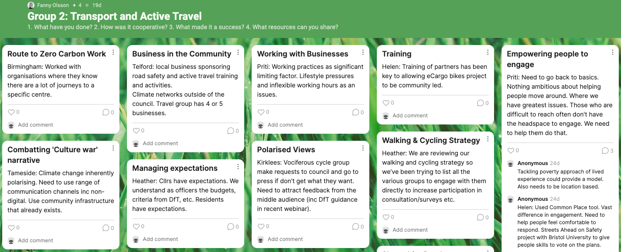
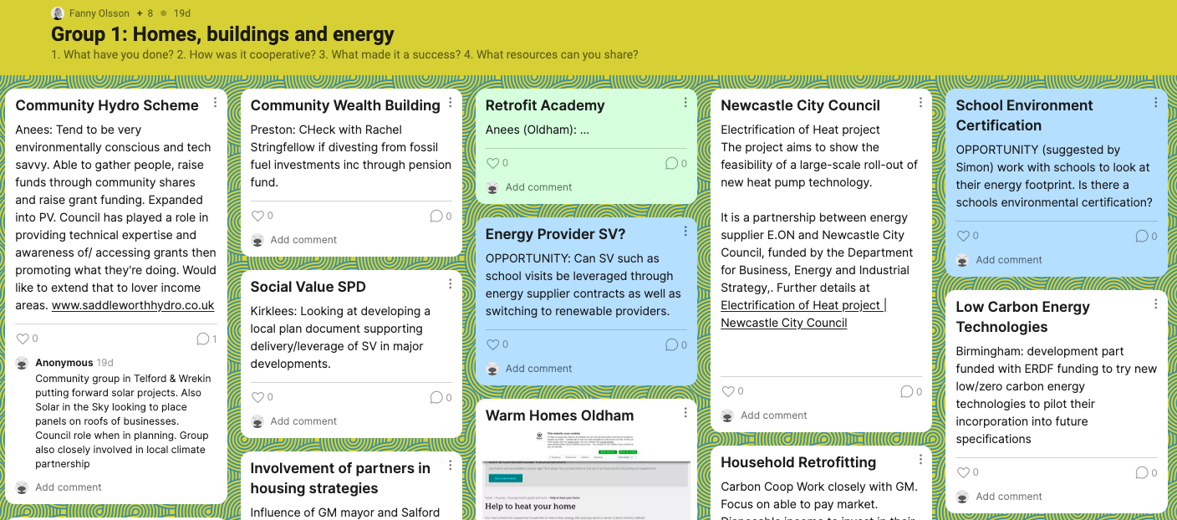
Workshop update
4 workshops
~40 people participants in total
11 local authorities were represented
The workshops focused on:
sharing good practice of green and sustainable initiatives
identifying the ways in which cooperative values and principles can enable good climate change policy and practice
Notes:
CWaC, Kirklees, Newcastle CC, Oldham, Preston CC, Rochdale BC, South Tyneside MBC, Sunderland CC, Tameside MBC and Telford & Wrekin

Slide 4
Toolkit outline
An opening page on why cooperative values and principles are good for climate change work
Climate change case studies which showcase examples that aligns with the CCIN values and principles
Areas of further exploration and things to build on
Conclusion

Slide 5
Examples of case studies

Slide 6
1. Social partnership: We will strengthen the co-operative partnership between citizens, communities, enterprises and Councils, based on a shared sense of responsibility for wellbeing and mutual benefit
2. Democratic engagement: We will support the active engagement of the full range of residents in decision making and priority setting
3. Co-production: We will develop systems that enable citizens to be equal partners in designing and commissioning public services and in determining the use of public resources
4. Enterprise and social economy: We will promote community-based approaches to economic development that focus on supporting the creation of jobs, social enterprises and other businesses and providing an environment for co-operative and mutual enterprises to thrive
5. Maximising social value: We will support the development of a framework and criteria for social value, giving substance to the concept and supporting Councils with the tools to ensure better local social and economic outcomes
6. Community leadership and a new role for councillors: We will explore ways for councils to act as a platform for helping the community to contribute to local outcomes, and to re-think the role of councillors as community connectors, brokers and leaders
7. New models of meeting priority needs: In exploring new ways of meeting the priority needs of our communities we will encourage models, such as co-operatives and mutuals, which give greater influence and voice to staff and users
8. Innovation: We will embrace innovation in how we work with local communities to drive positive change
9. Learning: We will capture and ‘expand’ the experience and learning from individual projects and approaches in order to encourage broader application of co-operative principles within individual member Councils and across the Network
Notes:
We have reached out to 9 councils, asking them to provide additional information via a survey for approx. 30 case studies. Most of these speak clearly to the 5 first values. Value no. 7 is represented in several of the other values and we will cover value 8 and 9 in the final section of the report as an area of further exploration and opportunity.

Slide 7
Social Partnership
Kirklees | Alignment of priorities across services - Public Health, Transport Planning, Highways Road Safety, Environmental Health, Communities, Education to design and deliver active travel in school settings (reviewing the whole system)
 | Food and cookery workshops in communities seeking to reduce food waste with a focus on low income areas in turn reducing food poverty.
Telford and Wrekin | Worked closely with local businesses to help adopt green practice (funding for specific initiatives, e.g. in school canteens)
Birmingham | Anchor network approach, CWB focus.
 | Collaborative cross-sector taskforce after climate emergency declaration, reviewed working versions of the action plan
Cheshire West and Chester | Working with local agricultural stakeholders to develop the potential for anareobic digestion of farm waste & biomethane production (potentially with CCS in future). This seems to stack up as a commercially viable case based on existing revenue streams for low carbon fuels.
Oldham | Built 19 new homes with low carbon heating - Worked with other Councils and universities across Europe to develop and implement the model. All properties are occupied and residents are benefiting from low carbon living. Specifications, learning from tenant experience
 | Warm House Oldham, Working with Councillors, residents, energy companies, installers, charities and third sector organisations. Provided a safety net for residents in fuel poverty, particularly important during the pandemic lockdowns. Oldham working across council depts. Used COVID winter support funding to alleviate fuel poverty as well as food poverty.

Slide 8
Democratic engagement
Tameside | Green Summit
Cheshire West and Chester | Multi activities open community events (variety, good location, suitable time) – better than questionnaire
Preston | Climate Action Preston delivering Young People’s Summer Roadshow to get YP input on climate issues
Telford and Wrekin | Using opportunity to reengage residents in walking and cycling strategy

Slide 9
Co-production
GMCA | Clean Air Plan for GM – co-produced. GMCA. Engaged service users and residents in development of GM transport – did shift the plan
 | Influence of GM mayor and Salford Leader on GM Housing Strategy bringing in co-production. Inc housing associations and VCS Carbon Coop
Tameside | Godley Green. Emerging Partnership with ENW to future proof initial phases of development post planning , e.g. charging points, Solar Panels; link to existing energy network. Shared vision through early engagement, opportunities for enhanced R&D and Knowledge Transfer. High School adjacent to site - further opportunities to collaborate with the school

Slide 10
Enterprise and social economy
Kirklees | Collaboration with the WYCA to promote behaviour change funding they have to engage with businesses, linking them with our Economic Resilience team who host a web platform called Kirklees Business Hub, for the benefit of increased promotion and engagement with businesses in Active Travel offers.
 | Collaboration with School re cycle and scooter parking. We found a local fabricator who produced some designs and built the racks at a discount. The council helped promote and match funded the monies raised.
Birmingham | eCargo scheme - training of partners has been key to allowing eCargo bikes project to be community led
 | eBike Brum - community-led cycling activities. Active Wellbeing Society - cycling on prescription. Funding bid
Telford and Wrekin | Solar in the Sky looking to place panels on roofs of businesses. Council role when in planning. Group also closely involved in local climate partnership
Oldham | Bulky Bob, social enterprise. Employs individuals with barriers to work, e.g people with special educational needs
 | Community Hydro Scheme. Council has played a role in providing technical expertise and awareness of/ accessing grants then promoting what they're doing. Would like to extend that to lower income areas.

Slide 11
Maximising social value
Birmingham | Business Charter, incorporates social values leading to Veolia supplying Education. Apprenticeships. Community grants. Educational material. Importance of leveraging commitments from major providers.
Kirklees | Promoted circular economy approaches to local manufacturers through a series of webinars and support in partnership with Leeds Uni and lining businesses up for support through combined authority funding. Response was reasonable from local businesses, through the first phase. CE is not a very familiar concept for many but other do like Camira (ocean recycled fabric) or use bigger policies like IKEA. Can share questionnaire, slides - worked with Leeds Uni
Preston | Collaborative approach to climate emergency declaration and social value procurement work
Telford and Wrekin | Veolia run an educational workshop programme for school children and groups. E.g. Junior Street Champion prog. KS1 & KS2. In conjunction with community participation team. Target of 50 schools within contract year. Prog of 10 workshops. Veolia have developed online workshop that can be delivered by them or by teachers. And school eco committees. Litter picks and helping schools think about how they are reducing their waste.

Slide 12
Community leadership and
a new role for councillors
Can you give an example of where your Council or Councillors has been a platform for helping the community to combat climate change, for example as community connectors, brokers and leaders?

Slide 13
Survey questions
Which Local Authority is this case study from?
What was the aim or purpose of the work?
What did the Council do?
Please provide an overview of the councils role/s and actions.
What was the outcome?
Please explain what the work has achieved, and the benefits it has brought.
What happen to make it a success?
Please provide a few examples of specific things that the council or its partners did and why they made a difference.
Which of these co-operative values does it most relate to?
Please explain why you think it relates to that value

Slide 14
Next steps
Survey deadline is 20 August
Next steering group meeting is on the 9 September at which we will provide an update on the work, including sharing draft case studies

Slide 15
Fanny Olsson | Practice Development Manager
fanny@collaboratecic.com | collaboratecic.com

Slide 16
About Collaborate CIC
We are a social consultancy and research organisation that helps people and organisations work together to tackle complex social challenges. We do this by supporting communities and partners in places across the UK to develop the relationships, behaviours, leadership and infrastructure that enable collaboration. We produce practical tools and frameworks that influence the debate about social change, work to build a movement for collaboration and help people to collaborate in their own contexts.
Anna Randle, Chief Executive
Elle Dodd, Snr. Head of Practice
Fanny Olsson, Practice Development Manager

