Slide 1
Understanding The Digital Divide

Slide 2
Partners
Cardiff Council
Cheshire West and Chester Council
Greater Manchester Combined Authority
Kirklees Council
Newcastle Council
Plymouth Council
Rochdale Council
Sunderland Council

Slide 3
Understanding the Digital Divide
Improved understanding of available data
Approaches to residents consultation
Informing Adult learning approaches
Targeting access to digital learning within community venues
Access to equipment
Notes:
COVID-19
Cut across the programme BUT created interesting learning
Challenge of moving to virtual working for so many areas of work, and then trying to understand those people who cannot connect digitally.
Key issue for running consultations, for learning approaches, huge impact on use of community venues

Slide 4
Improved understanding of available data
Seeking to understand what information is out there
Performing a survey to hear what works and what doesn’t
Creating a toolkit discussing pros and cons of options
Notes:
Most DI projects begin with an attempt to quantitatively and qualitatively assess the impact of exclusion in a borough. There are lots of ways to approach this and it’s hard to unpick which avenues are worth pursuing.
We are collating information on datasets used by councils to understand the geographic and demographic shape of digital exclusion in a given area, as well as the number of excluded residents.
Asking for feedback on datasets and research methods used by other councils, with a view to creating a rounded toolkit discussing the options available and the benefits of each.

Slide 5
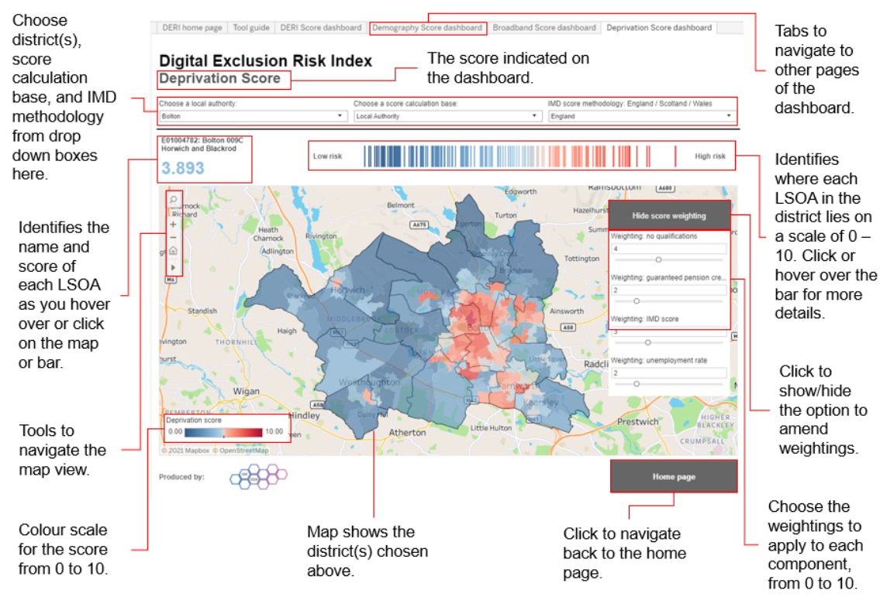
Improved understanding of available data
Notes:
Digital Exclusion Risk Index

Slide 6
Approaches to residents consultation
Developing and sharing a bank of survey questions – also allowing comparison of results
Consultation approaches
Libraries and community centres
Customer contact centres
Face to face outreach
Notes:
Low footfall in libraries and community centres – many have been closed or still with low footfall
Using contact centres to ask people calling in to complete short survey – picks up on those people who are choosing to interact by phone rather than web
Using COVID marshalls, community wardens to complete using tablets in deprived wards where lowest response rate
Pushing through CVS partnerships using hard copies and F2F discussion
Sunderland - big issue being paying for data. This is being refined further to look at ward level and consider free WIFI hotspots
Why are people excluded – device, cost of data, notspot, skills, interest
To what extent are they excluded. Spectrum - not binary.

Slide 7
Informing Adult learning approaches
Mapping the offer, uptake and satisfaction and identifying gaps
Change of focus with new cohorts of learners – those on furlough or newly redundant
Challenge of how to teach digital skills virtually
Advertising courses – digital skills are a means to an end for many people
Notes:
What’s In the Box telephone training by Newcastle – done by phone and talk people through opening up their new device, how to plug it in , how to charge, where the on button is
Little take up for ‘essential digital skills’ courses – focus on how to:
employment (how to find and apply for work digitally;
health (making a virtual GP appt);
family (how to support your kids);
and life (more general skills)

Slide 8
Targeting access to digital learning within community venues
The outcome most impacted on by the pandemic
Closure and reduced footfall in community venues and libraries
Specific Hubs developed in areas of deprivation (by IMD), loaning devices with the hubs there for skills and connectivity

Slide 9
Access to Equipment
‘Try a chromebook, try a tablet’ library
Range of programmes gifting or selling cheap equipment
Access is not the same as use
Key issue around enabling accessing to data
Notes:
Variety of approaches to enabling access to equipment
Chromebooks – very safe, easy to wipe and re-use
Some found issues not having access to word. Very data dependent
Lending libraries
Kirklees digital hubs are in areas of deprivation (by IMD), loaning devices for three month periods, with the hubs there for skills and connectivity. Exploring potential for a rural hub, focus on will/skills rather than affordability
Well worth paying more for unlimited data
Need to go back to people during the loan period – ensure they’re still using, haven’t hit problems
Put systems in place for understanding the level of use – benefit
When people give equipment back do they simply become digitally excluded again?

Slide 10
The Toolkit
Digital Exclusion Risk Index
National Data Sources
Residents Survey Questions – Cardiff Council
Resident Survey Questions – Cheshire West and Chester
Residents Survey Questions – Newcastle Council
Residents Survey Questions – Plymouth Council
Residents Survey Questions – Sunderland Council
Digital Device Lending – Kirklees device loan process and forms
Digital Device Lending - Which device?
Digital Inclusion Partnership Terms of Reference - Cheshire West and Chester
Digital Inclusion Partnership Terms of Reference - Kirklees
Digital Inclusion Partnership Terms of Reference – Plymouth
Links to additional information

Slide 11
Governance approaches
Not originally identified as a theme, but a key point coming through discussions
Range of partnership approaches and contexts
CVS organisations have been key to outreach in many areas

Slide 12
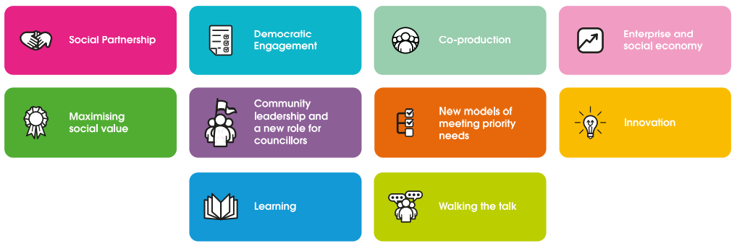
The Cooperative Difference

