Slide 1
VCFSE Update Oldham CCIN Network Dec 21

Slide 2
VCFSE Role in Covid19 Response
VCFSE organisations have been critical partners in Covid19 response
Strategic leadership
Humanitarian aid
Adapting services to maintain provision
Community Engagement
Volunteer recruitment and deployment
Action Together have played a key role in all of this, as well as fundraising and managing the distribution of funds to the sector
Raised funds through JustGiving and launched Covid19 Response Fund
Distributing pooled funds from Thriving Communities, Standing Together & Housing Providers
More than 146 organisations have been supported through Covid19 Response Fund, totalling more than £170,000
Also supported in distribution of DEFRA Emergency Assistance Grant & Community Champions

Slide 3
VCFSE Role in Covid19 Response
However there remain challenges for the sector during this time
Came into pandemic with low financial resilience
Reduced opportunities to generate income
Volunteers isolating / shielding
Rising demand
Some activities unable to operate, others with more demand than ever
Emergency funding is just that – often doesn’t cover core costs
Used COMF funding to establish fund to support the sector in Covid19 recovery - £200k One Oldham Fund Established
Enabling them to continue to play critical role
Supporting sustainability of organisations in the longer-term

Slide 6
VCFSE Sustainability & Investment

Slide 7
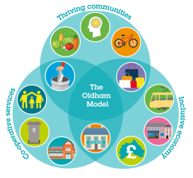
‘Our ambition is to empower communities to do more for themselves and to develop an asset based approach to early intervention. This is dependent on a sustainable and thriving VCSFE sector.
We aim to develop a strategic approach to investment in the sector, bringing internal and external funding together to invest around shared priorities and outcomes for Oldham.
This will be at the heart of a wider approach to supporting the sector from our social value procurement policy, how we use our physical assets, to how we develop a new approach to commissioning.’
Oldham Locality Plan
Notes:
This slide is to provide some context to this work – we’ve made commitments as a partnership within the Locality to plan to investment in the sector, and to supporting their sustainability through other policy such as social value and use of physical assets. This is recognition of the sector’s role in delivering health and wellbeing outcomes through a whole range of different activities and interventions.

Slide 8
GM VCFSE Commissioning Framework Recommendations
Embed the importance of the VCFSE
Invest strategically in the infrastructure required for building community capacity
Better knowledge, understanding and access
Accessible procurement and a strategic approach to grants
A core focus on co-design and co-production
Embed social value
Develop and implement evaluation framework
Notes:
Just to put this in context of current policy thinking around this; GM VCFSE commissioning framework which was published earlier this year and includes a series of recommendations with regards investment in the sector. Recommendations 2 & 4 specifically make reference to grant investment to the sector and ensuring there is investment in core infrastructure to support the sector, but also ensuring the grant giving is strategic and aligned to core priorities. [include quotes]

Slide 9
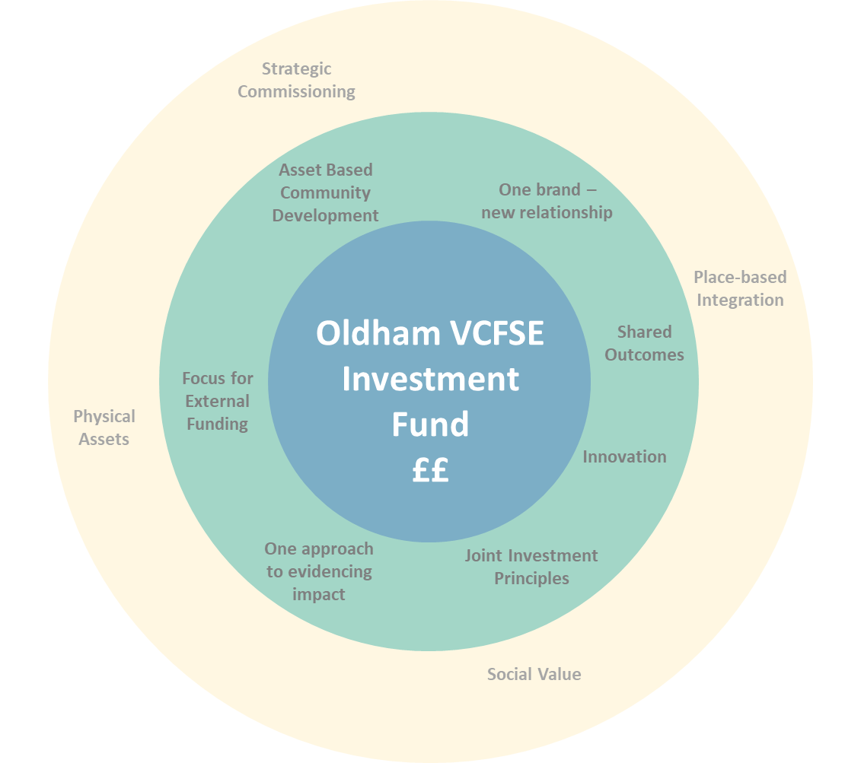
Single Investment Fund Concept
Pooled resources to invest strategically with joint investment principles and governance
Invest to deliver shared outcomes (aligned to key priorities; community wealth building, tackling poverty, place-based working)
Single brand, single process, one approach to evidencing impact – clear signal to sector
Focus for external funding
Align to support capacity e.g. community development, evaluation
Opportunity to drive innovation
Notes:
Purpose
Ensure investment in the sector is coordinated and aligned to our broader strategy.
Identify key priorities and intended outcomes based on population need, existing assets and gaps within the sector.
Act as the vehicle for all existing, planned and new grant investment into the sector.

Slide 10
Links to Community Wealth Building
Objective
Social Value Procurement
Social value from public sector spend contributes to the local VCFSE ecosystem through partnerships or investment, and supports VCSE service providers
Consider links to market development of sector & asset-based commissioning
Social Enterprise
Start-up and development of enterprise with social purpose is encouraged and aligned to key sectors and priorities for social and economic recovery.
Proactive engagement with market to encourage social enterprises as suppliers and within supply chains.
Physical Assets
Community use of public service assets delivers social value through a cooperative approach to usage of land and buildings, including through asset transfer.
Activity
Co-development of Social Value TOMs framework
Engagement of sector
Local Access Programme/Oldham in Place – engagement event & bid development
LGA funded expert support to community centre network – linked to O&S review of CAT
Engagement, co-production & co-design
Notes:
I wanted to include just a quick slide on where this work on sustainability of the VCFSE sector has been linking with elements of the community wealth building work so far.
Social Value can support the sector through in-kind and direct investment, as well as potentially through promoting the use of VCFSE organisations within the supply chain or as providers. So we’ve been involved in the co-development of the TOMs framework, and there’s more to do in engaging the sector in the use of the portal as providers.
Similarly Social Enterprises make up a proportion of our sector locally, and we want to encourage growth of this. Not all community orgs can be social enterprises but it’s important for organisations with a social purpose to be considering that business model where there is an opportunity for income generation. We were involved in initial bid development for Local Access and Action Together remain a key partner as the In Place programme develops, this provides a real opportunity to develop financing models which can work for community led or community focussed organisations.
Likewise we often share our physical assets with VCFSE organisations, and this can provide real security which may not be available through other landlords and an opportunity through CAT to leverage investment through a long-term lease etc. Involvement with CAT steering group in implementation of revised process and O&S review of this, plus brought in a small amount of expert resource through an LGA grant to support community centre network to develop re-ision their role, develop some shared infrastructure and develop ways to demonstrate their value which makes a potential investable proposition.

