Slide 1
Social Value

Slide 2
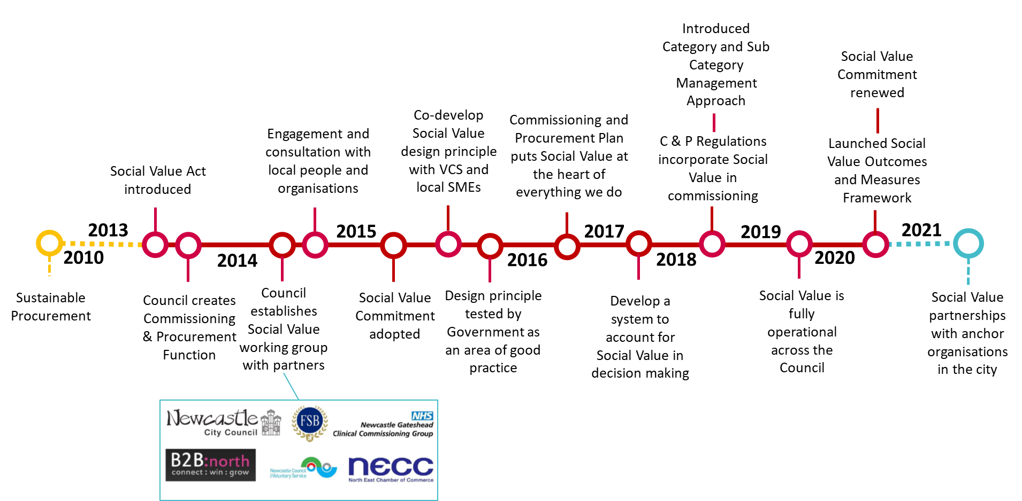
Journey so far

Slide 3
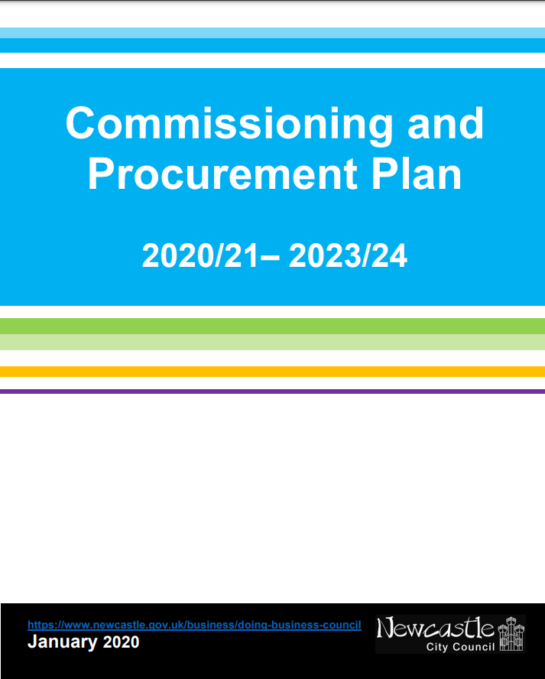
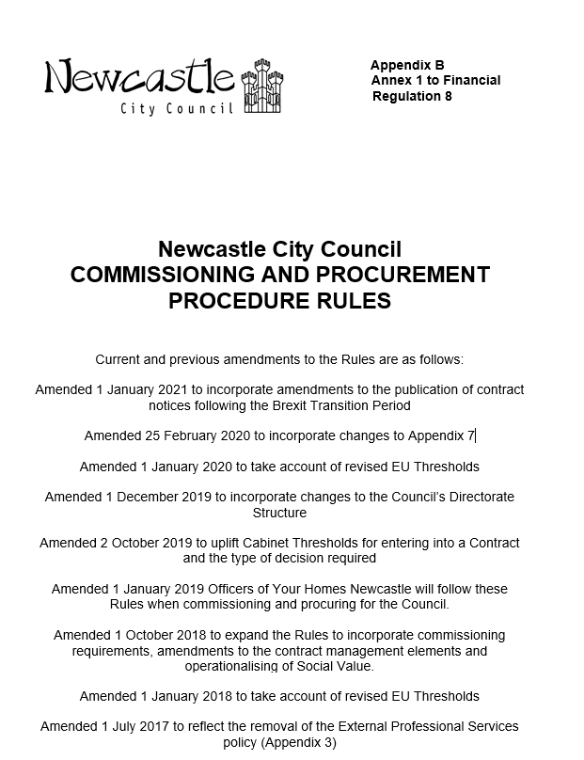
Social Value Commitment
Social value policy & leadership

Slide 4
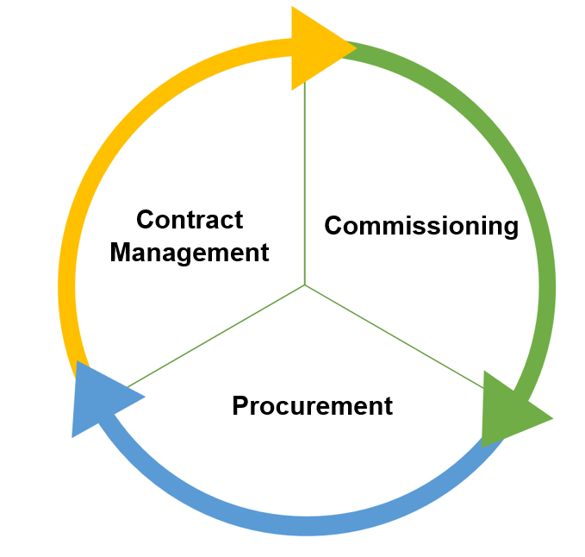
Measure through:
Performance reporting
Qualitative case studies
Contract meetings
Develop capacity through:
Market consultation
Sharing best practice
Identify through:
Market analysis
Impact assessments
Engagement Consultation
Design though:
Contract specification
Lotting
Contract length
Delivery Location
Tender readiness support
Reflect design in:
procurement routes
Design through:
performance measures
tender evaluation questions
X
Not just an add-on during procurement
In the planning, design and delivery of services

Ways of working

Slide 5
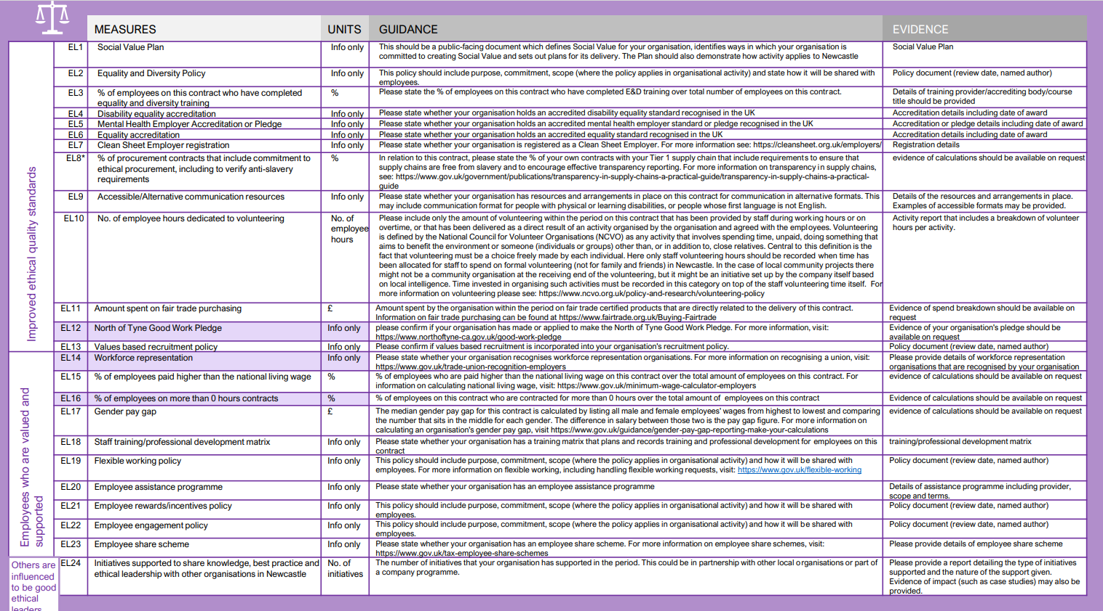
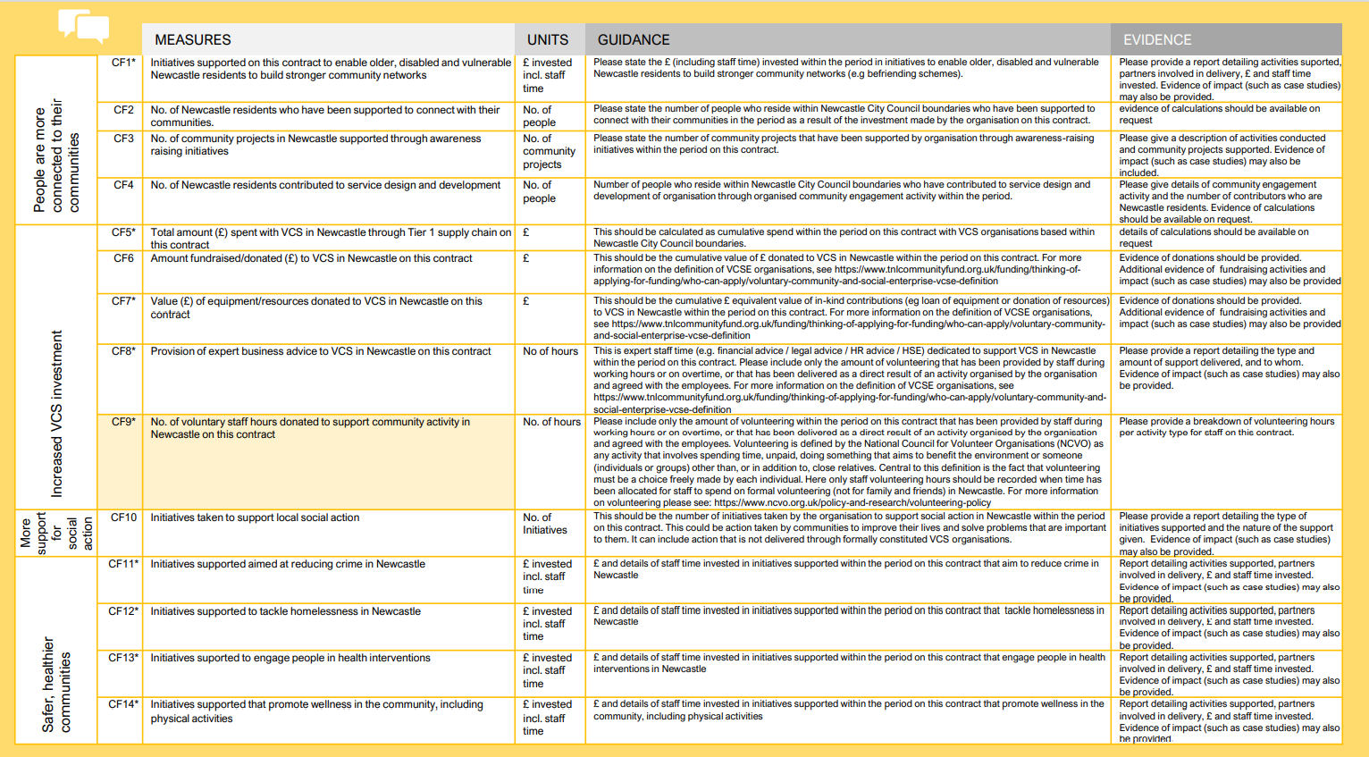
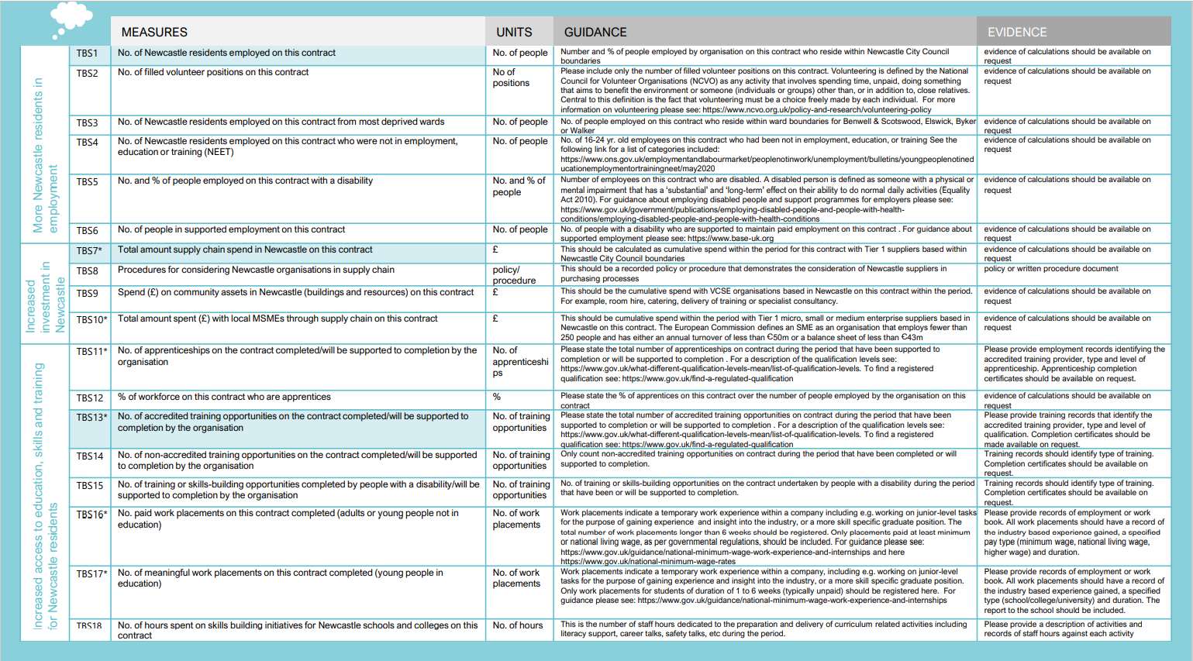
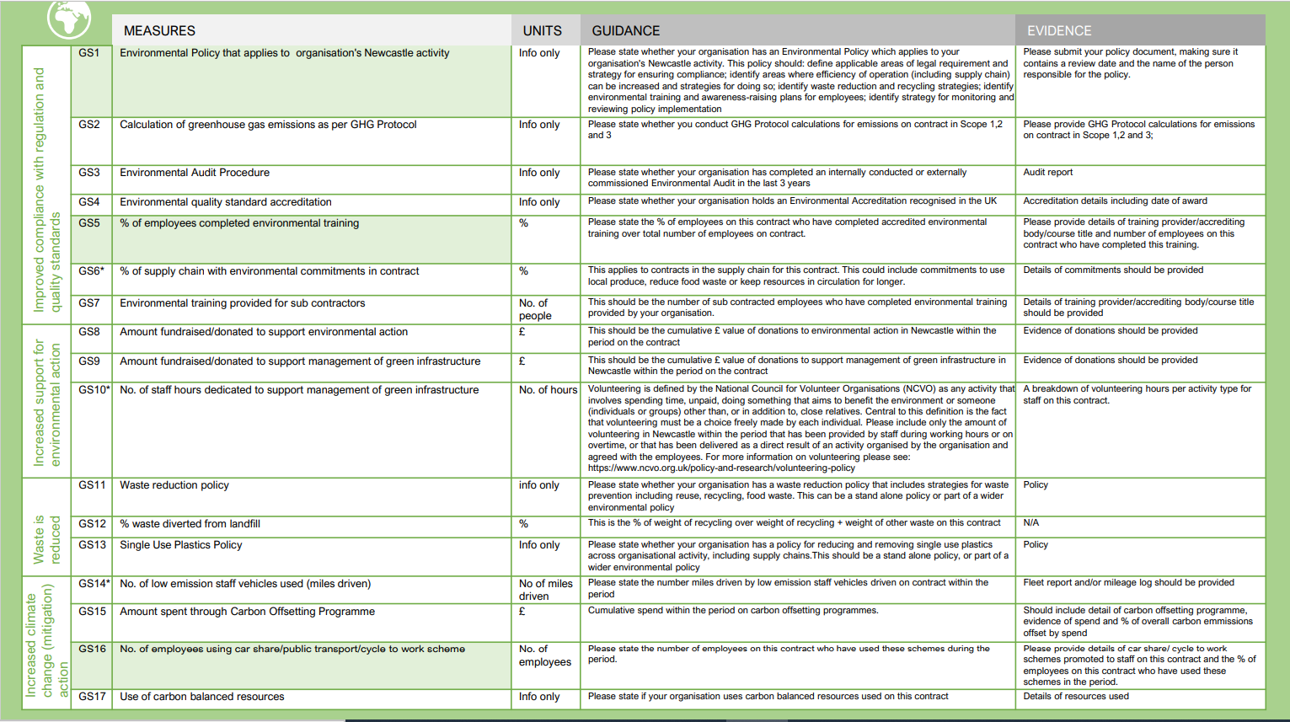
Design tools

Slide 6
Levelling up
Procurement Reform Green Paper
National Procurement Policy Statement
Social Value
COVID response
Decarb/Net Zero action
PPN 11/20 Reserving Procurements
Social value in LA focus

Slide 7
Renewals
New policy agendas
Grant funded procurement
COVID/contract delivery
COVID/pressures on buyers
PPN guidance/no legislative change
Procurement reform burden
Sustained budget cuts
NO ADDED RESOURCE
Challenges for commercial teams

Slide 8
Recognise these pressures in our organisation
Set our priorities for procurement at the highest level
Make procurement everyone’s business – understand service areas’ requirements of commercial teams
Understand our legal position and how we manage risk – share across organisation
Build social value into every part of the commissioning and procurement process, ensuring buy in and participation across the organisation
What can we do?

