Slide 1
Being a Co-operative Council

Slide 2
with CCIN
Encourage Members and Officers to undertake CCIN certified training modules
Offer CCIN accredited training courses for member and officer development
Actively participate in the CCIN Officer Network
Member of the CCIN governance
Engaged in Policy Labs and / or Prototypes
Engaged in WhatsApp Groups
Submit regular Case Studies for inclusion on CCIN website
Engage with CCIN social media channels
Use the CCIN Dynamic Purchasing System to bring in capacity & expertise

Slide 3
as a council
Signed the ‘Councils for Fair Tax' Declaration
Pay Real Living Wage
Are part of a Real Living Wage City/Borough/Town
Signed the ‘Modern Slavery’ Charter
Identified a Co-operative Champion (Member &/or Officer) for the council
Actively encourage co-op innovation within staff teams
Playing a central-role in tackling the Climate Emergency

Slide 4
community wealth building
Promote a progressive procurement policy
Support the creation of a regional mutual/community bank
Work with local anchor institutions to buy local
Regulate rent and rates for ‘local’ businesses in council-owned property
Local Employment schemes
Insourcing Council Services as an objective
Offer business rate rebates for those that become Living Wage Accredited

Slide 5
co-operative placemaking
Committed to community engagement
Invest in local community Share offers particularly those focusing on community energy
Supporting local enterprises to convert into coops/worker coops
Established a cooperative development network
Established a co-operative development strategy
Have an Asset Transfer policy to manage land and assets which support Community Land Trusts
Investigating ways to develop community energy production in order to tackle the climate emergency

Slide 6
The icons should be used to demonstrate how Co-operative Councils are putting our co-operative principles into practice, demonstrating the ‘cooperative difference’ in the work that they are doing.
Councils and organisations who receive CCIN funding to undertake Policy Labs and Policy Prototypes are asked to adopt these icons to show the ‘co-operative difference’ from this project work.

Slide 7
Our Values
Whilst not a registered co-operative, the CCIN has adopted the Co-operative Values developed by the ICA:
Co-operatives are based on the values of self-help, self-responsibility, democracy, equality, equity and solidarity.
In the tradition of their founders, co-operative members believe in the ethical values of honesty, openness, social responsibility and caring for others.

Slide 8
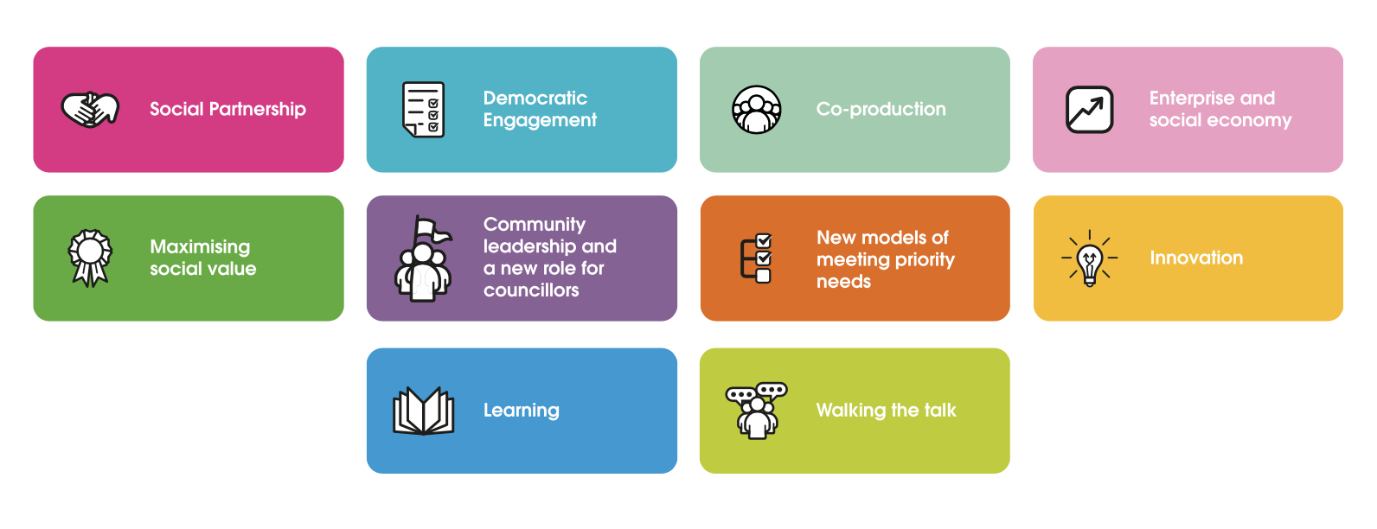
Our Principles
https://www.councils.coop/about-us/our-values-and-principles/

