Slide 1
Inclusive Procurement in Kirklees
An ongoing journey…
CCIN Officers Call – November 2021

Slide 2
Inclusive Economy in Kirklees: the Seven Box Framework
Spend with Local Impact | Anchor organisations purchasing in a way that encourages local providers to bid for work and incentivising providers to commit to increasing social value (e.g. employing apprentices) through the delivery of these contracts.
Employment & Skills | Ensuring that education, training and skills opportunities are open and accessible to people from all places and backgrounds, and that they are prepared for good work that pays a living wage and provide paths to professional development.
Assets | Recognising that anchor organisations hold significant assets that can be made available to community organisations. This includes estates but also equipment and other goods.
Tackling Poverty | Part of our economy being inclusive is doing the most we can to avoid individuals and households falling into poverty and guaranteeing that when it happens that support is provided to quickly help them out of poverty.
Grassroots | Supporting new and existing community organisations and engaging them in the development of plans and services is essential to ensuring creation of an inclusive economy.
Understanding Local Impact | Developing an economy that serves individuals from all places and communities requires that we understand how skills, assets and needs differ in order that we can deliver targeted interventions and measure impact.
Environmental Sustainability | It is now widely acknowledged that we are in the midst of a climate emergency and that we must transition – locally, nationally and globally – to a low carbon economy. This must be a just transition that does not further disadvantage already disadvantaged groups – particularly those that have been impacted negatively by previous industrial transitions.

Slide 3
Timeline
Kirklees Inclusive Growth Group formed
CLES report commissioned
Begin implementing category management approach
Start of Social Value Portal pilot
GO Awards
Winner; Procurement Project of the Year
Public Contract Regs 2015
2013
2014
2015
2016
2017
2018
2019
2020
2021
SV Act comes into effect
Kirklees SV Policy Statement & Guidance
Kirklees Procurement Strategy 2013-17
Procurement Transformation Project
Embedding local spend analysis
GO Awards
Winner; Team of the year
Highly Commended; Procurement Innovation
Review of TOMs
GO Awards Winner; Best Procurement Delivery (Local Gvt)

Slide 4
What’s going well?
Category management
Calibre of procurement professionals
Recognition through procurement awards
Strong Yorkshire and Humber procurement network and support
Increase in local spend

Slide 5
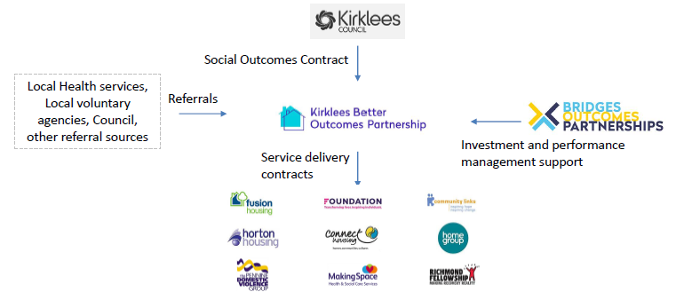
Kirklees Better Outcomes Partnership
Social impact bond financed through MHCLG’s Fair Chance Fund
Services for the most vulnerable over 16s whose needs impact on ability to live independently and be at increased risk of homelessness
Often with disabilities, vulnerabilities, issues or lifestyle factors that increase risk
Aim to improve outcomes for the most vulnerable and reduce costly crisis interventions
Driving innovation and provide an inclusive, holistic service

Slide 6
Our local spend has risen significantly…

Slide 7
What are the challenges?
Local spend analysis
  What is local?
  Data sources
Getting anchors on board
Embedding social value considerations early
Maximising the best social value outcomes for our residents and places

Slide 8
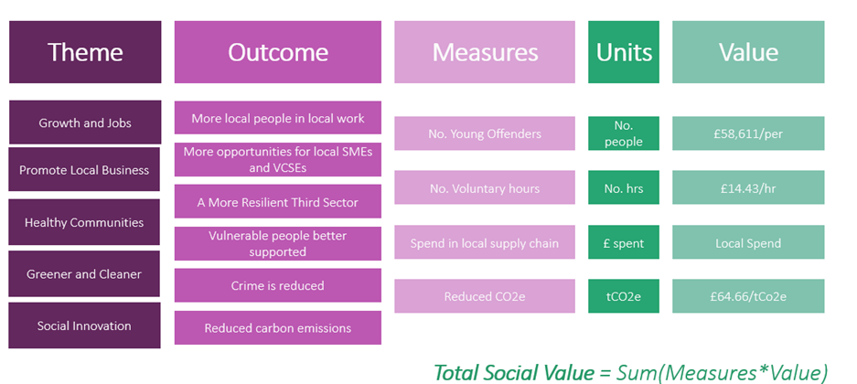
National TOMs Framework

Slide 9
Suppliers’ Social Value Commitments
In evaluation
Abandoned
Notes:
MFDs = multi-functional devices

Slide 10
Updating our TOMs framework
Main list reduced from 46 to 34
Lite list reduced from 22 to 16
Record only reduced from 9 to 3
Emphasis on guiding suppliers to make deliverable and high quality commitments
Recognition that:
  some measures are not limited to local
  Some have no added value if not used with weighting
  Applying weightings adds complexity

Slide 11
What’s next?
Continue to increase level of ambition and impact…
New Procurement Strategy and updated Social Value Policy Statement
Driving SV through capital investments
VCSE engagement
Continue to collaborate, share and learn;
  West Yorkshire
  Yorkshire and Humber

Slide 12
Thank you!
Jane Lockwood (janea.Lockwood@kirklees.gov.uk)
Jonathan Nunn (jonathan.nunn@kirklees.gov.uk)

