Slide 1



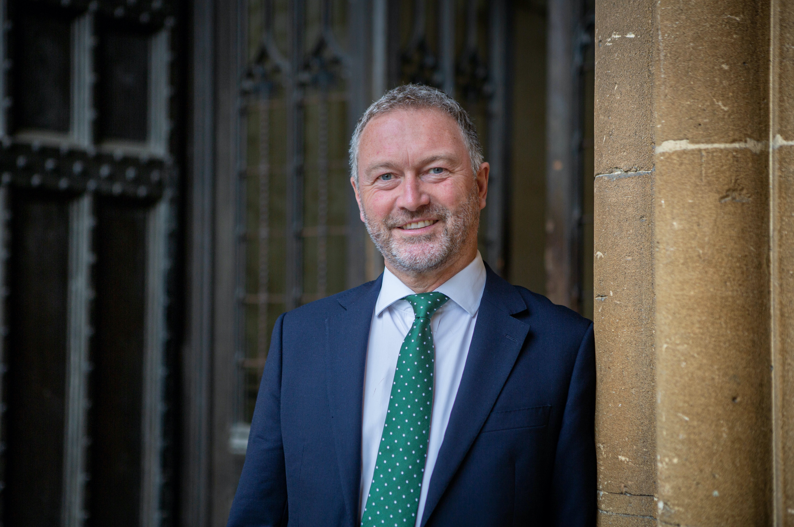
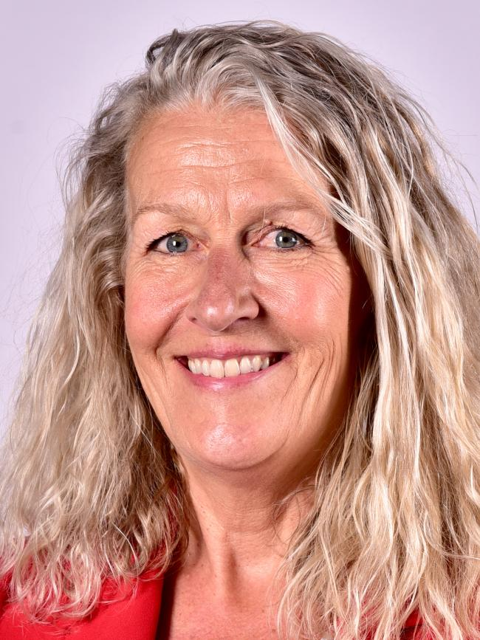
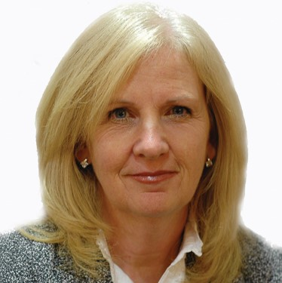
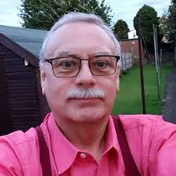

Join our Fringe at the
Labour Local Govt Conf
Wednesday 3rd Feb
11.15am – 12.15pm
#LabLocal21
#CoopCouncils
Steve Reed OBE MP
Hon President of the CCIN Shadow Secretary of State for Communities and Local Government
Cllr Louise Gittins
Leader, Cheshire West & Chester Council
Cllr Sharon Taylor OBE
Chair of CCIN
Leader, Stevenage Borough Council
Cllr Peter Curling
Leader
Hillingdon Labour & Coop Group

Slide 2
Steve Reed OBE, MP
Shadow Secretary of State for Communities
and Local Government
Honorary President of the CCIN
@SteveReedMP

Slide 3
Chair: Steve Reed OBE, MP
Panel:
Cllr Louise Gittins – Leader, Cheshire West and Chester Council
Cllr Sharon Taylor OBE - Chair, CCIN & Leader, Stevenage Borough Council
Cllr Peter Curling – Leader, Hillingdon Labour & Co-operative Group

Slide 4
82 Members
14 Supporters
32
19
31

Slide 5






























32 Councils 9m citizens £14bn budget

Slide 6



















Associate Members - 19

Slide 7

Download your copy:
http://bit.ly/CCIN-Covid

Slide 8

Supporting Communities
Councillor Louise Gittins
Leader of Cheshire West and Chester Council
@weezegee

Slide 9
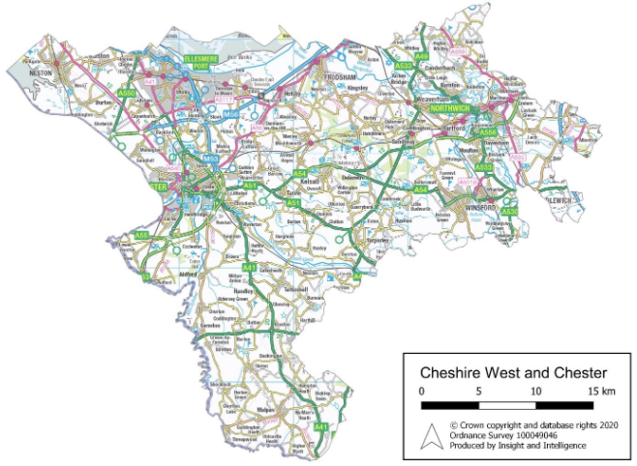
Cheshire West and Chester
North West England, bordering Wales and Merseyside
Hugely varied borough

Slide 10

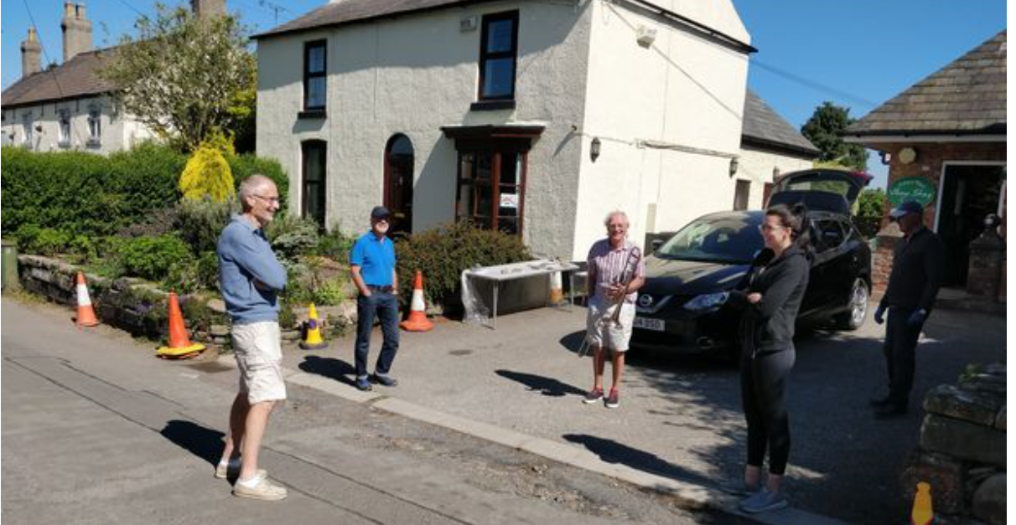
Volunteering
Over 2,000 local residents stepped up to volunteer to support their neighbours and communities during the pandemic

Slide 11

The Community Response Fund provided £250k of Council and £250k of local charitable funding to provide emergency funding to community initiatives across the borough responding to issues as a result of the coronavirus (COVID-19) crisis

Slide 12
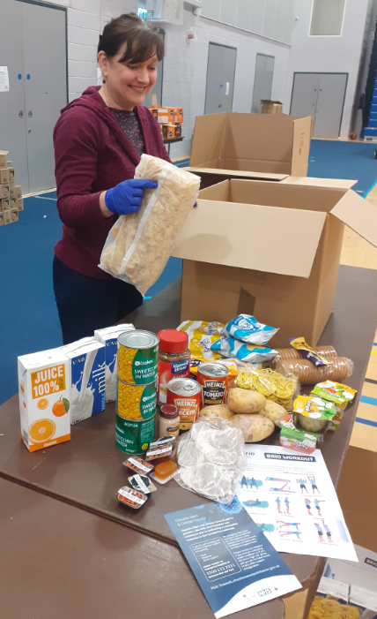
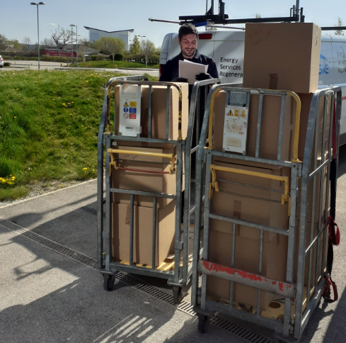
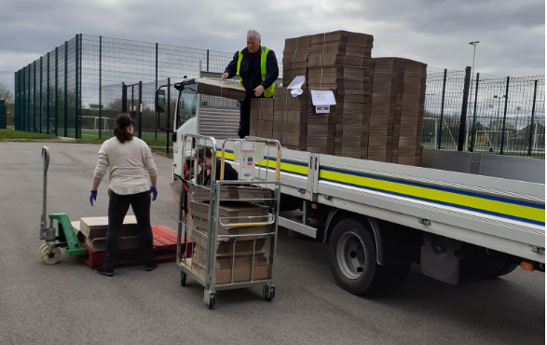
Food Hub
Staff worked to provide 1143 tailored food parcels - diabetic, vegetarian, vegan, halal and gluten-free - to shielding residents

Slide 13
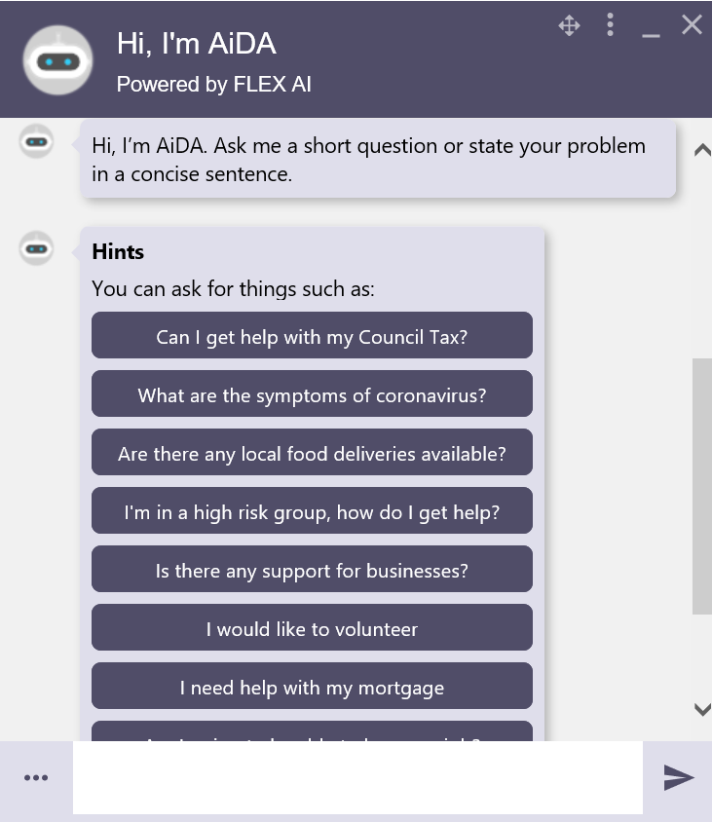
In March, bot queries on the Council website grew by 600%, allowing contact centre capacity to move to contacting people who should potentially have been shielding
Online Chatbot

Slide 14

Inspire Cheshire West
Interactive online space for residents to share their stories and ideas. In its first two weeks the site received more than 1,500 unique visitors and 116 separate stories and ideas were posted

Slide 15

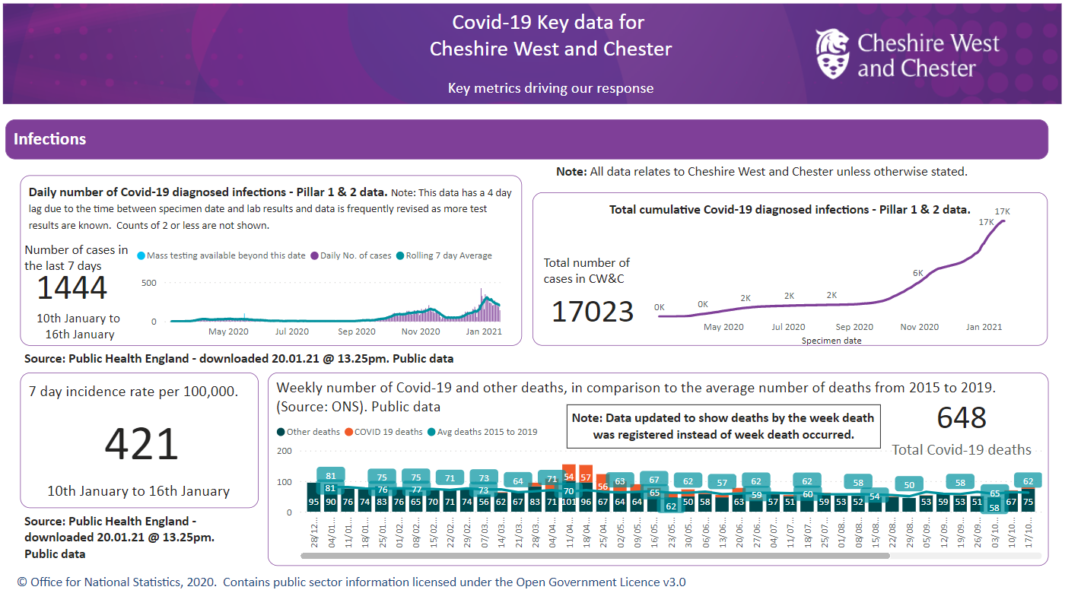
Focus on data – publicly available

Slide 16
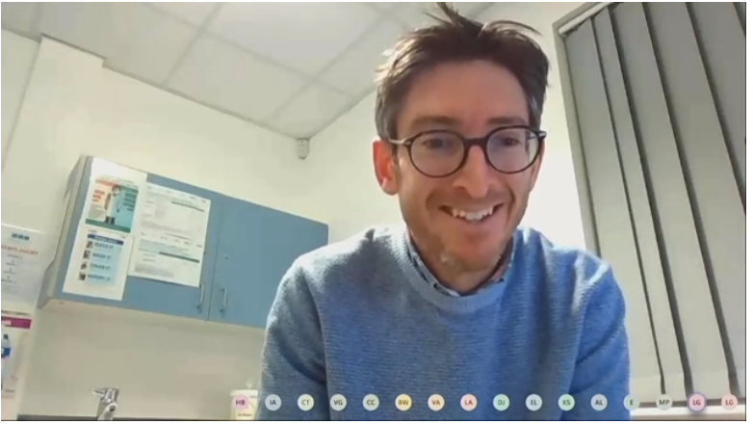
Outbreak Management Board
Webcast public meeting, including taking questions from the public
Six co-opted Members
Expert Witnesses

Slide 17

over 300 local people and organisations from across the borough have signed up as Community Champions, mainly individuals with close links to community groups and charities

Slide 18










Partnership is key

Slide 19
Welcome
Sharon Taylor OBE
Leader of the Council
A Cooperative and Inclusive Economy Charter
@SharonStevenage | @StevenageBC

Slide 20

Overview
The public, private and voluntary sectors working together.
Cooperating to respond to the pandemic.
Cooperating to rebuild the economy.
Notes:
Jane to lead
Poorly-maintained garage blocks
Damaged fencing and brick walls
Moss-strewn parks signage
Overgrown and neglected hedging

Slide 21
Unchartered Territory
A different type of recession that needs new responses.
An even greater need for partnership and cooperative working.
Making the most of national programmes but not relying on them.

Slide 22
Other Developments
A motion in support of community wealth building.
The roll out of the Cooperative Neighbourhood Programme.
Transforming the town centre.

Slide 23
About the Charter
Making sure that economic growth works for everyone
Working together to change things, and not just talking about change.
A clear focus and ambition.

Slide 24
About community wealth building
A charter that is rooted in community wealth building.
Holding and reinvesting more money locally.
Underpinned by four key themes:
  Procurement and social value
  Training and skills
  Growing the cooperative and social economy sector.
  Effectively tackling climate change

Slide 25
Summary of Main Themes
A clear ambition.
A fairer society, as people become more connected to their economy.
A more resilient economy, as people cooperate to create sustainable growth.

Slide 26
Responding to the Recession
.
The need for a step change to meet the challenges of recession.
Embedding growth within communities.
Communities and businesses with a shared interest to grow together.

Slide 27
Connecting People to Growth
Providing careers advice in schools.
Mentoring someone who wants to become self-employed.
Offering work placements to people who need extra support.
Supporting employers to become disability confident.
Shopping locally or volunteering with a community group.

Slide 28
Embedding Growth in Communities
Working with communities to break down barriers to training.
Purchasing goods and services from others in the local area.
Supporting cooperatives to start-up and grow.
Investing in local charities to provide wellbeing training for staff.
Pooling budgets and involving local people in delivery.

Slide 29
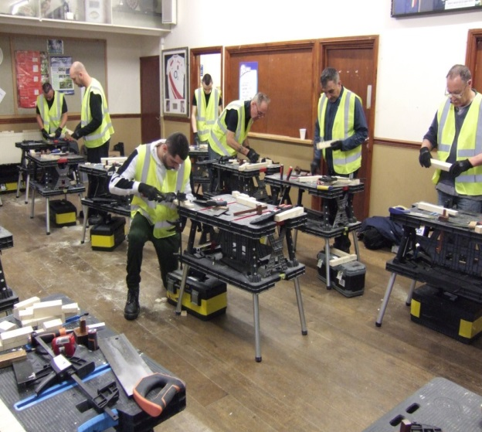
An Example of Connecting to the Economy
Engaging suppliers to provide routes into training and jobs through Stevenage Works.
Creating an onsite construction hub to support 150 local people into jobs.
300 local people improving their skills including people who are longer term unemployed.

Slide 30

An Example of Embedding Growth in Communities
Purchasing staff training from the voluntary and social enterprise sector, e.g. mental health training.
Providing community development and business support.
Helping to create accessible volunteer and job opportunities.

Slide 31
Key Milestone
To achieve 100 pledges of support for the charter in 100 days.

Slide 32
Cllr Peter Curling
Leader
Hillingdon Labour & Co-operative Group
@PeterCurling

Slide 33
Third Sector collaboration

Slide 34
Q&A

Slide 35
Download your copy:
http://bit.ly/CCIN-Covid
Contact: Comms@councils.coop

