Slide 1



Cities of Service Conference
28th January 2020

Slide 2
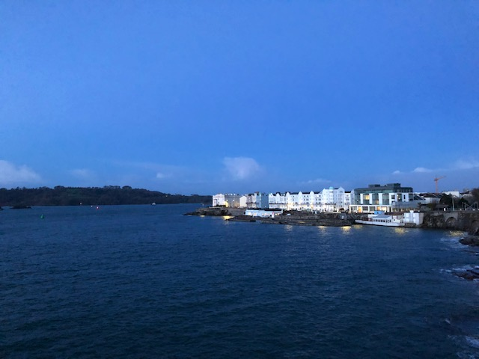

Slide 3
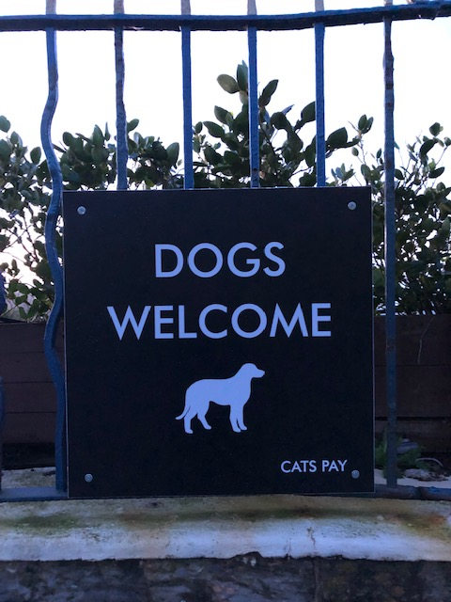

Slide 4
The Why?
We are on a mission to develop a single digital platform that is used as a powerful tool to connect, communicate, collaborate, inspire and recognise social action in order that we can……..
BUILD A NEW RELATIONSHIP
Develop a new relationship with our citizens so that they feel encouraged & supported to increase citizen action
JOINED UP
Removing duplication & isolation across the city particularly around community development & digital solutions
New relationship
with citizens
Partners across the
city joined up
ENGAGE WITH HARD TO REACH
No community is hard to reach. Rather it is often a city’s inability to engage in ways that suits citizens & communities.
Engage with hard to reach
citizens & communities
Community
Remove barriers to
Citizen engagement
REMOVE BARRIERS
In 2013 we found that 85% of respondents do want to be more involved in the decisions that affect them, their communities and the city as a whole.
COMMUNITIES SOLVE OWN PROBLEMS
The new platform focuses on enabling community development through creating the space & place by which individual citizens can self – select & communities can self-organise.
Encourage communities to
solve their own problems

Slide 5
What we are building
Four essential elements that we are building to develop & deliver a successful digital platform:
We constantly innovate using user research, user groups and adopting a user centred design approach.
Create a dynamic platform ecosystem that enables us to achieve critical mass across Plymouth.
Digital Platform
Collaborative
Innovation
City
Engagement
Tech Enabled
Data Eco system
Data is a valuable resource in order to obtain a more detailed knowledge of specific habits, preferences and needs of people to improve decision making.
Foster a supportive enabling environment. Our aim is to help colleagues engage with org’s across the city using our digital tools and techniques.

Slide 6
What we are enabling?
Peer support
Social Investment
Grant making
Time credits/Timebank
Community asset ownership
Crowdfunding
Sandbox/labs
Informal volunteering
Social Action
Community organising
Social Innovation
Skills & dev
Formal volunteering
Our Plymouth
Platform
Governance
Befriending & helping
Network
Business support
Social prescribing
Heath & wellbeing
Community resources
Digital Health
GP referrals
Wellbeing hubs
Support groups

Slide 7
What will Plymouth enable?
You will be able to match volunteers with opportunities across the city
You will be able to mobilise your neighbours around community action
You will be able to crowdfund around a community need
We will be working with the health sector on supporting the delivery of social prescribing
Citizens will have an digital resource that helps them navigate all the activities across the city
Real time data driven insights can help you track and demonstrate positive outcomes, social impact and value, understand behaviour and predict challenges
Social Action
Social Innovation
Social Health & Wellbeing

Slide 8
We will also support?
We get excited about improving citizen and community engagement across the city of Plymouth. Here’s why……….
Pioneering Plymouth
Growing Plymouth
Tech Enabled
With a joined up, collaborative city partnership, information will be freely passed between agencies, citizens & business creating an ecosystem of shared data & experiences that brings overall value to the citizen & community.
We will support our communities and citizens to build on and release their skills and capacity to fully contribute to the future prosperity of the city. This is will in turn deliver social value
The city will have a digital platform capable of supporting citizen & communities activities, experiences & opportunities.
Collaborative
Agile & Responsive
It is unlikely that any large project such as this will end up the way we picture it at the start, it has to be responsive and adaptive to change. A truly citizen-centric project should be agile and flexible so that it can continue to adapt to the participants needs.
Driven by Insight
Caring & Confident
Plymouth
Tech Enabled
We will be able to bring insight direct from the end-user. Their needs, challenges, questions and feedback will be the bedrock upon which every project is built & delivered. Data & insight is built into our strategy & offering.
Ensure there is a voice for all, promote independence and choice for citizens either individually or collectively. Also aim to instill confidence and pride within our city and its communities, by enabling people
to have a say in decision making and putting citizens at the centre.

Slide 9
The Story so far……
Phase 1
Discover & Design
We’ve been testing the tech & doing user research
We have been raising initial funds
Building partnerships
And, putting a team in place to deliver
Phase 2
Develop an MVP
We’ve received significant funding from PCC
We are running 6 pilot projects
We are working hard on the UX of the tech
We are becoming a co-operative
Phase 3
Scale
We expect to roll out to the rest of the city engaging over 250 org’s & 50k citizens by 2022
We want to attract further funding
We will be sharing our experiences with other cities globally

Slide 10
What’s next?
Our Plymouth is right at the beginning of its journey, we are still in the test phase. We have achieved a lot, but we can do more. A lot more and very quickly………
Enabling several pilot projects across the city:
Inclusive Growth
Timebank
City Council Employees
Crowd fund Plymouth
Wellbeing hubs
Mayflower Makers
Citizen & community engagement:
We are actively looking for community org’s & groups to join the platform so we scale
We are engaging the business community to bring citizens onto the platform
We are mapping connections & digital across the city
Developing the tech:
We are in the middle of next stage product design
We will build an bespoke app
We are developing crowd funding features
We are exploring how the tech can enable & promote health & well being across the city

Slide 11
Our Plymouth is becoming a co-operative
We strongly believe that the multiplicity of the stakeholder interests turns Our Plymouth into a stronger business with greater sustainability for the co-operative and the people of Plymouth.
Through our various stakeholders we have a shared vision that prioritises equality, sustainability, and social justice.
It also means that by sharing ownership, we create greater levels of engagement, interest & concern for what we want to achieve.
We will be a co-operative owned and controlled democratically by a variety of city stakeholders who wish to work together to achieve their shared interests.

Slide 12
The social impact we will have….
Citizens as Innovators
Citizens as Resources
Citizens as Asset Holders
Citizens as Community Developers
Citizens may know things that many professionals don’t
Citizens have time, information and financial resources that they are willing to invest to improve their own quality of life and into helping others
Citizens have diverse capabilities and talents which they can share with professionals and other citizens
Citizens can engage in collaborative rather than paternalistic
relationships with service providers, with other service users and with others
Support Social Movement
Build Social Value
Create Sustainable
Social Capital

Slide 13
Questions……
Ann Holman
Executive Director
07739 695560
@annholman

