Slide 1

Bristol Cities of Service
The Journey This Far

Slide 2
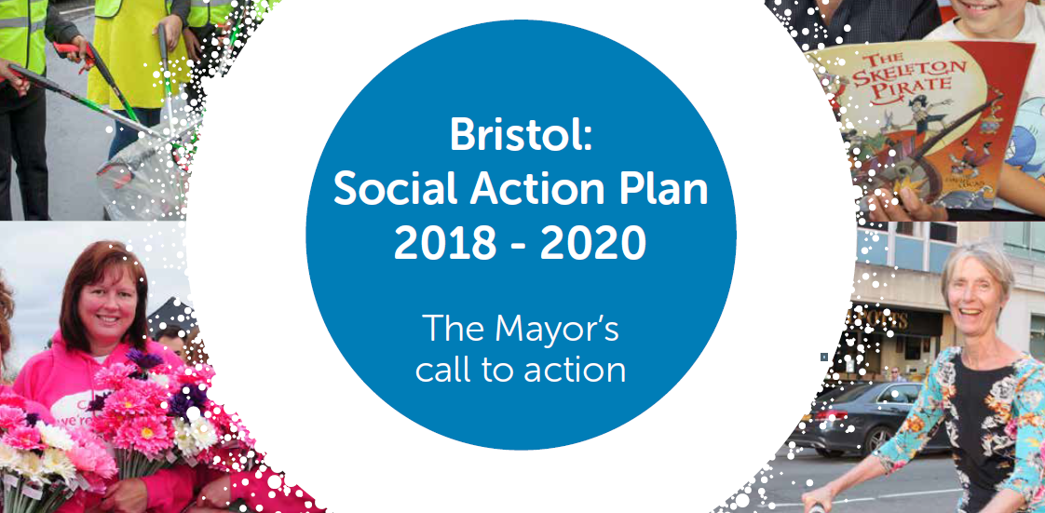
The Mayors Social Action Plan
The Mayors aspiration for the City
Goal: provide a reading volunteer for everyone child that needs one! (300 a year)
Strong emphasis on social action/active citizenship

Slide 3


Slide 4
The Bristol Reading in Schools Consortium (BRISc)
Network of Partners with an interest in reading
Strong emphasis on exploring what partners offered to schools in the city
The beginning of a coordinated offer for the city for reading interventions.

Slide 5
Change Management
Internal restructure
Second Phase of Connected Communities
Building on Can Do Bristol Concept
Comprehensive offer for pathways into reading

Slide 6
Evolution of BRISc
Strategic focus on reading in Bristol
Developing/building consensus
Explore and evaluate the impact of our schemes

Slide 7
Adapting our Training
Historically delivered a one day training (BR@P)
Very Demanding
Tested a half day training
Outcome of the experiment was positive and yielding the same or better results

Slide 8
Good News Stories
Celebration Event – informal network of volunteers
Business Volunteers coming on board
Southmead pilot Project
Evolution of our training

Slide 9
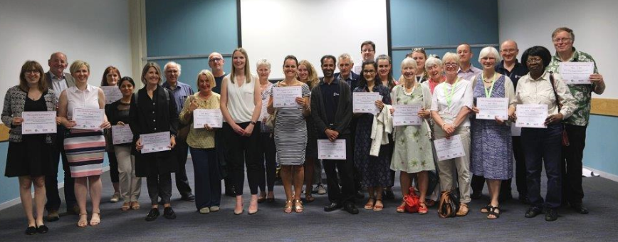
Volunteers from across the programme came together for the first time

Slide 10
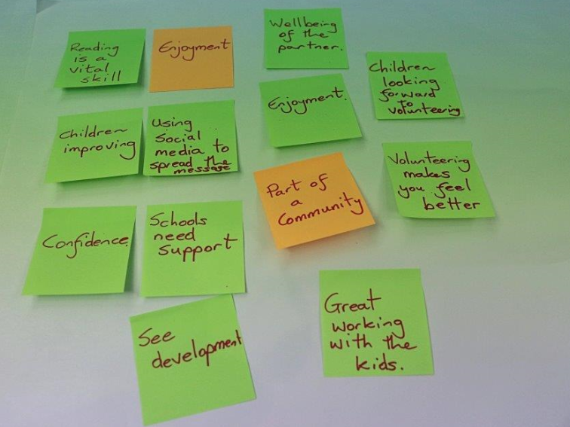
Comments from Volunteers

Slide 11
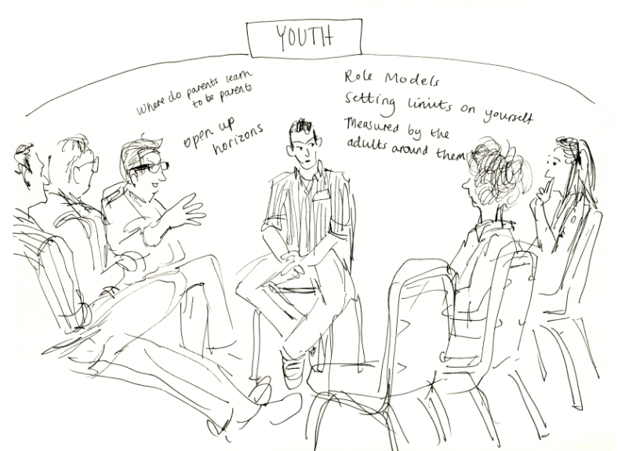
Southmead Project

Slide 12
Southmead
Adults treasuring young people in their locality
Lengthy but rewarding process from start to finish
Volunteers using their initiative championing the scheme locally
They now support their three local primary schools

Slide 13
Achievements against Mayoral social Action Plan
From April 2017 to End March 2020:
From 179 active volunteers to 400
From 55 of whom over 50s to 160
From 425 young people worked with to over 1,000 young people
From Working in 35 Bristol primary schools to 87

Slide 14
Developing sustainability via Can.Do.Bristol
Experiment to connect social value to Procurement
Explore the BRISc model for the future
Joint promotion of BRISc
Building on local community connections (BAME and Faith and Religious Groups)
Streamline the BR@P training

Slide 15
Next Steps
Finish evaluation
Finalise the realignment of BRISC
New Players?
Explore different business models
Learning City Campaign in March

