Slide 1
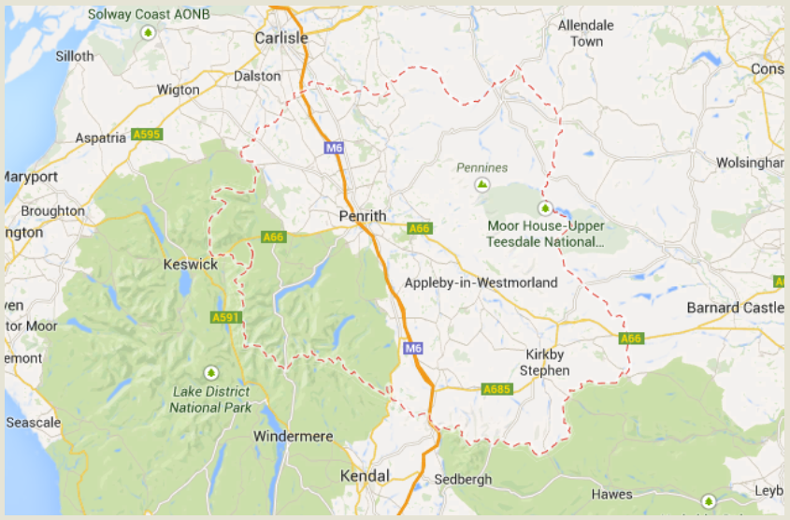

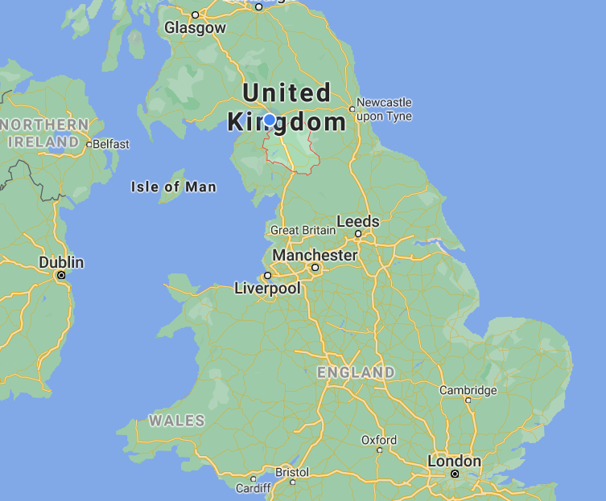


Slide 2
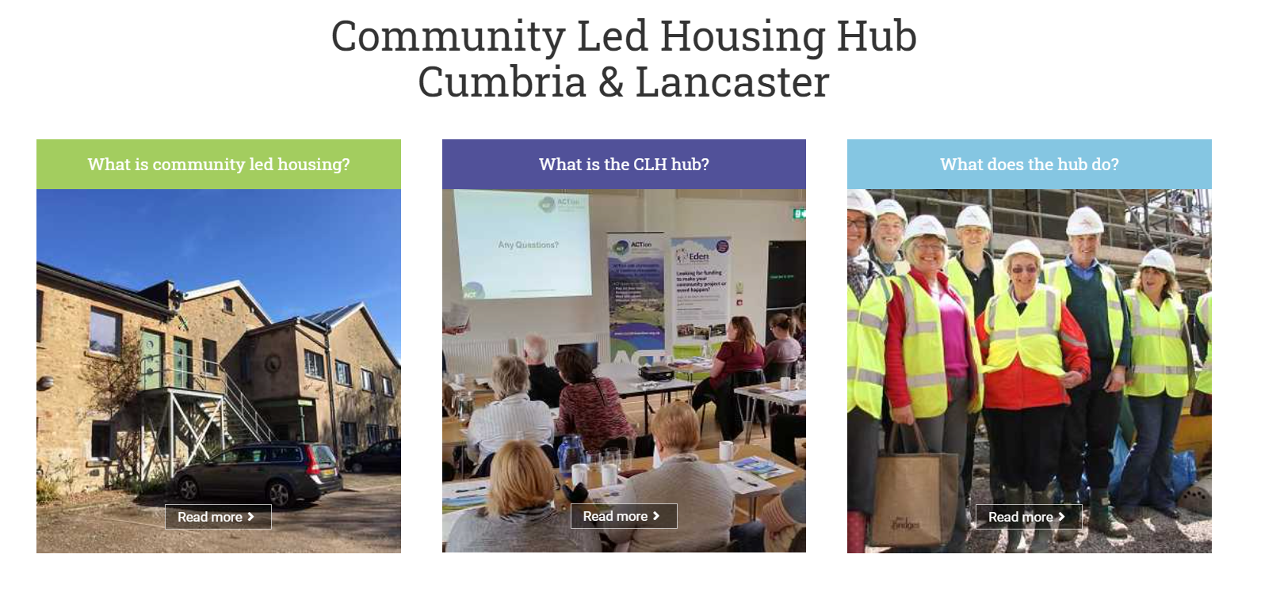

Eden’s Community Led Housing Programme
Community Housing Fund: £938,640 received from government. Grant funding programme set up covering all aspects of CLH projects but particular emphasis on site acquisition and group development
Officer responsible for the programme provides project support - accredited CLH Enabler and a member of the CCH Community Led Housing Local Authorities Group
Emphasis on creating supportive environment and infrastructure for CLH (e.g. jointly commissioning a CLH Hub with other districts; positive Local Plan policies; public/private sector partnerships)
Increasing landowner awareness / understanding of CLH – unlocking sites which otherwise wouldn’t come forward

Slide 3


Slide 4

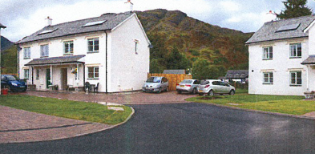
Improving technical support to Community-Led Housing groups: tapping into local Registered Provider development expertise
Eden Housing Association
Partner organisation to Eden District Council – stock transfer
Registered Provider and Homes England Investment Partner
2 Community Led Housing projects (supported by Eden District Council’s Community Housing Fund) make up a large part of Eden Housing’s development programme over next two years

Slide 5
Range of options on a scale from higher levels community group project responsibility/ technical workload, to higher levels of input from the RP:
Higher input from community group
Option 2: The CLT owns the land and funds the development.
EHA project manages the development and manages the completed units with an agreed local lettings policy for a fee.
Option 1: The CLT owns the land, project manages and funds the development.
EHA will manage the completed units with a local lettings policy for an agreed fee.
Option 4: The CLT has control of key elements such as the design phase and the lettings policy.
EHA will fund and manage the development process and own the land and completed properties.
Option 3: The CLT has input into the design phase and the lettings policy.
EHA will lease the land from the CLT for a period of 125 years and fully fund the development of it.
Higher input from RP

